Slide 1

Redux
The good the bad and the not so good

Slide 2
intro
https://redux.js.org/introduction/getting-started
https://react-redux.js.org/introduction/getting-started

Slide 3
Install
npm install react-redux
npm install @reduxjs/toolkit react-redux

Slide 4
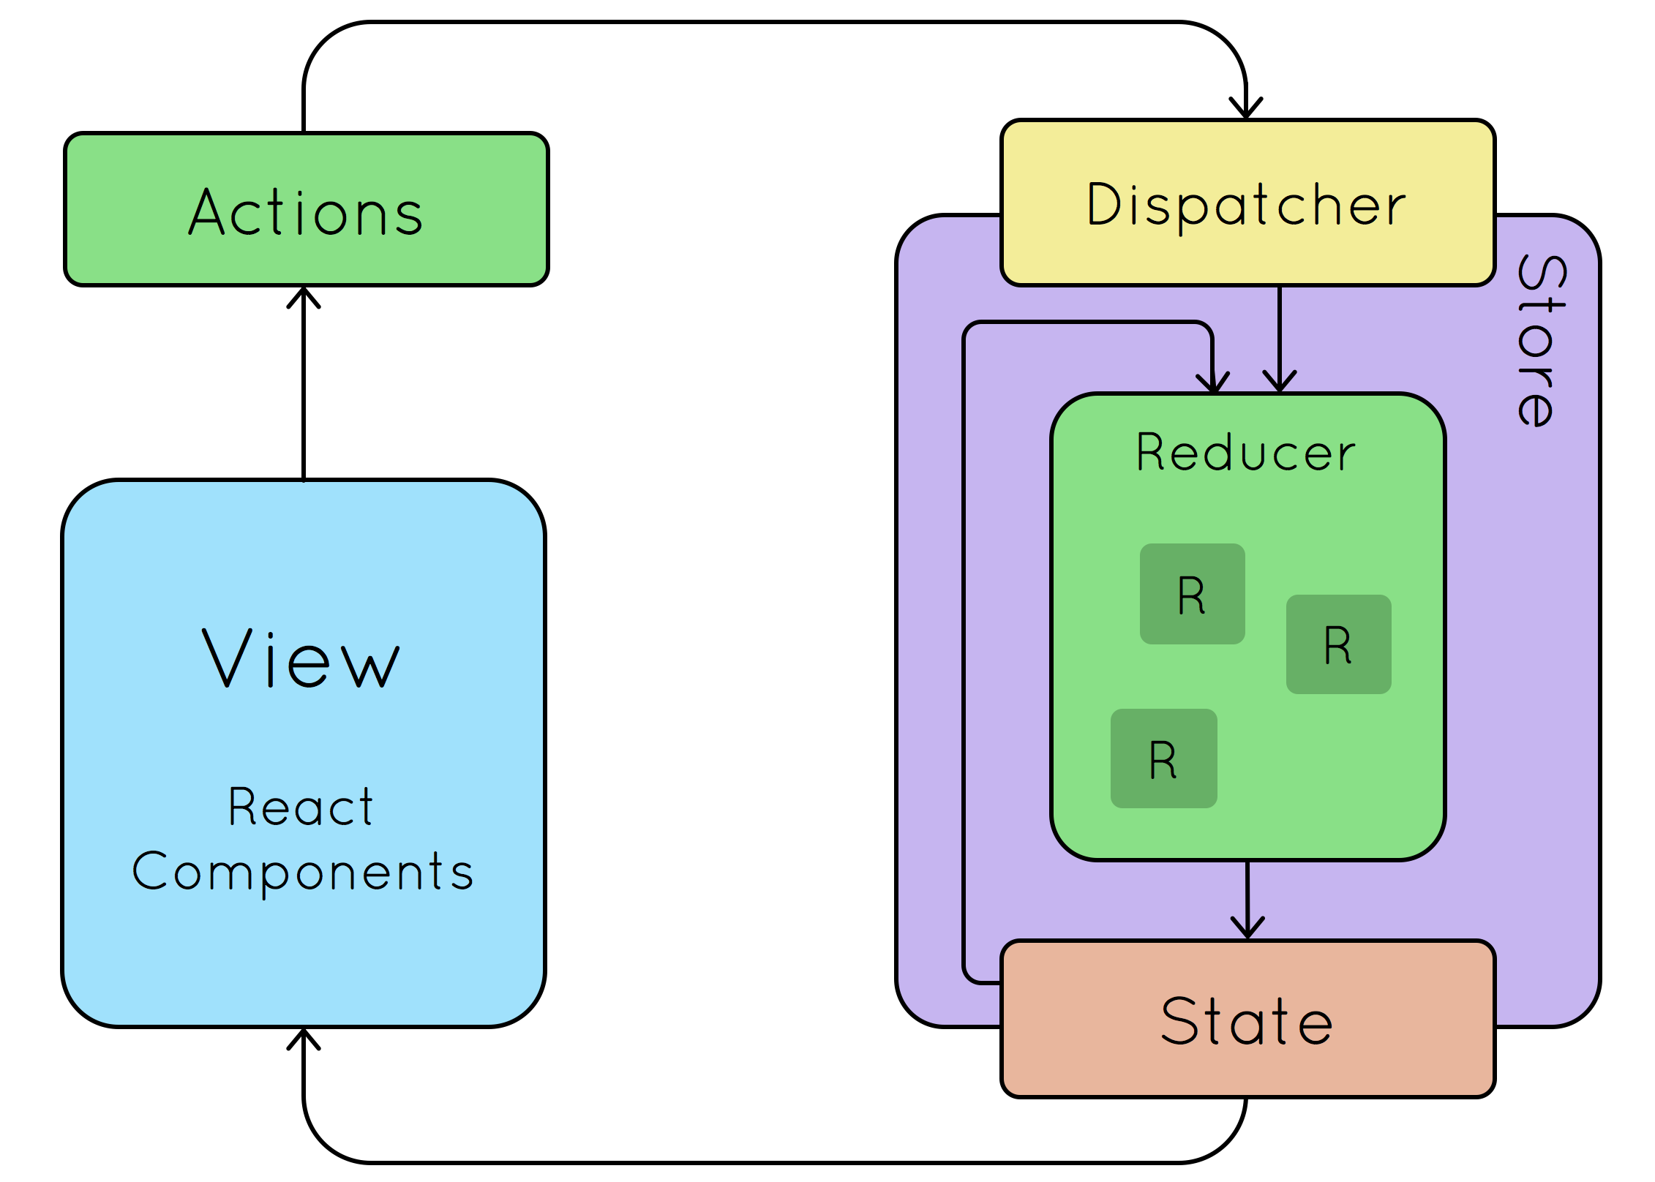
How does it work
Actions: Define what actions you can take on the state.
Reducers: Define how actions modify the state.
Store: Create the Redux store.

Slide 5
Let’s talk
The Redux store holds and manages the entire state tree of a Redux application. To understand how the store contains all the data and how it works, let's break it down step by step:

Slide 6
Initialization
When you create a Redux store using createStore(reducer, [preloadedState], [enhancer]) (or configureStore in Redux Toolkit), you provide it with a root reducer. If you also provide the preloadedState, it will be the initial state of the store, otherwise, the initial state will be determined by the default values in your reducers.

Slide 7
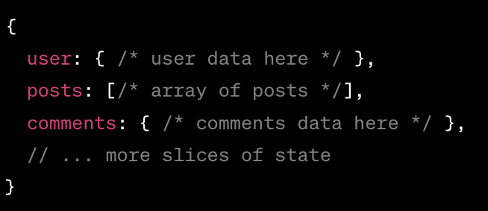
State Tree
The state in a Redux store is often visualized as a state tree because it's a single JavaScript object that holds the state of your entire application. Each branch or "slice" of this tree corresponds to a specific piece of the state managed by a specific reducer. For example:

Slide 8
Actions
The only way to change the state inside the store is to dispatch an action. An action is a plain JavaScript object that describes what happened. It must have a type field, and it can also contain additional data in other fields.

Slide 9
Reducers
When an action is dispatched, the store calls the root reducer function with the current state and the dispatched action. The reducer function determines how to update the state based on the action's type (and possibly its payload or other fields).
Reducers are pure functions: they don't modify the input state. Instead, they return a new state object if there are changes or the original state if there aren't. In Redux, it's crucial that reducers are pure to ensure predictability and traceability of state changes.

Slide 10
Storing the Data
Once the root reducer processes the action (and potentially the slice reducers, if you use combineReducers), the store will update its internal state with the new state returned by the reducer.

Slide 11
Subscribers
Components or other parts of the application can "subscribe" to the store to be notified when the state changes. This is typically handled by the react-redux library when using Redux with React. When the state changes, subscribers can react accordingly, often resulting in a re-render of UI components.

Slide 12
middleware in redux
In Redux, a middleware is a higher-order function that provides a third-party extension point between dispatching an action and the moment it reaches the reducer. Middleware is used for a wide range of tasks, including logging, error reporting, asynchronous logic, and more.

Slide 13
More
Conceptually, you can think of middleware as a conveyor belt situated between an action being dispatched and the reducer that processes it. Every action goes through the middleware before reaching the reducer. During this journey, the middleware can inspect the action, delay it, modify it, log it, dispatch other actions, or even stop it from reaching the reducer.

Slide 14
Core Principles of Middleware
Intercepting Actions: Middleware can peek at every action dispatched to the store.
Transforming Actions: Middleware can modify the dispatched action or even create and dispatch a new one.
Delaying Actions: It can introduce asynchronicity, such as waiting for an API call to complete.
Stopping Actions: If a certain condition is met, a middleware can prevent the action from reaching the reducers.
Chainable: Multiple middlewares can be composed, and they execute in sequence.

Slide 15
How Middleware Works
https://redux.js.org/understanding/history-and-design/middleware

Slide 16
Common Uses of Middleware
Logging: Log every action that's dispatched along with the state before and after.
Asynchronous Actions: Handle asynchronous logic (API calls, timers) and dispatch actions based on the result. Redux Thunk and Redux Saga are popular middlewares for this purpose.
Error Handling: Catch any errors thrown during action dispatch or reducer execution.
Action Filtering: Prevent certain actions from reaching the reducers based on specific conditions.
Cache: Implement caching strategies for specific actions.

Slide 17
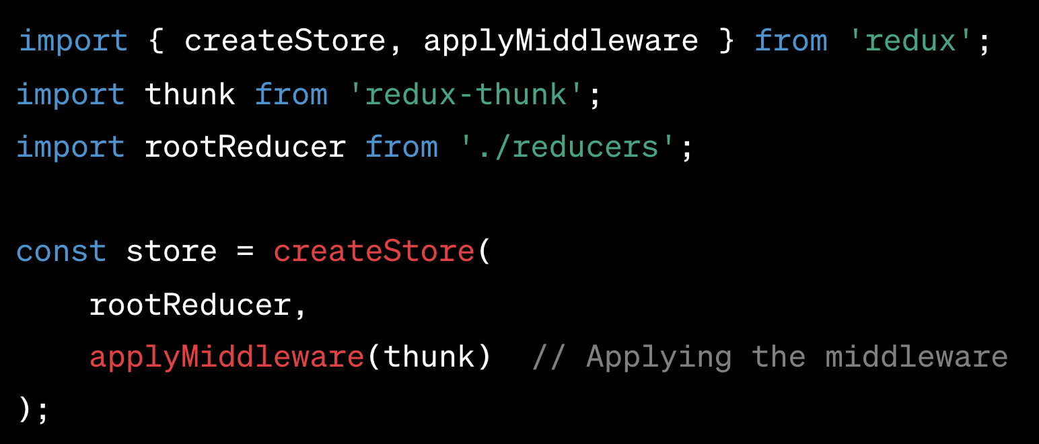
Setting up Middleware

Slide 18
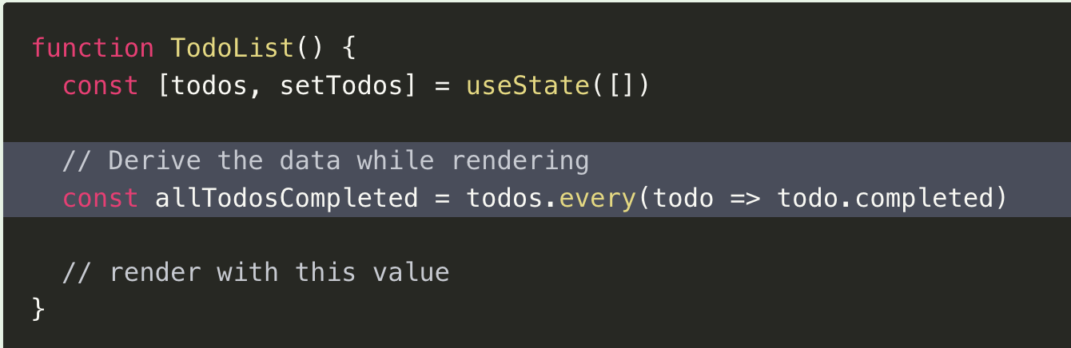
Deriving Data
https://redux.js.org/usage/deriving-data-selectors

Slide 24
Call the api
https://redux-toolkit.js.org/api/createAsyncThunk
npm install redux-thunk

Slide 25
Redux Thunk
Redux Thunk is a middleware that allows you to write action creators that return a function instead of an action object. This function can then be used to dispatch other actions, either immediately or after some asynchronous operations like API calls.

Slide 26
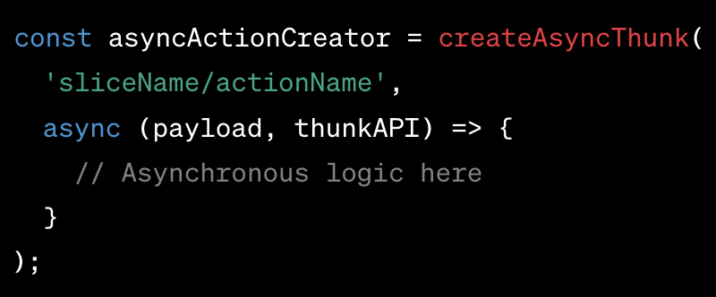
Basic Structure

Slide 27
params
Action Type String: The first argument is a string that will be used as the prefix for the generated action types.
Payload Creator Function: The second argument is a callback function that should return a promise. It contains the asynchronous logic and can dispatch other actions if needed.

Slide 28
Generated Action Types
Pending: Represents the start of the async operation (e.g., 'sliceName/actionName/pending').
Fulfilled: Represents a successful completion of the async operation (e.g., 'sliceName/actionName/fulfilled').
Rejected: Represents a failed async operation (e.g., 'sliceName/actionName/rejected').

Slide 29
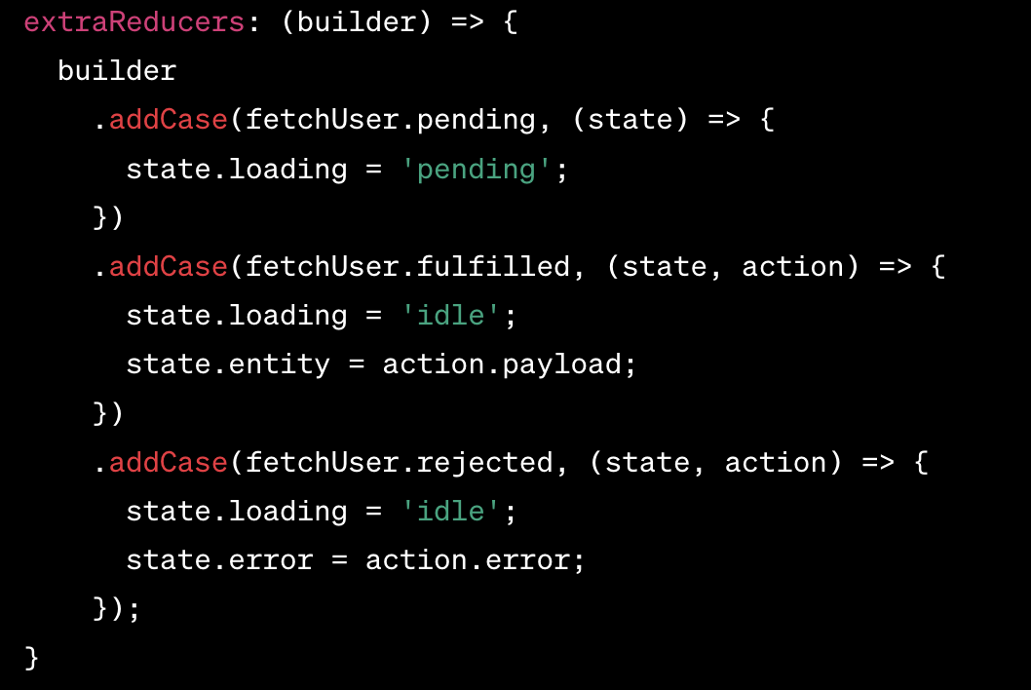
Handling Actions in a Slice

Slide 30
Benefits
Consistency: It provides a standardized approach to handling async actions.
Reduced Boilerplate: You don't need to manually define multiple action types or action creators for each async operation.
Built-in Handling: Automatically handles common scenarios like loading states and errors.

