Slide 2
Git- intro
Git is a distributed version control system (VCS) that is widely used for software development. It is used to keep track of changes made to the source code of a project, making it easier for multiple people to collaborate on the same codebase.
Git has a number of features that make it well-suited for software development, including:
Distributed: With Git, each user has a full copy of the entire codebase and its history, so they can work offline and have a backup of the code. This also makes it easier to merge changes from different users.
Branching and merging: Git makes it easy to create and switch between different branches of a codebase, allowing multiple people to work on different parts of the code at the same time. Changes can then be merged back into the main branch when they are ready.
Snapshots: Git stores the entire codebase as a series of snapshots, rather than as a series of changes. This makes it easier to see the state of the code at any point in its history, and to revert to an earlier version if needed.
Staging area: Git has a staging area, where changes can be reviewed and staged before being committed to the codebase. This makes it easier to keep track of what changes have been made, and to only commit the changes that are ready.

Slide 3

How to get started
Create a GitHub account: Go to the GitHub website (https://github.com) and sign up for a free account.
Install Git: Git is the version control system that GitHub is built on. You'll need to install Git on your computer in order to use GitHub. You can download Git from the official website (https://git-scm.com/downloads).
Configure Git: After installing Git, you'll need to configure your name and email address, which will be associated with your Git commits. You can do this by running the following commands in your terminal or command prompt:

Slide 4
What after
Create a repository: A repository is a place to store your code and collaborate with others. To create a new repository on GitHub, click on the "+" icon in the upper-right corner of the GitHub website and select "New repository". Give your repository a name, a description, and select whether it should be public or private.
Clone the repository: After creating a repository, you'll need to clone it to your local machine so you can start making changes. You can clone a repository by clicking the "Clone or download" button on the repository page, copying the repository URL, and running the following command in your terminal or command prompt:

Slide 5
Git commit
In Git, a commit is a saved change to the codebase. Commits are the building blocks of Git, representing a set of changes to the code at a specific point in time.
Each commit has a unique identifier called a hash, which is generated based on the contents of the commit. Commits also have a message that provides a brief description of the changes made in the commit.
When you make changes to the code, you can stage those changes in Git using the git add command. This adds the changes to the Git staging area, where they can be reviewed and committed. To save the changes to the codebase, you use the git commit command, which creates a new commit in the Git history.

Slide 6

Push changes
Push your changes: Finally, you'll need to push your changes back to the remote repository on GitHub. You can do this by running the following command in your terminal or command prompt:

Slide 7
Example

Slide 8

writing-mode
The "writing-mode" property in CSS is used to control the direction of text in a block-level container. It determines the orientation of the text, whether it is horizontal or vertical, and in which direction it flows.
The writing-mode property can have the following values:
horizontal-tb: The default value. The text flows from left to right, and from top to bottom.
vertical-lr: The text flows from top to bottom, and from left to right.
vertical-rl: The text flows from top to bottom, and from right to left.

Slide 9
white-space
The "white-space" property in CSS is used to control the handling of white spaces and line breaks in a block of text. It determines how white spaces and line breaks are rendered in a block of text.
The white-space property can have the following values:
normal: The default value. White spaces are collapsed, and text wraps when it reaches the end of a line.
nowrap: White spaces are preserved, and text does not wrap when it reaches the end of a line.
pre: White spaces are preserved, and text wraps only when a line break is encountered.
pre-wrap: White spaces are preserved, and text wraps when it reaches the end of a line or when a line break is encountered.
pre-line: White spaces are collapsed, and text wraps when it reaches the end of a line or when a line break is encountered.

Slide 10
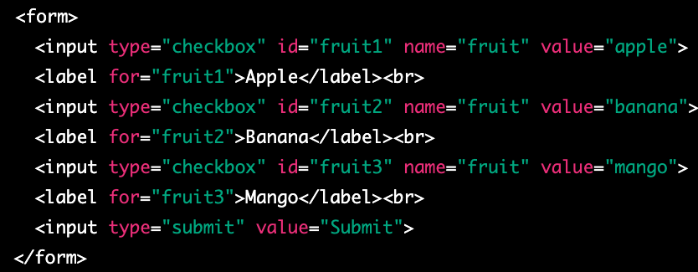
checkbox
A checkbox is a graphical control element used in web forms to allow a user to make multiple selections from a set of options. In HTML, a checkbox is created using the <input type="checkbox"> element.
A checkbox is displayed as a small square box on the web page, which can be either checked or unchecked. When a user clicks on a checkbox, the box is filled with a checkmark and its state changes to checked. If a user clicks on the checkbox again, the checkmark is removed and the state changes back to unchecked.
Checkboxes can be used to collect data in web forms, where a user can select one or more options from a list. The selected options can be submitted to a server-side script for processing.

Slide 11
Wait I want to select only more then one at the time
If you want to allow the user to select multiple checkboxes at the same time, you can give each checkbox a different name attribute. This way, when a user selects one checkbox, it does not affect the state of other checkboxes.

Slide 12
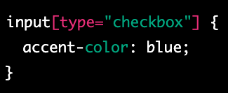
accent-color
The accent-color CSS property sets the accent color of an element. The accent color is used by various user interface controls (such as buttons, checkboxes, and range controls) to make them more visually appealing.
The accent-color property can be set to a specific color value (e.g. red, #ff0000, rgb(255,0,0)) or can be set to inherit the value from the parent element using inherit.

Slide 13
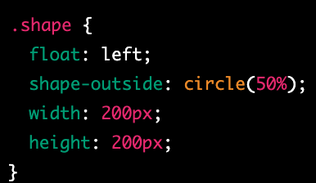
shape-outside
shape-outside is a CSS property that allows you to define a non-rectangular shape that text content will flow around. This can be useful for creating more interesting and visually appealing layouts, especially when combined with other CSS properties such as float and clear.
The shape-outside property is used to specify the shape that text should wrap around. You can define the shape using one of several different values:
none: This is the default value, and means that text will not wrap around any shape.
rectangle: This value allows you to define a rectangular shape using the inset or circle functions, which take four or three values respectively to create a rectangle or circle.
circle(): This function takes one value, which is the radius of the circle, and creates a circle shape.
ellipse(): This function takes two values, which are the horizontal and vertical radii of the ellipse, and creates an elliptical shape.
polygon(): This function allows you to define an arbitrary polygon shape using a series of x,y coordinate pairs.

Slide 14
Remainder- clip path
This property is used to clip the element itself, creating a visible shape for the element. It doesn't affect the flow of the content around it. By using clip-path, you can create visually appealing shapes for your elements, such as images, that are displayed on the webpage.

Slide 15
shape-image-threshold
shape-image-threshold is a CSS property that is used in combination with the shape-outside property to control the transparency threshold of an image used as a shape.
When using an image as a shape with the shape-outside property, the browser determines the shape of the image based on its transparency. The shape-image-threshold property allows you to set a threshold value that determines which parts of the image are considered transparent or opaque.
The shape-image-threshold property takes a single value, which is a percentage between 0% and 100%. This value specifies the transparency threshold for the image. Any pixels in the image that are more transparent than the specified threshold are considered transparent, and any pixels that are less transparent than the threshold are considered opaque.

Slide 16
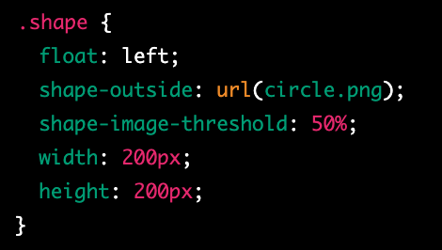
example
In this example, we have defined a class called shape that uses float: left and the shape-outside property to create a circular shape using an image file called circle.png. We have also set the shape-image-threshold property to 50%, which means that any pixels in the image that are more than 50% transparent will be considered transparent.
It's worth noting that the shape-image-threshold property is not widely supported by all browsers, so you may need to use fallback techniques or alternative approaches for older browsers. Additionally, if the image file used for the shape-outside property is not available or cannot be loaded, the shape-image-threshold property will have no effect.

Slide 17
shape-margin
shape-margin is a CSS property that is used in combination with the shape-outside property to add space around the shape that text will flow around.
When using the shape-outside property to create a non-rectangular shape for text to flow around, it can be helpful to add some space between the shape and the text. The shape-margin property allows you to specify the amount of space to add around the shape.
The shape-margin property takes a single value, which can be a length, a percentage, or the auto keyword. A positive value will add space around the shape, while a negative value will remove space. The auto value will cause the browser to automatically calculate the margin based on the size and shape of the element.

Slide 18
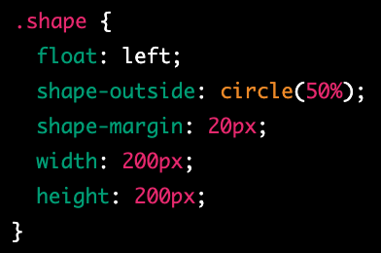
example
In this example, we have defined a class called shape that uses float: left and the shape-outside property to create a circular shape. We have also set the shape-margin property to 20px, which adds 20 pixels of space around the shape. Finally, we have set the width and height of the element to define its size.
It's worth noting that the shape-margin property is not widely supported by all browsers, so you may need to use fallback techniques or alternative approaches for older browsers. Additionally, the exact behavior of the shape-margin property may vary depending on the size and shape of the element being used as the shape, as well as the size and layout of the surrounding text content.

Slide 19
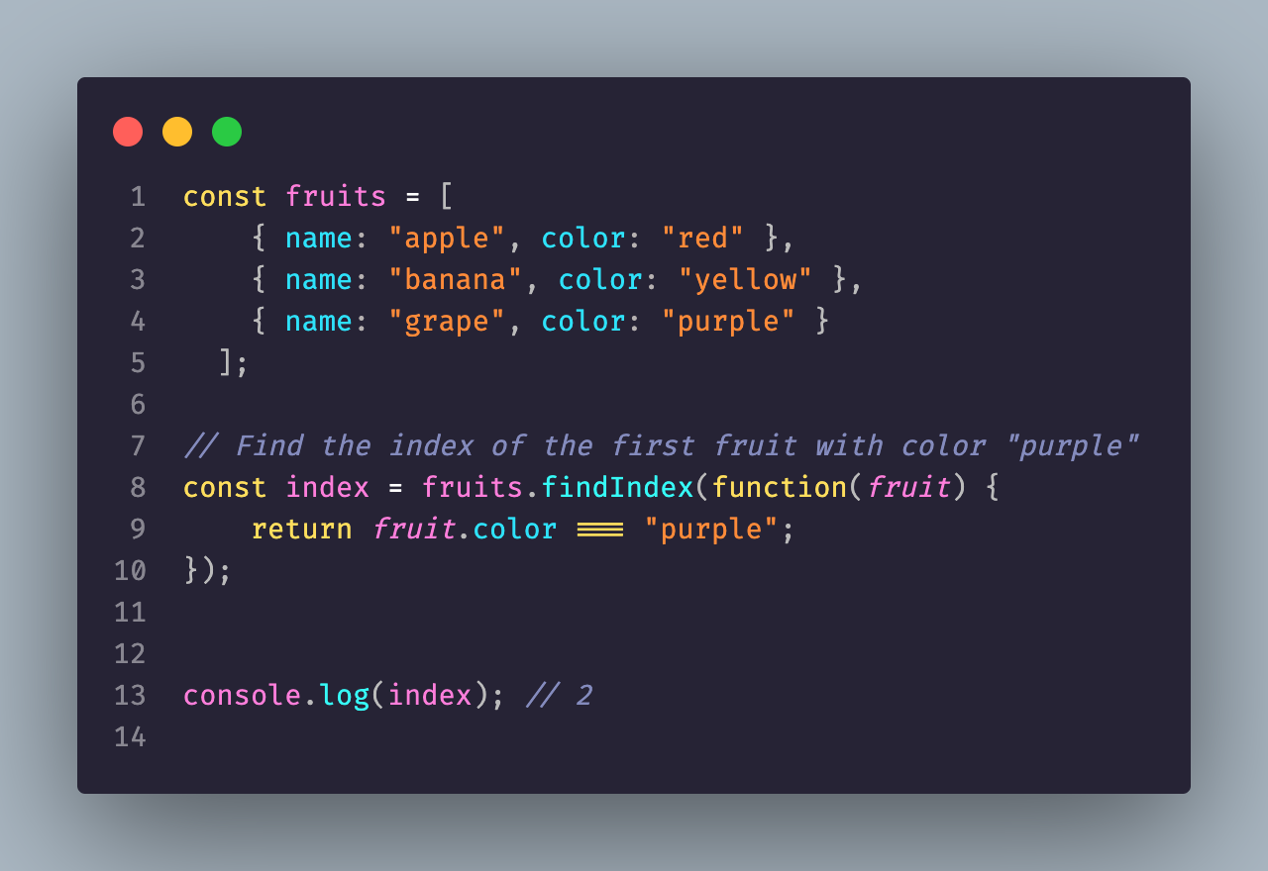
Anonymous Functions
In JavaScript, a function is a block of code that performs a specific task. Anonymous functions are functions that are defined without a name and are often used as arguments to other functions or as return values of other functions. Unlike named functions, anonymous functions are not bound to a particular identifier, making them more flexible and versatile.

Slide 20
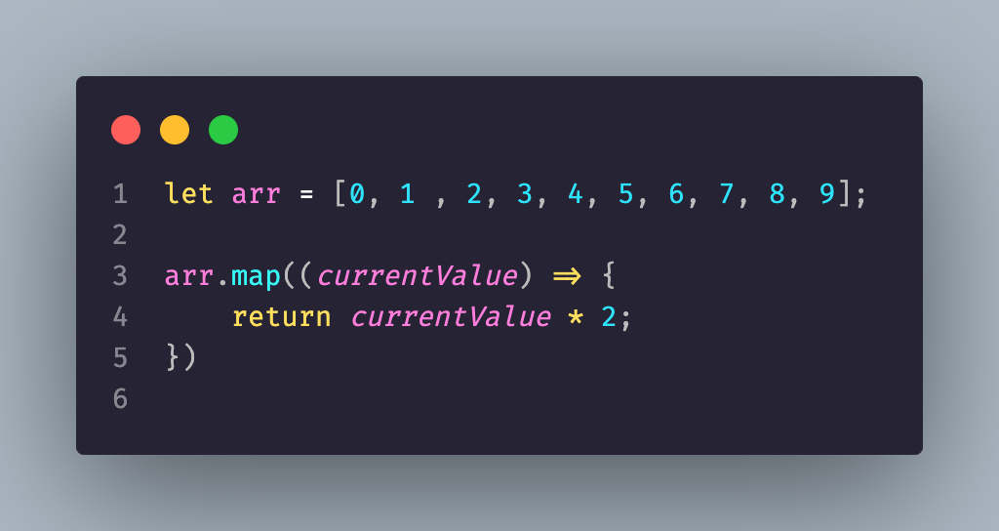
Arrow functions
Arrow functions are a relatively new feature in JavaScript that were introduced in ES6 (ECMAScript 2015). They are a shorthand way to write functions, making them easier to read and write. Arrow functions have a few key differences from traditional JavaScript functions:

Slide 21
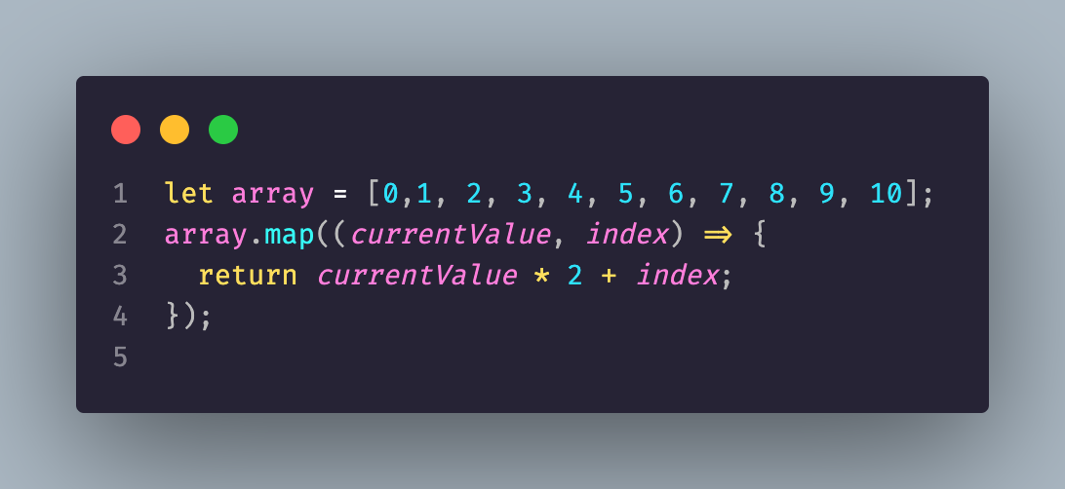
Array.map
Array.map() is a popular method in JavaScript that allows developers to iterate over an array and transform each element in the array based on a callback function. In this presentation, we will explore what Array.map() is, how it works, and why it is useful in JavaScript.

Slide 22
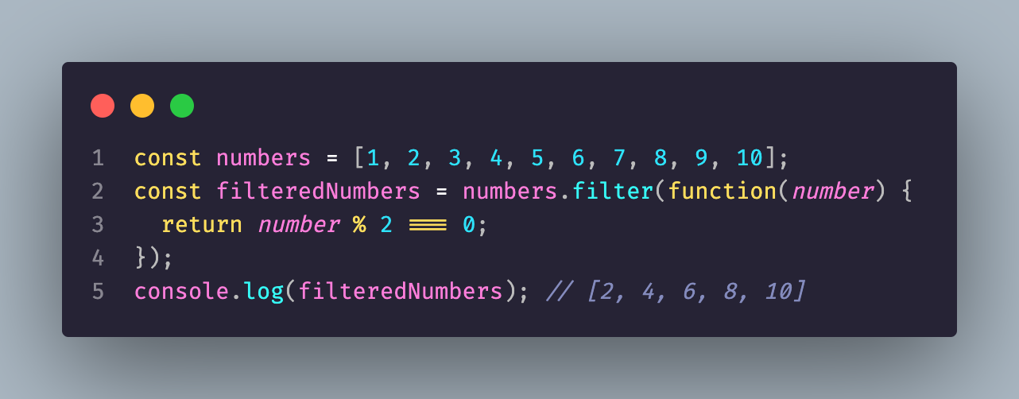
Js filter
filter() is a built-in method in JavaScript that allows developers to filter elements from an array based on a specific condition. The method creates a new array with all the elements that pass the condition specified by a callback function.

Slide 23
typescript
TypeScript is an open-source programming language that is a strict syntactical superset of JavaScript. TypeScript is designed to make it easier to build large-scale web applications by providing optional static type-checking, object-oriented features, and other advanced language features that are not available in plain JavaScript.

Slide 24
key features of TypeScript
Static Typing: One of the main features of TypeScript is static typing, which allows developers to define the types of variables, functions, and other elements in their code. This makes it easier to catch errors and bugs early in the development process and to build more robust and scalable applications.
Object-Oriented Features: TypeScript also supports object-oriented programming features such as classes, interfaces, and inheritance. This makes it easier to write object-oriented code in a familiar syntax that is similar to other object-oriented programming languages such as Java or C#.
Advanced Language Features: TypeScript also includes other advanced language features such as enums, generics, and union types that are not available in plain JavaScript. These features make it easier to write more expressive and maintainable code.
Compatibility with JavaScript: TypeScript is designed to be compatible with existing JavaScript code and libraries, which means that developers can gradually introduce TypeScript into their projects without having to rewrite their entire codebase.
Tooling: TypeScript comes with a set of tools that make it easier to develop, debug, and maintain TypeScript code. These tools include a TypeScript compiler, a language service that provides code completion and other features in code editors, and other development tools.

Slide 25
Node install
Go to the Node.js website: Visit the Node.js website at https://nodejs.org. This is the official website for Node.js and contains the latest version of Node.js available for download.
Download the Node.js installer: On the Node.js website, you will see two options for downloading Node.js: "Recommended for most users" and "Other downloads". If you are new to Node.js, we recommend selecting the "Recommended for most users" option. Click on the "Download" button to download the installer for your operating system (Windows, macOS, or Linux).
Run the installer: Once the installer has finished downloading, run it on your machine to begin the installation process. Follow the prompts to complete the installation. You may need to agree to the terms of service and select an installation location.
Verify the installation: After the installation is complete, you can verify that Node.js has been installed correctly by opening a terminal or command prompt and typing the following command:

Slide 26
First thing
npm install -g typescript
tsc --init
to complie the code into JavaScript tsc filename.ts

Slide 27
Let’s start
Create a folder named js and folder name ts
Create a file name index.ts with some code
then add to the root folder the tsconfig.json file
Write in the terminal tsc
And you see you js file

Slide 28
Wait what is the index.js.map
The index.js.map file is a source map file generated by the TypeScript compiler when the sourceMap option is set to true in the tsconfig.json configuration file.
A source map is a file that maps the compiled JavaScript code back to its original TypeScript source code, enabling source-level debugging of the compiled code. The source map contains information such as the original file name, line numbers, and column numbers for each line of the compiled JavaScript code.
When you run your compiled TypeScript code, your browser or debugging tool can use the source map file to display the original TypeScript code in the debugger, making it easier to debug your code.
The index.js.map file should not be served to the client in a production environment, as it contains sensitive information about the original source code. Instead, it should only be used during development and debugging.

Slide 29
How to debug
Open with live server and click debug URL and pass the live server url

Slide 30
null

Slide 31
undefined
In JavaScript and TypeScript, undefined is a special value that represents the absence of a value. It is a primitive data type that has only one possible value, also called undefined.
There are several ways in which a variable or expression can evaluate to undefined:
If you declare a variable but don't assign it a value, the variable will have an initial value of undefined.
If you try to access a property or element that doesn't exist on an object or array, the result will be undefined.
If you declare a function that doesn't return a value, or return a value explicitly without a value, the return value will be undefined.

Slide 32
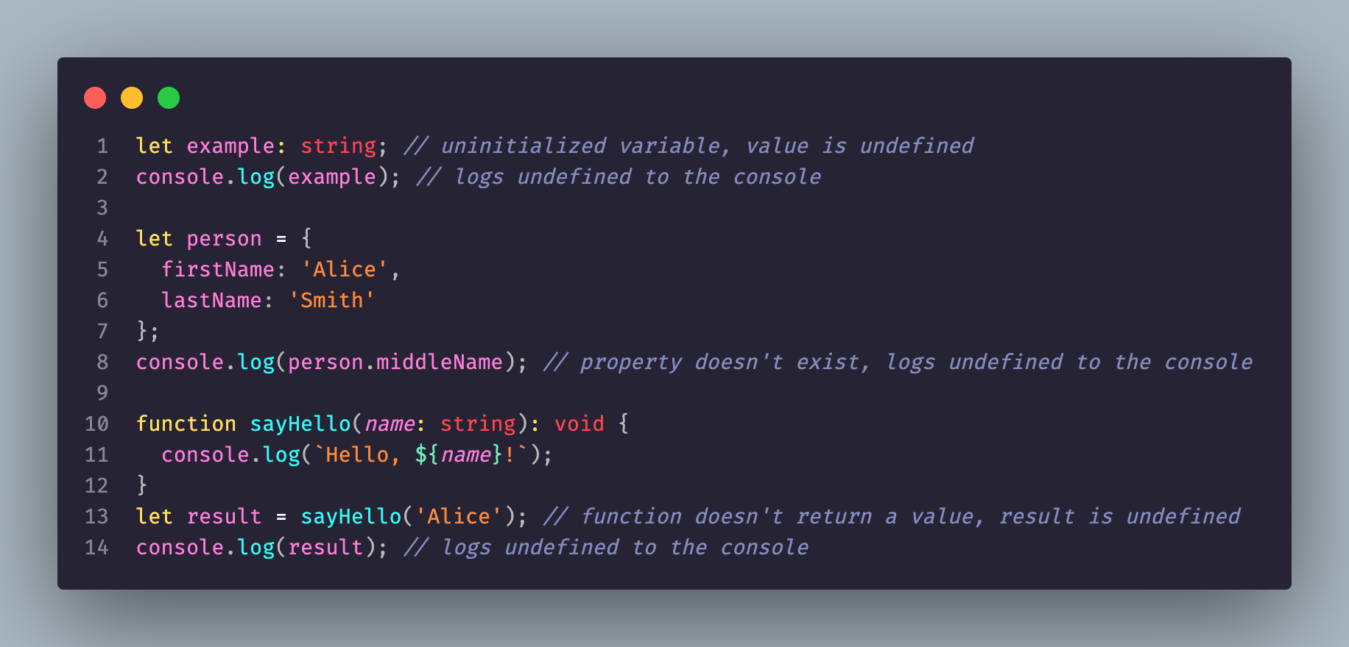
example

Slide 33
null
In JavaScript and TypeScript, null is a special value that represents the intentional absence of any object value. It is a primitive data type that has only one possible value, also called null.
There are several ways in which a variable or expression can evaluate to null:
If you explicitly assign the value null to a variable, that variable will have the value of null.
If a function returns null as a deliberate indication that it didn't find a value.
If an API returns null to represent an empty or non-existent value.

Slide 34
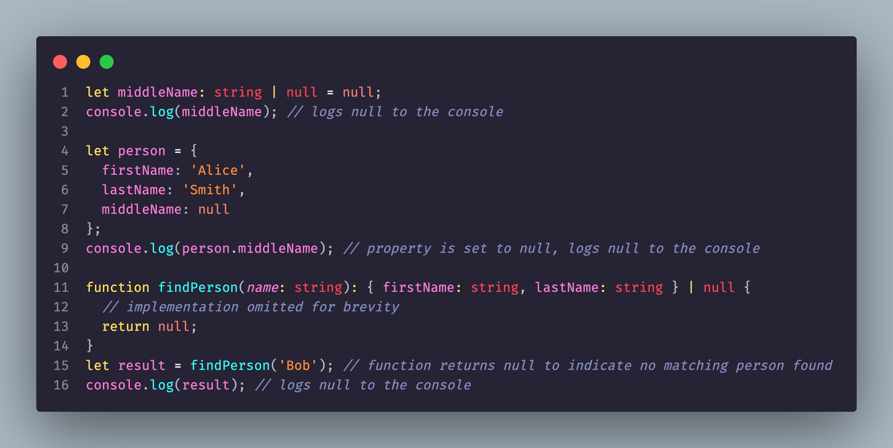
example

Slide 35
union type
In TypeScript, a union type is a type that can have multiple types, but only those types. Union types are created using the | operator between the types.
Union types are useful in situations where a variable or parameter can take on multiple types of values, such as when working with data from external sources or when implementing a function with multiple possible return types. By defining a union type for a variable or parameter, we can ensure that the code handling that value is designed to handle all of the possible types it may take on.

Slide 36
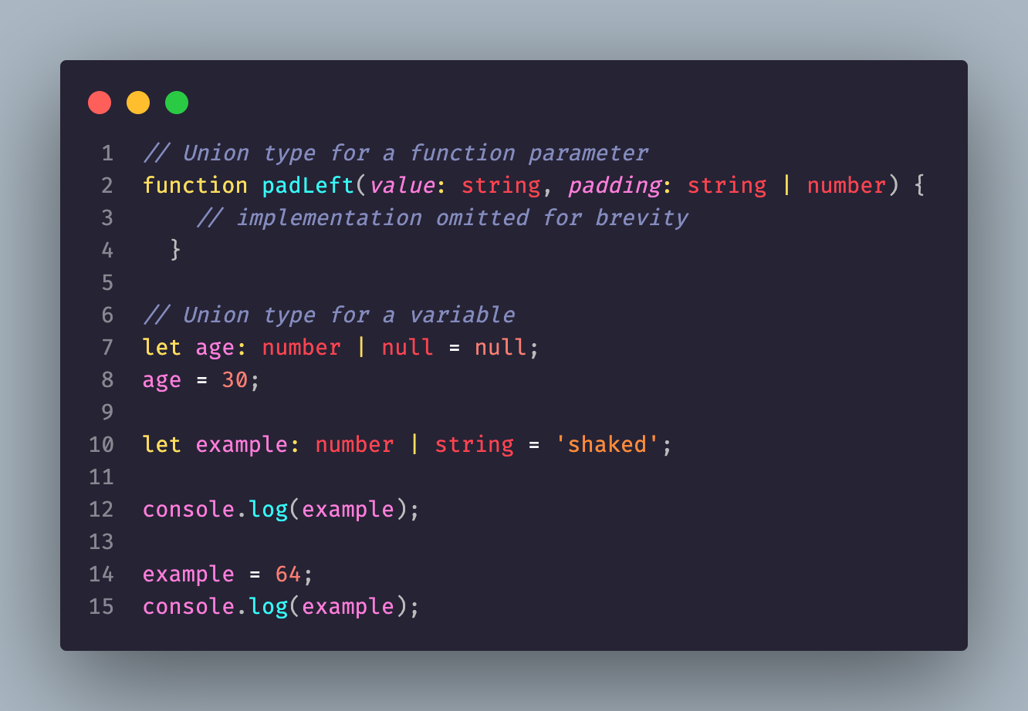
example

Slide 37
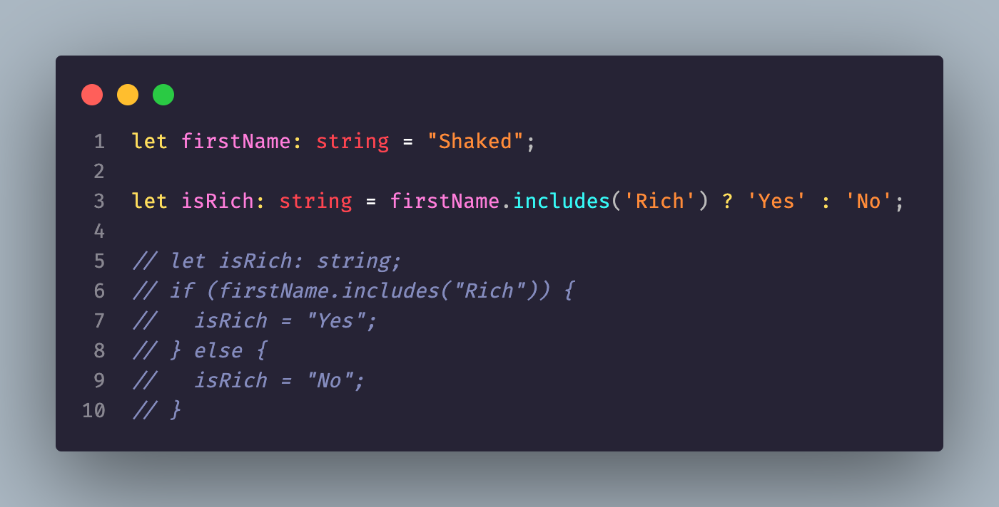
ternary operator ?
In JavaScript, the ternary operator is a shorthand way to write an if-else

Slide 38
‘string’.includes(‘str’)
The includes() method returns a boolean value that indicates whether the string contains the specified substring. It's case-sensitive, so it will only match substrings that have the same case as the original string.

Slide 39
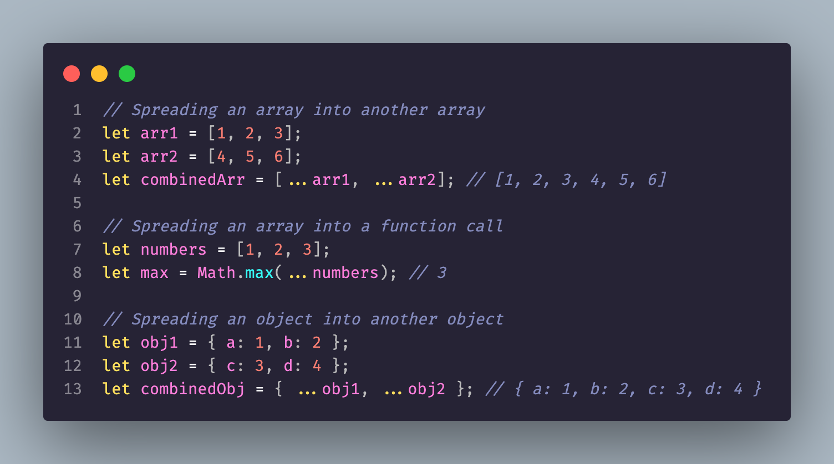
spread operator
n JavaScript and TypeScript, the spread operator (...) is a powerful feature that allows you to spread the contents of an iterable object (such as an array or an object) into another iterable object or function call.

Slide 40
interface
In TypeScript, an interface is a way to define a contract for an object that describes the shape of the object and the types of its properties and methods. Interfaces can be very useful in TypeScript for defining contracts that your code must conform to. They can help catch errors at compile-time, provide better tooling and editor support, and make your code more robust and maintainable.

Slide 41
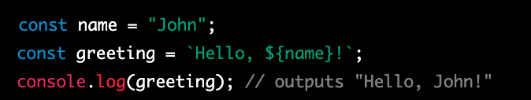
templates
Template literals are a feature of ECMAScript 6 (ES6) that allows you to embed expressions inside string literals, using a syntax that makes it easier to write complex strings.
In the example {var name}, the curly braces {} are used to enclose a variable name name. When the template literal is evaluated, the value of name is inserted into the string at the position of the curly braces.

Slide 42
function
n TypeScript, a function has a structure that consists of several elements. Here are the main components of a TypeScript function:
Function Name: A function can have a name, which is optional. If a function has a name, it can be called by its name.
Parameters: Parameters are the inputs to the function, and they are enclosed in parentheses after the function name. Parameters are separated by commas.
Return Type: A function can have a return type, which is the data type of the value that the function returns. The return type is specified after the parameters and a colon.
Function Body: The function body contains the code that executes when the function is called. The function body is enclosed in curly braces {}.

Slide 43
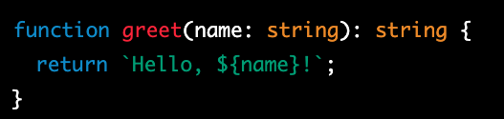
example
In this example, the function is named greet, it takes a single parameter called name, which is of type string. The function returns a string value, which is also specified in the function signature.
The function body is contained within curly braces {} and contains a single line of code that returns a string message.

Slide 44
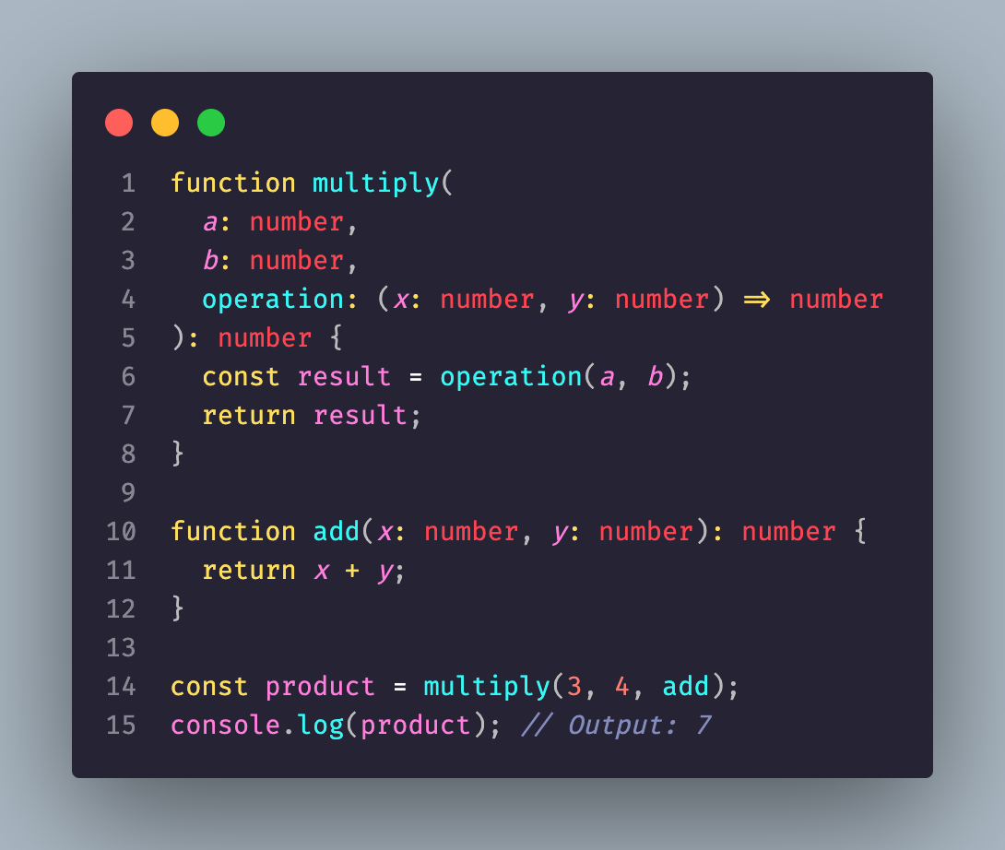
Pass a function as a parameter

Slide 45
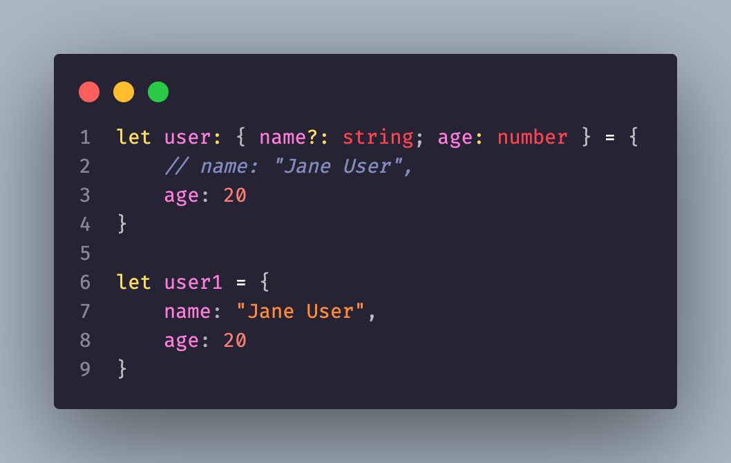
Object Types
New way to declare object

Slide 46
readonly
In TypeScript, the readonly keyword is used to make properties and variables immutable, meaning that their values cannot be changed after they are initialized.
There are two main uses of the readonly keyword in TypeScript:

Slide 47
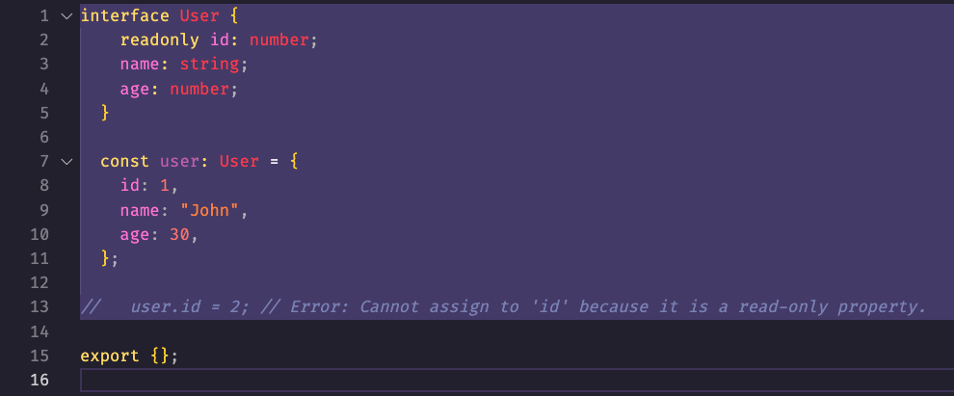
Interface usecase
Read-only Properties in Interfaces: In an interface, you can declare a property as read-only to indicate that it cannot be modified after it is initialized.
In this example, the name property in the Person interface is declared as read-only, which means that its value cannot be changed once it is initialized. When we try to change the value of the name property in the person object, TypeScript throws an error because the property is read-only.

Slide 48
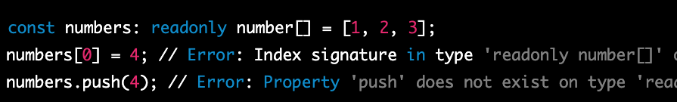
Prevent reassigned
Readonly Variables: In a variable declaration, you can use the readonly keyword to indicate that the variable cannot be reassigned to a different value after it is initialized.

Slide 49
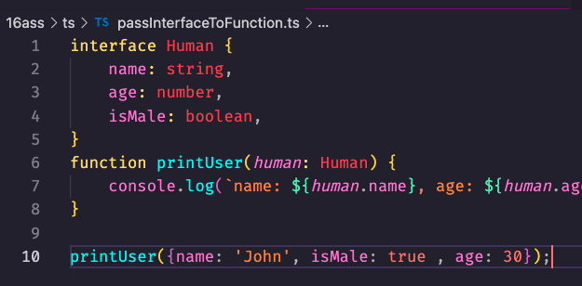
Pass interface to function

Slide 50
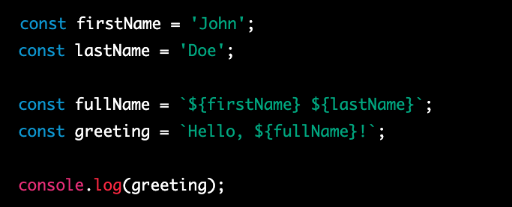
Template literals
Template literals are a feature in TypeScript (as well as in JavaScript) that allow you to embed expressions and variables inside a string literal using backticks (`...`) and ${...} syntax.

Slide 51
Type
In TypeScript, the type keyword is used to create new type aliases. Type aliases allow you to define a new name for an existing type, making it easier to use and understand in your code.
Type can also be used as an alias into force a structure

Slide 52
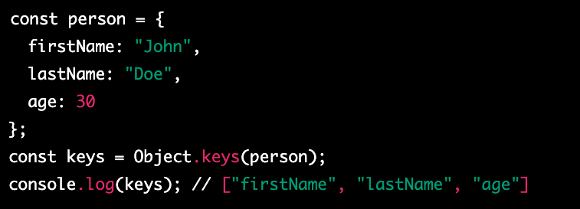
Object.keys
Object.keys() is a built-in method in JavaScript that is used to extract the keys of an object and return them in an array. The method takes an object as an argument and returns an array of strings, which represent the keys of the object.

Slide 54
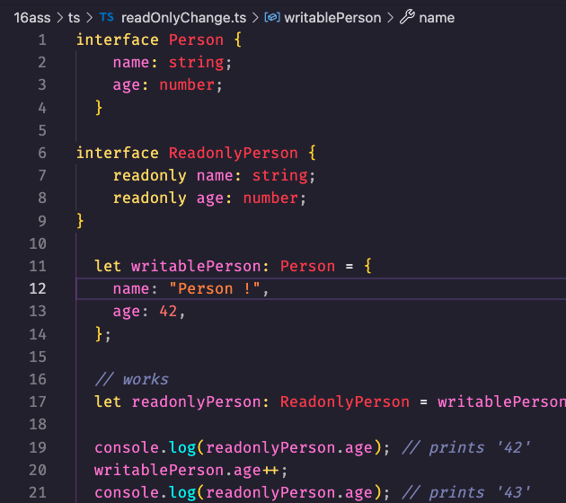
Readonly change

Slide 55
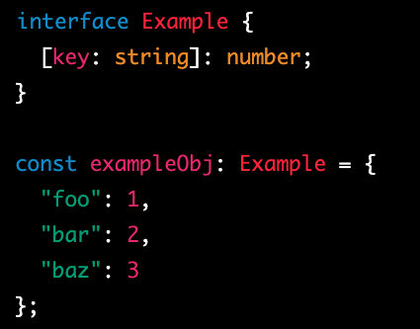
Index Signatures
Index Signatures in TypeScript allow you to define a dynamic property on an object, where the property name can be a string or a number, and the value can be of any type.
In this example, we define an interface called Example with an Index Signature that specifies that all keys must be strings and all values must be numbers. We then create an object of type Example called exampleObj and add three properties to it, using string keys and numeric values.
Index Signatures are useful for working with objects that have dynamic properties or when you want to define an object with an unknown number of properties. However, it's important to keep in mind that using Index Signatures can make it harder to catch errors at compile-time, since the properties are not explicitly defined.

Slide 56
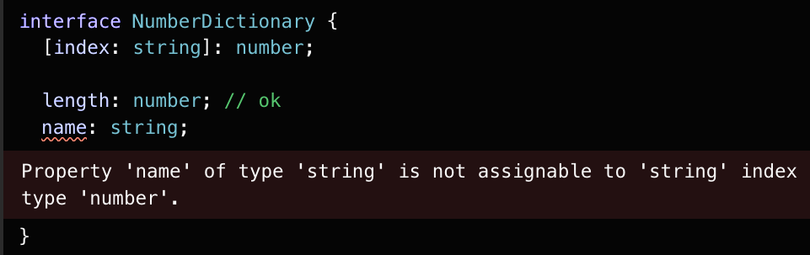
Errors

Slide 58
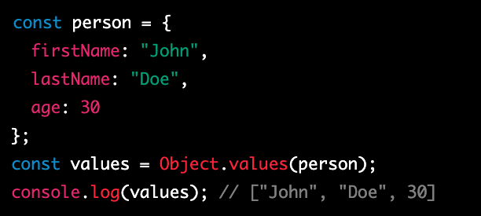
Object.values()
Object.values() is a built-in method in JavaScript that is used to extract the values of an object and return them in an array. The method takes an object as an argument and returns an array of values, which represent the values of the object.

Slide 59
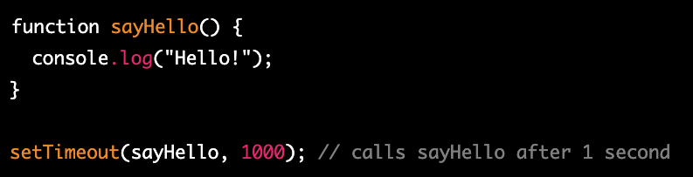
setTimeout
setTimeout is a built-in function in JavaScript that allows you to schedule a function to be executed after a specified amount of time has elapsed. This is useful in situations where you want to delay the execution of a function, or when you want to run a function repeatedly at a fixed interval.

Slide 60
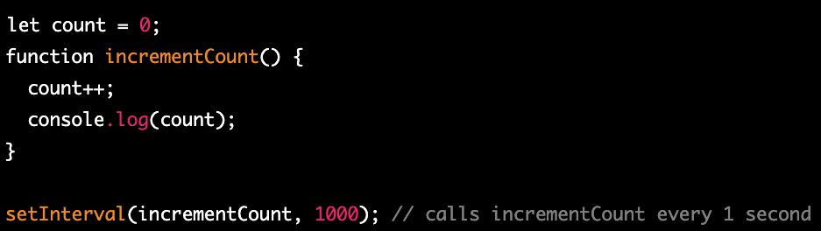
setInterval
setInterval is a built-in function in JavaScript that allows you to schedule a function to be executed repeatedly at a fixed interval. This is useful in situations where you want to run a function on a regular basis, such as updating the time or animation frames.

Slide 61

Promises
Promises are a way to handle asynchronous operations in JavaScript and TypeScript. They provide a way to handle the outcome of an asynchronous operation, either a successful outcome or a failure.
In JavaScript, a Promise is an object that represents the eventual completion (or failure) of an asynchronous operation and its resulting value. Promises have three states:
Pending: The initial state. The promise is neither fulfilled nor rejected.
Fulfilled: The operation completed successfully, and the promise has a resulting value.
Rejected: The operation failed, and the promise has a reason for the failure.
In TypeScript, Promises are typed, allowing developers to specify the type of value the promise will eventually resolve with. This provides additional type safety when working with asynchronous operations.

Slide 62
New Promise
In JavaScript, the Promise constructor is used to create a new Promise object. The Promise object represents the eventual completion (or failure) of an asynchronous operation and its resulting value.
When you create a new Promise, you pass in a function that has two arguments: resolve and reject. These are functions that you call when the asynchronous operation is complete, either successfully or with an error.
The resolve function is called with the successful result of the asynchronous operation. This result is passed to any attached then handlers that are waiting for the Promise to resolve.
The reject function is called with an error object if the asynchronous operation fails. This error object is passed to any attached catch handlers that are waiting for the Promise to reject.

Slide 63
Try catch
In TypeScript, you can use the try/catch statement to handle exceptions that may occur during the execution of your code. The try block contains the code that may throw an exception, and the catch block contains the code that handles the exception.
Using try/catch in TypeScript allows you to gracefully handle exceptions that may occur during the execution of your code. It can help make your code more resilient and less likely to crash or produce unexpected behavior.

Slide 64
Call stack
In JavaScript, the call stack is a data structure that is used to keep track of the execution of function calls. It is a last-in, first-out (LIFO) structure that records the active function invocation at the top of the stack.
Whenever a function is called, a new frame is added to the top of the call stack to record the function's execution context. This frame includes the function's arguments, local variables, and the return address, which is the point in the code where the function was called.
As the function executes, statements are added and removed from the top of the stack until the function returns. When the function returns, its frame is removed from the top of the stack, and control returns to the calling function.

Slide 65
Event loop
In JavaScript, the event loop is a mechanism that enables asynchronous processing and non-blocking I/O operations. It is responsible for managing the execution of tasks and events in a single-threaded environment, which is the case in JavaScript.
The event loop continuously monitors the call stack and the message queue for new tasks and events to process. When the call stack is empty, the event loop checks the message queue for the next task or event to process. If a task or event is found, it is pushed onto the call stack and executed.
Tasks are scheduled using the setTimeout, setInterval, and setImmediate functions, among others. When a task is scheduled, it is added to the message queue and will be executed by the event loop when the call stack is empty.
https://www.youtube.com/watch?v=8aGhZQkoFbQ
16:00

Slide 66
JSON
JSON (JavaScript Object Notation) is a lightweight data interchange format that is widely used in web development and other computer applications. It is a text-based format that is easy to read and write, and can be easily parsed and generated by a variety of programming languages.
JSON is designed to represent simple data structures, such as objects and arrays, using a syntax that is similar to JavaScript object literals. JSON data consists of key-value pairs, where the keys are always strings and the values can be any valid JSON data type, including strings, numbers, booleans, null, objects, and arrays.

Slide 67
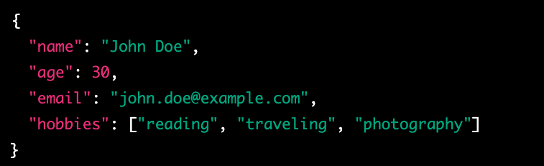
JSON example

Slide 68
Let’s start talk about getting data!
We define a variable url that contains the URL of the web API that we want to retrieve data from.
We call the fetch function with the URL as its argument. The fetch function returns a promise that resolves to a Response object, which represents the HTTP response that we receive from the API.
We chain a then method to the promise returned by fetch. This then method takes a callback function that is executed when the promise is resolved. Inside this callback function, we call the json method on the Response object to parse the response body as JSON. The json method returns a new promise that resolves to the parsed JSON data.
We chain another then method to the promise returned by the json method. This then method takes another callback function that is executed when the promise is resolved. Inside this callback function, we log the parsed JSON data to the console.
We chain a catch method to the promises returned by fetch and json. This catch method takes a callback function that is executed when any of the promises in the chain are rejected. Inside this callback function, we log the error to the console.

Slide 69
Fetch
The fetch API and promises allow us to asynchronously retrieve data from a web API without blocking the main thread of execution. The fetch function returns a promise that resolves to a Response object, which we can use to parse the response body as JSON using the json method. By chaining promises together using then and catch methods, we can handle asynchronous errors and perform operations on the data returned by the API in a readable and organized way.

Slide 70
BASS
Back end as a service

Slide 71
Let’s start talk about getting data!

Slide 72
Let’s start talk about getting data!

Slide 73
Let’s start talk about getting data!

Slide 74
Let’s start talk about getting data!

Slide 75
Let’s start talk about getting data!

Slide 76
Let’s start talk about getting data!

Slide 77
Let’s start talk about getting data!

