Slide 1
Classes ts
In TypeScript, classes provide a way to define and create objects with a blueprint or template for their properties and behavior. They allow you to apply object-oriented programming principles in your TypeScript code. Here's how you can work with classes in TypeScript:

Slide 2
What you have in a class
Properties: Inside a class, you can define properties to represent the state or characteristics of objects created from that class.
Methods: Methods are functions defined within a class that define the behavior or actions associated with objects created from that class. Methods can also have access modifiers and can access the class's properties.

Slide 3
What is a class
In programming, a class is a blueprint or template for creating objects that share common properties and behaviors. It serves as a blueprint that defines the structure and behavior of objects that can be instantiated (created) based on that blueprint.
A class encapsulates data (properties) and functions (methods) that operate on that data. It provides a way to define the state and behavior of objects. The properties represent the characteristics or attributes of an object, while the methods define the actions or operations that the object can perform.

Slide 4
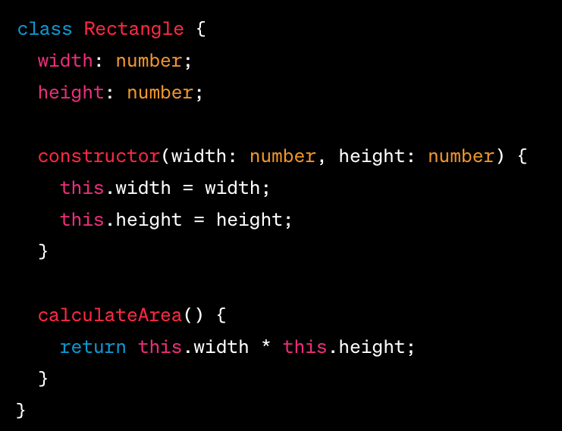
why
Classes help organize code and promote code reuse by allowing you to define a common structure and behavior once and create multiple instances (objects) based on that class. Each object created from a class is known as an instance or an object of that class.

Slide 5
Inheritance
Inheritance is a key concept in object-oriented programming that allows you to create a new class (derived class or subclass) based on an existing class (base class or superclass). The derived class inherits the properties and methods of the base class, enabling code reuse and promoting the concept of hierarchical relationships between classes.
In TypeScript, you can implement inheritance using the extends keyword. Here's how you can work with inheritance:

Slide 6
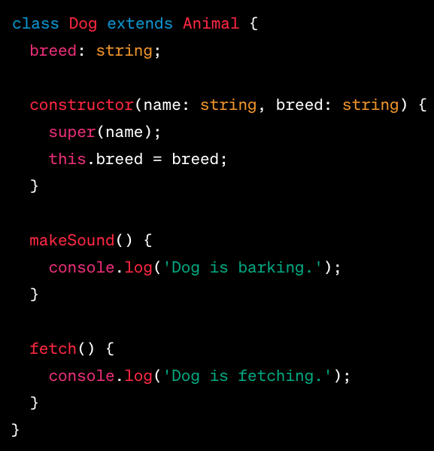
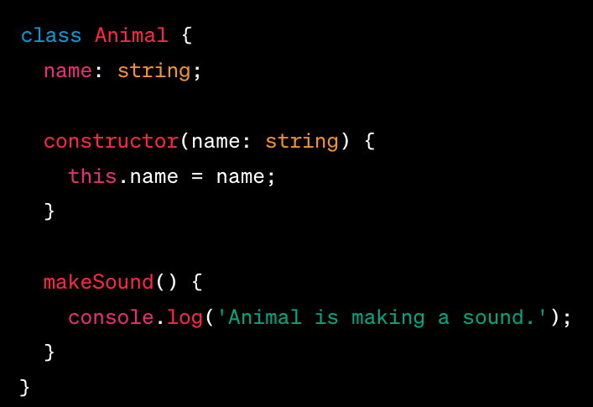
example

Slide 7
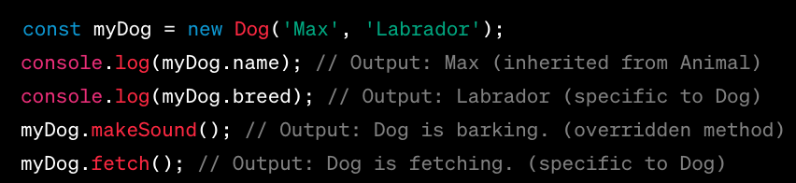
Example - more

Slide 8
Polymorphism
Polymorphism is a concept in object-oriented programming that allows objects of different classes to be treated as objects of a common base class. It enables you to write code that can work with objects of multiple types, providing flexibility and extensibility in your programs. TypeScript supports polymorphism through inheritance and method overriding.
Base Class and Derived Classes: Polymorphism relies on a base class and one or more derived classes. The base class defines a common interface, while the derived classes extend the base class and provide specific implementations. Here's an example:

Slide 9
Example in week 18
In the example above, the printArea function accepts an object of type Shape. It doesn't need to know the specific type of the object, as long as it adheres to the common interface defined by the Shape base class. When invoking the calculateArea() method, the appropriate implementation based on the actual object type (Circle or Rectangle) is automatically called.
Polymorphism allows you to write generic code that can work with different objects, promoting code reusability and flexibility. It enables you to create more extensible and modular systems where you can introduce new derived classes without modifying existing code that relies on the base class.
By leveraging polymorphism, you can achieve dynamic behavior and flexibility in your TypeScript applications, making your code more adaptable to changes and enhancing code maintainability.

Slide 10
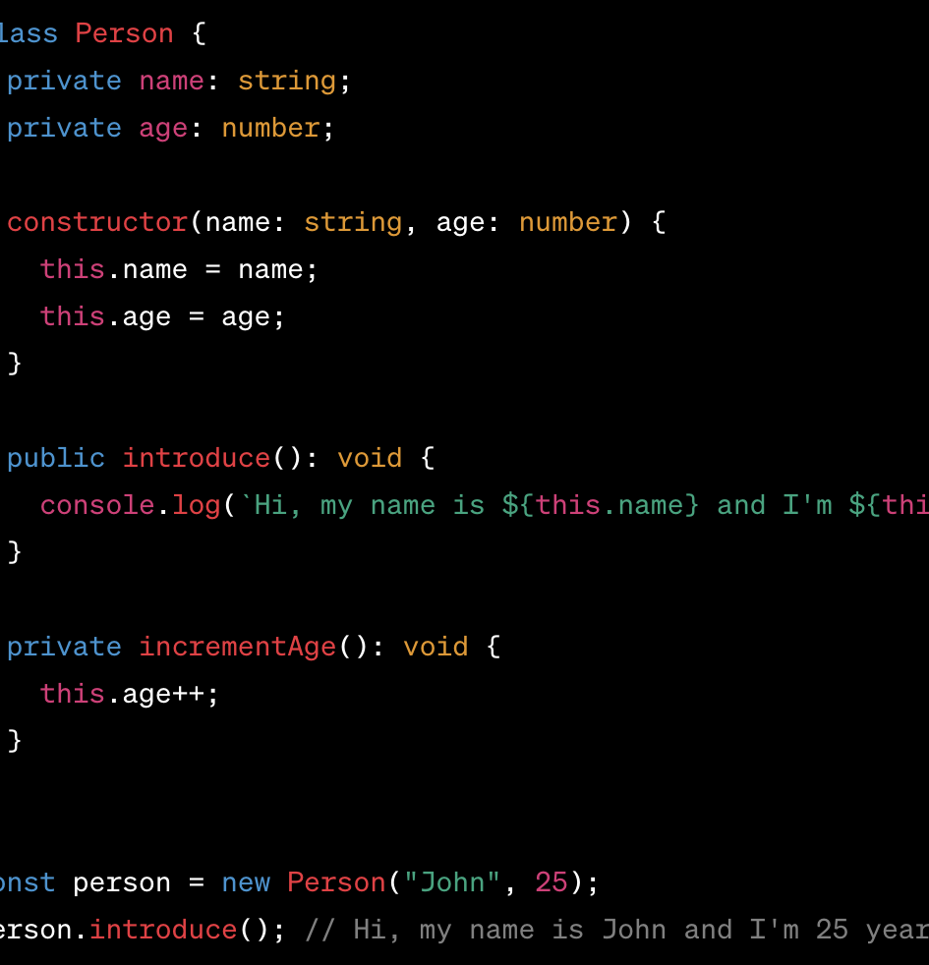
Private
In TypeScript, the private modifier is used within classes to restrict access to class members (properties and methods) from outside the class. It ensures that the members marked as private can only be accessed and modified within the class itself.

Slide 11
Get and set
Getters and setters are special methods in a class that provide a way to access (get) and modify (set) the values of its private or protected properties. They allow for controlled access and manipulation of the class's internal state.
In TypeScript, you can define getters and setters using the get and set keywords, respectively. They are typically associated with a specific property and provide a level of encapsulation by allowing controlled access to the property's value.

Slide 12
To check if an object is of a specific type in TypeScript, you can use the instanceof operator or the typeof operator. Here's how you can use each approach:
Using the instanceof operator: The instanceof operator checks if an object is an instance of a particular class or has a specific class in its prototype chain.
Using the typeof operator: The typeof operator checks the type of a value or expression, primarily for primitive types (e.g., number, string, boolean) and built-in types.

Slide 15
React and Next.js
React and Next.js are both popular tools used in web development, but they serve different purposes and have distinct features. Here's an overview of React and Next.js
In summary, React is a JavaScript library for building user interfaces, while Next.js is a framework that extends React with server-side rendering (SSR) and static site generation (SSG) capabilities. Next.js simplifies the process of building server-rendered React applications and provides additional features to enhance performance, routing, and data fetching. The choice between React and Next.js depends on the specific requirements of your project. If you need server-side rendering or static site generation, Next.js is a great choice, while React alone is suitable for client-side rendering applications.

Slide 16
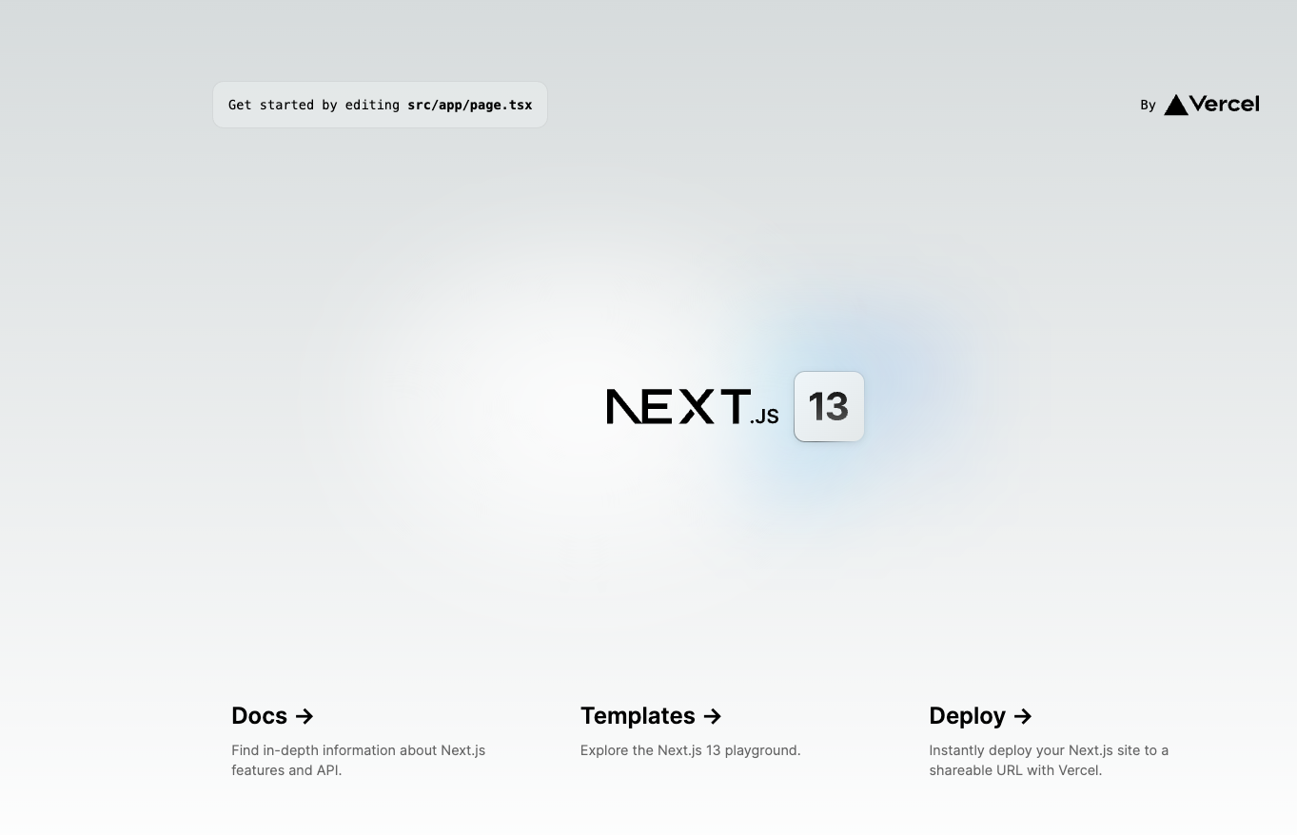
Next.js
npx create-next-app my-app
Let’s fill the options
And we get this page

Slide 17
folders
.next: This folder is automatically generated by Next.js when you run the project. It contains the build artifacts, compiled JavaScript files, and other assets needed for server-side rendering and client-side rendering.
pages: This directory is where you define the pages of your Next.js application. Each file in this directory represents a unique route in your application. For example, pages/index.js corresponds to the homepage route ("/"), and pages/about.js corresponds to the about page route ("/about").
public: The public folder is where you place static assets such as images, fonts, and other files that you want to serve directly. These files can be accessed using the / path in the URL. For example, a file named logo.png placed in the public folder can be accessed at

Slide 18
more
components: The components folder is where you can organize and store reusable UI components. Components in this folder can be used across multiple pages or other components within your application.
styles: You can create a styles folder to store your CSS or styling-related files. Next.js allows you to use various styling methodologies, such as CSS modules or CSS-in-JS libraries. You can configure the styling approach that suits your project needs.
utils: The utils folder is used to store utility functions or helper files that can be shared across different parts of your application.

Slide 19
more
pages/api: If you choose not to use a separate api folder, Next.js provides a default pages/api directory to define serverless functions or API routes directly within the pages directory.
api: The api folder is not a default folder but can be added to organize serverless functions or API routes. Next.js allows you to create API routes using serverless functions, and placing them in this folder can provide a clear separation for your API-related code.

Slide 20
Layout.tsx
In a Next.js project, the Layout.tsx file (or Layout.js for JavaScript projects) is typically used to define a layout component that wraps around the individual pages of your application. It provides a consistent structure and styling for the common elements present across multiple pages, such as header, footer, navigation menu, or sidebars.

Slide 21
Use case
Here's some information about the Layout.tsx file:
Purpose: The primary purpose of the Layout component is to encapsulate the shared layout structure and styling in one central place, making it easier to maintain and modify the overall appearance of your application.
Component Structure: The Layout.tsx file typically contains a React functional or class component. It renders the common layout elements and components, such as header, footer, navigation, or sidebar, based on your application's design and requirements.
Children Components: The Layout component usually takes the children prop, which represents the content of each individual page. The children prop is rendered inside the layout component, allowing the content of each page to be placed within the common layout structure.
Styling: You can apply styling to the Layout component using CSS or a CSS-in-JS library of your choice. This allows you to define consistent styling for the layout elements across all pages.
Dynamic Layout: Depending on your project's needs, the Layout component can be made dynamic. For example, you can pass props to the Layout component to conditionally render specific elements or modify the layout based on the current page or user authentication status.
Code Reusability: By creating a separate Layout.tsx file, you can reuse the same layout component across multiple pages, promoting code reusability and maintaining a consistent user experience throughout the application.

Slide 22
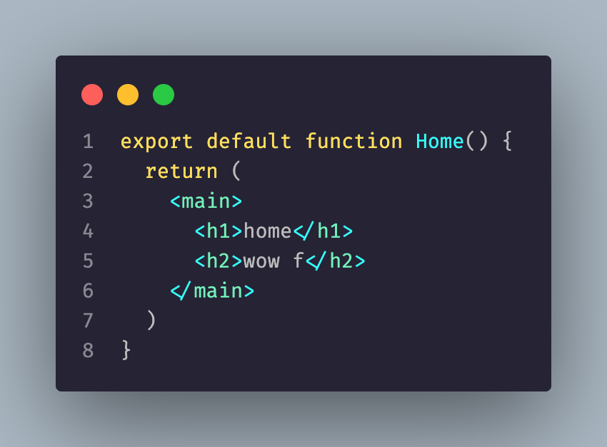
Let’s see an example in the introLayout folder
Code expain – in react we write in jsx or tsx, e
TSX (TypeScript JSX) is an extension of the TypeScript language that allows you to write JSX syntax within TypeScript files. JSX is a syntax extension in React that allows you to write HTML-like code within JavaScript or TypeScript.

Slide 23
The strucure of a page
We create a function and we export it as default, we just have to make sure the function return some jsx/tsx code.
Which is for know only html code

Slide 24
.module.css and file.css
In a Next.js project, the file naming convention .module.css is used to denote CSS modules. Let's understand the difference between a regular CSS file and a CSS module:
Regular CSS File: file.css
Syntax: A regular CSS file follows standard CSS syntax.
Global Scope: Styles defined in a regular CSS file have a global scope and can affect all elements in your application.
Class Name Clashes: There is a possibility of class name clashes when multiple CSS files are used.
Class Selection: Selecting elements in CSS is done using class selectors, IDs, or HTML tag names.

Slide 25
CSS Module:
Syntax: CSS modules also follow standard CSS syntax.
Local Scope: Styles defined in a CSS module are scoped locally to the component where they are imported.
Class Name Composition: CSS modules automatically generate unique class names to avoid class name clashes. These unique class names are generated based on the file name and can be accessed in the component file.
Class Selection: In CSS modules, you can select elements using the imported class names as variables in your component code.

Slide 26
advantages
The key advantage of CSS modules is that they provide better encapsulation and prevent style conflicts between different components. By using unique class names, CSS modules enable developers to write more maintainable and reusable styles.

Slide 27
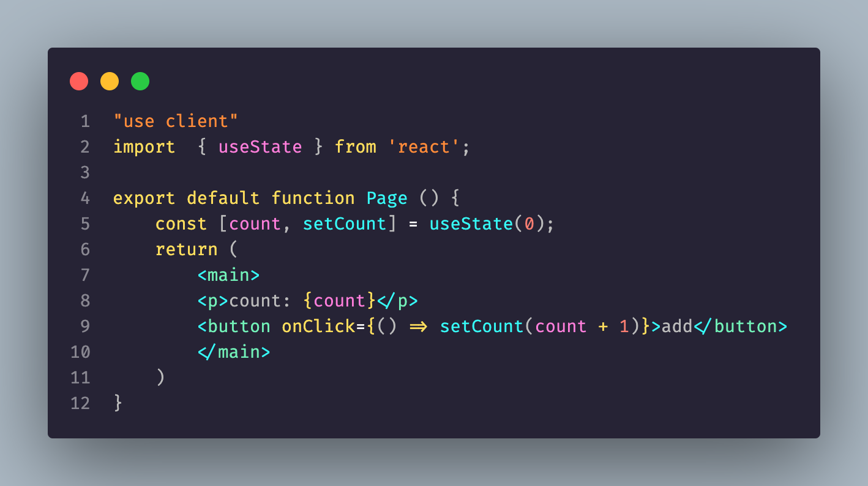
Let’s create a counter app
In the code snippet, we first import the useState hook from the react package. This hook allows us to add state to our functional component.
Within the Page component, we call the useState hook and pass the initial value of 0. This initializes the count state variable to 0 and provides us with the setCount function to update its value.
The return statement renders the JSX code that represents the component's structure. The current value of count is displayed in a paragraph element, and a button is provided to increment the count when clicked.
This revised code snippet should now accurately convey the usage of the useState hook in Next.js.

Slide 28
Tsx basic syntax
TSX (TypeScript JSX) is a syntax extension for TypeScript that allows you to write JSX (JavaScript XML) syntax within TypeScript code. It is commonly used in frameworks like React and Next.js. Here's a brief overview of TSX syntax.
File Extension:
TypeScript files that contain JSX code have the .tsx extension.
Importing Dependencies:
Import the necessary dependencies at the beginning of your file, just like in regular TypeScript files.
JSX Elements:
JSX allows you to write HTML-like elements in your TypeScript code. For example, you can write <div>, <span>, <h1>, etc.

Slide 29

More about that

Slide 32

Supabase!

Slide 33
What is it
Supabase is an open-source Firebase alternative and a cloud-based development platform that provides a set of tools and services for building scalable and secure web and mobile applications. It combines the functionalities of a database, authentication system, and real-time event handling, making it easier for developers to create and manage their applications.
Postgres Database
Real-time Subscriptions
Authentication and Authorization
Storage
API Generation
Security and Scalability
Open-Source and Self-Hostable

Slide 34
How to start
Create a vite project
Add the library npm i @supabase/supabase-js

Slide 35
Select - get
A GET request is a type of HTTP request method used to retrieve or fetch data from a specified resource. It is one of the most commonly used methods in web development and is considered a safe and idempotent operation, meaning it does not modify the resource and can be repeated multiple times without changing the server state.
When making a GET request, the client (typically a web browser or an API client) sends a request to the server with a specific URL (Uniform Resource Locator) that points to the desired resource. The server then responds with the requested data or an error message if the resource is not found.

Slide 36

Select – get supabase

Slide 37
Get key characteristics
Idempotence: GET requests are considered idempotent because they should not have any side effects on the server. Repeating the same GET request multiple times should yield the same result.
Data Passing: GET requests can pass data to the server through query parameters. Query parameters are appended to the URL and are typically in the form of key-value pairs. For example, https://api.example.com/users?id=123 passes the id parameter with a value of 123.
Caching: GET requests can be cached by the client or intermediate systems like proxies. Caching helps improve performance by allowing subsequent requests to be served from a cache rather than fetching data from the server again.
Security: GET requests should not be used to send sensitive information as the data is visible in the URL. Passwords, API keys, and other sensitive data should be transmitted using more secure methods like POST requests with encrypted connections (HTTPS).

Slide 38
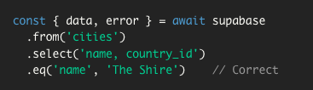
Get with filters
To perform a SELECT query with a condition using Supabase, you can use the .select() method and provide a filter or condition using the .eq() method. Here's an example: https://supabase.com/docs/reference/javascript/using-filters

Slide 39

Get grater than
Match only rows where column is greater than value.

Slide 40

Insert – post
Perform an INSERT into the table or view.

Slide 41
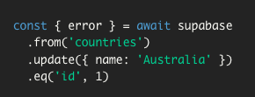
Update - put
A PUT request is a type of HTTP request method used to update or replace an existing resource on the server. It is commonly used to modify the state or properties of a resource with the data provided in the request payload.

Slide 42
Delete
A DELETE request is a type of HTTP request method used to delete a specified resource on the server. It is commonly used to remove data or resources from a server or database.
Here are some key characteristics of DELETE requests:
Resource Deletion: The primary purpose of a DELETE request is to delete a specific resource identified by a URL or URI. When the server receives a DELETE request, it performs the appropriate action to remove the resource from its storage.
Idempotence: DELETE requests are considered idempotent, which means that multiple identical DELETE requests have the same effect as a single request. If a resource is deleted successfully, subsequent DELETE requests for the same resource will have no effect.
No Request Body: Unlike PUT or POST requests, DELETE requests typically do not include a request payload or body. The URL or URI itself is used to identify the resource to be deleted.
Confirmation: After a successful DELETE operation, the server usually responds with a status code indicating the success of the deletion. However, the response may not contain the actual deleted resource. Some APIs may include additional information in the response payload to confirm the deletion.

Slide 43

Delete supabase
Perform a DELETE on the table or view.
delete() should always be combined with filters to target the item(s) you wish to delete.
If you use delete() with filters and you have RLS enabled, only rows visible through SELECT policies are deleted. Note that by default no rows are visible, so you need at least one SELECT/ALL policy that makes the rows visible.

Slide 44

Order by - supabase
Order the query result by column.

Slide 45
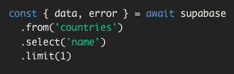
limit
Limit the query result by count.

Slide 46
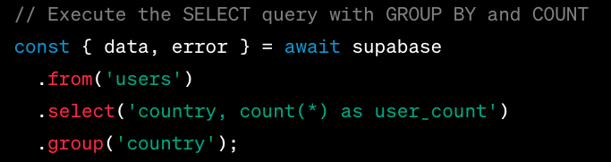
Group by

Slide 47
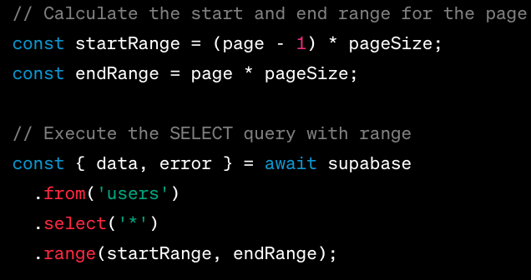
pagination

