Slide 1

React / Next.ts
Let the game begin

Slide 2
What is Next.js?
Next.js is a React framework developed and maintained by Vercel. It provides a solution to build server-rendered React applications, static websites, and more. The framework offers features like server-side rendering (SSR), static site generation (SSG), automatic code splitting, hot module replacement, and many other features right out of the box.

Slide 3
When should you use Next.js?
Next.js is particularly useful when you need to build a highly performant, SEO-friendly web application. Some common use cases include:
Server-Side Rendered applications: Next.js shines when you need to build an application that relies on server-side rendering. This is particularly useful when you need to improve the initial page load time, which can be crucial for SEO.
Static Site Generation: If you need to build a blog, portfolio, or any website with content that doesn't change often, Next.js is an excellent choice due to its static site generation capabilities.
API Routes: If you want to build a web application that also includes API endpoints, Next.js comes with API routes out of the box.
Performant application: Next.js automatically splits your code into various bundles, so users only load what's necessary for each page. This improves performance.

Slide 4
Why should you use Next.js?
Improved SEO: Traditional single-page applications (SPAs) built with React suffer from SEO issues because the content is loaded client-side and search engine bots often see an empty page. Next.js offers SSR and SSG, which allows search engine bots to see the fully rendered page.
Performance optimization: Next.js automatically implements code splitting, which means every page only loads what’s necessary for that page. This leads to faster page loads.
Development experience: Next.js offers features like hot code reloading, automatic routing, and universal rendering which make development smoother.
Incremental Static Regeneration: This feature allows you to update static content after you have built your site, without needing to rebuild the entire site. This makes it ideal for sites with static content that needs to update frequently.
Versatility: Next.js works great for both small and large scale applications. It's a great choice whether you're creating a personal project or a large, enterprise-level application.
Community and Ecosystem: Since Next.js is built on top of React, you have access to the robust React ecosystem, and there's a large community for Next.js itself as well.

Slide 5
folder structure
.next/: This is a folder generated automatically when you run your Next.js application in development mode (npm run dev). It contains the compiled version of your project and should not be touched.
node_modules/: This folder contains all the dependencies and libraries used in your project. They are installed via npm or yarn.
pages/: This is one of the most important folders in a Next.js project. Every file in the pages directory becomes a route. For example, pages/index.js maps to your site's homepage (/). If you create a pages/about.js, it will be accessible at /about. The pages/api directory is used for creating API routes.
_app.js: This file is used to initialize pages. You can apply page-level layouts, keep state between page transitions, add global CSS styles, etc. It's a sort of wrapper component for all your other pages.
_document.js: This file is used to augment your application's <html> and <body> tags. This is commonly used to insert shared page headers, stylesheets, etc.

Slide 6
More folders
public/: The public directory is used to serve static assets such as images, scripts, or stylesheets. Files inside the public folder can be referenced from the root of the application similar to the pages folder.
styles/: This folder is typically used for storing your CSS or Sass files. If you're using CSS-in-JS solutions like styled-components or emotion, you might not have this folder.
package.json: This file includes metadata about your project and its dependencies. When you install a package using npm or yarn, it gets listed here under "dependencies" or "devDependencies".
next.config.js: This optional file is used to configure advanced features of Next.js. It's not created by default, you would create it when you need to customize the default settings provided by Next.js.

Slide 7
What is React?
React is a JavaScript library for building user interfaces, primarily for single-page applications. It's used for handling the view layer for web and mobile apps. React allows you to design simple views for each state in your application, and it efficiently updates and renders the right components when your data changes.

Slide 8
Tsx?
TSX stands for TypeScript XML. It is a syntax extension for TypeScript, the statically typed superset of JavaScript developed by Microsoft, that includes JSX support. JSX, which stands for JavaScript XML, is a syntax extension for JavaScript that allows you to write HTML-like syntax directly in your JavaScript (or TypeScript) code.
The combination of TypeScript and JSX (TSX) provides a powerful development environment, allowing you to leverage the features of both technologies. TypeScript brings static typing to your codebase, improving tooling capabilities and making your code more predictable and easier to debug. JSX, on the other hand, brings a declarative syntax for building user interfaces in JavaScript.

Slide 9
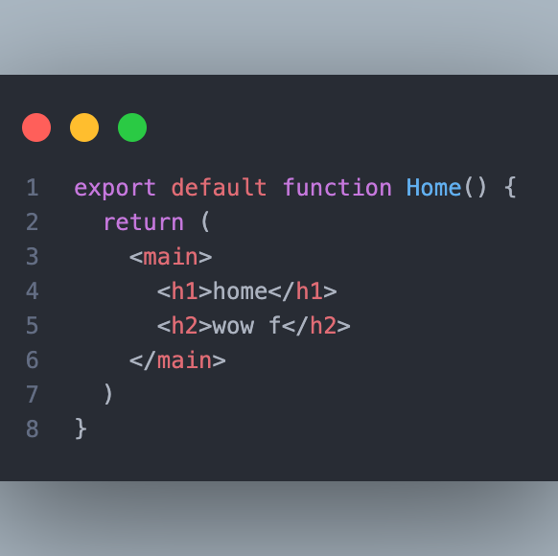
How do we start?
We start by exporting a function, with tsx

Slide 10
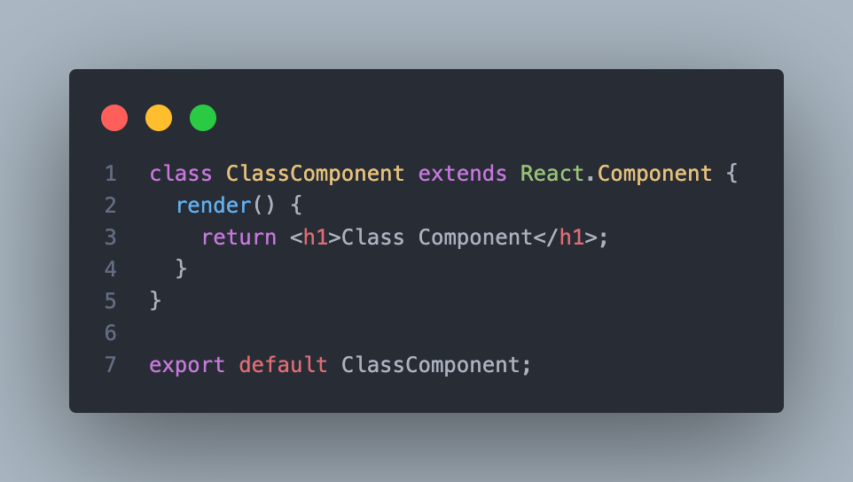
Classes?
You can create a class component but this is old and we will no deal with this anymore !

Slide 11
Let’s start count (useState)
In React, useState is a built-in hook that allows functional components to have state variables. Prior to React 16.8, state could only be managed in class components using the this.state approach, but with the introduction of hooks, functional components gained the ability to manage state as well.
The useState hook is used to declare state variables inside functional components, providing a way to store and update state data without the need for a class. It takes an initial value as its argument and returns an array containing the current state value and a function to update that state.

Slide 12
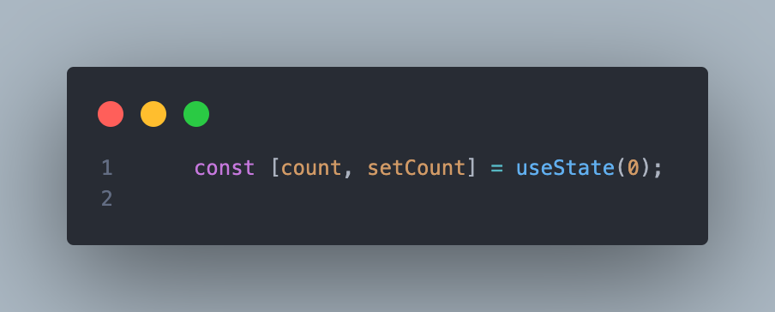
Example

Slide 13
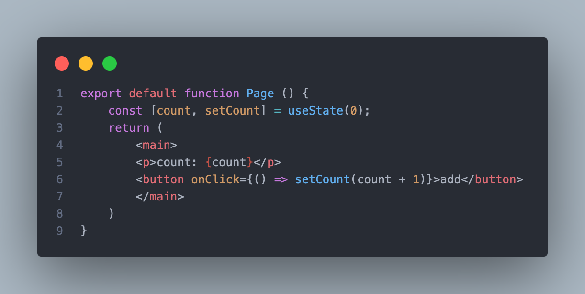
In a component

Slide 14
Why do we need the function
stateVariable: This is the current value of the state variable. You can access and use it just like any other variable in your component.
setStateFunction: This is a function provided by React to update the state. When you call this function with a new value, React will re-render the component with the updated state.
initialValue: This is the initial value you want to set for the state variable.

Slide 15
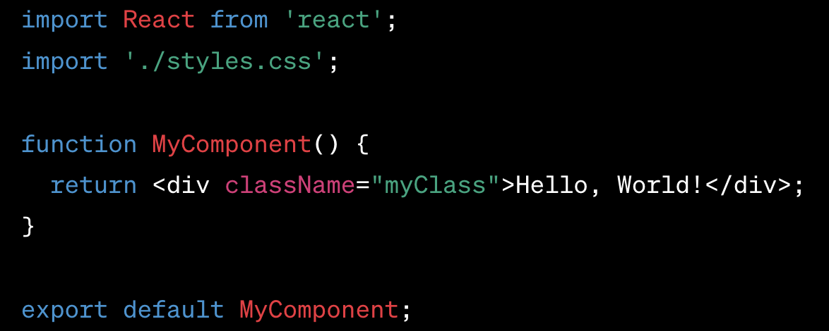
Wait what with my css?
Regular CSS Import: You can use the regular CSS import syntax to include a CSS file in your component or application. This method is straightforward and widely used.

Slide 16
Wait what is the className?
In React, the className attribute is used to apply CSS classes to HTML elements and components. It is the React equivalent of the traditional class attribute used in regular HTML. Since class is a reserved keyword in JavaScript, React uses className to set the class name for an element.

Slide 17
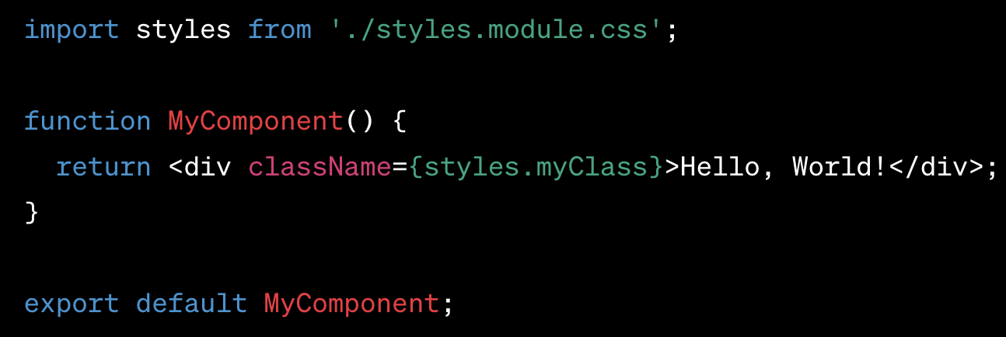
CSS Modules:
CSS Modules allow you to write modular CSS code and import it into your component. When you use CSS Modules, your styles will be scoped to the component, avoiding any global style clashes.
To use CSS Modules, rename your .css files with the .module.css extension, and then import them in your component like this:

Slide 18
explain
CSS Modules is a technique used in React (and other frameworks) to scope CSS styles to a specific component or module. It is an alternative way to manage styles that helps avoid global style clashes and promotes modular and maintainable CSS code. CSS Modules allow you to define styles for a component in a separate CSS file and use unique class names that are locally scoped to that component.
Scoped Styles: When using CSS Modules, each component gets its own unique class names, effectively scoping the styles to that specific component. This means that the styles defined in one component will not affect other components, helping to prevent unintended style conflicts.

Slide 19
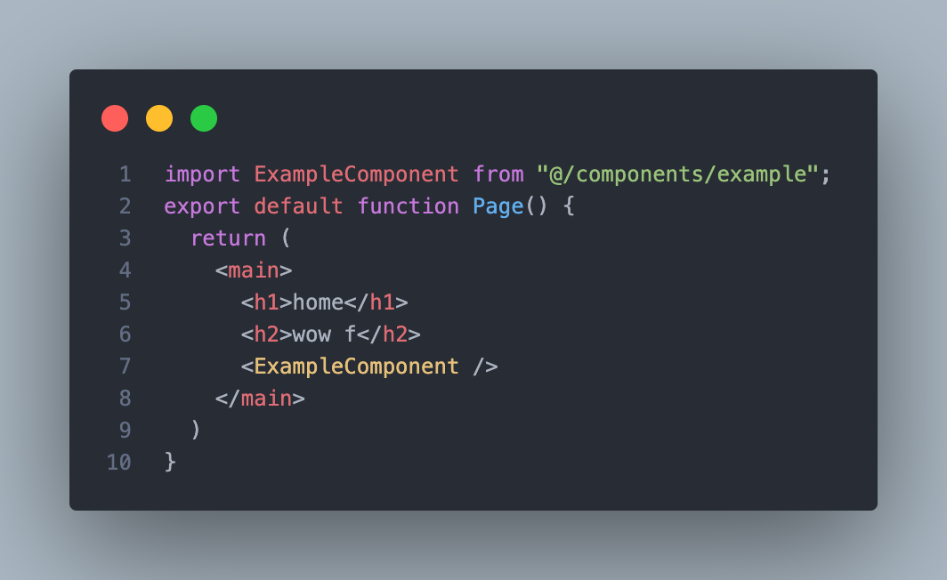
Import components

Slide 20
layout
https://nextjs.org/docs/app/building-your-application/routing/defining-routes

Slide 21
props
In React, "props" is an abbreviation for "properties," and it's a mechanism for passing data from a parent component to a child component. Props are a fundamental concept in React and play a significant role in building reusable and modular components.
When you create a React component, you can pass data to it by setting attributes (props) in the component's JSX tag. These props are then accessible within the component and can be used to customize its behavior, appearance, or any other aspect of the component's rendering.

Slide 22

Optinal props just put ?

Slide 23
useEffect
useEffect is a React Hook that allows you to perform side effects in functional components. Side effects refer to any action that affects the external world, such as fetching data from an API, subscribing to events, updating the document title, or manipulating the DOM.
In class components, side effects were typically handled using lifecycle methods like componentDidMount, componentDidUpdate, and componentWillUnmount. However, with the introduction of React Hooks, you can achieve the same functionality in functional components using the useEffect hook.

Slide 24
useEffect
useEffect is a React Hook that allows you to perform side effects in functional components. Side effects refer to any action that affects the external world, such as fetching data from an API, subscribing to events, updating the document title, or manipulating the DOM.
In class components, side effects were typically handled using lifecycle methods like componentDidMount, componentDidUpdate, and componentWillUnmount. However, with the introduction of React Hooks, you can achieve the same functionality in functional components using the useEffect hook.

Slide 25
What is zustand
Zustand is a small, fast and scaleable bearbones state-management solution that is primarily based on the concept of "global state". It's often compared with Redux and MobX, but it aims to be simpler and less boilerplate heavy.

Slide 26
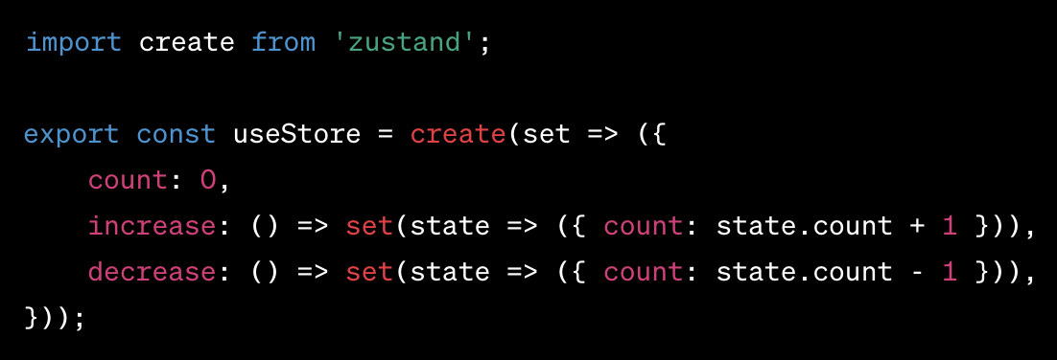
Zustand
Zustand is a lightweight state management library for React, which is also compatible with Next.js. It helps you to manage state in a flexible and scalable way without much boilerplate.

Slide 27
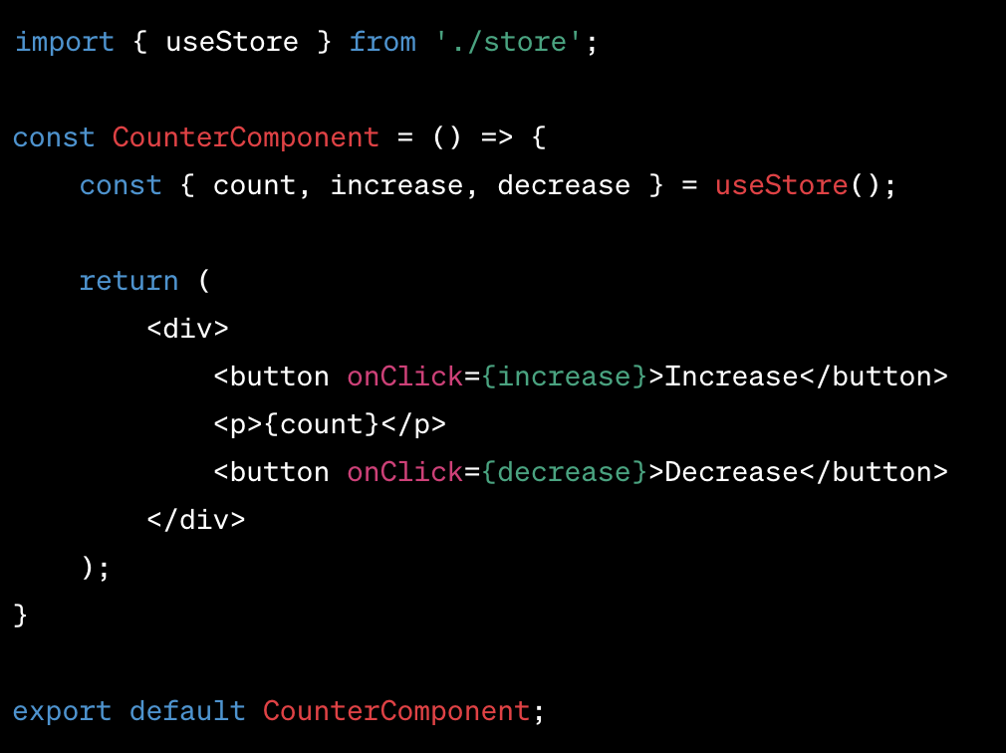
Use the store in a component
Use the store in a component: Now, you can use this store in your Next.js components using the useStore hook.

Slide 28
Remember!
The useStore() hook lets you access state and actions defined in your Zustand store. You can call increase and decrease directly from your component, and Zustand will take care of updating the state and rerendering your component when necessary.
Remember, each component that uses useStore will have access to the same global state, so it's perfect for sharing state between components. Also, Zustand is perfectly compatible with Server Side Rendering (SSR) and Static Site Generation (SSG) in Next.js, which makes it a great option for state management in this context.

Slide 29
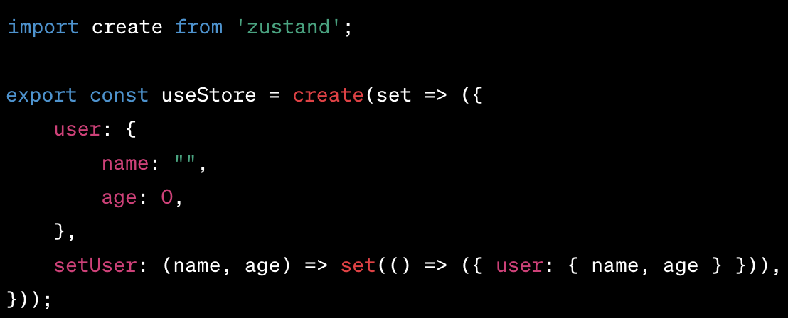
Objects as state
Objects as state: If you have a complex state that's structured like an interface, you can use it in Zustand just like you would any other state.

Slide 30
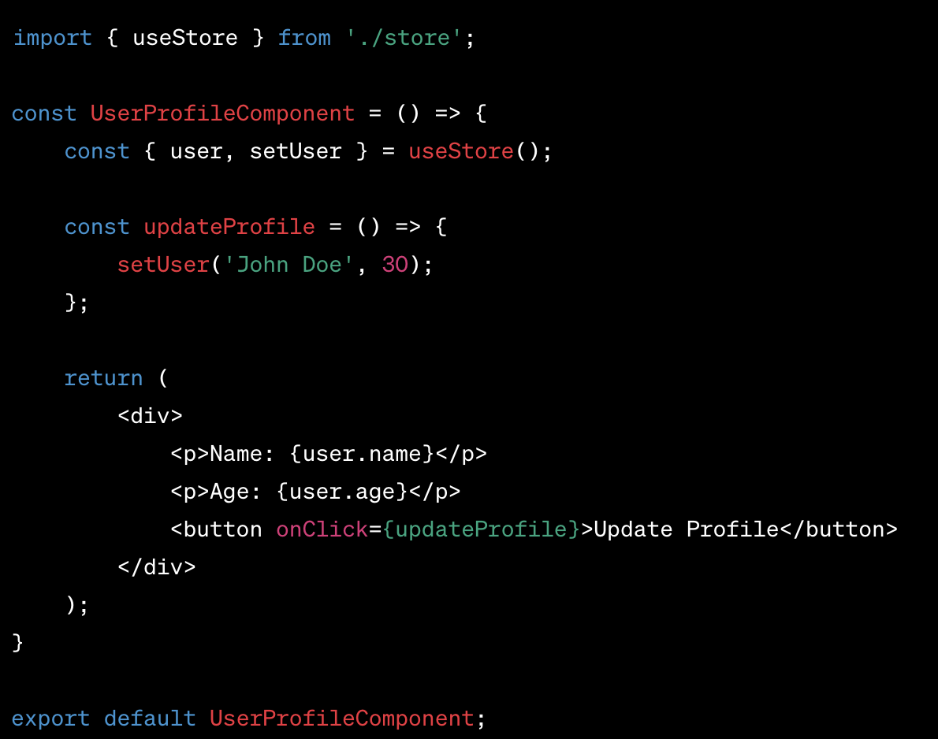
Use in component

Slide 31
What about array?

Slide 32
Break?
No!
Let’s learn about array.reduce

Slide 33
Jotai
Jotai is a minimalist state management library for React that aims to bring simplicity to the concept of global state management. Developed by the team at PMND, it is based on the same atomic model as Recoil, but it simplifies the API and removes some of the more complex features.

Slide 34
Here are the key concepts:
Atoms: Atoms in Jotai are fundamental units of state. They are created using the atom function and can be read from or written to from any component. The API is very similar to the useState hook in React.
Components: To read from and write to an atom, you use the useAtom hook within a React component.
Derived atoms: Jotai allows you to create derived atoms, i.e., atoms whose value is derived from other atoms. These derived atoms automatically update when their dependencies change.
Atom Families: An atom family is a function that takes a parameter and returns an atom. This is useful when you want to create multiple atoms that have similar behavior but operate on different pieces of state.

Slide 35
Atom family (need to add)

Slide 36
Recoil
Recoil is a state management library for React applications developed by Facebook. Recoil lets you create a data-flow graph that flows from atoms (shared state) through selectors (pure functions) and down into your React components.

Slide 37
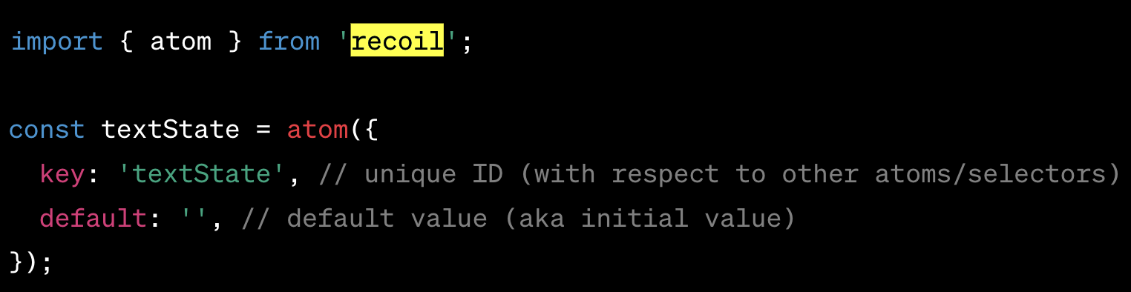
Key concepts in Recoil are
Atoms: Atoms are units of state. They're writeable and subscribable: when an atom is updated, each subscribed component is re-rendered with the new value. Components subscribe to atoms by using the useRecoilState hook.

Slide 38
Atoms
Atoms: Atoms are units of state. They're writeable and subscribable: when an atom is updated, each subscribed component is re-rendered with the new value. Components subscribe to atoms by using the useRecoilState hook.

Slide 39
Selectors
Selectors: Selectors transform this state either synchronously or asynchronously. Derived state is a transformation of state. You can think of derived state as the output of passing state to a pure function that modifies the given state in some way. Derived state is represented in Recoil by a selector.

Slide 40
components
Components: In React components, you can use several hooks provided by Recoil to access atoms and selectors. Here are some of the main hooks:
useRecoilState: returns a tuple where the first element is the state of the atom/selector and the second element is a setter.
useRecoilValue: returns the value of the atom/selector.
useSetRecoilState: returns a setter function.
useResetRecoilState: returns a function that can be used to reset the value of the atom to its default.

Slide 42
Redux
Redux is a state management tool often used with JavaScript libraries or frameworks such as React, Angular, or Vue.js. It helps manage the state of your application in a predictable manner, following three fundamental principles:
Single source of truth: The state of your whole application is stored in a single state tree object within a single Redux store.
State is read-only: The only way to change the state is to dispatch an action. An action is a plain JavaScript object describing what happened.
Changes are made with pure functions: To specify how the state tree is transformed by actions, you write reducers which are pure functions.

Slide 43
actions
Actions: Actions are plain JavaScript objects that represent payloads of information that send data from your application to your Redux store. They are the only source of information for the store. Actions must have a type property indicating the type of action being performed. Types should typically be defined as string constants.

Slide 44
Reducers
Reducers: Actions describe what happened, but don't specify how the application's state changes in response. This is the job of a reducer. A reducer is a pure function that takes the current state and an action, and returns the next state.

Slide 45
Store
Store: The store is the object that brings action and reducers together. It has a few responsibilities:
Holds application state;
Allows access to state via getState();
Allows state to be updated via dispatch(action);
Registers listeners via subscribe(listener);
Handles unregistering of listeners via the function returned by subscribe(listener).

Slide 46
Data flow
Data Flow: Redux architecture revolves around a strict unidirectional data flow. The data lifecycle in any Redux app follows these 4 steps:
You call store.dispatch(action).
The Redux store calls the reducer function you gave it. The store will pass two arguments to the reducer: the current state tree and the action.
The root reducer may combine the output of multiple reducers into a single state tree.
The Redux store saves the complete state tree returned by the root reducer.
This cycle repeats every time an action is dispatched.

Slide 47
Middleware
Middleware: Redux middleware provides a third-party extension point between dispatching an action, and the moment it reaches the reducer. It's popular use cases include logging actions, crash reporting, performing asynchronous tasks, etc.

Slide 49

routing system
File-based routing: The routing system in Next.js is file-based. This means that every file inside the pages directory of a Next.js project corresponds to a route on the website. For example, a file at pages/about.js would correspond to the /about route on the website.
Dynamic routing: Next.js also supports dynamic routing. If you create a file inside the pages directory with brackets in the filename, like pages/posts/[id].js, it will act as a dynamic route. The [id] part in the filename is a placeholder for some actual value. So if a user visits /posts/1, Next.js will render the pages/posts/[id].js file and provide the 1 as a parameter that can be accessed within the page.

Slide 50

Let’s go <a>
https://nextjs.org/docs/app/building-your-application/routing

Slide 51
Routs.ts
https://nextjs.org/docs/app/building-your-application/routing/route-handlers

Slide 52

GET POST UPDATE and DELETE
In the context of web development and HTTP protocol, GET, POST, PUT (often used for update operations), and DELETE are methods defined by the HTTP protocol used for CRUD (Create, Read, Update, Delete) operations.

Slide 53

GET
GET: This is used to retrieve data from a server. When you enter a URL in your browser, you are sending a GET request to retrieve the page. GET requests should only receive data and should have no other effect.

Slide 54

POST
POST: This is used to send data to a server to create a new resource. The data is included in the body of the request. This could be used when submitting a form, for example.

Slide 55
UPADTE
PUT: This is used to update a resource on a server. The request contains the updated data in the body. Unlike PATCH, PUT requests require the entire updated entity to be sent in the request, not just the changes.

Slide 56
DELETE
DELETE: This is used to delete a resource on the server.

Slide 57
Next response
https://nextjs.org/docs/app/api-reference/functions/next-response

Slide 58

What is a Cookie?
Cookies are small pieces of data stored on a user's computer by their web browser while they're browsing. They're used to remember information about the user, such as login information, site preferences, or what's in their shopping cart. Cookies can also be used to track a user's browsing history for targeted advertising purposes.

Slide 59
How does a Cookie Work?
When a user visits a website for the first time, the website may create a cookie and send it to the user's browser. The browser will then store this cookie on the user's computer. When the user visits the website again, the browser sends the cookie back to the website, allowing the website to remember the user's previous activity.
Cookies consist of a name-value pair, where the name is the name of the cookie, and the value is the information the cookie is storing. Cookies also have expiration dates, and they are removed once they expire.

Slide 60
When do We Use Cookies?
Cookies are used whenever a website needs to remember specific information about a user or their preferences. Some common uses for cookies include:
Keeping a user logged in: When a user logs in to a website, the website can store a cookie on the user's computer so that they don't have to log in again each time they visit.
Storing user preferences: If a user sets specific preferences for a website, such as language or layout, these preferences can be stored in a cookie so they're remembered the next time the user visits.
Tracking user activity: Websites often use cookies to track a user's browsing history and behavior. This data can be used for things like targeted advertising or analytics.
Shopping carts: For e-commerce sites, cookies can keep track of items a user has added to their shopping cart, so they can continue browsing and still keep their chosen items in the cart.

Slide 61

HTML forms
In HTML, a form is a component that allows users to input data that can then be sent to a server for processing. Forms can contain various types of input elements like text fields, checkboxes, radio buttons, dropdown menus, file inputs, submit buttons, etc. The data entered into these inputs is then packaged and sent to a server when the user submits the form.
action attribute: This attribute on a <form> specifies where to send the form-data when a form is submitted.
method attribute: This attribute on a <form> defines the HTTP method (GET or POST) to send the form-data.

Slide 62
formAction
The formAction attribute in HTML specifies where to send the form-data when a form is submitted. It overrides the action attribute on the <form> element.
In the context of a Next.js application, formAction can be utilized in a similar manner to direct form data to different locations based on certain conditions. For example, you may have a form that, under normal circumstances, sends data to one endpoint, but in specific cases, it needs to send the data to a different endpoint. You can use the formAction attribute on a submit button (<input type="submit"> or <button type="submit">) to override the form's action attribute.

Slide 63
Data Fetching, Caching, and Revalidating
https://nextjs.org/docs/app/building-your-application/data-fetching/fetching-caching-and-revalidating

Slide 64
Server Data fetch

Slide 65
Client data

Slide 66
Client vs server
Client-side rendering (CSR) and server-side rendering (SSR) each have their own unique benefits and use-cases. Here's a breakdown:

Slide 67
Client-Side Rendering (CSR)
Interactive User Experience: By rendering content in the browser, CSR can create more fluid, app-like user experiences. Users can see changes without having to refresh the page.
Reduced Server Load: Since the server only sends the necessary JSON data, instead of the fully-rendered HTML, there's less processing work for the server.
Easier Updates: Updating or altering the UI is often more straightforward with CSR because you're working directly in the client environment.
SPA (Single Page Application) Benefits: CSR is usually employed in SPAs, enabling navigation between pages without refreshing the entire page.

Slide 68
CSR drawback
SEO Challenges: Some search engines may struggle to properly index CSR sites, potentially hurting search rankings.
Slower Initial Load Time: The initial rendering can take longer because the client must download more JavaScript and render the first view itself.
May Require Modern Browsers: CSR might exclude some users on very old or limited browsers that struggle with JavaScript execution.

Slide 69
SSR
Faster Initial Page Load: By rendering the HTML on the server and sending it to the browser, SSR provides content to the user more quickly. This is particularly beneficial for users on slow connections.
SEO Advantages: Search engines can more easily crawl and index the content, which can improve search rankings.
Broader Compatibility: SSR works well even in browsers with limited or disabled JavaScript capabilities.
Predictable Rendering: The server has complete control over what gets rendered, providing consistency across different clients.

Slide 70
SSR drawbacks
More Server Resources: SSR requires more server processing, which can increase costs and complexity.
Less Interactive: Without additional client-side logic, SSR pages might feel less dynamic and interactive.
Complexity with State Management: Managing user sessions and state can become more complex with SSR, especially when interactivity is required.

Slide 71
Conclusion
CSR is often favored for applications where interactivity, and a dynamic, app-like experience is desired. It's less suitable for content-heavy sites where SEO is critical or where very broad browser support is required.
SSR, on the other hand, is preferred for sites where initial page load speed, SEO, and compatibility are key factors. It might not be as suitable for highly interactive applications where a more dynamic UI is required.
Hybrid approaches that combine CSR and SSR are also becoming more common, allowing developers to leverage the best aspects of both rendering methods.

Slide 72
React dev tools
React DevTools is a set of tools that make it easier to work with React and React Native applications. They are available as browser extensions for Chrome, Firefox, and other browsers, as well as a standalone application that can connect to React Native.
Component Inspection: React DevTools lets developers inspect the React component tree, displaying the hierarchy, props, state, and hooks. You can see the rendered output and how components interact with each other.

Slide 74
React children
In React, children is a special prop that allows you to pass components as data to other components, creating a parent-child relationship between components. It lets you define the content inside a component tag and access that content within the component, allowing for more flexible and reusable components.

Slide 75
Next and supabase
https://supabase.com/docs/guides/getting-started/quickstarts/nextjs

