Slide 2
Git- intro
Git is a distributed version control system (VCS) that is widely used for software development. It is used to keep track of changes made to the source code of a project, making it easier for multiple people to collaborate on the same codebase.
Git has a number of features that make it well-suited for software development, including:
Distributed: With Git, each user has a full copy of the entire codebase and its history, so they can work offline and have a backup of the code. This also makes it easier to merge changes from different users.
Branching and merging: Git makes it easy to create and switch between different branches of a codebase, allowing multiple people to work on different parts of the code at the same time. Changes can then be merged back into the main branch when they are ready.
Snapshots: Git stores the entire codebase as a series of snapshots, rather than as a series of changes. This makes it easier to see the state of the code at any point in its history, and to revert to an earlier version if needed.
Staging area: Git has a staging area, where changes can be reviewed and staged before being committed to the codebase. This makes it easier to keep track of what changes have been made, and to only commit the changes that are ready.

Slide 3

How to get started
Create a GitHub account: Go to the GitHub website (https://github.com) and sign up for a free account.
Install Git: Git is the version control system that GitHub is built on. You'll need to install Git on your computer in order to use GitHub. You can download Git from the official website (https://git-scm.com/downloads).
Configure Git: After installing Git, you'll need to configure your name and email address, which will be associated with your Git commits. You can do this by running the following commands in your terminal or command prompt:

Slide 4
What after
Create a repository: A repository is a place to store your code and collaborate with others. To create a new repository on GitHub, click on the "+" icon in the upper-right corner of the GitHub website and select "New repository". Give your repository a name, a description, and select whether it should be public or private.
Clone the repository: After creating a repository, you'll need to clone it to your local machine so you can start making changes. You can clone a repository by clicking the "Clone or download" button on the repository page, copying the repository URL, and running the following command in your terminal or command prompt:

Slide 5
Git commit
In Git, a commit is a saved change to the codebase. Commits are the building blocks of Git, representing a set of changes to the code at a specific point in time.
Each commit has a unique identifier called a hash, which is generated based on the contents of the commit. Commits also have a message that provides a brief description of the changes made in the commit.
When you make changes to the code, you can stage those changes in Git using the git add command. This adds the changes to the Git staging area, where they can be reviewed and committed. To save the changes to the codebase, you use the git commit command, which creates a new commit in the Git history.

Slide 6

Push changes
Push your changes: Finally, you'll need to push your changes back to the remote repository on GitHub. You can do this by running the following command in your terminal or command prompt:

Slide 7
Example

Slide 8
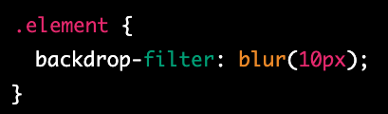
backdrop-filter
backdrop-filter is a CSS property that allows you to apply graphical effects, such as blurring or color shifting, to the area behind an element. It provides a way to create a visual effect that makes the content behind an element more prominent or less obtrusive.

Slide 9
Example

Slide 10
perspective
In CSS, perspective is a property that is used to create a 3D space in which elements can be positioned and transformed. When you apply perspective to an element, it creates a depth and distance effect, making it appear as if the element is closer or farther away from the viewer.
To add perspective to an element, you can use the CSS perspective property. The value of the perspective property is the distance between the viewer and the z=0 plane. The greater the value of the perspective property, the smaller the 3D effect will be. Conversely, the smaller the value of the perspective property, the larger the 3D effect will be.

Slide 11

currentColor
In CSS, currentColor is a keyword that represents the value of the current color being used for a particular property. It is commonly used in conjunction with the color property to make it easier to apply the same color to multiple elements.
For example, let's say you have a link that you want to style with a certain color, but you also want to use the same color for the hover state and for the background color of a container element. Instead of manually setting the color value for each of these properties, you can use the currentColor keyword to automatically apply the current color value to each of them.

Slide 12
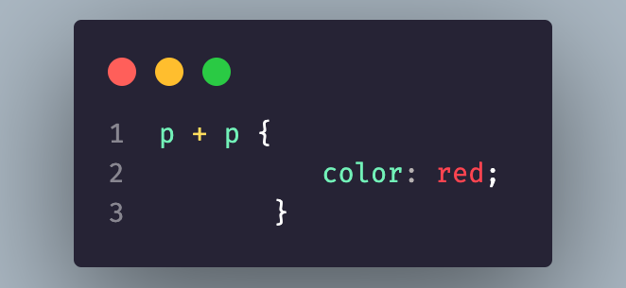
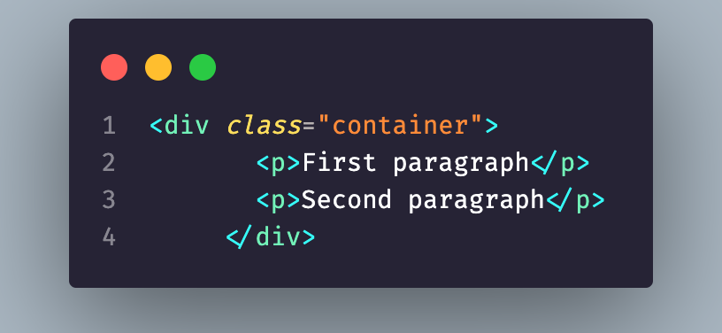
+ -> css
In CSS, the + (plus) selector is called the adjacent sibling combinator, which selects the first element that immediately follows another element, and both share the same parent.
In this example, the p + p selector selects the second p element only when it immediately follows another p element. This means that only the second p element will be styled with the color: red rule.
Note that the + selector only selects the immediately following sibling element. If you want to select all following sibling elements that match the same selector, you should use the ~ (general sibling) selector instead.

Slide 13
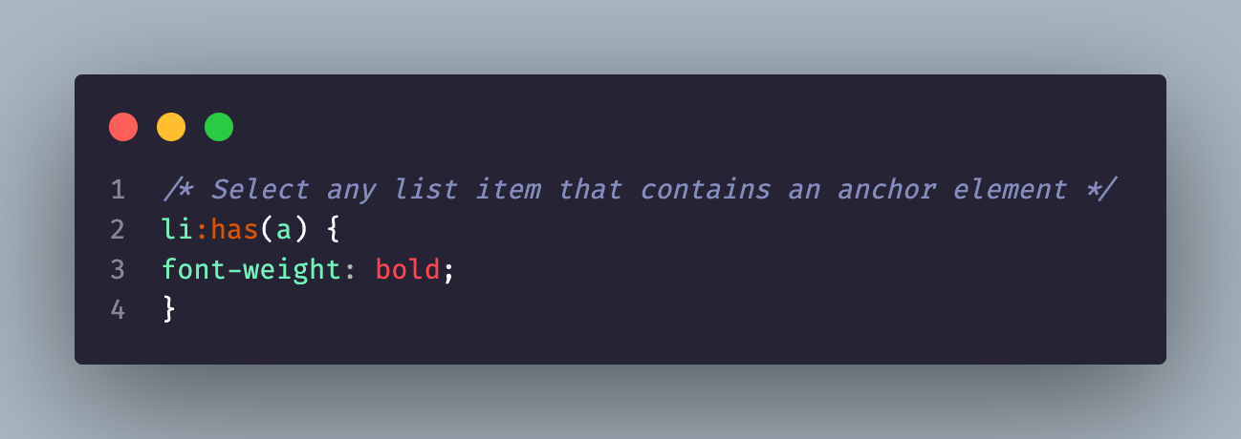
:has
In CSS, the :has() selector is a proposed selector that would allow you to select elements based on their descendants. However, as of February 2023, the :has() selector is not yet supported in any web browser.
The :has() selector is intended to be a powerful and flexible selector that would enable you to select an element based on the presence of a specific descendant, regardless of the descendant's position in the HTML document tree.
In this example, the :has(a) selector would select any li element that contains an a element. This would make it easy to style all list items that contain links, regardless of where they are located in the HTML document tree.

Slide 14
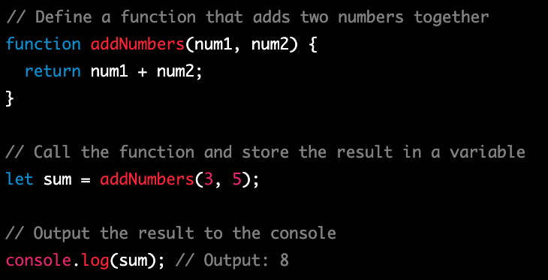
Functions
Functions are an essential concept in JavaScript and are used to group a set of related actions together and to reuse code. Functions are like recipes that you can use to perform a specific task, and can take input (known as parameters) and produce output (known as return values).
In this example, the addNumbers() function takes two parameters (num1 and num2) and returns their sum. The function is called with arguments 3 and 5 and the result is stored in the sum variable. Finally, the result is output to the console using console.log().
Functions are a powerful tool in JavaScript and can be used to make your code more efficient and reusable. They can be used to create libraries of code that can be easily shared and used in multiple projects, and can be used to encapsulate complex logic and make it easier to manage and maintain your code.

Slide 15
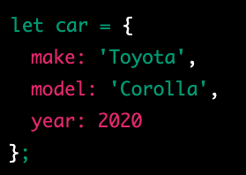
object
In JavaScript, an object is a data type that stores data as key-value pairs. Each key in an object is a string, and each value can be any data type, including other objects. Objects in JavaScript are similar to dictionaries in other programming languages.

Slide 16

How can I access the keys

Slide 17
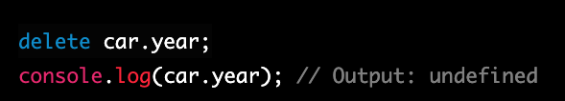
How can I delete from the object
the year property is removed from the car object using the delete operator.

Slide 18
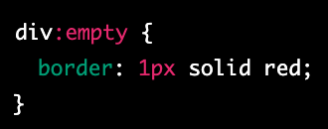
CSS -> :empty
In CSS, the empty selector is a pseudo-class that allows you to select elements that have no children
In this example, the div:empty selector selects all div elements that have no children, and applies a red border to them.
The :empty pseudo-class is useful when you want to style elements that don't have any content, such as placeholders or empty containers. You can use it to create visual cues to indicate to users that certain elements are empty or to highlight empty areas of a layout.
It's important to note that the :empty selector only selects elements that have no children. If an element has whitespace or comments inside it, it will not be considered empty and the :empty selector will not select it. If you want to select elements that have only whitespace or comments inside them, you can use the :blank selector instead.
Overall, the :empty selector is a useful tool in CSS that allows you to target and style elements that have no children.

Slide 19
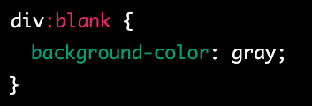
Blank - css
In CSS, the :blank selector is a pseudo-class that allows you to select elements that only contain whitespace characters, such as spaces, tabs, and line breaks. The :blank selector is similar to the :empty selector, but it also matches elements that have only whitespace characters.
In this example, the div:blank selector selects all div elements that only contain whitespace characters, and applies a gray background to them.
The :blank selector is useful when you want to target elements that have no visible content, such as empty form fields or elements that contain only whitespace characters. It can be used to create visual cues to indicate to users that certain elements are empty or to highlight empty areas of a layout.
It's important to note that the :blank selector is not yet widely supported by all browsers, and may not work in older versions of some browsers. Additionally, the :blank selector only works on elements that contain visible text; it does not work on elements that have no text at all.
Overall, the :blank selector is a useful tool in CSS that allows you to target and style elements based on their content.

Slide 20
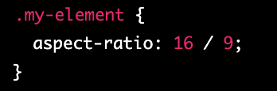
aspect ratio
The aspect-ratio property in CSS is a relatively new addition, introduced in CSS 4, and it allows you to explicitly set the aspect ratio of an element using a single property. It is a shorthand property that combines the width and height properties with a slash ("/") separator to indicate the aspect ratio of the element.
The values for width and height can be any length or percentage value, and the aspect ratio is expressed as a ratio of those values.
For example, to create an element with a 16:9 aspect ratio, you can set the aspect-ratio property to 16 / 9, like this:
This will ensure that the element maintains a proportional relationship between its width and height, even if its dimensions change due to resizing or changes in the viewport.
The aspect-ratio property is particularly useful for responsive design, as it allows you to create elements that maintain their aspect ratio as the viewport or container size changes. It can also be combined with other properties like object-fit to control how the element is displayed within its container.
Note that as of February 2023, the aspect-ratio property is not widely supported in all browsers, so it's a good idea to check for browser compatibility before using it in production.

Slide 21

writing-mode
The "writing-mode" property in CSS is used to control the direction of text in a block-level container. It determines the orientation of the text, whether it is horizontal or vertical, and in which direction it flows.
The writing-mode property can have the following values:
horizontal-tb: The default value. The text flows from left to right, and from top to bottom.
vertical-lr: The text flows from top to bottom, and from left to right.
vertical-rl: The text flows from top to bottom, and from right to left.

Slide 22

word-spacing
The "word-spacing" property in CSS sets the space between words in a block of text. It is used to adjust the spacing between words for better readability or to create a specific visual effect.
The word-spacing property can be set in pixels, em, or percentage values. A positive value increases the space between words, while a negative value decreases it. The default value is "normal".

Slide 23
white-space
The "white-space" property in CSS is used to control the handling of white spaces and line breaks in a block of text. It determines how white spaces and line breaks are rendered in a block of text.
The white-space property can have the following values:
normal: The default value. White spaces are collapsed, and text wraps when it reaches the end of a line.
nowrap: White spaces are preserved, and text does not wrap when it reaches the end of a line.
pre: White spaces are preserved, and text wraps only when a line break is encountered.
pre-wrap: White spaces are preserved, and text wraps when it reaches the end of a line or when a line break is encountered.
pre-line: White spaces are collapsed, and text wraps when it reaches the end of a line or when a line break is encountered.

Slide 24
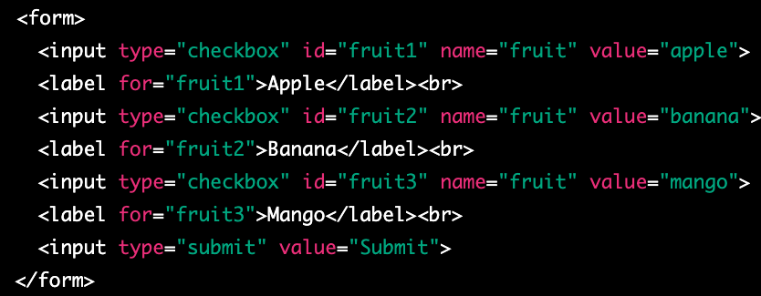
checkbox
A checkbox is a graphical control element used in web forms to allow a user to make multiple selections from a set of options. In HTML, a checkbox is created using the <input type="checkbox"> element.
A checkbox is displayed as a small square box on the web page, which can be either checked or unchecked. When a user clicks on a checkbox, the box is filled with a checkmark and its state changes to checked. If a user clicks on the checkbox again, the checkmark is removed and the state changes back to unchecked.
Checkboxes can be used to collect data in web forms, where a user can select one or more options from a list. The selected options can be submitted to a server-side script for processing.

Slide 25
Wait I want to select only more then one at the time
If you want to allow the user to select multiple checkboxes at the same time, you can give each checkbox a different name attribute. This way, when a user selects one checkbox, it does not affect the state of other checkboxes.

Slide 26
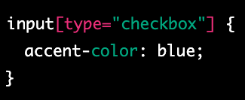
accent-color
The accent-color CSS property sets the accent color of an element. The accent color is used by various user interface controls (such as buttons, checkboxes, and range controls) to make them more visually appealing.
The accent-color property can be set to a specific color value (e.g. red, #ff0000, rgb(255,0,0)) or can be set to inherit the value from the parent element using inherit.

Slide 27
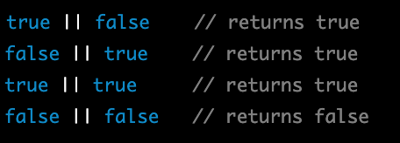
JS OR ||
In JavaScript, the || operator is known as the logical OR operator. It is used to combine two or more Boolean expressions and returns a result of true if at least one of the expressions is true, and false if all of the expressions are false.

Slide 28
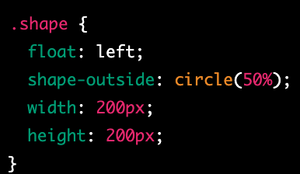
shape-outside
shape-outside is a CSS property that allows you to define a non-rectangular shape that text content will flow around. This can be useful for creating more interesting and visually appealing layouts, especially when combined with other CSS properties such as float and clear.
The shape-outside property is used to specify the shape that text should wrap around. You can define the shape using one of several different values:
none: This is the default value, and means that text will not wrap around any shape.
rectangle: This value allows you to define a rectangular shape using the inset or circle functions, which take four or three values respectively to create a rectangle or circle.
circle(): This function takes one value, which is the radius of the circle, and creates a circle shape.
ellipse(): This function takes two values, which are the horizontal and vertical radii of the ellipse, and creates an elliptical shape.
polygon(): This function allows you to define an arbitrary polygon shape using a series of x,y coordinate pairs.

Slide 29
shape-image-threshold
shape-image-threshold is a CSS property that is used in combination with the shape-outside property to control the transparency threshold of an image used as a shape.
When using an image as a shape with the shape-outside property, the browser determines the shape of the image based on its transparency. The shape-image-threshold property allows you to set a threshold value that determines which parts of the image are considered transparent or opaque.
The shape-image-threshold property takes a single value, which is a percentage between 0% and 100%. This value specifies the transparency threshold for the image. Any pixels in the image that are more transparent than the specified threshold are considered transparent, and any pixels that are less transparent than the threshold are considered opaque.

Slide 30
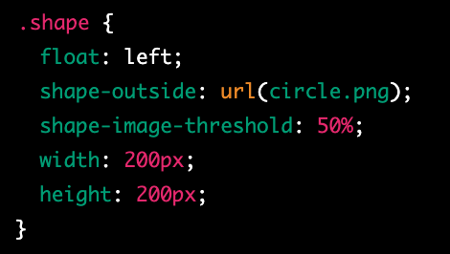
example
In this example, we have defined a class called shape that uses float: left and the shape-outside property to create a circular shape using an image file called circle.png. We have also set the shape-image-threshold property to 50%, which means that any pixels in the image that are more than 50% transparent will be considered transparent.
It's worth noting that the shape-image-threshold property is not widely supported by all browsers, so you may need to use fallback techniques or alternative approaches for older browsers. Additionally, if the image file used for the shape-outside property is not available or cannot be loaded, the shape-image-threshold property will have no effect.

Slide 31
shape-margin
shape-margin is a CSS property that is used in combination with the shape-outside property to add space around the shape that text will flow around.
When using the shape-outside property to create a non-rectangular shape for text to flow around, it can be helpful to add some space between the shape and the text. The shape-margin property allows you to specify the amount of space to add around the shape.
The shape-margin property takes a single value, which can be a length, a percentage, or the auto keyword. A positive value will add space around the shape, while a negative value will remove space. The auto value will cause the browser to automatically calculate the margin based on the size and shape of the element.

Slide 32
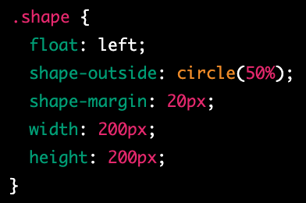
example
In this example, we have defined a class called shape that uses float: left and the shape-outside property to create a circular shape. We have also set the shape-margin property to 20px, which adds 20 pixels of space around the shape. Finally, we have set the width and height of the element to define its size.
It's worth noting that the shape-margin property is not widely supported by all browsers, so you may need to use fallback techniques or alternative approaches for older browsers. Additionally, the exact behavior of the shape-margin property may vary depending on the size and shape of the element being used as the shape, as well as the size and layout of the surrounding text content.

Slide 33

array
In JavaScript, an array is a data structure that allows you to store and manipulate a collection of values. An array can contain any type of value, including numbers, strings, booleans, objects, and even other arrays.

Slide 34

access individual elements
You can access individual elements of an array using their index, which is a zero-based integer that corresponds to the position of the element in the array. For example, to access the first element of the myArray array, you would use the following code:

Slide 35

Change element
You can also modify the contents of an array by assigning a new value to an element at a specific index. For example, to change the value of the second element in the myArray array, you would use the following code:

Slide 36
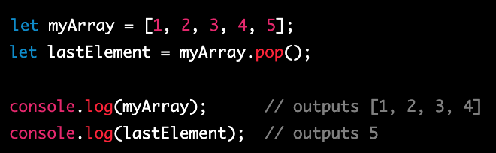
Array pop
In JavaScript, the pop() function is an array method that removes the last element from an array and returns that element. The original array is then modified, with the last element being removed.

Slide 37
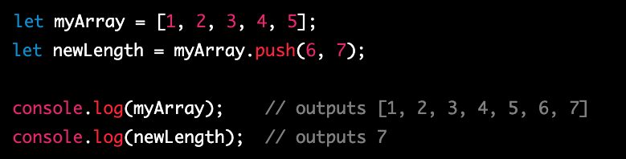
Array push
In JavaScript, the push() method is an array method that adds one or more elements to the end of an array and returns the new length of the array. The original array is then modified, with the new elements being added to the end.

Slide 38
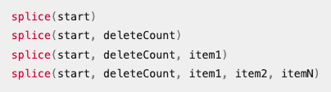
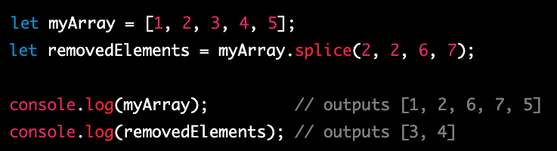
splice
In JavaScript, the splice() function is an array method that allows you to add or remove elements from an array at a specific index. The original array is modified as a result of the function.
The syntax for using the splice() function is as follows:
https://developer.mozilla.org/en-US/docs/Web/JavaScript/Reference/Global_Objects/Array/splice

Slide 39
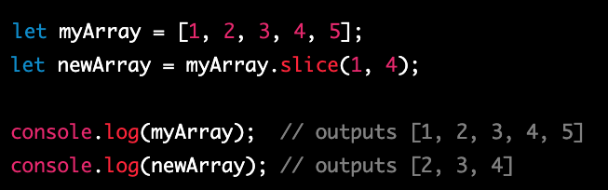
slice
In JavaScript, the slice() function is an array method that returns a shallow copy of a portion of an array into a new array object. The original array is not modified as a result of the function.

Slide 40
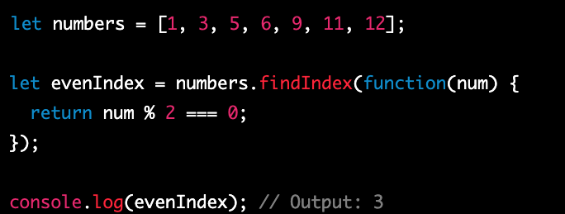
findIndex
In JavaScript, the findIndex() method is an array method that returns the index of the first element in an array that satisfies a given condition. It returns -1 if no element in the array satisfies the condition. The findIndex() method takes a callback function as an argument, which is executed for each element in the array until a matching element is found.

Slide 41
concat
In JavaScript, the concat() method is an array method that is used to merge two or more arrays into a new array. The original arrays are not modified, and a new array is returned that contains all the elements of the original arrays in the order in which they were concatenated.
The concat() method can be called on any array and takes one or more arguments, each of which is an array to be concatenated with the original array. The resulting concatenated array is a new array object that is returned by the concat() method.

Slide 42
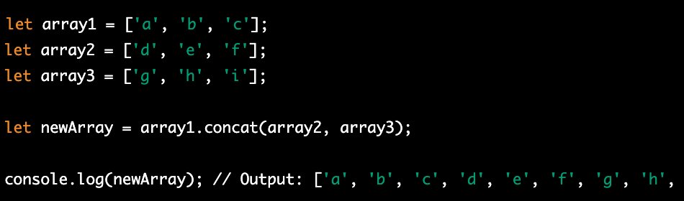
Concat example

Slide 43
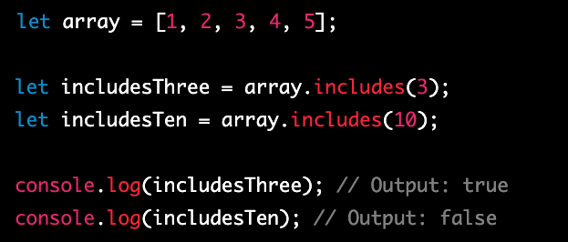
includes
In JavaScript, the includes() method is an array method that is used to determine whether an array contains a specific element. It returns a Boolean value indicating whether the element is found in the array or not.
The includes() method can be called on any array and takes one or two arguments. The first argument is the element to search for, and the second argument (optional) is the starting index of the search

Slide 44
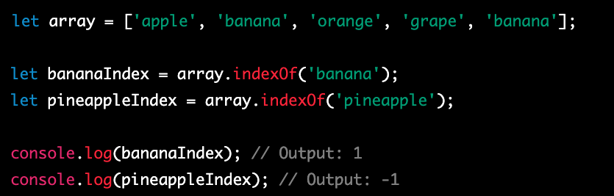
indexOf
In JavaScript, the indexOf() method is an array method that is used to search an array for a specified element and returns the index of the first occurrence of the element. If the element is not found, it returns -1.
The indexOf() method can be called on any array and takes one or two arguments. The first argument is the element to search for, and the second argument (optional) is the starting index of the search.

Slide 46
shallow copy and a deep copy
In JavaScript, a shallow copy and a deep copy are two different ways of creating a new object or array that is a copy of an existing object or array. The difference between the two lies in how nested objects and arrays are handled.
A shallow copy of an object or array creates a new object or array with the same top-level properties or elements as the original, but any nested objects or arrays are still referenced by the new object or array. This means that if you modify a nested object or array in the new copy, the corresponding object or array in the original will also be modified. Shallow copies can be created using methods such as the slice() or concat() array methods or the Object.assign() method.

Slide 47
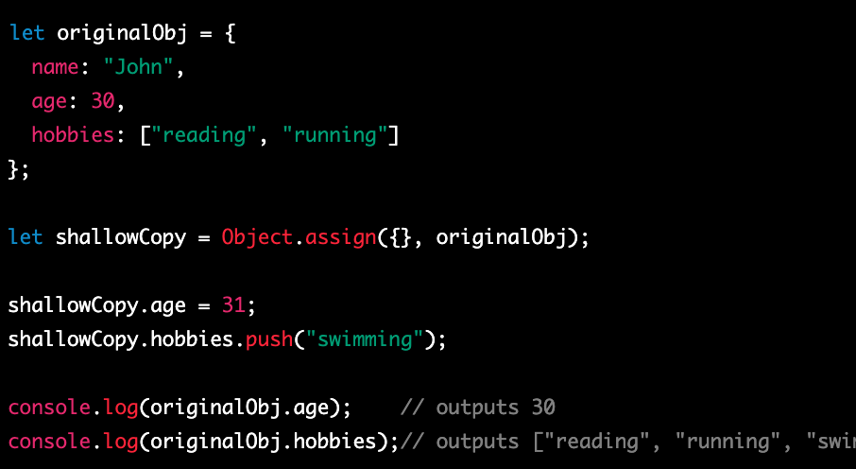
example

Slide 48
Document Object Model
The Document Object Model (DOM) is a programming interface for HTML and XML documents. It represents the structure of a document as a tree-like object model, with each element of the document represented as a node in the tree. The DOM provides a way for JavaScript to interact with the contents of an HTML or XML document, and manipulate it in various ways.
To interact with the DOM in JavaScript, you can use a variety of built-in methods and properties that are part of the global document object. The document object provides access to the root element of the HTML or XML document, as well as methods for querying and manipulating the document tree.

Slide 49
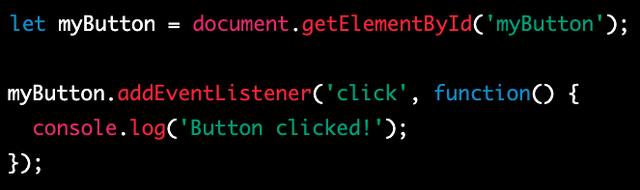
addEventListener
In JavaScript, you can use the addEventListener() method to add an event listener to an object, such as an HTML element or the window object. An event listener is a function that is executed when a specific event occurs, such as a user clicking a button or scrolling the window.

Slide 50
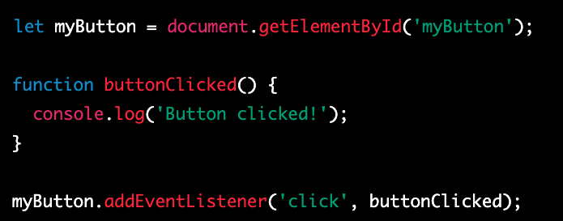
Another example

Slide 51

document
In JavaScript, the document object represents the HTML or XML document loaded in the current window or frame. It provides a way to access and manipulate the contents of the document, including the HTML elements, their properties, and the content displayed in the browser.
The document object is part of the global window object, and can be accessed from anywhere in your JavaScript code using the window.document or simply document syntax.

Slide 52
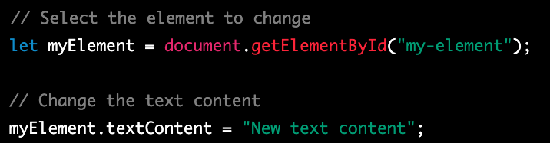
Change the Text of select element
In JavaScript, you can use the textContent property to change the text content of an HTML element that has been selected using one of the many methods available in the document object.

Slide 53
Css contain
The contain property is a CSS property that allows you to specify whether an element and its contents are independent of the rest of the document tree or not. This can be helpful for optimizing performance, especially when working with large or complex web pages.
The contain property takes one of several possible values:
none: This is the default value, and means that the element is not contained in any way. This can have performance implications if the element's contents interact with other parts of the document.
strict: This value means that the element and its contents are fully contained, and do not affect or are affected by other parts of the document. This can improve performance, especially for complex or nested elements.
content: This value means that the element's contents are contained, but the element itself may still interact with other parts of the document. This can be helpful for optimizing performance for specific elements or components.
size: This value means that the element's dimensions are contained, but its contents may still interact with other parts of the document. This can be helpful for optimizing performance for specific elements or components that are frequently resized.

Slide 54
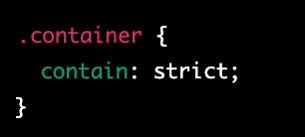
example
In this example, we have defined a class called container and set its contain property to strict. This means that the element and its contents are fully contained, and do not affect or are affected by other parts of the document.
It's worth noting that the contain property is not widely supported by all browsers, so you may need to use fallback techniques or alternative approaches for older browsers. Additionally, the exact behavior of the contain property may vary depending on the specific browser implementation and the context in which it is used.

Slide 55

motion-path
In CSS, the motion-path property is used to animate an element along a custom path, defined using a path element, or one of several basic shape functions.
The motion-path property is part of the CSS motion specification, which also includes the motion-offset, motion-rotation, and motion-distance properties, among others.

Slide 57
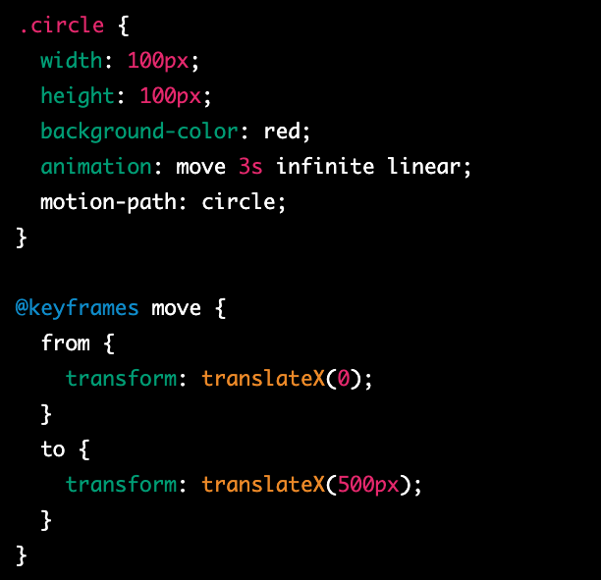
example
In this example, we have a circular element with a class of .circle. We use the animation property to create a linear animation that moves the element 500 pixels to the right over a duration of 3 seconds. We use the motion-path property to define the motion path of the element, using the circle value, which specifies a circular path.
The motion-path property can also be used with other basic shape functions, such as polygon(), ellipse(), and path(), which allow for more complex motion paths.
The motion-path property can be a powerful tool for creating dynamic, animated effects in CSS. It's supported in most modern web browsers, but may require vendor prefixes or other workarounds in some cases. It's important to test your code thoroughly and follow best practices to ensure that your web pages are optimized and accessible.

Slide 58

offset-path
offset-path is a CSS property that allows you to move an element along a path, while maintaining the element's original orientation. Unlike motion-path, offset-path does not animate an element along a path, but rather offsets it from its original position along the specified path.

Slide 59
offset-anchor
offset-anchor is a CSS property that works in conjunction with the offset-path property to define the starting point of the element along the path. The offset-anchor property allows you to specify where along the element the offset should be applied.
By default, the offset-anchor property is set to the center of the element, but you can adjust it to move the starting point of the offset to a different part of the element.

Slide 61
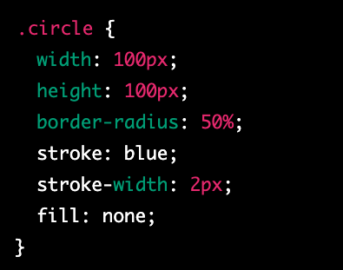
stroke
In CSS, the stroke property is used to control the outline of a shape or path. It is often used in conjunction with the fill property to create complex graphical effects.
The stroke property applies to the outline of the shape or path, while the fill property applies to the interior of the shape or path. Together, these properties allow you to control the appearance of both the outline and the fill of the shape.
The stroke property can be set to a color value, a keyword value, or a URL that points to an image. It can also be set to a combination of these values, using a comma-separated list.

