Slide 2
Git- intro
Git is a distributed version control system (VCS) that is widely used for software development. It is used to keep track of changes made to the source code of a project, making it easier for multiple people to collaborate on the same codebase.
Git has a number of features that make it well-suited for software development, including:
Distributed: With Git, each user has a full copy of the entire codebase and its history, so they can work offline and have a backup of the code. This also makes it easier to merge changes from different users.
Branching and merging: Git makes it easy to create and switch between different branches of a codebase, allowing multiple people to work on different parts of the code at the same time. Changes can then be merged back into the main branch when they are ready.
Snapshots: Git stores the entire codebase as a series of snapshots, rather than as a series of changes. This makes it easier to see the state of the code at any point in its history, and to revert to an earlier version if needed.
Staging area: Git has a staging area, where changes can be reviewed and staged before being committed to the codebase. This makes it easier to keep track of what changes have been made, and to only commit the changes that are ready.

Slide 3

How to get started
Create a GitHub account: Go to the GitHub website (https://github.com) and sign up for a free account.
Install Git: Git is the version control system that GitHub is built on. You'll need to install Git on your computer in order to use GitHub. You can download Git from the official website (https://git-scm.com/downloads).
Configure Git: After installing Git, you'll need to configure your name and email address, which will be associated with your Git commits. You can do this by running the following commands in your terminal or command prompt:

Slide 4
What after
Create a repository: A repository is a place to store your code and collaborate with others. To create a new repository on GitHub, click on the "+" icon in the upper-right corner of the GitHub website and select "New repository". Give your repository a name, a description, and select whether it should be public or private.
Clone the repository: After creating a repository, you'll need to clone it to your local machine so you can start making changes. You can clone a repository by clicking the "Clone or download" button on the repository page, copying the repository URL, and running the following command in your terminal or command prompt:

Slide 5
Git commit
In Git, a commit is a saved change to the codebase. Commits are the building blocks of Git, representing a set of changes to the code at a specific point in time.
Each commit has a unique identifier called a hash, which is generated based on the contents of the commit. Commits also have a message that provides a brief description of the changes made in the commit.
When you make changes to the code, you can stage those changes in Git using the git add command. This adds the changes to the Git staging area, where they can be reviewed and committed. To save the changes to the codebase, you use the git commit command, which creates a new commit in the Git history.

Slide 6

Push changes
Push your changes: Finally, you'll need to push your changes back to the remote repository on GitHub. You can do this by running the following command in your terminal or command prompt:

Slide 7
Example

Slide 8
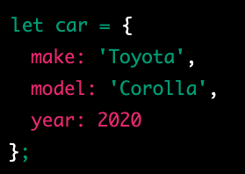
object
In JavaScript, an object is a data type that stores data as key-value pairs. Each key in an object is a string, and each value can be any data type, including other objects. Objects in JavaScript are similar to dictionaries in other programming languages.

Slide 9

How can I access the keys

Slide 10
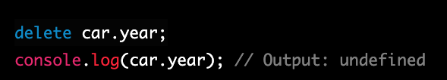
How can I delete from the object
the year property is removed from the car object using the delete operator.

Slide 11
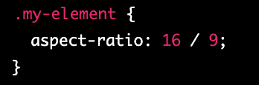
aspect ratio
The aspect-ratio property in CSS is a relatively new addition, and it allows you to explicitly set the aspect ratio of an element using a single property. It is a shorthand property that combines the width and height properties with a slash ("/") separator to indicate the aspect ratio of the element.
The values for width and height can be any length or percentage value, and the aspect ratio is expressed as a ratio of those values.
For example, to create an element with a 16:9 aspect ratio, you can set the aspect-ratio property to 16 / 9, like this:
This will ensure that the element maintains a proportional relationship between its width and height, even if its dimensions change due to resizing or changes in the viewport.
The aspect-ratio property is particularly useful for responsive design, as it allows you to create elements that maintain their aspect ratio as the viewport or container size changes. It can also be combined with other properties like object-fit to control how the element is displayed within its container.
Note that as of February 2023, the aspect-ratio property is not widely supported in all browsers, so it's a good idea to check for browser compatibility before using it in production.

Slide 12

writing-mode
The "writing-mode" property in CSS is used to control the direction of text in a block-level container. It determines the orientation of the text, whether it is horizontal or vertical, and in which direction it flows.
The writing-mode property can have the following values:
horizontal-tb: The default value. The text flows from left to right, and from top to bottom.
vertical-lr: The text flows from top to bottom, and from left to right.
vertical-rl: The text flows from top to bottom, and from right to left.

Slide 13

word-spacing
The "word-spacing" property in CSS sets the space between words in a block of text. It is used to adjust the spacing between words for better readability or to create a specific visual effect.
The word-spacing property can be set in pixels, em, or percentage values. A positive value increases the space between words, while a negative value decreases it. The default value is "normal".

Slide 14
white-space
The "white-space" property in CSS is used to control the handling of white spaces and line breaks in a block of text. It determines how white spaces and line breaks are rendered in a block of text.
The white-space property can have the following values:
normal: The default value. White spaces are collapsed, and text wraps when it reaches the end of a line.
nowrap: White spaces are preserved, and text does not wrap when it reaches the end of a line.
pre: White spaces are preserved, and text wraps only when a line break is encountered.
pre-wrap: White spaces are preserved, and text wraps when it reaches the end of a line or when a line break is encountered.
pre-line: White spaces are collapsed, and text wraps when it reaches the end of a line or when a line break is encountered.

Slide 15
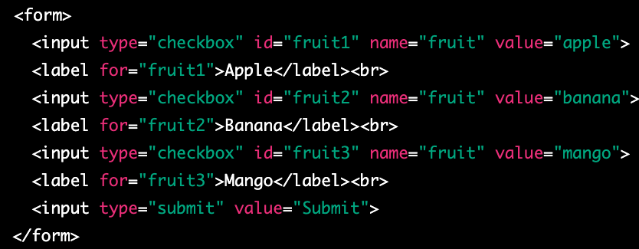
checkbox
A checkbox is a graphical control element used in web forms to allow a user to make multiple selections from a set of options. In HTML, a checkbox is created using the <input type="checkbox"> element.
A checkbox is displayed as a small square box on the web page, which can be either checked or unchecked. When a user clicks on a checkbox, the box is filled with a checkmark and its state changes to checked. If a user clicks on the checkbox again, the checkmark is removed and the state changes back to unchecked.
Checkboxes can be used to collect data in web forms, where a user can select one or more options from a list. The selected options can be submitted to a server-side script for processing.

Slide 16
Wait I want to select only more then one at the time
If you want to allow the user to select multiple checkboxes at the same time, you can give each checkbox a different name attribute. This way, when a user selects one checkbox, it does not affect the state of other checkboxes.

Slide 17
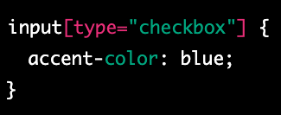
accent-color
The accent-color CSS property sets the accent color of an element. The accent color is used by various user interface controls (such as buttons, checkboxes, and range controls) to make them more visually appealing.
The accent-color property can be set to a specific color value (e.g. red, #ff0000, rgb(255,0,0)) or can be set to inherit the value from the parent element using inherit.

Slide 18
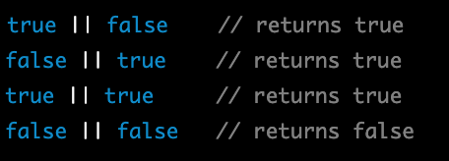
JS OR ||
In JavaScript, the || operator is known as the logical OR operator. It is used to combine two or more Boolean expressions and returns a result of true if at least one of the expressions is true, and false if all of the expressions are false.

Slide 19
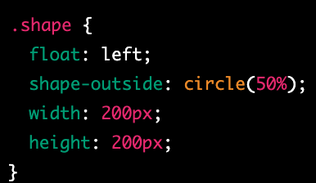
shape-outside
shape-outside is a CSS property that allows you to define a non-rectangular shape that text content will flow around. This can be useful for creating more interesting and visually appealing layouts, especially when combined with other CSS properties such as float and clear.
The shape-outside property is used to specify the shape that text should wrap around. You can define the shape using one of several different values:
none: This is the default value, and means that text will not wrap around any shape.
rectangle: This value allows you to define a rectangular shape using the inset or circle functions, which take four or three values respectively to create a rectangle or circle.
circle(): This function takes one value, which is the radius of the circle, and creates a circle shape.
ellipse(): This function takes two values, which are the horizontal and vertical radii of the ellipse, and creates an elliptical shape.
polygon(): This function allows you to define an arbitrary polygon shape using a series of x,y coordinate pairs.

Slide 20
Remainder- clip path
This property is used to clip the element itself, creating a visible shape for the element. It doesn't affect the flow of the content around it. By using clip-path, you can create visually appealing shapes for your elements, such as images, that are displayed on the webpage.

Slide 21
shape-image-threshold
shape-image-threshold is a CSS property that is used in combination with the shape-outside property to control the transparency threshold of an image used as a shape.
When using an image as a shape with the shape-outside property, the browser determines the shape of the image based on its transparency. The shape-image-threshold property allows you to set a threshold value that determines which parts of the image are considered transparent or opaque.
The shape-image-threshold property takes a single value, which is a percentage between 0% and 100%. This value specifies the transparency threshold for the image. Any pixels in the image that are more transparent than the specified threshold are considered transparent, and any pixels that are less transparent than the threshold are considered opaque.

Slide 22
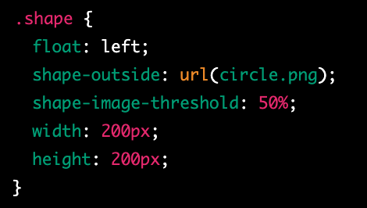
example
In this example, we have defined a class called shape that uses float: left and the shape-outside property to create a circular shape using an image file called circle.png. We have also set the shape-image-threshold property to 50%, which means that any pixels in the image that are more than 50% transparent will be considered transparent.
It's worth noting that the shape-image-threshold property is not widely supported by all browsers, so you may need to use fallback techniques or alternative approaches for older browsers. Additionally, if the image file used for the shape-outside property is not available or cannot be loaded, the shape-image-threshold property will have no effect.

Slide 23
shape-margin
shape-margin is a CSS property that is used in combination with the shape-outside property to add space around the shape that text will flow around.
When using the shape-outside property to create a non-rectangular shape for text to flow around, it can be helpful to add some space between the shape and the text. The shape-margin property allows you to specify the amount of space to add around the shape.
The shape-margin property takes a single value, which can be a length, a percentage, or the auto keyword. A positive value will add space around the shape, while a negative value will remove space. The auto value will cause the browser to automatically calculate the margin based on the size and shape of the element.

Slide 24
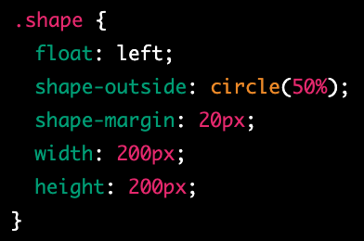
example
In this example, we have defined a class called shape that uses float: left and the shape-outside property to create a circular shape. We have also set the shape-margin property to 20px, which adds 20 pixels of space around the shape. Finally, we have set the width and height of the element to define its size.
It's worth noting that the shape-margin property is not widely supported by all browsers, so you may need to use fallback techniques or alternative approaches for older browsers. Additionally, the exact behavior of the shape-margin property may vary depending on the size and shape of the element being used as the shape, as well as the size and layout of the surrounding text content.

Slide 25

array
In JavaScript, an array is a data structure that allows you to store and manipulate a collection of values. An array can contain any type of value, including numbers, strings, booleans, objects, and even other arrays.

Slide 26

access individual elements
You can access individual elements of an array using their index, which is a zero-based integer that corresponds to the position of the element in the array. For example, to access the first element of the myArray array, you would use the following code:

Slide 27

Change element
You can also modify the contents of an array by assigning a new value to an element at a specific index. For example, to change the value of the second element in the myArray array, you would use the following code:

Slide 28
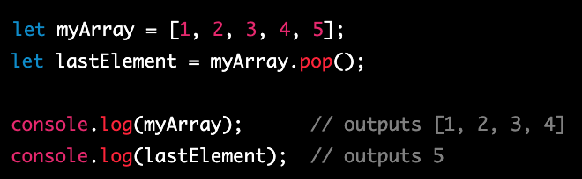
Array pop
In JavaScript, the pop() function is an array method that removes the last element from an array and returns that element. The original array is then modified, with the last element being removed.

Slide 29
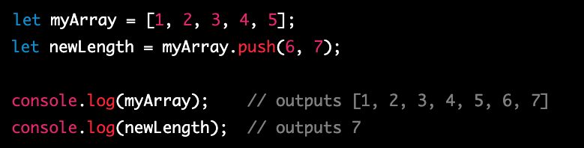
Array push
In JavaScript, the push() method is an array method that adds one or more elements to the end of an array and returns the new length of the array. The original array is then modified, with the new elements being added to the end.

Slide 30
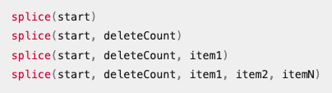
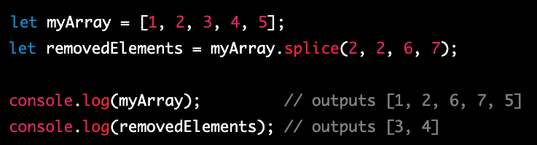
splice
In JavaScript, the splice() function is an array method that allows you to add or remove elements from an array at a specific index. The original array is modified as a result of the function.
The syntax for using the splice() function is as follows:
https://developer.mozilla.org/en-US/docs/Web/JavaScript/Reference/Global_Objects/Array/splice

Slide 31
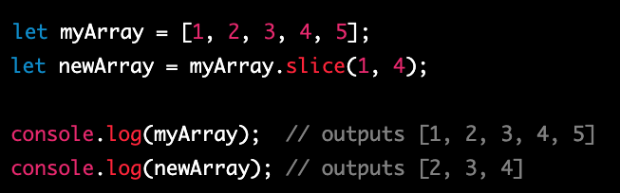
slice
In JavaScript, the slice() function is an array method that returns a shallow copy of a portion of an array into a new array object. The original array is not modified as a result of the function.

Slide 32
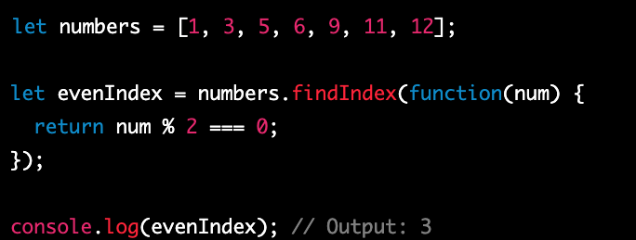
findIndex
In JavaScript, the findIndex() method is an array method that returns the index of the first element in an array that satisfies a given condition. It returns -1 if no element in the array satisfies the condition. The findIndex() method takes a callback function as an argument, which is executed for each element in the array until a matching element is found.

Slide 33
concat
In JavaScript, the concat() method is an array method that is used to merge two or more arrays into a new array. The original arrays are not modified, and a new array is returned that contains all the elements of the original arrays in the order in which they were concatenated.
The concat() method can be called on any array and takes one or more arguments, each of which is an array to be concatenated with the original array. The resulting concatenated array is a new array object that is returned by the concat() method.

Slide 34
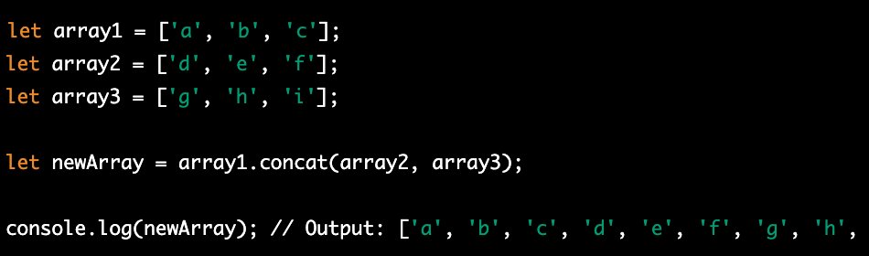
Concat example

Slide 35
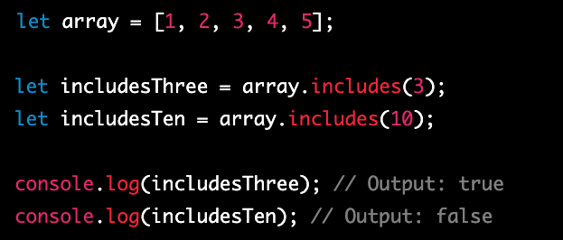
includes
In JavaScript, the includes() method is an array method that is used to determine whether an array contains a specific element. It returns a Boolean value indicating whether the element is found in the array or not.
The includes() method can be called on any array and takes one or two arguments. The first argument is the element to search for, and the second argument (optional) is the starting index of the search

Slide 36
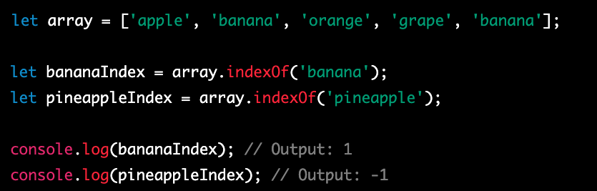
indexOf
In JavaScript, the indexOf() method is an array method that is used to search an array for a specified element and returns the index of the first occurrence of the element. If the element is not found, it returns -1.
The indexOf() method can be called on any array and takes one or two arguments. The first argument is the element to search for, and the second argument (optional) is the starting index of the search.

Slide 38
shallow copy and a deep copy
In JavaScript, a shallow copy and a deep copy are two different ways of creating a new object or array that is a copy of an existing object or array. The difference between the two lies in how nested objects and arrays are handled.
A shallow copy of an object or array creates a new object or array with the same top-level properties or elements as the original, but any nested objects or arrays are still referenced by the new object or array. This means that if you modify a nested object or array in the new copy, the corresponding object or array in the original will also be modified. Shallow copies can be created using methods such as the slice() or concat() array methods or the Object.assign() method.

Slide 39
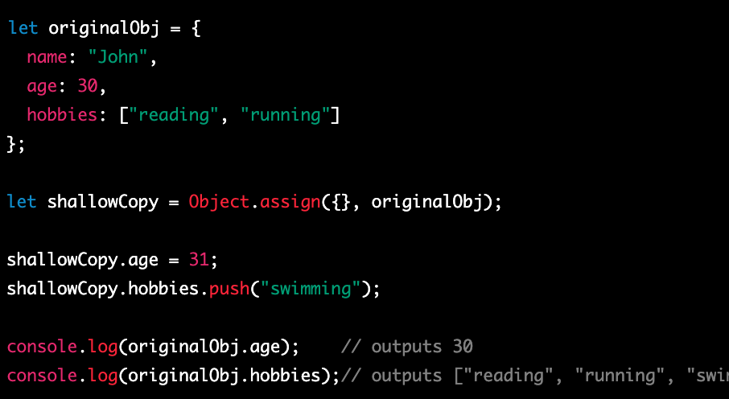
example

Slide 40
Document Object Model
The Document Object Model (DOM) is a programming interface for HTML and XML documents. It represents the structure of a document as a tree-like object model, with each element of the document represented as a node in the tree. The DOM provides a way for JavaScript to interact with the contents of an HTML or XML document, and manipulate it in various ways.
To interact with the DOM in JavaScript, you can use a variety of built-in methods and properties that are part of the global document object. The document object provides access to the root element of the HTML or XML document, as well as methods for querying and manipulating the document tree.

Slide 41
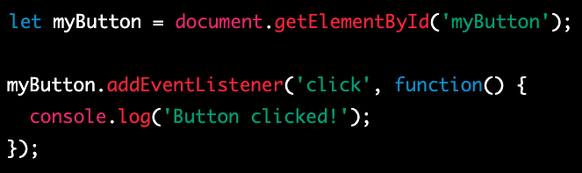
addEventListener
In JavaScript, you can use the addEventListener() method to add an event listener to an object, such as an HTML element or the window object. An event listener is a function that is executed when a specific event occurs, such as a user clicking a button or scrolling the window.

Slide 42
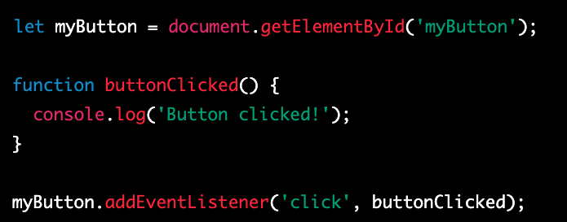
Another example

Slide 43

document
In JavaScript, the document object represents the HTML or XML document loaded in the current window or frame. It provides a way to access and manipulate the contents of the document, including the HTML elements, their properties, and the content displayed in the browser.
The document object is part of the global window object, and can be accessed from anywhere in your JavaScript code using the window.document or simply document syntax.

Slide 44
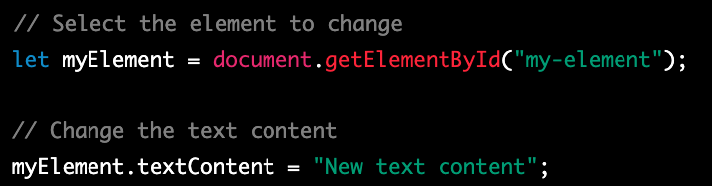
Change the Text of select element
In JavaScript, you can use the textContent property to change the text content of an HTML element that has been selected using one of the many methods available in the document object.

Slide 45
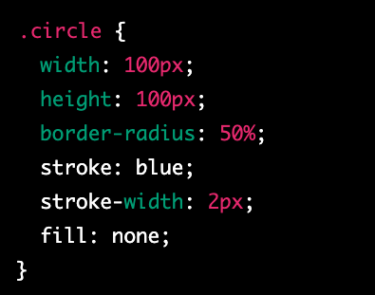
stroke
In CSS, the stroke property is used to control the outline of a shape or path. It is often used in conjunction with the fill property to create complex graphical effects.
The stroke property applies to the outline of the shape or path, while the fill property applies to the interior of the shape or path. Together, these properties allow you to control the appearance of both the outline and the fill of the shape.
The stroke property can be set to a color value, a keyword value, or a URL that points to an image. It can also be set to a combination of these values, using a comma-separated list.

Slide 46
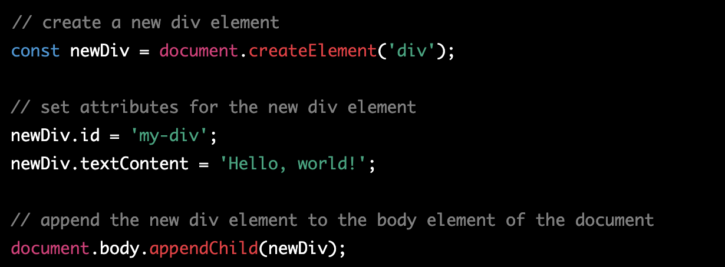
createElement
ou can create an element and add it to the DOM (Document Object Model) using the document.createElement() and parentNode.appendChild() methods.

Slide 47
appendChild
The appendChild() method is a JavaScript method that is used to add a new child node to an existing parent node in the DOM (Document Object Model). The new child node can be an element, a text node, or any other type of node.

Slide 48
querySelector
querySelector() is a JavaScript method that allows you to select and retrieve the first element that matches a specific CSS selector. It is commonly used in web development to access and manipulate elements in the Document Object Model (DOM).

Slide 49
querySelectorAll
querySelectorAll() is a JavaScript method that allows you to select and retrieve a list of all elements that match a specific CSS selector. It is commonly used in web development to access and manipulate elements in the Document Object Model (DOM).

Slide 50
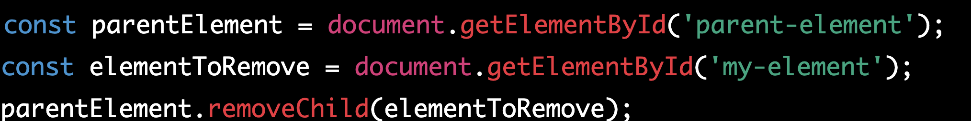
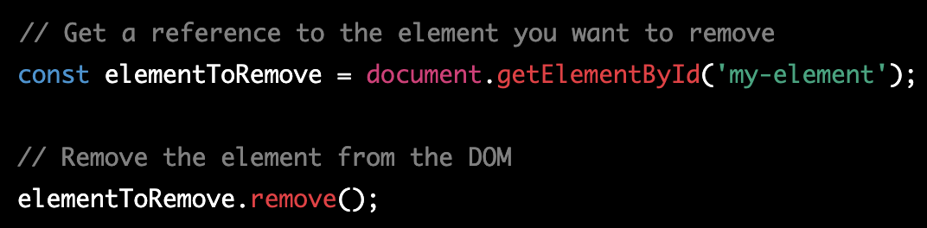
remove
In JavaScript, there are several ways to remove an element from the DOM (Document Object Model). The most common methods are the remove() method and the parentNode.removeChild() method.

Slide 51
Remove vs removeChild
The remove() method is a newer method that is supported in most modern browsers. It is called directly on the element that needs to be removed, and it removes the element from the DOM along with all its child nodes and event listeners.

Slide 52
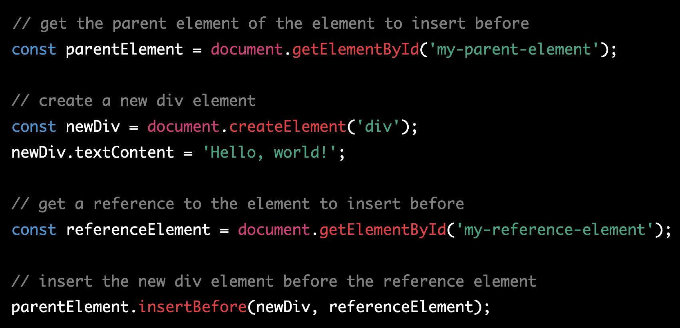
insertBefore
insertBefore() is a JavaScript method that allows you to insert a new node before an existing node in the DOM (Document Object Model). It is commonly used in web development to dynamically add, remove, or move elements in the DOM.

Slide 53
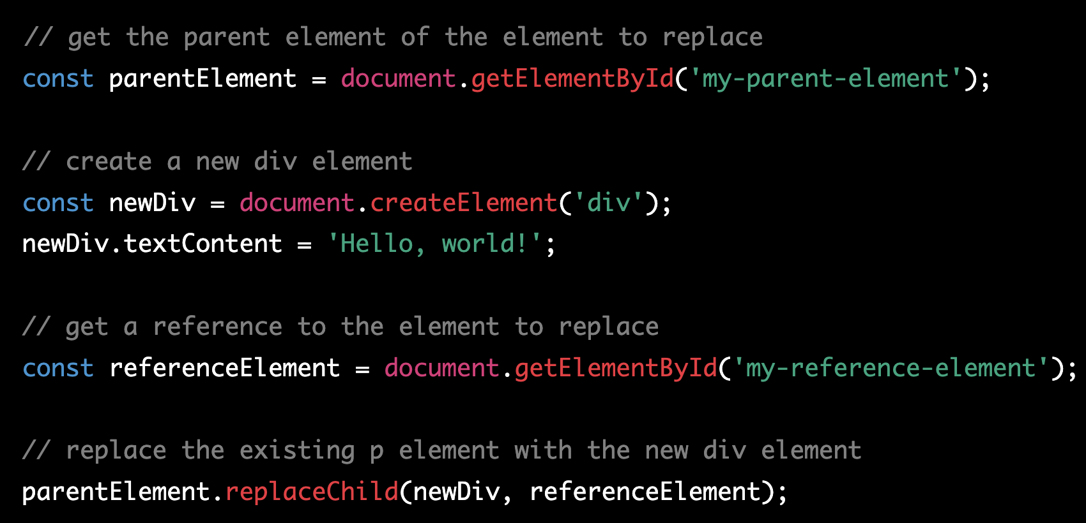
replaceChild
replaceChild() is a JavaScript method that allows you to replace an existing node with a new node in the DOM (Document Object Model). It is commonly used in web development to dynamically add, remove, or move elements in the DOM.

Slide 54
explian
In this example, we first use document.getElementById() to get a reference to the parent element of the element we want to replace in the DOM. We then create a new div element using document.createElement() and set its content using textContent.
We then use document.getElementById() again to get a reference to the element we want to replace. Finally, we use the replaceChild() method to replace the existing p element with the new div element in the DOM.
The replaceChild() method takes two arguments: the new node to replace the existing node with, and the existing node to replace. If you want to remove an existing node without replacing it with a new node, you can use the removeChild() method instead.

Slide 55
const
In JavaScript, the const keyword is used to declare a variable that cannot be reassigned once it has been initialized.
In JavaScript, const keyword is used to declare a variable that cannot be reassigned to a new value. However, it is important to note that const does not make the variable immutable or unchangeable, particularly when it is used with complex data types such as objects or arrays.
When a const variable is assigned an object, the variable itself cannot be reassigned to a new object, but the properties of the object can be modified. This is because the const keyword applies only to the variable's reference to the object in memory, not the contents of the object itself.

Slide 56
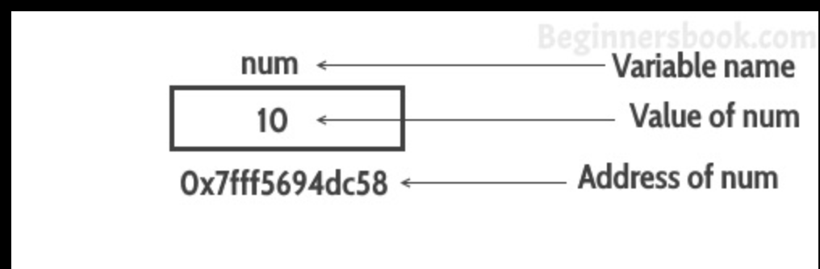
How does the memory works

Slide 57
For loop
In JavaScript, a for loop is a control flow statement that allows you to repeat a block of code a certain number of times.
initialization: This is where you initialize a counter variable or set up any initial conditions that are necessary for the loop to run. This part of the loop is only executed once, before the loop begins.
condition: This is where you specify the condition that must be true in order for the loop to continue. If the condition is false, the loop will terminate.
iteration: This is where you specify how the counter variable or any other variables used in the loop should be updated after each iteration of the loop. This part of the loop is executed at the end of each iteration, just before the condition is checked again.

Slide 58
example

