Slide 1

Let’s go!

Slide 2
List style (some small stuff)
There is many list-style-type including image with url (example : https://www.w3schools.com/css/tryit.asp?filename=trycss_list-style)

Slide 3
More option to style it
The list-style-type property can accept the following values:
disc: A filled circle (default value for ul elements)
circle: A hollow circle
square: A square
decimal: A decimal number (default value for ol elements)
decimal-leading-zero: A decimal number with a leading zero for values less than 10
lower-roman: Lowercase Roman numerals
upper-roman: Uppercase Roman numerals
lower-greek: Lowercase Greek letters
upper-latin: Uppercase ASCII letters
armenian: Armenian numbering
georgian: Georgian numbering
lower-alpha: Lowercase ASCII letters (same as lower-latin)
upper-alpha: Uppercase ASCII letters (same as upper-latin)

Slide 4
CSS hover
in CSS, the :hover pseudo-class is used to apply styles to an element when it is hovered over by the mouse pointer. The :hover pseudo-class can be used with most elements, and is often used to add visual effects such as hover states to buttons, links, and other interactive elements.
The :hover selector is used to select elements when you mouse over them.
p:hover {
background-color: black;
color: white;
}

Slide 5

Font-size
The font-size property in CSS is used to specify the size of the font for an element. The font size can be set to a specific size in pixels or points, or it can be set to one of several predefined size keywords, such as small, medium, and large.
Font-size: 35px;

Slide 6
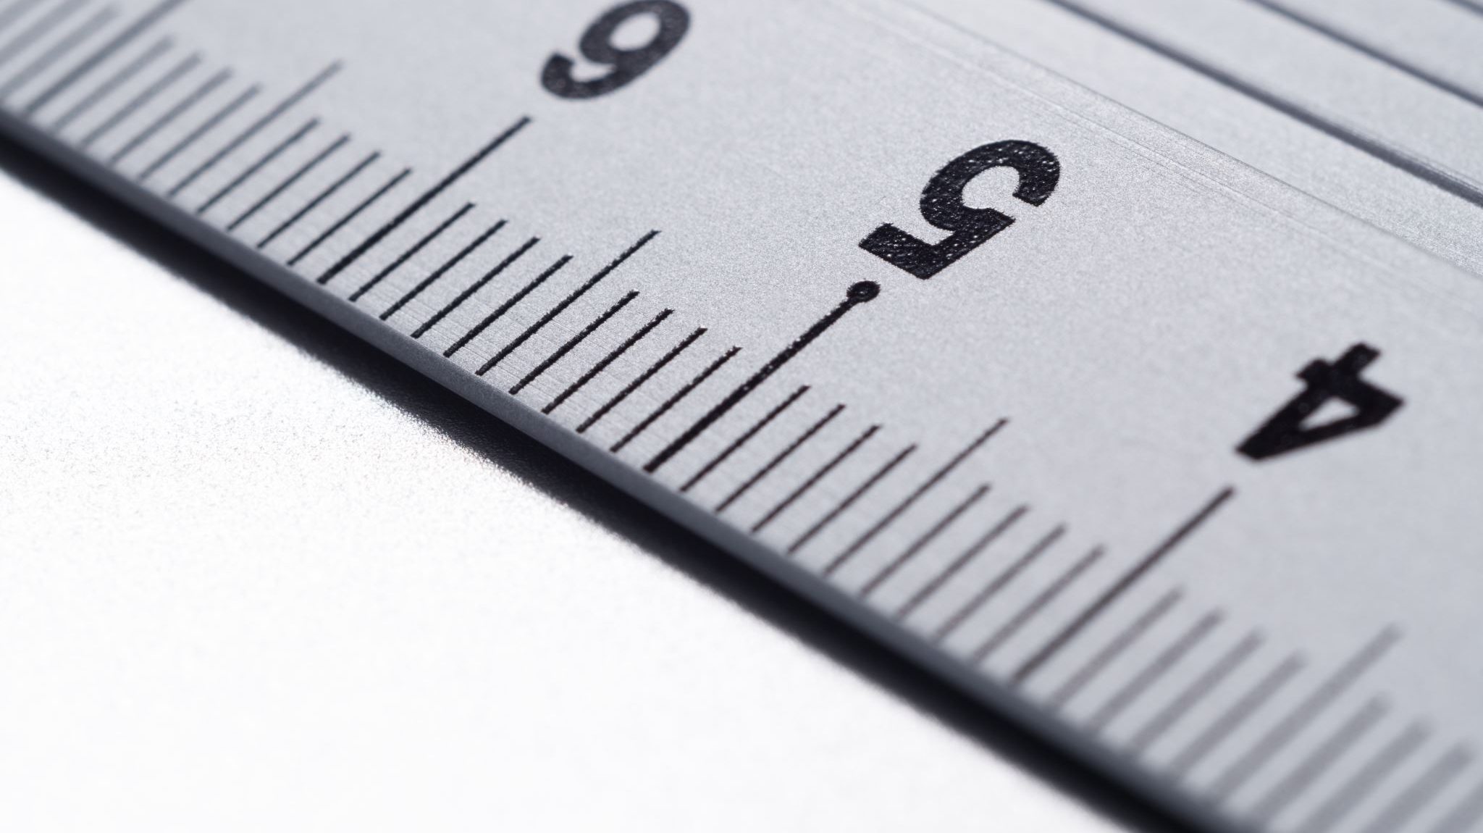
CSS units
In CSS, em and rem are units of measurement that are used to specify the size of font, padding, margin, and other elements.
em is a relative unit of measurement that is based on the size of the font of the element it is applied to. One em is equal to the size of the current font. For example, if the font size of an element is 16px, then 1em is equal to 16px. If the parent element's font size is 14px, then 1em is equal to 14px for that element. em values can be nested, so the size of an element can be based on the size of the parent element's font, which can be based on the size of its parent element's font, and so on.
rem is a relative unit of measurement that is based on the size of the root element (html) of the document. One rem is equal to the size of the root element's font. This means that 1rem is always equal to the same size, regardless of the font size of the parent element.
In addition to em and rem, there are several other units of measurement that can be used in CSS:
px (pixels): A fixed unit of measurement based on the resolution of the screen. One px is equal to one physical pixel on the screen.
pt (points): A fixed unit of measurement based on the size of a physical printed page. One pt is equal to 1/72 of an inch.
% (percentage): A relative unit of measurement based on the size of the parent element. For example, 50% is equal to half the size of the parent element.
vw (viewport width): A unit of measurement based on the width of the viewport (the browser window). One vw is equal to 1/100th of the viewport width.
vh (viewport height): A unit of measurement based on the height of the viewport (the browser window). One vh is equal to 1/100th of the viewport height.
Each of these units of measurement has its own use cases, and the appropriate unit should be chosen based on the specific needs of the design.

Slide 7
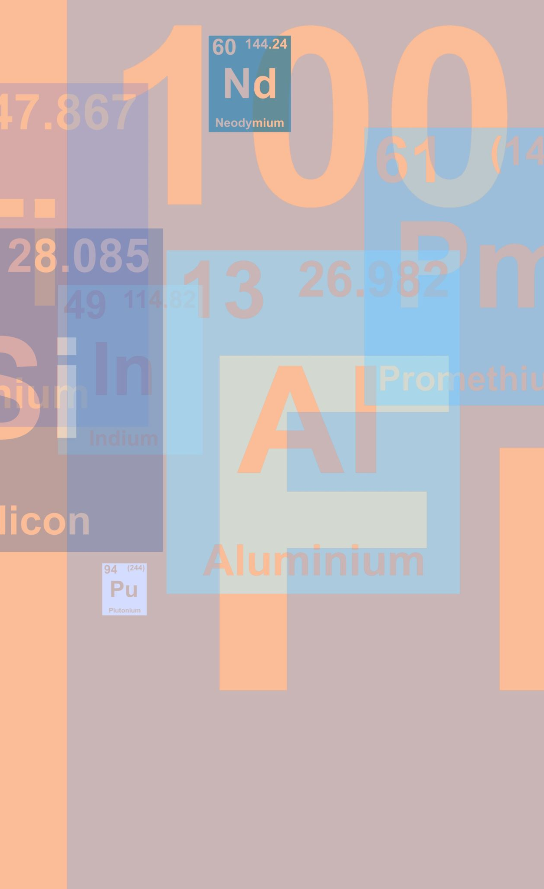
Rem vs em
em and rem are both relative units of measurement that are used to specify the size of font, padding, margin, and other elements in CSS. However, they are based on different references:
em is a relative unit of measurement that is based on the size of the font of the element it is applied to. One em is equal to the size of the current font. For example, if the font size of an element is 16px, then 1em is equal to 16px. If the parent element's font size is 14px, then 1em is equal to 14px for that element. em values can be nested, so the size of an element can be based on the size of the parent element's font, which can be based on the size of its parent element's font, and so on.
rem is a relative unit of measurement that is based on the size of the root element (html) of the document. One rem is equal to the size of the root element's font. This means that 1rem is always equal to the same size, regardless of the font size of the parent element.
em is often used when you want the size of an element to be based on the size of its parent element, while rem is often used when you want the size of an element to be based on the size of the root element of the document. Both em and rem can be useful for creating responsive designs that adapt to the size of the screen or the size of the font.

Slide 8

Wait separate it! Please this is to much
Ok ok let’s create a new folder to show that!
Create a new folders with 3 folders inside
Pages (the html files)
Img (the images)
Css (the css files)

Slide 9
Ok ok But the hover is not good enough
Then let’s animate it all!
But why?
There are many reasons you might want to animate your CSS. Some possible reasons include:
To draw the user's attention to a particular element or feature on the page.
To add visual interest and make the page more engaging.
To enhance the user experience by making the page more interactive and dynamic.
To make the page feel more alive and responsive.
To make transitions between different states of the page more smooth and seamless.
To make the page feel more polished and professional.
Keep in mind that you should use animation wisely and sparingly, as overuse can make the page feel cluttered and overwhelming. It's important to strike a balance and use animation in a way that enhances the user experience without becoming a distraction.

Slide 10
transform
The transform property in CSS allows you to apply a transformation to an element. A transformation is a visual effect that changes the appearance of an element in some way.
The transform property has a number of different functions that you can use to transform an element, including:
translate: Moves an element along the X and Y axes.
scale: Scales an element up or down in size.
rotate: Rotates an element clockwise or counterclockwise.
skew: Skews an element horizontally or vertically.

Slide 11
:focus
The :focus CSS pseudo-class represents an element (such as a form input) that has received focus. It is generally triggered when the user clicks or taps on an element or selects it with the keyboard's Tab key.

Slide 12
Some amazing tools
https://www.cssportal.com/css-text-gradient-generator/
This is a text gradient generator
Background-color gradient generator
https://cssgradient.io/
https://coolors.co/gradient-maker/665803-9e9b6b

Slide 13
Font weight
https://developer.mozilla.org/en-US/docs/Web/CSS/font-weight

Slide 14
Font-style
https://www.w3schools.com/cssref/pr_font_font-style.php

Slide 15
Stop! You need to try
Create a page with a transition on hover and focus also add some font style and make it bold on hover.

Slide 16

CSS position
in CSS, the position property is used to specify the type of positioning method used for an element. The position property can take one of four values.
static
relative
absolute
Fixed
sticky

Slide 17
static
static: this is the default value and means that the element will be positioned according to the normal flow of the document.

Slide 18
relative
relative: this means that the element will be positioned relative to its normal position, and you can use the top, right, bottom, and left properties to move the element around.

Slide 19
absolute
absolute: this means that the element will be positioned relative to its nearest positioned ancestor (instead of the viewport, like fixed), but still remove it from the normal flow of the document. However you can use the top, right, bottom, and left properties to move the element around.

Slide 20

fixed
fixed: this means that the element will be positioned relative to the viewport, and it will stay in the same place even if the page is scrolled.
it's important to note that the position property must be set for the top, right, bottom, and left properties to have any effect.

Slide 21

sticky
The position: sticky property in CSS allows elements to behave like position: relative until a certain point is reached, at which point they become position: fixed. This means that an element with position: sticky will be positioned relative to the viewport, and will "stick" to a certain point on the screen as the user scrolls.

Slide 22

Wait! Try it yourself
Task: Create a webpage that demonstrates the use of the different position values (static, relative, absolute, fixed)
Instructions:
Create a new HTML file and a new CSS file.
In the HTML file, create a div element with the class "container" to act as the parent element.
Inside the "container" div, create 4 div elements with the classes "static", "relative", "absolute", and "fixed" respectively.
In the CSS file, apply the following styles to the 4 div elements:
The "static" div should have a background color of "blue" and a width of "200px".
The "relative" div should have a background color of "green", a width of "150px", and a top and left value of "20px".
The "absolute" div should have a background color of "red", a width of "100px", and a top and right value of "20px".
The "fixed" div should have a background color of "purple", a width of "50px", and a bottom and left value of "20px".
Add some text content to each div element to make it easier to identify them.
Test your webpage in a browser, and make sure the position of the 4 div elements match the styles you have applied.
In a report, explain the difference in behavior and use cases for each position value you used in the task and how you would use each of them in a real-world scenario.

Slide 23
CSS - variables
CSS variables, also known as CSS custom properties, are a way to store and reuse values in a CSS stylesheet. They allow you to define a value once and use it in multiple places throughout your stylesheet, making it easier to maintain and update your CSS.
CSS variables are defined using the -- prefix and can be set on the :root selector or on any other element or class. They can be accessed using the var() function and are case-sensitive.

Slide 24
Box Shadow
The box-shadow property in CSS allows you to add a shadow effect to elements on a web page. It is used to create a drop shadow effect around an element's frame.
Here's an example of how to use the box-shadow property:

Slide 25
text-shadow
The text-shadow property in CSS is used to add a shadow effect to text. It is used to create a visual depth to text and add emphasis to it.
The text-shadow property takes several values, the first value is the horizontal offset of the shadow, the second value is the vertical offset of the shadow, the third value is the blur radius, and the fourth value is the color of the shadow. The horizontal and vertical offset values can be positive or negative, with positive values moving the shadow to the right and down, and negative values moving the shadow to the left and up. The blur radius value determines the spread of the shadow, with higher values creating a more diffuse shadow.

Slide 26
text-align
The text-align property in CSS is used to set the horizontal alignment of text within an element. The most common values are left, right, and center, which align the text to the left, right or center of the element respectively.
It's important to note that text-align property only works on block-level elements and inline-level elements such as span, a, strong, etc. Also, it does not work on replaced elements such as images, input, and canvas
Also, the text-align property can also be used to align the text in a table cell, header, and footer using the values left, right, center, and justify.

Slide 27
Child Selector (>)
The child selector selects all elements that are the children of a specified element.

Slide 28
Descendant Selector
The descendant selector matches all elements that are descendants of a specified element.

Slide 29
margin: auto
The margin: auto; property in CSS is used to center elements horizontally within their containing block. It works by setting the left and right margins to auto, which will distribute any remaining space evenly between them.

Slide 30
Try it!
Task: Create a webpage that demonstrates the use of CSS variables, box shadow, text-align and child selectors
Instructions:
Create a new HTML file and a new CSS file.
In the CSS file, create three CSS variables --main-color, --shadow-size, and --padding-size
In the HTML file, create a div element with the class "container" to act as the parent element.
Inside the "container" div, create 3 div elements with the classes "box1", "box2" and "box3" respectively.
In the CSS file, apply the following styles to the 3 div elements:
Use the CSS variable --main-color to set the background color of each div element.
Use the CSS variable --shadow-size to set the box-shadow property of each div element.
Use the CSS variable --padding-size to set the padding property of each div element.
Use the text-align property to center the text inside each div element.
Use the child selectors to apply different styles to the first and second div elements, such as different font-size, font-weight, and text-transform.
Use the :hover pseudo-class to change the background color of each div element when the user hovers over it.
Test your webpage in a browser, and make sure that the styles you have applied are working correctly.
Add some additional styles to make the webpage more visually appealing and interactive, such as hover effect, transitions or animations.

Slide 31
keyframe
A keyframe in CSS is a set of styles that are applied to an element at a specific point in time during an animation. Keyframes are used to define the start and end states of an animation, as well as any intermediate states that the animation should pass through.

Slide 32

border-radius
The border-radius CSS property rounds the corners of an element's outer border edge. You can set a single radius to make circular corners, or two radii to make elliptical corners.

Slide 33
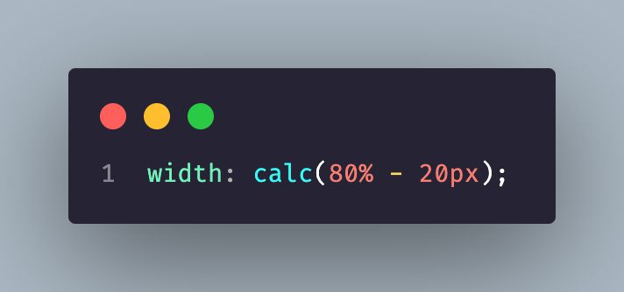
calc
The calc() function in CSS allows you to perform mathematical operations on property values. You can use it to add, subtract, multiply, and divide values in various units, such as pixels, percentages, and ems. For example, you can use it to set the width of an element to be 80% of the viewport width minus 20 pixels, by using the following code

Slide 34
clamp
The clamp() function is a mathematical function in CSS that allows you to set a value within a specific range. It takes three arguments: a minimum value, a preferred value, and a maximum value. If the preferred value is between the minimum and maximum values, it will be used. If the preferred value is less than the minimum, the minimum value will be used. If the preferred value is greater than the maximum, the maximum value will be used.

Slide 35
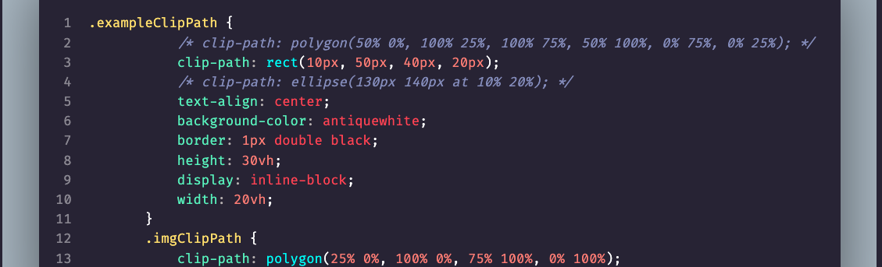
clip-path
The clip-path property in CSS allows you to define a specific region of an element to display, and hide the rest of the element. This can be useful for creating interesting shapes, masks, and other effects.

Slide 36

stacking context
A stacking context in CSS is a way of determining the order in which elements are rendered on a web page. The stacking context is determined by the position and z-index properties of elements, as well as any parent-child relationships between elements.
Elements with a position value of absolute, relative or fixed create a new stacking context. Also elements with a z-index value other than auto create a new stacking context. When an element creates a new stacking context, all of its child elements are rendered within that context, and are positioned relative to that element.
Elements with a z-index value of auto are positioned in the same stacking context as their parent element, and are rendered in the order that they appear in the HTML document. Elements with a higher z-index value will be rendered on top of elements with a lower z-index value, regardless of their order in the HTML document.

Slide 37
opacity
The opacity property in CSS is used to set the transparency level of an element. The property takes a value between 0 and 1, with 0 being completely transparent and 1 being completely opaque.

Slide 38
transform
The transform: translate(-50%, -50%); property in CSS is used to position an element relative to its parent container. It is used to move an element along the x and y axis.
The translate function takes two values, the first value is the distance along the x-axis and the second value is the distance along the y-axis. The value can be a length, percentage, or number. Negative values move the element to the left or up, positive values move the element to the right or down.
The -50% value for both the x and y axis, will move the element to the left by 50% of its width and up by 50% of its height. This will effectively center the element within its parent container.
.center {
position: absolute;
top: 50%;
left: 50%;
transform: translate(-50%, -50%);
}

Slide 39

tables
HTML tables are used to display data in a tabular format. Tables are divided into rows (with the tr element), and each row is divided into cells (with the td element). You can also use the th element to define table headers.

Slide 40
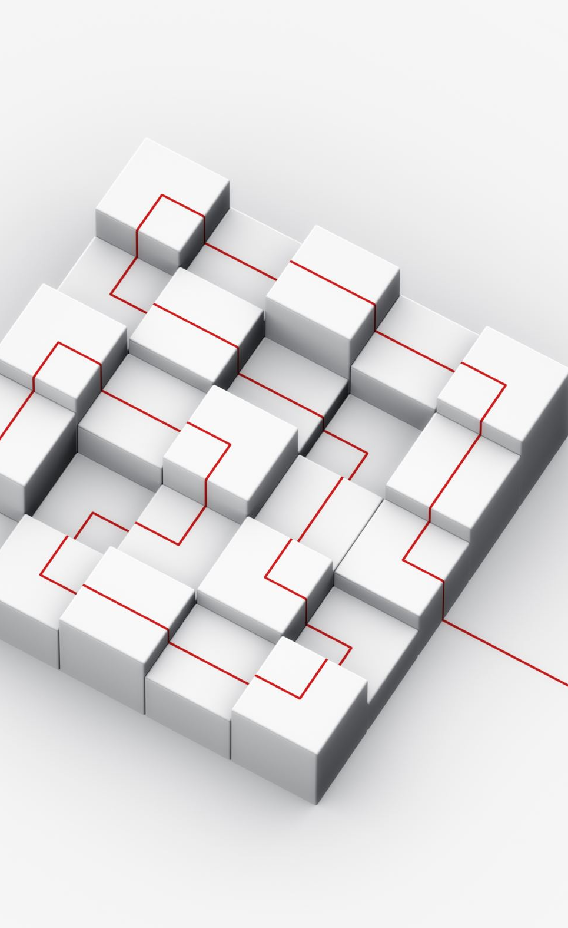
Flexbox
Flexbox is a layout module in CSS that makes it easier to create flexible, responsive designs. It allows elements within a container to be aligned and distributed in various ways, such as horizontally or vertically. Flexbox is particularly useful for creating flexible grid layouts, and it can also be used to create responsive navigation bars and other UI elements. It has a set of CSS properties that can be used to control the layout of elements within a flex container, such as flex-direction, justify-content, and align-items. Flexbox is supported in most modern web browsers.

Slide 41
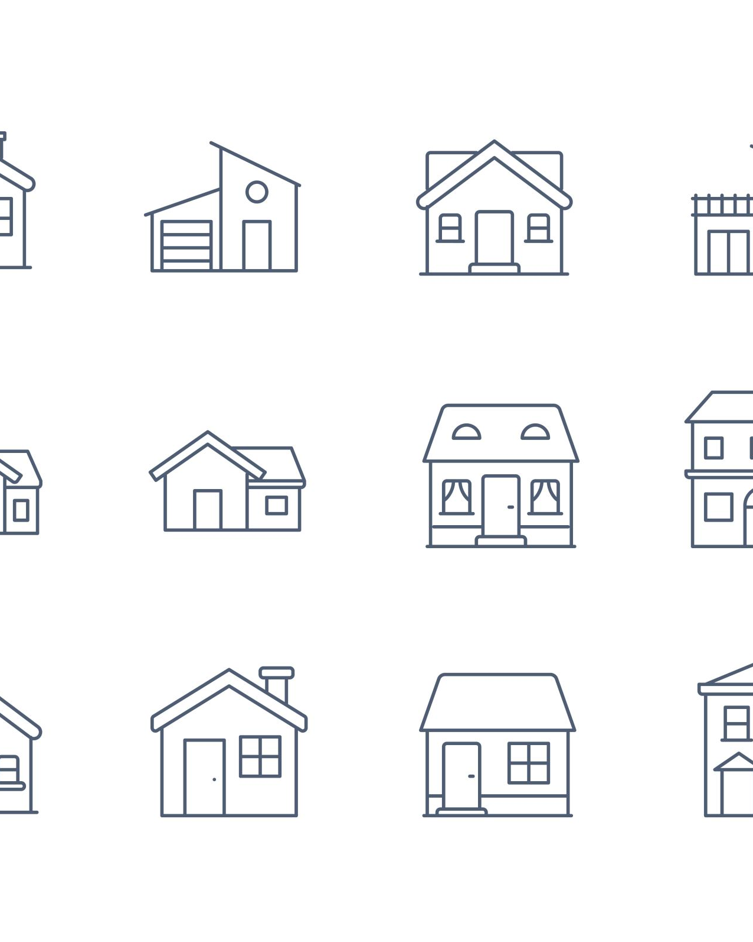
outlines
CSS outlines are a way to draw a line around an element, outside of the element's border. They can be used to highlight or emphasize an element, or to make it stand out from the background.
The outline property is a shorthand property that is used to set the outline width, style, and color all at once. It has the following syntax:
outline: <outline-width> <outline-style> <outline-color>;

Slide 42

float
The CSS float property is used to make an element float to the left or right of its containing element. When an element is floated, it is removed from the normal flow of the document and other elements will flow around it.
The float property can be set to left, right, or none.
left will make the element float to the left of its containing element.
right will make the element float to the right of its containing element.
none will make the element not float and be in normal flow

Slide 43
Float more
The text will flow around the image, which will be on the right side of the paragraph.
It's important to note that when an element is floated, the containing element will not automatically adjust its height to fit the floated element. This can lead to layout issues, so it's common to use the clear property in combination with float to fix it.
Additionally, it's a good practice to always set a width when using float, as it might cause unexpected behavior with the width of the element.
It's worth noting that flexbox and grid layout are now preferred over using float for layout and positioning as they are more powerful and flexible.

