Slide 1
Let’s go!

Slide 2
stacking context
A stacking context in CSS is a way of determining the order in which elements are rendered on a web page. The stacking context is determined by the position and z-index properties of elements, as well as any parent-child relationships between elements.
Elements with a position value of absolute, relative or fixed create a new stacking context. Also elements with a z-index value other than auto create a new stacking context. When an element creates a new stacking context, all of its child elements are rendered within that context, and are positioned relative to that element.
Elements with a z-index value of auto are positioned in the same stacking context as their parent element, and are rendered in the order that they appear in the HTML document. Elements with a higher z-index value will be rendered on top of elements with a lower z-index value, regardless of their order in the HTML document.

Slide 3
opacity
The opacity property in CSS is used to set the transparency level of an element. The property takes a value between 0 and 1, with 0 being completely transparent and 1 being completely opaque.

Slide 4
tables
HTML tables are used to display data in a tabular format. Tables are divided into rows (with the tr element), and each row is divided into cells (with the td element). You can also use the th element to define table headers.

Slide 5
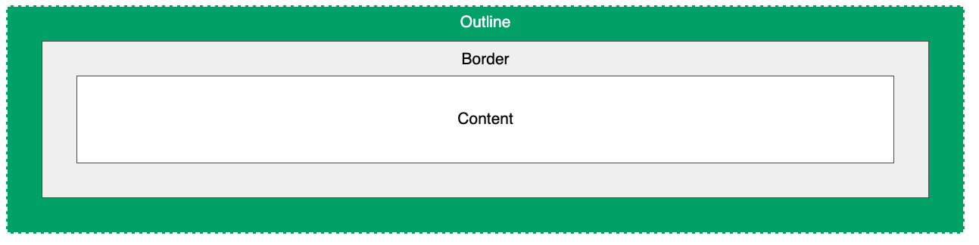
outlines
CSS outlines are a way to draw a line around an element, outside of the element's border. They can be used to highlight or emphasize an element, or to make it stand out from the background.
The outline property is a shorthand property that is used to set the outline width, style, and color all at once. It has the following syntax:
outline: <outline-width> <outline-style> <outline-color>;

Slide 6

Flexbox
Flexbox is a layout module in CSS that makes it easier to create flexible, responsive designs. It allows elements within a container to be aligned and distributed in various ways, such as horizontally or vertically. Flexbox is particularly useful for creating flexible grid layouts, and it can also be used to create responsive navigation bars and other UI elements. It has a set of CSS properties that can be used to control the layout of elements within a flex container, such as flex-direction, justify-content, and align-items. Flexbox is supported in most modern web browsers.

Slide 7
Javascript
Programming languages are a set of instructions that a computer can understand and execute. They are used to create software, applications, and other computer programs. There are many different types of programming languages, each with its own set of features and capabilities.
The basic concepts of programming languages include:
Syntax: The set of rules that dictate how a programming language should be written. This includes things like keywords, variable names, and operator symbols.
Variables: A container that holds a value that can be changed during the execution of a program.
Data Types: The type of data that a variable can hold, such as numbers, text, or true/false values.
Control Flow: The ability to control the flow of a program by making decisions and looping through sets of code.
Functions: A block of code that can be reused throughout a program.
Libraries: A collection of pre-written code that can be used to perform common tasks.
Object-oriented Programming (OOP): A programming paradigm that organizes code into objects, which have properties and methods.
Event-driven Programming: A programming paradigm that is based on reacting to specific events, like mouse clicks or button presses.
These concepts are common among many programming languages and are the basic building blocks of writing software. However, each language has its own unique syntax, set of libraries and frameworks, and specific uses cases. Some popular programming languages are C, C++, C#, Python, Java, JavaScript, Ruby, and Go.

Slide 8
CSS GRID
CSS Grid is a two-dimensional layout system for creating flexible and dynamic web pages. It allows designers to divide a web page into rows and columns, making it easier to arrange and align elements on a page. The CSS Grid Layout module enables authors to control the size, position, and layering of grid items within a grid container, making it an ideal solution for creating complex and responsive web designs. Some key features of CSS Grid include the ability to specify grid-template-rows and grid-template-columns, to create a grid of rows and columns of specific sizes, and the ability to place grid items into grid cells using grid-row and grid-column properties.

Slide 9
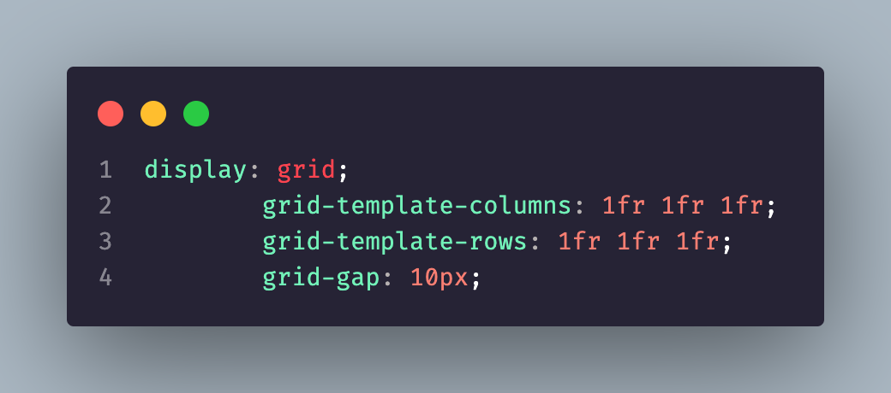
How to start?

Slide 10
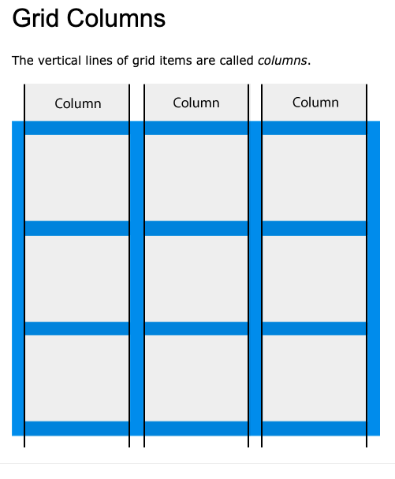
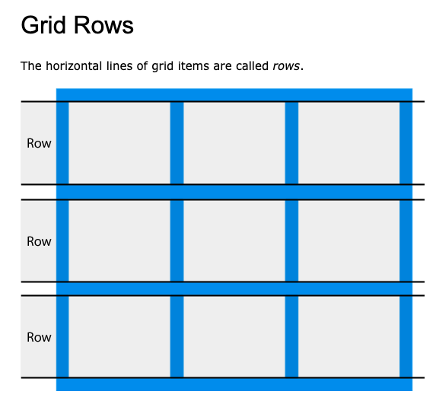
How is it looks like ?

Slide 11
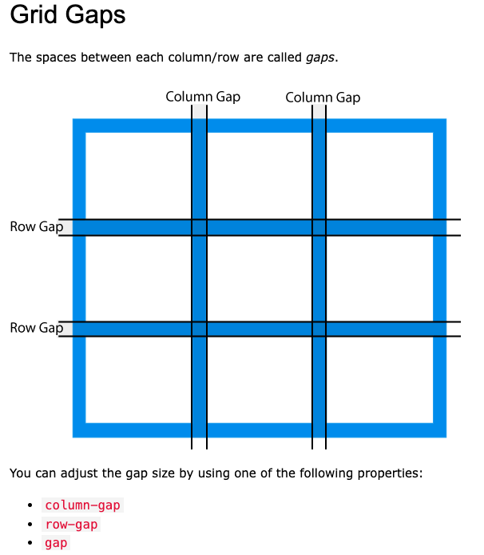
Gaps - grid

Slide 12
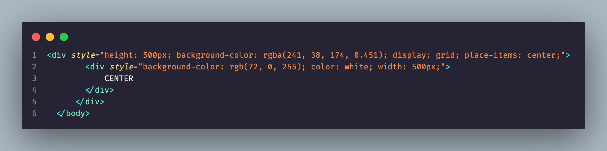
Center me just for fun!

Slide 13

Grid template columns
Grid template columns is a CSS property that allows you to specify the number of columns in a grid container and the width of each column. It is used in conjunction with CSS grid layout to create a flexible and responsive grid-based layout for web pages. The grid template columns property is set on the container element and its value is a series of values separated by spaces, each value representing the width of a column in the grid. The grid layout then uses these values to determine the number and size of columns in the grid.

Slide 14
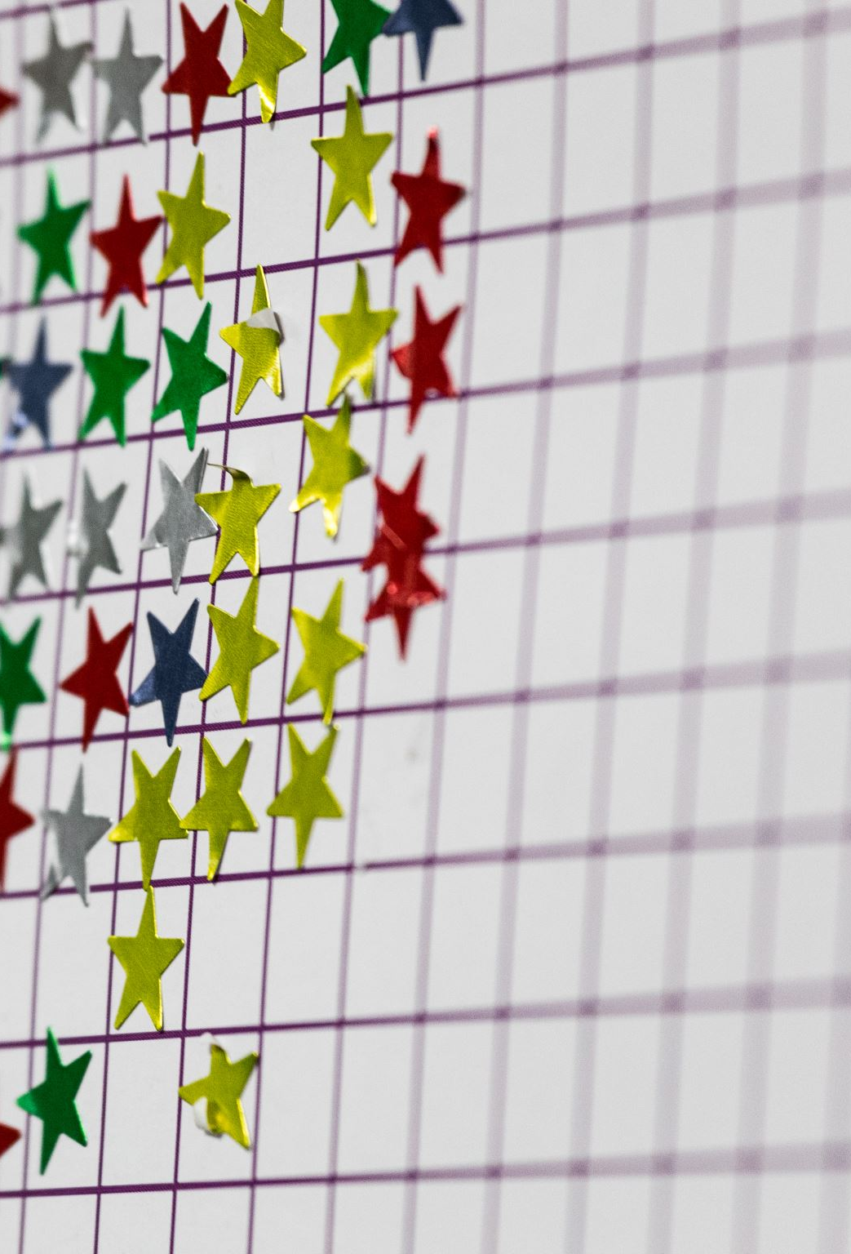
Grid templete rows
Grid Template Rows is a CSS property that defines the number and size of rows in a grid container. The property is set on a grid container element and is used to specify the size and pattern of rows in the grid. The value of the property can be a length value (e.g. 50px), a percentage value (e.g. 20%), or a repeating pattern of these values (e.g. 50px 1fr). The rows created by this property provide the structure for placing grid items (e.g. child elements) within the grid.

Slide 15

Let’s work and learn

Slide 16
grid-column-start and grid-column-end
grid-column-end and grid-column-start are CSS grid properties that define the ending and starting points of a grid item's column along the horizontal (x) axis. These properties are used to determine the size and position of a grid item within the grid container. The values of these properties can be specified as either a number (representing the line number) or a keyword (such as 'span'). The line numbers start from 1, and the end line is always one line beyond the last column line.

Slide 17
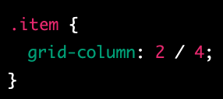
grid-column
grid-column is a CSS grid shorthand property that sets both the grid-column-start and grid-column-end properties in a single declaration. It is used to specify the position and size of a grid item along the horizontal (x) axis. The values of grid-column can be specified as either one or two values.
There is a short version
Grid-column: span 2;

Slide 18
grid-row-start and grid-row-end
grid-row-start and grid-row-end are CSS grid properties that define the starting and ending points of a grid item's row along the vertical (y) axis. These properties are used to determine the size and position of a grid item within the grid container. The values of these properties can be specified as either a number (representing the line number) or a keyword (such as 'span'). The line numbers start from 1, and the end line is always one line beyond the last row line.

Slide 19
grid-row
grid-row is a CSS grid shorthand property that sets both the grid-row-start and grid-row-end properties in a single declaration. It is used to specify the position and size of a grid item along the vertical (y) axis. The values of grid-row can be specified as either one or two values.

Slide 20
repeat
The "repeat" in CSS Grid refers to the ability to repeat a pattern of columns or rows defined by a grid template. It allows for creating grid items that repeat in a grid, saving the time and effort of specifying the layout for each individual item. The repeat() function takes two arguments: the number of times to repeat the pattern, and the pattern itself. For example: "repeat(3, 1fr 50px)" means repeating the pattern of 1fr followed by 50px three times in a row.

Slide 21
justify-items and align-items
justify-items and align-items are CSS properties that are used in grid layout to align the grid items within the grid container along the horizontal and vertical axes, respectively.
justify-items is used to align the grid items along the x (horizontal) axis within the grid container. Its values include: start, end, center, stretch, space-between, space-around, and space-evenly.
align-items is used to align the grid items along the y (vertical) axis within the grid container. Its values include: start, end, center, stretch, and baseline.

Slide 22
Place-items
Is a short hand for both of them you can just place-items:center;

Slide 23
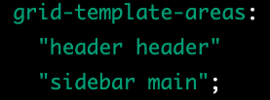
grid-template-areas
The grid-template-areas property in CSS is used to define named areas within a grid container. It allows you to create a visual representation of the grid layout using ASCII art, where each square represents a grid cell. The named areas can then be referred to in other grid properties, such as grid-area, to place grid items into the defined areas.

Slide 24
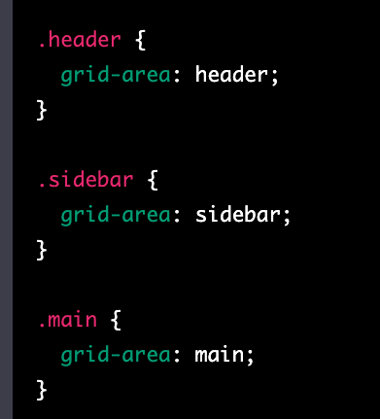
Grid-area
The "grid-area" property in CSS is used to assign a named area to a grid item. It allows you to create reusable grid areas that you can reference when defining the grid layout.
A grid area is created by specifying a name for it using the "grid-template-areas" property on the grid container, and then using the "grid-area" property on the grid items to assign them to the named areas.

Slide 25
filter
CSS filter property allows to apply graphical effects such as blur, brightness, contrast, grayscale, hue-rotate, invert, opacity, saturate, and sepia to an HTML element. It can be applied to any block-level or inline-level element. Syntax
https://developer.mozilla.org/en-US/docs/Web/CSS/filter

Slide 26
cursor
The cursor is the graphical pointer that indicates the position on a web page where the user is about to perform an action, such as clicking a link, typing text, or selecting an element.
CSS provides the cursor property to control the appearance of the cursor. Some of the commonly used cursor values are:
auto: The default cursor. It changes based on the current context.
default: The normal arrow cursor.
pointer: The clicking hand cursor.
wait: The waiting cursor with a spinning hourglass or watch.
text: The text editing I-beam cursor.
crosshair: The crosshair cursor.
move: The move cursor with four arrows pointing in different directions.

Slide 27
scroll-behavior
The scroll-behavior property in CSS is used to control the smooth scrolling behavior when the user clicks on a link or uses the back and forward buttons. It determines the animation transition between two points during the scroll.

Slide 28
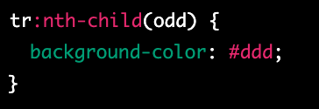
:nth-child
The "nth-child" selector in CSS allows you to target and style a specific HTML element based on its position among its siblings (i.e. other elements with the same parent). You can use the formula "nth-child(n)" to target the "n"th child element, where "n" can be any positive integer or a mathematical expression that evaluates to a positive integer.

Slide 29
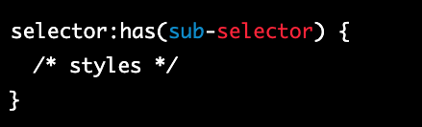
:has
The "has" selector in CSS allows you to target elements based on the presence of a particular selector within them. It can be used in combination with a general selector to match elements that contain a specific element within them.

Slide 30
specificity
CSS specificity is the mechanism that determines which CSS styles will be applied to an element when multiple styles are defined for the same element. It is based on the notion of "importance" and "specificity" of selectors.
Each selector has a specificity value, which is calculated based on its structure. The more specific the selector, the higher its specificity value, and the more likely it is to be applied to an element. The basic structure of specificity is calculated as follows:
0, 0, 0, X: inline styles
0, 0, Y, 0: ID selectors (#id)
0, Z, 0, 0: class selectors (.class), attribute selectors ([attribute]) and pseudo-class selectors (:hover, :active, etc.)
W, 0, 0, 0: element selectors (p, h1, etc.)
In case of conflicting styles, the browser will apply the style with the highest specificity value.
It is important to keep in mind that specificity can also make your styles hard to maintain, especially if you have complex selectors with high specificity values. A good practice is to keep selectors as simple and specific as necessary, and to avoid using !important unless absolutely necessary.

Slide 31
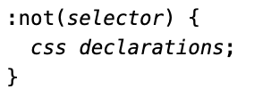
:not
The :not(selector) selector matches every element that is NOT the specified element/selector.

Slide 32

::first-letter
The ::first-letter selector is used to add a style to the first letter of the specified selector.

Slide 33
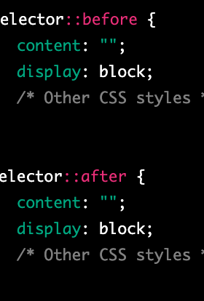
::before and ::after
The ::before and ::after pseudo-elements in CSS allow you to insert content before or after an element's content, without affecting the actual content. These pseudo-elements are often used to add visual effects to a page or to generate content that is not present in the HTML source code.

Slide 34

Hyphens
Hyphens are characters that are used to connect words to form a compound word, and to split words at the end of a line in justified text. They are represented by the symbol "-" and can be used for several purposes in written language.
To join two words together to form a compound word, e.g. "mother-in-law".
To split a word at the end of a line to avoid breaking the word between syllables. This is called hyphenation.
To specify negative numbers, e.g. "-5".
To form a range of values, e.g. "pages 25-30".
In CSS, hyphens are also used to specify hyphenation for long words in justified text. This is done using the hyphens property, which can have the values none, manual, auto, or inherit. The auto value allows the browser to automatically determine when to hyphenate words, while the manual value allows the developer to specify hyphenation points.

Slide 35
overflow
The overflow property in CSS is used to control how an element's content is displayed when the content is too large to fit inside the element's box. The overflow property can have one of the following values:
visible: The content is not clipped and is visible outside the element's box.
hidden: The content is clipped and not visible outside the element's box.
scroll: The content is clipped, and a scrollbar is added to the element's box so that the content can be scrolled to see the rest of it.
auto: The behavior is the same as scroll, but the scrollbar is only added when necessary.
The overflow property can be applied to either the x or y axis, or to both, by using the overflow-x and overflow-y properties, respectively.

Slide 36
visibility
The visibility and display properties in CSS control the visibility of an element on a web page.
visibility: hidden; sets the visibility of an element to hidden, meaning that the element still takes up space in the layout of the page, but is not visible to the user.
display: none; sets the display property of an element to none, meaning that the element does not take up any space in the layout of the page and is not visible to the user.
In short, visibility: hidden makes an element invisible but still affects the layout, while display: none makes an element completely invisible and does not affect the layout.

Slide 37
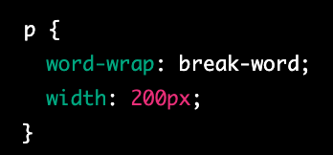
word-wrap
The word-wrap property in CSS determines whether or not long words (that would normally extend beyond the boundaries of an element's box) should be broken into multiple lines and wrapped within the element.
The word-wrap property can have one of the following values:
normal: The default value, which allows words to wrap to the next line if necessary.
break-word: Forces long words to break and wrap to the next line.
initial: Sets the property to its default value.
inherit: Inherits the property from its parent element.

Slide 38
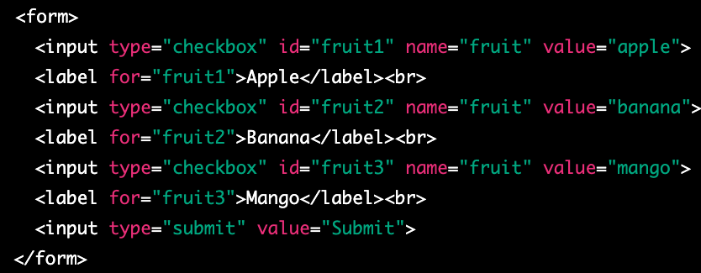
checkbox
A checkbox is a graphical control element used in web forms to allow a user to make multiple selections from a set of options. In HTML, a checkbox is created using the <input type="checkbox"> element.
A checkbox is displayed as a small square box on the web page, which can be either checked or unchecked. When a user clicks on a checkbox, the box is filled with a checkmark and its state changes to checked. If a user clicks on the checkbox again, the checkmark is removed and the state changes back to unchecked.
Checkboxes can be used to collect data in web forms, where a user can select one or more options from a list. The selected options can be submitted to a server-side script for processing.

Slide 39
Wait I want to select only more then one at the time
If you want to allow the user to select multiple checkboxes at the same time, you can give each checkbox a different name attribute. This way, when a user selects one checkbox, it does not affect the state of other checkboxes.

Slide 40
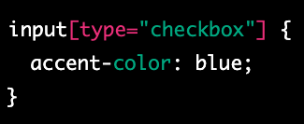
accent-color
The accent-color CSS property sets the accent color of an element. The accent color is used by various user interface controls (such as buttons, checkboxes, and range controls) to make them more visually appealing.
The accent-color property can be set to a specific color value (e.g. red, #ff0000, rgb(255,0,0)) or can be set to inherit the value from the parent element using inherit.

Slide 41
writing-mode
The "writing-mode" property in CSS is used to control the direction of text in a block-level container. It determines the orientation of the text, whether it is horizontal or vertical, and in which direction it flows.
The writing-mode property can have the following values:
horizontal-tb: The default value. The text flows from left to right, and from top to bottom.
vertical-lr: The text flows from top to bottom, and from left to right.
vertical-rl: The text flows from top to bottom, and from right to left.

Slide 42
word-spacing
The "word-spacing" property in CSS sets the space between words in a block of text. It is used to adjust the spacing between words for better readability or to create a specific visual effect.
The word-spacing property can be set in pixels, em, or percentage values. A positive value increases the space between words, while a negative value decreases it. The default value is "normal".

Slide 43
white-space
The "white-space" property in CSS is used to control the handling of white spaces and line breaks in a block of text. It determines how white spaces and line breaks are rendered in a block of text.
The white-space property can have the following values:
normal: The default value. White spaces are collapsed, and text wraps when it reaches the end of a line.
nowrap: White spaces are preserved, and text does not wrap when it reaches the end of a line.
pre: White spaces are preserved, and text wraps only when a line break is encountered.
pre-wrap: White spaces are preserved, and text wraps when it reaches the end of a line or when a line break is encountered.
pre-line: White spaces are collapsed, and text wraps when it reaches the end of a line or when a line break is encountered.

