Slide 1

Let’s go!

Slide 2
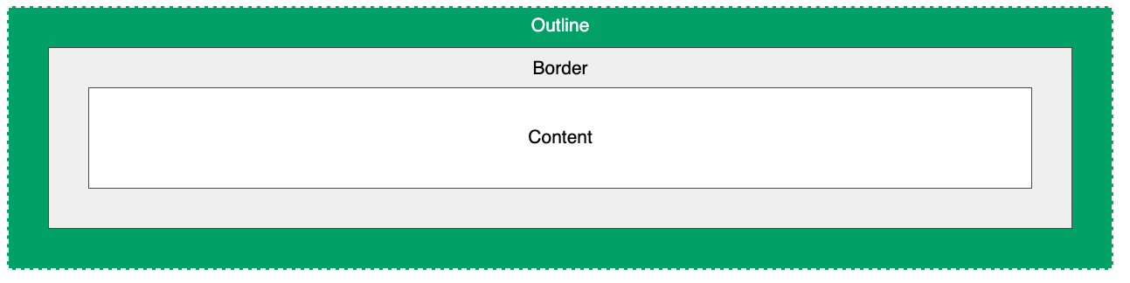
outlines
CSS outlines are a way to draw a line around an element, outside of the element's border. They can be used to highlight or emphasize an element, or to make it stand out from the background.
The outline property is a shorthand property that is used to set the outline width, style, and color all at once. It has the following syntax:
outline: <outline-width> <outline-style> <outline-color>;

Slide 3
Javascript
Programming languages are a set of instructions that a computer can understand and execute. They are used to create software, applications, and other computer programs. There are many different types of programming languages, each with its own set of features and capabilities.
The basic concepts of programming languages include:
Syntax: The set of rules that dictate how a programming language should be written. This includes things like keywords, variable names, and operator symbols.
Variables: A container that holds a value that can be changed during the execution of a program.
Data Types: The type of data that a variable can hold, such as numbers, text, or true/false values.
Control Flow: The ability to control the flow of a program by making decisions and looping through sets of code.
Functions: A block of code that can be reused throughout a program.
Libraries: A collection of pre-written code that can be used to perform common tasks.
Object-oriented Programming (OOP): A programming paradigm that organizes code into objects, which have properties and methods.
Event-driven Programming: A programming paradigm that is based on reacting to specific events, like mouse clicks or button presses.
These concepts are common among many programming languages and are the basic building blocks of writing software. However, each language has its own unique syntax, set of libraries and frameworks, and specific uses cases. Some popular programming languages are C, C++, C#, Python, Java, JavaScript, Ruby, and Go.

Slide 4
variables
In JavaScript, a variable is a container that holds a value that can change throughout the code. Variables are declared using the var, let, or const keyword, followed by the variable name and an equal sign. The value can be of any data type such as a number, string, or boolean. Var variables are function scoped and are hoisted to the top of their scope, while let and const are block scoped and not hoisted. Const is used to declare variables that cannot be reassigned after they are declared. It is important to choose the right keyword based on the intended use of the variable in the code.

Slide 5
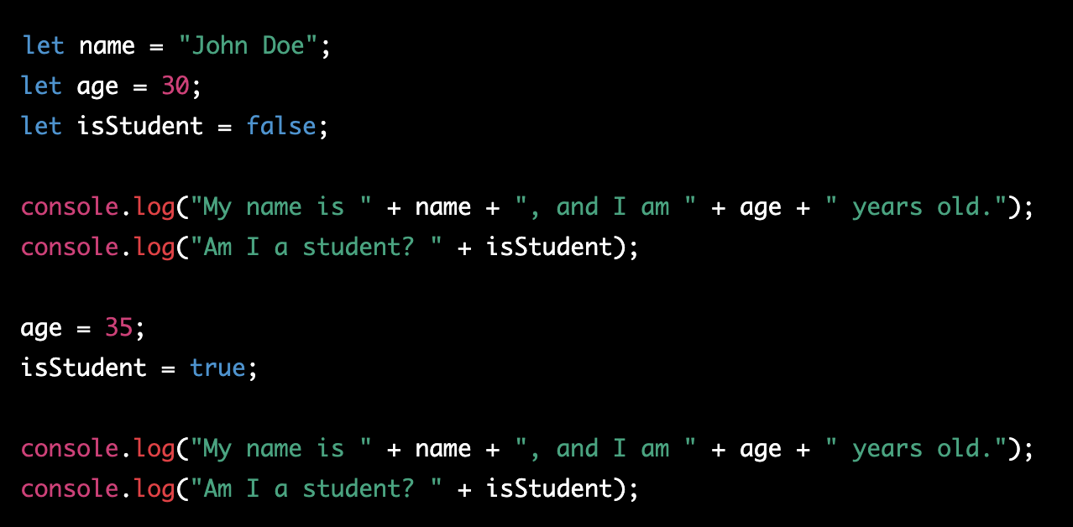
example

Slide 6
Console.log(“what is this?”)
console.log() is a function in JavaScript that writes a message to the console. The console is a debugging tool that is part of the browser's developer tools, and it allows developers to log messages and inspect the state of their application.
The console.log() function takes one or more arguments, and it displays these arguments as a string in the console.

Slide 7
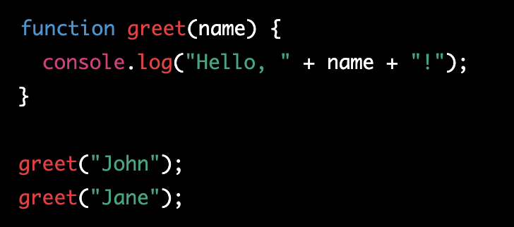
functions
In JavaScript, a function is a block of code that performs a specific task and can be called from other parts of the code. Functions allow you to break down a complex problem into smaller, reusable pieces, and to structure your code in a way that makes it easier to maintain and understand.

Slide 8
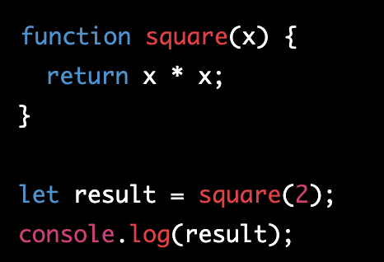
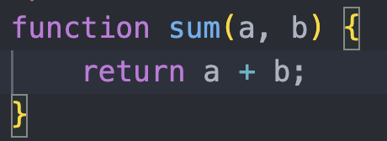
More examples

Slide 9
Return?
The return keyword in JavaScript is used to exit a function and specify the value to be returned to the calling code. When a function encounters the return keyword, it immediately stops executing and returns the specified value to the caller.

Slide 10
How to react to actions
First let’s get the element
The document object in JavaScript represents the HTML document that is currently loaded in the browser. The document object provides several methods to interact with the HTML document, such as accessing and modifying its elements.
One of the most commonly used methods of the document object is getElementById, which allows you to access an HTML element by its unique id attribute. The getElementById method returns a reference to the element with the specified id, and you can then use this reference to manipulate the element or retrieve its properties.

Slide 11
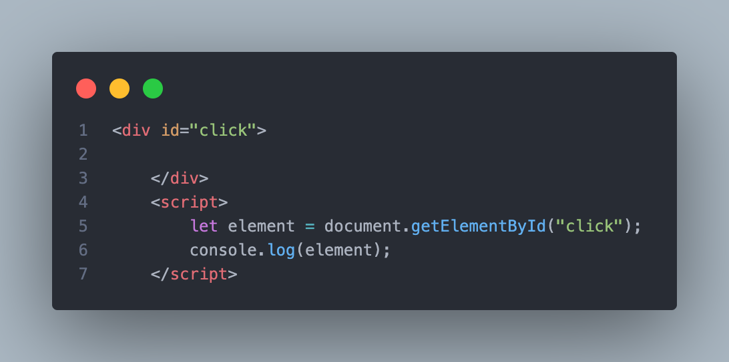
example

Slide 12
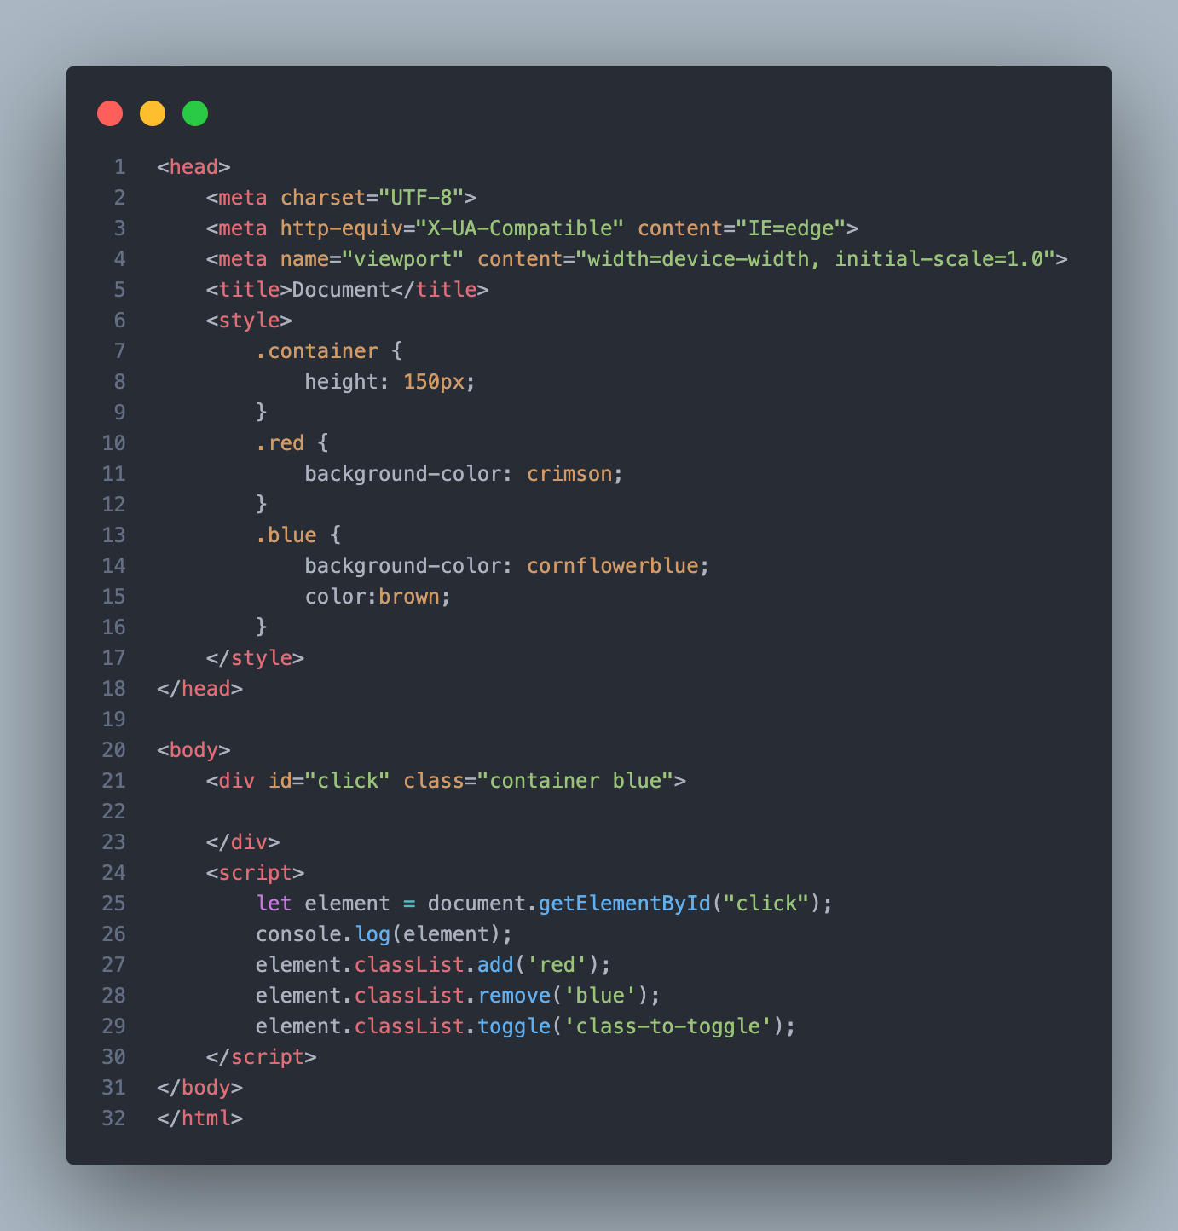
Add or remove class
To add a class to an element in JavaScript, you can use the classList.add method on the element's classList property:

Slide 13
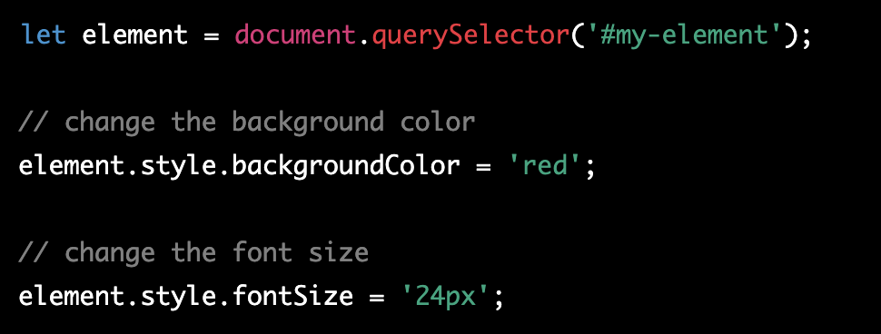
Change one css property
To change a CSS property with JavaScript, you can use the style property of an element. Here's an example:

Slide 14
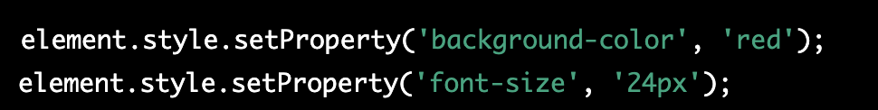
One more way

Slide 16
box
The CSS box model is the concept that describes the design and layout of elements in web pages. The CSS box model defines a rectangular area around every HTML element, consisting of:
Content: The area inside the box where the element's content is displayed.
Padding: The transparent area around the content, between the content and the border.
Border: A decorative line that surrounds the padding and content.
Margin: The transparent area outside the border, used to separate elements from one another.

Slide 17
Box-sizing
The "box-sizing" property in CSS allows you to specify how the size of an element should be calculated, and there are two possible values:
content-box (default): The size of an element is calculated based on its content, with padding and border added to the size of the content.
border-box: The size of an element includes its content, padding, and border, and specifies the total width and height of an element.
Using border-box is useful because it allows you to set the width and height of an element, including padding and border, without having to calculate the size of the content.

Slide 18
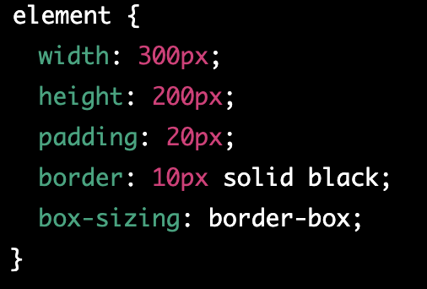
example

Slide 19
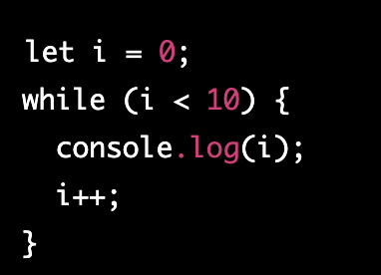
loops
Loops in JavaScript are used to repeatedly execute a block of code. There are two main types of loops in JavaScript: for loops and while loops.
For loops are used to iterate over a sequence of values, such as an array or a range of numbers.

Slide 20
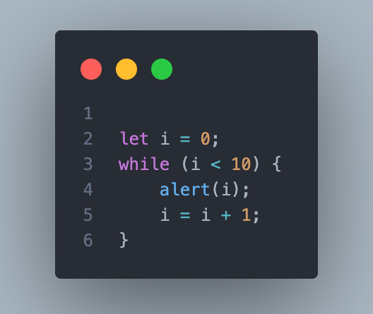
More example (while loop)

Slide 22
specificity
CSS specificity is the mechanism that determines which CSS styles will be applied to an element when multiple styles are defined for the same element. It is based on the notion of "importance" and "specificity" of selectors.
Each selector has a specificity value, which is calculated based on its structure. The more specific the selector, the higher its specificity value, and the more likely it is to be applied to an element. The basic structure of specificity is calculated as follows:
0, 0, 0, X: inline styles
0, 0, Y, 0: ID selectors (#id)
0, Z, 0, 0: class selectors (.class), attribute selectors ([attribute]) and pseudo-class selectors (:hover, :active, etc.)
W, 0, 0, 0: element selectors (p, h1, etc.)
In case of conflicting styles, the browser will apply the style with the highest specificity value.
It is important to keep in mind that specificity can also make your styles hard to maintain, especially if you have complex selectors with high specificity values. A good practice is to keep selectors as simple and specific as necessary, and to avoid using !important unless absolutely necessary.

Slide 23

::first-letter
The ::first-letter selector is used to add a style to the first letter of the specified selector.

Slide 24
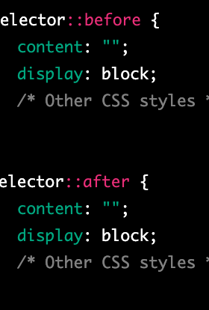
::before and ::after
The ::before and ::after pseudo-elements in CSS allow you to insert content before or after an element's content, without affecting the actual content. These pseudo-elements are often used to add visual effects to a page or to generate content that is not present in the HTML source code.

Slide 25

Hyphens
Hyphens are characters that are used to connect words to form a compound word, and to split words at the end of a line in justified text. They are represented by the symbol "-" and can be used for several purposes in written language.
To join two words together to form a compound word, e.g. "mother-in-law".
To split a word at the end of a line to avoid breaking the word between syllables. This is called hyphenation.
To specify negative numbers, e.g. "-5".
To form a range of values, e.g. "pages 25-30".
In CSS, hyphens are also used to specify hyphenation for long words in justified text. This is done using the hyphens property, which can have the values none, manual, auto, or inherit. The auto value allows the browser to automatically determine when to hyphenate words, while the manual value allows the developer to specify hyphenation points.

Slide 26
overflow
The overflow property in CSS is used to control how an element's content is displayed when the content is too large to fit inside the element's box. The overflow property can have one of the following values:
visible: The content is not clipped and is visible outside the element's box.
hidden: The content is clipped and not visible outside the element's box.
scroll: The content is clipped, and a scrollbar is added to the element's box so that the content can be scrolled to see the rest of it.
auto: The behavior is the same as scroll, but the scrollbar is only added when necessary.
The overflow property can be applied to either the x or y axis, or to both, by using the overflow-x and overflow-y properties, respectively.

Slide 27
visibility
The visibility and display properties in CSS control the visibility of an element on a web page.
visibility: hidden; sets the visibility of an element to hidden, meaning that the element still takes up space in the layout of the page, but is not visible to the user.
display: none; sets the display property of an element to none, meaning that the element does not take up any space in the layout of the page and is not visible to the user.
In short, visibility: hidden makes an element invisible but still affects the layout, while display: none makes an element completely invisible and does not affect the layout.

Slide 28
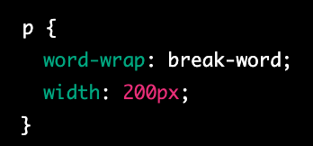
word-wrap
The word-wrap property in CSS determines whether or not long words (that would normally extend beyond the boundaries of an element's box) should be broken into multiple lines and wrapped within the element.
The word-wrap property can have one of the following values:
normal: The default value, which allows words to wrap to the next line if necessary.
break-word: Forces long words to break and wrap to the next line.
initial: Sets the property to its default value.
inherit: Inherits the property from its parent element.

Slide 29
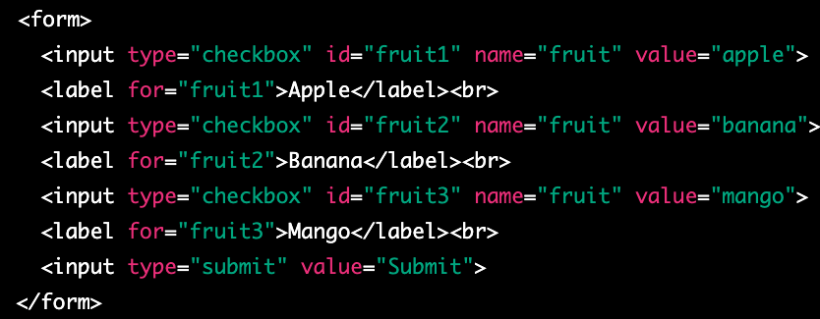
checkbox
A checkbox is a graphical control element used in web forms to allow a user to make multiple selections from a set of options. In HTML, a checkbox is created using the <input type="checkbox"> element.
A checkbox is displayed as a small square box on the web page, which can be either checked or unchecked. When a user clicks on a checkbox, the box is filled with a checkmark and its state changes to checked. If a user clicks on the checkbox again, the checkmark is removed and the state changes back to unchecked.
Checkboxes can be used to collect data in web forms, where a user can select one or more options from a list. The selected options can be submitted to a server-side script for processing.

Slide 30
Wait I want to select only more then one at the time
If you want to allow the user to select multiple checkboxes at the same time, you can give each checkbox a different name attribute. This way, when a user selects one checkbox, it does not affect the state of other checkboxes.

Slide 31
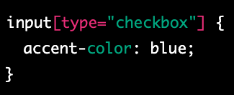
accent-color
The accent-color CSS property sets the accent color of an element. The accent color is used by various user interface controls (such as buttons, checkboxes, and range controls) to make them more visually appealing.
The accent-color property can be set to a specific color value (e.g. red, #ff0000, rgb(255,0,0)) or can be set to inherit the value from the parent element using inherit.

Slide 32
writing-mode
The "writing-mode" property in CSS is used to control the direction of text in a block-level container. It determines the orientation of the text, whether it is horizontal or vertical, and in which direction it flows.
The writing-mode property can have the following values:
horizontal-tb: The default value. The text flows from left to right, and from top to bottom.
vertical-lr: The text flows from top to bottom, and from left to right.
vertical-rl: The text flows from top to bottom, and from right to left.

Slide 33
word-spacing
The "word-spacing" property in CSS sets the space between words in a block of text. It is used to adjust the spacing between words for better readability or to create a specific visual effect.
The word-spacing property can be set in pixels, em, or percentage values. A positive value increases the space between words, while a negative value decreases it. The default value is "normal".

Slide 34
white-space
The "white-space" property in CSS is used to control the handling of white spaces and line breaks in a block of text. It determines how white spaces and line breaks are rendered in a block of text.
The white-space property can have the following values:
normal: The default value. White spaces are collapsed, and text wraps when it reaches the end of a line.
nowrap: White spaces are preserved, and text does not wrap when it reaches the end of a line.
pre: White spaces are preserved, and text wraps only when a line break is encountered.
pre-wrap: White spaces are preserved, and text wraps when it reaches the end of a line or when a line break is encountered.
pre-line: White spaces are collapsed, and text wraps when it reaches the end of a line or when a line break is encountered.

Slide 35
SVG
SVG stands for Scalable Vector Graphics and is a type of image format used to display vector graphics on the web. Unlike raster images (such as JPEG or PNG), which are composed of pixels and can become blurry when scaled, vector graphics are composed of paths, shapes, and lines, and can be scaled to any size without losing quality.
SVG graphics are created using XML markup and can be styled with CSS. They can be static or animated and can be interactive, allowing users to interact with the graphics through clicks, hover effects, and more.
SVG graphics can be embedded directly in HTML pages or can be included as separate files, and can be used for a variety of purposes, including:
Displaying logos and icons
Creating charts and graphs
Creating complex illustrations and animations
Providing scalable graphics for high-resolution displays
SVG has become a popular choice for web developers because of its versatility and scalability, and because it is an open standard that is well-supported by modern browsers.

Slide 36
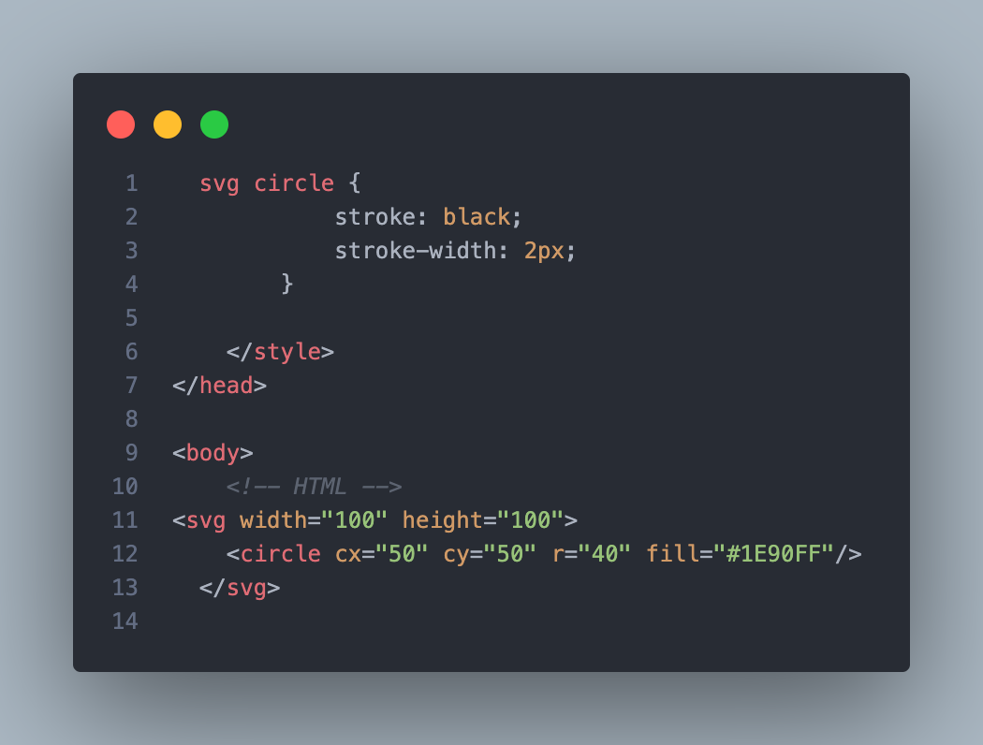
example

