Slide 2
Git- intro
Git is a distributed version control system (VCS) that is widely used for software development. It is used to keep track of changes made to the source code of a project, making it easier for multiple people to collaborate on the same codebase.
Git has a number of features that make it well-suited for software development, including:
Distributed: With Git, each user has a full copy of the entire codebase and its history, so they can work offline and have a backup of the code. This also makes it easier to merge changes from different users.
Branching and merging: Git makes it easy to create and switch between different branches of a codebase, allowing multiple people to work on different parts of the code at the same time. Changes can then be merged back into the main branch when they are ready.
Snapshots: Git stores the entire codebase as a series of snapshots, rather than as a series of changes. This makes it easier to see the state of the code at any point in its history, and to revert to an earlier version if needed.
Staging area: Git has a staging area, where changes can be reviewed and staged before being committed to the codebase. This makes it easier to keep track of what changes have been made, and to only commit the changes that are ready.

Slide 3

How to get started
Create a GitHub account: Go to the GitHub website (https://github.com) and sign up for a free account.
Install Git: Git is the version control system that GitHub is built on. You'll need to install Git on your computer in order to use GitHub. You can download Git from the official website (https://git-scm.com/downloads).
Configure Git: After installing Git, you'll need to configure your name and email address, which will be associated with your Git commits. You can do this by running the following commands in your terminal or command prompt:

Slide 4
What after
Create a repository: A repository is a place to store your code and collaborate with others. To create a new repository on GitHub, click on the "+" icon in the upper-right corner of the GitHub website and select "New repository". Give your repository a name, a description, and select whether it should be public or private.
Clone the repository: After creating a repository, you'll need to clone it to your local machine so you can start making changes. You can clone a repository by clicking the "Clone or download" button on the repository page, copying the repository URL, and running the following command in your terminal or command prompt:

Slide 5
Git commit
In Git, a commit is a saved change to the codebase. Commits are the building blocks of Git, representing a set of changes to the code at a specific point in time.
Each commit has a unique identifier called a hash, which is generated based on the contents of the commit. Commits also have a message that provides a brief description of the changes made in the commit.
When you make changes to the code, you can stage those changes in Git using the git add command. This adds the changes to the Git staging area, where they can be reviewed and committed. To save the changes to the codebase, you use the git commit command, which creates a new commit in the Git history.

Slide 6

Push changes
Push your changes: Finally, you'll need to push your changes back to the remote repository on GitHub. You can do this by running the following command in your terminal or command prompt:

Slide 7
Example

Slide 8
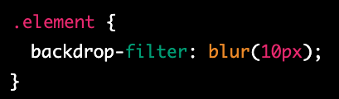
backdrop-filter
backdrop-filter is a CSS property that allows you to apply graphical effects, such as blurring or color shifting, to the area behind an element. It provides a way to create a visual effect that makes the content behind an element more prominent or less obtrusive.

Slide 9
Example

Slide 10
perspective
In CSS, perspective is a property that is used to create a 3D space in which elements can be positioned and transformed. When you apply perspective to an element, it creates a depth and distance effect, making it appear as if the element is closer or farther away from the viewer.
To add perspective to an element, you can use the CSS perspective property. The value of the perspective property is the distance between the viewer and the z=0 plane. The greater the value of the perspective property, the smaller the 3D effect will be. Conversely, the smaller the value of the perspective property, the larger the 3D effect will be.

Slide 11

currentColor
In CSS, currentColor is a keyword that represents the value of the current color being used for a particular property. It is commonly used in conjunction with the color property to make it easier to apply the same color to multiple elements.
For example, let's say you have a link that you want to style with a certain color, but you also want to use the same color for the hover state and for the background color of a container element. Instead of manually setting the color value for each of these properties, you can use the currentColor keyword to automatically apply the current color value to each of them.

Slide 12
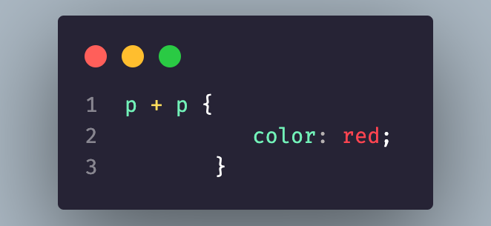
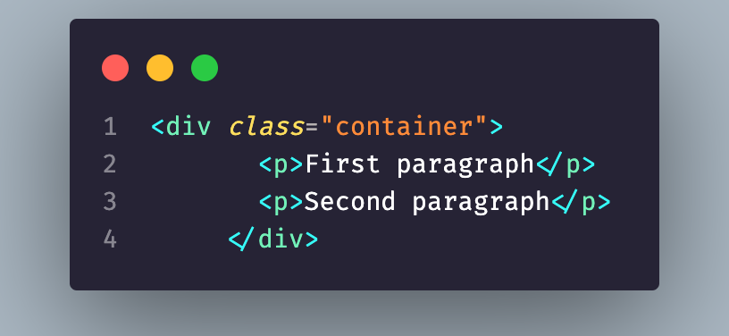
+ -> css
In CSS, the + (plus) selector is called the adjacent sibling combinator, which selects the first element that immediately follows another element, and both share the same parent.
In this example, the p + p selector selects the second p element only when it immediately follows another p element. This means that only the second p element will be styled with the color: red rule.
Note that the + selector only selects the immediately following sibling element. If you want to select all following sibling elements that match the same selector, you should use the ~ (general sibling) selector instead.

Slide 13
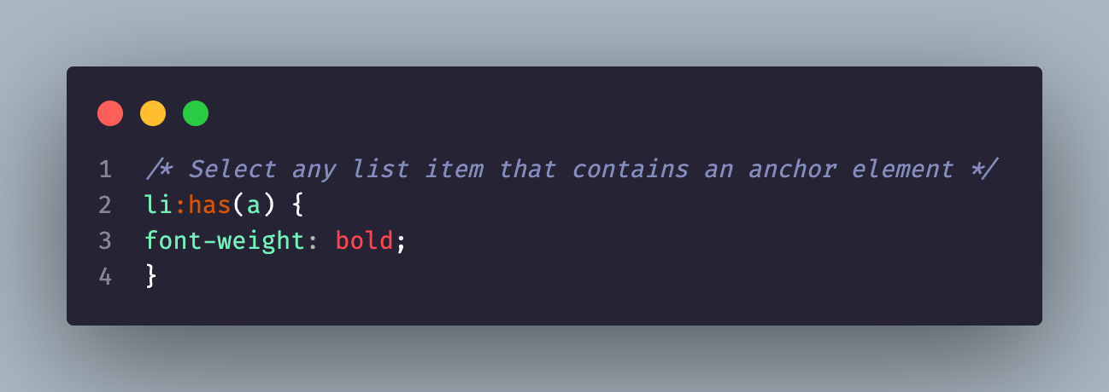
:has
In CSS, the :has() selector is a proposed selector that would allow you to select elements based on their descendants. However, as of February 2023, the :has() selector is not yet supported in any web browser.
The :has() selector is intended to be a powerful and flexible selector that would enable you to select an element based on the presence of a specific descendant, regardless of the descendant's position in the HTML document tree.
In this example, the :has(a) selector would select any li element that contains an a element. This would make it easy to style all list items that contain links, regardless of where they are located in the HTML document tree.

Slide 14
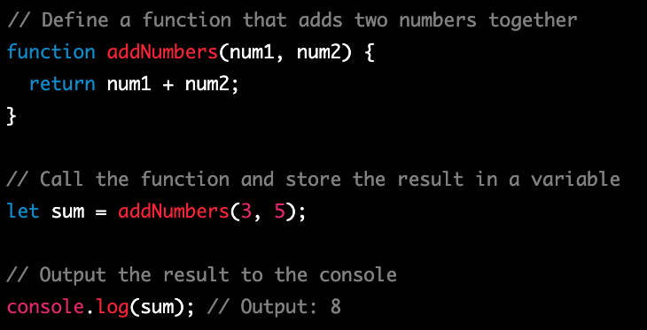
Functions
Functions are an essential concept in JavaScript and are used to group a set of related actions together and to reuse code. Functions are like recipes that you can use to perform a specific task, and can take input (known as parameters) and produce output (known as return values).
In this example, the addNumbers() function takes two parameters (num1 and num2) and returns their sum. The function is called with arguments 3 and 5 and the result is stored in the sum variable. Finally, the result is output to the console using console.log().
Functions are a powerful tool in JavaScript and can be used to make your code more efficient and reusable. They can be used to create libraries of code that can be easily shared and used in multiple projects, and can be used to encapsulate complex logic and make it easier to manage and maintain your code.

Slide 15
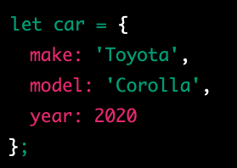
object
In JavaScript, an object is a data type that stores data as key-value pairs. Each key in an object is a string, and each value can be any data type, including other objects. Objects in JavaScript are similar to dictionaries in other programming languages.

Slide 16

How can I access the keys

Slide 17
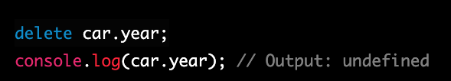
How can I delete from the object
the year property is removed from the car object using the delete operator.

Slide 18
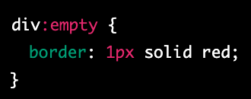
CSS -> :empty
In CSS, the empty selector is a pseudo-class that allows you to select elements that have no children
In this example, the div:empty selector selects all div elements that have no children, and applies a red border to them.
The :empty pseudo-class is useful when you want to style elements that don't have any content, such as placeholders or empty containers. You can use it to create visual cues to indicate to users that certain elements are empty or to highlight empty areas of a layout.
It's important to note that the :empty selector only selects elements that have no children. If an element has whitespace or comments inside it, it will not be considered empty and the :empty selector will not select it. If you want to select elements that have only whitespace or comments inside them, you can use the :blank selector instead.
Overall, the :empty selector is a useful tool in CSS that allows you to target and style elements that have no children.

Slide 19
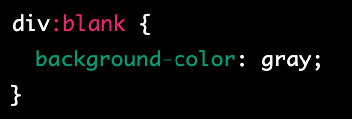
Blank - css
In CSS, the :blank selector is a pseudo-class that allows you to select elements that only contain whitespace characters, such as spaces, tabs, and line breaks. The :blank selector is similar to the :empty selector, but it also matches elements that have only whitespace characters.
In this example, the div:blank selector selects all div elements that only contain whitespace characters, and applies a gray background to them.
The :blank selector is useful when you want to target elements that have no visible content, such as empty form fields or elements that contain only whitespace characters. It can be used to create visual cues to indicate to users that certain elements are empty or to highlight empty areas of a layout.
It's important to note that the :blank selector is not yet widely supported by all browsers, and may not work in older versions of some browsers. Additionally, the :blank selector only works on elements that contain visible text; it does not work on elements that have no text at all.
Overall, the :blank selector is a useful tool in CSS that allows you to target and style elements based on their content.

Slide 20
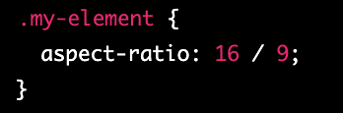
aspect ratio
The aspect-ratio property in CSS is a relatively new addition, introduced in CSS 4, and it allows you to explicitly set the aspect ratio of an element using a single property. It is a shorthand property that combines the width and height properties with a slash ("/") separator to indicate the aspect ratio of the element.
The values for width and height can be any length or percentage value, and the aspect ratio is expressed as a ratio of those values.
For example, to create an element with a 16:9 aspect ratio, you can set the aspect-ratio property to 16 / 9, like this:
This will ensure that the element maintains a proportional relationship between its width and height, even if its dimensions change due to resizing or changes in the viewport.
The aspect-ratio property is particularly useful for responsive design, as it allows you to create elements that maintain their aspect ratio as the viewport or container size changes. It can also be combined with other properties like object-fit to control how the element is displayed within its container.
Note that as of February 2023, the aspect-ratio property is not widely supported in all browsers, so it's a good idea to check for browser compatibility before using it in production.

Slide 24
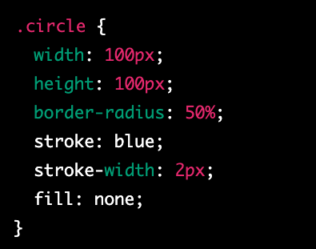
stroke
In CSS, the stroke property is used to control the outline of a shape or path. It is often used in conjunction with the fill property to create complex graphical effects.
The stroke property applies to the outline of the shape or path, while the fill property applies to the interior of the shape or path. Together, these properties allow you to control the appearance of both the outline and the fill of the shape.
The stroke property can be set to a color value, a keyword value, or a URL that points to an image. It can also be set to a combination of these values, using a comma-separated list.

