Slide 1
testing

Slide 2
types of test
Unit Testing: Tests individual components or functions in isolation, focusing on the smallest parts of an application.
Integration Testing: Checks how different parts of the application work together, from integrating small units to entire modules.
Functional Testing: Ensures that the application functions as expected from an end-user perspective.
End-to-End Testing: Simulates real user scenarios from start to finish to ensure the complete flow works as intended.
Performance Testing: Evaluates the system's performance under various conditions, including load, stress, and scalability.

Slide 3
Unit testing
npm install --save-dev jest
npm install --save-dev babel-jest @babel/preset-env @babel/preset-react @testing-library/react
npm install --save-dev @testing-library/jest-dom
npm install --save-dev ts-jest
npm install --save-dev jest @types/jest ts-jest @testing-library/react @testing-library/jest-dom

Slide 4
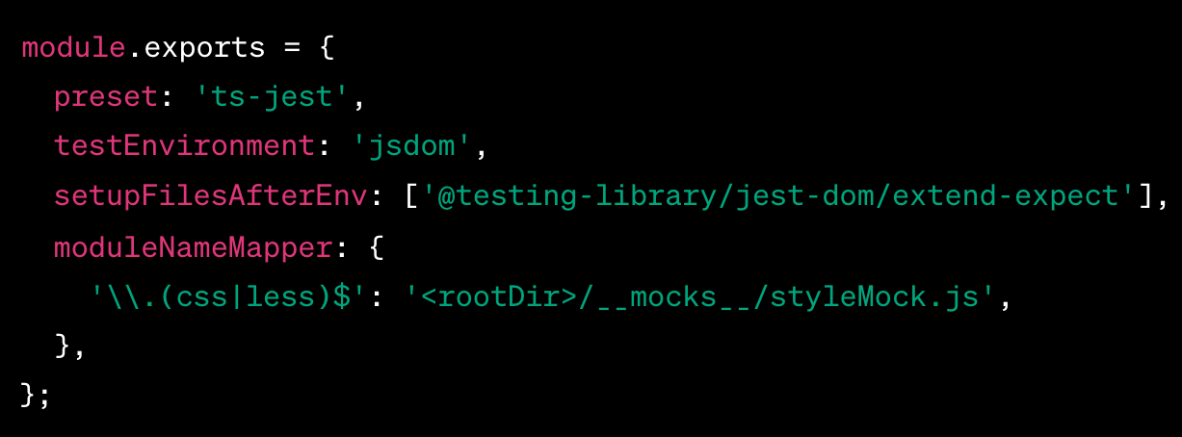
Create a Jest configuration file
(jest.config.js) or add the configuration in your package.json.
jest.config.js

Slide 5
For typescript
'^.+\\.(ts|tsx)$': 'ts-jest'

Slide 6
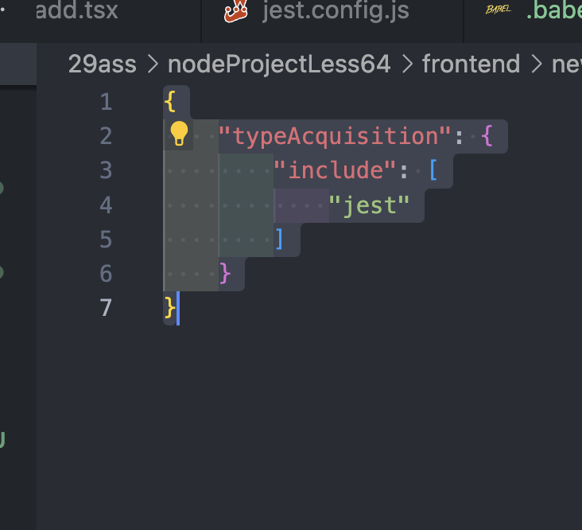
Create jsconfig.json

