Slide 2
Git- intro
Git is a distributed version control system (VCS) that is widely used for software development. It is used to keep track of changes made to the source code of a project, making it easier for multiple people to collaborate on the same codebase.
Git has a number of features that make it well-suited for software development, including:
Distributed: With Git, each user has a full copy of the entire codebase and its history, so they can work offline and have a backup of the code. This also makes it easier to merge changes from different users.
Branching and merging: Git makes it easy to create and switch between different branches of a codebase, allowing multiple people to work on different parts of the code at the same time. Changes can then be merged back into the main branch when they are ready.
Snapshots: Git stores the entire codebase as a series of snapshots, rather than as a series of changes. This makes it easier to see the state of the code at any point in its history, and to revert to an earlier version if needed.
Staging area: Git has a staging area, where changes can be reviewed and staged before being committed to the codebase. This makes it easier to keep track of what changes have been made, and to only commit the changes that are ready.

Slide 3

How to get started
Create a GitHub account: Go to the GitHub website (https://github.com) and sign up for a free account.
Install Git: Git is the version control system that GitHub is built on. You'll need to install Git on your computer in order to use GitHub. You can download Git from the official website (https://git-scm.com/downloads).
Configure Git: After installing Git, you'll need to configure your name and email address, which will be associated with your Git commits. You can do this by running the following commands in your terminal or command prompt:

Slide 4
What after
Create a repository: A repository is a place to store your code and collaborate with others. To create a new repository on GitHub, click on the "+" icon in the upper-right corner of the GitHub website and select "New repository". Give your repository a name, a description, and select whether it should be public or private.
Clone the repository: After creating a repository, you'll need to clone it to your local machine so you can start making changes. You can clone a repository by clicking the "Clone or download" button on the repository page, copying the repository URL, and running the following command in your terminal or command prompt:

Slide 5
Git commit
In Git, a commit is a saved change to the codebase. Commits are the building blocks of Git, representing a set of changes to the code at a specific point in time.
Each commit has a unique identifier called a hash, which is generated based on the contents of the commit. Commits also have a message that provides a brief description of the changes made in the commit.
When you make changes to the code, you can stage those changes in Git using the git add command. This adds the changes to the Git staging area, where they can be reviewed and committed. To save the changes to the codebase, you use the git commit command, which creates a new commit in the Git history.

Slide 6

Push changes
Push your changes: Finally, you'll need to push your changes back to the remote repository on GitHub. You can do this by running the following command in your terminal or command prompt:

Slide 7
Example

Slide 8
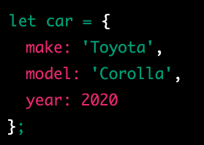
object
In JavaScript, an object is a data type that stores data as key-value pairs. Each key in an object is a string, and each value can be any data type, including other objects. Objects in JavaScript are similar to dictionaries in other programming languages.

Slide 9

writing-mode
The "writing-mode" property in CSS is used to control the direction of text in a block-level container. It determines the orientation of the text, whether it is horizontal or vertical, and in which direction it flows.
The writing-mode property can have the following values:
horizontal-tb: The default value. The text flows from left to right, and from top to bottom.
vertical-lr: The text flows from top to bottom, and from left to right.
vertical-rl: The text flows from top to bottom, and from right to left.

Slide 10
white-space
The "white-space" property in CSS is used to control the handling of white spaces and line breaks in a block of text. It determines how white spaces and line breaks are rendered in a block of text.
The white-space property can have the following values:
normal: The default value. White spaces are collapsed, and text wraps when it reaches the end of a line.
nowrap: White spaces are preserved, and text does not wrap when it reaches the end of a line.
pre: White spaces are preserved, and text wraps only when a line break is encountered.
pre-wrap: White spaces are preserved, and text wraps when it reaches the end of a line or when a line break is encountered.
pre-line: White spaces are collapsed, and text wraps when it reaches the end of a line or when a line break is encountered.

Slide 11
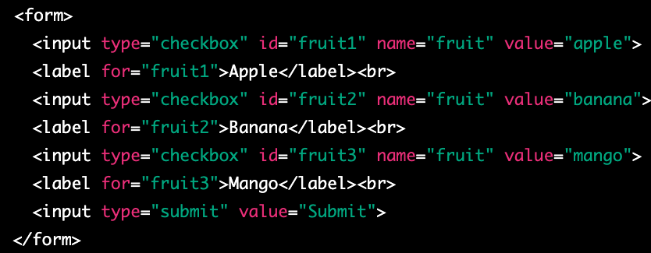
checkbox
A checkbox is a graphical control element used in web forms to allow a user to make multiple selections from a set of options. In HTML, a checkbox is created using the <input type="checkbox"> element.
A checkbox is displayed as a small square box on the web page, which can be either checked or unchecked. When a user clicks on a checkbox, the box is filled with a checkmark and its state changes to checked. If a user clicks on the checkbox again, the checkmark is removed and the state changes back to unchecked.
Checkboxes can be used to collect data in web forms, where a user can select one or more options from a list. The selected options can be submitted to a server-side script for processing.

Slide 12
Wait I want to select only more then one at the time
If you want to allow the user to select multiple checkboxes at the same time, you can give each checkbox a different name attribute. This way, when a user selects one checkbox, it does not affect the state of other checkboxes.

Slide 13
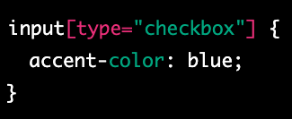
accent-color
The accent-color CSS property sets the accent color of an element. The accent color is used by various user interface controls (such as buttons, checkboxes, and range controls) to make them more visually appealing.
The accent-color property can be set to a specific color value (e.g. red, #ff0000, rgb(255,0,0)) or can be set to inherit the value from the parent element using inherit.

Slide 14
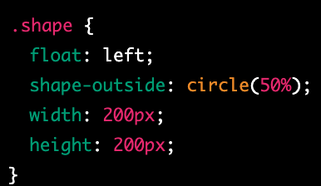
shape-outside
shape-outside is a CSS property that allows you to define a non-rectangular shape that text content will flow around. This can be useful for creating more interesting and visually appealing layouts, especially when combined with other CSS properties such as float and clear.
The shape-outside property is used to specify the shape that text should wrap around. You can define the shape using one of several different values:
none: This is the default value, and means that text will not wrap around any shape.
rectangle: This value allows you to define a rectangular shape using the inset or circle functions, which take four or three values respectively to create a rectangle or circle.
circle(): This function takes one value, which is the radius of the circle, and creates a circle shape.
ellipse(): This function takes two values, which are the horizontal and vertical radii of the ellipse, and creates an elliptical shape.
polygon(): This function allows you to define an arbitrary polygon shape using a series of x,y coordinate pairs.

Slide 15
Remainder- clip path
This property is used to clip the element itself, creating a visible shape for the element. It doesn't affect the flow of the content around it. By using clip-path, you can create visually appealing shapes for your elements, such as images, that are displayed on the webpage.

Slide 16
shape-image-threshold
shape-image-threshold is a CSS property that is used in combination with the shape-outside property to control the transparency threshold of an image used as a shape.
When using an image as a shape with the shape-outside property, the browser determines the shape of the image based on its transparency. The shape-image-threshold property allows you to set a threshold value that determines which parts of the image are considered transparent or opaque.
The shape-image-threshold property takes a single value, which is a percentage between 0% and 100%. This value specifies the transparency threshold for the image. Any pixels in the image that are more transparent than the specified threshold are considered transparent, and any pixels that are less transparent than the threshold are considered opaque.

Slide 17
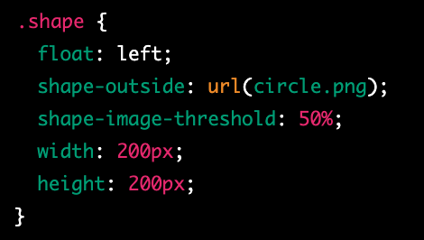
example
In this example, we have defined a class called shape that uses float: left and the shape-outside property to create a circular shape using an image file called circle.png. We have also set the shape-image-threshold property to 50%, which means that any pixels in the image that are more than 50% transparent will be considered transparent.
It's worth noting that the shape-image-threshold property is not widely supported by all browsers, so you may need to use fallback techniques or alternative approaches for older browsers. Additionally, if the image file used for the shape-outside property is not available or cannot be loaded, the shape-image-threshold property will have no effect.

Slide 18
shape-margin
shape-margin is a CSS property that is used in combination with the shape-outside property to add space around the shape that text will flow around.
When using the shape-outside property to create a non-rectangular shape for text to flow around, it can be helpful to add some space between the shape and the text. The shape-margin property allows you to specify the amount of space to add around the shape.
The shape-margin property takes a single value, which can be a length, a percentage, or the auto keyword. A positive value will add space around the shape, while a negative value will remove space. The auto value will cause the browser to automatically calculate the margin based on the size and shape of the element.

Slide 19
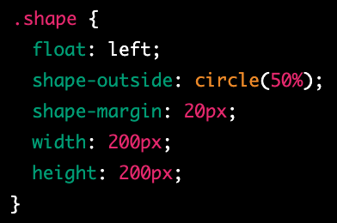
example
In this example, we have defined a class called shape that uses float: left and the shape-outside property to create a circular shape. We have also set the shape-margin property to 20px, which adds 20 pixels of space around the shape. Finally, we have set the width and height of the element to define its size.
It's worth noting that the shape-margin property is not widely supported by all browsers, so you may need to use fallback techniques or alternative approaches for older browsers. Additionally, the exact behavior of the shape-margin property may vary depending on the size and shape of the element being used as the shape, as well as the size and layout of the surrounding text content.

Slide 20
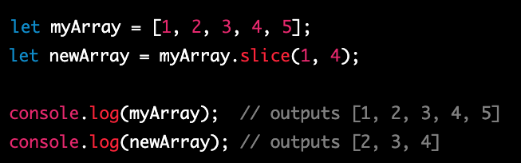
slice
In JavaScript, the slice() function is an array method that returns a shallow copy of a portion of an array into a new array object. The original array is not modified as a result of the function.

Slide 21
concat
In JavaScript, the concat() method is an array method that is used to merge two or more arrays into a new array. The original arrays are not modified, and a new array is returned that contains all the elements of the original arrays in the order in which they were concatenated.
The concat() method can be called on any array and takes one or more arguments, each of which is an array to be concatenated with the original array. The resulting concatenated array is a new array object that is returned by the concat() method.

Slide 22
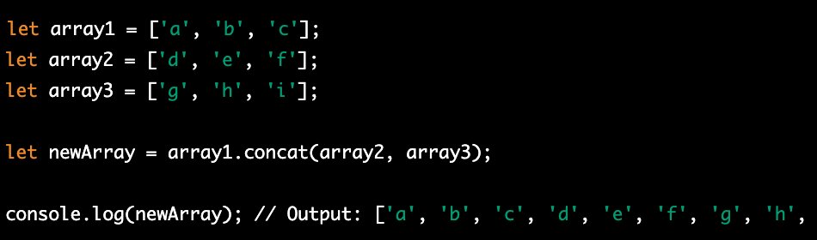
Concat example

Slide 23
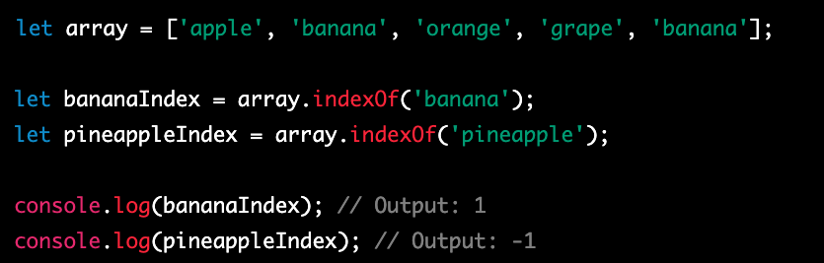
indexOf
In JavaScript, the indexOf() method is an array method that is used to search an array for a specified element and returns the index of the first occurrence of the element. If the element is not found, it returns -1.
The indexOf() method can be called on any array and takes one or two arguments. The first argument is the element to search for, and the second argument (optional) is the starting index of the search.

Slide 25
shallow copy and a deep copy
In JavaScript, a shallow copy and a deep copy are two different ways of creating a new object or array that is a copy of an existing object or array. The difference between the two lies in how nested objects and arrays are handled.
A shallow copy of an object or array creates a new object or array with the same top-level properties or elements as the original, but any nested objects or arrays are still referenced by the new object or array. This means that if you modify a nested object or array in the new copy, the corresponding object or array in the original will also be modified. Shallow copies can be created using methods such as the slice() or concat() array methods or the Object.assign() method.

Slide 26
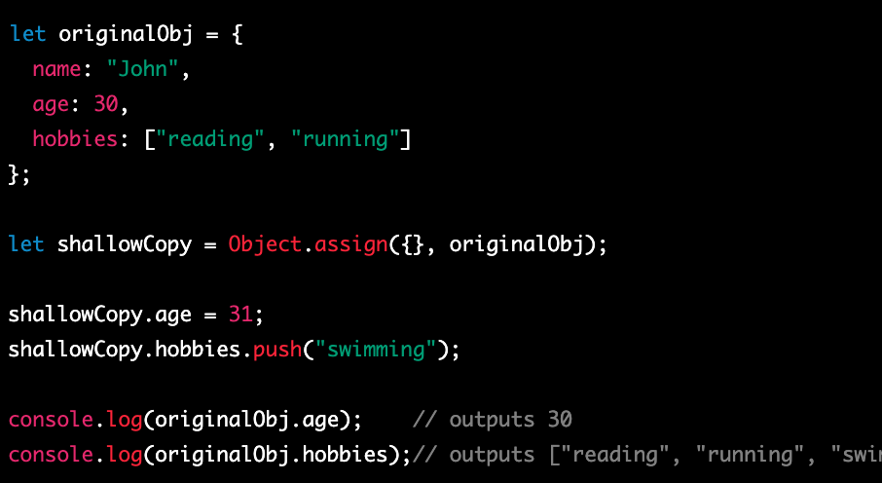
example

Slide 27
Document Object Model
The Document Object Model (DOM) is a programming interface for HTML and XML documents. It represents the structure of a document as a tree-like object model, with each element of the document represented as a node in the tree. The DOM provides a way for JavaScript to interact with the contents of an HTML or XML document, and manipulate it in various ways.
To interact with the DOM in JavaScript, you can use a variety of built-in methods and properties that are part of the global document object. The document object provides access to the root element of the HTML or XML document, as well as methods for querying and manipulating the document tree.

Slide 28
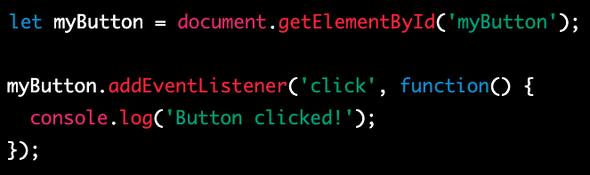
addEventListener
In JavaScript, you can use the addEventListener() method to add an event listener to an object, such as an HTML element or the window object. An event listener is a function that is executed when a specific event occurs, such as a user clicking a button or scrolling the window.

Slide 29
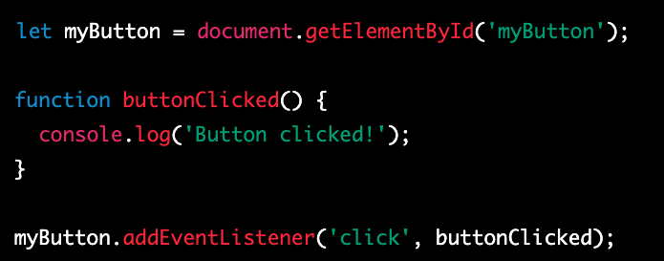
Another example

Slide 30

document
In JavaScript, the document object represents the HTML or XML document loaded in the current window or frame. It provides a way to access and manipulate the contents of the document, including the HTML elements, their properties, and the content displayed in the browser.
The document object is part of the global window object, and can be accessed from anywhere in your JavaScript code using the window.document or simply document syntax.

Slide 31
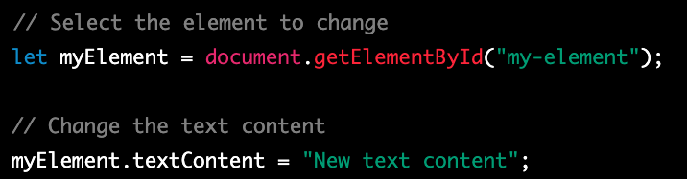
Change the Text of select element
In JavaScript, you can use the textContent property to change the text content of an HTML element that has been selected using one of the many methods available in the document object.

Slide 32
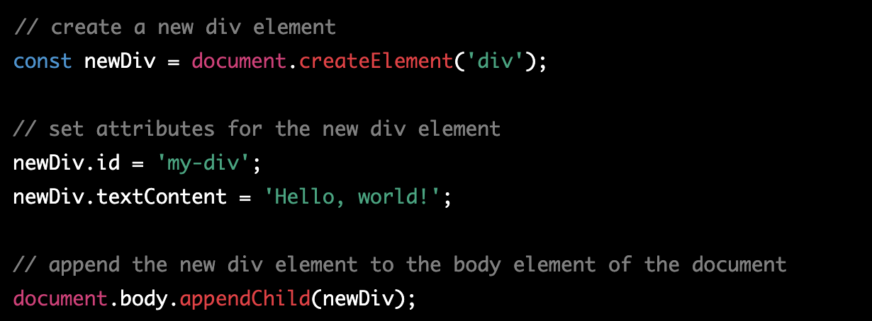
createElement
create an element and add it to the DOM (Document Object Model) using the document.createElement() and parentNode.appendChild() methods.

Slide 33
appendChild
The appendChild() method is a JavaScript method that is used to add a new child node to an existing parent node in the DOM (Document Object Model). The new child node can be an element, a text node, or any other type of node.

Slide 34
querySelector
querySelector() is a JavaScript method that allows you to select and retrieve the first element that matches a specific CSS selector. It is commonly used in web development to access and manipulate elements in the Document Object Model (DOM).

Slide 35
querySelectorAll
querySelectorAll() is a JavaScript method that allows you to select and retrieve a list of all elements that match a specific CSS selector. It is commonly used in web development to access and manipulate elements in the Document Object Model (DOM).

Slide 36
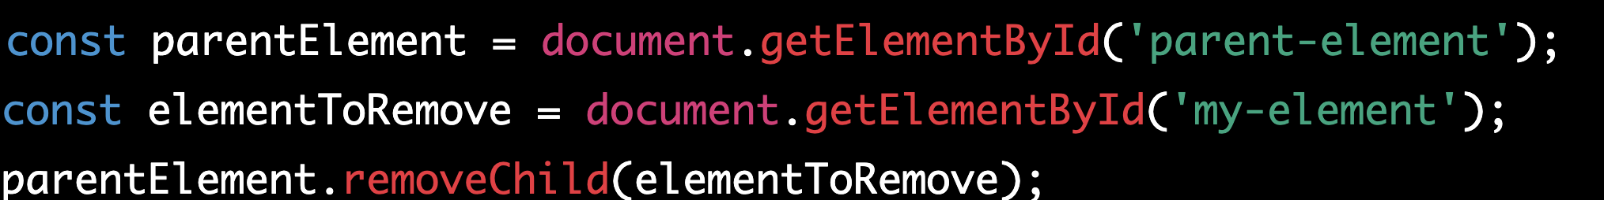
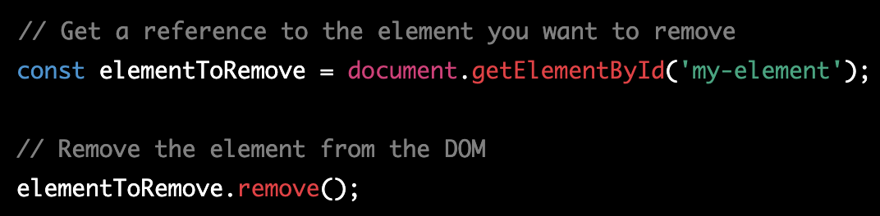
remove
In JavaScript, there are several ways to remove an element from the DOM (Document Object Model). The most common methods are the remove() method and the parentNode.removeChild() method.

Slide 37
Remove vs removeChild
The remove() method is a newer method that is supported in most modern browsers. It is called directly on the element that needs to be removed, and it removes the element from the DOM along with all its child nodes and event listeners.

Slide 38
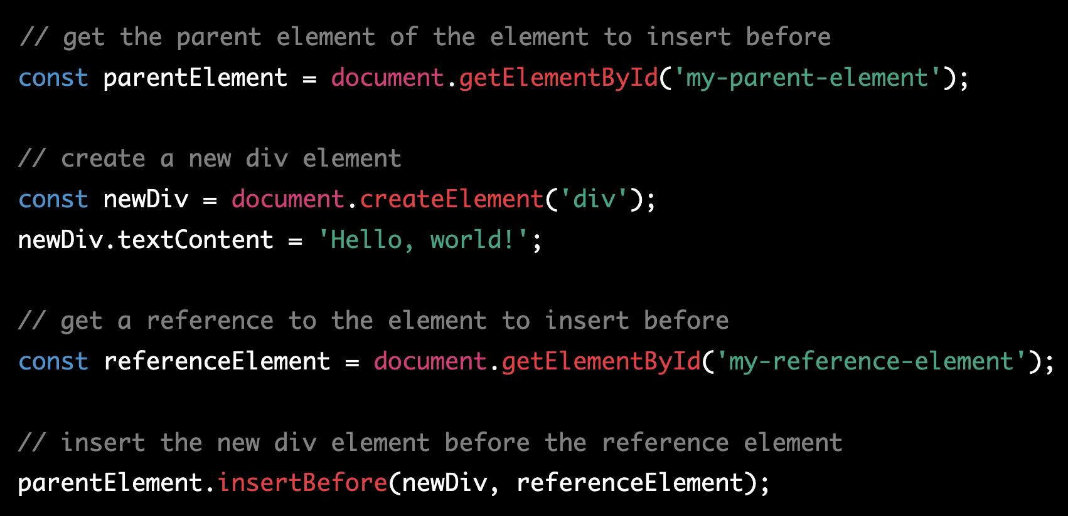
insertBefore
insertBefore() is a JavaScript method that allows you to insert a new node before an existing node in the DOM (Document Object Model). It is commonly used in web development to dynamically add, remove, or move elements in the DOM.

Slide 39
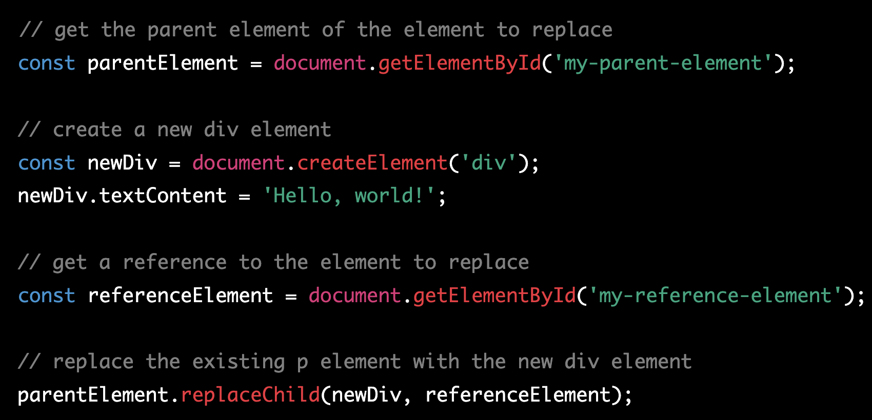
replaceChild
replaceChild() is a JavaScript method that allows you to replace an existing node with a new node in the DOM (Document Object Model). It is commonly used in web development to dynamically add, remove, or move elements in the DOM.

Slide 40
explian
In this example, we first use document.getElementById() to get a reference to the parent element of the element we want to replace in the DOM. We then create a new div element using document.createElement() and set its content using textContent.
We then use document.getElementById() again to get a reference to the element we want to replace. Finally, we use the replaceChild() method to replace the existing p element with the new div element in the DOM.
The replaceChild() method takes two arguments: the new node to replace the existing node with, and the existing node to replace. If you want to remove an existing node without replacing it with a new node, you can use the removeChild() method instead.

Slide 41
const
In JavaScript, the const keyword is used to declare a variable that cannot be reassigned once it has been initialized.
In JavaScript, const keyword is used to declare a variable that cannot be reassigned to a new value. However, it is important to note that const does not make the variable immutable or unchangeable, particularly when it is used with complex data types such as objects or arrays.
When a const variable is assigned an object, the variable itself cannot be reassigned to a new object, but the properties of the object can be modified. This is because the const keyword applies only to the variable's reference to the object in memory, not the contents of the object itself.

Slide 42
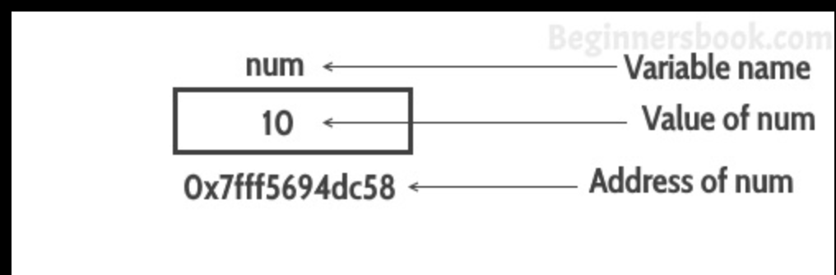
How does the memory works

Slide 43
For loop
In JavaScript, a for loop is a control flow statement that allows you to repeat a block of code a certain number of times.
initialization: This is where you initialize a counter variable or set up any initial conditions that are necessary for the loop to run. This part of the loop is only executed once, before the loop begins.
condition: This is where you specify the condition that must be true in order for the loop to continue. If the condition is false, the loop will terminate.
iteration: This is where you specify how the counter variable or any other variables used in the loop should be updated after each iteration of the loop. This part of the loop is executed at the end of each iteration, just before the condition is checked again.

Slide 44
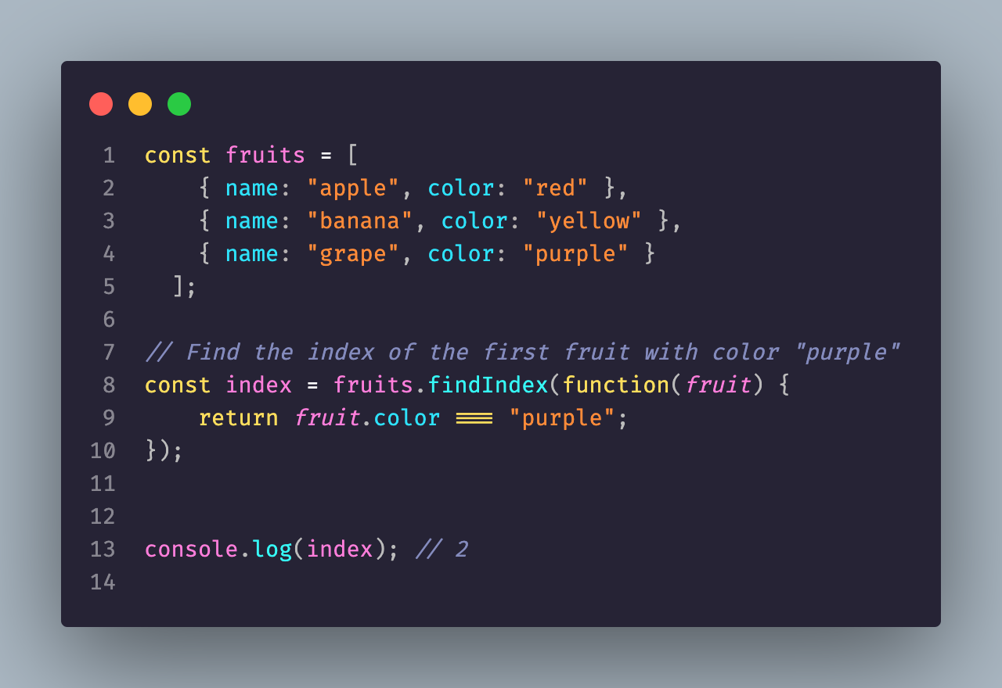
Anonymous Functions
In JavaScript, a function is a block of code that performs a specific task. Anonymous functions are functions that are defined without a name and are often used as arguments to other functions or as return values of other functions. Unlike named functions, anonymous functions are not bound to a particular identifier, making them more flexible and versatile.

Slide 45
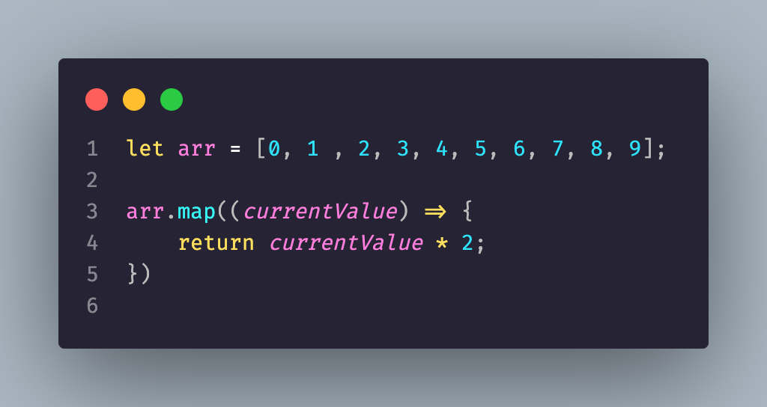
Arrow functions
Arrow functions are a relatively new feature in JavaScript that were introduced in ES6 (ECMAScript 2015). They are a shorthand way to write functions, making them easier to read and write. Arrow functions have a few key differences from traditional JavaScript functions:

Slide 46
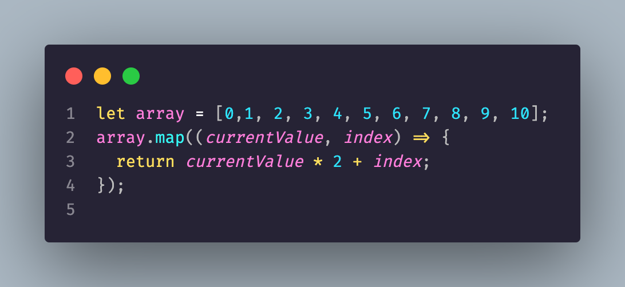
Array.map
Array.map() is a popular method in JavaScript that allows developers to iterate over an array and transform each element in the array based on a callback function. In this presentation, we will explore what Array.map() is, how it works, and why it is useful in JavaScript.

Slide 47
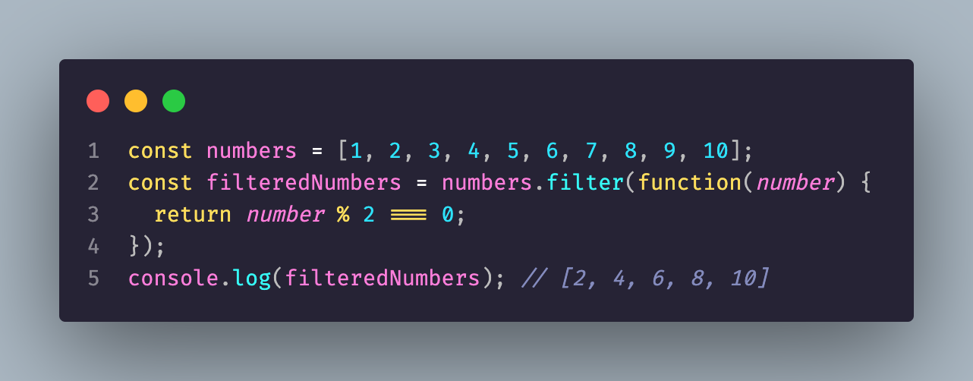
Js filter
filter() is a built-in method in JavaScript that allows developers to filter elements from an array based on a specific condition. The method creates a new array with all the elements that pass the condition specified by a callback function.

Slide 48
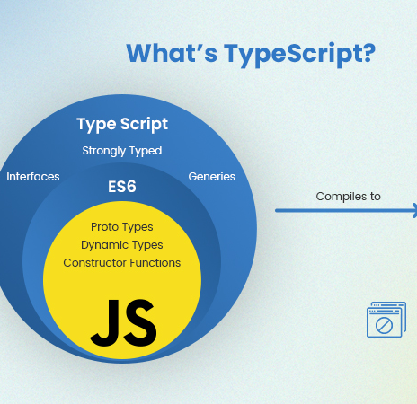
typescript
TypeScript is an open-source programming language that is a strict syntactical superset of JavaScript. TypeScript is designed to make it easier to build large-scale web applications by providing optional static type-checking, object-oriented features, and other advanced language features that are not available in plain JavaScript.

Slide 49
key features of TypeScript
Static Typing: One of the main features of TypeScript is static typing, which allows developers to define the types of variables, functions, and other elements in their code. This makes it easier to catch errors and bugs early in the development process and to build more robust and scalable applications.
Object-Oriented Features: TypeScript also supports object-oriented programming features such as classes, interfaces, and inheritance. This makes it easier to write object-oriented code in a familiar syntax that is similar to other object-oriented programming languages such as Java or C#.
Advanced Language Features: TypeScript also includes other advanced language features such as enums, generics, and union types that are not available in plain JavaScript. These features make it easier to write more expressive and maintainable code.
Compatibility with JavaScript: TypeScript is designed to be compatible with existing JavaScript code and libraries, which means that developers can gradually introduce TypeScript into their projects without having to rewrite their entire codebase.
Tooling: TypeScript comes with a set of tools that make it easier to develop, debug, and maintain TypeScript code. These tools include a TypeScript compiler, a language service that provides code completion and other features in code editors, and other development tools.

Slide 50
Node install
Go to the Node.js website: Visit the Node.js website at https://nodejs.org. This is the official website for Node.js and contains the latest version of Node.js available for download.
Download the Node.js installer: On the Node.js website, you will see two options for downloading Node.js: "Recommended for most users" and "Other downloads". If you are new to Node.js, we recommend selecting the "Recommended for most users" option. Click on the "Download" button to download the installer for your operating system (Windows, macOS, or Linux).
Run the installer: Once the installer has finished downloading, run it on your machine to begin the installation process. Follow the prompts to complete the installation. You may need to agree to the terms of service and select an installation location.
Verify the installation: After the installation is complete, you can verify that Node.js has been installed correctly by opening a terminal or command prompt and typing the following command:

Slide 51
First thing
npm install -g typescript
tsc --init
tsc filename.ts

Slide 52
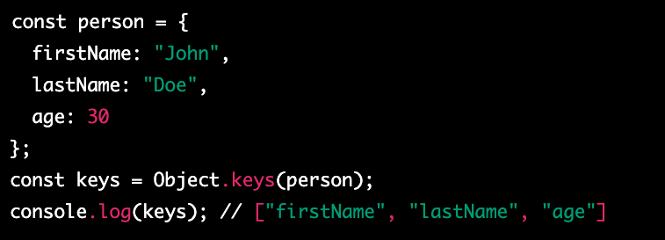
Object.keys
Object.keys() is a built-in method in JavaScript that is used to extract the keys of an object and return them in an array. The method takes an object as an argument and returns an array of strings, which represent the keys of the object.

Slide 53
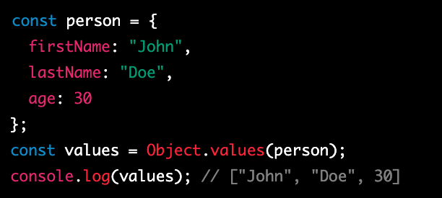
Object.values()
Object.values() is a built-in method in JavaScript that is used to extract the values of an object and return them in an array. The method takes an object as an argument and returns an array of values, which represent the values of the object.

Slide 54
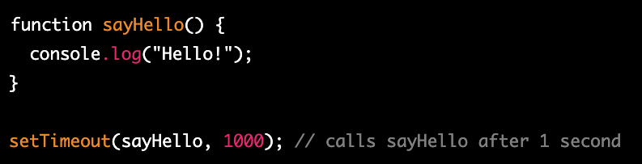
setTimeout
setTimeout is a built-in function in JavaScript that allows you to schedule a function to be executed after a specified amount of time has elapsed. This is useful in situations where you want to delay the execution of a function, or when you want to run a function repeatedly at a fixed interval.

Slide 55
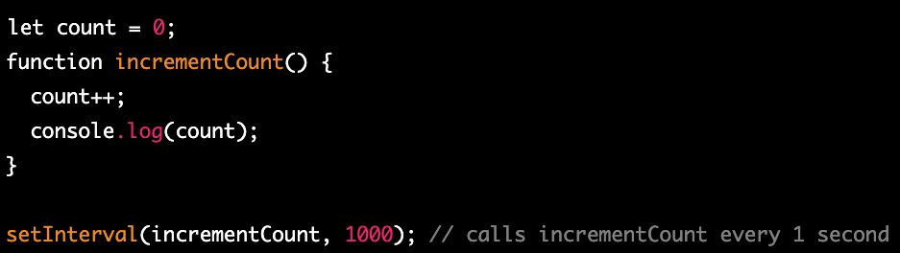
setInterval
setInterval is a built-in function in JavaScript that allows you to schedule a function to be executed repeatedly at a fixed interval. This is useful in situations where you want to run a function on a regular basis, such as updating the time or animation frames.

