Slide 2
Vite new project files and folder
node_modules/: This folder contains all the third-party dependencies that your project requires.
public/: This folder contains any static assets (such as images or fonts) and the HTML file that Vite uses as the entry point for your application.
favicon.ico: This is the favicon for your application.
index.html: This is the HTML file that serves as the entry point for your application. You can modify this file to add any additional scripts, stylesheets, or content that your application requires.
src/: This folder contains all of your source code.
main.ts: This is the main entry point for your application. This file is responsible for rendering your root component and mounting it to the DOM.
App.ts: This is the root component of your application. You can modify this file to define the structure and behavior of your application.
components/: This folder contains any additional components that your application requires.
MyComponent.ts: This is an example component that you can modify or delete. You can create additional components by adding new TypeScript files to this folder.
package.json: This file contains information about your project, including its dependencies, scripts, and other metadata.
tsconfig.json: This file contains TypeScript-specific configuration options for your project.
vite.config.ts: This file contains Vite-specific configuration options for your project.
By default, Vite is configured to use TypeScript as the primary language for your project. This means that you can write your code in TypeScript and Vite will automatically compile it to JavaScript when you run the development server or build your project for production.

Slide 3
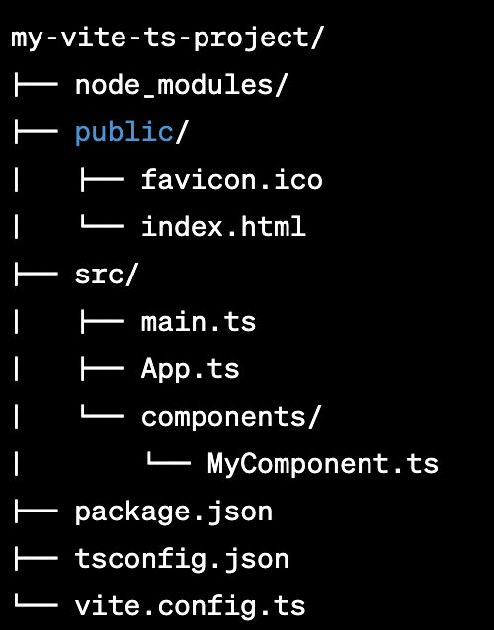
Vite folder and files

Slide 4
create multiple pages
To create multiple pages in a Vite vanilla TypeScript project, you can follow these steps:
Create a new directory inside the src folder for each page you want to create. For example, you might create a directory called home for your homepage, and a directory called about for your about page.
Inside each directory, create an index.html file that represents the HTML content of that page.
If you want to add any custom JavaScript for a particular page, create a new .ts file in the corresponding directory, such as home.ts or about.ts.
Add any necessary CSS files or other assets to the page directory.

Slide 5
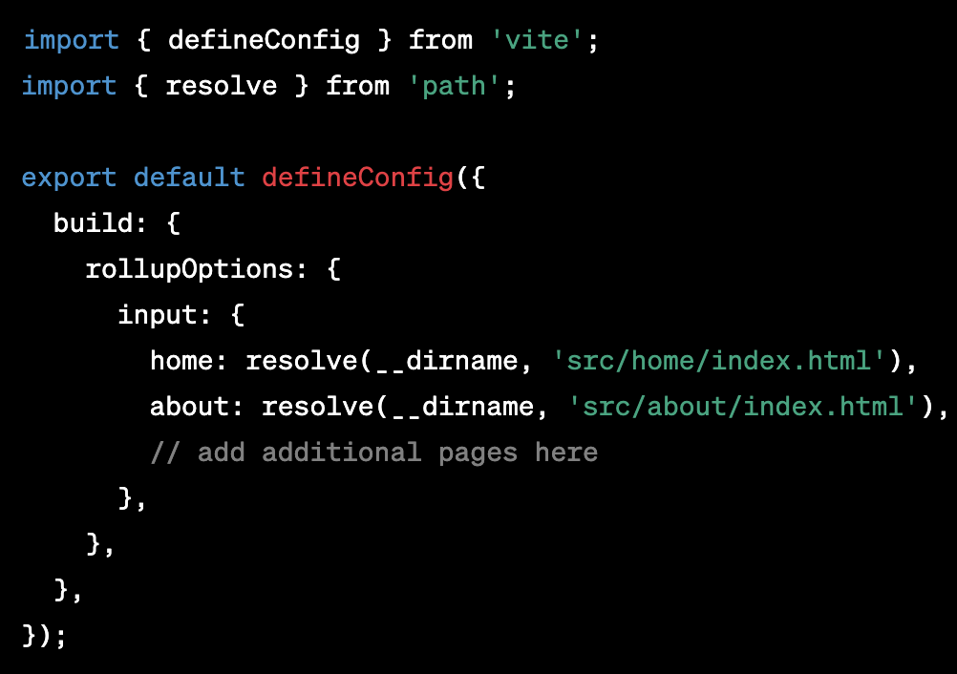
more
To configure Vite to build each page as a separate HTML file, you can add the following code to your vite.config.ts file:

Slide 6
more
This code tells Vite to use each index.html file as the entry point for a separate page.
In each HTML file, add the necessary links to your stylesheets and JavaScript files, as well as any other HTML content for that page.
To navigate between pages, you can add links or buttons to your HTML files that point to the appropriate pages. For example, to link to your about page, you can add the following to your index.html file:
<a href="/about/">About Us</a>

Slide 8
Narrowing
In TypeScript, narrowing is the process of refining the type of a variable or expression based on additional information that is available to the compiler at a certain point in the program. This can be done using various constructs such as type guards, type assertions, and control flow analysis.
Type guards are functions or expressions that return a boolean value, which is used by the TypeScript compiler to narrow the type of a variable. For example, the typeof operator can be used as a type guard to narrow the type of a variable based on its type at runtime

Slide 9
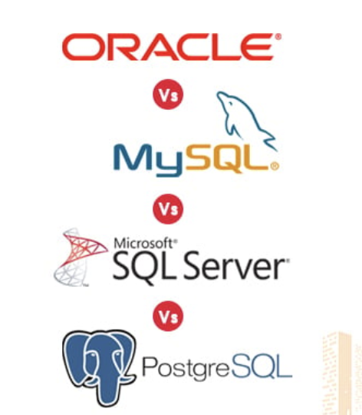
Narrowing types options

Slide 10
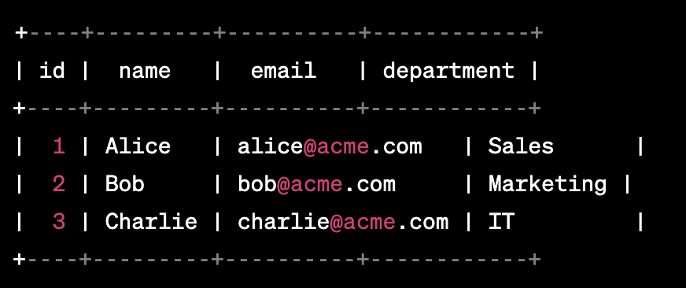
Wait what with null and undefiend

Slide 11
SQL
SQL (Structured Query Language) is a programming language designed for managing and manipulating relational databases. It is widely used in modern data-driven applications to interact with and retrieve data from databases. SQL is a declarative language, meaning that you specify what you want to retrieve or manipulate from the database, and the database management system (DBMS) figures out how to execute your request.

Slide 12
SQL - 2
Some common tasks that can be accomplished using SQL include:
Creating and modifying tables: You can use SQL to create new tables in a database, modify existing tables, or delete tables altogether.
Inserting and updating data: You can use SQL to add new rows to a table, modify existing rows, or delete rows from a table.
Querying data: You can use SQL to retrieve data from one or more tables in a database, and filter, group, or sort the results in a variety of ways.
Joining tables: You can use SQL to combine data from two or more tables in a database, based on a common field or set of fields.

Slide 13
SQL - 3
SQL is a standard language, meaning that it is recognized and implemented by most relational database management systems, including MySQL, Oracle, Microsoft SQL Server, and PostgreSQL, among others. This makes it a very powerful tool for working with data in a variety of contexts.
To use SQL, you typically interact with a database management system using a client application or a command-line interface. You write SQL statements to perform various operations on the database, and the DBMS responds with the requested data or executes the requested operation. SQL can be used for both simple queries and complex data analysis tasks, making it a versatile tool for working with data in a wide range of applications.

Slide 14
SQL versions

Slide 15
Which one is the best
There are several different types of SQL database management systems (DBMS) available, each with its own strengths and weaknesses. Here are some of the most popular SQL database systems:
MySQL: MySQL is an open-source DBMS that is widely used for web applications. It's known for its scalability, performance, and ease of use. MySQL is often used in conjunction with other open-source technologies, such as PHP and Apache, to build web applications.
PostgreSQL: PostgreSQL is an open-source DBMS that is known for its robustness, extensibility, and support for advanced SQL features. It's often used for enterprise applications and is considered to be one of the most powerful and capable SQL databases available.
Microsoft SQL Server: Microsoft SQL Server is a proprietary DBMS that is widely used in enterprise environments, particularly in Windows-based environments. It's known for its scalability, reliability, and support for advanced features such as high availability and data warehousing.
Oracle: Oracle is a proprietary DBMS that is widely used in enterprise environments for mission-critical applications. It's known for its scalability, performance, and support for advanced features such as data warehousing and business intelligence.
SQLite: SQLite is a lightweight, open-source DBMS that is often used in mobile applications and embedded systems. It's known for its simplicity, speed, and small size.
MariaDB: MariaDB is a community-developed fork of MySQL that aims to be a drop-in replacement for MySQL. It's known for its performance, scalability, and open-source nature.

Slide 16
install PostgreSQL
Download and install PostgreSQL:
For Windows: Download the installer from the PostgreSQL website and run it to install PostgreSQL.
For macOS: You can use Homebrew to install PostgreSQL. Open a terminal and run the command brew install postgresql.
For Linux: You can install PostgreSQL using your distribution's package manager. For example, on Ubuntu, you can run the command sudo apt-get install postgresql.
Once PostgreSQL is installed, you can start the PostgreSQL server. On Windows, you can start the PostgreSQL service from the Services app. On macOS and Linux, you can start the PostgreSQL server from the terminal using the command sudo service postgresql start.
By default, PostgreSQL creates a user account called postgres. You can switch to this user by running the command su - postgres on the terminal.
Once you're logged in as the postgres user, you can access the PostgreSQL command-line interface by running the command psql. This will open the PostgreSQL shell, where you can run SQL commands to interact with the database.
To create a new database, run the command createdb <database-name> in the PostgreSQL shell. Replace <database-name> with the name you want to give to your database.
You can connect to the database using the command psql <database-name>. This will open the PostgreSQL shell for the specified database, where you can run SQL commands to create tables, insert data, and perform other database operations.

Slide 17
Sample db
https://www.postgresqltutorial.com/postgresql-getting-started/postgresql-sample-database/

Slide 18
SQL OTO
In a relational database, a one-to-one (1:1) relationship refers to a situation where one record in a table is associated with exactly one record in another table, and vice versa. This type of relationship is often used to break down a large table into smaller, more manageable tables that are easier to work with and maintain.
For example, consider a database that stores information about employees and their workstations. Each employee can have only one workstation assigned to them, and each workstation can be assigned to only one employee. In this case, we could create two tables: one for employees and one for workstations, and establish a one-to-one relationship between them.

Slide 19
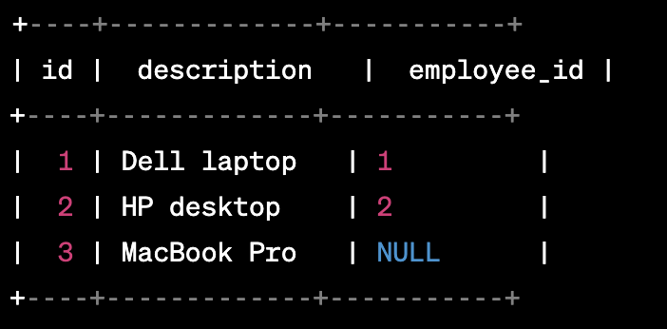
One to one example

Slide 20
One to many
In a relational database, a one-to-many (1:N) relationship refers to a situation where one record in a table is associated with one or more records in another table, but each record in the second table is associated with only one record in the first table. This type of relationship is one of the most common types of relationships in a database, and is used to break down large tables into smaller, more manageable tables.
For example, consider a database that stores information about customers and their orders. Each customer can have multiple orders, but each order is associated with only one customer. In this case, we could create two tables: one for customers and one for orders, and establish a one-to-many relationship between them.

Slide 21
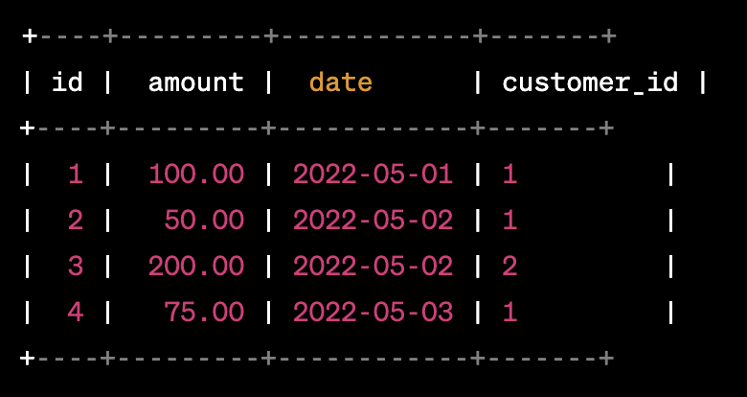
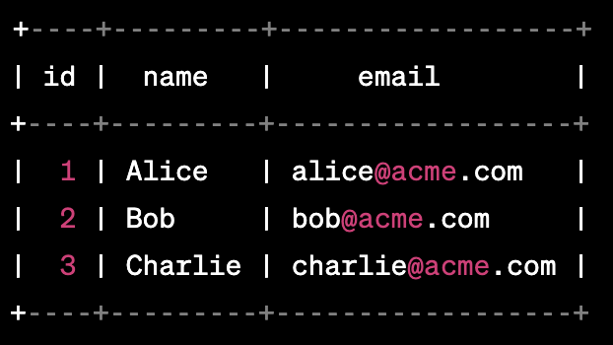
Many to many relation

Slide 22

More info
In this example, the customer_id column in the orders table establishes the one-to-many relationship between the two tables. Each record in the orders table is associated with one record in the customers table, but each record in the customers table can be associated with multiple records in the orders table.
Note that in this type of relationship, the primary key of the table on the "one" side (in this case, the id column in the customers table) becomes a foreign key in the table on the "many" side (in this case, the customer_id column in the orders table). This foreign key is used to establish the relationship between the two tables.

Slide 23
SELECT
selecting data from a database table is one of the most fundamental operations in SQL. The SELECT statement is used to retrieve data from one or more tables in a database. Here's a guide to using the SELECT statement in SQL:

Slide 24

Select all

Slide 25

Filtering data
You can use the WHERE clause to filter data based on a specified condition. For example, to retrieve all rows from a table where the value in the "age" column is greater than or equal to 18, you can use the following statement:

Slide 26

Sorting data
Sorting data: You can use the ORDER BY clause to sort the results of a SELECT statement based on one or more columns. For example, to retrieve all rows from a table and sort them in descending order based on the "name" column, you can use the following statement:

Slide 27

Limiting results
Limiting results: You can use the LIMIT clause to limit the number of rows returned by a SELECT statement. For example, to retrieve the top 10 rows from a table, you can use the following statement:

Slide 28
Joining tables
Joining tables: You can use the JOIN clause to combine data from two or more tables. There are several types of JOINs, including INNER JOIN, LEFT JOIN, RIGHT JOIN, and FULL OUTER JOIN. For example, to retrieve data from two tables that are joined on a common column, you can use the following statement:
SELECT * FROM table1 JOIN table2 ON table1.common_column = table2.common_column;

Slide 29
update
UPDATE table_name SET column1 = value1, column2 = value2, ... WHERE condition;
The UPDATE statement starts with the UPDATE keyword, followed by the name of the table to be updated. The SET keyword is used to specify the columns to be updated and their new values. The WHERE clause is used to specify which rows to update.

Slide 30
Update all
Updating all rows: To update all rows in a table, you can omit the WHERE clause. For example, to set the value of the "status" column to "inactive" for all rows in a table, you can use the following statement:

Slide 31
Update condition
Updating specific rows: To update specific rows in a table, you can use the WHERE clause to specify a condition that must be met. For example, to set the value of the "status" column to "inactive" for all rows in a table where the "age" column is less than 18, you can use the following statement:

Slide 32
Updating multiple columns
Updating multiple columns: You can update multiple columns in a single UPDATE statement by specifying each column and its new value separated by a comma. For example, to set the value of the "status" column to "inactive" and the value of the "last_updated" column to the current date and time for all rows in a table where the "age" column is less than 18, you can use the following statement:
UPDATE table_name SET status = 'inactive', last_updated = NOW() WHERE age < 18;

Slide 33
View
In SQL, a view is a virtual table that is based on the result of a SELECT statement. Views allow you to store a pre-defined SELECT statement as an object in the database, which can be used like a table in subsequent queries.

Slide 34
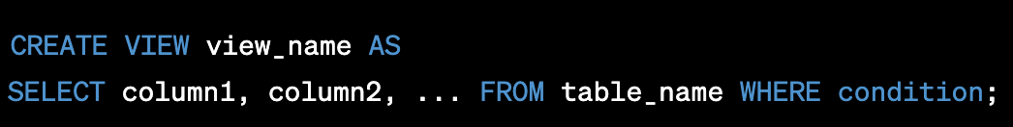
Create view
Creating a view: To create a view, you use the CREATE VIEW statement followed by a SELECT statement that defines the columns and rows to be included in the view. For example:
The view_name is the name of the view you are creating, and the SELECT statement defines the columns and rows to be included in the view.

Slide 35

Using view
Using a view: Once a view is created, you can use it like a table in subsequent SELECT statements. For example:
In this example, the view_name is used like a table in the SELECT statement, and the WHERE clause specifies a condition to filter the results.

Slide 36
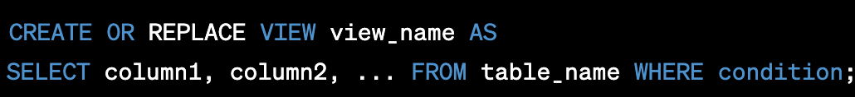
update
Updating a view: You can update the definition of a view by using the CREATE OR REPLACE VIEW statement. For example:
This statement replaces the existing view definition with the new SELECT statement.

Slide 37
Delete it
Dropping a view: To remove a view from the database, you can use the DROP VIEW statement. For example:
DROP VIEW view_name;
Views can be useful in a variety of situations, such as when you want to simplify complex queries or limit the amount of data returned in a query. They are also commonly used for security purposes, as you can grant permissions to a view without granting access to the underlying table.

Slide 38
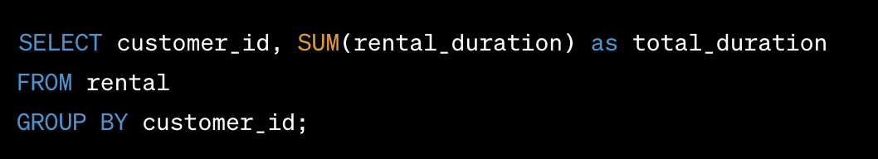
Group BY
The GROUP BY clause in SQL is used to group rows from a table based on one or more columns. It is typically used in conjunction with aggregate functions to perform calculations on groups of rows rather than individual rows. The GROUP BY clause allows you to generate summary information and perform data analysis on subsets of data.

Slide 39
Having
The HAVING keyword is used in SQL to filter the results of a query based on conditions that involve aggregate functions. It is typically used in conjunction with the GROUP BY clause to specify conditions on groups of rows rather than individual rows.
The HAVING clause comes after the GROUP BY clause in a query and is used to filter the grouped data based on aggregate function results. It allows you to specify conditions that involve aggregate functions such as COUNT, SUM, AVG, MIN, or MAX.

Slide 40
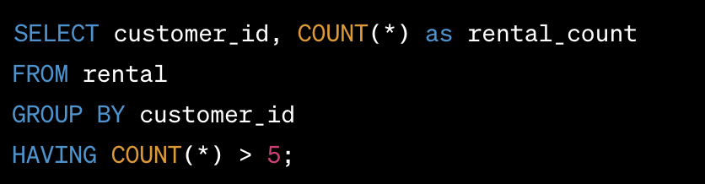
Example having

Slide 41
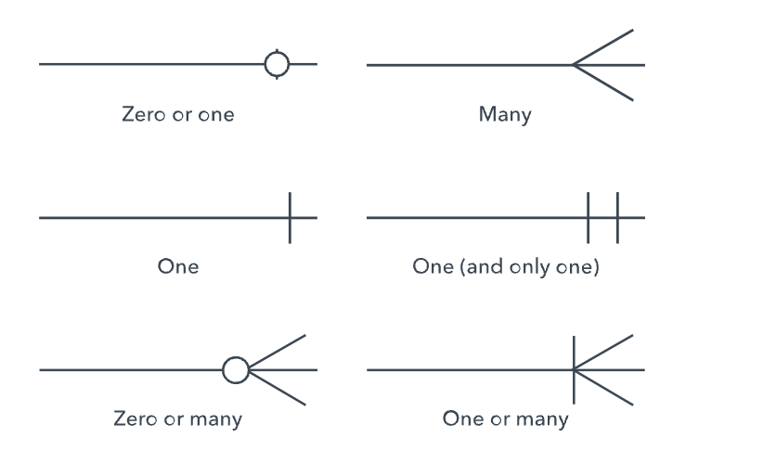
erd

Slide 42
Sql nested query
A nested query, also known as a subquery, is a query within another query. It allows you to use the results of one query as a condition or data source for another query. In SQL, a nested query can be used in various scenarios, such as filtering data, performing calculations, or retrieving specific information based on certain conditions.
To illustrate a nested query, let's use the example of the Sakila database. This database is commonly used for demonstration purposes and represents a DVD rental store. We'll focus on two tables: customer and rental. The customer table contains information about the customers, while the rental table stores details about the DVD rentals.
Suppose we want to retrieve the names of customers who have rented movies more than once. We can achieve this using a nested query. Here's an example in PostgreSQL:

Slide 43
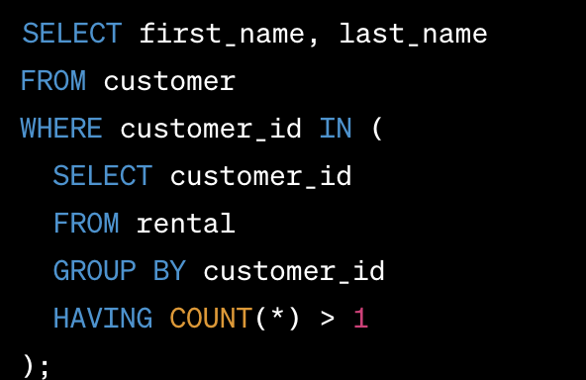
example

Slide 44
indexes
Indexes in SQL are database objects used to improve the performance of queries by providing a quick lookup mechanism for retrieving data based on specific columns. They are data structures that store a sorted copy of the values in one or more columns of a table, along with a pointer to the corresponding row.
Indexes work similarly to an index in a book: they allow you to quickly locate specific data without having to scan the entire table. By creating indexes on commonly queried columns, you can significantly reduce the amount of disk I/O required to retrieve the desired data, resulting in faster query execution.

Slide 45
Key aspects
Creating Indexes: Indexes can be created on one or multiple columns of a table using the CREATE INDEX statement. When creating an index, you can choose between different types of indexes, such as B-tree, hash, or bitmap indexes, depending on the database system you are using.
Types of Indexes: The most common type of index is a B-tree index, which provides balanced tree-based searching for efficient data retrieval. Other types of indexes include hash indexes, which are suitable for exact match lookups, and bitmap indexes, which are useful for columns with a small number of distinct values.
Index Cardinality: Index cardinality refers to the number of distinct values in an indexed column. Higher cardinality generally leads to more effective index usage, as it allows the database to quickly narrow down the search space.
Index Selectivity: Index selectivity measures how selective an index is in terms of filtering rows. A highly selective index means that it filters out a large portion of the rows, resulting in more efficient queries.
Index Maintenance: Indexes need to be maintained to stay up-to-date with changes in the underlying data. Insertions, updates, and deletions on indexed columns require corresponding modifications to the index, which can impact performance. It's essential to strike a balance between the benefits of indexing and the overhead of maintaining indexes.
Query Optimization: The database optimizer uses indexes to determine the most efficient execution plan for queries. It analyzes the available indexes and statistics to decide which index(es) to use or whether to perform a full table scan.
Index Guidelines: While indexes can improve query performance, it's important to use them judiciously. Over-indexing can lead to increased storage requirements and slower write operations. It's recommended to create indexes on frequently queried columns, columns used in join conditions, and columns involved in range-based or equality-based searches.

Slide 46
Indexes types
There are various types of indexes in SQL, and the availability of specific index types can vary depending on the database management system (DBMS) you are using. Here are some common types of indexes:
B-Tree Index: B-tree (balanced tree) indexes are the most common type of index used in SQL databases. They provide efficient searching for a wide range of values by storing the data in a balanced tree structure. B-tree indexes are suitable for columns that have a large number of distinct values.
Hash Index: Hash indexes use a hash function to map the indexed values to a specific location in the index structure. They are efficient for exact match lookups, but they may not perform well for range-based queries or inequality conditions. Not all DBMSs support hash indexes.
Bitmap Index: Bitmap indexes store a bitmap for each distinct value in the indexed column. Each bit in the bitmap represents a row in the table, indicating whether the corresponding row contains the indexed value or not. Bitmap indexes are efficient for low cardinality columns (columns with a small number of distinct values).
Function-Based Index: Function-based indexes allow you to create an index based on an expression or function applied to one or more columns. These indexes are useful when you frequently perform queries or filters based on derived values or calculations.
Full-Text Index: Full-text indexes are specialized indexes designed for efficient text-based searching. They are used to search for specific words or phrases within large amounts of textual data. Full-text indexes are typically used in database systems that provide advanced text search capabilities.
Partial Index: A partial index is an index created on a subset of rows that meet a specific condition. It allows you to create an index only for the relevant portion of the data, reducing the index size and improving query performance for specific subsets of data.
Clustered Index: A clustered index determines the physical order of the data in a table. In a clustered index, the rows of the table are physically sorted based on the indexed column(s). Each table can have only one clustered index. Clustered indexes are often used on primary key columns.
Non-Clustered Index: A non-clustered index is a separate structure from the data rows in a table. It stores the indexed column(s) along with a pointer to the corresponding data rows. Multiple non-clustered indexes can be created on a table to improve query performance for different columns.
It's important to note that not all DBMSs support every type of index mentioned above. The availability and specific capabilities of index types may vary depending on the database system you are using. It's recommended to consult the documentation of your specific DBMS for detailed information on the available index types and their usage.

Slide 47
Cluster index
A clustered index is a type of index in a database that determines the physical order of the data in a table. Unlike other types of indexes that store a separate data structure, a clustered index directly affects the way data is stored on disk.
In a clustered index, the rows of a table are physically organized on disk to match the order of the indexed column(s). This means that the data in the table is physically sorted and stored based on the values of the indexed column(s). As a result, the data is stored in a specific order, and the order of the index directly corresponds to the order of the data on disk.

Slide 48
Key points
Single Clustered Index per Table: Each table can have only one clustered index. When a clustered index is created, it replaces any existing clustered index on the table.
Impact on Data Insertion and Modification: When data is inserted or modified in a table with a clustered index, the database engine must physically rearrange the data to maintain the clustered order. This can impact the performance of data modification operations, as the engine may need to move or split existing data pages.
Improved Data Retrieval: A clustered index can enhance the performance of queries that access the table based on the indexed column(s) or when queries benefit from accessing the data in the same order as the index. Since the data is physically stored in the same order as the index, accessing rows sequentially can be more efficient.
Considerations for Choosing a Clustered Index: When selecting a column(s) for a clustered index, it's important to consider the selectivity and distribution of the values. Choosing a column with high selectivity (where values are distinct) and even distribution can lead to better clustering and improved query performance.

Slide 49
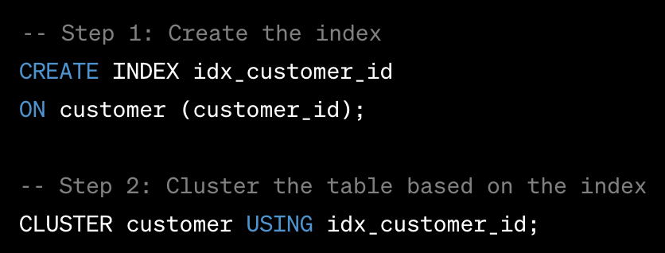
Let’s create one
In PostgreSQL, you can create a clustered index using the CLUSTER command. However, it's important to note that creating a clustered index in PostgreSQL requires a different approach compared to other databases. Instead of directly creating a clustered index, you need to first use the CLUSTER command to physically cluster the data based on an existing index. Here's an example of how you can cluster the customer table based on the customer_id column:

Slide 50
Algorithms and Time Complexity
Introduction to Algorithms: Algorithms are step-by-step instructions or processes for solving a particular problem. They are fundamental in computer science and play a crucial role in designing efficient and scalable solutions. An algorithm provides a clear and unambiguous set of instructions that can be executed by a computer or a human to solve a problem.
Time Complexity: Time complexity is a measure of the amount of time required by an algorithm to solve a problem as a function of the input size. It provides an estimation of the running time of an algorithm and helps evaluate its efficiency. Time complexity is typically expressed using big O notation.

Slide 51
Big O Notation
Big O notation is a mathematical notation used to describe the upper bound or worst-case behavior of an algorithm. It represents the growth rate of the algorithm's running time relative to the input size. In big O notation, the running time of an algorithm is expressed as a function of n, where n represents the input size.

Slide 52
examples
Common Time Complexities: Here are some common time complexities and their corresponding growth rates:
O(1): Constant time complexity. The running time of the algorithm does not depend on the input size. Example: accessing an element in an array by index.
O(log n): Logarithmic time complexity. The running time grows logarithmically with the input size. Example: binary search.
O(n): Linear time complexity. The running time grows linearly with the input size. Example: iterating through an array.
O(n log n): Log-linear time complexity. The running time grows in proportion to n multiplied by the logarithm of n. Example: efficient sorting algorithms like merge sort and quicksort.
O(n^2): Quadratic time complexity. The running time grows quadratically with the input size. Example: nested loops.
O(2^n): Exponential time complexity. The running time grows exponentially with the input size. Example: brute-force algorithms.
O(n!): Factorial time complexity. The running time grows factorially with the input size. Example: algorithms that generate all permutations or combinations.

Slide 53
sorting
Sorting algorithms are algorithms designed to arrange elements in a specific order, such as ascending or descending order. There are various sorting algorithms, each with its own characteristics, advantages, and time complexities. Here are some common sorting algorithms and their time complexities:
[5 , 6 , 2, 1 , 8 , 10]
[1 , 2 , 5 , 6, ,8 , 10]

Slide 54
Bubble Sort
Time Complexity: Best case - O(n), Average case - O(n^2), Worst case - O(n^2)
Bubble Sort compares adjacent elements and swaps them if they are in the wrong order. It repeatedly traverses the array, moving the largest elements to the end of the array in each pass.

Slide 55
Selection Sort
Time Complexity: Best case - O(n^2), Average case - O(n^2), Worst case - O(n^2)Selection Sort finds the minimum element in the unsorted portion of the array and swaps it with the element at the beginning of the unsorted portion. It repeatedly selects the smallest remaining element and places it in the correct position.

Slide 56
Insertion Sort
Time Complexity: Best case - O(n), Average case - O(n^2), Worst case - O(n^2)
Insertion Sort builds the sorted portion of the array one element at a time. It repeatedly selects an element from the unsorted portion and inserts it into its correct position in the sorted portion.

Slide 57
Merge Sort
Time Complexity: Best case - O(n log n), Average case - O(n log n), Worst case - O(n log n)
Merge Sort is a divide-and-conquer algorithm that divides the array into two halves, recursively sorts them, and then merges the sorted halves back together. It guarantees a stable sorting result.

Slide 58
Binary tree
A binary tree is a type of data structure that has the following properties:
Each node in a binary tree has a maximum of two children. Conventionally, these two children are referred to as the left child and the right child.
The topmost node in the tree is known as the root of the tree. If this node is null, then the tree is empty.
Each node in a binary tree consists of a data element, a reference to its left child, and a reference to its right child.

Slide 59
Quick Sort
Time Complexity: Best case - O(n log n), Average case - O(n log n), Worst case - O(n^2)
Quick Sort partitions the array into two parts based on a pivot element. It recursively sorts the sub-arrays on either side of the pivot. Quick Sort is widely used due to its average-case time complexity and efficiency in practice.

Slide 60
Heap Sort
Time Complexity: Best case - O(n log n), Average case - O(n log n), Worst case - O(n log n)
Heap Sort uses a binary heap data structure to build a heap from the input array. It repeatedly extracts the maximum element from the heap and places it at the end of the sorted portion.

Slide 63
triggers
Triggers in SQL are special database objects that are associated with tables and are automatically executed in response to specific events or actions that occur on the table. Triggers are used to enforce data integrity, implement business rules, automate actions, or maintain data consistency in the database.
Triggers in SQL are special database objects that are associated with tables and are automatically executed in response to specific events or actions that occur on the table. Triggers are used to enforce data integrity, implement business rules, automate actions, or maintain data consistency in the database.
A trigger consists of three main components:
Event: The event is the specific action or operation that triggers the execution of the trigger. Common events include INSERT, UPDATE, and DELETE operations on a table.
Condition: The condition, also known as the trigger's "when" clause, specifies the condition that must be met for the trigger to be executed. It determines whether the trigger logic should be executed or not.
Trigger Logic: The trigger logic contains the SQL statements or procedural code that is executed when the trigger is fired. It can include queries, data modifications, stored procedure calls, or any other valid SQL statements.

Slide 64
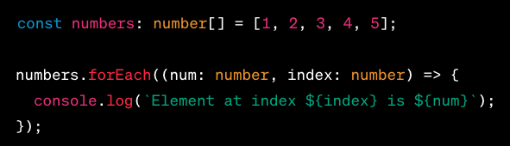
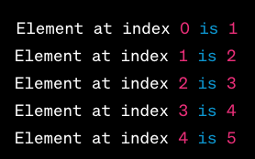
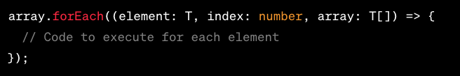
forEach
In TypeScript and Javascript, the forEach loop is a convenient way to iterate over elements in an array or any iterable object. It allows you to execute a specified function for each element in the collection.

Slide 65
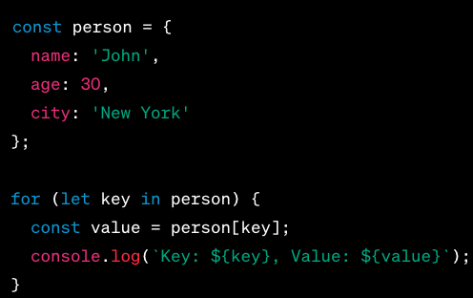
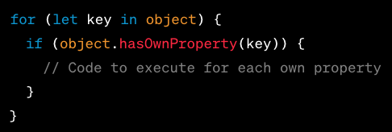
For in
In TypeScript, the for...in loop is used to iterate over the enumerable properties of an object. It allows you to loop through the keys or property names of an object. The syntax is as follows

Slide 66
async and await
In TypeScript, async and await are keywords used to work with asynchronous operations and promises in a more synchronous and readable manner. They provide a way to write asynchronous code that looks and behaves like synchronous code, making it easier to handle and reason about asynchronous tasks.

Slide 67
Map
In JavaScript, the Map is a built-in data structure that allows you to store key-value pairs. It provides an efficient way to associate values with unique keys and perform various operations on them. Here are some key points about Map in JavaScript:
Key-Value Pairs: A Map object stores key-value pairs where each key can be of any type (including objects or functions) and each value can be of any type as well.
Unique Keys: Unlike JavaScript objects, Map allows you to use any value as a key, and it maintains the uniqueness of the keys. This means that each key can only exist once in a Map, and if you try to add a duplicate key, it will overwrite the existing entry.
Iteration Order: Map preserves the insertion order of the keys. When iterating over a Map, the elements will be returned in the order they were added.

Slide 68
Map methods
set(key, value): Adds a new key-value pair to the Map.
get(key): Retrieves the value associated with a given key.
has(key): Checks if a key exists in the Map.
delete(key): Removes a key-value pair from the Map by its key.
size: Returns the number of key-value pairs in the Map.
clear(): Removes all key-value pairs from the Map.

Slide 69
differences
In JavaScript, there are differences between objects created using {} (object literals) and the Map data structure. Here are some distinctions:
Key Types: In objects, the keys are limited to strings or symbols. On the other hand, Map allows any type of value, including objects, functions, and other primitives, as keys.
Iteration Order: Objects do not guarantee a specific order for iterating over their properties. The iteration order in objects may vary based on the JavaScript engine or implementation details. In contrast, Map preserves the insertion order of its entries, ensuring a consistent iteration order.
Size and Performance: Objects do not have a built-in property to determine their size (number of properties). To calculate the size of an object, you need to manually iterate over its properties. In contrast, Map provides a size property to directly access the number of key-value pairs it contains.
Built-in Methods: Objects have a set of built-in methods and properties available to them, such as Object.keys(), Object.values(), and Object.entries(), which allow you to manipulate and iterate over their properties. Map provides specific methods for working with its data, such as set(), get(), has(), and delete(), which make it convenient to manage key-value pairs.
Key Equality: Objects use reference equality for keys. This means that if you have two objects with the same properties and values, they will be considered different keys in an object. In contrast, Map uses the concept of "key equality" based on the SameValueZero algorithm. This algorithm considers two values as equal if they have the same type and are either the same value or both NaN.
Memory Management: Objects created using object literals are more lightweight and memory-efficient compared to Map. If you need a simple key-value store without the need for specific Map features like custom key types or guaranteed iteration order, objects may be a better choice for memory usage.
In summary, while both objects and Map can be used for storing key-value pairs in JavaScript, Map provides additional features like support for various key types, guaranteed iteration order, and dedicated methods for working with its data. Objects, on the other hand, are more lightweight and commonly used for general-purpose key-value storage. The choice between objects and Map depends on the specific requirements of your use case.

Slide 70
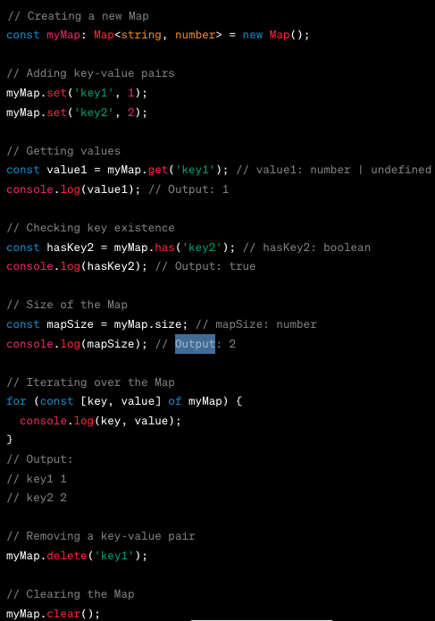
example

Slide 71
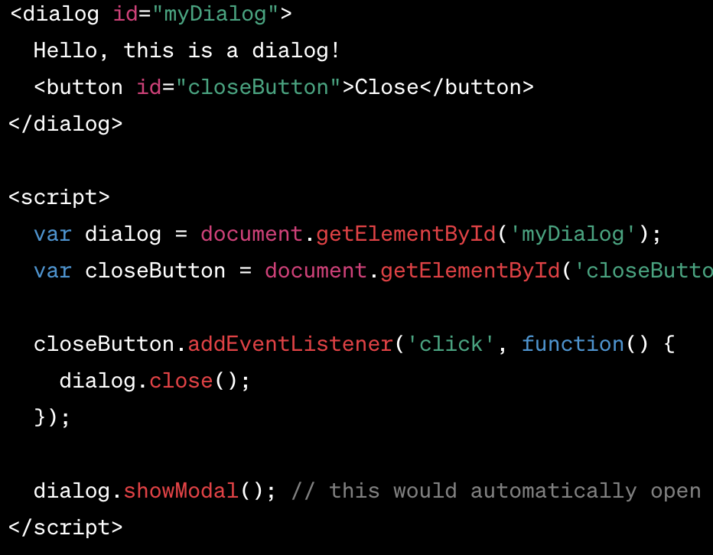
Dialog (new)
The <dialog> tag in HTML is a way to create a popup dialog box or a modal on a webpage. Introduced in HTML5, the <dialog> element makes it easier to create popup dialogs and modals on a web page.

Slide 72
Container query

Slide 73
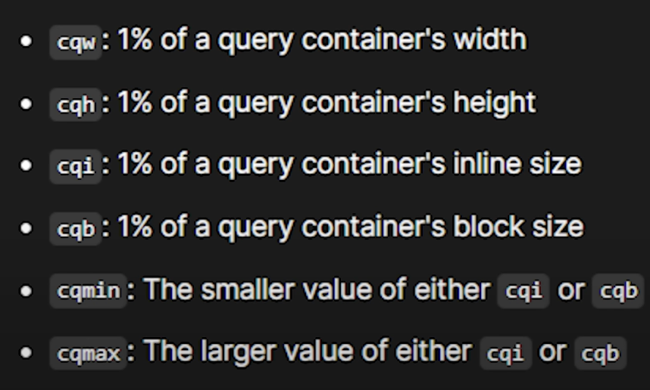
Container units

Slide 74
Color mix
The color-mix() functional notation takes two <color> values and returns the result of mixing them in a given colorspace by a given amount.
https://developer.mozilla.org/en-US/docs/Web/CSS/color_value/color-mix

