Slide 1
OOP
Let’s go

Slide 2
Classes ts
In TypeScript, classes provide a way to define and create objects with a blueprint or template for their properties and behavior. They allow you to apply object-oriented programming principles in your TypeScript code. Here's how you can work with classes in TypeScript:

Slide 3
What you have in a class
Properties: Inside a class, you can define properties to represent the state or characteristics of objects created from that class.
Methods: Methods are functions defined within a class that define the behavior or actions associated with objects created from that class. Methods can also have access modifiers and can access the class's properties.

Slide 4
What is a class
In programming, a class is a blueprint or template for creating objects that share common properties and behaviors. It serves as a blueprint that defines the structure and behavior of objects that can be instantiated (created) based on that blueprint.
A class encapsulates data (properties) and functions (methods) that operate on that data. It provides a way to define the state and behavior of objects. The properties represent the characteristics or attributes of an object, while the methods define the actions or operations that the object can perform.

Slide 5
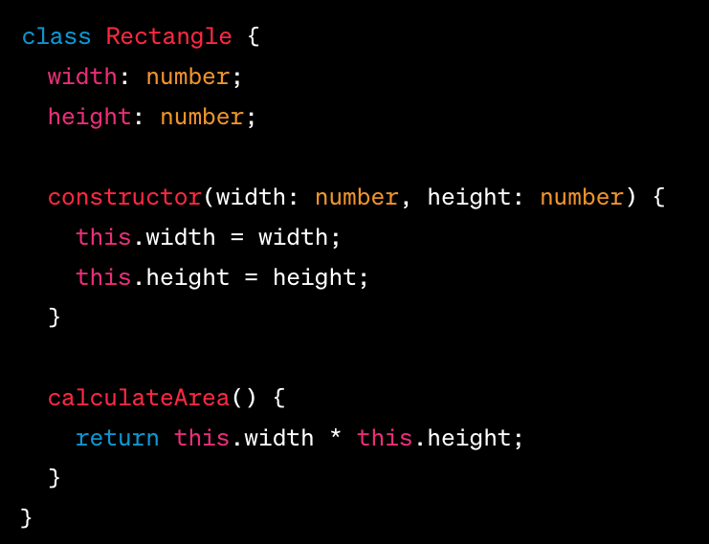
why
Classes help organize code and promote code reuse by allowing you to define a common structure and behavior once and create multiple instances (objects) based on that class. Each object created from a class is known as an instance or an object of that class.

Slide 6
Inheritance
Inheritance is a key concept in object-oriented programming that allows you to create a new class (derived class or subclass) based on an existing class (base class or superclass). The derived class inherits the properties and methods of the base class, enabling code reuse and promoting the concept of hierarchical relationships between classes.
In TypeScript, you can implement inheritance using the extends keyword. Here's how you can work with inheritance:

Slide 7
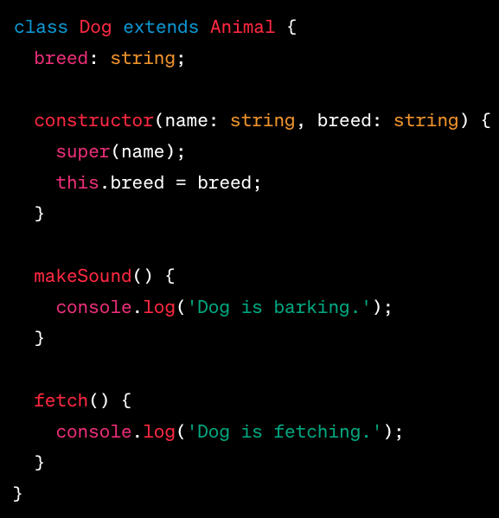
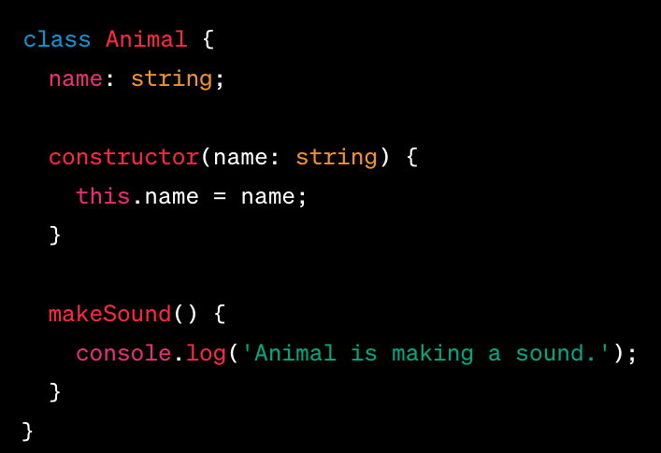
example

Slide 8
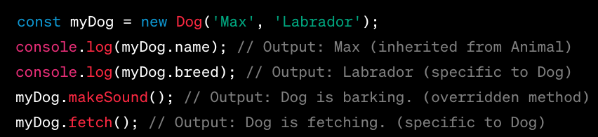
Example - more

Slide 9
Polymorphism
Polymorphism is a concept in object-oriented programming that allows objects of different classes to be treated as objects of a common base class. It enables you to write code that can work with objects of multiple types, providing flexibility and extensibility in your programs. TypeScript supports polymorphism through inheritance and method overriding.
Base Class and Derived Classes: Polymorphism relies on a base class and one or more derived classes. The base class defines a common interface, while the derived classes extend the base class and provide specific implementations. Here's an example:

Slide 10
Example in week 18
In the example above, the printArea function accepts an object of type Shape. It doesn't need to know the specific type of the object, as long as it adheres to the common interface defined by the Shape base class. When invoking the calculateArea() method, the appropriate implementation based on the actual object type (Circle or Rectangle) is automatically called.
Polymorphism allows you to write generic code that can work with different objects, promoting code reusability and flexibility. It enables you to create more extensible and modular systems where you can introduce new derived classes without modifying existing code that relies on the base class.
By leveraging polymorphism, you can achieve dynamic behavior and flexibility in your TypeScript applications, making your code more adaptable to changes and enhancing code maintainability.

Slide 11
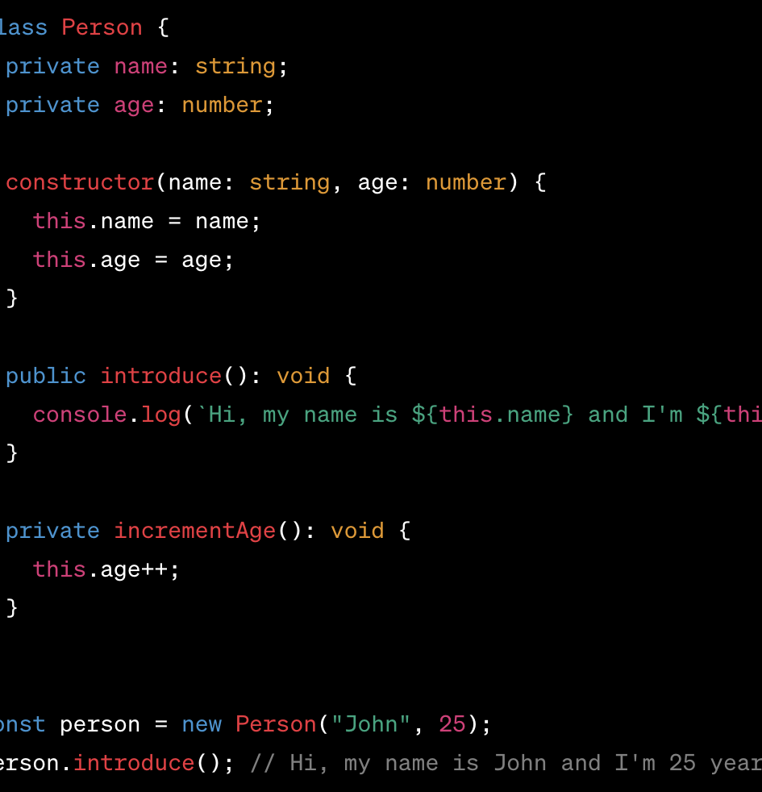
Private
In TypeScript, the private modifier is used within classes to restrict access to class members (properties and methods) from outside the class. It ensures that the members marked as private can only be accessed and modified within the class itself.

Slide 12
Get and set
Getters and setters are special methods in a class that provide a way to access (get) and modify (set) the values of its private or protected properties. They allow for controlled access and manipulation of the class's internal state.
In TypeScript, you can define getters and setters using the get and set keywords, respectively. They are typically associated with a specific property and provide a level of encapsulation by allowing controlled access to the property's value.

Slide 13
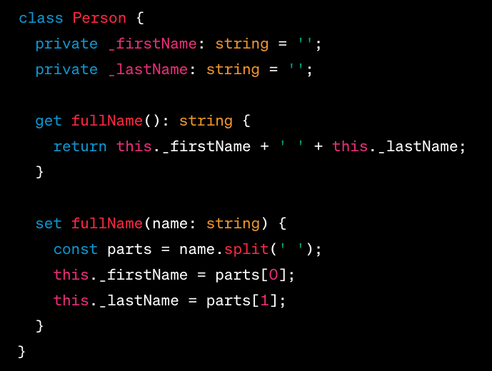
example

Slide 14
Check type
To check if an object is of a specific type in TypeScript, you can use the instanceof operator or the typeof operator. Here's how you can use each approach:
Using the instanceof operator: The instanceof operator checks if an object is an instance of a particular class or has a specific class in its prototype chain.
Using the typeof operator: The typeof operator checks the type of a value or expression, primarily for primitive types (e.g., number, string, boolean) and built-in types.

Slide 15
encupsulation
Encapsulation is one of the fundamental principles of object-oriented programming (OOP) that promotes the bundling of data and methods within a class, while controlling access to that internal state from outside the class.

Slide 16
Why
Data Hiding: Encapsulation enables the hiding of internal data within a class, making it private or protected. This prevents direct access to the internal state of an object from outside the class, ensuring that data integrity and consistency are maintained.
Access Control: Encapsulation provides mechanisms for controlling access to the internal state and behavior of an object. By using access modifiers like private, protected, and public, the class can define which members (variables and methods) can be accessed from outside the class.
Information Abstraction: Encapsulation allows the class to present a clean and simplified interface to the outside world. It abstracts away the complexity of internal implementation details and exposes only the necessary information and functionality, promoting a clear separation of concerns and reducing dependencies.
Encapsulating Methods: In addition to encapsulating data, encapsulation also involves encapsulating methods or functions within a class. This means that the behavior associated with the class's data is also bundled together, ensuring that data manipulation and operations are performed in a controlled and consistent manner.

Slide 17
Eweek 22 file
In this example, the Car class encapsulates the brand, model, and year of a car. The properties _brand, _model, and _year are private, meaning they can only be accessed within the class itself.
The public getter methods getBrand(), getModel(), and getYear() provide access to retrieve the values of the private properties. These methods allow controlled access to the encapsulated data.
The public setter method setYear(year) allows updating the _year property with a new value. However, before updating, it performs a validation check to ensure that the provided year is valid (between 1900 and the current year). If the year is invalid, it logs an error message.
By encapsulating the data and exposing it through getter and setter methods, the Car class maintains control over how the properties are accessed and updated. This helps maintain data integrity and allows for additional logic or validation to be implemented.

Slide 18
Inheritance
Inheritance is a key concept in TypeScript (as well as in object-oriented programming in general) that allows a class to inherit properties and methods from another class. It enables code reuse, promotes the concept of "is-a" relationship, and facilitates building class hierarchies.
In TypeScript, you can create a subclass by using the extends keyword followed by the name of the superclass. The subclass inherits all the non-private members (properties and methods) of the superclass and can add additional members or override existing ones.

Slide 19
Key aspects
Superclass and Subclass: Inheritance involves two classes: the superclass (also known as the base class or parent class) and the subclass (also known as the derived class or child class). The subclass extends the superclass, acquiring its properties and methods.
"is-a" Relationship: Inheritance represents an "is-a" relationship between classes. For example, if you have a Vehicle superclass and a Car subclass, you can say that "a car is a vehicle."
Code Reuse: Inheritance promotes code reuse by allowing subclasses to inherit and use the properties and methods of the superclass. This reduces duplication and promotes modular and maintainable code.
Extending and Overriding: Subclasses can extend the functionality of the superclass by adding new members or overriding existing ones. This allows customization and specialization of behavior in the context of the subclass.
Access Modifiers: In TypeScript, access modifiers (public, protected, and private) control the visibility and accessibility of members in the superclass and subclass. Subclasses can access protected and public members of the superclass, but private members are not accessible.
Super Keyword: The super keyword is used in the subclass to refer to the superclass and access its members. It can be used to call the superclass's constructor or invoke overridden methods.
Method Overriding: Subclasses can override methods inherited from the superclass by providing their own implementation. This allows subclasses to provide specific behavior while still adhering to the common interface defined in the superclass.

Slide 20
Inheritance - example
In this example, we have a base class Vehicle that represents a generic vehicle with brand and model properties. It has a method getInfo() that returns the information about the vehicle.
The Car class extends the Vehicle class, inheriting its properties and methods. It adds a private _numWheels property to represent the number of wheels specific to a car. It overrides the getInfo() method and calls the parent class's implementation using super.getInfo() while adding the car-specific information.
The Motorcycle class also extends the Vehicle class. It introduces a private _hasSidecar property to indicate whether the motorcycle has a sidecar. The getInfo() method is overridden to include motorcycle-specific information.
By utilizing inheritance, the Car and Motorcycle classes inherit the common properties and behavior from the Vehicle class while allowing specialization and customization for the specific types of vehicles.

Slide 21
Polymorphism
Polymorphism is a fundamental concept in TypeScript (as well as in object-oriented programming) that allows objects of different types to be treated as instances of a common type. It enables flexibility, code reuse, and promotes the concept of "one interface, multiple implementations."
In TypeScript, polymorphism can be achieved through method overriding and method overloading, along with interfaces and abstract classes. Here are some important points to understand about polymorphism in TypeScript:

Slide 22
key
Polymorphic Relationships: Polymorphism is based on the concept of polymorphic relationships, where objects of different classes can be treated as instances of a common type or interface. This allows for more generic programming and the ability to write code that can work with different object types without being tightly coupled to specific implementations.
Method Overriding: Polymorphism is often achieved through method overriding. In TypeScript, a subclass can provide its own implementation of a method that is already defined in its superclass. This allows the subclass to customize or specialize the behavior of the method while adhering to the common interface defined in the superclass.
Interface Polymorphism: Interfaces in TypeScript define contracts that classes can adhere to. By using interfaces, you can define a common set of methods that multiple classes can implement. Then, you can treat objects of those classes as instances of the interface type, allowing you to work with objects of different classes through a common interface.
Abstract Classes: Abstract classes in TypeScript can also contribute to achieving polymorphism. Abstract classes serve as templates for subclasses and can define abstract methods that subclasses must implement. Abstract classes can provide a common interface and allow subclasses to have their own implementations of specific methods, promoting polymorphic behavior.
Method Overloading: Method overloading in TypeScript allows a class to have multiple methods with the same name but different parameter types or numbers. This allows for flexible method invocation based on the types or numbers of the arguments, enabling polymorphic behavior.

Slide 23
Polymorphism
In this example, we have a base class Animal that represents an animal with a _name property and a makeSound() method. The makeSound() method is implemented with a generic message in the base class.
The Cat and Dog classes extend the Animal class. They override the makeSound() method with their own specific sound implementations.
We then create an array animals containing instances of both Cat and Dog objects. By calling the makeSound() method on each object, we can observe polymorphic behavior. The specific sound implementation of each subclass is invoked based on the object type at runtime.

Slide 24
Abstraction
Abstraction is a fundamental concept in TypeScript (as well as in object-oriented programming) that focuses on creating simplified and generalized representations of real-world entities. It involves hiding unnecessary implementation details and exposing only the essential features and behaviors.
In TypeScript, abstraction is achieved through abstract classes and interfaces. Here are some important points to understand about abstraction in TypeScript:

Slide 25
key
Abstract Classes: Abstract classes in TypeScript serve as templates for other classes. They cannot be instantiated directly but are meant to be extended by other classes. Abstract classes can define abstract methods that subclasses must implement. They can also contain concrete methods with default behavior that subclasses can inherit.
Abstract Methods: Abstract methods are declared in abstract classes but do not contain an implementation. Subclasses that extend the abstract class must provide their own implementation of the abstract methods. Abstract methods define a common interface for subclasses to adhere to, ensuring that specific behaviors are implemented in each subclass.
Interfaces: Interfaces in TypeScript define contracts that classes can adhere to. They provide a way to define a set of methods that a class must implement. Interfaces focus on defining the structure and behavior that classes should have without specifying the implementation details. Classes can implement multiple interfaces, allowing them to fulfill multiple contracts.
Encapsulation: Abstraction is closely related to encapsulation. Encapsulation involves bundling data and methods together and controlling their access. Abstraction focuses on exposing only the essential information and behaviors, hiding the unnecessary implementation details. This promotes code modularity, reduces dependencies, and provides a clear separation of concerns.
Code Modularity and Reusability: Abstraction promotes code modularity and reusability by creating generalized representations and interfaces. By defining abstract classes and interfaces, you can create reusable components that provide a common interface for different implementations. This allows for code reuse, extensibility, and easier maintenance.

Slide 26
Abstraction
In this example, we have an abstract class Shape that represents a generic shape. It has a protected property _name and an abstract method calculateArea().
The calculateArea() method is declared as abstract in the Shape class, which means it does not have an implementation in the base class. The concrete subclasses (Circle and Rectangle) are responsible for providing their own implementation of the calculateArea() method.
The display() method in the Shape class provides a common behavior to display the shape's name and calculated area.
The Circle and Rectangle classes extend the Shape class and implement the calculateArea() method according to their specific shape formulas.
We create instances of Circle and Rectangle, and call the display() method. This demonstrates abstraction, as the Shape class provides an abstraction of a generic shape, while the concrete subclasses provide specific implementations of the abstract method. The caller can interact with the Shape class and its common behavior without needing to know the specific details of each shape's calculation.

Slide 27
Association
Association is a relationship between two or more classes in TypeScript (as well as in object-oriented programming) where objects of one class are connected or associated with objects of another class. It represents how classes interact and collaborate with each other to fulfill a certain functionality or requirement.
In TypeScript, association between classes can be established in various ways, such as through member variables, method parameters, or return types. Here are some important points to understand about association in TypeScript:

Slide 28
Association
Relationship Types: Association can be classified into different relationship types based on the nature of the association between classes:
Aggregation: Represents a "has-a" relationship, where one class contains or holds instances of another class. It indicates a whole-part relationship, where the associated class can exist independently.
Composition: Represents a strong form of aggregation, where the associated class is a crucial part of the whole and cannot exist without it. It indicates a "composed-of" relationship, where the associated class is exclusive to the parent class.
Association: Represents a general relationship where two or more classes are connected, but the relationship is not a whole-part or exclusive one. It indicates a more loosely coupled relationship between classes.
Class Collaboration: Through association, classes can collaborate and interact with each other by using the associated class's members, calling its methods, or accessing its properties. This allows classes to exchange information, delegate tasks, or perform actions collectively to achieve a desired functionality.
Flexibility and Modularity: Association provides flexibility and modularity by allowing classes to be loosely coupled. It enables classes to interact with each other through defined interfaces or contracts, promoting code maintainability, extensibility, and reusability.
Multiplicity: Multiplicity refers to the cardinality of the association, indicating how many objects of one class are associated with objects of another class. For example, a one-to-one association means each object of one class is associated with exactly one object of another class, while a one-to-many association means each object of one class is associated with multiple objects of another class.
Dependency Injection: Association is often used in the context of dependency injection, where objects of one class are injected into another class to fulfill its dependencies. This allows for loose coupling and promotes the principle of "programming to interfaces."

Slide 29
Association
In this example, we have two classes: Player and Team. The Player class represents a player with a private _name property and a getName() method to retrieve the player's name.
The Team class represents a team with a private _name property and an association with Player instances. It has methods to add players to the team (addPlayer()) and retrieve the players (getPlayers()).
We create instances of Player representing individual players (player1, player2). Then, we create an instance of Team (team) and associate the players with the team using the addPlayer() method.
To display the team name and its players, we retrieve the players using the getPlayers() method and iterate over them.
This example demonstrates association, where the Team class has an association with multiple instances of the Player class. It allows for managing and accessing a collection of related objects (players) within the context of a team.

Slide 30
Overloading and Overriding
Overloading and overriding are two important concepts in TypeScript (as well as in object-oriented programming) that involve methods in classes. Let's explore each concept in relation to TypeScript:
Method Overloading:
Method overloading allows a class to have multiple methods with the same name but different parameter types or numbers.
In TypeScript, method overloading is achieved by declaring multiple method signatures in the class, each specifying a different set of parameters.
The compiler selects the appropriate method based on the number and types of arguments used when invoking the method.
Method overloading provides flexibility and allows a class to provide different behaviors for different argument combinations.

Slide 31
Method Overriding
Method overriding occurs when a subclass provides its own implementation of a method that is already defined in its superclass.
The subclass overrides the method to customize or specialize its behavior while adhering to the common interface defined in the superclass.
In TypeScript, method overriding is achieved by redefining a method in the subclass with the same name and parameters as in the superclass.
The overridden method in the subclass should have the override modifier to explicitly indicate that it is intended to override the superclass's implementation.

Slide 32
Overloading and Overriding
in this example, we have a base class Shape that has a method getInfo() and a method calculateArea().
The Circle and Rectangle classes extend the Shape class and override both getInfo() and calculateArea() methods.
The getInfo() method is overridden in both subclasses to include additional information specific to each shape.
The calculateArea() method is overridden to provide the respective area calculation formulas for circles and rectangles.
We create instances of Circle and Rectangle and call the getInfo() and calculateArea() methods on each object.
This demonstrates method overriding, as the subclasses provide their own implementation of the base class methods, using the super keyword to access the base class implementation.
Method overloading is not explicitly demonstrated in this example. Method overloading in TypeScript involves providing multiple method signatures with different parameter combinations within a single class, enabling flexible invocation of methods with different argument types or numbers.

Slide 33
Access Modifiers
Access modifiers in TypeScript are keywords that define the accessibility and visibility of class members (properties and methods) within a class or from outside the class. They provide control over how the members can be accessed and manipulated by other code.
TypeScript provides three access modifiers:

Slide 34
Access Modifiers
public:
The public access modifier allows class members to be accessed from anywhere, both within the class and outside of it.
It is the default access modifier if none is explicitly specified.
Public members can be accessed and modified by any code that has access to an instance of the class.
protected:
The protected access modifier restricts the visibility of members to the class and its subclasses (derived classes).
Protected members cannot be accessed or modified from outside the class or its subclasses.
However, they can be accessed and modified within the class itself and any subclass that extends the class.
private:
The private access modifier restricts the visibility of members to the class itself.
Private members cannot be accessed or modified from outside the class, including its subclasses.
They can only be accessed and modified within the class that declares them.
Private members are often used to encapsulate implementation details and hide them from external code.

Slide 35
Access Modifiers
In this example, we have a Car class with different access modifiers:
The _brand property is marked as private, meaning it can only be accessed within the class itself.
The _model property is marked as protected, allowing it to be accessed within the class and its subclasses.
The year property is marked as public, which means it can be accessed from anywhere.
The getBrand() method is marked as private, so it can only be accessed within the class itself.
The getModel() method is marked as protected, allowing it to be accessed within the class and its subclasses.
The displayInfo() method is marked as public and can be accessed from anywhere. It internally accesses the private _brand property and the protected _model property.
We create instances of Car and SportsCar, and demonstrate the access to properties and methods based on their access modifiers. Note that accessing private or protected members outside of the class or its subclasses will result in a compilation error.

Slide 36
Polymorphic Relationships
In this example, we define an Shape interface that declares a getArea() method. Both the Circle and Rectangle classes implement this Shape interface and provide their own implementation for the getArea() method.
The Circle class represents a circle and calculates its area based on the provided radius.
The Rectangle class represents a rectangle and calculates its area based on the provided length and width.
We create instances of Circle and Rectangle and assign them to variables of type Shape, which is the interface type. This allows us to treat these objects polymorphically, accessing the common getArea() method defined in the Shape interface.
By utilizing interfaces, we establish a polymorphic relationship where objects of different classes (Circle and Rectangle) are treated as instances of a common type (Shape). This enables us to invoke the getArea() method on each object, even though they have different implementations, providing flexibility and code reusability.

Slide 37
Design Patterns
Design patterns are proven, reusable solutions to common design problems that occur in software development. They provide a structured approach to solving specific design challenges and promote code organization, maintainability, and extensibility. TypeScript, being an object-oriented language, can effectively utilize design patterns to improve software architecture and development.

Slide 38
Creational Patterns
Creational patterns focus on object creation mechanisms, providing flexibility in creating objects and decoupling the client code from the specific classes being instantiated.
Examples of creational patterns include the Singleton pattern, Factory pattern, Abstract Factory pattern, Builder pattern, and Prototype pattern.
TypeScript enables the implementation of these patterns by utilizing its class-based syntax, interfaces, and type system.

Slide 39
Structural Patterns
Structural patterns deal with the composition of classes and objects to form larger structures and provide convenient ways to work with complex object relationships.
Examples of structural patterns include the Adapter pattern, Decorator pattern, Facade pattern, Composite pattern, and Proxy pattern.
TypeScript's support for classes, interfaces, and type checking facilitates the implementation of these patterns and promotes code modularity and flexibility.

Slide 40
Behavioral Patterns
Behavioral patterns focus on the interaction between objects and the distribution of responsibilities among them.
These patterns provide solutions for communication, coordination, and collaboration between objects, promoting loose coupling and flexibility.
Examples of behavioral patterns include the Observer pattern, Strategy pattern, Command pattern, Template Method pattern, and Iterator pattern.
TypeScript's support for interfaces, inheritance, and function types enables the implementation of these patterns and facilitates polymorphism and dynamic behavior.

Slide 41
TypeScript-Specific Patterns
TypeScript, with its unique features and static type checking, can facilitate the implementation of patterns specific to the language.
Examples include the Module pattern, which leverages TypeScript's module system, and the Dependency Injection pattern, which can benefit from TypeScript's strong type system for managing dependencies.

Slide 42
Design Patterns
In this example, we have implemented the Factory Design Pattern. The Shape interface represents the common behavior that all shapes should have, which is defined by the draw() method.
The Circle and Rectangle classes implement the Shape interface and provide their own implementation of the draw() method.
The ShapeFactory class acts as the factory responsible for creating different shapes based on a given type. It has a createShape() method that accepts a type as an argument and returns the corresponding shape object.
In the usage section, we create an instance of the ShapeFactory. Using the factory, we create a circle and a rectangle object by calling the createShape() method with the respective shape type. Then, we invoke the draw() method on each shape object, which executes the specific drawing logic for that shape.
The Factory Design Pattern allows for the creation of objects without exposing the instantiation logic to the client. It provides a centralized place (the factory) for creating objects based on specific conditions or requirements. This pattern promotes loose coupling and code maintainability by separating object creation from object usage.

