Slide 1

Trees

Slide 2
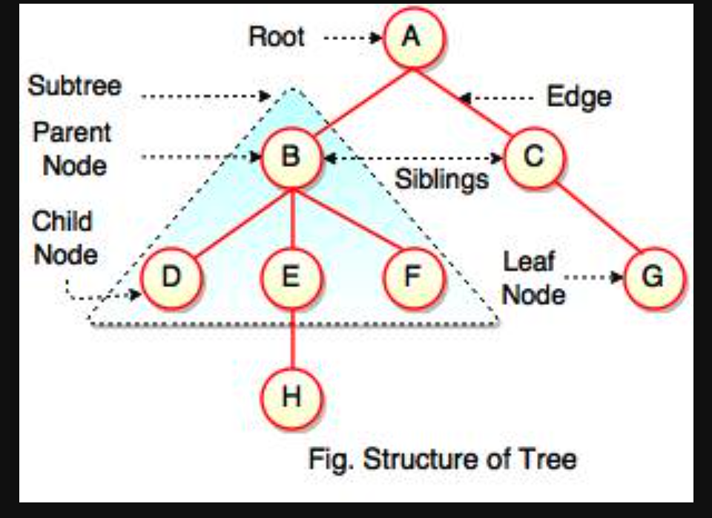
What is all the stuff

Slide 3
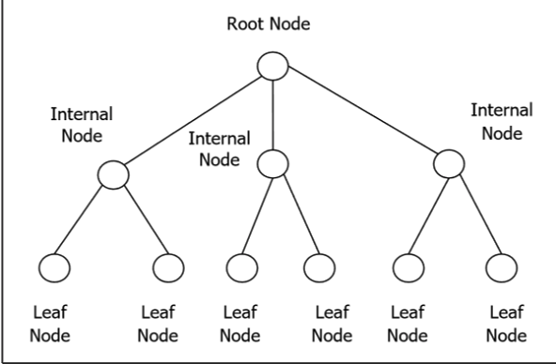
Nodes

Slide 4
more
Leaf: A leaf node, also known as an external node, is a node that has no children. In other words, both the left and right child references of a leaf node are null.
Internal Node: An internal node is a node that has at least one child. It is not a leaf node.
Siblings: Nodes that have the same parent are called siblings. For example, if a parent node has two children, those children are considered siblings.
Height: The height of a binary tree is the length of the longest path from the root to a leaf node. It represents the number of edges along the longest downward path from the root to a leaf.

Slide 5
What is Binary Tree?
In TypeScript, a binary tree is a hierarchical data structure consisting of nodes, where each node has at most two children: a left child and a right child. Binary trees are widely used in computer science and can be implemented in TypeScript using classes and objects.

Slide 6
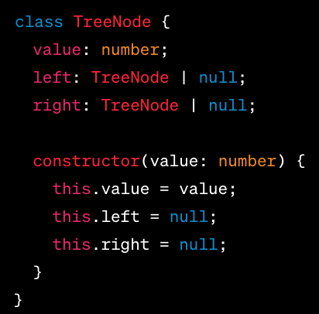
example

Slide 7
What make him special
A binary tree, in the context of computer science and data structures, possesses several properties that define its structure and behavior. Here are the key properties of a binary tree:
Root: The root is the topmost node of the binary tree. It serves as the starting point for traversing or accessing the tree.
Node: Each element or entity within a binary tree is called a node. Each node contains a value and may have references (pointers) to its left and right child nodes.
Parent and Child: Nodes in a binary tree have relationships with other nodes. A node that points to another node is called the parent, and the node being pointed to is called the child. Each node can have at most two children: a left child and a right child.

Slide 8
more
Depth (Level): The depth or level of a node represents the length of the path from the root to that specific node. The root node has a depth of 0, and each level below the root increases the depth by 1.
Balanced vs. Unbalanced: A binary tree is considered balanced if the heights of its left and right subtrees do not differ by more than a specified amount (usually 1). If a binary tree does not meet this condition, it is considered unbalanced.
Full Binary Tree: A full binary tree is a tree in which every node has either 0 or 2 children. In other words, every node is either a leaf or has two children.
Complete Binary Tree: A complete binary tree is a binary tree in which all levels, except possibly the last one, are completely filled, and all nodes are as far left as possible.

Slide 9
Pre-order
Pre-order traversal is a method used to traverse or visit all the nodes in a tree. It is called "pre-order" because it visits the nodes in the following order:
Visit the current node.
Traverse the left subtree (recursively apply pre-order traversal to the left child).
Traverse the right subtree (recursively apply pre-order traversal to the right child).
In pre-order traversal, the current node is visited before its children. This means that when performing pre-order traversal, you process the nodes in a top-down manner, starting from the root and moving towards the leaves.

Slide 10
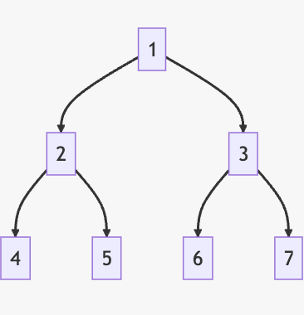
In order
In-order traversal is a method used to visit the nodes of a binary tree in a specific order. The "in-order" part of the term means that nodes are visited in the order: left child, parent, right child.
4, 2, 5, 1, 6, 3, 7.

Slide 11
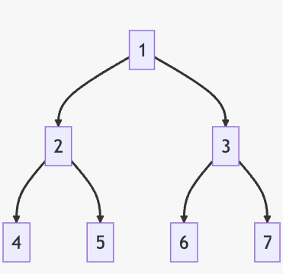
Post order traversal
Post-order traversal is a method used for visiting the nodes of a binary tree. The term "post-order" refers to the order in which nodes are visited:
First, the left subtree is visited.
Then, the right subtree is visited.
Finally, the root (or parent) node is visited.
This process is applied recursively to each subtree until all nodes have been visited.
4, 5, 2, 6, 7, 3, 1.

Slide 12
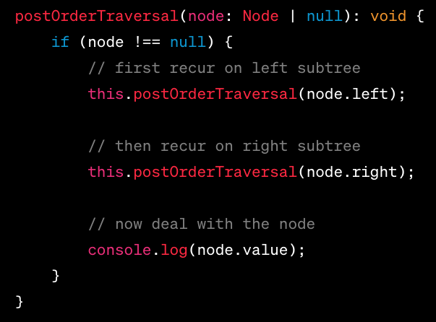
Postorder example code

Slide 13
Try it yourself Task 1: Implement a Binary Tree
Define a class Node that has two properties: value that stores the value of the node, and left and right that point to the left and right children of the node respectively.
Define a class BinaryTree that has one property: root which points to the root node of the tree. The BinaryTree class should also have the following methods:
insert(value): This method should insert a new node with the given value into the tree.
contains(value): This method should return a boolean indicating whether the tree contains a node with the given value.

Slide 14
Task 2: Tree Traversal
Implement the following tree traversal methods in the BinaryTree class:
inOrderTraversal(): This method should print the nodes of the binary tree in in-order traversal.
preOrderTraversal(): This method should print the nodes of the binary tree in pre-order traversal.
postOrderTraversal(): This method should print the nodes of the binary tree in post-order traversal.
Submission: Submit your code file. Make sure your code is well-commented, explaining what each part of the code does.

Slide 15
linked list
A linked list is a linear data structure, similar to an array, but instead of each element pointing to its next element by its physical placement in memory, each element points to its next element by storing a reference to it.

Slide 16
Type of linked list
Node: The fundamental unit of a linked list is a node. Each node contains two elements: data and a reference (or link) to the next node in the sequence.
Head: The first node in a linked list is referred to as the head. The head node is the starting point for any traversal of the list.
Tail: The last node in a linked list, the one which has no subsequent node and its reference (or link) is null, is known as the tail.
Types of Linked Lists:
Singly Linked List: In a singly linked list, each node in the list stores the contents of the node and a pointer or reference to the next node in the list. It does not store any pointer or reference to the previous node. It is the simplest form of linked list.
Doubly Linked List: In a doubly linked list, each node contains a reference to the next node as well as the previous node. This allows for a greater variety of O(1) update operations, including insertions and deletions at both ends.
Circular Linked List: In a circular linked list, the last node contains a reference to the first node as next and the first node has a reference to the last node as previous.

Slide 17
operations
Insertion: Nodes can be added to a linked list by reassigning the pointers from the existing nodes to the new node.
Deletion: Nodes can be removed from a linked list by reassigning the pointers around the node to be removed.
Traversal: Moving through a linked list node-by-node is known as traversal.
Searching: Looking for a specific value in a linked list.
Updating: Changing the value of a node.

Slide 18
Task 1: Implement a Singly Linked List
Define a class Node that has two properties: value that stores the value of the node, and next that points to the next node in the list.
Define a class LinkedList that has two properties: head which points to the first node of the list and tail which points to the last node of the list. The LinkedList class should also have the following methods:
append(value): This method should add a new node with the given value to the end of the list.
prepend(value): This method should add a new node with the given value to the beginning of the list.
delete(value): This method should remove all nodes with the given value from the list.
find(value): This method should return the first node with the given value; if the node is not found, it should return null.
print(): This method should print the values of the nodes in the list in order from head to tail.

Slide 19
Task 2: Test Your LinkedList Class
Create a new LinkedList object and use the append, prepend, delete, find, and print methods to demonstrate that they work as expected.
Submission: Submit your code file. Make sure your code is well-commented, explaining what each part of the code does.
If you finish the assignment early, try implementing a method to reverse the linked list.
Remember, practice is key when learning new concepts in computer science. Don't hesitate to ask for help if you're stuck, and most importantly, have fun coding!

Slide 20
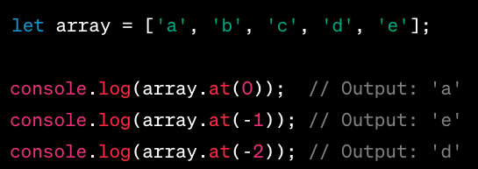
TS fun array at
The at() method is a relatively new addition to the JavaScript Array object. It takes an integer value and returns the item at that index. The key feature of the at() method is that it allows for negative integers, which count back from the last item in the array.

Slide 21
TS fun array reduce
The reduce() method in JavaScript is a powerful function that allows you to iterate over an array and condense it into a single value. This could be a sum, an average, a concatenated string, or any other single value derived from the array's elements.

Slide 22
TS fun reduce args
he reduce() method takes two arguments:
A reducer function (required)
An initial value (optional)
The reducer function itself takes four arguments:
Accumulator (required)
Current Value (required)
Current Index (optional)
Source Array (optional)

Slide 23
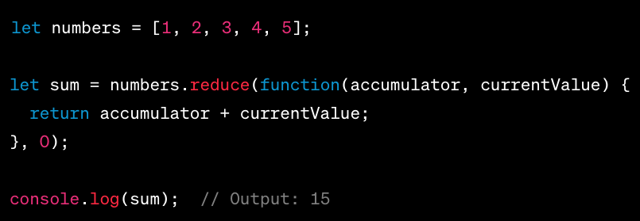
example

Slide 24
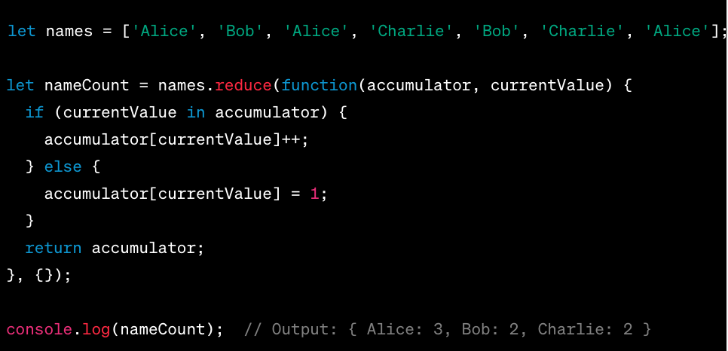
Another example

