Slide 1
HTML
HTML tags are built using angle brackets, like this:

Slide 2
HTML
HTML stands for Hypertext Markup Language, and it is the standard markup language for creating web pages. HTML consists of a series of tags that are used to define the structure and content of a web page.

Slide 3
How does it looks like
For most cases <tag></tag> example <h2>text</h2> <p>p is here</p>
Some cases are <tag> example <br> <img src=“”>

Slide 4
What is attributes
All HTML elements can have attributes
Attributes provide additional information about elements
Attributes are always specified in the start tag
Attributes usually come in name/value pairs like: name="value"
example for that is the <img src=“/dog.png”> or <a href=“link.com”>you will see that next</a>

Slide 5
Let’s link it
What is the a tag, an a tag is a tag that will allow us to link website.
For example put in your site
<a href=“https://nodomain.com/”>link is here</a>

Slide 6
HTML Formatting Elements
Formatting elements were designed to display special types of text:
<b> - Bold text
<strong> - Important text
<i> - Italic text
<em> - Emphasized text
<mark> - Marked text
<small> - Smaller text
<del> - Deleted text
<ins> - Inserted text
Try: <b>My name is:</b> Shaked

Slide 7
COMMENTS
<!–
Write your comments here
For example my name is… What my name is >> slim shady
-->
The role of comments is to explain the code, or part of it.

Slide 8

Images
Images can have many attributes including width, height, alt, src for example:
<img src=”image_link.png" alt=”text is here about the image" width=”800" height=”450">

Slide 9
Image Map
Image map is kind of a link inside an image and will add us the option to have different link on the image.
<img src="https://www.w3schools.com/html/workplace.jpg" alt="Workplace" usemap="#workmap"> <map name="workmap"> <area shape="rect" coords="34,44,270,350" alt="Computer" href=”https://nodomain.com">
<area shape="rect" coords="290,172,333,250" alt="Phone" href=”apple.com">
</map>

Slide 10
Wait if image is an image what is a picture
Picture is just an html element that will display different images baesd on the sized of the page.
<picture> <source media="(min-width: 650px)" srcset="img_food.jpg"> <source media="(min-width: 465px)" srcset="img_car.jpg"> <img src="img_girl.jpg"> </picture>

Slide 11
ifream
The <iframe> element, or "inline frame," is used to embed another HTML document within the current HTML document. It allows you to display a separate web page within a frame on your current page.
The <iframe> element is specified using the src attribute, which specifies the URL of the document to be embedded.
The <iframe> element is useful for embedding content from other websites, such as YouTube videos, Google Maps, or external web applications. However, it should be used with caution, as it can potentially introduce security vulnerabilities to your site if the embedded content is not trusted.

Slide 12

Ul and ol
Sure! The ul element represents an unordered list of items, typically rendered as a bulleted list. The ol element represents an ordered list of items, typically rendered as a numbered list. Here are some examples:

Slide 13
form
Legend - The <legend> HTML element represents a caption for the content of its parent
Fieldset- The <fieldset> HTML element is used to group several controls as well as labels (<label>) within a web form.
Label- The <label> HTML element represents a caption for an item in a user interface.
Input- The <input> HTML element is used to create interactive controls for web-based forms in order to accept data from the user; a wide variety of types of input data and control widgets are available, depending on the device and user agent. The <input> element is one of the most powerful and complex in all of HTML due to the sheer number of combinations of input types and attributes.

Slide 14
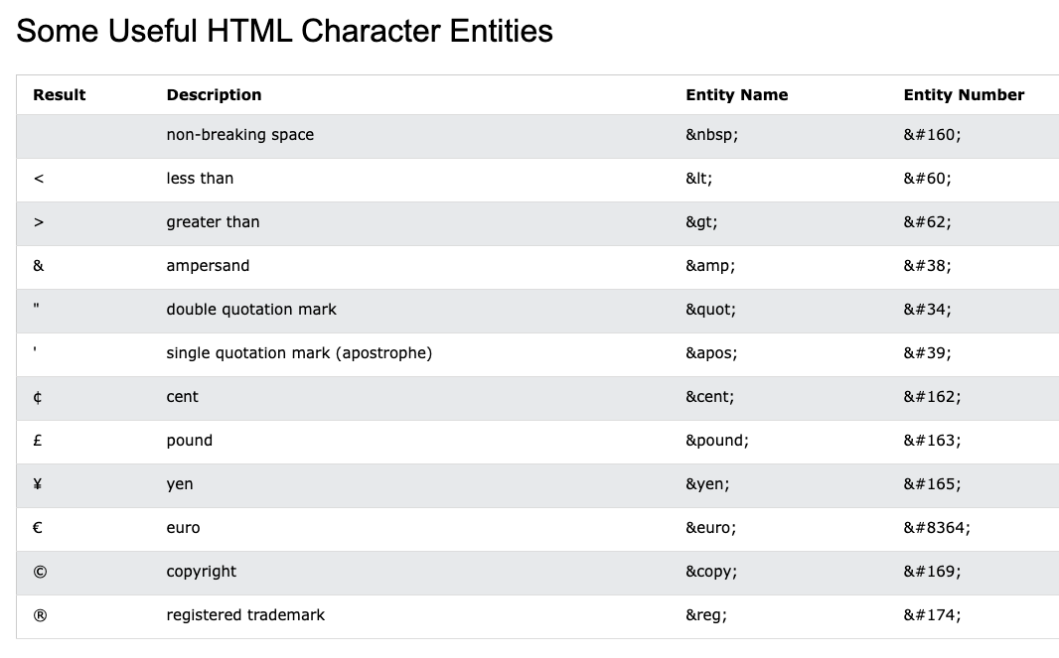

Slide 15

Cascading Style Sheets (CSS) is a stylesheet language used for describing the look and formatting of a document written in HTML. CSS is used to control the appearance of web pages, including colors, layout, and fonts.
With CSS, you can create style rules that specify how elements in an HTML document should be displayed. For example, you can use CSS to set the font and color of headings, or to specify the size and style of a paragraph. CSS rules are made up of selectors and declarations.

Slide 16
example
<h1 style="background-color:DodgerBlue;">Shaked</h1> <p style="background-color:red;">This is a p el</p>
<h1 style="border:2px solid Violet;">my name is?</h1>

Slide 17
Colors
HEX: A HEX color code is a six-digit string that represents a color. It is written as a hash symbol followed by three pairs of hexadecimal digits, representing the values of the red, green, and blue channels of the color. For example, #ff0000 is a HEX code for the color red.
RGB: An RGB color value is specified with the rgb() function, which takes three parameters: the values for the red, green, and blue channels. Each value can range from 0 to 255. For example, rgb(255, 0, 0) is the same color as #ff0000.
HSL: An HSL color value is specified with the hsl() function, which takes three parameters: the hue, saturation, and lightness of the color. The hue is a value between 0 and 360, representing the position on the color wheel. The saturation and lightness are values between 0% and 100%. For example, hsl(0, 100%, 50%) is the same color as #ff0000.
Predefined colors: There are also a number of predefined color names that can be used in HTML and CSS. Some examples include red, blue, green, and purple.

Slide 18
Example
<!-- Using a HEX color code -->
<h1 style="color: #ff0000;">Red Heading</h1>
<!-- Using an RGB color value -->
<p style="color: rgb(0, 0, 255);">Blue Paragraph</p>
<!-- Using an HSL color value -->
<div style="background-color: hsl(120, 100%, 50%);">Green Box</div>
<!-- Using a predefined color name -->
<button style="color: purple;">Purple Button</button>

Slide 19
What is in the head
<title>: This tag defines the title of the document, which is usually displayed in the title bar or tab of the web browser.
<link>: This tag is used to link to external resources, such as stylesheets or favicons.
<meta>: This tag is used to provide metadata about the document, such as its author, keywords, and description.
<style>: This tag is used to define style information for the document, such as fonts and colors.

Slide 20
What you need to do?
Create three pages, each containing three images. Each page should also contain a paragraph with content and links within it. Additionally, include an iframe from YouTube and another website on each page. On one of the pages, create an ordered list and color each element. On another page, create an unordered list and add a border to each element.
Add picture element with three different images.

