Slide 1
Let’s go!

Slide 2
stacking context
A stacking context in CSS is a way of determining the order in which elements are rendered on a web page. The stacking context is determined by the position and z-index properties of elements, as well as any parent-child relationships between elements.
Elements with a position value of absolute, relative or fixed create a new stacking context. Also elements with a z-index value other than auto create a new stacking context. When an element creates a new stacking context, all of its child elements are rendered within that context, and are positioned relative to that element.
Elements with a z-index value of auto are positioned in the same stacking context as their parent element, and are rendered in the order that they appear in the HTML document. Elements with a higher z-index value will be rendered on top of elements with a lower z-index value, regardless of their order in the HTML document.

Slide 3
opacity
The opacity property in CSS is used to set the transparency level of an element. The property takes a value between 0 and 1, with 0 being completely transparent and 1 being completely opaque.

Slide 4
tables
HTML tables are used to display data in a tabular format. Tables are divided into rows (with the tr element), and each row is divided into cells (with the td element). You can also use the th element to define table headers.

Slide 5
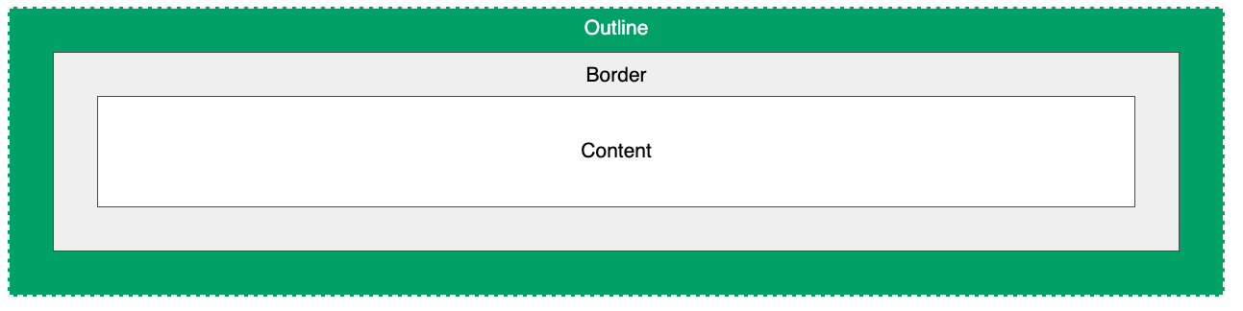
outlines
CSS outlines are a way to draw a line around an element, outside of the element's border. They can be used to highlight or emphasize an element, or to make it stand out from the background.
The outline property is a shorthand property that is used to set the outline width, style, and color all at once. It has the following syntax:
outline: <outline-width> <outline-style> <outline-color>;

Slide 6

Flexbox
Flexbox is a layout module in CSS that makes it easier to create flexible, responsive designs. It allows elements within a container to be aligned and distributed in various ways, such as horizontally or vertically. Flexbox is particularly useful for creating flexible grid layouts, and it can also be used to create responsive navigation bars and other UI elements. It has a set of CSS properties that can be used to control the layout of elements within a flex container, such as flex-direction, justify-content, and align-items. Flexbox is supported in most modern web browsers.

Slide 7
Javascript
Programming languages are a set of instructions that a computer can understand and execute. They are used to create software, applications, and other computer programs. There are many different types of programming languages, each with its own set of features and capabilities.
The basic concepts of programming languages include:
Syntax: The set of rules that dictate how a programming language should be written. This includes things like keywords, variable names, and operator symbols.
Variables: A container that holds a value that can be changed during the execution of a program.
Data Types: The type of data that a variable can hold, such as numbers, text, or true/false values.
Control Flow: The ability to control the flow of a program by making decisions and looping through sets of code.
Functions: A block of code that can be reused throughout a program.
Libraries: A collection of pre-written code that can be used to perform common tasks.
Object-oriented Programming (OOP): A programming paradigm that organizes code into objects, which have properties and methods.
Event-driven Programming: A programming paradigm that is based on reacting to specific events, like mouse clicks or button presses.
These concepts are common among many programming languages and are the basic building blocks of writing software. However, each language has its own unique syntax, set of libraries and frameworks, and specific uses cases. Some popular programming languages are C, C++, C#, Python, Java, JavaScript, Ruby, and Go.

Slide 8
CSS GRID
CSS Grid is a two-dimensional layout system for creating flexible and dynamic web pages. It allows designers to divide a web page into rows and columns, making it easier to arrange and align elements on a page. The CSS Grid Layout module enables authors to control the size, position, and layering of grid items within a grid container, making it an ideal solution for creating complex and responsive web designs. Some key features of CSS Grid include the ability to specify grid-template-rows and grid-template-columns, to create a grid of rows and columns of specific sizes, and the ability to place grid items into grid cells using grid-row and grid-column properties.

Slide 9
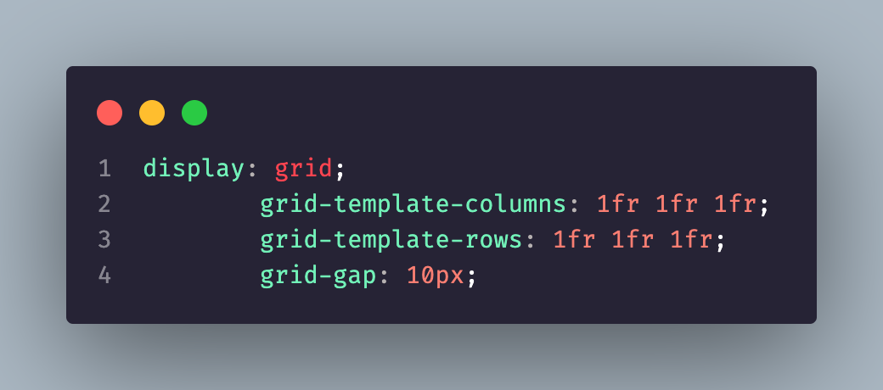
How to start?

Slide 10
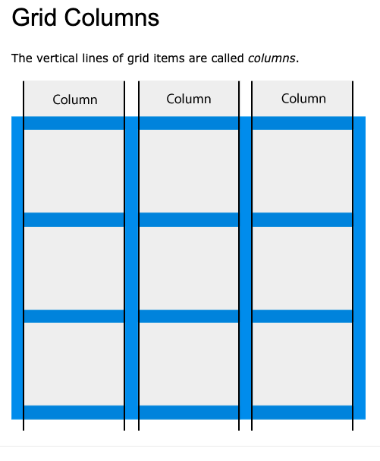
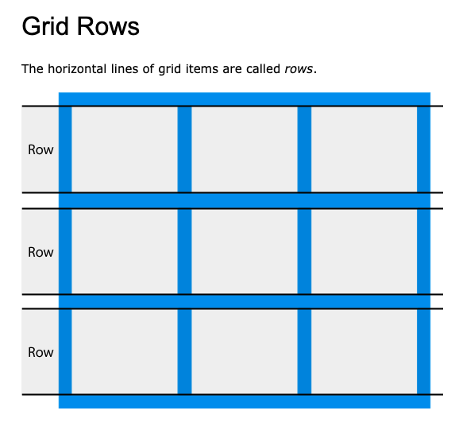
How is it looks like ?

Slide 11
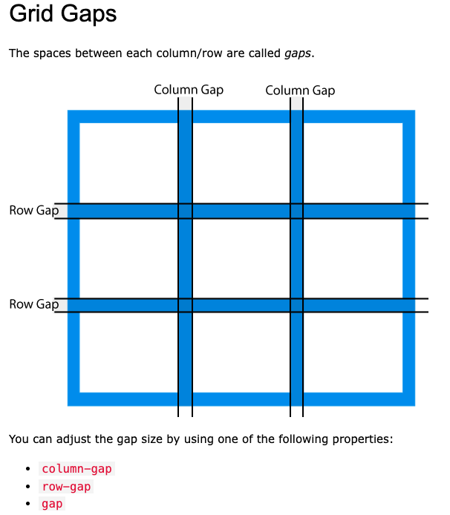
Gaps - grid

Slide 12
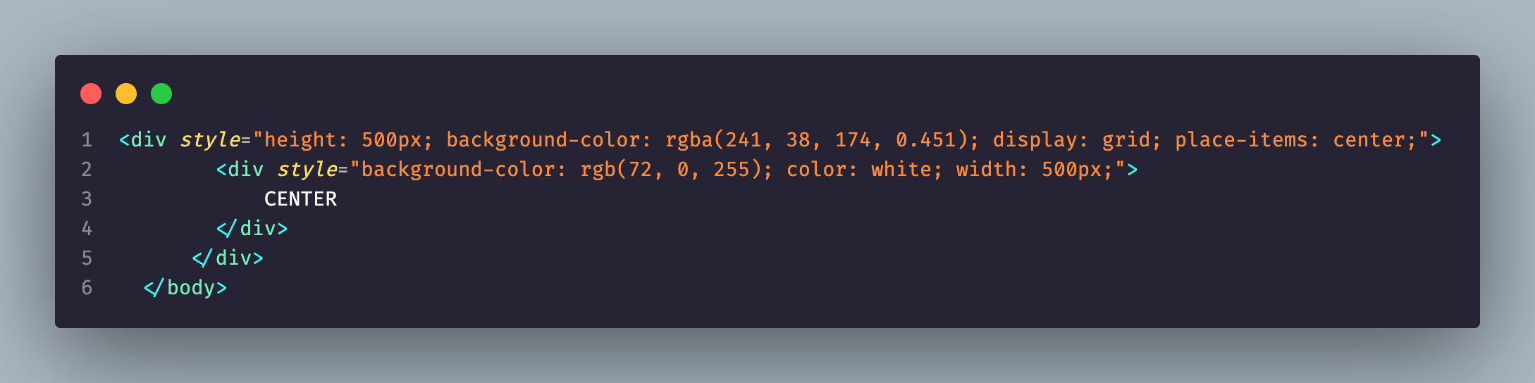
Center me just for fun!

Slide 13
Grid template columns
Grid template columns is a CSS property that allows you to specify the number of columns in a grid container and the width of each column. It is used in conjunction with CSS grid layout to create a flexible and responsive grid-based layout for web pages. The grid template columns property is set on the container element and its value is a series of values separated by spaces, each value representing the width of a column in the grid. The grid layout then uses these values to determine the number and size of columns in the grid.

Slide 14
Grid templete rows
Grid Template Rows is a CSS property that defines the number and size of rows in a grid container. The property is set on a grid container element and is used to specify the size and pattern of rows in the grid. The value of the property can be a length value (e.g. 50px), a percentage value (e.g. 20%), or a repeating pattern of these values (e.g. 50px 1fr). The rows created by this property provide the structure for placing grid items (e.g. child elements) within the grid.

Slide 15

Let’s work and learn

Slide 16
grid-column-start and grid-column-end
grid-column-end and grid-column-start are CSS grid properties that define the ending and starting points of a grid item's column along the horizontal (x) axis. These properties are used to determine the size and position of a grid item within the grid container. The values of these properties can be specified as either a number (representing the line number) or a keyword (such as 'span'). The line numbers start from 1, and the end line is always one line beyond the last column line.

Slide 17
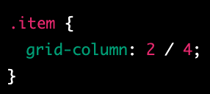
grid-column
grid-column is a CSS grid shorthand property that sets both the grid-column-start and grid-column-end properties in a single declaration. It is used to specify the position and size of a grid item along the horizontal (x) axis. The values of grid-column can be specified as either one or two values.
There is a short version
Grid-column: span 2;

Slide 18
grid-row-start and grid-row-end
grid-row-start and grid-row-end are CSS grid properties that define the starting and ending points of a grid item's row along the vertical (y) axis. These properties are used to determine the size and position of a grid item within the grid container. The values of these properties can be specified as either a number (representing the line number) or a keyword (such as 'span'). The line numbers start from 1, and the end line is always one line beyond the last row line.

Slide 19
grid-row
grid-row is a CSS grid shorthand property that sets both the grid-row-start and grid-row-end properties in a single declaration. It is used to specify the position and size of a grid item along the vertical (y) axis. The values of grid-row can be specified as either one or two values.

Slide 20
repeat
The "repeat" in CSS Grid refers to the ability to repeat a pattern of columns or rows defined by a grid template. It allows for creating grid items that repeat in a grid, saving the time and effort of specifying the layout for each individual item. The repeat() function takes two arguments: the number of times to repeat the pattern, and the pattern itself. For example: "repeat(3, 1fr 50px)" means repeating the pattern of 1fr followed by 50px three times in a row.

Slide 21
justify-items and align-items
justify-items and align-items are CSS properties that are used in grid layout to align the grid items within the grid container along the horizontal and vertical axes, respectively.
justify-items is used to align the grid items along the x (horizontal) axis within the grid container. Its values include: start, end, center, stretch, space-between, space-around, and space-evenly.
align-items is used to align the grid items along the y (vertical) axis within the grid container. Its values include: start, end, center, stretch, and baseline.

Slide 22
Place-items
Is a short hand for both of them you can just place-items:center;

