Slide 1

React / Next.ts
Let the game begin

Slide 2
What is Next.js?
Next.js is a React framework developed and maintained by Vercel. It provides a solution to build server-rendered React applications, static websites, and more. The framework offers features like server-side rendering (SSR), static site generation (SSG), automatic code splitting, hot module replacement, and many other features right out of the box.

Slide 3
When should you use Next.js?
Next.js is particularly useful when you need to build a highly performant, SEO-friendly web application. Some common use cases include:
Server-Side Rendered applications: Next.js shines when you need to build an application that relies on server-side rendering. This is particularly useful when you need to improve the initial page load time, which can be crucial for SEO.
Static Site Generation: If you need to build a blog, portfolio, or any website with content that doesn't change often, Next.js is an excellent choice due to its static site generation capabilities.
API Routes: If you want to build a web application that also includes API endpoints, Next.js comes with API routes out of the box.
Performant application: Next.js automatically splits your code into various bundles, so users only load what's necessary for each page. This improves performance.

Slide 4
Why should you use Next.js?
Improved SEO: Traditional single-page applications (SPAs) built with React suffer from SEO issues because the content is loaded client-side and search engine bots often see an empty page. Next.js offers SSR and SSG, which allows search engine bots to see the fully rendered page.
Performance optimization: Next.js automatically implements code splitting, which means every page only loads what’s necessary for that page. This leads to faster page loads.
Development experience: Next.js offers features like hot code reloading, automatic routing, and universal rendering which make development smoother.
Incremental Static Regeneration: This feature allows you to update static content after you have built your site, without needing to rebuild the entire site. This makes it ideal for sites with static content that needs to update frequently.
Versatility: Next.js works great for both small and large scale applications. It's a great choice whether you're creating a personal project or a large, enterprise-level application.
Community and Ecosystem: Since Next.js is built on top of React, you have access to the robust React ecosystem, and there's a large community for Next.js itself as well.

Slide 5
folder structure
.next/: This is a folder generated automatically when you run your Next.js application in development mode (npm run dev). It contains the compiled version of your project and should not be touched.
node_modules/: This folder contains all the dependencies and libraries used in your project. They are installed via npm or yarn.
pages/: This is one of the most important folders in a Next.js project. Every file in the pages directory becomes a route. For example, pages/index.js maps to your site's homepage (/). If you create a pages/about.js, it will be accessible at /about. The pages/api directory is used for creating API routes.
_app.js: This file is used to initialize pages. You can apply page-level layouts, keep state between page transitions, add global CSS styles, etc. It's a sort of wrapper component for all your other pages.
_document.js: This file is used to augment your application's <html> and <body> tags. This is commonly used to insert shared page headers, stylesheets, etc.

Slide 6
More folders
public/: The public directory is used to serve static assets such as images, scripts, or stylesheets. Files inside the public folder can be referenced from the root of the application similar to the pages folder.
styles/: This folder is typically used for storing your CSS or Sass files. If you're using CSS-in-JS solutions like styled-components or emotion, you might not have this folder.
package.json: This file includes metadata about your project and its dependencies. When you install a package using npm or yarn, it gets listed here under "dependencies" or "devDependencies".
next.config.js: This optional file is used to configure advanced features of Next.js. It's not created by default, you would create it when you need to customize the default settings provided by Next.js.

Slide 7
What is React?
React is a JavaScript library for building user interfaces, primarily for single-page applications. It's used for handling the view layer for web and mobile apps. React allows you to design simple views for each state in your application, and it efficiently updates and renders the right components when your data changes.

Slide 8
Tsx?
TSX stands for TypeScript XML. It is a syntax extension for TypeScript, the statically typed superset of JavaScript developed by Microsoft, that includes JSX support. JSX, which stands for JavaScript XML, is a syntax extension for JavaScript that allows you to write HTML-like syntax directly in your JavaScript (or TypeScript) code.
The combination of TypeScript and JSX (TSX) provides a powerful development environment, allowing you to leverage the features of both technologies. TypeScript brings static typing to your codebase, improving tooling capabilities and making your code more predictable and easier to debug. JSX, on the other hand, brings a declarative syntax for building user interfaces in JavaScript.

Slide 9
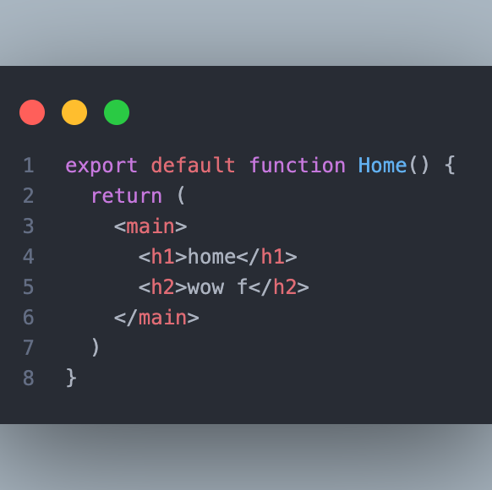
How do we start?
We start by exporting a function, with tsx

Slide 10
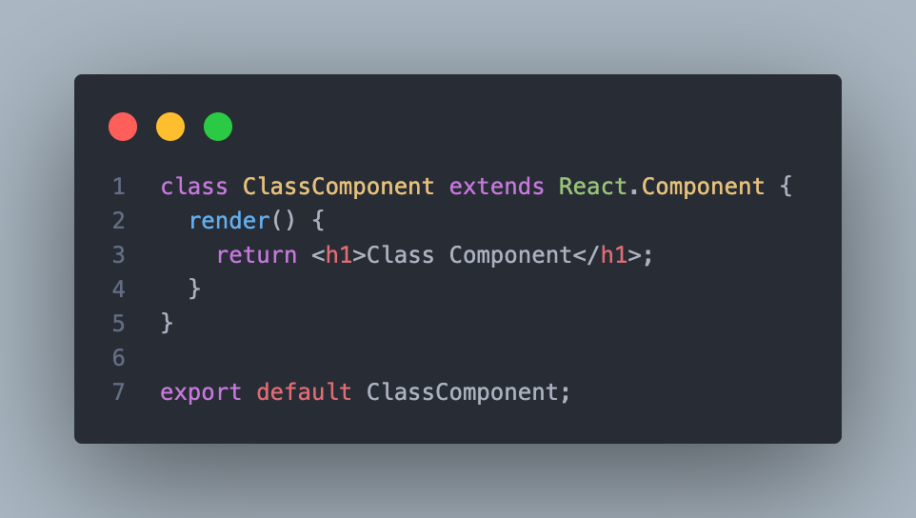
Classes?
You can create a class component but this is old and we will no deal with this anymore !

Slide 11
Let’s start count (useState)
In React, useState is a built-in hook that allows functional components to have state variables. Prior to React 16.8, state could only be managed in class components using the this.state approach, but with the introduction of hooks, functional components gained the ability to manage state as well.
The useState hook is used to declare state variables inside functional components, providing a way to store and update state data without the need for a class. It takes an initial value as its argument and returns an array containing the current state value and a function to update that state.

Slide 12
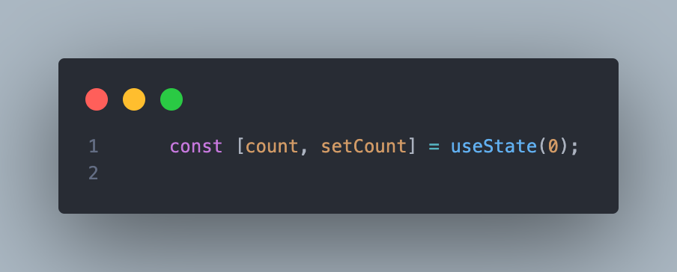
Example

Slide 13
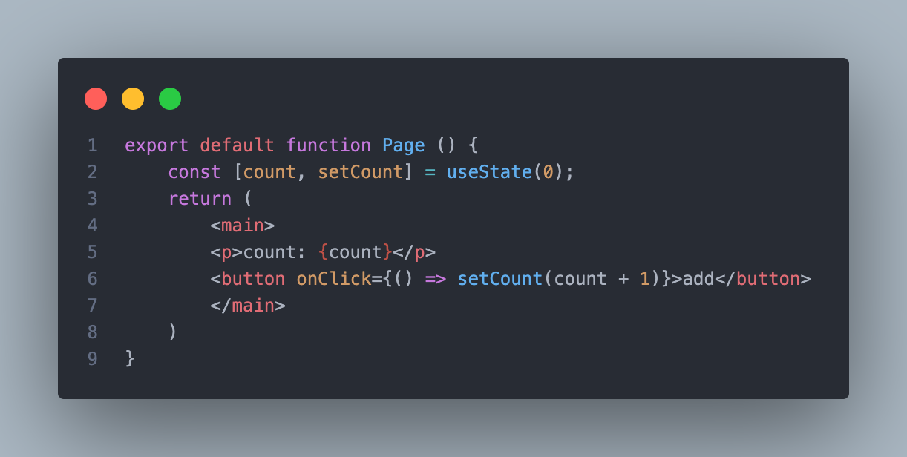
In a component

Slide 14
Why do we need the function
stateVariable: This is the current value of the state variable. You can access and use it just like any other variable in your component.
setStateFunction: This is a function provided by React to update the state. When you call this function with a new value, React will re-render the component with the updated state.
initialValue: This is the initial value you want to set for the state variable.

Slide 15
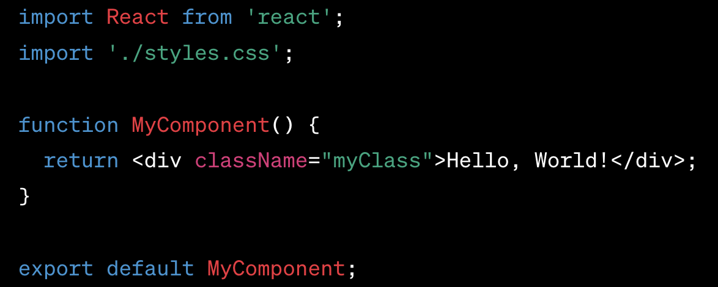
Wait what with my css?
Regular CSS Import: You can use the regular CSS import syntax to include a CSS file in your component or application. This method is straightforward and widely used.

Slide 16
Wait what is the className?
In React, the className attribute is used to apply CSS classes to HTML elements and components. It is the React equivalent of the traditional class attribute used in regular HTML. Since class is a reserved keyword in JavaScript, React uses className to set the class name for an element.

Slide 17
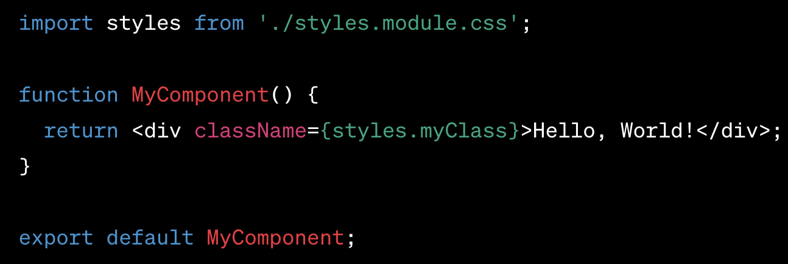
CSS Modules:
CSS Modules allow you to write modular CSS code and import it into your component. When you use CSS Modules, your styles will be scoped to the component, avoiding any global style clashes.
To use CSS Modules, rename your .css files with the .module.css extension, and then import them in your component like this:

Slide 18
explain
CSS Modules is a technique used in React (and other frameworks) to scope CSS styles to a specific component or module. It is an alternative way to manage styles that helps avoid global style clashes and promotes modular and maintainable CSS code. CSS Modules allow you to define styles for a component in a separate CSS file and use unique class names that are locally scoped to that component.
Scoped Styles: When using CSS Modules, each component gets its own unique class names, effectively scoping the styles to that specific component. This means that the styles defined in one component will not affect other components, helping to prevent unintended style conflicts.

Slide 19
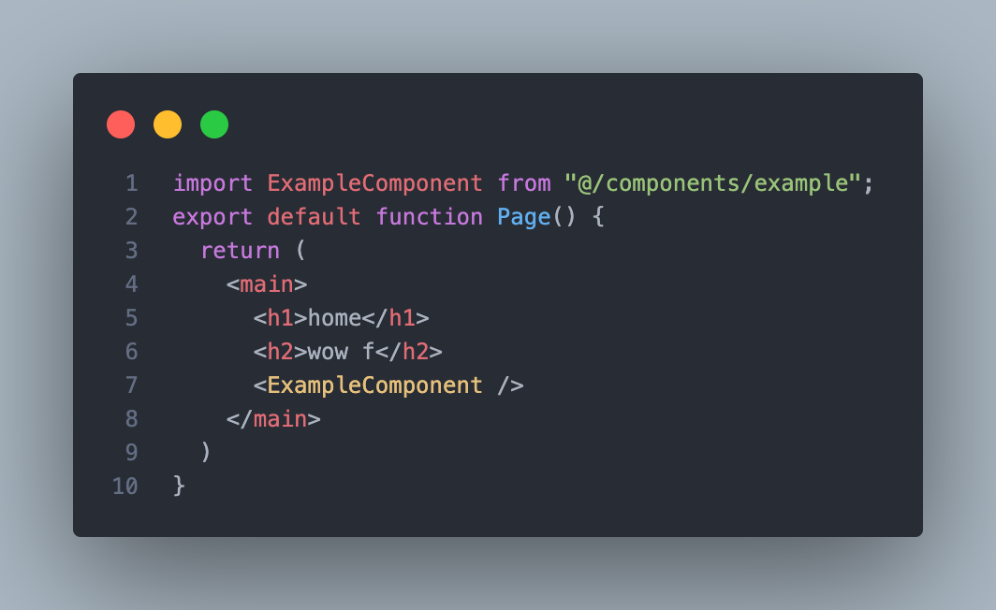
Import components

Slide 20
layout
https://nextjs.org/docs/app/building-your-application/routing/defining-routes

Slide 21
props
In React, "props" is an abbreviation for "properties," and it's a mechanism for passing data from a parent component to a child component. Props are a fundamental concept in React and play a significant role in building reusable and modular components.
When you create a React component, you can pass data to it by setting attributes (props) in the component's JSX tag. These props are then accessible within the component and can be used to customize its behavior, appearance, or any other aspect of the component's rendering.

Slide 22

Optinal props just put ?

Slide 23
useEffect
useEffect is a React Hook that allows you to perform side effects in functional components. Side effects refer to any action that affects the external world, such as fetching data from an API, subscribing to events, updating the document title, or manipulating the DOM.
In class components, side effects were typically handled using lifecycle methods like componentDidMount, componentDidUpdate, and componentWillUnmount. However, with the introduction of React Hooks, you can achieve the same functionality in functional components using the useEffect hook.

Slide 24
useEffect
useEffect is a React Hook that allows you to perform side effects in functional components. Side effects refer to any action that affects the external world, such as fetching data from an API, subscribing to events, updating the document title, or manipulating the DOM.
In class components, side effects were typically handled using lifecycle methods like componentDidMount, componentDidUpdate, and componentWillUnmount. However, with the introduction of React Hooks, you can achieve the same functionality in functional components using the useEffect hook.

