Slide 1
Dashbored
File created on: 02/01/2025 3:20:19 GMT+2

Slide 2
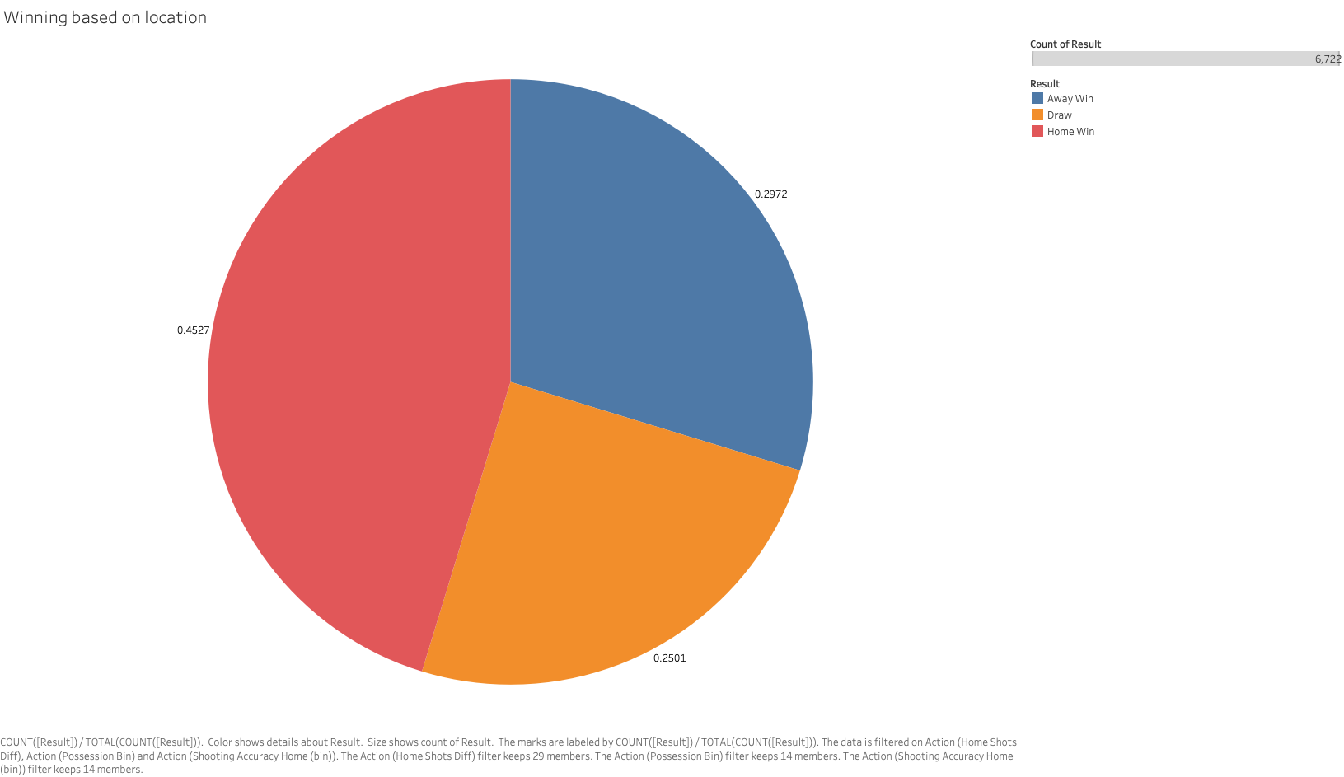

Slide 3
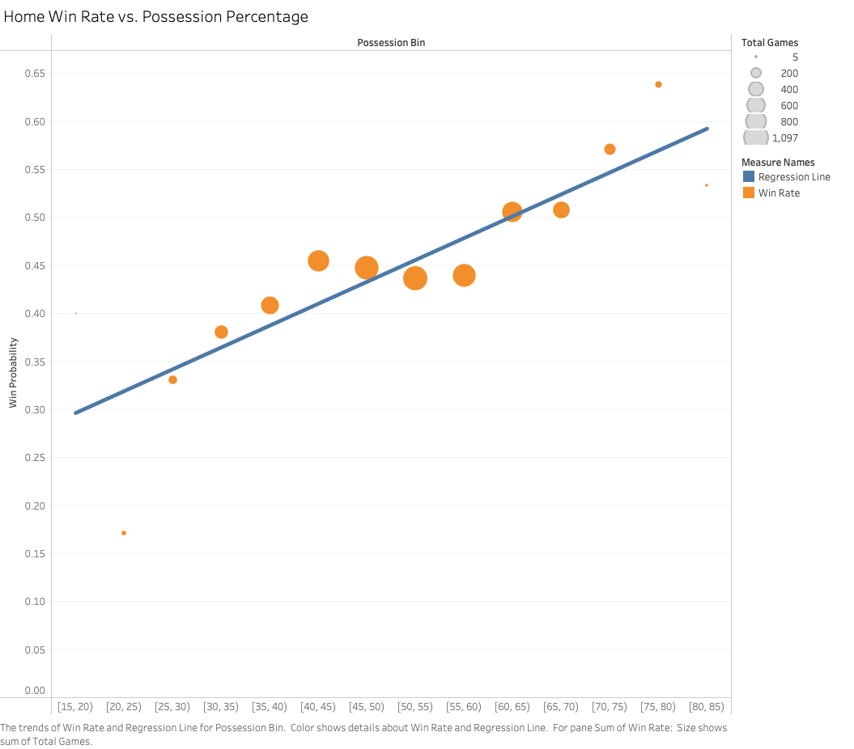

Slide 4
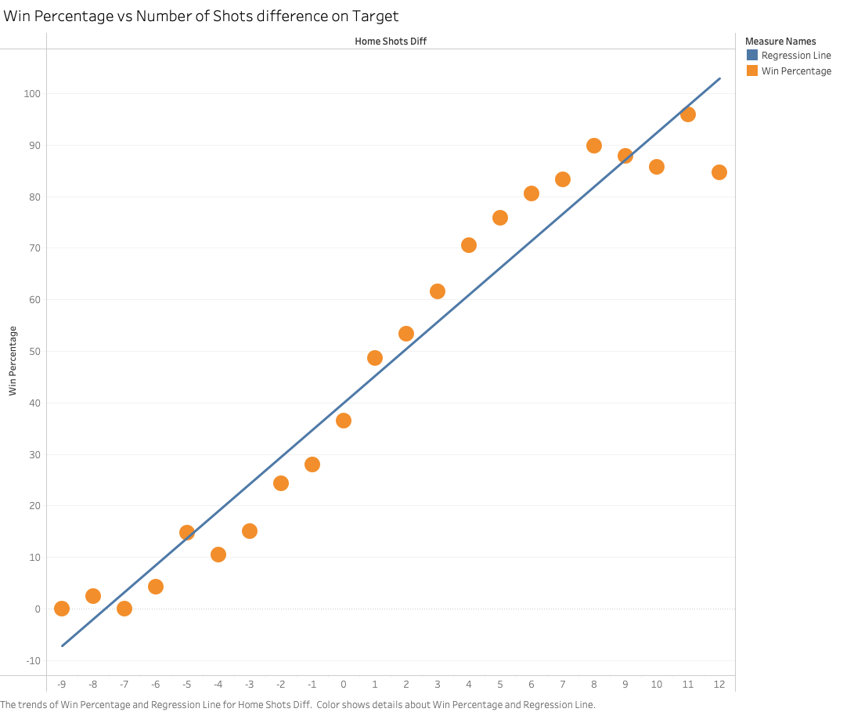

Slide 5
