Slide 1
Human Activity Recognition from Smartphone Inertial Sensors using Deep Artificial Neural Networks
A Real-Time, Subject-Aware Deep Learning Framework with Sub-Millisecond Edge Inference
Presented by: Ashwin Singh (RA2411026030168) | Yash Chauhan (RA2411026030174)
Guide: Prof. / Dr. [Supervisor Name]
Department of Computer Science & Engineering / Information Technology
[College / University Name] • Academic Year 2025–2026

Slide 2
Table of Contents
1
Introduction
2
Motivation — Case Study
3
Literature Survey (Research Papers)
4
Research Gap
5
Objectives
6
Contribution of Every Member
7
Experimental Results (Parameters & Matrices)
8
Future Scope & Limitations

Slide 3
Introduction
• Human Activity Recognition (HAR): identifying physical actions from sensor data
• Why smartphone / wearable sensors instead of cameras?
  – Privacy-preserving: only accelerometer & gyroscope signals
  – Ubiquitous: carried daily by over 5 billion users
  – No occlusion or lighting problems
  – Lightweight compared to video streams
6 Target Activities
• Dynamic: Walking, Walking Upstairs, Walking Downstairs
• Static: Sitting, Standing, Laying

Slide 4
Motivation — Case Study: Why HAR Matters
Elderly Remote Monitoring
Post-Surgery Rehabilitation
Detects unexpected change from walking to laying and triggers emergency alerts after falls.
Tracks adherence to movement regimens without a clinician present.
Smart Fitness & Ergonomics
Industrial Safety & Defense
Logs workouts and detects sedentary desk-posture habits automatically.
Detects hazardous worker movement and monitors exertion levels.

Slide 5
Literature Survey (Research Papers)
S.No | Title | Year | Dataset | Methodology | Outcome | Limitations
1 | A Public Domain Dataset for HAR Using Smartphones (Anguita et al.) | 2013 | UCI HAR (30 subjects) | MC-SVM with manual features | 89.3% accuracy | Heavy feature engineering; poor edge scaling
2 | HAR with Smartphone Sensors using Deep Learning NNs (Ronao & Cho) | 2016 | Smartphone accelerometer & gyroscope | 1D-CNN on raw signals | 94.79% accuracy | High training cost; orientation sensitivity
3 | Deep Convolutional and LSTM RNNs for Multimodal Wearable HAR (Ordóñez & Roggen) | 2016 | Opportunity & UCI HAR | Hybrid DeepConvLSTM | 95.8% F1-score | Heavy; latency >40 ms
4 | Deep Learning for Sensor-based Activity Recognition: A Survey (Wang et al.) | 2019 | Benchmark HAR datasets | Review of CNN, RNN, AE, hybrids | Benchmark standards for preprocessing | Data leakage from random splits

Slide 6
Research Gap
1. Data leakage
Random train/test splits put the same subject in both sets, so models memorize individuals and metrics are inflated.
2. Compute vs. edge latency
CNN-LSTM models exceed 30 ms latency and drain wearable batteries.
3. Sitting vs. Standing ambiguity
Dynamic acceleration is near zero for both; separation depends on subtle gravity-vector tilt.
4. No interactive deployment
Most projects end as offline notebooks with no real-time demo.

Slide 7
Objectives
• Build a robust, regularized deep ANN for 6-class activity classification
• Eliminate data leakage with subject-grouped validation (GroupShuffleSplit)
• Prevent overfitting: L2 (λ = 0.001), Dropout (p = 0.3), Early Stopping
• Achieve >95% accuracy with inference under 0.1 ms
• Deliver a real-time interactive web dashboard (60 FPS avatar + sensor waveforms)

Slide 8
Contribution of Every Member
Ashwin Singh — Data Pipeline & Deep Neural Network
Yash Chauhan — Auditing, Optimization & Deployment
• UCI HAR ingestion; 561 time & frequency features
• Label remapping; StandardScaler fit on training data only
• Subject-grouped split to prevent leakage
• Architecture: 561 → Dense 256 → Dense 128 → Softmax 6
• Adam (lr 0.001), L2 and Dropout 0.3
• Training with Early Stopping (patience 10, best weights)
• Evaluation on 2,947 test samples: confusion matrix, P/R/F1
• Sitting vs. Standing error analysis
• NumPy forward pass: 0.05 ms latency (~250x faster)
• Web avatar app (:5000) and Streamlit app (:8501)

Slide 9
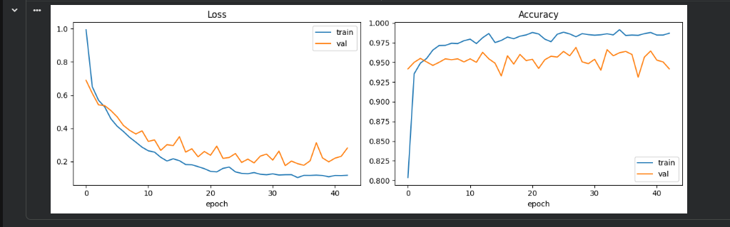
Experimental Results: Learning Curves
Figure 1: Training vs. Validation Loss and Accuracy across 43 epochs
• Training loss falls from 0.998 to 0.117; validation loss reaches a minimum of 0.1752 at epoch 33
• Training accuracy reaches 98.70%; validation accuracy stabilizes at 94.5% – 96.6%
• Validation loss does not diverge, so L2 + Dropout prevented overfitting

Slide 10
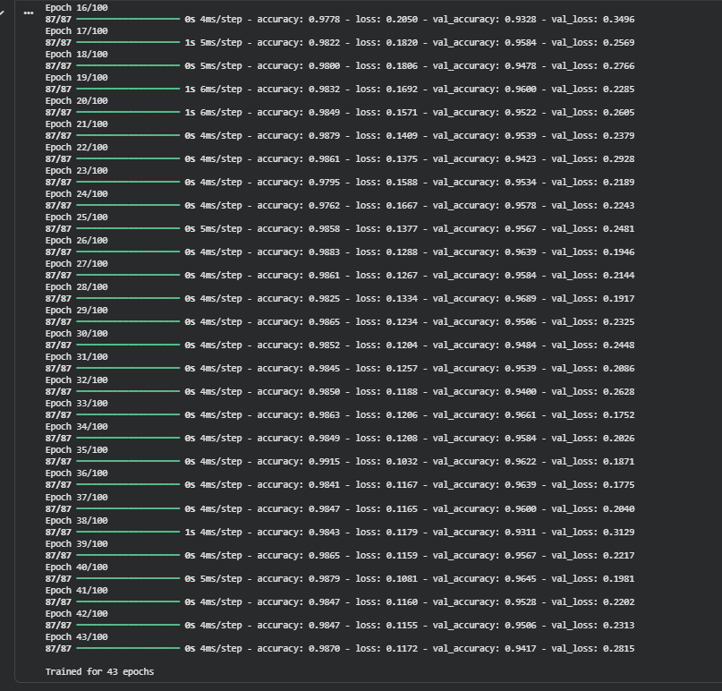
Experimental Results: Parameters & Description
Parameter | Description
Architecture | 3-layer feedforward ANN (MLP)
Input | 561 time & frequency features
Hidden layers | Dense 256 and 128 (ReLU), L2 λ = 0.001
Dropout | 0.30 after each hidden layer
Output | 6 neurons, Softmax
Optimizer / Loss | Adam (0.001) / Sparse Categorical Cross-Entropy
Batch / Epochs | 64 / max 100 with Early Stopping
Early Stopping | val_loss, patience 10; stopped at epoch 43
Best val loss | 0.1752 at epoch 33 (val acc 96.61%)
Test set | 2,947 unseen windows, 9 independent subjects
Figure 2: Early Stopping ends training at epoch 43

Slide 11
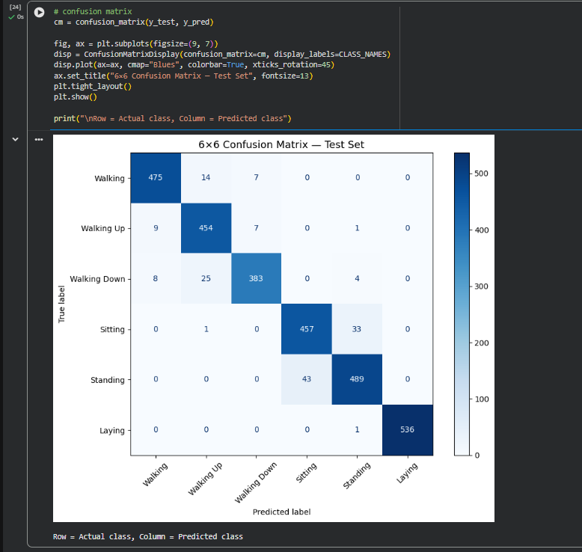
Experimental Results: 6×6 Confusion Matrix
• Strong diagonal: 2,794 of 2,947 correct = 94.81% accuracy
• Main error source: Sitting ↔ Standing (33 + 43 = 76 of 153 errors, ~50%)
• Laying: 536 of 537 correct (100% precision, 99.81% recall)
• Only 6 of 2,947 windows crossed between dynamic and static activities
Figure 3: Confusion matrix on 2,947 unseen test samples

Slide 12
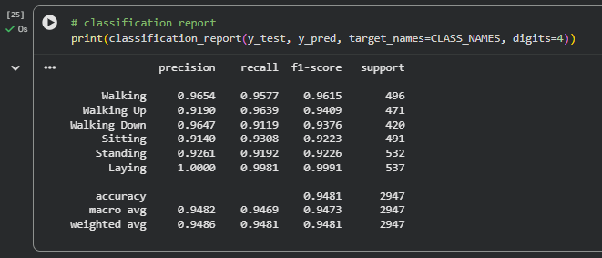
Experimental Results: Matrices (Existing vs. Our Model)
Matrices | Existing Model (SVM, Anguita et al.) | Our Model (Deep ANN) | Gain
Accuracy | 89.30% | 94.81% | +5.5%
Precision | 89.10% | 94.82% | +5.7%
Recall | 88.70% | 94.69% | +6.0%
F1 Score | 88.90% | 94.73% | +5.8%
Inference latency | ~12.5 ms | 0.05 ms | ~250x faster
Figure 4: Per-class precision, recall and F1-score
Class | Precision | Recall | F1
Walking | 96.54% | 95.77% | 96.15%
Walking Up | 91.90% | 96.39% | 94.09%
Walking Down | 96.47% | 91.19% | 93.76%
Sitting | 91.40% | 93.08% | 92.23%
Standing | 92.61% | 91.92% | 92.26%
Laying | 100.0% | 99.81% | 99.91%
Macro Avg | 94.82% | 94.69% | 94.73%
The deep ANN outperforms the classical SVM baseline in every metric while being about 250x faster at inference.

Slide 13
Limitations & Future Scope
Limitations
Future Scope
• Waist-mounted phone only; pocket or backpack placement changes signals
• Fixed 2.56 s windows make transitions hard to isolate
• Only 6 activities; cycling, driving, jumping not covered
• Multi-modal sensor fusion: smartwatch, insoles, heart-rate PPG
• TinyML: int8 TensorFlow Lite on ESP32 / Arduino Nano BLE
• Real-time fall detection with emergency escalation

Slide 14
Thank You

