Slide 1

A Lightweight Machine Learning Framework for Mitigating DoS Attacks in IoT Networks
Palguni T R 1SI22AD031
Deepthi U 1SI22AD012
Meghashree R 1SI22AD026
Guide :
Dr. M B Nirmala
Associate Professor

Slide 2
Introduction to the Project
The rapid growth of IoT devices has brought transformative benefits across various industries, but it has also introduced critical security vulnerabilities, especially to Denial of Service (DoS) attacks. These attacks overwhelm IoT networks by flooding them with malicious traffic, leading to service disruptions.
This project proposes a lightweight machine learning framework designed to detect and mitigate DoS attacks in real-time, while maintaining minimal computational and energy overhead.
The framework clusters sensor nodes to facilitate efficient monitoring, and uses Decision Tree algorithm,random forest,K-nearest neighbor(KNN), longest short-term memory(LSTM), neural network(Multilayer perceptron) to identify malicious activity such as excessive recharge requests.
The solution provides a balance between security and resource efficiency, ensuring that IoT networks remain secure without compromising performance.

Slide 3
Problem Statement
DoS Attacks on IoT Networks: Denial of Service (DoS) attacks disrupt the availability of IoT networks by overwhelming systems with malicious traffic, causing downtime and degraded performance.
Resource Constraints of IoT Devices: IoT devices have limited computational and energy resources, making it difficult to implement traditional security solutions that require high processing power and energy.
Need for Real-time Detection: IoT networks require rapid detection and response to DoS attacks to minimize disruptions and maintain the continuous operation of critical services.
Accuracy in Detection: The detection system must accurately differentiate between legitimate traffic and attacks, avoiding false positives and negatives to ensure the integrity and availability of services.
Scalability and Efficiency: The solution must scale to accommodate growing IoT networks while minimizing computational and energy overhead to preserve the performance and longevity of resource-constrained devices.

Slide 4
Objectives:
To Develop a Lightweight Machine Learning Framework: Aim to design an efficient framework using machine learning techniques to detect and mitigate DoS attacks with minimal computational and energy overhead.
To Ensure Real-time Detection and Response: Strive to enable real-time detection and mitigation of DoS attacks, ensuring that IoT devices remain operational without significant disruptions.
To Achieve High Detection Accuracy: Focus on ensuring that the framework accurately identifies malicious traffic while minimizing false positives and false negatives, preserving legitimate traffic and system availability.
To Maintain Energy Efficiency: Aim to optimize the framework to minimize energy consumption, making it suitable for deployment on resource-constrained IoT devices without affecting their performance.
To Enhance Security and Reliability: Work towards improving the overall security, reliability, and resilience of IoT networks by providing a robust solution against DoS attacks, ensuring the continuous availability of services in these environments.

Slide 5
LITERATURE SURVEY
Paper Title | Author Name | Objective | Proposed Method | Drawbacks
An Intrusion Detection and Prevention System against DOS Attacks for Internet-Integrated WSN | Santhosh Kumar B J, Somnath Sinha | Develop an IDPS to safeguard Internet-integrated WSNs from DoS attacks, specifically focusing on flooding and jamming attacks | IDS monitors key security metrics such as PDR and residual packet energy to detect anomalies. When inconsistencies are detected,such as congestion or unauthorized access, the system takes preventive actions like blocking communication to mitigate the attacks. | Relying solely on encryption-based techniques for DoS attack prevention in WSNs has been proven inefficient, often failing to address the complexity and variety of DoS attacks effectively. Implementing a multi-layered security approach that combines anomaly detection, behavioral analysis, and machine learning techniques could enhance the detection and prevention of diverse DoS attacks in internet-integrated WSNs.
Detection of Denial-of-Service Attack in Wireless Sensor Networks: A Lightweight Machine Learning Approach | Muawia A Elsadig | Building lightweight machine learning approach for detecting DoS attacks in WSNs using a DT algorithm with the Gini feature selection method. | This study presents a lightweight machine learning approach for detecting DoS attacks in WSNs using a Decision Tree algorithm with Gini feature selection. It addresses WSN vulnerabilities, particularly resource constraints like limited energy, low computational power, and restricted bandwidth, which make them susceptible to DoS attacks. | The proposed decision tree (DT) algorithm, while effective, may not achieve the highest accuracy compared to more complex models like Random Forest (RF), which, although slower, can outperform it in certain scenarios. Utilizing an ensemble learning approach that combines the strengths of multiple classifiers, such as RF and DT, could improve accuracy

Slide 6
Dos attack Detection in wireless sensor networks (WSN)Using Hybrid Machine learning Model | G Sankara Rao Muvvala Harshitha | The primary objective of this paper is to develop an efficient and accurate method for detecting Denial of Service (DoS) attacks in Wireless Sensor Networks (WSN). | The paper proposes a hybrid machine learning model combining supervised and unsupervised techniques to detect DoS attacks in WSNs. It processes network traffic to identify abnormal patterns, leveraging multiple classifiers for improved detection while reducing computational overhead by filtering data at different network stages. | The hybrid model's complexity may lead to increased latency in real-time detection due to the integration of multiple classifiers. Implementing adaptive algorithms that dynamically adjust the classification strategy based on network conditions could enhance detection efficiency while minimizing latency in identifying DoS attacks in WSNs.
Denial of service attack detection through machine learning for the IoT | Naeem Firdous Syed, Zubair Baig | This paper aims to propose a machine learning-based framework to detect Application layer DoS attacks on the MQTT protocol in IoT systems, demonstrating high detection accuracy with reduced false positives. | The proposed framework detects MQTT-based DoS attacks in IoT environments using count-based flow and control packet field size/length features. Three machine learning algorithms—AODE, C4.5, and MLP—were evaluated, showing high effectiveness in detecting attacks using these features. | Invalid authentication attacks have minimal impact with a single source, and memory exhaustion attacks require a large volume of attack packets. Additionally, real-world dataset analysis is lacking.we will incorporate datasets for better feature assessment and enhance detection of subtle attack patterns.

Slide 7
Literature Survey phase 2
A Machine Learning Approach for DDoS (Distributed Denial of Service) Attack Detection Using Multiple Linear Regression | Swathi Sambangi and Lakshmeeswari Gondi | develop a machine learning model using regression analysis to detect DDoS and Bot attacks in a Cloud environment based on the CICIDS 2017 dataset and Friday afternoon traffic logs. | It involves applying multiple regression analysis on the CICIDS 2017 benchmark dataset, focusing on Friday afternoon traffic logs, to detect DDoS and Bot attacks in a Cloud environment. | The proposed approach has a moderate accuracy of 73.79%, which is lower than advanced models like deep learning, and its reliance on feature reduction may hinder scalability for larger datasets or real-time applications. we are implimenting 5 algoritms which gives better accuracy
An efficient and robust deep learning based network anomaly detection against distributed denial of service attacks | Ömer KASIM | an AE-SVM model for detecting DDoS attacks by reducing false positives and improving classification performance using normalized network data and feature leaning. | It uses an autoencoder for feature learning and dimensionality reduction, followed by a support vector machine for classifying DDoS attacks based on features from the CICIDS dataset and virtually generated traffic. | Deep learning methods face challenges with computational overhead and may struggle to generalize to novel, unseen DDoS attack patterns. we have used LSTM and Neural Network are better than that

Slide 8
SDN-Based Architecture for Transport and Application Layer DDoS Attack Detection by Using Machine and Deep Learning | NOE MARCELO YUNGAICELA-NAULA , CESAR VARGAS-ROSALES | implement a modular, SDN-based architecture for detecting transport and application layer DDoS attacks using multiple ML/DL models, achieving high accuracy with up-to-date security datasets. | utilizes a modular SDN-based architecture combined with multiple ML/DL models to detect transport and application layer DDoS attacks, tested on CICDoS2017 and CICDDoS2019 datasets in a simulated Mininet-ONOS environment. | Existing studies often use outdated datasets and lack real-world deployment assessments, limiting their effectiveness. we will be generating realistic datasets
Towards a machine learning-based framework for DDOS attack detection in software-defined IoT (SD-IoT) networks | Jalal Bhayo a, Syed Attique Shah b | develop a machine learning-based framework for detecting DDoS attacks in Software-Defined IoT (SD-IoT) networks, enhancing security and mitigating attack risks. | integrates a machine learning-based detection module into the SDN-WISE IoT controller, using Naive Bayes, Decision Tree, and SVM algorithms to classify network traffic and achieve high detection accuracy (up to 98.1%). | additional CPU (3%) and memory (3%) usage, which may challenge scalability in resource-constrained IoT settings. we will not be using any extra memory

Slide 9
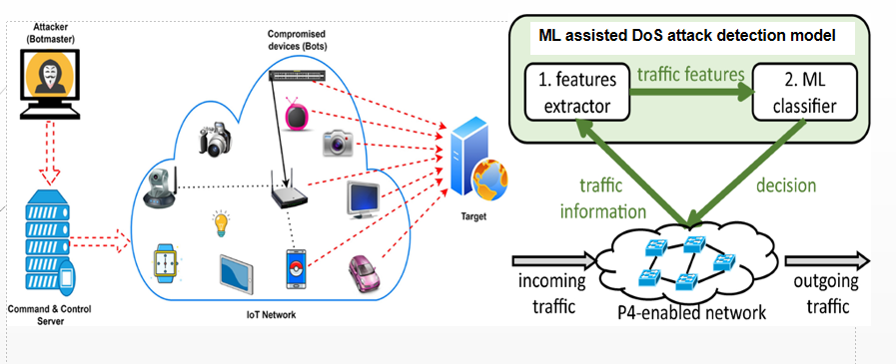
System Design
network
DOS Attack

Slide 10
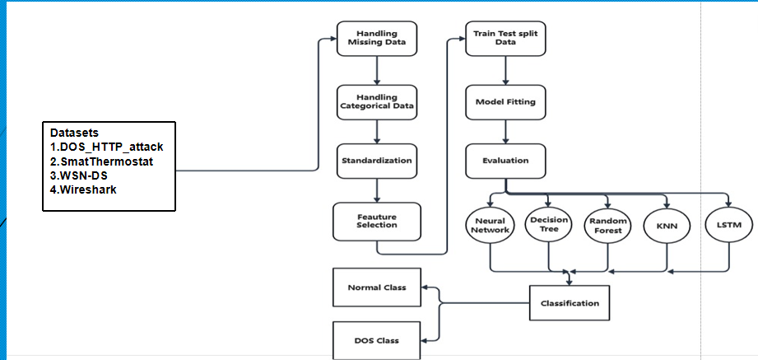
Highlevel Design
The flowchart illustrates a complete machine learning pipeline that processes Wireshark network data through preprocessing steps, trains multiple ML models (Neural Network, Decision Tree, Random Forest, KNN, LSTM), and classifies traffic as either Normal or DOS class.

Slide 11
Requirements to develop the project
Tool used | Tool Name | Description
Programming Language | Python | The primary programming language for implementing machine learning algorithms, data processing, and IoT applications due to its simplicity and extensive libraries.
Machine learning library | Scipy, | A machine learning library offering tools for preprocessing, splitting datasets, model building, and evaluation.
Data Visualization Tool | Seaborn | Built on top of Matplotlib, it helps create attractive statistical graphics.

Slide 12
Tool used | Tool Name | Description
Data Processing Library | Pandas | Essential for data manipulation and analysis, particularly for handling and preprocessing datasets effectively.
Data generation tool | Wireshark | uses libpcap (Unix) and Npcap (Windows) libraries for low-level network packet capturing and filtering.

Slide 13
Algorithm and Datasets used
Decision Tree: It is a flowchart-like structure used for classification and regression, where internal nodes represent feature tests, branches represent outcomes, and leaves represent decisions or predictions.
Random Forest: It is an ensemble learning method that combines multiple decision trees to improve accuracy and robustness. It aggregates predictions from individual trees to reduce overfitting and improve generalization in classification and regression tasks.
K-Nearest Neighbor: It is a lazy learning algorithm that classifies data points based on the majority class of their closest neighbors. It uses a distance metric (e.g., Euclidean) to find similarity between data points.
Long Short Term Memory: It is a type of recurrent neural network (RNN) designed to handle sequential data by maintaining long-term dependencies. Its gated architecture prevents vanishing or exploding gradients, making it suitable for time-series prediction and natural language processing.
Neural Network: It is a computational model inspired by the human brain, consisting of layers of interconnected nodes (neurons) that process data hierarchically. It learns patterns and relationships in data through backpropagation and weight optimization.
Datasets:Dos_Attack_HTTP_Dataset,WSN_DS,Smart Thermostat Dataset

Slide 14
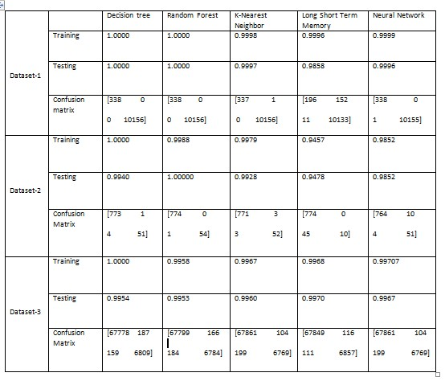
Accuracy Of Algorithm

Slide 15
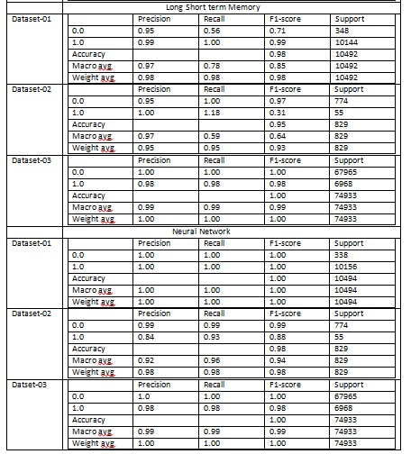
Classification Report on Test Data

Slide 16
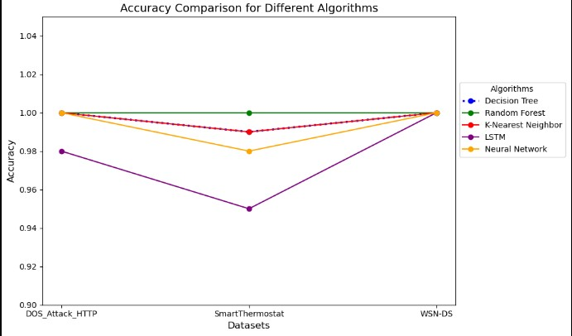
This graph compares the accuracy of Decision Tree, Random Forest, KNN, LSTM, and Neural Network across three datasets. Random Forest and Decision Tree consistently achieve high accuracy, while LSTM shows lower accuracy on the SmartThermostat dataset. Neural Network and KNN display stable performance with minor variations.

Slide 17
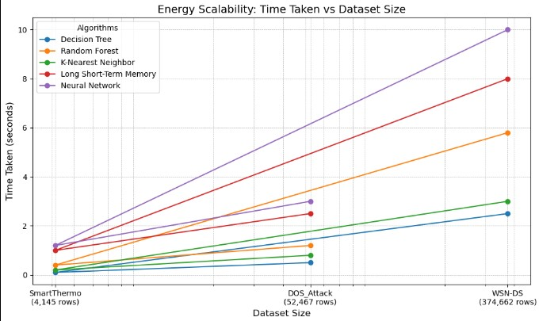
This graph shows the time taken by different algorithms as dataset size increases. Decision Tree and Random Forest are the most efficient, with minimal time increases. KNN and Neural Network require more time, especially on larger datasets, while LSTM shows the steepest time increase, indicating higher computational costs.

Slide 18
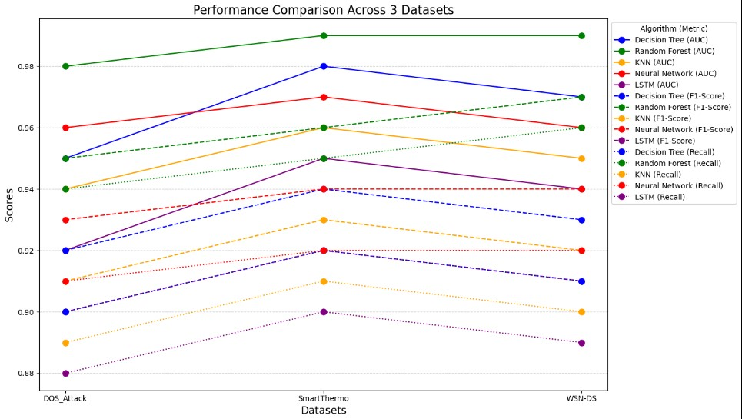
The graph compares five algorithms across three datasets using AUC, F1-Score, and Recall. Each algorithm's performance is shown with different line styles. The Y-axis displays scores from 0.88 to 0.99, and LSTM performs the best overall.

Slide 19
Introduction to Wireshark
Wireshark is a widely-used network protocol analyzer that allows users to capture, inspect, and analyze network traffic in real-time. It is a powerful tool for network troubleshooting, analysis, software and protocol development, and education.
Key Features:
Packet Capture: Wireshark captures data from live network traffic or reads from previously saved capture files.
Detailed Analysis: It provides detailed information about each packet, including headers, payloads, and protocol-specific details.
Filtering: Users can apply display and capture filters to isolate specific types of traffic, making analysis more manageable.
Protocol Support: Wireshark supports a wide range of network protocols, allowing it to dissect and interpret a variety of network communications.
Graphical User Interface (GUI): Wireshark offers a user-friendly GUI that simplifies the process of examining complex data.
Wireshark is often used by network administrators, security analysts, and developers to diagnose network issues, monitor network performance, and detect security breaches. It is open-source and available for multiple platforms, including Windows, macOS, and Linux.

Slide 20
Purpose of Wireshark
Network Troubleshooting: Wireshark helps network administrators identify and resolve network issues, such as connectivity problems, slow performance, or unusual traffic patterns.
Protocol Analysis: It enables detailed examination of network protocols, helping developers understand how different protocols behave and interact, which is useful for debugging and improving network applications.
Security Analysis: Wireshark can be used to detect malicious activity, such as unauthorized access, data exfiltration, or network attacks, making it a valuable tool for security professionals.
Education and Training: It is widely used in educational settings to teach students about networking concepts, protocols, and packet analysis.
Compliance and Auditing: Organizations can use Wireshark to ensure network traffic complies with policies and regulatory requirements.

Slide 21
Generate dataset in Wireshark
Capturing Network Traffic
Open Wireshark: Launch Wireshark on your computer.
Select the Network Interface: In the main Wireshark window, you’ll see a list of available network interfaces. Choose the interface that you want to capture traffic on (e.g., Wi-Fi or Ethernet).
Start Capturing: Click on the network interface or the Start Capturing Packets button (the blue shark fin icon). Wireshark will start capturing all the network packets on that interface.
Generate Traffic: Perform the activities you want to capture (e.g., browsing websites, downloading files, etc.).
Stop Capturing: Once you have captured enough data, click the Stop Capturing Packets button (the red square icon) or go to Capture > Stop.

Slide 22
Add Parameters:
Click Edit > Preferences, and select the protocol you want to modify under Protocols. Edit Parameters by adjusting the fields or settings available for the selected protocol, then click OK to apply the changes.
Saving the Capture
Save the Capture File:
  Go to File > Save As.
  Choose a location, file name, and file format (e.g., .pcap or .pcapng).
  Click Save to save the captured data as a dataset file.
Opening Existing Capture Files:
If you have a pre-existing capture file, you can open it by going to File > Open and selecting the capture file you want to analyze.
Filtering and Analyzing Data:
Use Wireshark’s filtering features to narrow down the dataset to specific types of traffic or protocols. This is helpful for creating datasets focused on particular network activities.

Slide 23



Slide 24
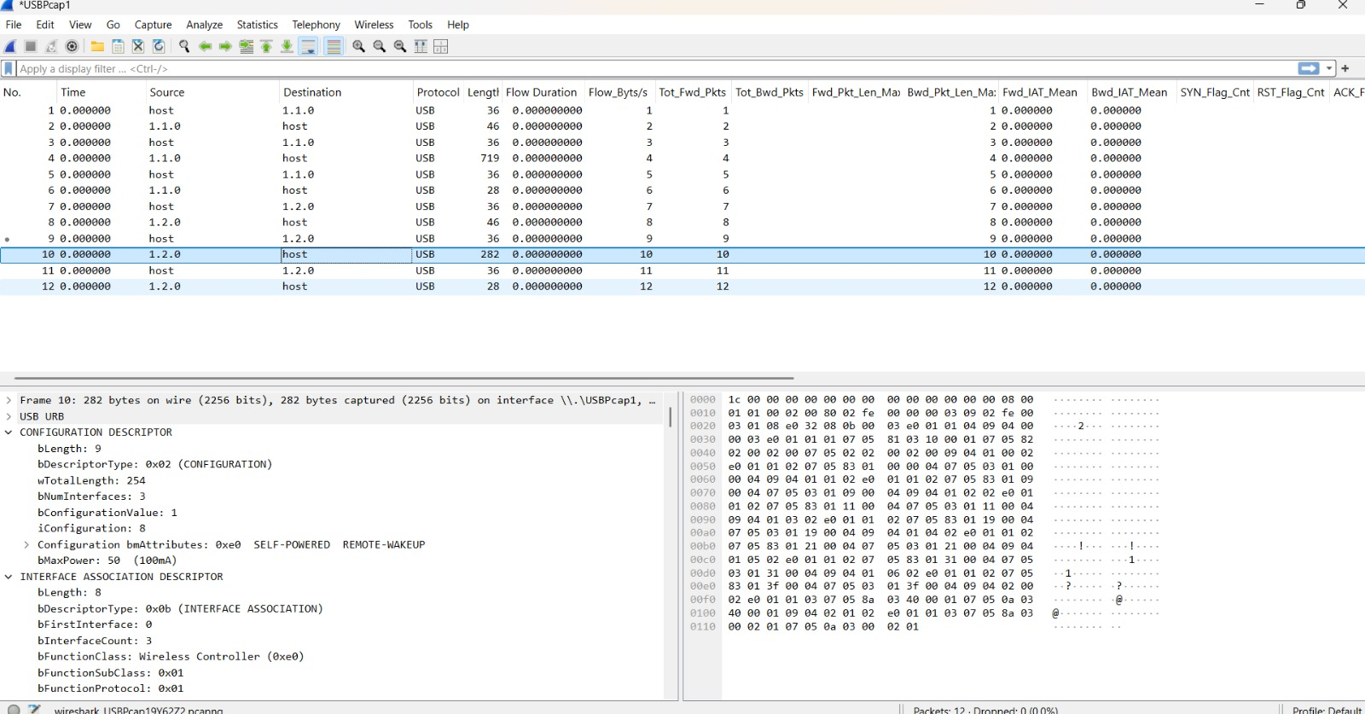

Slide 25
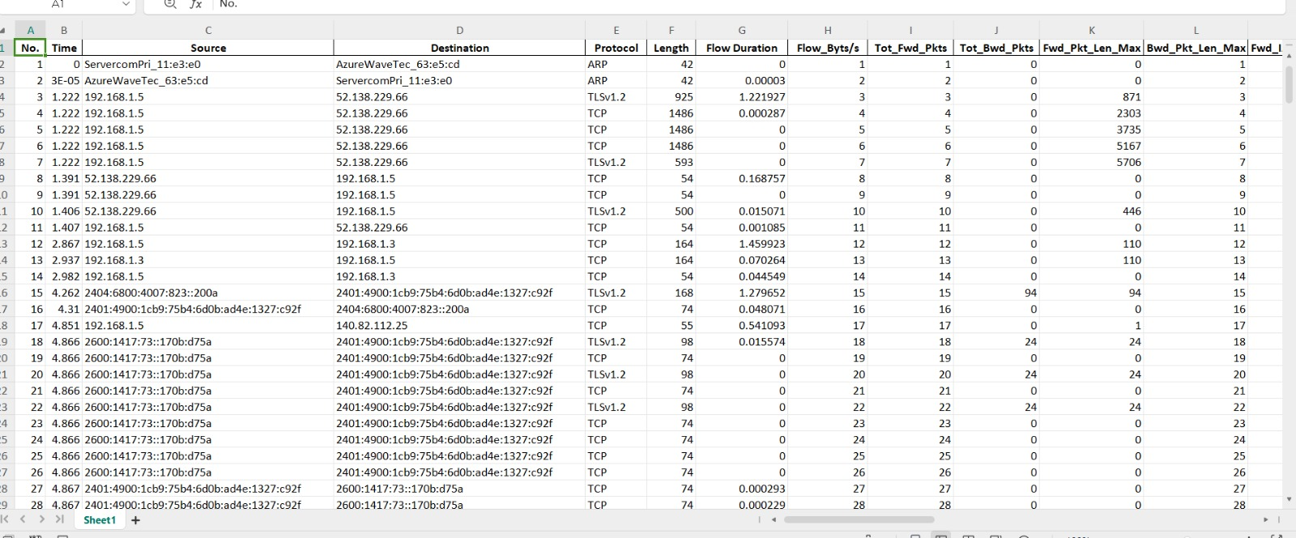
Generated dataset

Slide 26
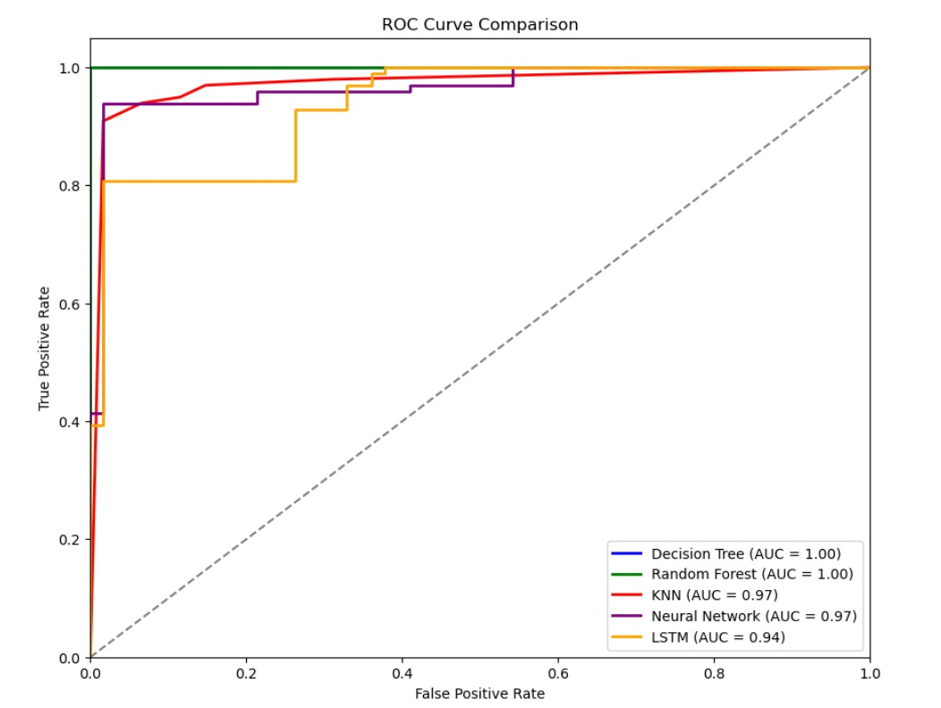
Comparison of Graph
This ROC curve compares five models: Decision Tree, Random Forest, KNN, Neural Network, and LSTM. The AUC scores show Decision Tree and Random Forest performing perfectly (AUC = 1.00), followed by KNN and Neural Network (AUC = 0.97), and LSTM (AUC = 0.94). A higher AUC indicates better model performance in distinguishing between classes. The curves closer to the top-left corner represent better-performing models.

Slide 27
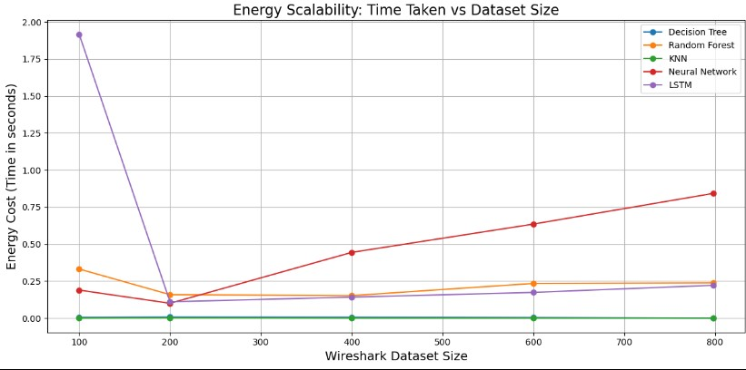
Comparison of Graph
This graph compares the energy cost (time in seconds) for different machine learning models as the size of the Wireshark dataset increases. It shows that Decision Tree, Random Forest, and KNN have relatively low and stable energy costs across different dataset sizes. Neural Network and LSTM exhibit higher energy costs, with LSTM showing a sharp decrease after an initial peak and Neural Network increasing steadily with dataset size. This indicates that simpler models are more energy-efficient for larger datasets, while complex models like LSTM may require optimization for scalability.

Slide 28
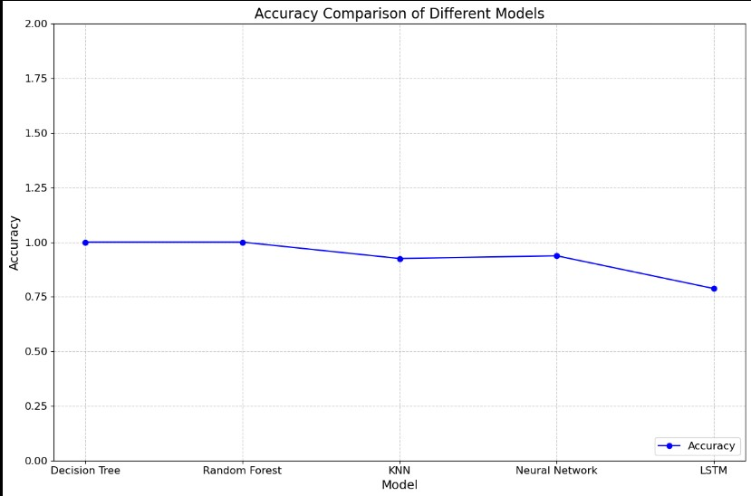
This graph compares the accuracy of five models: Decision Tree, Random Forest, KNN, Neural Network, and LSTM. Decision Tree and Random Forest achieve the highest accuracy (close to 1.0). KNN and Neural Network follow with slightly lower accuracy. LSTM shows the lowest accuracy, indicating it performed the weakest on the dataset.

Slide 29
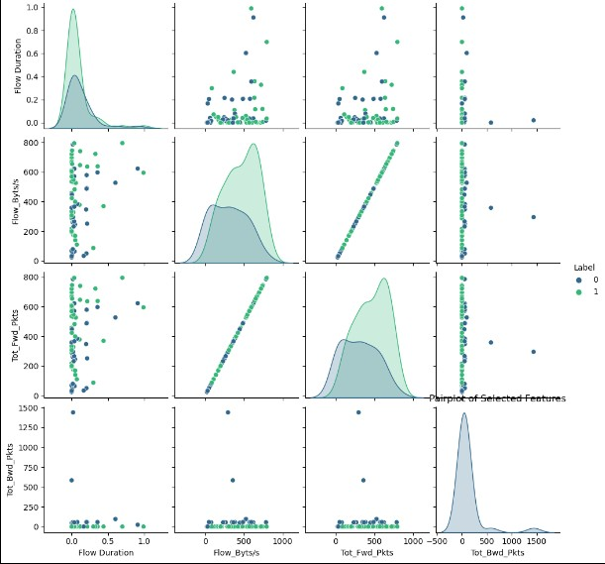
This pair plot visualizes relationships between the features Flow Duration, Flow_Byts/s, Tot_Fwd_Pkts, and Tot_Bwd_Pkts. Each scatter plot shows the interaction between two features, while the diagonal displays their distributions. The data points are color-coded by Label (0 or 1), highlighting class differences. It helps identify patterns, correlations, and feature separability between the two classes. This is useful for feature selection and understanding data distribution in a classification context.

Slide 30
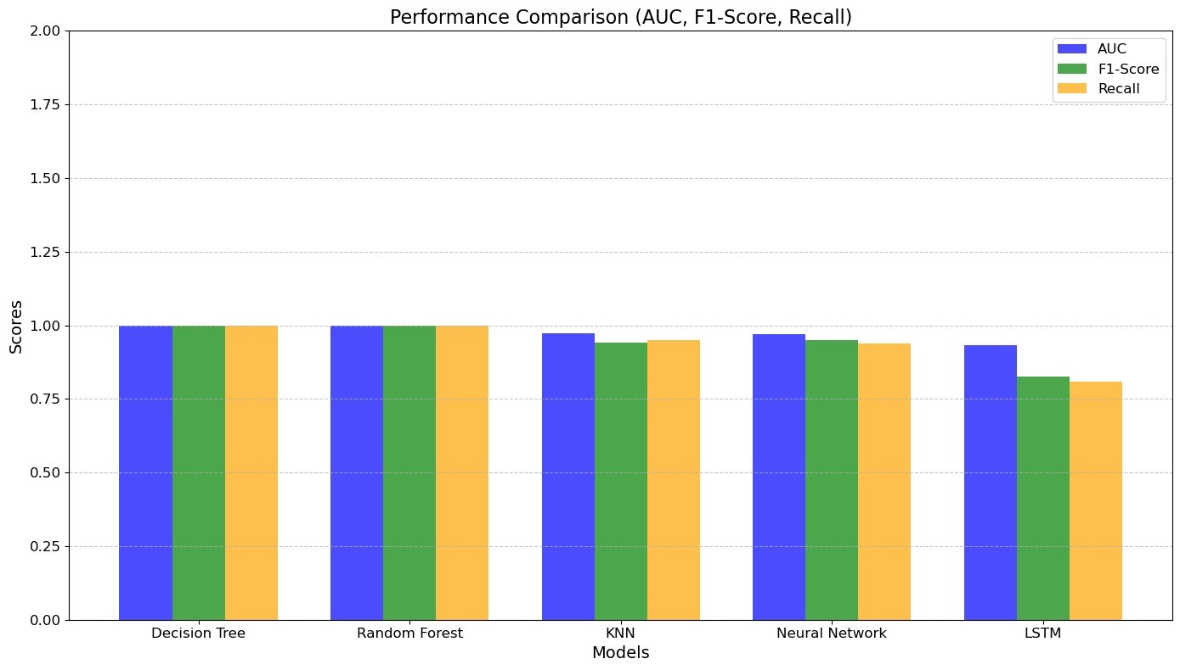
Performance comparison
The graph compares 5 machine learning models (Decision Tree, Random Forest, KNN, Neural Network, and LSTM) across 3 performance metrics (AUC, F1-Score, and Recall). Decision Tree and Random Forest show the best overall performance with scores near 1.0, while LSTM performs the worst with scores around 0.8-0.9 across all metrics.

Slide 31
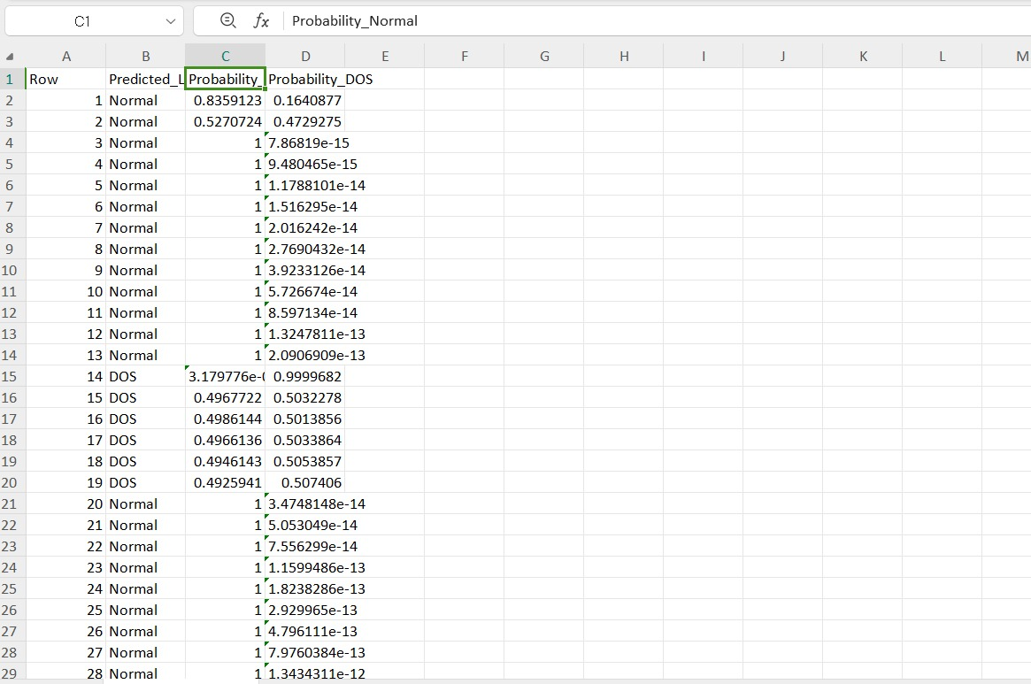
Output of generated dataset

Slide 32
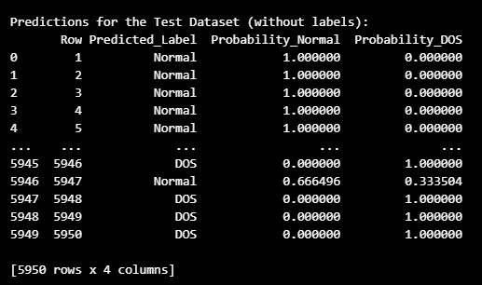
Predicted output of code

Slide 33
Applications of the Proposal
1. Smart Home Automation:
Use Case: In smart homes, various IoT devices such as smart locks, lights, and thermostats are interconnected.
Significance: The framework can monitor traffic to these devices, detecting and mitigating DoS attacks that could prevent users from controlling their home environment, thus ensuring reliability and security.
2. Healthcare Monitoring Systems:
Use Case: Wearable health devices continuously transmit data about patients’ vital signs.
Significance: By protecting against DoS attacks, the framework ensures continuous monitoring and timely alerts, which are critical for patient safety and effective healthcare delivery.
3. Industrial IoT (IIoT):
Use Case: In industrial environments, sensors and machines communicate to optimize production processes.
Significance: The framework safeguards against DoS attacks that could disrupt operations, ensuring that machinery continues to function efficiently and reducing the risk of financial losses due to downtime.

Slide 34
4. Smart Cities:
Use Case: Smart city applications involve traffic management systems, waste management, and public safety surveillance.
Significance: The framework helps maintain the availability of critical services by mitigating attacks on IoT infrastructure, thus enhancing urban safety and efficiency.
5. Connected Vehicles:
Use Case: Vehicles equipped with IoT sensors for navigation and safety features require reliable communication with other vehicles and infrastructure.
Significance: By protecting against DoS attacks, the framework ensures that safety features remain operational, thereby enhancing road safety and reducing the risk of accidents.
6. Environmental Monitoring:
Use Case: Sensors collect data on air quality, weather conditions, and pollution levels.
Significance: The framework ensures continuous data flow, enabling timely responses to environmental changes and supporting public health initiatives.

Slide 35
Conclusion
In summary, the proposed lightweight machine learning framework for mitigating Denial of Service (DoS) attacks in Internet of Things (IoT) networks effectively addresses a critical security challenge faced by modern IoT deployments.
By utilizing algorithms like Decision Tree algorithm,random forest,K-nearest neighbor(KNN), longest short-term memory(LSTM), neural network(Multilayer perceptron) the framework efficiently detects and mitigates DoS attacks while maintaining low computational overhead, making it suitable for resource-constrained environments.
The architecture supports clustered sensor nodes, enabling real-time data exchange and analysis, which is vital for identifying malicious activities promptly. Its versatility allows integration into various applications, including smart homes, healthcare, industrial systems, and smart cities, ensuring robust protection against potential disruptions.
This framework not only enhances the security and reliability of IoT networks but also contributes to their overall performance, fostering a safer and more efficient connected environment.Overall, this project sets the stage for future research and advancements in IoT security, emphasizing the need for effective defenses against cyber threats.

Slide 36
References
Syed, N. F., Baig, Z., Ibrahim, A., & Valli, C. (2020). Denial of service attack detection through machine learning for the IoT. Journal of Information and Telecommunication, 4(4), 482-503. https://doi.org/10.1080/24751839.2020.1767484\
Sadhwani, S., Manibalan, B., Muthalagu, R., & Pawar, P. (n.d.). A lightweight model for DDoS attack detection using machine learning techniques. Department of Computer Science, Birla Institute of Technology and Science Pilani, Dubai Campus. Dubai International Academic City, Dubai.
Kumar, S. B. J., & Sinha, S. (2023). DoS attack detection in wireless sensor networks (WSN) using hybrid machine learning model. In 10th International Conference on Signal Processing and Integrated Networks (SPIN 2023) (pp. 384-387). IEEE. https://doi.org/10.1109/SPIN57001.2023.10117098
Elsadig, M. A. (2023). Detection of denial-of-service attack in wireless sensor networks: A lightweight machine learning approach. IEEE Access, 11, 83537-83551. https://doi.org/10.1109/ACCESS.2023.3303113&#8203;:contentReference[oaicite:0]{index=0}.
AL Mukhaini, G., Anbar, M., Manickam, S., Al-Amiedy, T. A., & Momani, A. (2024). A systematic literature review of recent lightweight detection approaches leveraging machine and deep learning mechanisms in Internet of Things networks. Journal of King Saud University: Computer and Information Sciences, 36(1), 101866. https://doi.org/10.1016/j.jksuci.2023.05.012

