Slide 1
An Introduction to Perspective
Presented by 张潇锋

Slide 2
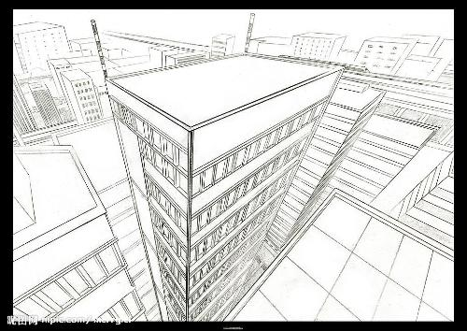
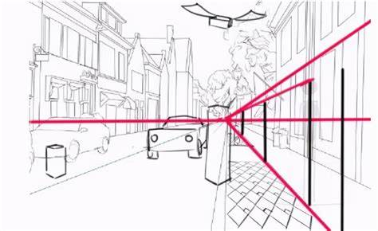
Introduction

Slide 3

Introduction
A feature of perspective:
Farther object looks smaller.

Slide 4
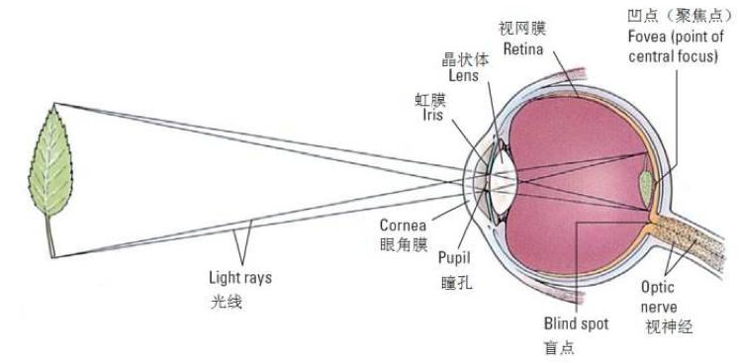
Geometric Explanation

Slide 5
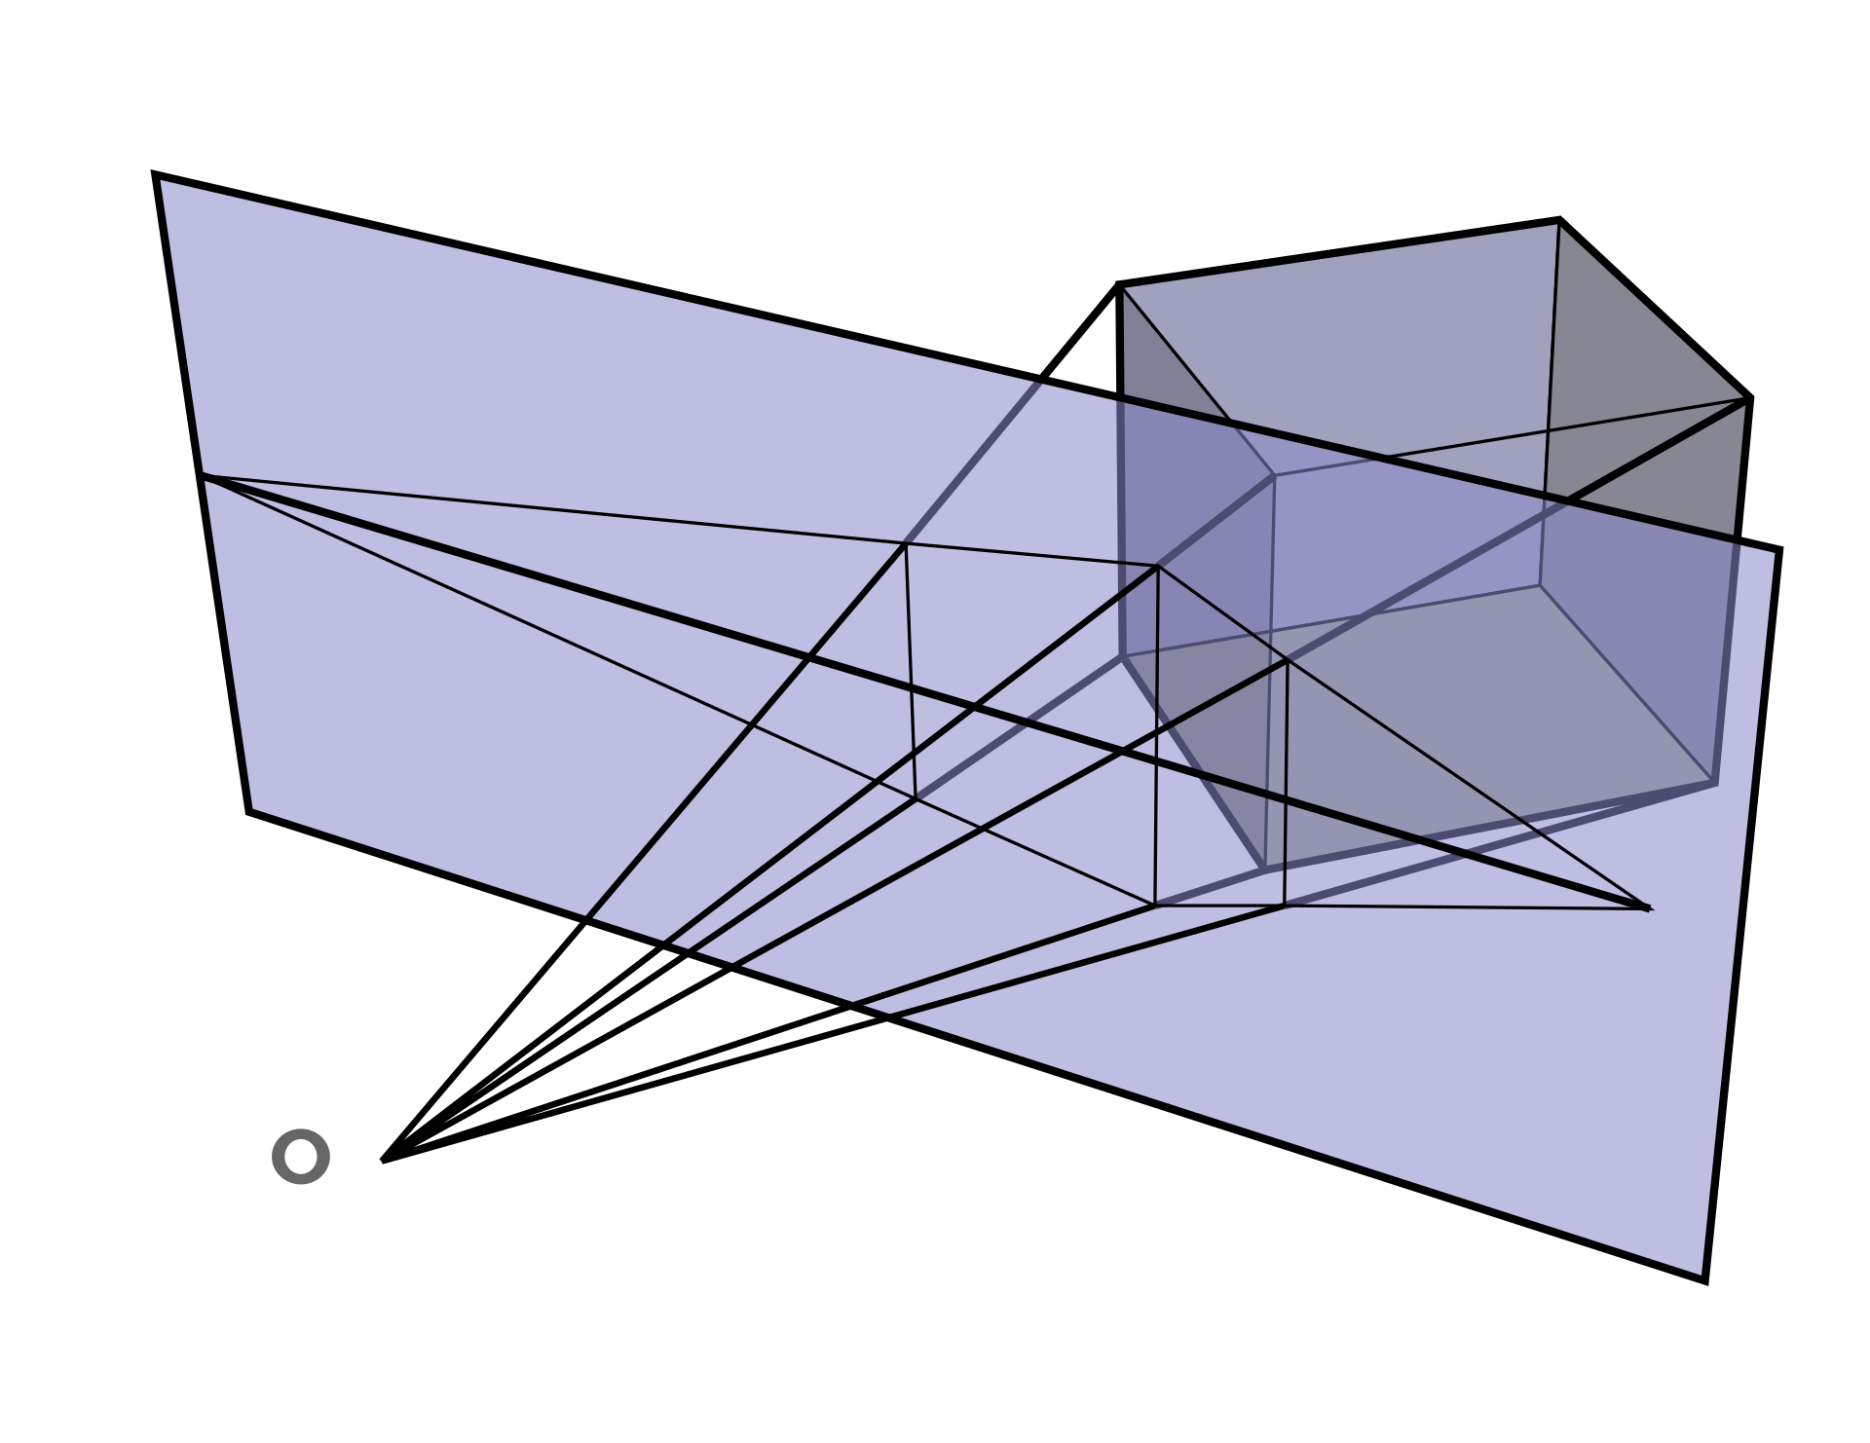
Geometric Explanation
Perspective works by representing the light that passes from a scene through an imaginary rectangle (the picture plane), to the viewer's eye, as if a viewer were looking through a window and painting what is seen directly onto the windowpane.
(From Wikipedia)

Slide 6

Geometric Explanation
Perspective Transformation:
$x^{′}=\frac{xl}{z}$
$y^{′}=\frac{yl}{z}$
$z^{′}=l$ (This variable is not useful though)

Slide 7
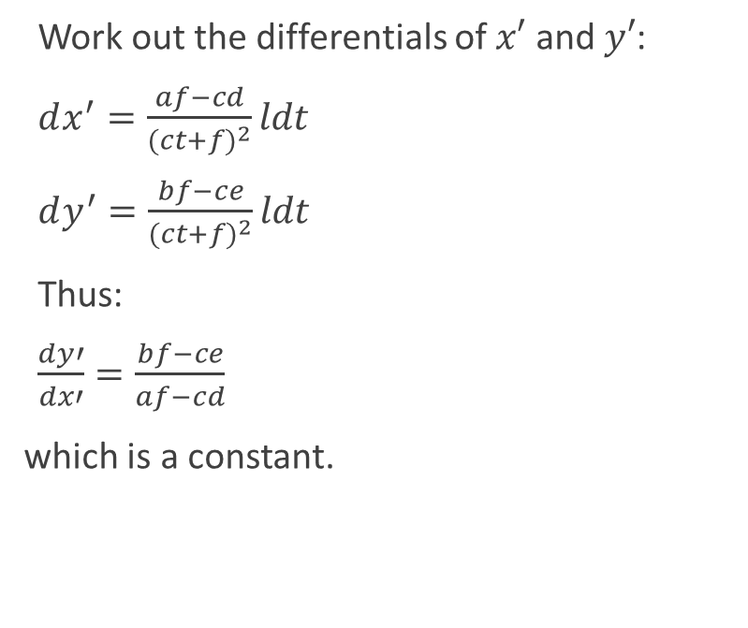
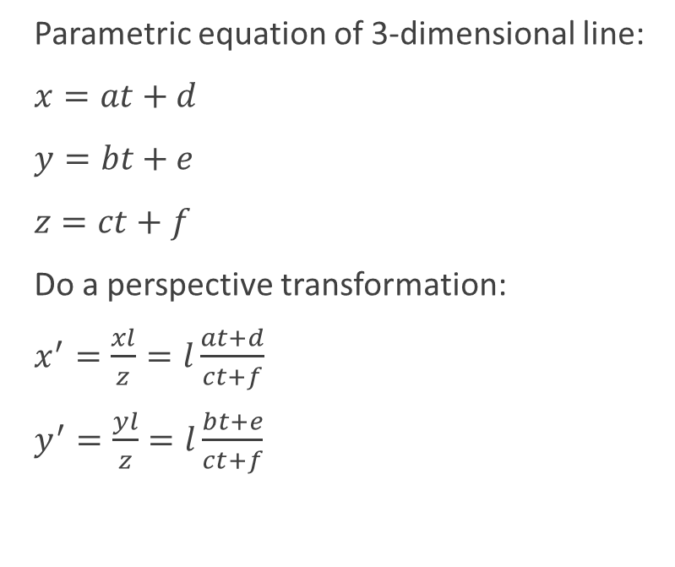
Vanishing Point
Parametric equation: 参数方程
Differential: 微分
Parametric equation of 3-dimensional line:
$x=at+d$
$y=bt+e$
$z=ct+f$
Do a perspective transformation:
$x^{′}=\frac{xl}{z}=l\frac{at+d}{ct+f}$
$y^{′}=\frac{yl}{z}=l\frac{bt+e}{ct+f}$
Work out the differentials of $x′$ and $y′$:
$dx^{′}=\frac{af−cd}{{(ct+f)}^{2}}ldt$
$dy^{′}=\frac{bf−ce}{{(ct+f)}^{2}}ldt$
Thus:
$\frac{dy′}{dx′}=\frac{bf−ce}{af−cd}$
which is a constant.

Slide 8
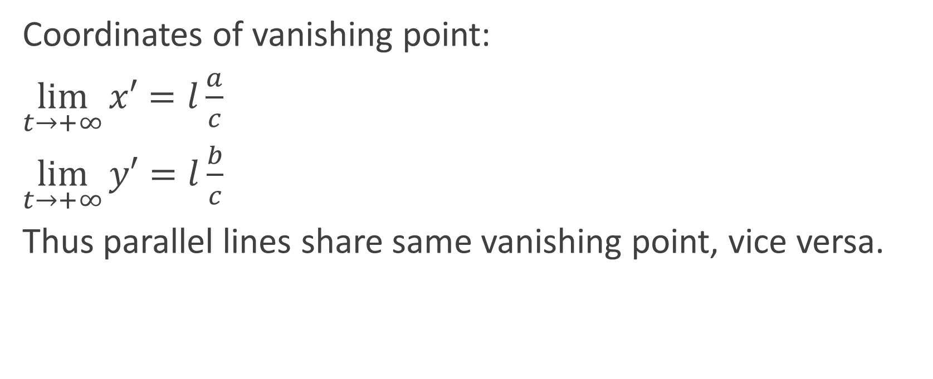
Vanishing Point
Coordinates of vanishing point:
$\lim_{t→+∞}{x′}=l\frac{a}{c}$
$\lim_{t→+∞}{y′}=l\frac{b}{c}$
Thus parallel lines share same vanishing point, vice versa.

Slide 9
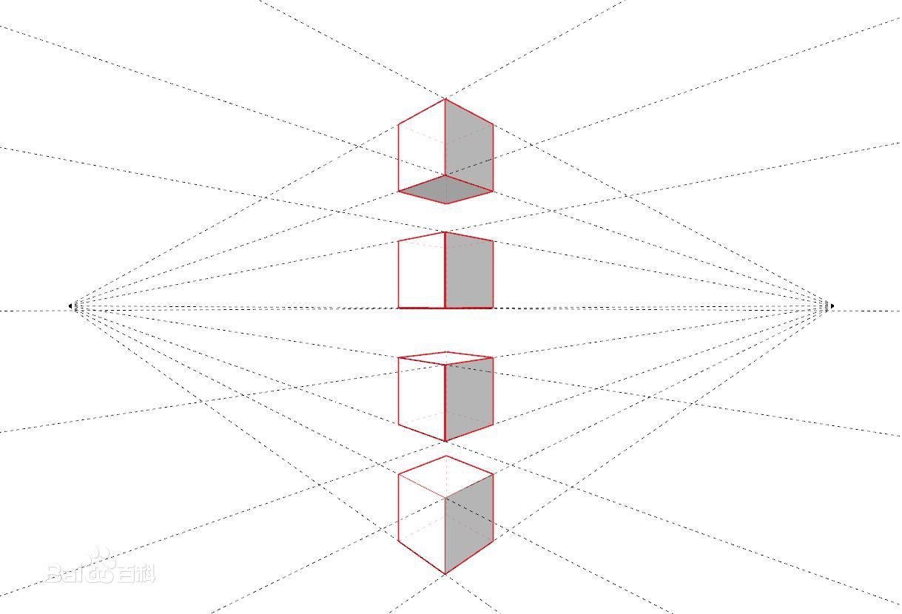
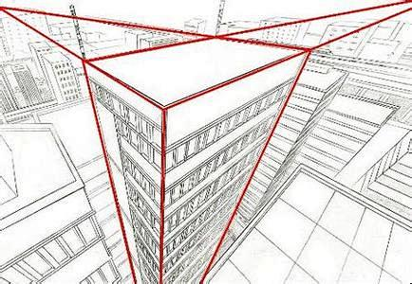
Vanishing Point

Slide 10
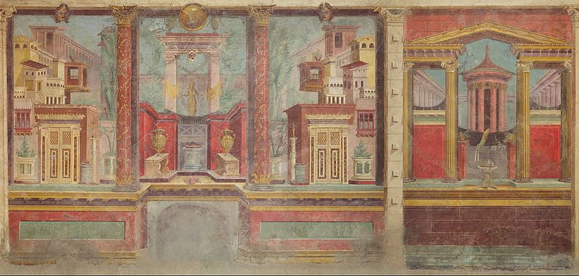
Some (Linear) Perspective Arts
Fresco from the Villa of Publius Fannius Synistor in Boscoreale near Pompeii, 1st ct. BC

Slide 11
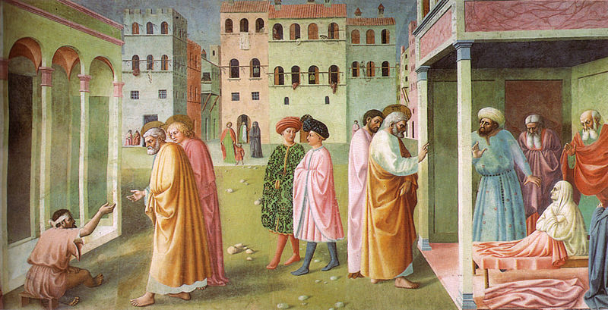
Some (Linear) Perspective Arts
Detail of Masolino da Panicale's St. Peter Healing a Cripple and the Raising of Tabitha (c. 1423), the earliest extant artwork known to use a consistent vanishing point

Slide 12
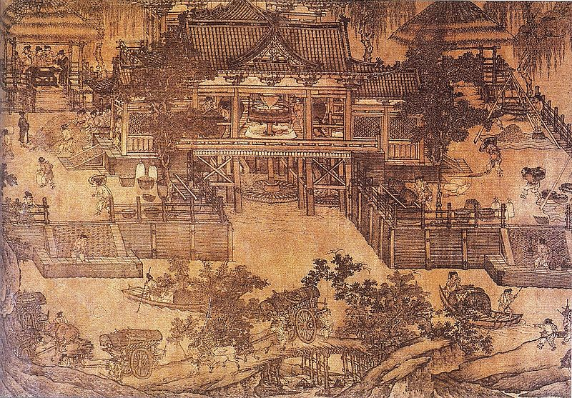
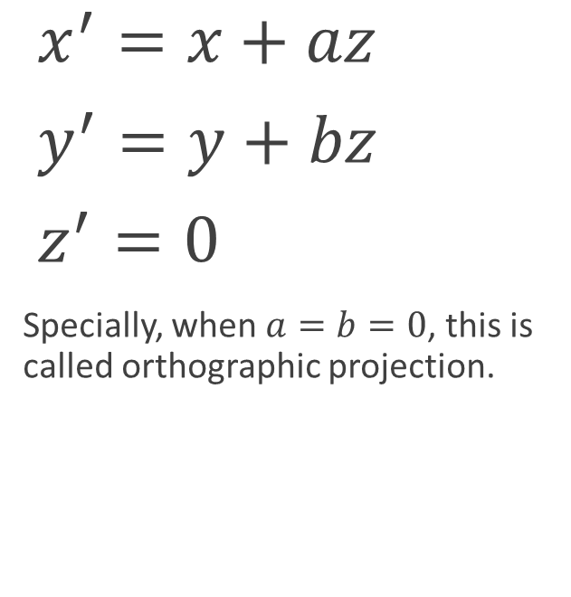
Oblique Projection
Oblique: 斜(形容词)
Ortho-: (前缀)正交相关的
$x^{′}=x+az$
$y^{′}=y+bz$
$z^{′}=0$
Specially, when $a=b=0$, this is called orthographic projection.
A Northern Song Dynasty (960-1127) era Chinese painting of a water-powered mill for grain, with surrounding river transport.

Slide 13
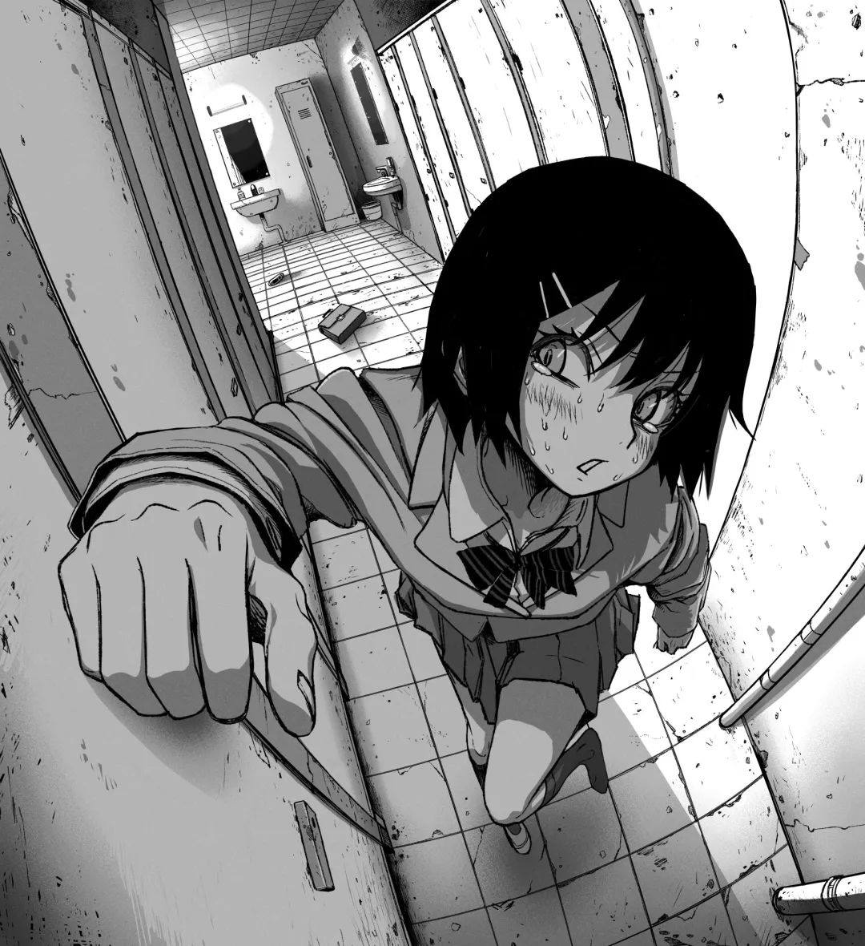

Curvilinear Perspective
Great Circle: 大圆
(球上的与球心共平面的圆)
Ellipse: 椭圆
$d=\sqrt{x^{2}+y^{2}+z^{2}}$
$x^{′}=\frac{xR}{d}$
$y^{′}=\frac{yR}{d}$
$z^{′}=\frac{zR}{d}$
A line that does not pass through the origin is projected to a great circle on the sphere, which is further projected to an ellipse on the plane. The ellipse has the property that its long axis is a diameter of the "bounding circle".
(From Wikipedia)
トイレダッシュ
By 果坂青/omao
pid: 81052176

Slide 14
The End
Thanks for listening!

