Slide 1
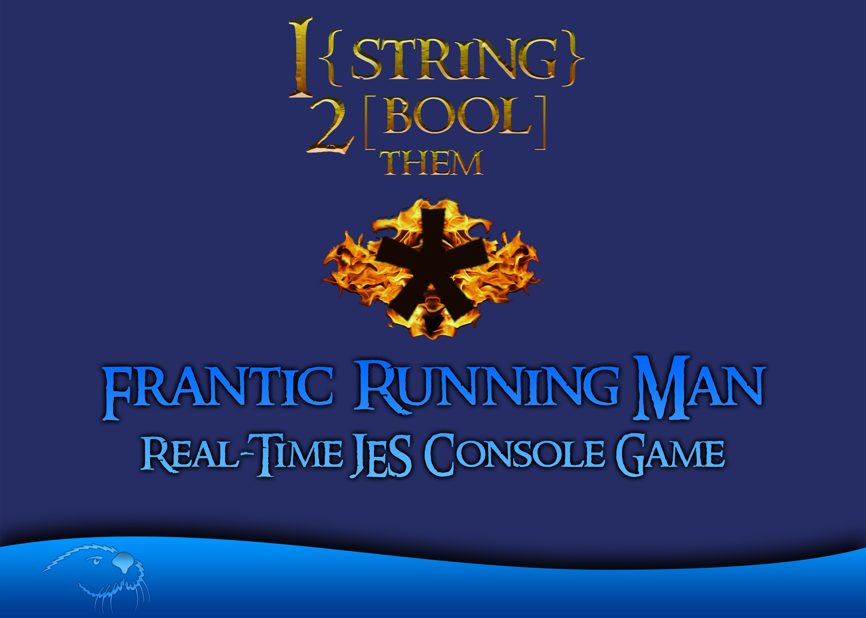
Sevren Gail
Christopher Rendall

Slide 2

Objective
To best utilize our Python development skills, we decided to create an original concept for a text-based game. Our goal was to create a fast-paced game with advanced and creative sound capabilities. We decided to take an original approach to truly test and fortify our Python programming abilities. The resulting product lived up to this, and was named, “Frantic Running Man.”

Slide 3
Approach
We decided the best approach to complete this objective was to split the workload in half. Sevren Gail would take on all of the game programming and logic, and Christopher Rendall would take on sound manipulation and development. Our responsibilities would end up overlapping, as we would frequently have ideas and suggestions for one another. The actual programming did not overlap, however, and we were both individually responsible for our corresponding areas of development.

Slide 4
Results
The end product turned out better than we had initially hoped. Sevren went above and beyond in developing fun and addictive gameplay enveloped in an attractive text-based user interface. Chris, who was originally planning to manipulate recorded sound to create sound effects, ended up also writing a square-wave synthesizer that produces chip-tune style music.

Slide 5
Enough Talk, Let’s See It!
The following slides will depict screen shots from our finished game with descriptions of gameplay. To play this game yourself, feel free to download our Python file here.

Slide 6
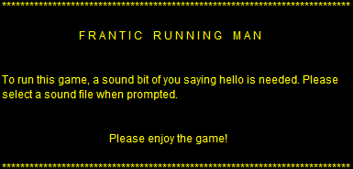
Request for Sound
The game begins with a request from the user: a sound file of them saying, “hello.”

Slide 7
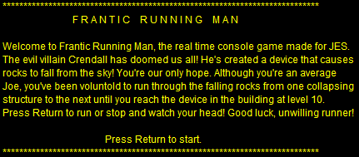
How About a Story?
Frantic Running Man is an adventure!

Slide 8
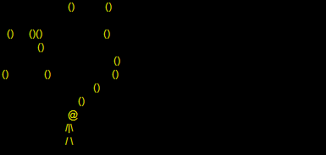
Don’t Forget Gameplay!
The gameplay is simple, but difficult. The player is given three lives, and must try to reach level 10. Through each level, the player avoids falling rocks by pressing the return key to alternate between running and standing still. Animation and audio are impossible to depict through a still image, so be sure to play the game yourself!

Slide 9
We Have Learned!
Christopher and Sevren have both learned a lot in this course!
Christopher
Learning Git has made team programming much more manageable and efficient!
Learning how to manipulate sound is an incredible skill to have. Through programming, I have even learned how to generate sound waves!
Image manipulation has been very interesting! Creating filters taught me to think about pictures programmatically.
Sevren

Slide 10
Links
Team Google Document: https://docs.google.com/a/csumb.edu/document/d/1CVo5UKoyV5URSeAW8xaAdLzrQJuXk4yIYseijh77VEI/edit?usp=sharing
Team GitHub:
https://github.com/1string2boolthem/CST-205
And, in case you missed it the first time, Frantic Running Man!:
Frantic Running Man

