Slide 1
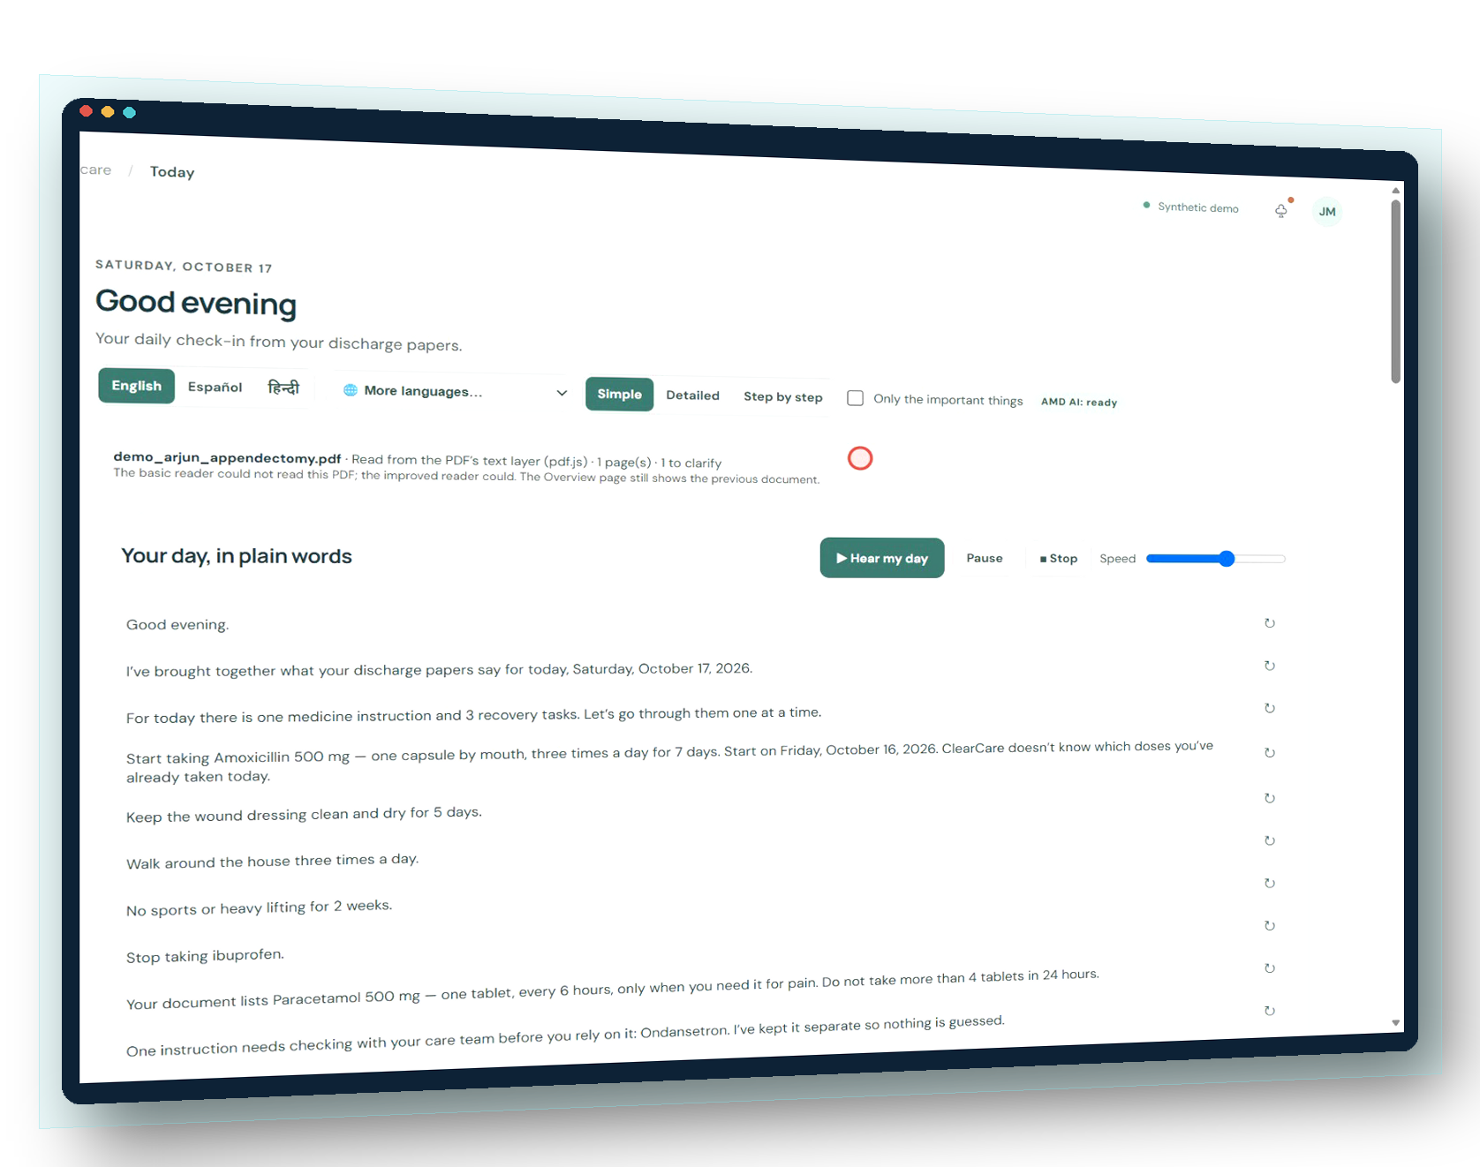
ClearCare
Recovery deserves understanding.
Turns a patient’s own discharge instructions into a clear, multilingual, voice-supported daily recovery plan — without adding medical advice.
AI language work runs on AMD Developer Cloud (model DeepSeek-V4-Flash) · Health and Wellbeing track
Notes:
ClearCare: a working desktop prototype for the AMD Developer Hackathon ACT III, Health and Wellbeing track. Everything shown uses synthetic patient data. The screenshot is a real frame of the running app, rendered in perspective. AMD claim: AI explanations, translations and the Care Agent's reasoning call the AMD-hosted endpoint developer.amd.com.cn/radeon/api/v1 with the DeepSeek-V4-Flash model; deterministic parts run locally.

Slide 2
The forgotten part of care: the first weeks at home
Recovery at home
Discharge
The family is now responsible for medicines, warning signs and visits
Hospital
A few minutes of explanation and several pages of instructions
Clinicians, nurses and monitors around the patient
Support drops sharply at exactly the moment responsibility moves to the family.
Notes:
Frame the gap ClearCare addresses: the transition from supervised care to home. No statistics are quoted on this slide because we did not independently verify any.

Slide 3
Arjun is twelve. His mother has four pages and a worried evening
?
Unclear instructions
A synthetic but realistic story
After an appendix operation, Arjun’s discharge letter lists an antibiotic, a painkiller "only when needed", “Ondansetron 4” (four what?), “do not take ibuprofen”, wound care, no sports for two weeks, a follow-up with Dr. Mehta, and when to call 108.
His mother thinks in Kannada. The letter is in medical English. Nobody will be there at 2 a.m. when she wonders whether a second dose is allowed.
Missing units, conflicting doses, vague dates
अ
Language barrier
Care happens in the family’s language
⏰
Daily follow-through
Which dose, which day, which visit
!
Knowing when to get help
Warning signs buried in paragraphs
Notes:
This is the demo scenario used in both videos. The letter is synthetic (CLEARCARE_DEMO_AUTOMATION/fixtures/demo_arjun_appendectomy.pdf).

Slide 4
Existing tools solve neighbouring problems
Category | Built for | What is left for the family
Telemedicine and booking platforms | Finding and consulting clinicians | Understanding and following the plan at home, every day
General medical chatbots | Open health questions | Answers limited to their own papers, checked before display
Medication reminder apps | Reminders the user types in | A schedule taken from the clinician’s document, with unclear items flagged
Translation tools | Any text | Doses and medicine names guaranteed unchanged
ClearCare | The first weeks after discharge | Source-grounded plan · calendar · voice · own language · clear limits
Compared by category purpose, not by specific products. No market study was done; see CLEARCARE_DIFFERENTIATION.md.
Notes:
Fair framing: these categories are good at what they are built for. ClearCare does not book visits, diagnose or prescribe.

Slide 5
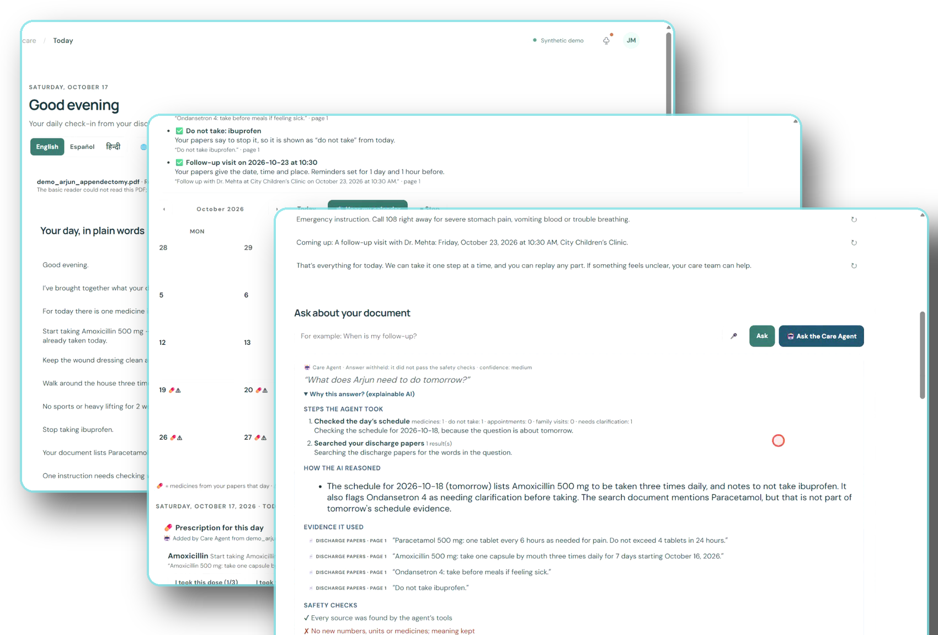
Introducing ClearCare
1
Reads the papers
PDF read on this computer; every item keeps its source line
2
Plans the day
Today view and a family calendar filled automatically
3
Speaks your language
English, Spanish, Hindi built in; 38 more via AMD AI, verified
4
Knows its limits
Unclear items flagged; urgent messages escalate; no prescribing
Notes:
All three screens are real frames from the recorded app (synthetic patient), rendered with depth.

Slide 6
From discharge letter to daily follow-through
1
3
5
7
2
4
6
Discharge PDF
Verification
Calendar
Safety escalation
Extraction
Recovery plan
Voice + language
Read locally (pdf.js)
Unclear or high-risk → flagged
Calendar Agent fills it
Urgent → 108 / 112 / 911
Rules keep source line + page
Today view, plain words
Read aloud, 41 languages
Deterministic code on the user’s computer does steps 1–5; the AMD model explains, translates and reasons — and every AI output is checked against the source before it is shown.
Notes:
Accurate split of responsibilities: extraction, verification, calendar and safety gate are deterministic; AMD powers explanation, translation, open questions and the Care Agent reasoning.

Slide 7
Attentive like family, bounded like a good system
Generic chatbot
ClearCare
– Answers from general knowledge
✓ Answers only from the family’s own papers
– Same answer style for everyone
✓ “Make that easier” → a simpler wording of the same instruction
– Language = translation
✓ Medicine names, doses and numbers locked; each line verified
– Forgets between sessions
✓ Keeps the plan, calendar and ticked doses on this computer (with consent)
– May reassure or advise
✓ Never judges symptoms; urgent words → emergency numbers
ClearCare always says it is an AI tool, not a doctor or a person.
Notes:
Emotional quality comes from helpfulness, consistency and plain language, not from pretending to be human.

Slide 8
Architecture: local by default, AMD for language intelligence
Desktop window
Deterministic core (no AI)
AMD Developer Cloud
Microsoft Edge (app mode) · plain ES modules · pdf.js · Web Speech voices · localStorage (plan, calendar, ticks)
• Extraction engine (source line + page)
• Fidelity verifier (numbers, units, names, negation, frequency, severity)
• Safety gate (5 languages)
• Calendar Agent
• Care Agent planner + tools
• Built-in EN / ES / HI wording
Endpoint developer.amd.com.cn/radeon/api/v1
Model: DeepSeek-V4-Flash
• Explain one instruction
• Answer open questions
• Translate (38 languages)
• Care Agent reasoning
Every output verified before display
Local Node.js server
Binds 127.0.0.1 / ::1 only · holds the AMD key · request queue (1 per minute) · telemetry without patient text
Not claimed: local GPU or ROCm execution. Unverified: which AMD hardware serves the hosted endpoint.
Notes:
Matches the code: server.js + lib/ext/*.js on loopback; public/ext/* in the browser; lib/ext/amd-provider.js calls the AMD endpoint. Inference is remote. We could not confirm whether this endpoint is the same service as the event FAQ's Token Factory or which GPUs serve it.

Slide 9
Same medical facts in every language
English
हिन्दी · Hindi
ಕನ್ನಡ · Kannada
rules (not AI)
built-in rules (not AI)
AMD AI · verified
Keep taking Apixaban 5 mg, twice a day. Do not stop taking it unless your provider tells you to. This is a high-alert medicine, so ClearCare keeps it on your “check with your care team” list and doesn’t set reminders for it.
Apixaban 5 mg, दिन में दो बार लेते रहें। जब तक डॉक्टर न कहें, इसे लेना बंद न करें। यह ज़्यादा जोखिम वाली दवा है, इसलिए ClearCare इसे “देखभाल टीम से पूछें” सूची में रखता है और इसके रिमाइंडर नहीं लगाता।
Apixaban 5 mg ಅನ್ನು ದಿನಕ್ಕೆ ಎರಡು ಬಾರಿ ತೆಗೆದುಕೊಳ್ಳುತ್ತಿರಿ. ನಿಮ್ಮ ಆರೈಕೆದಾರರು ಹೇಳದ ಹೊರತು ಅದನ್ನು ನಿಲ್ಲಿಸಬೇಡಿ. ಇದು ಹೆಚ್ಚಿನ-ಎಚ್ಚರಿಕೆಯ ಔಷಧಿಯಾಗಿದೆ, ಆದ್ದರಿಂದ ClearCare ಅದನ್ನು ನಿಮ್ಮ “ಆರೈಕೆ ತಂಡದೊಂದಿಗೆ ಪರಿಶೀಲಿಸಿ” ಪಟ್ಟಿಯಲ್ಲಿ ಇರಿಸುತ್ತದೆ ಮತ್ತು ಅದಕ್ಕೆ ಜ್ಞಾಪನೆಗಳನ್ನು ಹೊಂದಿಸುವುದಿಲ್ಲ.
12/12
Hindi lines with identical numbers
12/12
Kannada lines verified (AMD)
12/12
Kannada lines with names unchanged
Automated checks on 12 synthetic instructions. Not yet reviewed by qualified human translators.
Notes:
Texts are taken verbatim from docs/evidence/multilingual-eval.json (live AMD run, 17 Oct 2026). Medicine names, doses and numbers are locked as tokens before translation; a literal back-translation must pass the same fidelity verifier.

Slide 10
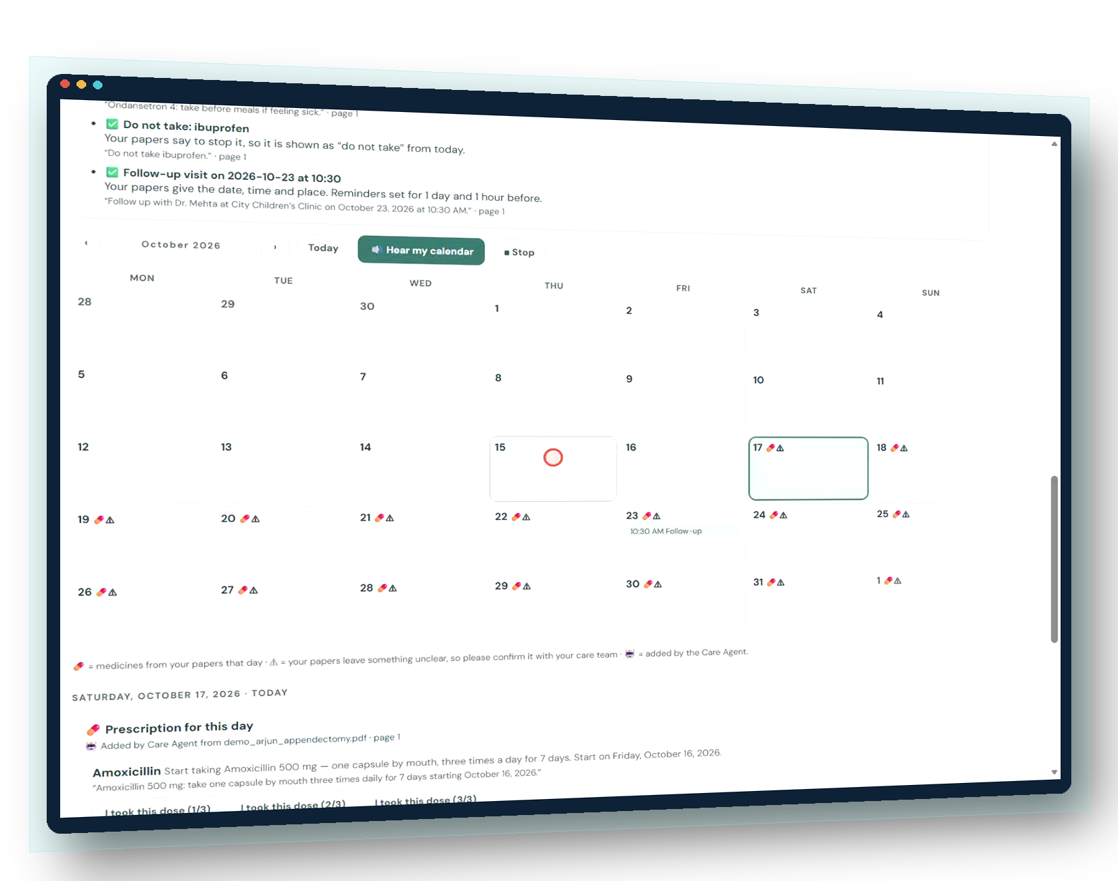
A recovery calendar that fills itself — and explains why
Calendar Agent
Adds every dated visit and medicine course from the papers; logs each decision with the source line
⚠ instead of guesses
Missing place, unit or date → shown with the reason, no reminders
Completion tracking
Visits attended, doses ticked, “missed?” prompts; kept after a refresh
Hear my calendar
Next verified visit, today’s medicines, items to confirm
Notes:
Measured: 7/7 dated visits on the right day and time, 4/4 undated visits kept off the calendar, 0 invented (tools/eval-calendar.mjs). Persistence verified with real page reloads (journey J03–J05).

Slide 11
Safety is architecture, not a disclaimer
🚨
Urgent symptoms
🛡
Care changes
Chest pain, breathing trouble, vomiting blood… in 5 languages → emergency numbers, no AI
“Double / skip / stop / prescribe” → care team, with the document’s own words
✔
Verified AI
⚠
Uncertainty visible
Numbers, units, names, negations checked; failures withheld
Unclear or high-risk items flagged, never scheduled by guessing
Live example: AMD’s simplification of “Acetaminophen 500 mg … every 6 hours as needed” dropped the interval and “as needed” — ClearCare withheld it (number_missing, pair_missing, pair_missing, prn_lost).
Notes:
Safety-gate challenge set: 20/20 urgent messages escalated, 0/12 false alarms, 9/9 medicine-change, 4/4 prescribing, 2/2 skip-visit. Written by the team — not an independent red team. See CLEARCARE_MEDICAL_SAFETY.md.

Slide 12
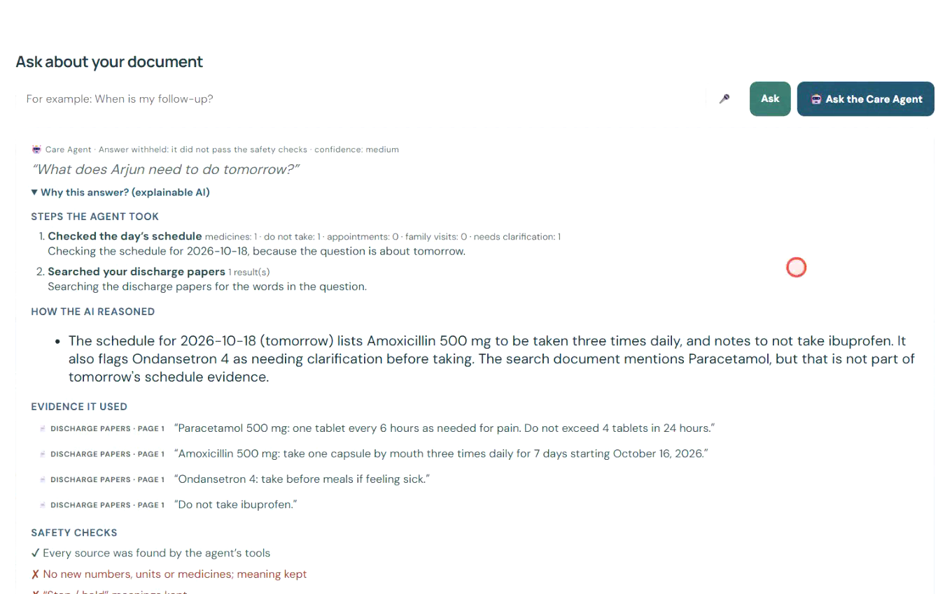
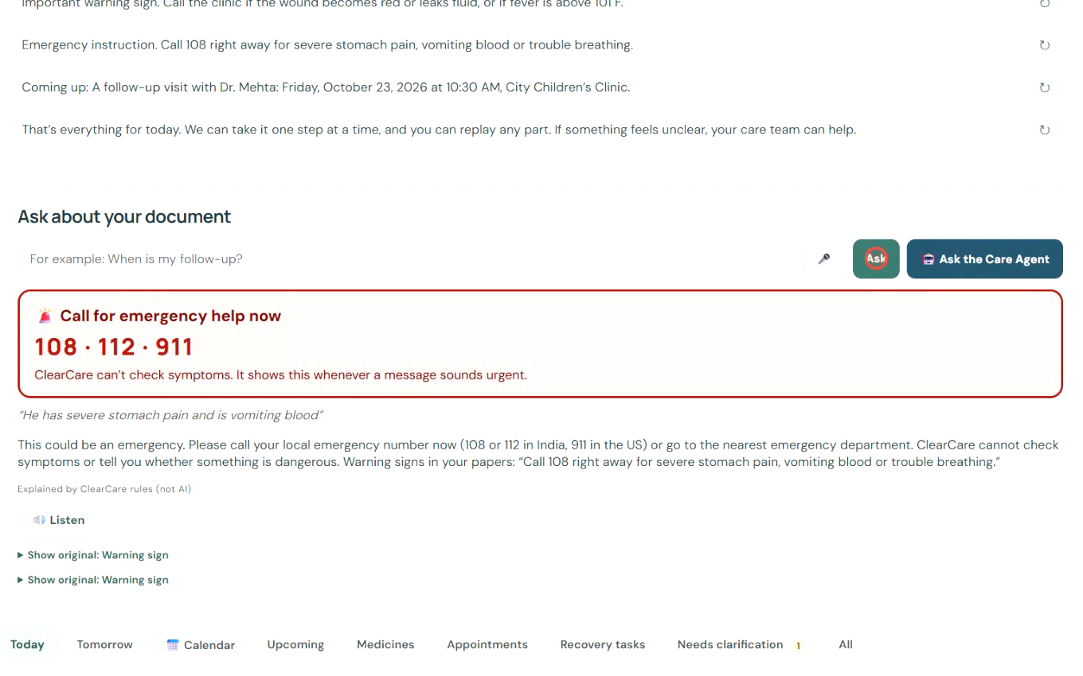
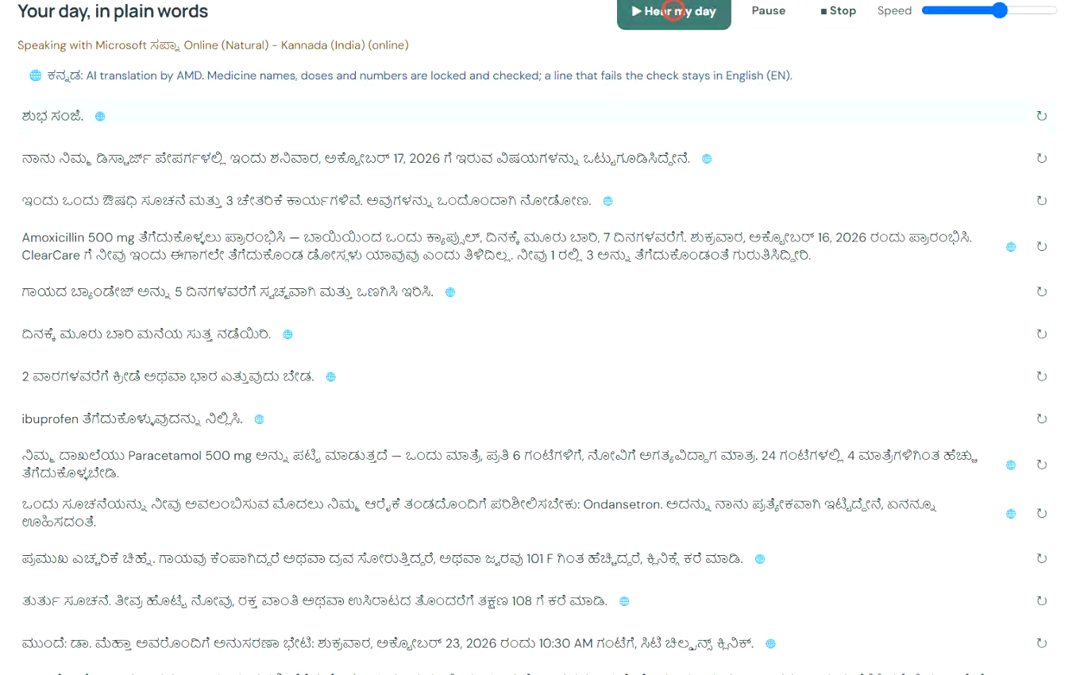

See it working
Care Agent · live AMD
Safety responses
Kannada · AMD, verified
Public repository
github.com/1stsimplifycode/ClearCare-Understand-My-Care-Instructions
Videos in the submission package
CLEARCARE_AMD_ACT_III_DEMO.mp4 — 3–5 minute hackathon demo
Stakeholder walkthrough: scripted and reproducible (CLEARCARE_DEMO_AUTOMATION), not yet rendered
Screens are real recordings of the running app with synthetic data. The recorder cannot capture the app’s own speech; the voice in use is shown on screen.
Notes:
No public video URL exists yet; upload the MP4s and add the link here. The QR code points to the real public repository.

Slide 13
Tested, not just demonstrated
110/110
0
47/47
23/23
extraction checks on 11 synthetic documents
clinically significant extraction errors
safety challenge cases handled as intended
patient-journey browser checks (4 runs)
Live AMD (17 Oct 2026)
Explanation: 3.8 s (withheld by verifier)
Care Agent: 9.7 s, verified
Kannada, 12 lines: 99.8 s, 12/12 verified
Auth failure and timeout reported correctly
Few samples on a rate-limited key: not a benchmark. No clinical-outcome claims.
Notes:
Every number comes from files in docs/evidence (CLEARCARE_TEST_RESULTS.md explains methods and denominators). The 1 skipped browser test needs OCR tools not installed on the test PC.

Slide 14
Who benefits, and how it could be adopted
Patients and families
Realistic adoption path
Hospital gives ClearCare alongside the discharge letter
Runs on the family’s computer; documents stay local
Care team reviews flagged questions at follow-up
Pilot first, with clinician-reviewed wording
1
Understand and follow the plan they were given, in their own language, any time of day
Discharge and nursing teams
2
Fewer “what did they mean by…” calls; unclear lines surface as questions before they become errors
Hospitals in multilingual regions
3
One English discharge letter, many family languages, with doses guaranteed unchanged
No pilots, customers or partners exist yet. No market figures are claimed.
Notes:
Business value is argued from the workflow, not from unverified statistics.

Slide 15
Built today, and what comes next
✓ Implemented and tested
→ Planned (not built)
Source-grounded extraction with flags
Today view, voice, pause/stop, speed
Calendar Agent, completion tracking, reminders, .ics
EN/ES/HI built in; 38 languages via AMD, verified
Care Agent with explainable trace
Safety gate in 5 languages
AMD request pacing and observability
Hosted demo URL for judges
Clinician review of wording and safety texts
Fluent human review of Hindi, Kannada and others
Caregiver usability study (plan in docs/)
Phone notifications and mobile layout
Scanned-PDF OCR on by default
Higher-rate AMD key; more languages built in
Notes:
Left column is verified in CLEARCARE_TEST_RESULTS.md; right column is not implemented.

Slide 16
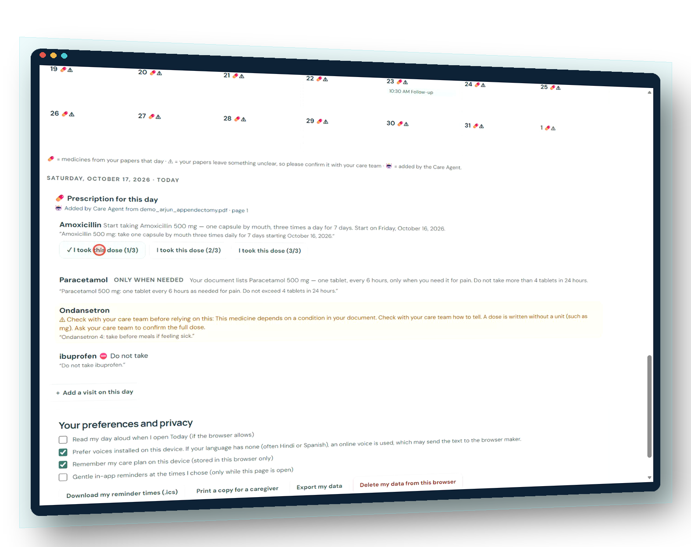
Leaving the hospital shouldn’t mean facing recovery alone.
ClearCare explains the care that was prescribed — in the family’s language, every day, with clear limits — and AMD-powered AI does the language work, checked before anyone sees it.
github.com/1stsimplifycode/ClearCare-Understand-My-Care-Instructions
Notes:
Close on the human promise and the verified engineering. Invite judges to the repository and the walkthrough video.

