Slide 1
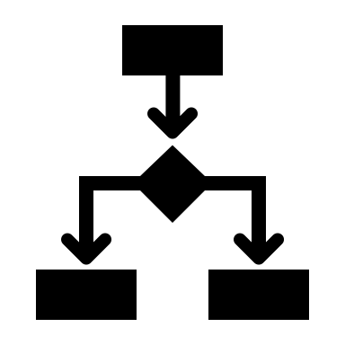
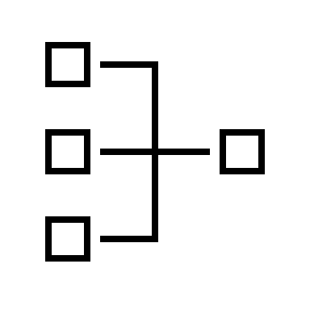











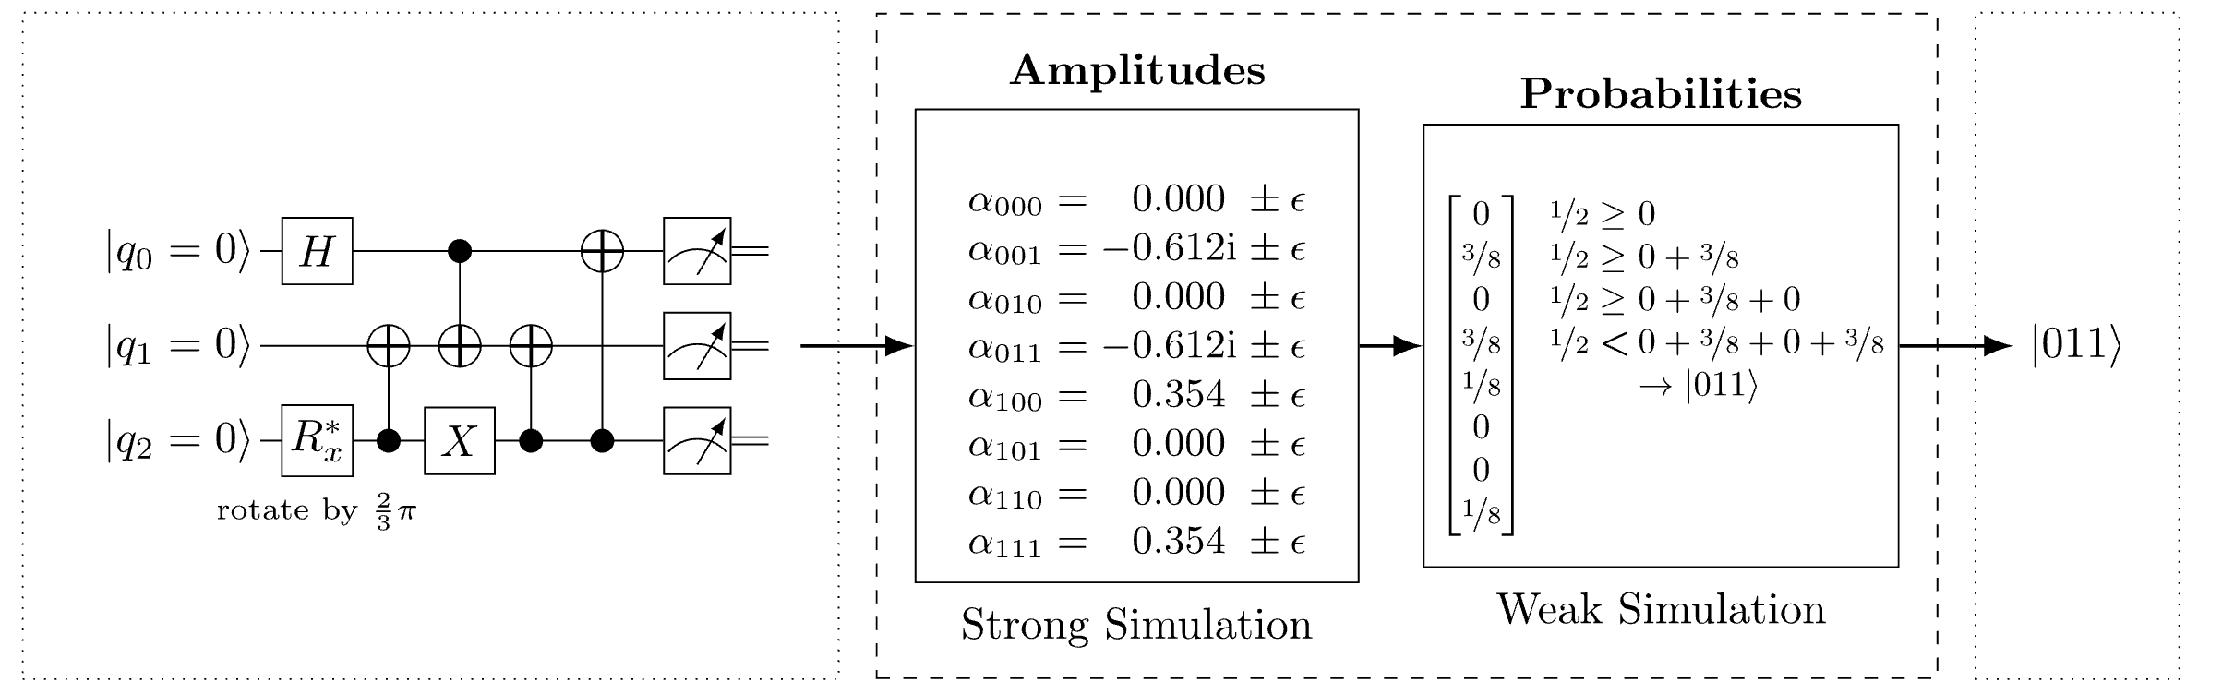



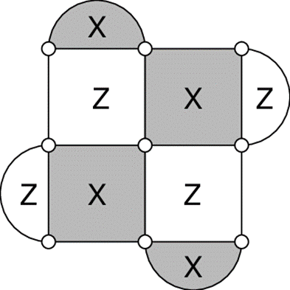



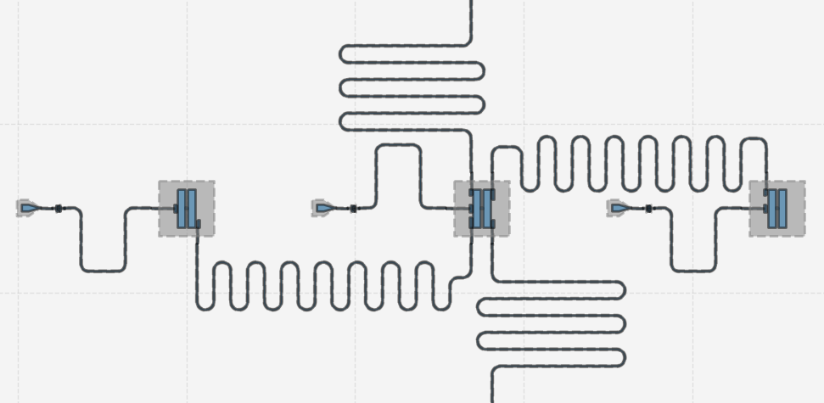

The Munich Quantum Toolkit (MQT)
Design Automation Tools and Software for Quantum Computing
Robert Wille and Team
Contact: robert.wille@tum.de
https://www.cda.cit.tum.de/research/quantum/mqt
Abstract
Data Structures / Core Methods
Quantum computers are becoming a reality. But designing applications for these devices requires automated, efficient, and user-friendly software tools that cater to the needs of end-users, engineers, and physicists at every level of the design flow. The Munich Quantum Toolkit (MQT) is a collection of design automation tools and software for quantum computing developed by the Chair for Design Automation at the Technical University of Munich. This flyer provides an overview of the provided solutions. For each step in the design flow, numbered nodes indicate
12
13
14
In order to tackle the complexity of important design tasks, the MQT utilizes efficient data structures (e.g., for the representation and manipulation of quantum states and operations) as well as dedicated core methods (e.g., allowing to realize optimal methods) including:
Decision
Diagrams
Tensor
Networks
ZX-Calculus
SAT/SMT Solvers
Machine
Learning
Heuristics
the respectively available software repositories (summarized on the back of this flyer). All software is available as open-source on GitHub.
For performance reasons, most tools are implemented in C++ with convenient Python bindings and compatibility to tools such as Qiskit.
Application
Simulation
1
2
Application
3
Workflow from classical problem to quantum solution
Automated problem encoding, execution, and decoding
Classical simulation of quantum circuits based on decision diagrams
Includes sampling, noise-aware simulation, hybrid Schrödinger-Feynman approaches, approximation strategies, expectation value computations, etc.
Compilation
Quantum Circuit
Simulation
Measurement
4
5
6
7
8
Simulation
Determining good compilation options
Reversible circuit/quantum oracle synthesis
Technology-specific mapping
Quantum circuit mapping/SWAP gate insertion
Shuttling for Trapped Ions
Multi-level (Qudit) Compilation
Compilation
Verification
9
Original Circuit
Compiled Circuit
Equivalence checking of quantum circuits
Verification of compilation results
Using decision diagrams and ZX-calculus
Verification
Original Circuit
=
Compiled Circuit
Error Correction
Decoding algorithms
Automated code construction and numerical simulations
10
Error Correction
Hardware
Application-specific physical design for superconducting platform
11
Tool Overview
Open-source
Implementations
Hardware

Slide 2

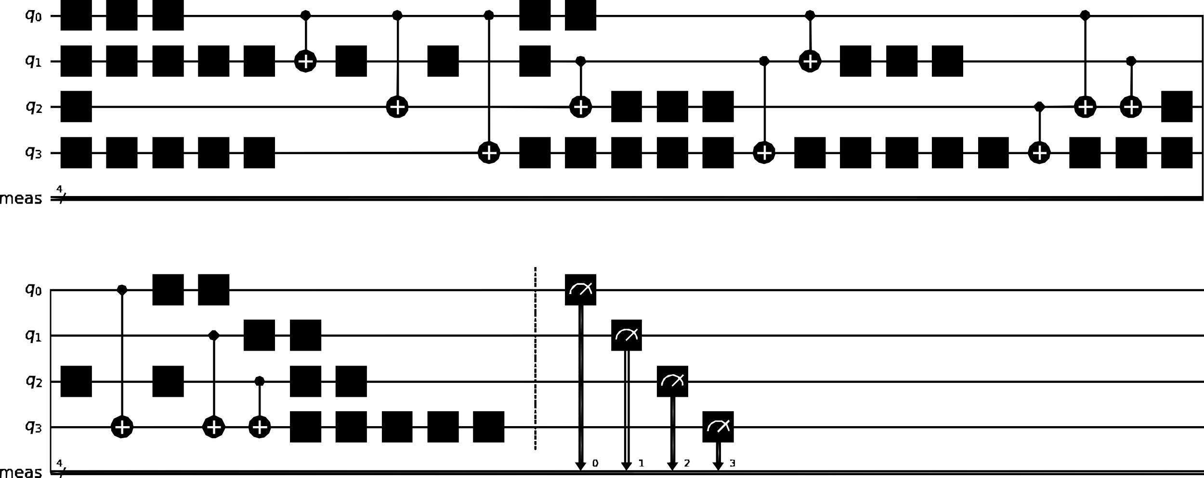

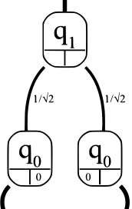

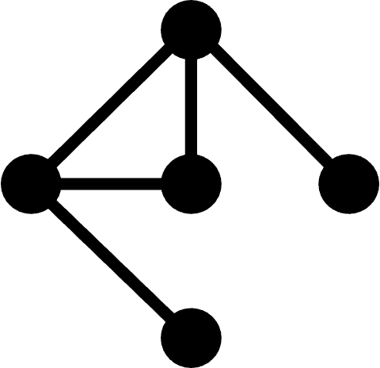
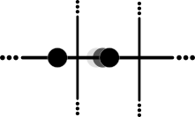
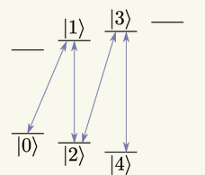
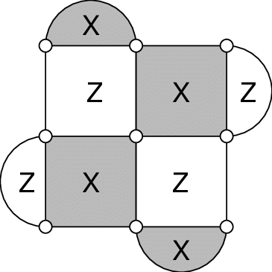




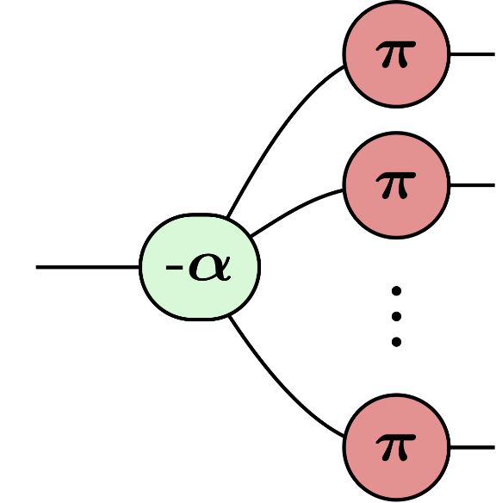




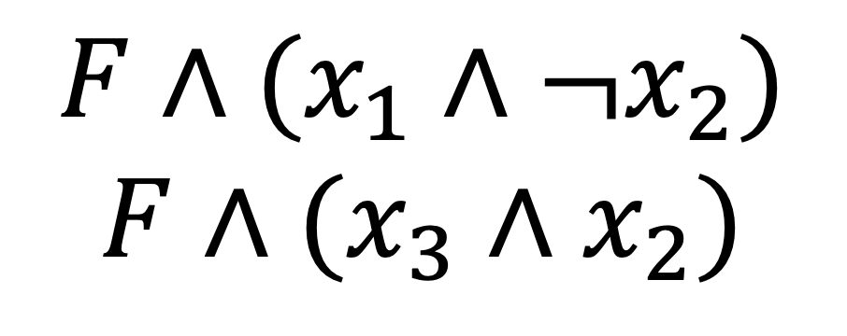
MQT ProblemSolver
MQT Bench
1
Application
2
Application
A Tool for Solving Problems Using Quantum Computing
A Quantum Circuit Benchmark Suite
PyPI
www.cda.cit.tum.de/mqtbench
github.com/cda-tum/mqt-bench
PyPI
github.com/cda-tum/mqt-problemsolver
MQT DDSIM
MQT Predictor
3
Simulation
4
Compilation
A Tool for Classical Quantum Circuit Simulation based on Decision Diagrams
PyPI
A Tool for Determining Good Quantum Circuit Compilation Options
PyPI
github.com/cda-tum/mqt-predictor
PyPI
github.com/cda-tum/mqt-ddsim
MQT SyReC
MQT QMAP
5
Compilation
6
Compilation
A Tool for the Synthesis of Reversible Circuits/Quantum Computing Oracles
PyPI
A Tool for Quantum Circuit Mapping
And Clifford Circuit Optimization/Synthesis
github.com/cda-tum/mqt-syrec
PyPI
github.com/cda-tum/mqt-qmap
PyPI
MQT IonShuttler
MQT Qudits
7
Compilation
8
Compilation
A Tool for Generating Shuttling Schedules for QCCD Architectures
A Tool for Compiling High-Dimensional Quantum Systems
github.com/cda-tum/mqt-ion-shuttler
github.com/cda-tum/mqt-qudit-compilation github.com/cda-tum/mqt-qudit-entanglement-compilation
MQT QCEC
MQT QECC
9
Verification
10
QECC
A Tool for Quantum Circuit Equivalence Checking
=
A Tool for Quantum Error Correcting Codes
github.com/cda-tum/mqt-qcec
PyPI
PyPI
github.com/cda-tum/mqt-qecc
MQT DASQA
MQT DDVis
11
Hardware
12
Data Structures
A Tool for Designing Alternative Superconducting Quantum Architectures
A Web-Application Visualizing Decision Diagrams for Quantum Computing
github.com/cda-tum/mqt-dasqa
www.cda.cit.tum.de/app/ddvis
github.com/cda-tum/mqt-ddvis
MQT Core
MQT QuSAT
13
Data Structures
14
Core Methods
The Backbone of the MQT
Intermediate Representation (IR)
Decision Diagram and ZX Package
A Tool for Encoding Quantum Computing using Satisfiability Testing (SAT) Techniques
$$F∧(x_{1}∧{¬x}_{2})$$
$$F∧(x_{3}∧x_{2})$$
github.com/cda-tum/mqt-core
PyPI
github.com/cda-tum/mqt-qusat
PyPI

