Slide 1
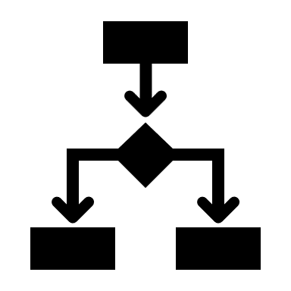
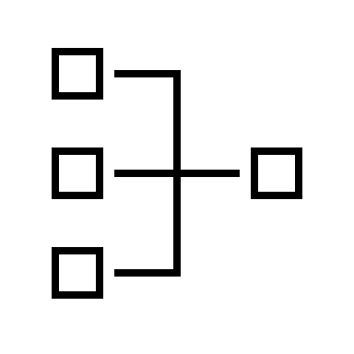











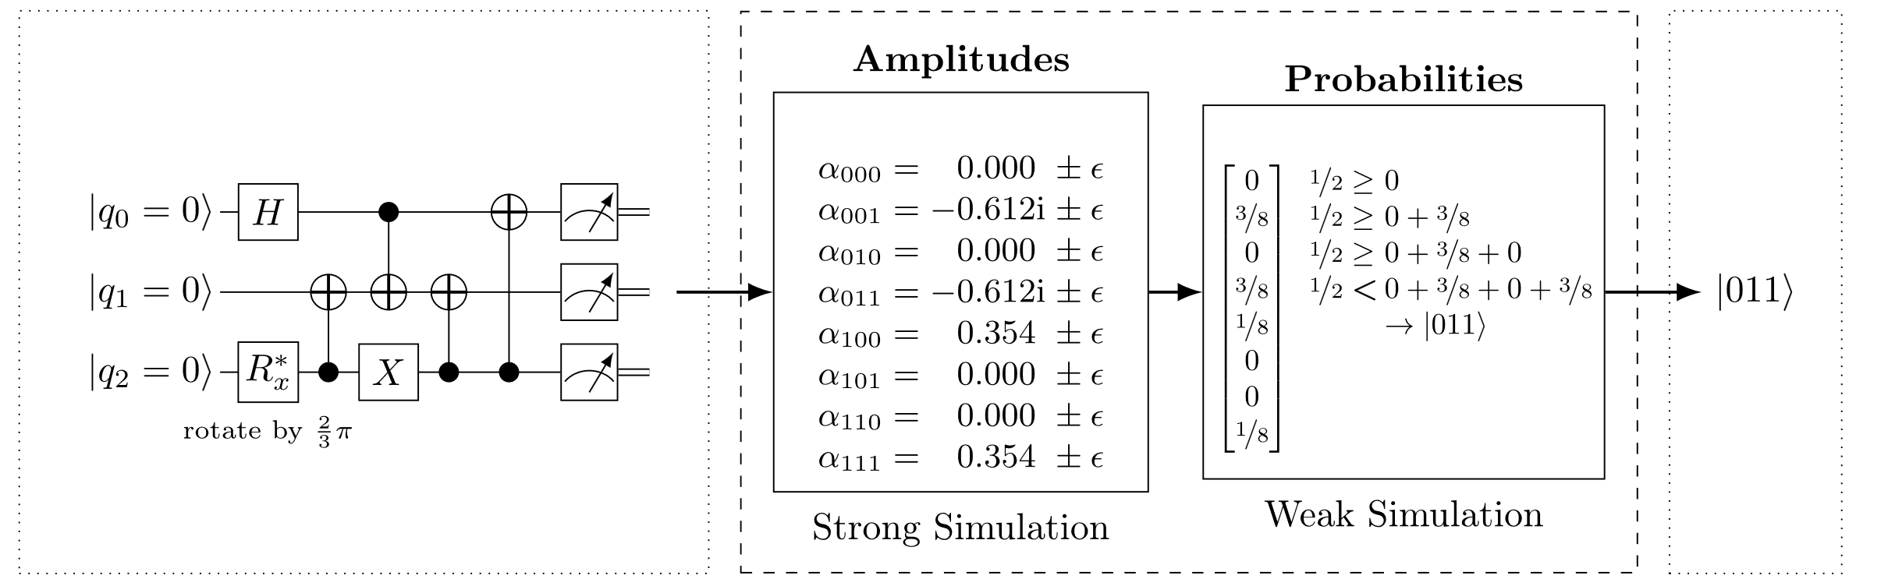



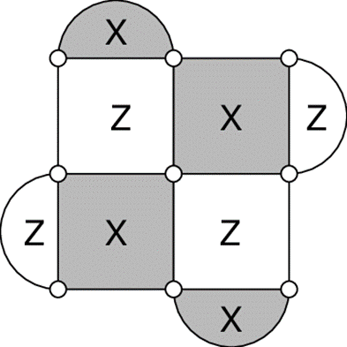



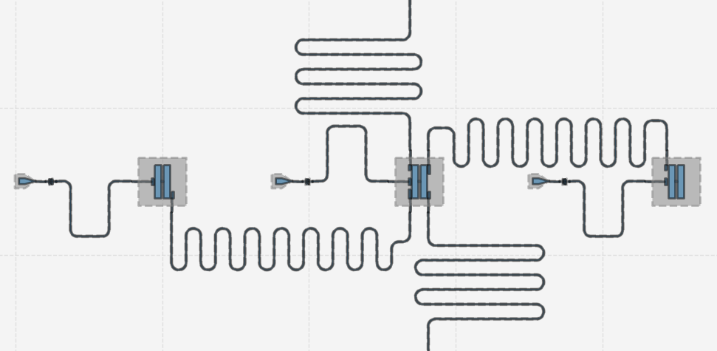

The Munich Quantum Toolkit (MQT)
Design Automation Tools and Software for Quantum Computing
Robert Wille and Team
Contact: robert.wille@tum.de
https://www.cda.cit.tum.de/research/quantum/mqt
Abstract
Data Structures / Core Methods
Quantum computers are becoming a reality. But designing applications for these devices requires automated, efficient, and user-friendly software tools that cater to the needs of end-users, engineers, and physicists at every level of the design flow. The Munich Quantum Toolkit (MQT) is a collection of design automation tools and software for quantum computing developed at the Chair for Design Automation at the Technical University of Munich. This flyer provides an overview of the provided solutions. For each step in the design flow, numbered nodes indicate
11
12
13
14
15
16
In order to tackle the complexity of important design tasks, the MQT utilizes efficient data structures (e.g., for the representation and manipulation of quantum states and operations) as well as dedicated core methods (e.g., allowing to realize optimal methods) including:
Decision
Diagrams
Tensor
Networks
ZX-Calculus
SAT/SMT Solvers
Machine
Learning
Heuristics
the correspondingly available software repositories (summarized on the back of this flyer). All software is available as open-source.
For performance reasons, all tools are implemented in C++ with convenient Python bindings and compatibility to other tools.
Application
Simulation
Workflow from classical problem to quantum solution
Automated problem encoding, execution, and decoding
1
2
Application
3
Simulation of gate-based quantum circuits based on decision diagrams
Includes sampling, noise-aware simulation, Hybrid Schrödinger Feynman approaches, approximation strategies, etc.
Compilation
Quantum Circuit
Simulation
Measurement
4
5
6
7
8
Simulation
Determining good compilation options
Reversible circuit/quantum oracle synthesis
Technology-specific mapping
Quantum circuit mapping/SWAP gate insertion
Shuttling for Trapped Ions
Multi-level (Qudit) Compilation
Compilation
Verification
Original Circuit
Compiled Circuit
9
Equivalence checking of quantum circuits
Verification of compilation results
Verification
Original Circuit
=
Compiled Circuit
Error Correction
Decoding algorithms
Automated code construction and numerical simulations
10
Error Correction
Hardware
Application-specific physical design for superconducting platform
All tools are available as open-source imple-mentations on GitHub.
Hardware

Slide 2

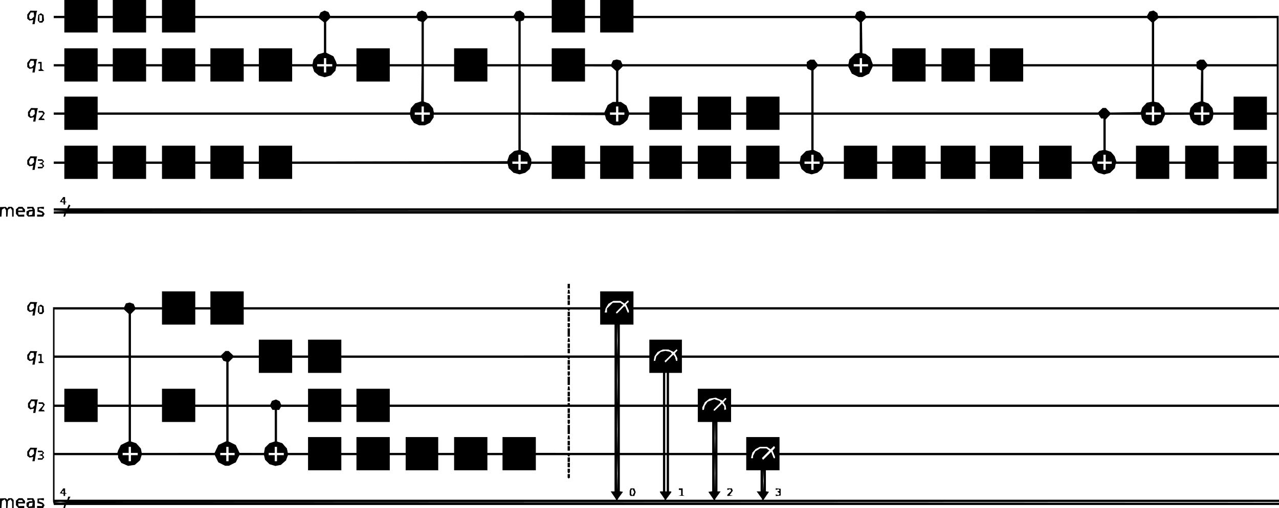

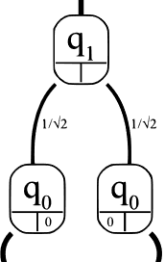

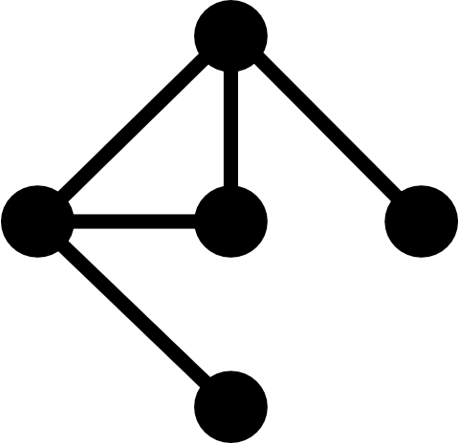
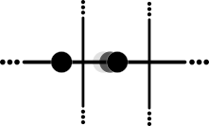
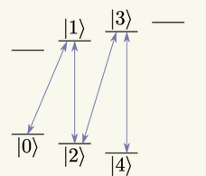
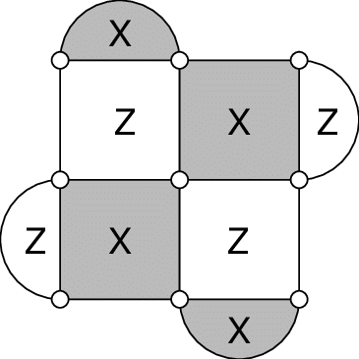



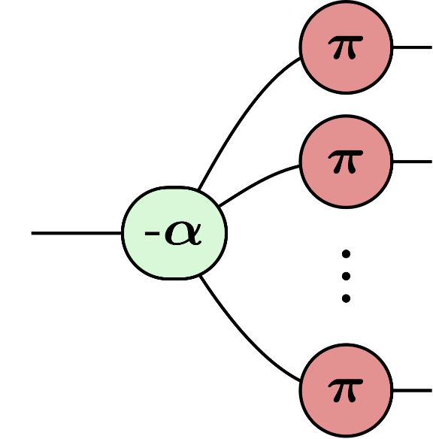




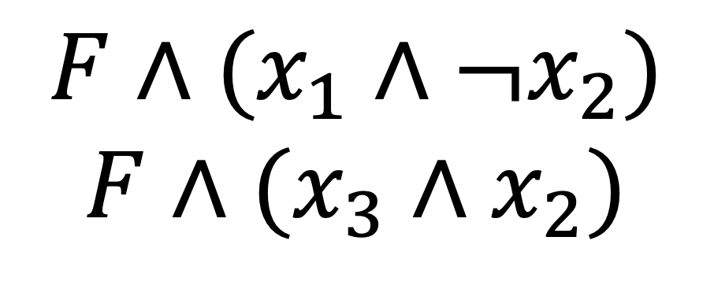
MQT ProblemSolver
MQT Bench
1
Application
2
Application
A Tool for Solving Problems Using Quantum Computing
A Quantum Circuit Benchmark Suite
PyPI
PyPI
github.com/cda-tum/mqtproblemsolver
www.cda.cit.tum.de/mqtbench
github.com/cda-tum/mqtbench
MQT DDSIM
MQT Predictor
3
Simulation
4
Compilation
A Tool for Classical Quantum Circuit Simulation based on Decision Diagrams
A Tool for Determining Good Quantum Circuit Compilation Options
PyPI
PyPI
PyPI
github.com/cda-tum/ddsim
github.com/cda-tum/mqtpredictor
MQT SyReC
MQT QMAP
5
Compilation
6
Compilation
A Tool for the Synthesis of Reversible Circuits/Quantum Computing Oracles
A Tool for Quantum Circuit Mapping
PyPI
PyPI
PyPI
github.com/cda-tum/syrec
github.com/cda-tum/qmap
PyPI
MQT IonShuttler
MQT Qudits
7
Compilation
8
Compilation
A Tool for Generating Shuttling Schedules for QCCD Architectures
A Tool for Compiling High-Dimensional Quantum Systems
github.com/cda-tum/ion-shuttler
github.com/cda-tum/qudit-compilation github.com/cda-tum/qudit-entanglement-compilation
MQT QCEC
MQT QECC
9
Verification
10
QECC
A Tool for Quantum Circuit Equivalence Checking
=
A Tool for Quantum Error Correcting Codes
PyPI
github.com/cda-tum/qcec
PyPI
PyPI
github.com/cda-tum/qecc
MQT DDPackage
MQT DDVis
11
Data Structures
12
Data Structures
A Decision Diagram Package for Quantum Computing
A Web-Application visualizing Decision Diagrams for Quantum Computing
github.com/cda-tum/dd_package
www.cda.cit.tum.de/app/ddvis
github.com/cda-tum/ddvis
MQT QFR
MQT Logic Blocks
13
Data Structures
14
Data Structures
An Intermediate Representation for Quantum Circuits and Computations
An Interface Library for SAT/SMT Abstractions
github.com/cda-tum/qfr
github.com/cda-tum/logicblocks
MQT ZX
MQT QuSAT
15
Data Structures
16
Core Methods
A ZX-Calculus Package
A Tool for Encoding Quantum Computing using Satisfiability Testing (SAT) Techniques
$$F∧(x_{1}∧{¬x}_{2})$$
$$F∧(x_{3}∧x_{2})$$
github.com/cda-tum/zx
PyPI
PyPI
github.com/cda-tum/qusat

