Slide 1
Fuzz Windows Kernel Via Javascript
fanxiaocao(TinySec) and pjf

Slide 2


About Me
work for (NYSE:QIHU)
Finder of : MS16-018/CVE-2016-0048 MS16-034/CVE-2016-0096 MS16-090/CVE-2016-3252
MS16-123/CVE-2016-7211 more is coming…
Author of Javascript Kernel Fuzzer.
Notes:
Chinese Biggest Network security company

Slide 3


Role
Driver Developer
Day
Vulnerablility
Night

Slide 4

Background
Write C code
Compiled and build
fuzzer.exe
Transfer
Clean fuzz machine
Notes:
fuzz .jnt and .ico file. Need a method to update my fuzzer source code quickly.

Slide 5
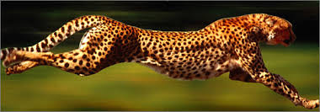
I need use a script
Fast!
Modify an direct exceute on the clean fuzz machine
Notes:
fuzz .jnt and .ico file. Need a method to update my fuzzer source code quickly.

Slide 6





Compare and chose

Slide 7
Why Javascript?
syntax simliar to C
Easy
Simple
Hate Python style

Slide 8
But
Can’t call any win32 api
Need a Engine
Can’t directly access memory
Can’t call syscall

Slide 9

Why not Node.js
Asynchronous
Too complex
No pointer
Can’t do syscall

Slide 10
Chose Javascript Engine
Microsoft Active Script
Slow and hard to use
Mozilla SpiderMonkey
Slow and can’t do callback
Google V8
Fast but hard to use
Microsoft Chakra
Fast but only on IE11 and Edge

Slide 11

finally choise - Chakra
Easy to embed
Fast
Build-in after win8.1

Slide 12
JSRT Project goal
Directly call any win32 api
Directly do syscall
Directly access memory
Easy to binding

Slide 13
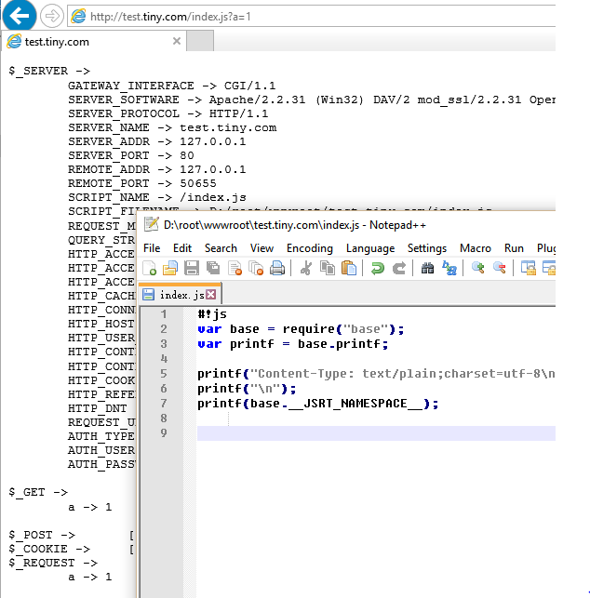
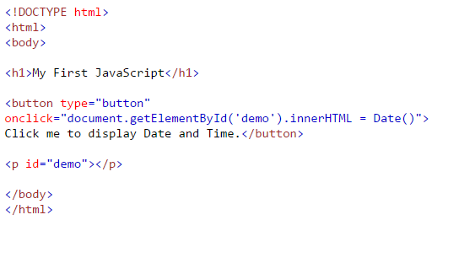
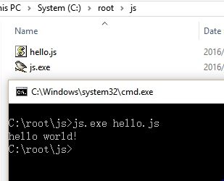
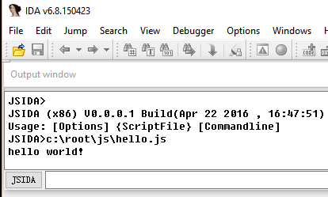
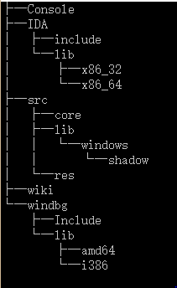
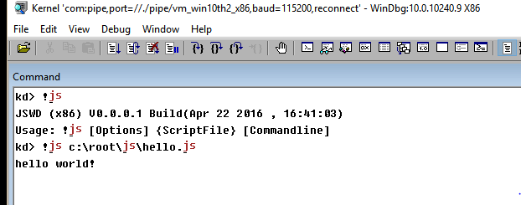
JSRT – 3 version and 4 roles

Slide 14
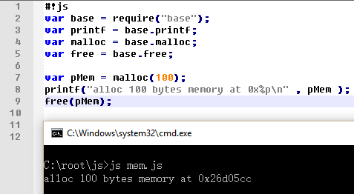
Directly access memory
Use number to simulation pointer
Build base stdanard library
Provide memory fucntion binding like:
Malloc ,free,setuchar/getuchar…

Slide 15
Call win32 api
GetModuleHandle ,
GetProcAddress , LoadLibrary
var hKernek32 = GetModuleHandle(“kernel32”) ;
Invoke/cInvoke
var pBeep = GetProcAddress(hKernel32 , “Beep”);
Invoke(pBeep , 100 , 1000);
Bind/cBind
var fnBeep = Bind(hKernel32 , “Beep" , “nn");
fnBeep(100 , 1000);
Thunk/cThunk
Support Callback function like user32!EnumWindow

Slide 16
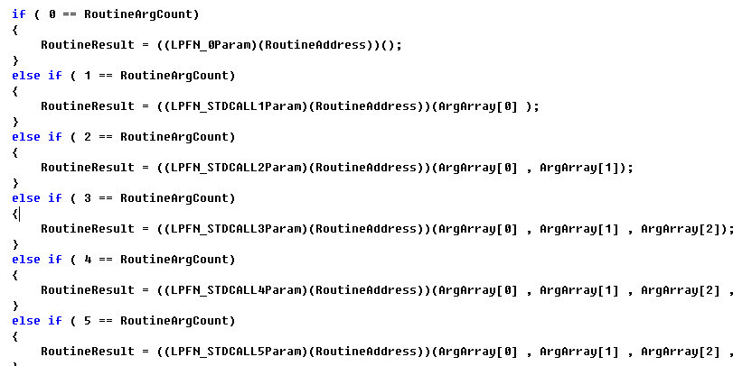
Invoke any function
Translate all param to basic type : number and pointer
Only push number and pointer address to stack

Slide 17
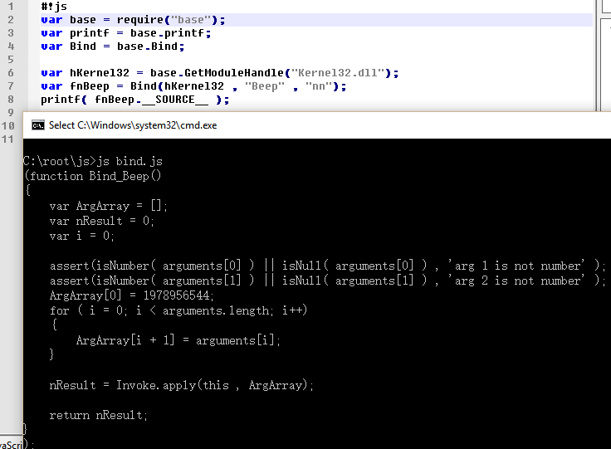
Dynamic binding any function

Slide 18
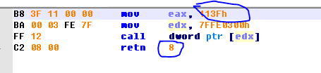
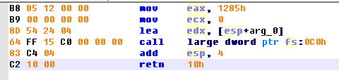

Do syscall
Build asm instruction in memory
I386
WOW64
AMD64

Slide 19
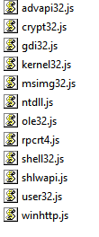
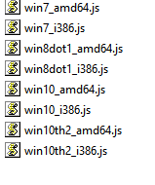
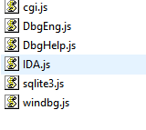
Build JS base libraray
api
shadowssdt
Context routine

Slide 20
Now
We can finally use JS do anything like c ,
let’s go to the kernel ,
Find the weak of win32k.sys

Slide 21

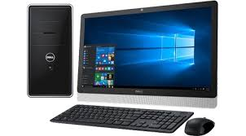
What I use
js.exe
Verifier.exe
win32kfuzz.js
DigTool.sys
4 vul in win32k in first week
One Normal PC

Slide 22
How to fuzz kernel?
Choose the complext target.
Complext Logic.
More complext , more bugs!
Complext Relation.
Complext call-path.

Slide 23

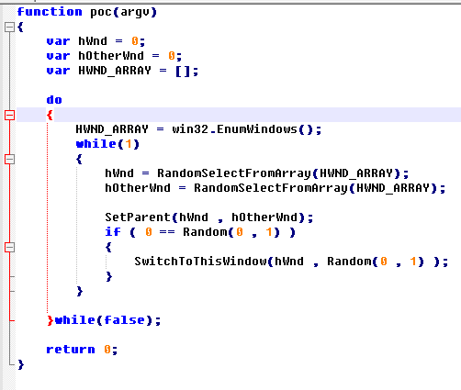
Story of MS16-034/ CVE-2016-0096

Slide 24
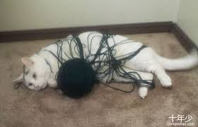
Complext Relation
After this POC run , the result is confuse and complext , even me can not say the windows relation clearly.
And so do win32k.sys , haha.

Slide 25

First kernel vulnerabliy fuzzed via JS!

Slide 26
The undocument code
Fuzzer and hacker like undocument , it’s usually mean’s some thing powerfull and internaly , and may be weakly.

Slide 27
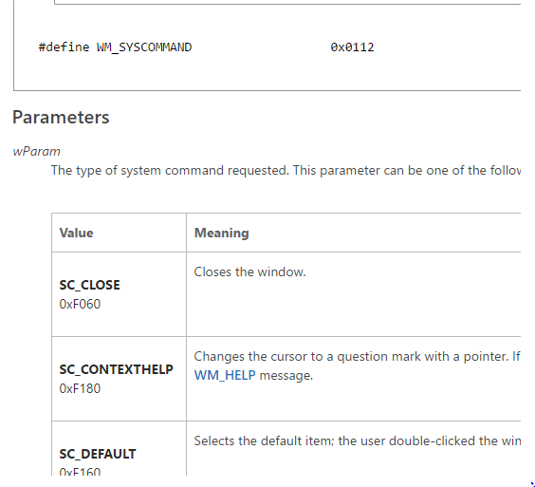
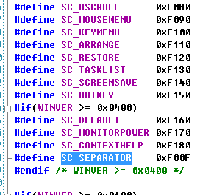
WM_SYSCOMMAND
0xF00F ?
Undocument != Invalid

Slide 28
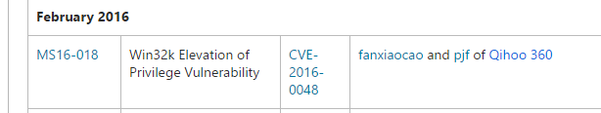
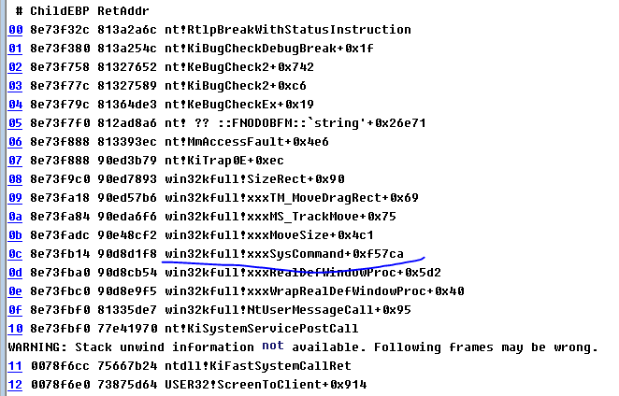
story of MS16-034/CVE-2016-0048

Slide 29
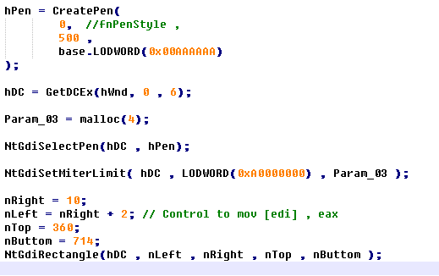
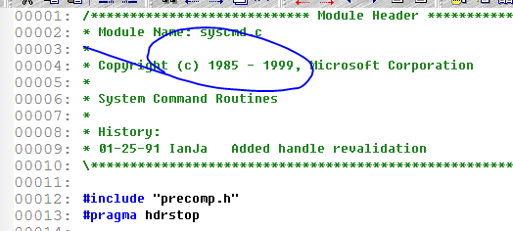
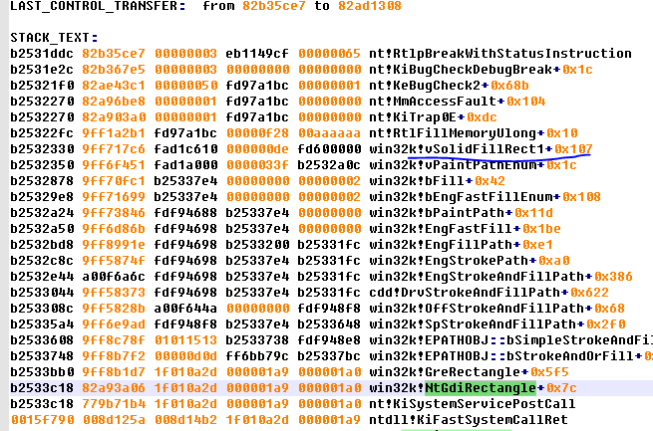
Old and complext Code
Win32k.sys has many old code ,like gdi rect , regin , hwnd , and DC routines.
Some may even older than me

Slide 30
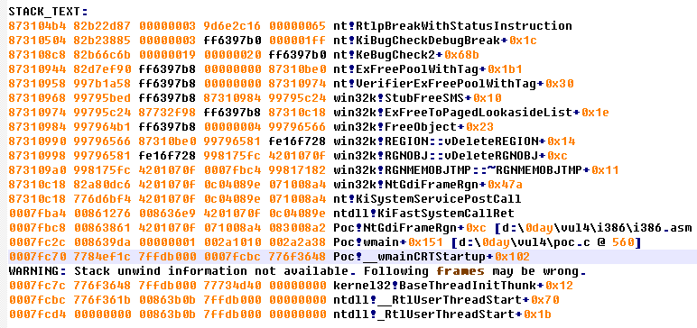
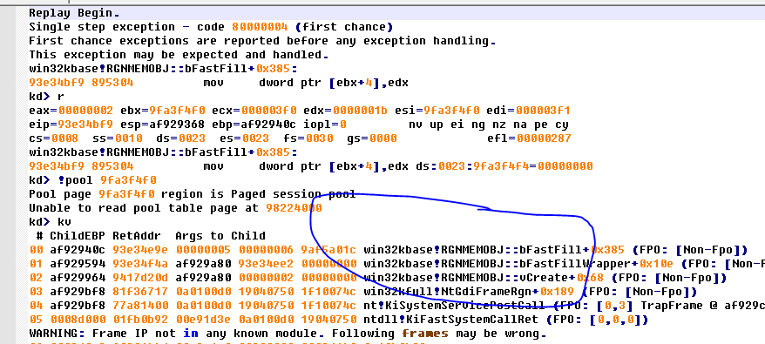
DigTool – OOB Detect
Verifier can only report at BAD_POOL_HEAD after pool head was corrupt , but with DigTool , we can
Catch the exception at first time

Slide 31
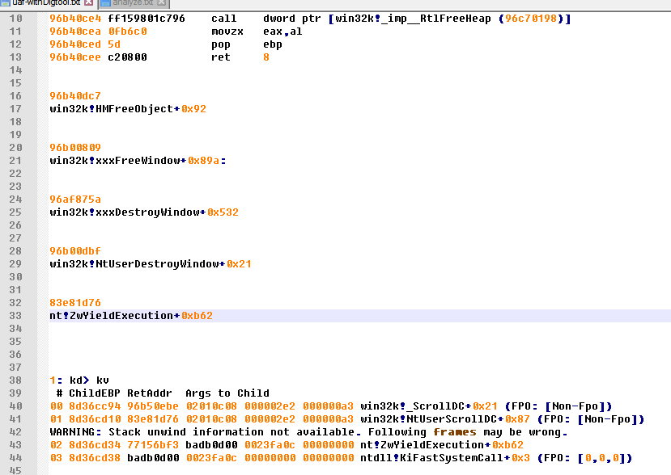
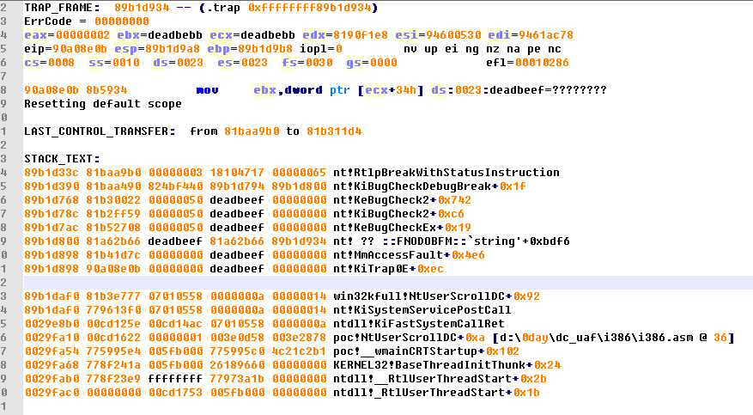
DigTool – UAF Detect
A UAF vul , only when it access to a invalid address , it can be reported by verifier , but with DigTool , we can record where memory is free , and where is used.

Slide 32
final
Different think about fuzz , cause different result.

Slide 33
Thank you
Sorry for my pool english
root@tinysec.net

