Slide 1
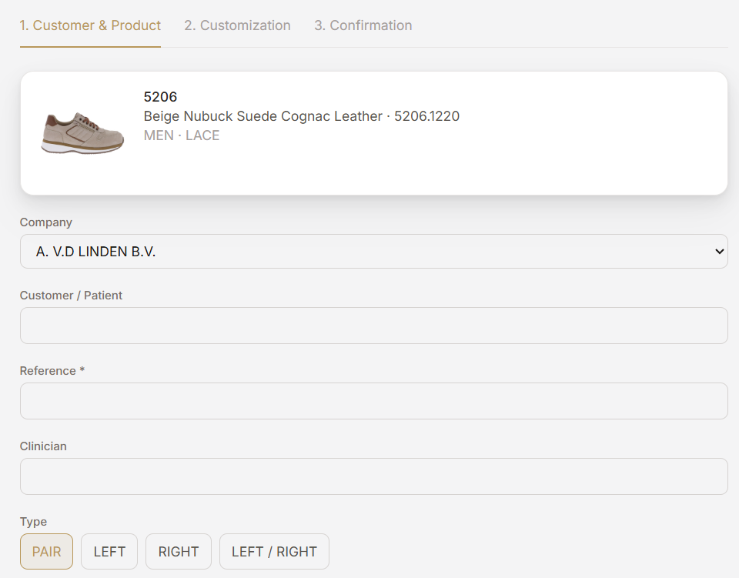
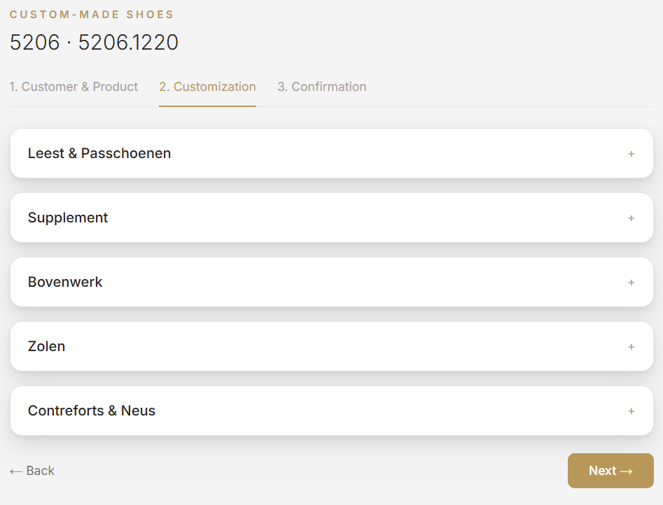
Required field
Required field
Start this page with all the tabs closed
Isn’t this the same?
Note, if I only schoose left or right, then in the rest of the form it needs to be only that side.

Slide 2

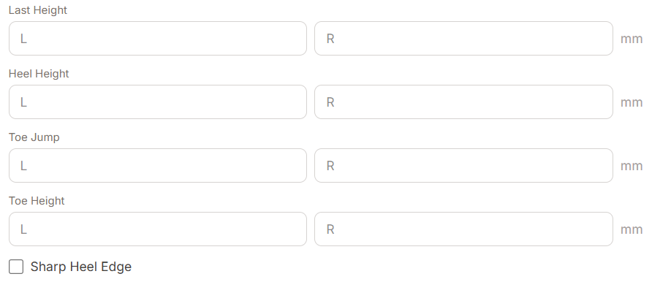
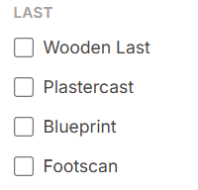
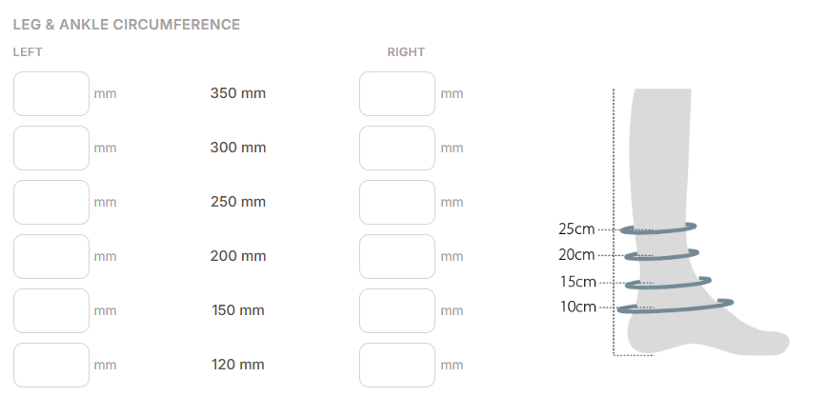
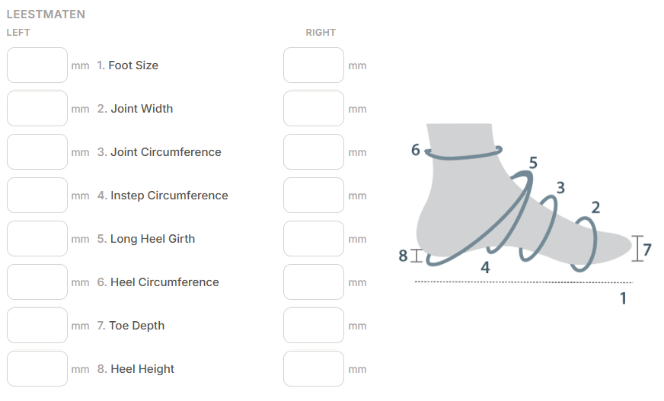
Make dropdown menu:
Low last
100mm
120mm
150mm
200mm
220mm
250mm
300mm
350mm
Requird field
Delete
When last height is indicated at 100mm then that is a required field (in last and ankle circumference)
Same for last height: 150mm, 200mm, 250, 300, 350
Write as mm not as cm (this is standard throughout the whole form)
Last measurements
Extend with:
120mm
220mm
300mm
350mm
Extend with: 100mm

Slide 3
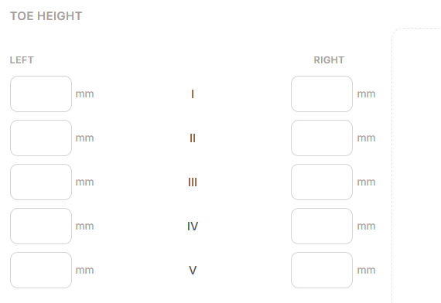
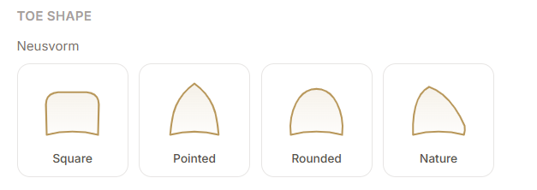
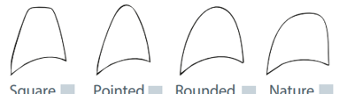

Not the correct drawings
If box is checked then give option for:
Fitting shoe of last
Fitting shoe including supplement. (when checked, supplement form is required)
This is correct

Slide 4

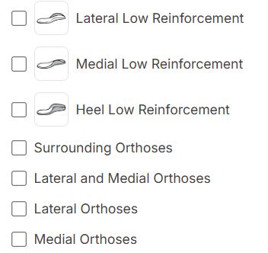
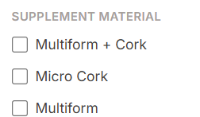
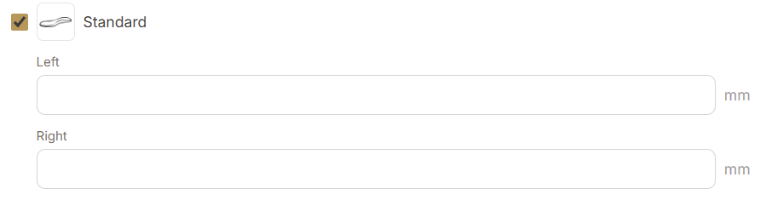
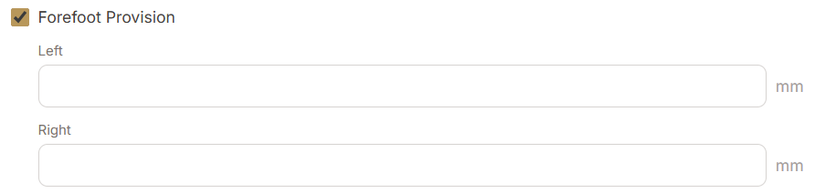

Change the names of the different supplement types
Lateral under ankle reinforcement
No height indication needed
Medial under ankle reinforcement
Lateral/medial under ankle reinforcement
Lateral/medial over ankle reinforcement covering achilles tendon
Height indication needed
Lateral/medial over ankle reinforcement
Lateral over ankle orthosis
Medial over ankle orthosis
No height indication needed
Heelhight:
L R
mm mm
Heelhight if it is filled in in the Last and fitting shoe tab. Then autofill it here. If not, then make it a required field
This should also be autofilled in the soles tab
Keep the same
Change material for all reinforcements into:
Ercoflex
Renoflex 1.1
Renoflex 1.5
Renoflex 1.9

Slide 5
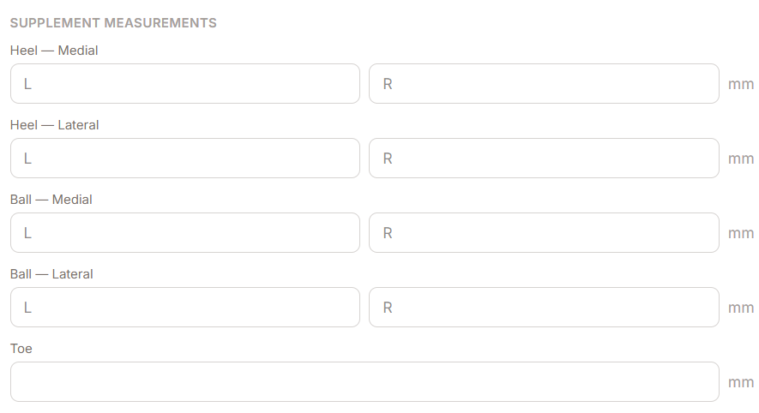

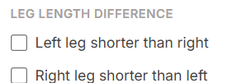
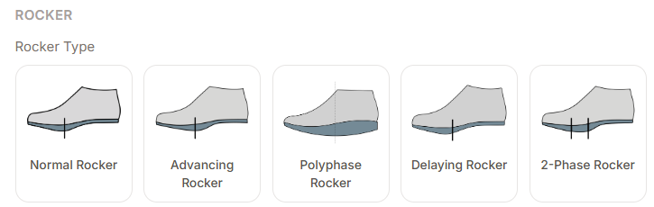
No medial and lateral needed. Only heel
Keep like this, no changes
Keep like this, no changes
When rocker is checked. Mm don’t have to be indicated.

Slide 6

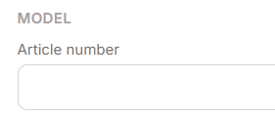

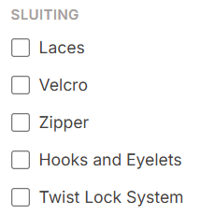
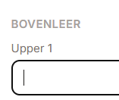
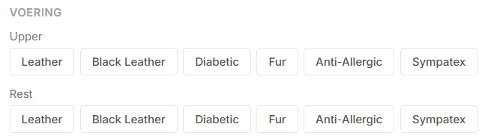
Change to; Schacht
Show only when: Leather and Black leather are checked.
Auto fill in from start
Required field
Enter an extra checkbox with: Closure as model
When checked, then there can be no choices for other closures. (check box by default)
Enter an extra checkbox with: Leathers as model
When checked, then there can be no choices for other leathers. (check box by default)
When a client wants to choos a different closure on a model then a popup must apear with the following tekst: A surcharge may apply if closures other than the standard closure is chosen.
When a client wants to choos the colours on a model then a popup must apear with the following tekst: A surcharge may apply if colors other than the standard colors are chosen.
Make no difference between upper an rest in lining. The checkbox should only say: Lining

Slide 7
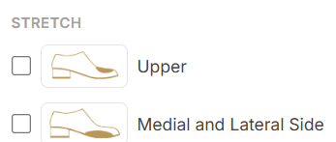
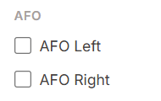
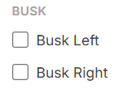
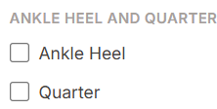

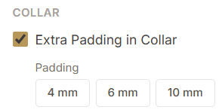
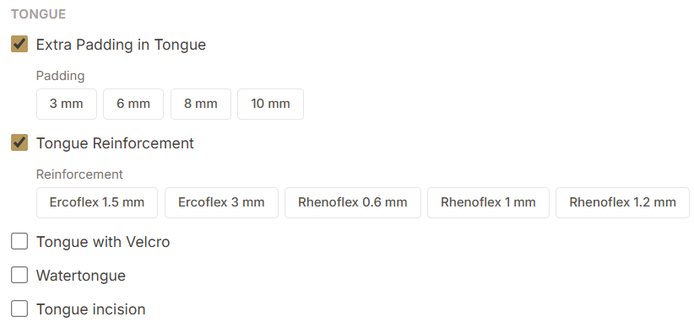
Delete
When stretch is checked, show popup with: Stretch is only possible if the model allows it.
Delete
Delete
Keep
Keep
Keep

Slide 8

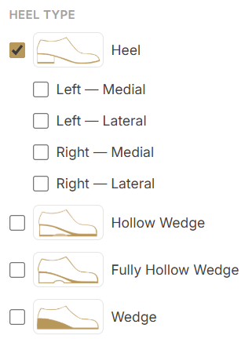

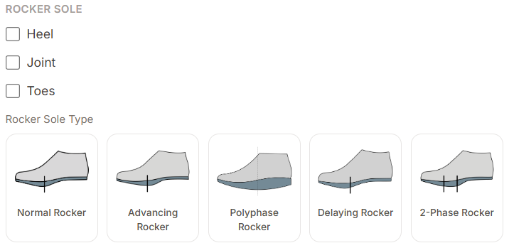
Keep, Measurement back default
Delete for all heel types
Keep
Rocker sole: yes/no if yes, then this field apears
Keep, autofill this from : Last & fitting shoe and supplements tab. If it is not filled in earlier in the form, then make it a required field.

Slide 9

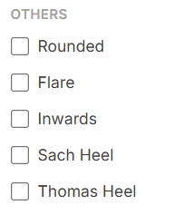
Keep
Keep

Slide 10
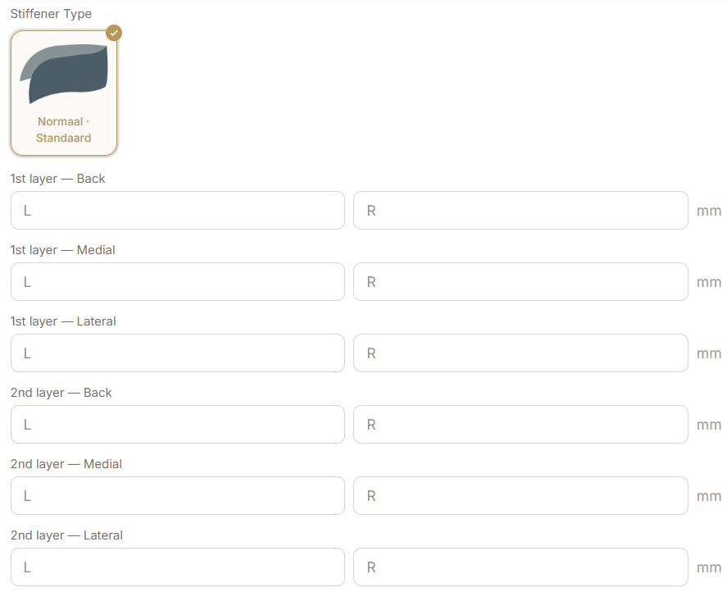
It must be possible to select different stiffeners for the left and right. The table as indicated below will be removed. Only for the high counter must a height be specified. This is a required field. For every selection made, a material selection must be made. Dropdown as shown
An information button must be added containing the following text: All requested modifications will be placed between the lining and the upper leather. If this is not possible, the modification will be built up on the lining, after which the upper leather will be made over it. This may incur additional costs.
Material dropdown:
Renoflex 1.2
Renoflex 1.5
Renoflex 1.9
Renoflex 1.2 double
Renoflex 1.5 double
Renoflex 1.9 double
Ercoflex 2
Ercoflex 3
Ercoflex 2/Renoflex 1.2
Ercoflex 2/Renoflex 1.5
Ercoflex 2/Renoflex 1.9
Ercoflex 3/Renoflex 1.2
Ercoflex 3/Renoflex 1.5
Ercoflex 3/Renoflex 1.9
Leather
Delete for all stiffner types

Slide 11
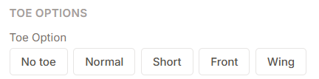


Normal as default
Change name into: Toe reinforcement options
Change name into: No reinforcement
Delete
Keep
Delete

