Slide 1
SIL765 - Assignment 1
Data Encryption Standard Implementation
By:
Yash Gupta (2013CS10302)
Ujjwal Sinha (2012CH70185)

Slide 2
DES - Introduction:
DES is a block cipher, meaning that it operates on plaintext blocks of a given size (64-bits) and returns ciphertext blocks of the same size.
It is based on Fiestel cipher, and has 16 rounds.
Input block of 64 bits is divided into two blocks of 32 bits each, a left half block L and a right half R.
Before the Fiestel rounds, the input block is permuted using a special initial permutation, which is inverted after the Fiestel rounds.

Slide 3
Project Overview
We implement DES using C/C++
All blocks are stored as unsigned integers (32-bit or 64-bit)
There are 2 basic functions: encrypt(plain, key, outputs) and decrypt(cipher, key, outputs)
Key schedule is implemented by key_round(i, CD) and inv_key_round(i, CD)
Fiestel box is implemented by fiestel_box(R,K)
To assist these functions, following are also used: initial_permutation(), inv_initial_permutation(); expansion_box(), selection_box(), permutation_box(); permutation_choice1_box(), permutation_choice2_box(), shift_boxes(), …

Slide 4
DES Encryption
Here we take plain-text to be “FEED1337BEAD8787” and key to be “0E329232EA6D0D73” in hexadecimal format.
Both plain text and the key is converted to binary format and we get a 64 bit block of plain text and key.
Out of 64 bits of key, 8 bits of key are redundant parity bits.
Initial permutation is applied to plain text.
Permuted plaintext is split into L and R; key is used to initiate key schedule.
Iterate over 16 rounds by invoking f-box, XOR’ing and swapping appropriately
Perform final swap and invert initial permutation.
Cipher-text = “1A4AE1F807D29195”

Slide 5
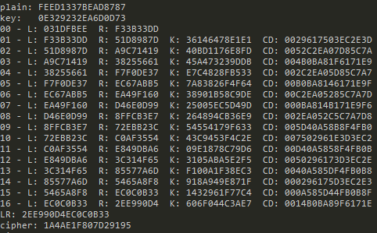
DES Encryption Output

Slide 6
DES Decryption
Take cipher-text to be “1A4AE1F807D29195” and key to be “0E329232EA6D0D73”
Apply initial permutation, split into two 32-bit blocks and swap.
Iterate over 16-rounds in the reverse direction to invert the encryption As XOR is it’s own inverse, this is trivial
For key schedule, reverse the shift schedule and right-shift instead of left. Works because total amount shifted equals 28 (for each 28-bit bock C and D).
Finally obtain plain-text by combining L and R and applying inverse initial permutation.
Plain text = “FEED1337BEAD8787”

Slide 7
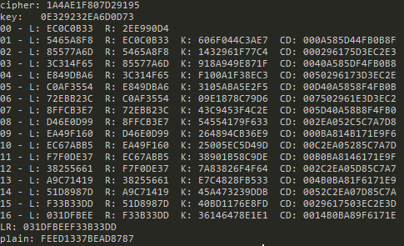
DES Decryption Output

Slide 8
DES Validation:
To validate DES implementation: Output of the J^{th} encryption round should be identical to the output of the (16-J)^{th} decryption round.
In the encrypt() and decrypt() functions, store the intermediate outputs in an array.
Finally assert that J^{th} and (16-J)^{th} outputs of encrypt and decrypt respectively are equal.
The program executes successfully with no assertion faliures, thus validating our implementation.

Slide 9
THANK YOU!

