Slide 1

Presentation on E-Commerce Online Shopping

Slide 2
What is E-Commerce..?
Commonly Known as Electronic Marketing.
It consists of selling and buying goods and services over an electronic systems such as the internet and the other computer network.
WHY USE E-COMMERCE:
Low entry cost.
Reduce Transaction Cost.
Access to the global market.
Good market share can be captured.

Slide 3
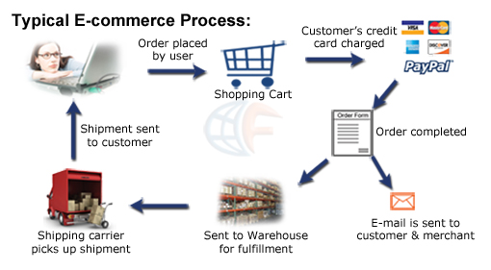
Process of E-Commerce

Slide 4
FEATURES
Registration
Login
Categories of products
Searching
Add to cart
Make Payment

Slide 5
Specifications:
PHP
HTML, JavaScript
CSS, Bootstrap
Ajax
MySql

Slide 6
Using Ajax…
As we know that AJAX and javascript can make a site quicker and more receptive to the client on the grounds that they make activity on a website page without stacking the whole page in the program.

Slide 7
Use of AJAX in E-Commerce
AJAX is as often as possible utilized for logging as a part of to records, enrolling with a site, looking through item postings, or adding an item to your shopping cart.
They can decrease the quantity of moves some individual needs to make or they can diminish the measure of disorder on the page by concealing a few bits of data unless they are asked for, abstaining from over-burdening your clients with an excessive amount of data without a moment's delay.

Slide 8
Continued…
With the help of Ajax Shopping Cart Extension is powerfully overhauled as new things are added to it.
This methodology would let clients keep searching and adding things to their carts without waiting after every snap for a full-page overhaul.

Slide 9
BOOTSRAP AS FRAMEWORKS
Bootstrap is the most popular CSS Framework for developing responsive and mobile-first websites.
It has also library for web designers to create UI design for ecommerce web sites. Quickly prototype with ready made blocks and plugins.

Slide 10
And we are making use of MySQL Database and a PayPal Sandbox REST API implementation.

Slide 11
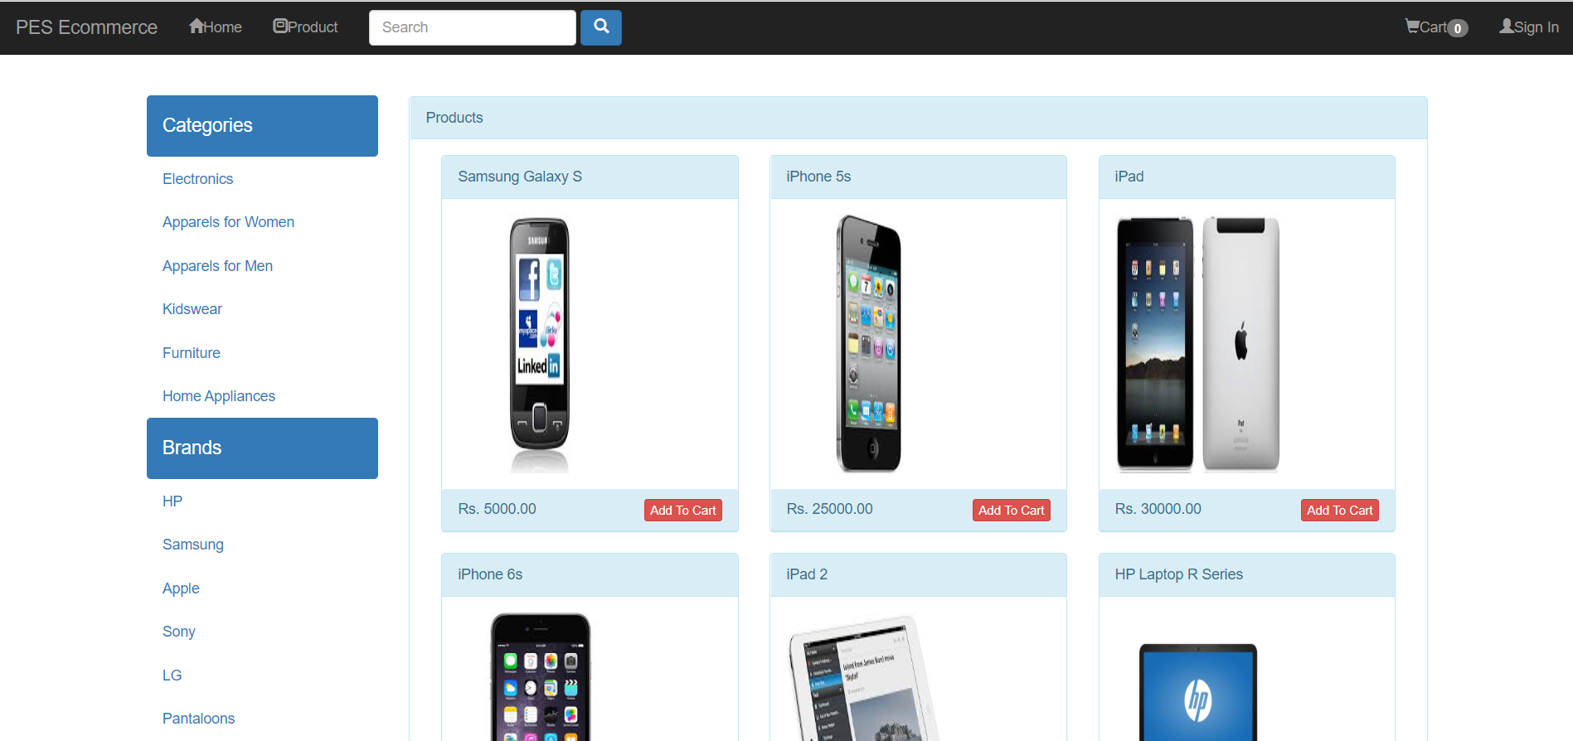

Slide 12
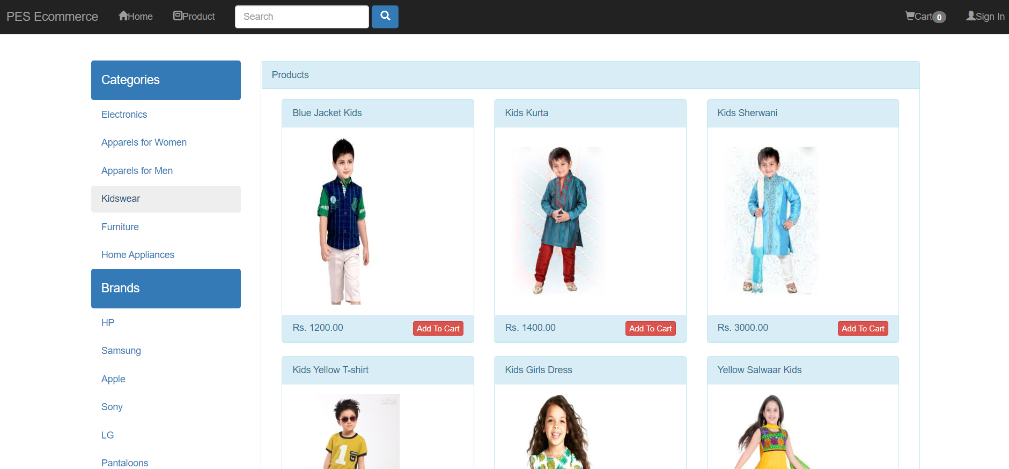

Slide 13
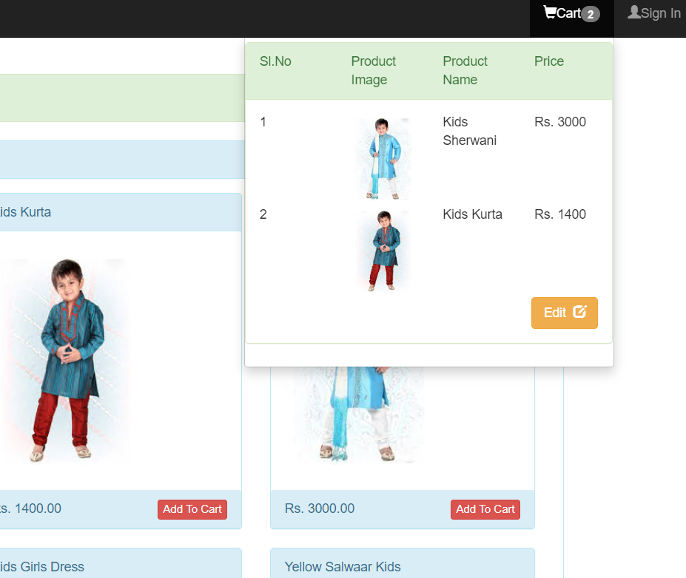

Slide 14
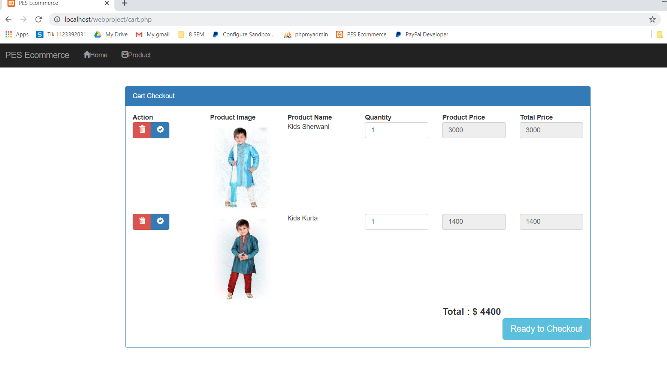

Slide 15
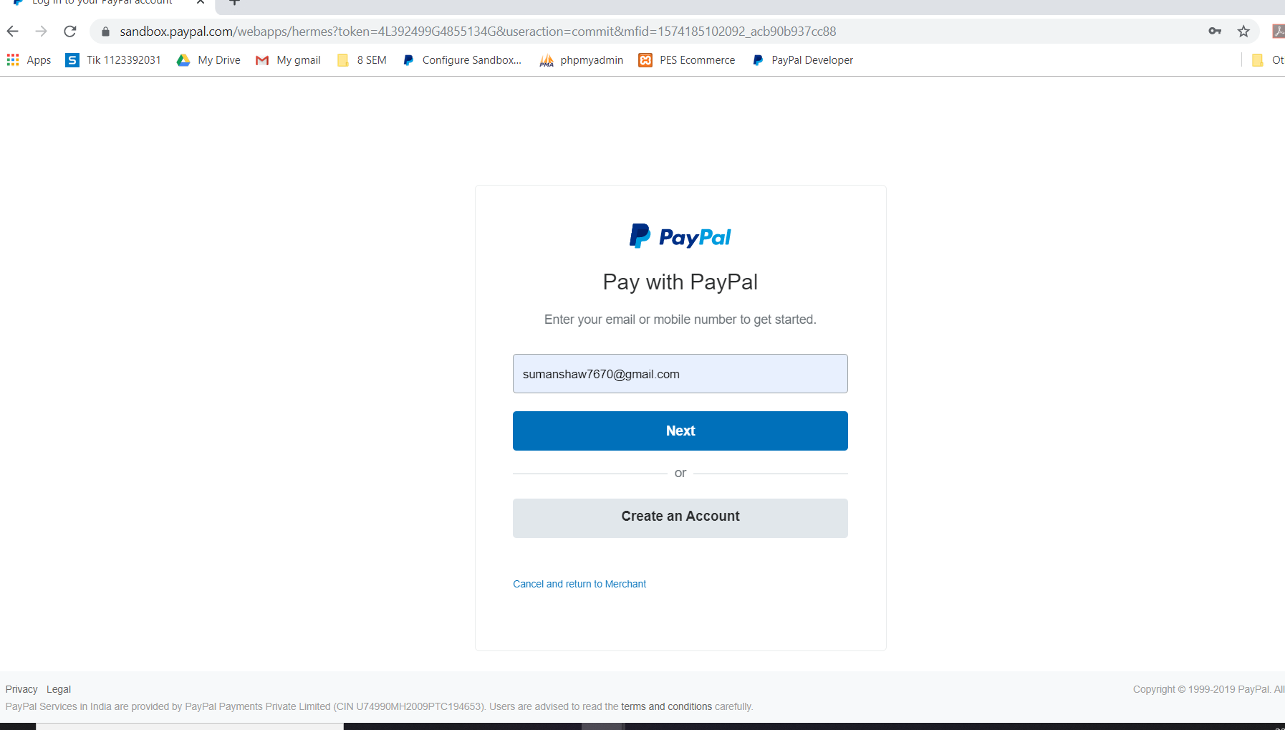

Slide 16
