Slide 1
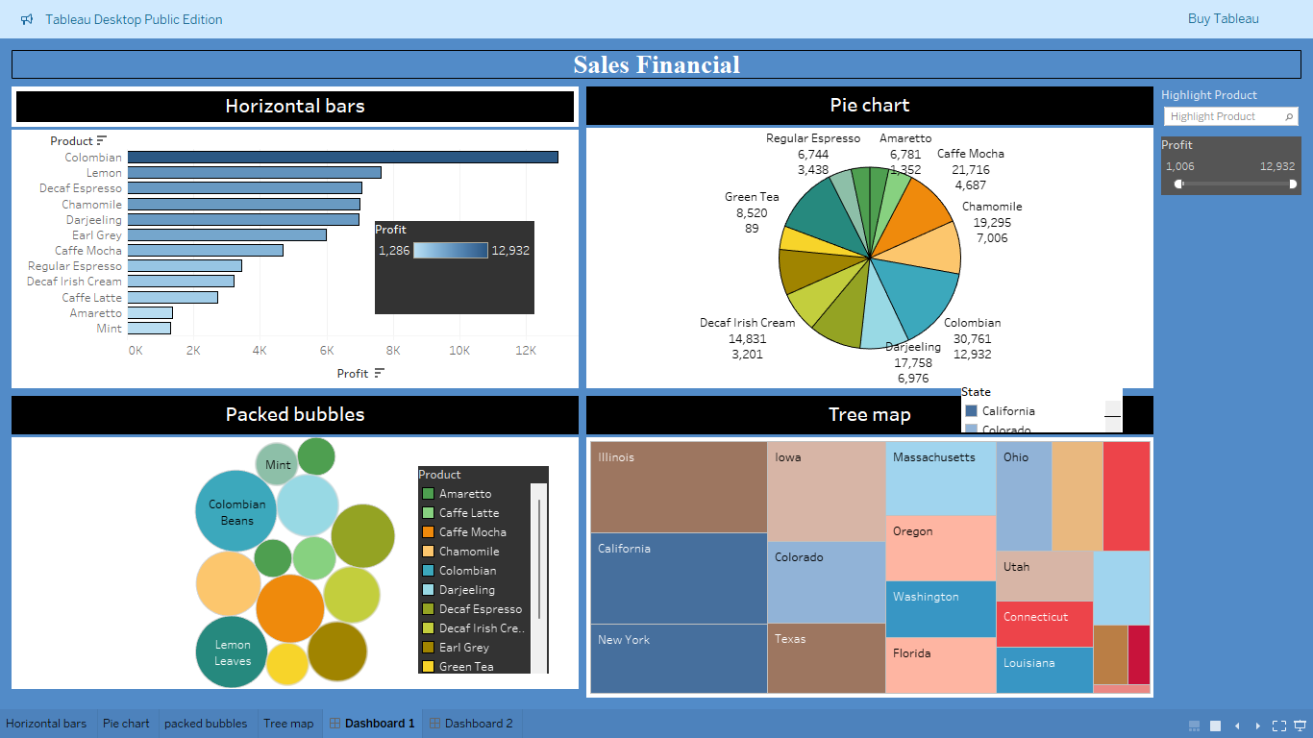

Slide 2
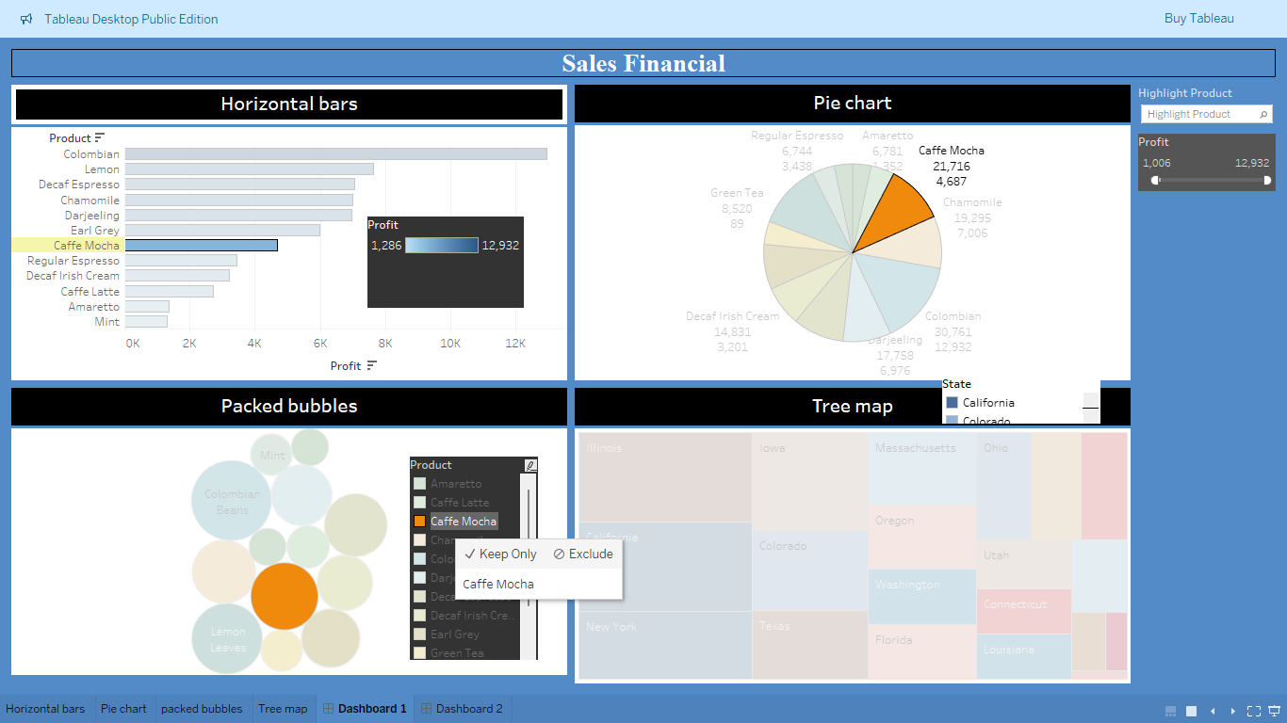

Slide 3
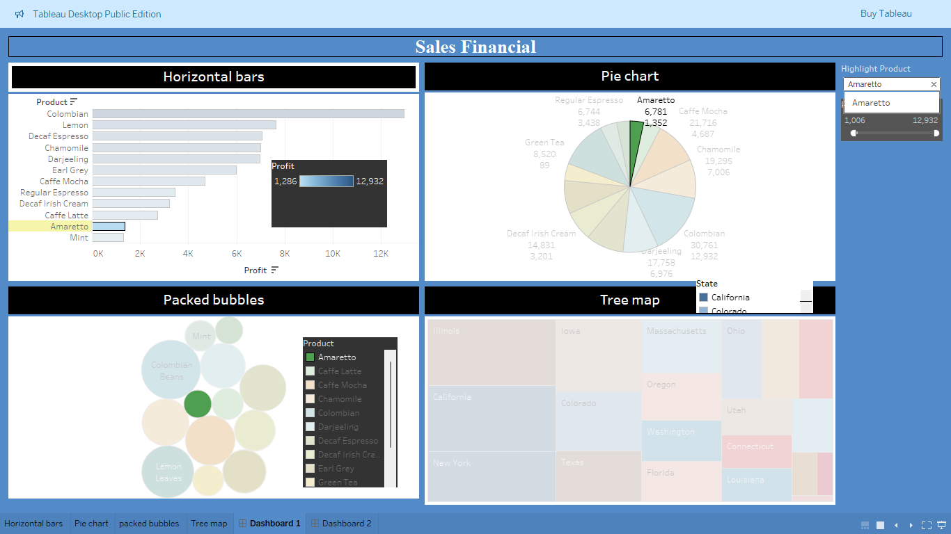

Slide 4
1. Horizontal Bars (Top-Left)
Displays profit by product.
Colombian product leads with the highest profit (12,932).
Other top performers include Lemon, Decaf Espresso, and Chamomile.
2. Pie Chart (Top-Right)
Also shows product-wise distribution of profits.
Highlights:
Colombian (30,761 total, 12,932 profit).
Darjeeling and Chamomile are also significant contributors.
Products like Amaretto and Mint have lower profits.
3. Packed Bubbles (Bottom-Left)
Visually reinforces product performance.
Larger bubbles for high-performing products like Colombian and Lemon.
Color coding helps differentiate products.
4. Tree Map (Bottom-Right)
Shows state-wise profit distribution.
Key states:
California, Illinois, New York, and Texas are prominent.
Smaller boxes represent lower-performing states like Louisiana, Connecticut, etc.
5. Interactive Filters (Right Sidebar)
Filter by highlight product or profit range using a slider.

