Slide 1
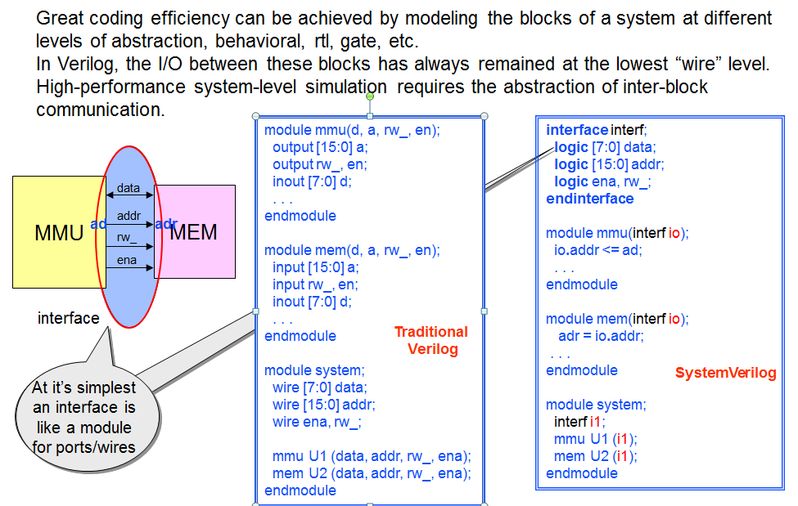
Interfaces

Slide 2
Interfaces – Characteristics
Brings abstraction-level enhancements to ports and internals
Interface may contain any legal System Verilog code except module definitions and/or instances.
tasks, functions, initial/always blocks, parameters, etc.
Bus timing, pipelining, etc. may be captured in an interface rather than the connecting modules.
Interfaces are defined once and used widely, so it simplifies design.
Interfaces are synthesizable.

Slide 3
ModPorts
Different users of interface need different views
Master/Slave
Monitor/driver
Modport construct allows you to group signals and specify directions

Slide 4
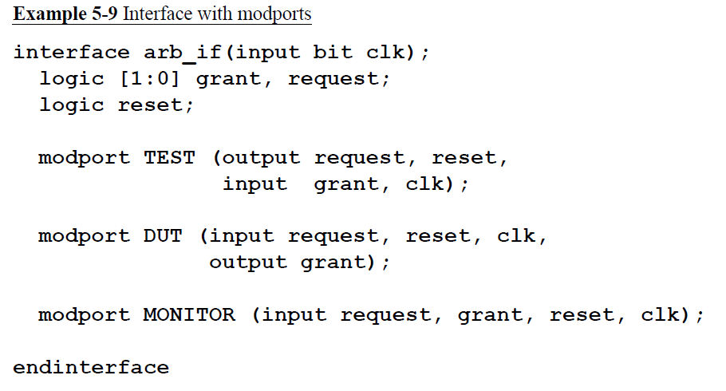
Mod port example

Slide 5
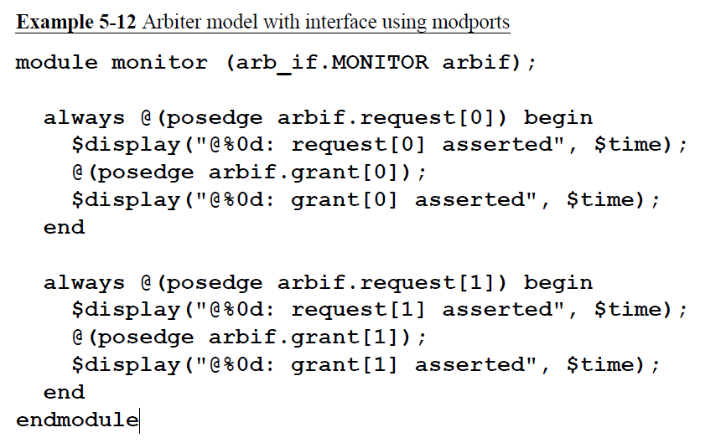
Mod port example - usage

