Slide 1
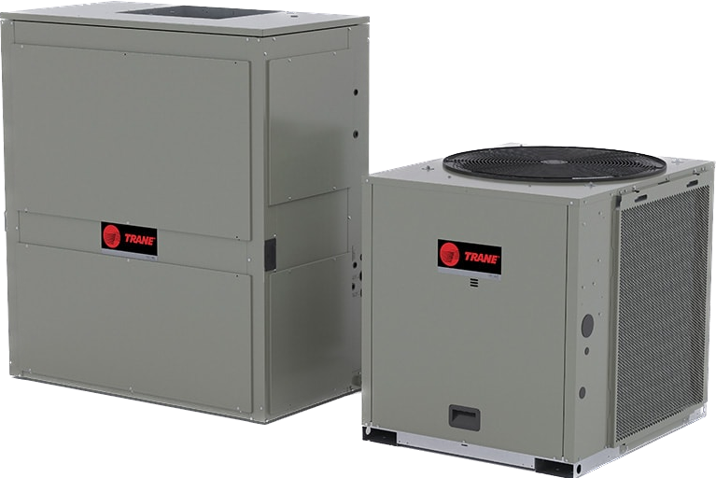
Odyssey Wiring Summary
for Symbio 700 Pairing Scenarios

Slide 2
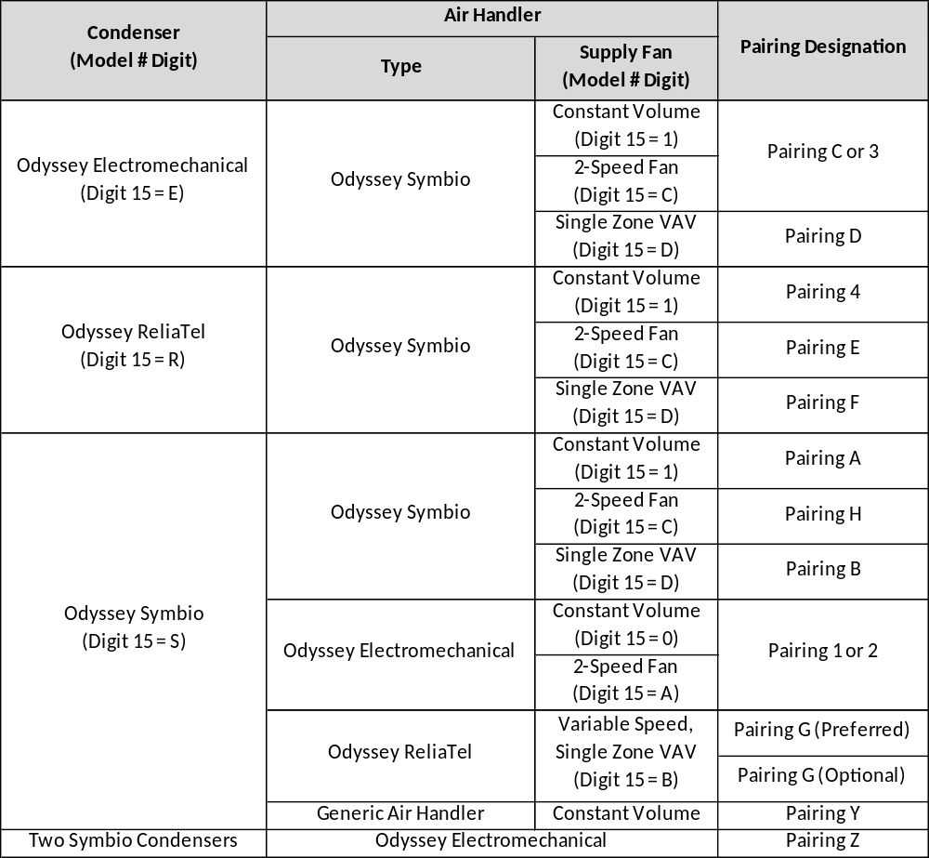
Symbio/Odyssey Pairings
Trane Symbio 700, Trane Legacy, and non-Trane Scenarios
Notes:
Since the combinations of condensers and air handlers is vast, each pairing is identified with a specific designation. Depending on the pairing designation, the wiring between the condenser, air handler, and thermostat / zone sensor varies. In addition, the number of wires required between the condenser and air handler varies with each pairing. Refer to the following diagrams for a high-level wiring summary. Refer to SS-SVN016* for additional wiring instructions.

Slide 3
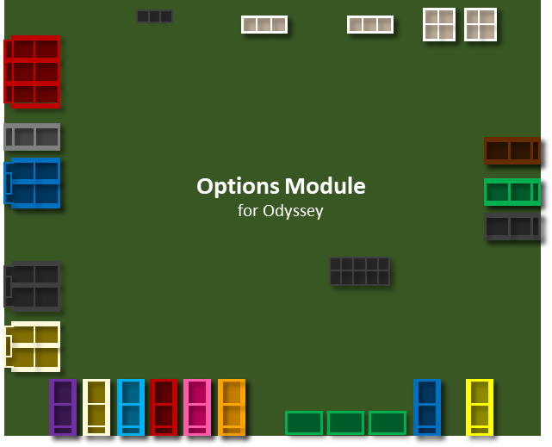
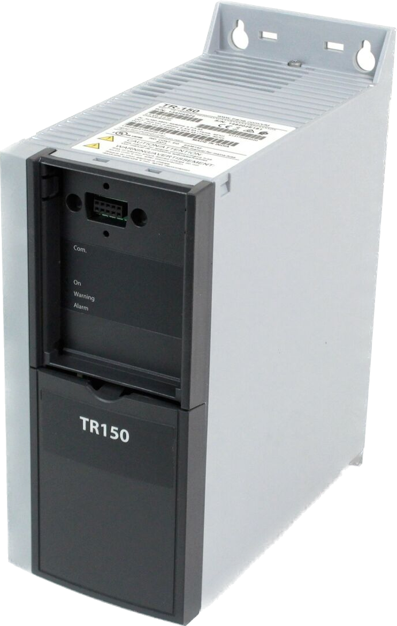
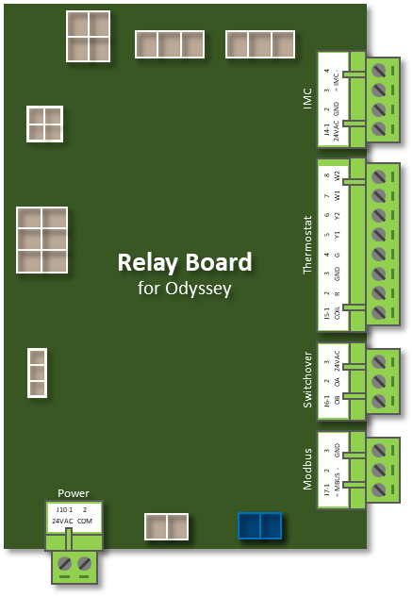
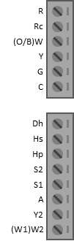
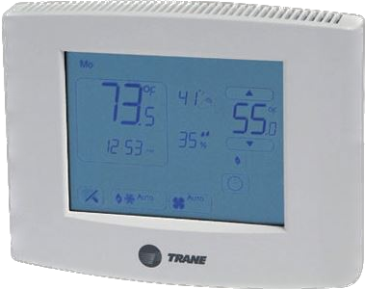
Pairing C or 3
Odyssey AHU with Electromechanical Condenser
*
IMC
Terminal
Strip
Control Wiring
1
TR150
VFD
B1
B2
Y1
Y2
EDC
R
LTB1
2
Thermostat Wiring
Air Handling Unit:
Condenser:
Trane Odyssey
Two-Speed Fan
Electromechanical
1
Thermostat wire – 5 conductors. REQUIRED for this pairing scenario.
2
Thermostat wire – 7 conductors. REQUIRED for this pairing scenario.
* Options Module required for electric heat, SZVAV, and heat pump applications.
Thermostat
Notes:
For pairings C and 3, the heating and cooling control is provided by the thermostat. Wire the thermostat to the relay board in the Trane Odyssey air handling unit. Use separate control wiring between the electromechanical condenser and Trane Odyssey air handler. Depending on the exact features of the air handler and condenser pairing, the number of conductors needed for that control wire may vary. Refer to the wiring diagrams in the installation guide SS-SVN016* for additional field wiring information.

Slide 4
Pairing D
Odyssey Single Zone VAV (SZVAV) AHU with Electromechanical Condenser
*
IMC
Terminal
Strip
Control Wiring
1
TR150
VFD
B1
27
B2
12
18
Y1
50
Y2
53
EDC
R
LTB1
2
Thermostat Wiring
Air Handling Unit:
Condenser:
Trane Odyssey
SZVAV
Electromechanical
1
Thermostat wire – 5 conductors. REQUIRED for this pairing scenario.
2
Thermostat wire – 7 conductors. REQUIRED for this pairing scenario.
* Options Module required for electric heat, SZVAV, and heat pump applications.
Thermostat
Notes:
For pairings D, the heating and cooling control is provided by the thermostat. Wire the thermostat to the relay board that has been factory installed in the new Trane Odyssey air handler. Use separate control wiring to connect the air handler to the terminal strip in the electromechanical condenser. Depending on the exact features of the air handler and condenser pairing, the number of conductors needed for that control wire may vary. The VFD in the air handler is factory wired to the relay board and requires no field connection. Refer to the wiring diagrams in the installation guide SS-SVN016* for additional field wiring information.

Slide 5

Pairing 4 (Thermostat)
Odyssey Constant Volume AHU with ReliaTel Condenser
*
IMC
Terminal
Strip
Control Wiring
1
RTRM
B1
ReliaTel
R
CD
R
Y1
W1/O
G
W2
Y2
X2
T
H1
COM
H2
EF
Thermostat Wiring
LTB1
2
Air Handling Unit:
Condenser:
Trane Odyssey
Constant Speed Fan
Trane ReliaTel
1
Thermostat wire – 6 conductors. REQUIRED for this pairing scenario.
2
Thermostat wire – 7 conductors. REQUIRED for this pairing scenario.
* Options Module required for electric heat, SZVAV, and heat pump applications.
Thermostat
Notes:
For pairing 4, the heating and cooling control is provided by the thermostat. Wire the thermostat to the RTRM controller in the Trane ReliaTel condenser. Use separate control wiring between the condenser and Trane Odyssey air handler. Depending on the exact features of the air handler and condenser pairing, the number of conductors needed for that control wire may vary. Refer to the wiring diagrams in the installation guide SS-SVN016* for additional field wiring information.

Slide 6

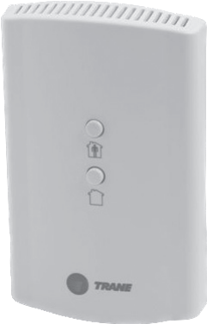
Pairing 4 (Zone Sensor)
Odyssey Constant Volume AHU with ReliaTel Condenser
*
IMC
Terminal
Strip
Control Wiring
1
RTRM
B1
ReliaTel
R
CD
1
2
3
4
5
H1
H2
Zone Sensor Wiring
EF
2
LTB1
Air Handling Unit:
Condenser:
Trane Odyssey
Constant Speed Fan
Zone
Common
Cool Setpt
Mode
Heat Setpt
Trane ReliaTel
1
Thermostat wire – 6 conductors. REQUIRED for this pairing scenario.
2
Zone sensor wire – Up to 7 conductors may be required depending on the specific sensor used.
Zone Sensor
* Options Module required for electric heat, SZVAV, and heat pump applications.
Notes:
For pairing 4, the heating and cooling control is provided by the ReliaTel controller. Wire the zone sensor to the proper terminals on the Trane ReliaTel controller in the condenser. Use separate control wiring between the condenser and Trane Odyssey air handler. Depending on the exact features of the air handler and condenser pairing, the number of conductors needed for that control wire may vary. Refer to the wiring diagrams in the installation guide SS-SVN016* for additional field wiring information.

Slide 7
Pairing E or F (Thermostat)
Odyssey Two-Speed/SZVAV AHU with ReliaTel Condenser
*
IMC
Terminal
Strip
Control Wiring
1
RTRM
TR150
VFD
(SZVAV only)
B1
ReliaTel
R
CD
R
Y1
W1/O
G
W2
Y2
X2
T
H1
COM
H2
EF
Thermostat Wiring
LTB1
2
Air Handling Unit:
Condenser:
Trane Odyssey
Two-Speed/SZVAV
Trane ReliaTel
1
Thermostat wire – 6 conductors. REQUIRED for this pairing scenario.
2
Thermostat wire – 7 conductors. REQUIRED for this pairing scenario.
* Options Module required for electric heat, SZVAV, and heat pump applications.
Thermostat
Notes:
For pairings E and F, the heating and cooling control is provided by the thermostat. Wire the thermostat to the RTRM controller in the Trane ReliaTel condenser. Use separate control wiring between the condenser and Trane Odyssey air handler. Depending on the exact features of the air handler and condenser pairing, the number of conductors needed for that control wire may vary. The VFD in the air handler is factory wired to the relay board and requires no field wiring. Refer to the wiring diagrams in the installation guide SS-SVN016* for additional field wiring information.

Slide 8
Pairing E or F (Zone Sensor)
Odyssey Two-Speed/SZVAV AHU with ReliaTel Condenser
*
IMC
Terminal
Strip
Control Wiring
1
RTRM
TR150
VFD
(SZVAV only)
B1
ReliaTel
R
CD
1
2
3
4
5
H1
H2
Zone Sensor Wiring
EF
2
LTB1
Air Handling Unit:
Condenser:
Trane Odyssey
Two-Speed/SZVAV
Zone
Common
Cool Setpt
Mode
Heat Setpt
Trane ReliaTel
1
Thermostat wire – 6 conductors. REQUIRED for this pairing scenario.
2
Zone sensor wire – Up to 7 conductors may be required depending on the specific sensor used.
Zone Sensor
* Options Module required for electric heat, SZVAV, and heat pump applications.
Notes:
For pairings E and F, the heating and cooling control is provided by the ReliaTel controller. Wire the zone sensor to the proper terminals on the Trane ReliaTel controller in the condenser. Use separate control wiring between the condenser and Trane Odyssey air handler. Depending on the exact features of the air handler and condenser pairing, the number of conductors needed for that control wire may vary. The VFD in the air handler is factory wired to the relay board and requires no field wiring. Refer to the wiring diagrams in the installation guide SS-SVN016* for additional field wiring information.

Slide 9
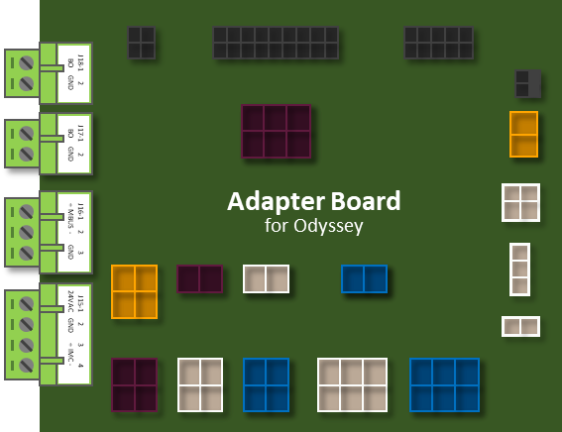
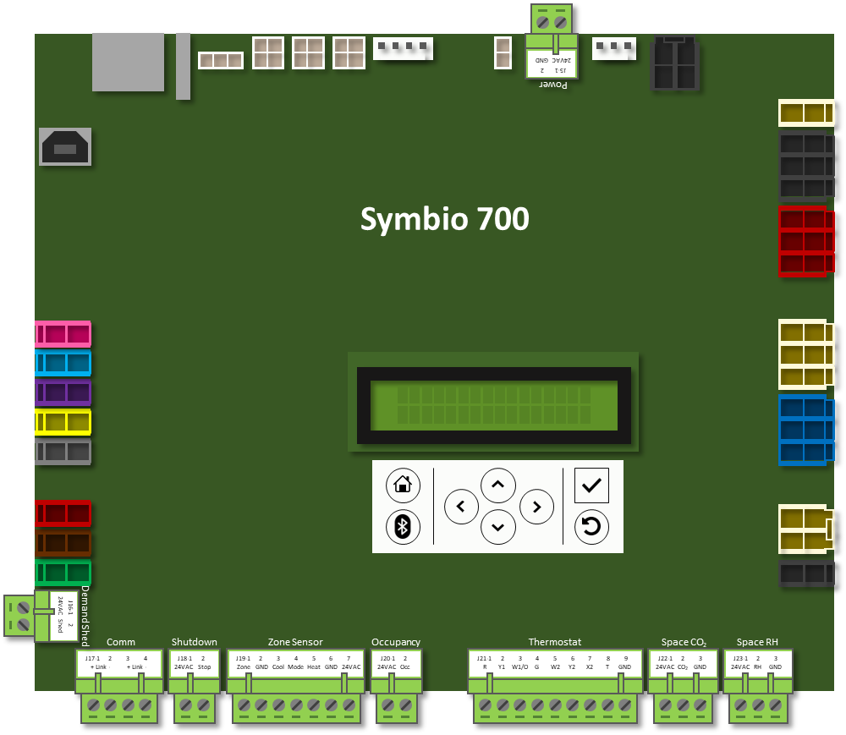
Pairing B (BACnet MS/TP, Thermostat)
Odyssey SZVAV AHU with Odyssey/Symbio 700 Condenser
*
IMC
Communication (Modbus)
1
TR150
VFD
(SZVAV only)
3
Communication (Proprietary)
Control Wiring
2
4
BACnet/BMS
5
BMS communication requires the advanced controller
Condenser:
Air Handling Unit:
6
Thermostat Wiring
Trane Odyssey
Symbio 700
Trane Odyssey
SZVAV
[Digit 15 = D]
1
Twisted pair communication cable. Required only for SZVAV applications. Modbus comm.
2
Thermostat wire – At least 4 conductors. REQUIRED for this pairing scenario.
3
Twisted-pair communication cable. Required only for Electric Heat, SZVAV applications. Proprietary comm.
4
Twisted pair communication cable(s) [daisy-chained]. Required only for BACnet MS/TP to BMS.
5
Twisted pair communication cable(s) [daisy-chained]. Required only for BACnet MS/TP to BMS.*
* Options Module required for electric heat, SZVAV, and heat pump applications.
(* Second twisted pair not required for the last controller on the daisy-chain link)
Thermostat
6
Thermostat wire – Up to 7 conductors
Notes:
For pairings A and B, the heating and cooling control is this specific scenario is provided by the thermostat connected to the Symbio 700 controller in the Trane Odyssey condenser. Separate control wiring is required between the condenser and Trane Odyssey air handler. Up to two additional communication cables are needed for electric heat applications or for SZVAV applications with a VFD. Those two communication cables must be twisted-pair cables, not thermostat wire. Lastly, for BACnet MS/TP communication to the Symbio 700 controller, two additional communication cables are needed to complete the daisy-chain connection to and from the controller, unless the unit is at the end of the communication link, in which case only one communication cable is needed. For BACnet/IP, a single ethernet cable is used to connect the Symbio 700 to the network switch (BACnet/IP not shown).

Slide 10
Pairing A (BACnet MS/TP, Thermostat)
Odyssey Constant Volume with Odyssey/Symbio 700 Condenser
*
IMC
2
Communication (Proprietary)
1
Control Wiring
3
BACnet/BMS
4
BMS communication requires the advanced controller
Condenser:
Air Handling Unit:
5
Thermostat Wiring
Trane Odyssey
Symbio 700
Trane Odyssey
Constant Volume
[Digit 15 = 1]
1
Thermostat wire – At least 4 conductors. REQUIRED for this pairing scenario.
2
Twisted-pair communication cable. Required only for Electric Heat applications. Proprietary comm.
3
Twisted pair communication cable(s) [daisy-chained]. Required only for BACnet MS/TP to BMS.
4
Twisted pair communication cable(s) [daisy-chained]. Required only for BACnet MS/TP to BMS.*
(* Second twisted pair not required for the last controller on the daisy-chain link)
* Options Module required for electric heat and heat pump applications.
5
Thermostat wire – Up to 7 conductors
Thermostat
Notes:
For pairings A and B, the heating and cooling control is this specific scenario is provided by the thermostat connected to the Symbio 700 controller in the Trane Odyssey condenser. Separate control wiring is required between the condenser and Trane Odyssey air handler. Up to two additional communication cables are needed for electric heat applications or for SZVAV applications with a VFD. Those two communication cables must be twisted-pair cables, not thermostat wire. Lastly, for BACnet MS/TP communication to the Symbio 700 controller, two additional communication cables are needed to complete the daisy-chain connection to and from the controller, unless the unit is at the end of the communication link, in which case only one communication cable is needed. For BACnet/IP, a single ethernet cable is used to connect the Symbio 700 to the network switch (BACnet/IP not shown).

Slide 11
Pairing A or B (BACnet MS/TP, Thermostat)
Odyssey Constant Volume or SZVAV AHU with Odyssey/Symbio 700 Condenser
*
IMC
Communication (Modbus)
1
TR150
VFD
(SZVAV only)
3
Communication (Proprietary)
Control Wiring
2
4
BACnet/BMS
5
BMS communication requires the advanced controller
Condenser:
Air Handling Unit:
6
Thermostat Wiring
Trane Odyssey
Symbio 700
Trane Odyssey
Constant Volume
or SZVAV
[Digit 15 = D]
1
Twisted pair communication cable. Required only for SZVAV applications. Modbus comm.
2
Thermostat wire – At least 4 conductors. REQUIRED for this pairing scenario.
3
Twisted-pair communication cable. Required only for Electric Heat, SZVAV applications. Proprietary comm.
4
Twisted pair communication cable(s) [daisy-chained]. Required only for BACnet MS/TP to BMS.
5
Twisted pair communication cable(s) [daisy-chained]. Required only for BACnet MS/TP to BMS.*
* Options Module required for electric heat, SZVAV, and heat pump applications.
(* Second twisted pair not required for the last controller on the daisy-chain link)
Thermostat
6
Thermostat wire – Up to 7 conductors
Notes:
For pairings A and B, the heating and cooling control is this specific scenario is provided by the thermostat connected to the Symbio 700 controller in the Trane Odyssey condenser. Separate control wiring is required between the condenser and Trane Odyssey air handler. Up to two additional communication cables are needed for electric heat applications or for SZVAV applications with a VFD. Those two communication cables must be twisted-pair cables, not thermostat wire. Lastly, for BACnet MS/TP communication to the Symbio 700 controller, two additional communication cables are needed to complete the daisy-chain connection to and from the controller, unless the unit is at the end of the communication link, in which case only one communication cable is needed. For BACnet/IP, a single ethernet cable is used to connect the Symbio 700 to the network switch (BACnet/IP not shown).

Slide 12
Pairing A or B (BACnet MS/TP, Zone Sensor)
Odyssey Constant Volume or SZVAV AHU with Odyssey/Symbio 700 Condenser
*
IMC
Modbus
1
TR150
VFD
(SZVAV only)
3
Communication (Proprietary)
Control Wiring
2
4
BACnet/BMS
5
BMS communication requires the advanced controller
Condenser:
Air Handling Unit:
Trane Odyssey
Symbio 700
Trane Odyssey
Constant Volume or SZVAV
Zone Sensor Wiring
6
1
Twisted pair communication cable. Required only for SZVAV applications. Modbus comm.
Zone
Common
Cool Setpt
Mode
Heat Setpt
2
Thermostat wire – At least 4 conductors. REQUIRED for this pairing scenario.
3
Twisted-pair communication cable. Required only for Electric Heat, SZVAV applications. Proprietary comm.
4
Twisted pair communication cable(s) [daisy-chained]. Required only for BACnet MS/TP to BMS.
5
Twisted pair communication cable(s) [daisy-chained]. Required only for BACnet MS/TP to BMS.*
* Options Module required for electric heat, SZVAV, and heat pump applications.
(* Second twisted pair not required for the last controller on the daisy-chain link)
Zone Sensor
6
Zone sensor wire – Up to 7 conductors may be required depending on the specific sensor used.
Notes:
For pairings A and B, the heating and cooling control in this scenario is normally provided by the Symbio 700 controller in the Trane Odyssey condenser. Separate control wiring is required between the condenser and Trane Odyssey air handler. Up to two additional communication cables are needed for electric heat applications or for SZVAV applications with a VFD. Those two communication cables must be twisted-pair cables, not thermostat wire. Lastly, for BACnet MS/TP communication to the Symbio 700 controller, two additional communication cables are needed to complete the daisy-chain connection to and from the controller, unless the unit is at the end of the communication link, in which case only one communication cable is needed. For BACnet/IP, a single ethernet cable is used to connect the Symbio 700 to the network switch (BACnet/IP not shown).

Slide 13


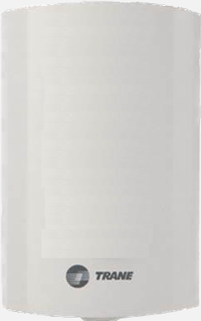
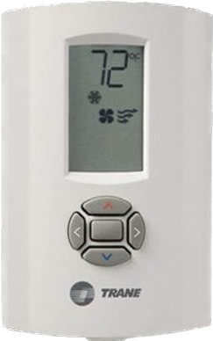
Pairing A or B (Air-Fi Wireless)
Odyssey Constant Volume or SZVAV AHU with Odyssey/Symbio 700 Condenser
*
IMC
Communication (Modbus)
1
TR150
VFD
(SZVAV only)
3
Communication (Proprietary)
Control Wiring
2
Condenser:
Air Handling Unit:
BMS communication requires the advanced controller
Trane Odyssey
Symbio 700
Trane Odyssey
Constant Volume or SZVAV
Air-Fi Wireless WCI
1
Twisted pair communication cable. Required only for SZVAV applications. Modbus comm.
2
Thermostat wire – At least 4 conductors. REQUIRED for this pairing scenario.
Air-Fi Wireless Space Sensor
3
Twisted-pair communication cable. Required only for Electric Heat, SZVAV applications. Proprietary comm.
* Options Module required for electric heat, SZVAV, and heat pump applications.
Notes:
For pairings A and B, the heating and cooling control in this scenario is normally provided by the Symbio 700 controller in the Trane Odyssey condenser. Separate control wiring is required between the condenser and Trane Odyssey air handler. Up to two additional communication cables are needed for electric heat applications or for SZVAV applications with a VFD. Those two communication cables must be twisted-pair cables, not thermostat wire. Lastly, for Air-Fi Wireless communication to the Symbio 700 controller, The wiring harness provided with the WCI is sufficient for most installations of this pairing scenario. For BACnet/IP, a single ethernet cable is used to connect the Symbio 700 to the network switch (BACnet/IP not shown).

Slide 14
Pairing H (BACnet MS/TP, Thermostat)
Odyssey Two-Speed AHU with Odyssey/Symbio 700 Condenser
*
IMC
Control Wiring
1
2
BACnet/BMS
3
BMS communication requires the advanced controller
Condenser:
Air Handling Unit:
4
Thermostat Wiring
Trane Odyssey
Symbio 700
Trane Odyssey
Two-Speed Fan
1
Thermostat wire – At least 7 conductors. REQUIRED for this pairing scenario.
2
Twisted pair communication cable(s) [daisy-chained]. Required only for BACnet MS/TP to BMS.
3
Twisted pair communication cable(s) [daisy-chained]. Required only for BACnet MS/TP to BMS.*
(* Second twisted pair not required for the last controller on the daisy-chain link)
4
Thermostat wire – 7 conductors
* Options Module required for electric heat, SZVAV, and heat pump applications.
Thermostat
Notes:
For pairing H, the heating and cooling control is provided by the thermostat connected to the Symbio 700 controller in the Trane Odyssey condenser. Separate control wiring is required between the condenser and Trane Odyssey 2-speed air handler. For BACnet MS/TP communication to the Symbio 700 controller, two additional communication cables are needed to complete the daisy-chain connection to and from the controller, unless the unit is at the end of the communication link, in which case only one communication cable is needed. For BACnet/IP, a single ethernet cable is used to connect the Symbio 700 to the network switch (BACnet/IP not shown).

Slide 15
Pairing H (BACnet MS/TP, Zone Sensor)
Odyssey Two-Speed AHU with Odyssey/Symbio 700 Condenser
*
*
IMC
5
Communication (Proprietary)
Control Wiring
1
2
BACnet/BMS
3
BMS communication requires the advanced controller
Condenser:
Air Handling Unit:
Trane Odyssey
Symbio 700
Trane Odyssey
Two-Speed Fan
Zone Sensor Wiring
4
1
Thermostat wire – At least 7 conductors. REQUIRED for this pairing scenario.
Zone
Common
Cool Setpt
Mode
Heat Setpt
2
Twisted pair communication cable(s) [daisy-chained]. Required only for BACnet MS/TP to BMS.
3
Twisted pair communication cable(s) [daisy-chained]. Required only for BACnet MS/TP to BMS.*
(* Second twisted pair not required for the last controller on the daisy-chain link)
4
Zone sensor wire – Up to 7 conductors may be required depending on the specific sensor used.
* Options Module required for electric heat, SZVAV, and heat pump applications.
5
Twisted-pair communication cable. Required only for Electric Heat, SZVAV applications. Proprietary comm.
Zone Sensor
Notes:
For pairing H, the heating and cooling control is normally provided by the Symbio 700 controller in the Trane Odyssey condenser. Separate control wiring is required between the condenser and Trane Odyssey 2-speed air handler. For BACnet MS/TP communication to the Symbio 700 controller, two additional communication cables are needed to complete the daisy-chain connection to and from the controller, unless the unit is at the end of the communication link, in which case only one communication cable is needed. For BACnet/IP, a single ethernet cable is used to connect the Symbio 700 to the network switch (BACnet/IP not shown).

Slide 16
Pairing H (Air-Fi Wireless)
Odyssey Two-Speed AHU with Odyssey/Symbio 700 Condenser
*
IMC
1
Communication (Proprietary)
2
Control Wiring
Condenser:
Air Handling Unit:
BMS communication requires the advanced controller
Trane Odyssey
Symbio 700
Trane Odyssey
Two-Speed Fan
Air-Fi Wireless WCI
1
Twisted pair communication cable. Required only for SZVAV applications with VFD. Proprietary comm.
2
Thermostat wire – At least 7 conductors. REQUIRED for this pairing scenario.
Air-Fi Wireless Space Sensor
* Options Module required for electric heat, SZVAV, and heat pump applications.
Notes:
For pairing H, the heating and cooling control is normally provided by the Symbio 700 controller in the Trane Odyssey condenser. Separate control wiring is required between the condenser and Trane Odyssey 2-speed air handler. Lastly, for Air-Fi Wireless communication to the Symbio 700 controller, The wiring harness provided with the WCI is sufficient for most installations of this pairing scenario. For BACnet/IP, a single ethernet cable is used to connect the Symbio 700 to the network switch (BACnet/IP not shown).

Slide 17
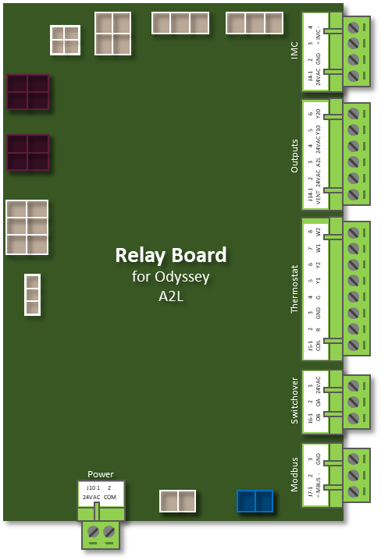
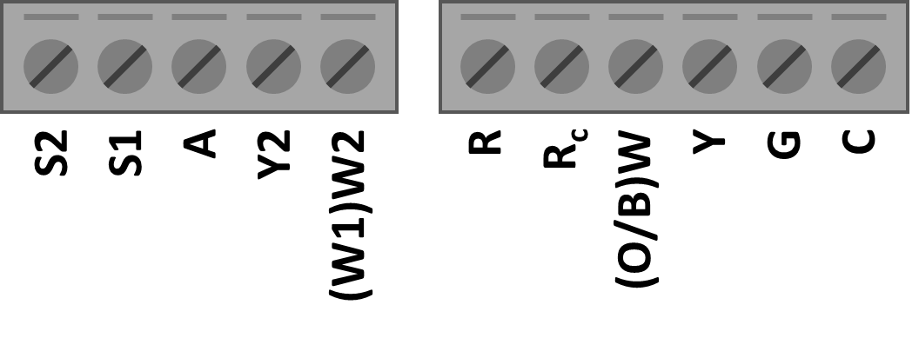
R-410A
Condenser Cooling Thermostat Wiring
Odyssey 2-Speed AHU with Odyssey/Symbio 700 Condenser
*
IMC
Control Wiring
2
1
Thermostat Wiring
Condenser:
Air Handling Unit:
Trane Odyssey
Symbio 700
Trane Odyssey
Two-Speed Fan
1
Thermostat wire – Up to 7 conductors
2
Thermostat wire – Up to 7 conductors.
* Options Module required for electric heat and heat pump applications.
Thermostat
Notes:
For the standard cooling only thermostat only scenario, the heating and cooling control is provided by the thermostat. A single control cable is required between the Odyssey condenser and Trane Odyssey 2-speed air handler.
The Symbio 700 controller accepts Y1 and Y2 inputs as requests for each compressor cooling stage.

Slide 18
R-410A
Heat Pump Thermostat Wiring
Odyssey 2-Speed AHU with Odyssey/Symbio 700 Heat Pump Condenser
*
IMC
Control Wiring
2
1
Thermostat Wiring
Condenser:
Air Handling Unit:
Trane Odyssey
Symbio 700 Heat Pump
Trane Odyssey
Two-Speed Fan
1
Thermostat wire – Up to 7 conductors
2
Thermostat wire – Up to 8 conductors.
* Options Module required for electric heat and heat pump applications.
Thermostat
Notes:
For the standard heat pump thermostat scenario, the heating and cooling control is provided by the thermostat. A single control cable is required between the Odyssey condenser and Trane Odyssey 2-speed air handler.
The Symbio 700 controller accepts Y1 and Y2 inputs as requests for each compressor cooling stage and the O input for the heat pump reversing valve.
Note: Electric heat is not available in the condenser heat pump defrost mode.

Slide 19
Pairing 1 or 2 (BACnet MS/TP, Thermostat)
Electromechanical Constant Volume AHU with Odyssey/Symbio 700 Condenser
Terminal
Strip
W1
W2
Control Wiring
J
1
G
Y1
Y2
B1
R
2
B2
BACnet/BMS
LTB2
3
BMS communication requires the advanced controller
Condenser:
Air Handling Unit:
4
Thermostat Wiring
Trane Odyssey
Symbio 700
Electromechanical
Constant Volume
1
Thermostat wire – At least 6 conductors. REQUIRED for this pairing scenario.
2
Twisted pair communication cable(s) [daisy-chained]. Required only for BACnet MS/TP to BMS.
3
Twisted pair communication cable(s) [daisy-chained]. Required only for BACnet MS/TP to BMS.*
(* Second twisted pair not required for the last controller on the daisy-chain link)
4
Thermostat wire – 7 conductors. REQUIRED in all cases.
Thermostat
Notes:
For pairings 1 and 2, the heating and cooling control is normally provided by the thermostat connected to the Symbio 700 controller in the Trane Odyssey condenser. Separate control wiring is required between the condenser and electromechanical air handler. For BACnet MS/TP communication to the Symbio 700 controller, two additional communication cables are needed to complete the daisy-chain connection to and from the controller, unless the unit is at the end of the communication link, in which case only one communication cable is needed. For BACnet/IP, a single ethernet cable is used to connect the Symbio 700 to the network switch (BACnet/IP not shown).

Slide 20
Pairing 1 or 2 (BACnet MS/TP, Zone Sensor)
Electromechanical Constant Volume AHU with Odyssey/Symbio 700 Condenser
Terminal
Strip
W1
W2
Control Wiring
J
1
G
Y1
Y2
B1
R
2
B2
Zone sensors not supported in this application; use thermostat instead
LTB2
BACnet/BMS
3
BMS communication requires the advanced controller
Condenser:
Air Handling Unit:
Trane Odyssey
Symbio 700
Electromechanical
Constant Volume
Zone Sensor Wiring
4
1
Thermostat wire – At least 6 conductors. REQUIRED for this pairing scenario.
Zone
Common
Cool Setpt
Mode
Heat Setpt
2
Twisted pair communication cable(s) [daisy-chained]. Required only for BACnet MS/TP to BMS.
3
Twisted pair communication cable(s) [daisy-chained]. Required only for BACnet MS/TP to BMS.*
(* Second twisted pair not required for the last controller on the daisy-chain link)
4
Zone sensor wire – Up to 7 conductors may be required depending on the specific sensor used.
Zone Sensor
Notes:
For pairings 1 and 2, the heating and cooling control is normally provided by the Symbio 700 controller in the Trane Odyssey condenser. Separate control wiring is required between the condenser and electromechanical air handler. For BACnet MS/TP communication to the Symbio 700 controller, two additional communication cables are needed to complete the daisy-chain connection to and from the controller, unless the unit is at the end of the communication link, in which case only one communication cable is needed. For BACnet/IP, a single ethernet cable is used to connect the Symbio 700 to the network switch (BACnet/IP not shown).

Slide 21
Pairing 1 or 2 (Air-Fi Wireless)
Electromechanical Constant Volume AHU with Odyssey/Symbio 700 Condenser
Terminal
Strip
W1
W2
J
Control Wiring
1
G
Y1
2
Y2
B1
Air-Fi WCI
3
R
Zone sensors not supported in this application; use thermostat instead
B2
BMS communication requires the advanced controller
LTB2
Condenser:
Air Handling Unit:
Trane Odyssey
Symbio 700
Electromechanical
Constant Volume
Air-Fi Wireless WCI
1
Thermostat wire – At least 6 conductors. REQUIRED for this pairing scenario.
2
Thermostat wire – At least 2 conductors. REQUIRED for this pairing scenario and Air-Fi Wireless.
Air-Fi Wireless Space Sensor
3
Twisted pair communication cable. Required only for Air-Fi Wireless in this pairing scenario.
Notes:
For pairings 1 and 2, the heating and cooling control is normally provided by the Symbio 700 controller in the Trane Odyssey condenser. Separate control wiring is required between the condenser and electromechanical air handler. For Air-Fi Wireless communication, two additional communication cables are needed. Use a two-conductor thermostat wire for the 24v power connection and a twisted pair for the IMC communication between the WCI and adapter board. For BACnet/IP, a single ethernet cable is used to connect the Symbio 700 to the network switch (BACnet/IP not shown).

Slide 22
Pairing G Option 1 (BACnet MS/TP, Thermostat)
ReliaTel SZVAV AHU with Odyssey/Symbio 700 Condenser
Electric
Heat
Accessory
Terminal
Strip
1
Communication (Modbus)
W1
W2
TR150
VFD
J
68
G
Control Wiring
69
2
Y1
50
Y2
53
B1
R
3
B2
BACnet/BMS
4
EDC
CD
LTB2
BMS communication requires the advanced controller
Condenser:
Air Handling Unit:
5
Thermostat Wiring
Trane Odyssey
Symbio 700
Trane ReliaTel
SZVAV
1
Twisted pair communication cable. Required for SZVAV/VFD in this pairing scenario. Modbus comm.
2
Thermostat wire – At least 7 conductors. REQUIRED for this pairing scenario.
3
Twisted pair communication cable(s) [daisy-chained]. Required only for BACnet MS/TP to BMS.
4
Twisted pair communication cable(s) [daisy-chained]. Required only for BACnet MS/TP to BMS.*
(* Second twisted pair not required for the last controller on the daisy-chain link)
5
Thermostat wire – 7 conductors. REQUIRED in all cases.
Thermostat
Notes:
For pairing G (preferred), the heating and cooling control is normally provided by the thermostat connected to the Symbio 700 controller in the Trane Odyssey condenser. Separate control wiring is required between the condenser and Trane ReliaTel SZVAV air handler. An additional communication cable is required between the adapter board in the condenser and VFD in the air handler. For BACnet MS/TP communication to the Symbio 700 controller, two additional communication cables are needed to complete the daisy-chain connection to and from the controller, unless the unit is at the end of the communication link, in which case only one communication cable is needed. For BACnet/IP, a single ethernet cable is used to connect the Symbio 700 to the network switch (BACnet/IP not shown).

Slide 23
Pairing G Option 1 (BACnet MS/TP, Zone Sensor)
ReliaTel SZVAV AHU with Odyssey/Symbio 700 Condenser
Electric
Heat
Accessory
Terminal
Strip
Modbus
W1
1
W2
TR150
VFD
(SZVAV only)
J
68
G
Control Wiring
69
2
Y1
Y2
B1
R
3
B2
Zone sensors not supported in this application; use thermostat instead
EDC
BACnet/BMS
4
CD
LTB2
BMS communication requires the advanced controller
Condenser:
Air Handling Unit:
Trane Odyssey
Symbio 700
Trane ReliaTel
SZVAV
Zone Sensor Wiring
5
1
Twisted pair communication cable. Required for SZVAV/VFD in this pairing scenario.
Zone
Common
Cool Setpt
Mode
Heat Setpt
2
Thermostat wire – At least 7 conductors. REQUIRED for this pairing scenario.
3
Twisted pair communication cable(s) [daisy-chained]. Required only for BACnet MS/TP to BMS.
4
Twisted pair communication cable(s) [daisy-chained]. Required only for BACnet MS/TP to BMS.*
(* Second twisted pair not required for the last controller on the daisy-chain link)
5
Zone sensor wire – Up to 7 conductors may be required depending on the specific sensor used.
Zone Sensor
Notes:
For pairing G (preferred), the heating and cooling control is normally provided by the Symbio 700 controller in the Trane Odyssey condenser. Separate control wiring is required between the condenser and Trane ReliaTel SZVAV air handler. An additional communication cable is required between the adapter board in the condenser and VFD in the air handler. For BACnet MS/TP communication to the Symbio 700 controller, two additional communication cables are needed to complete the daisy-chain connection to and from the controller, unless the unit is at the end of the communication link, in which case only one communication cable is needed. For BACnet/IP, a single ethernet cable is used to connect the Symbio 700 to the network switch (BACnet/IP not shown).

Slide 24
Pairing G Option 1 (Air-Fi Wireless)
ReliaTel SZVAV AHU with Odyssey/Symbio 700 Condenser
Electric
Heat
Accessory
Terminal
Strip
Modbus
W1
1
W2
TR150
VFD
(SZVAV only)
J
68
G
Control Wiring
69
2
Y1
Y2
3
B1
Air-Fi WCI
R
Zone sensors not supported in this application; use thermostat instead
4
B2
BMS communication requires the advanced controller
EDC
CD
LTB2
Condenser:
Air Handling Unit:
Trane Odyssey
Symbio 700
Trane ReliaTel
SZVAV
Air-Fi Wireless WCI
1
Twisted pair communication cable. Required for SZVAV/VFD in this pairing scenario.
2
Thermostat wire – At least 7 conductors. REQUIRED for this pairing scenario.
Air-Fi Wireless Space Sensor
3
Thermostat wire – At least 2 conductors. REQUIRED for this pairing scenario and Air-Fi Wireless.
4
Twisted pair communication cable. Required only for Air-Fi Wireless in this pairing scenario.
Notes:
For pairing G (preferred), the heating and cooling control is normally provided by the Symbio 700 controller in the Trane Odyssey condenser. Separate control wiring is required between the condenser and Trane ReliaTel SZVAV air handler. An additional communication cable is required between the adapter board in the condenser and VFD in the air handler. For Air-Fi Wireless communication, two additional communication cables are needed. Use a two-conductor thermostat wire for the 24v power connection and a twisted pair for the IMC communication between the WCI and adapter board. For BACnet/IP, a single ethernet cable is used to connect the Symbio 700 to the network switch (BACnet/IP not shown).

Slide 25
Pairing G Option 2 (BACnet MS/TP, Thermostat)
ReliaTel Two-Speed SZVAV AHU with Odyssey/Symbio 700 Condenser
Terminal
Strip
W1
W2
Control Wiring
J
1
TR150
VFD
(SZVAV only)
G
Y1
Y2
B1
R
2
B2
CD
BACnet/BMS
3
LTB2
BMS communication requires the advanced controller
Condenser:
Air Handling Unit:
4
Thermostat Wiring
Trane Odyssey
Symbio 700
Trane ReliaTel
Two-Speed SZVAV
1
Thermostat wire – At least 7 conductors. REQUIRED for this pairing scenario.
2
Twisted pair communication cable(s) [daisy-chained]. Required only for BACnet MS/TP to BMS.
3
Twisted pair communication cable(s) [daisy-chained]. Required only for BACnet MS/TP to BMS.*
(* Second twisted pair not required for the last controller on the daisy-chain link)
4
Thermostat wire – 7 conductors. REQUIRED in all cases.
Thermostat
Notes:
For pairing G (optional), the heating and cooling control is normally provided by the thermostat connected to the Symbio 700 controller in the Trane Odyssey condenser. Separate control wiring is required between the condenser and Trane ReliaTel two-speed SZVAV air handler. For this application, the relay board is field applied in the existing air handler and wired to the Symbio 700 and associated adapter board in the condenser. No additional field wiring is needed for the VFD in the air handler. For BACnet MS/TP communication to the Symbio 700 controller, two additional communication cables are needed to complete the daisy-chain connection to and from the controller, unless the unit is at the end of the communication link, in which case only one communication cable is needed. For BACnet/IP, a single ethernet cable is used to connect the Symbio 700 to the network switch (BACnet/IP not shown).

Slide 26
Pairing G Option 2 (BACnet MS/TP, Zone Sensor)
ReliaTel Two-Speed SZVAV AHU with Odyssey/Symbio 700 Condenser
Terminal
Strip
W1
W2
Control Wiring
J
1
TR150
VFD
(SZVAV only)
G
Y1
Y2
B1
R
2
B2
Zone sensors not supported in this application; use thermostat instead
CD
BACnet/BMS
3
LTB2
BMS communication requires the advanced controller
Condenser:
Air Handling Unit:
Trane Odyssey
Symbio 700
Trane ReliaTel
Two-Speed SZVAV
Zone Sensor Wiring
4
1
Thermostat wire – At least 7 conductors. REQUIRED for this pairing scenario.
Zone
Common
Cool Setpt
Mode
Heat Setpt
2
Twisted pair communication cable(s) [daisy-chained]. Required only for BACnet MS/TP to BMS.
3
Twisted pair communication cable(s) [daisy-chained]. Required only for BACnet MS/TP to BMS.*
(* Second twisted pair not required for the last controller on the daisy-chain link)
4
Zone sensor wire – Up to 7 conductors may be required depending on the specific sensor used.
Zone Sensor
Notes:
For pairing G (optional), the heating and cooling control is normally provided by the Symbio 700 controller in the Trane Odyssey condenser. Separate control wiring is required between the condenser and Trane ReliaTel two-speed SZVAV air handler. For this application, the relay board is field applied in the existing air handler and wired to the Symbio 700 and associated adapter board in the condenser. No additional field wiring is needed for the VFD in the air handler. For BACnet MS/TP communication to the Symbio 700 controller, two additional communication cables are needed to complete the daisy-chain connection to and from the controller, unless the unit is at the end of the communication link, in which case only one communication cable is needed. For BACnet/IP, a single ethernet cable is used to connect the Symbio 700 to the network switch (BACnet/IP not shown).

Slide 27
Pairing G Option 2 (Air-Fi Wireless)
ReliaTel Two-Speed SZVAV AHU with Odyssey/Symbio 700 Condenser
Terminal
Strip
W1
W2
Control Wiring
J
1
TR150
VFD
(SZVAV only)
G
Y1
Y2
2
B1
Air-Fi WCI
R
3
B2
Zone sensors not supported in this application; use thermostat instead
CD
BMS communication requires the advanced controller
LTB2
Condenser:
Air Handling Unit:
Trane Odyssey
Symbio 700
Trane ReliaTel
Two-Speed SZVAV
Air-Fi Wireless WCI
1
Thermostat wire – At least 7 conductors. REQUIRED for this pairing scenario.
2
Thermostat wire – At least 2 conductors. REQUIRED for this pairing scenario and Air-Fi Wireless.
Air-Fi Wireless Space Sensor
3
Twisted pair communication cable. Required only for Air-Fi Wireless in this pairing scenario.
Notes:
For pairing G (optional), the heating and cooling control is normally provided by the Symbio 700 controller in the Trane Odyssey condenser. Separate control wiring is required between the condenser and Trane ReliaTel two-speed SZVAV air handler. For this application, the relay board is field applied in the existing air handler and wired to the Symbio 700 and associated adapter board in the condenser. No additional field wiring is needed for the VFD in the air handler. For Air-Fi Wireless communication, two additional communication cables are needed. Use a two-conductor thermostat wire for the 24v power connection and a twisted pair for the IMC communication between the WCI and adapter board. For BACnet/IP, a single ethernet cable is used to connect the Symbio 700 to the network switch (BACnet/IP not shown).

Slide 28
Pairing Y (BACnet MS/TP, Thermostat)
Constant Volume AHU (By Others) with Odyssey/Symbio 700 Condenser
Terminal
Strip
W1
W2
G
Y1
Control Wiring
1
Y2
B1
R
SH
2
BACnet/BMS
3
BMS communication requires the advanced controller
Condenser:
Air Handling Unit:
Thermostat Wiring
Trane Odyssey
Symbio 700
Generic AHU
Constant Volume
4
1
Thermostat wire – At least 4 conductors. REQUIRED for this pairing scenario.
2
Twisted pair communication cable(s) [daisy-chained]. Required only for BACnet MS/TP to BMS.
3
Twisted pair communication cable(s) [daisy-chained]. Required only for BACnet MS/TP to BMS.*
(* Second twisted pair not required for the last controller on the daisy-chain link)
4
Thermostat wire – 7 conductors. REQUIRED in all cases.
Thermostat
Notes:
For pairing Y, the heating and cooling control is normally provided by the thermostat connected to the Symbio 700 controller in the Trane Odyssey condenser. Separate control wiring is required between the condenser and generic constant volume air handler. For this application, the terminal strip in the existing air handler is wired to the Symbio 700 and associated adapter board in the Trane Odyssey condenser. For BACnet MS/TP communication to the Symbio 700 controller, two additional communication cables are needed to complete the daisy-chain connection to and from the controller, unless the unit is at the end of the communication link, in which case only one communication cable is needed. For BACnet/IP, a single ethernet cable is used to connect the Symbio 700 to the network switch (BACnet/IP not shown).

Slide 29
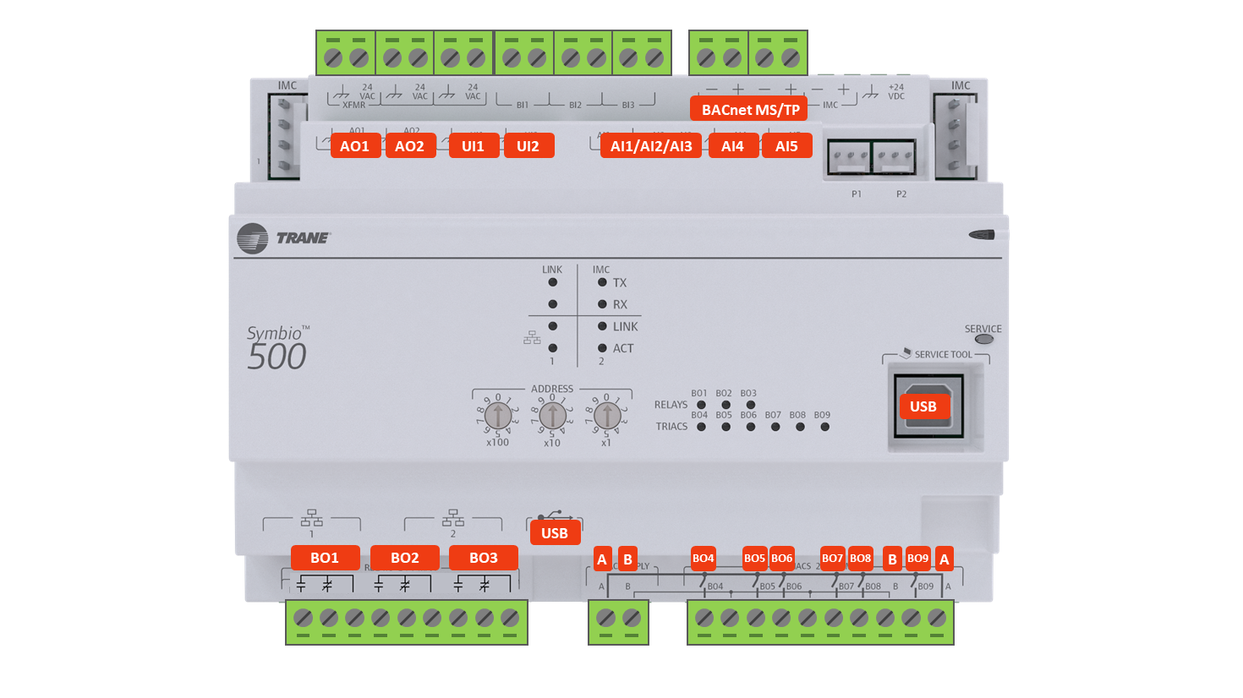

Pairing __ (BACnet MS/TP, Symbio 500 AHU)
Constant Volume AHU (Symbio 500) with Odyssey/Symbio 700 Condenser
2
BACnet MS/TP
BACnet MS/TP
BMS communication requires the advanced controller
Condenser:
Air Handling Unit:
3
BACnet MS/TP
Control Wiring
Trane Odyssey
Symbio 700
Symbio 500 AHU
Constant Volume
1
1
Thermostat wire – Up to 7 conductors depending on the application.
2
Twisted pair communication cable(s) [daisy-chained].
3
Twisted pair communication cable(s) [daisy-chained].*
(* Second twisted pair not required for the last controller on the daisy-chain link)
Notes:
This pairing has not yet been assigned a pairing identification number. In this pairing the DX air handling unit is controlled with a Symbio 500 controller. Legacy AHUs may have also included either a Trane UC400 or UC600 controller, with similar connections. For this application, the Symbio 500 controller in the AHU is acting as the “thermostat” for the control of the Symbio 700 condenser. The outputs of the Symbio 500 in the AHU are directly wired to the thermostat inputs of the Symbio 700 in the condenser. The addition of BACnet communication to the Symbio 700 controller allows the BMS to view the pertinent status points. The Symbio 500 AHU controller in this example is applied with the Rooftop Unit / Heat Pump (RTU/HP) pre-packaged solution (PPS) programs.

Slide 30
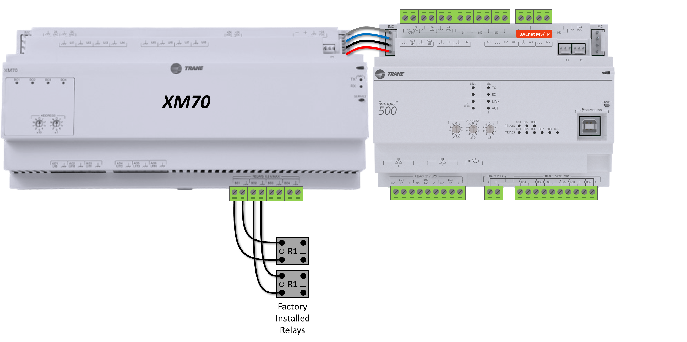
Pairing __ (BACnet MS/TP, Symbio 500 AHU)
Symbio 500 AHU with Odyssey/Symbio 700 Condenser
BACnet MS/TP
2
BACnet MS/TP
BMS communication requires
the advanced Symbio 700 controller
Control Wiring
1
Condenser:
Air Handling Unit:
3
BACnet MS/TP
Trane Odyssey
Symbio 700
Symbio 500 AHU
1
Thermostat wire – Up to 3 conductors depending on the application.
2
Twisted pair communication cable(s) [daisy-chained].
3
Twisted pair communication cable(s) [daisy-chained].*
(* Second twisted pair not required for the last controller on the daisy-chain link)
Notes:
This pairing has not yet been assigned a pairing identification number. In this pairing the DX air handling unit is controlled with a Symbio 500 controller. Legacy AHUs may have also included either a Trane UC400 or UC600 controller, with similar connections. For this application, the Symbio 500 controller in the AHU is acting as the “thermostat” for the control of the Symbio 700 condenser. The outputs of the Symbio 500 in the AHU are directly wired to the thermostat inputs of the Symbio 700 in the condenser. The addition of BACnet communication to the Symbio 700 controller allows the BMS to view the pertinent status points. The Symbio 500 AHU controller in this example is applied with the Rooftop Unit / Heat Pump (RTU/HP) pre-packaged solution (PPS) programs.

Slide 31
Pairing Y (BACnet MS/TP, Zone Sensor)
Constant Volume AHU (By Others) with Odyssey/Symbio 700 Condenser
Terminal
Strip
W1
W2
G
Y1
Control Wiring
1
Y2
B1
R
SH
2
Zone sensors not supported in this application; use thermostat instead
BACnet/BMS
3
BMS communication requires the advanced controller
Condenser:
Air Handling Unit:
Trane Odyssey
Symbio 700
Generic AHU
Constant Volume
Zone Sensor Wiring
4
1
Thermostat wire – At least 4 conductors. REQUIRED for this pairing scenario.
Zone
Common
Cool Setpt
Mode
Heat Setpt
2
Twisted pair communication cable(s) [daisy-chained]. Required only for BACnet MS/TP to BMS.
3
Twisted pair communication cable(s) [daisy-chained]. Required only for BACnet MS/TP to BMS.*
(* Second twisted pair not required for the last controller on the daisy-chain link)
4
Zone sensor wire – Up to 7 conductors may be required depending on the specific sensor used.
Zone Sensor
Notes:
For pairing Y, the heating and cooling control is normally provided by the Symbio 700 controller in the Trane Odyssey condenser. Separate control wiring is required between the condenser and generic constant volume air handler. For this application, the terminal strip in the existing air handler is wired to the Symbio 700 and associated adapter board in the Trane Odyssey condenser. For BACnet MS/TP communication to the Symbio 700 controller, two additional communication cables are needed to complete the daisy-chain connection to and from the controller, unless the unit is at the end of the communication link, in which case only one communication cable is needed. For BACnet/IP, a single ethernet cable is used to connect the Symbio 700 to the network switch (BACnet/IP not shown).

Slide 32
Pairing Y (Air-Fi Wireless)
Constant Volume AHU (By Others) with Odyssey/Symbio 700 Condenser
Terminal
Strip
W1
W2
G
Y1
Control Wiring
1
Y2
B1
R
2
SH
Air-Fi WCI
Zone sensors not supported in this application; use thermostat instead
3
BMS communication requires the advanced controller
Condenser:
Air Handling Unit:
Trane Odyssey
Symbio 700
Generic AHU
Constant Volume
Air-Fi Wireless WCI
1
Thermostat wire – At least 7 conductors. REQUIRED for this pairing scenario.
2
Thermostat wire – At least 2 conductors. REQUIRED for this pairing scenario and Air-Fi Wireless.
Air-Fi Wireless Space Sensor
3
Twisted pair communication cable. Required only for Air-Fi Wireless in this pairing scenario.
Notes:
For pairing Y, the heating and cooling control is normally provided by the Symbio 700 controller in the Trane Odyssey condenser. Separate control wiring is required between the condenser and generic constant volume air handler. For this application, the terminal strip in the existing air handler is wired to the Symbio 700 and associated adapter board in the Trane Odyssey condenser. For Air-Fi Wireless communication, two additional communication cables are needed. Use a two-conductor thermostat wire for the 24v power connection and a twisted pair for the IMC communication between the WCI and adapter board. For BACnet/IP, a single ethernet cable is used to connect the Symbio 700 to the network switch (BACnet/IP not shown).

Slide 33
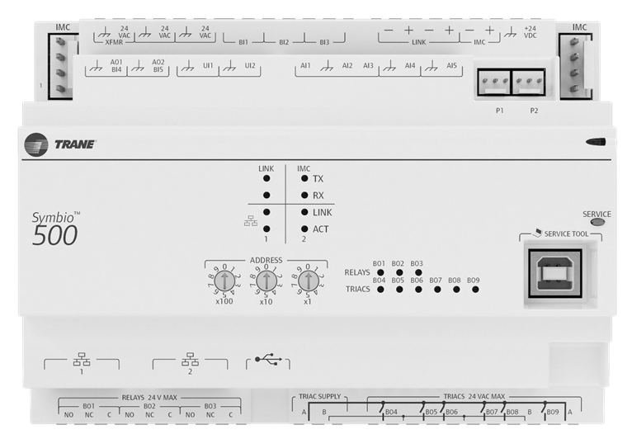
Condenser Control (Symbio 500, Zone Sensor)
Symbio 500 AHU with Odyssey/Symbio 700 Condenser
BACnet MS/TP
Control Wiring
2
Condenser:
Air Handling Unit:
1
Zone Sensor Wiring
Trane Odyssey
Symbio 700
Symbio 500 AHU
Constant Volume
Zone
Common
Cool Setpt
Mode
Heat Setpt
1
Thermostat wire – Up to 3 conductors
2
Thermostat wire – Up to 4 conductors.
Zone Sensor
Notes:
Questions:
Does this scenario also support 2-speed fan operation?
Can the power and common wires be moved from the Adapter Board to the Symbio 700?
Should we show heat pump details on this slide or dedicate another slide to that application?

Slide 34
Condenser Control (Symbio 500, Air-Fi)
Symbio 500 AHU with Odyssey/Symbio 700 Condenser
Control Wiring
1
Condenser:
Air Handling Unit:
Trane Odyssey
Symbio 700
Symbio 500 AHU
Constant Volume
Air-Fi Wireless WCI
1
Thermostat wire – Up to 4 conductors
Air-Fi Wireless Space Sensor
Notes:
Questions:
Does this scenario also support 2-speed fan operation?
Can the power and common wires be moved from the Adapter Board to the Symbio 700?
Should we show heat pump details on this slide or dedicate another slide to that application?

