Slide 1

实验三 动态路由RIP&OSPF的配置

Slide 2
动态路由协议
动态路由协议的特点：
根据网络系统的运行情况，路由器根据每种协议对应的算法自动调整路由，并计算出最终的路由表。
动态路由协议根据所连接的网络规模大小可分为:
1 )距离矢量路由协议
2 )链路状态路由协议

Slide 3
动态路由协议——RIP协议
RIP是最简单的距离矢量路由协议；
RIP路由协议以”跳数”作为度量单位，以计算路由；
RIP路由协议优先选择“跳数”最少的路径作为最优路径;
RIP路由协议所支持得最大“跳数”为15。

Slide 4
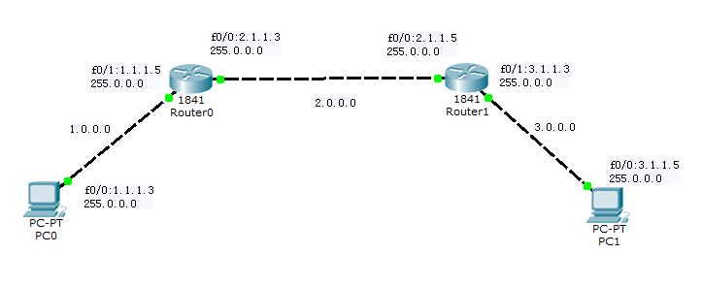
路由器配置实例

Slide 5
RIP协议的配置
RIP协议配置语法：
Router(config)#ip routing －－－启用IP路由协议
Router(config)#router rip －－－启用RIP路由协议
Router(config-router)#network ×.×.×.×－－－发布直连网段
Router(config-router)#version 2 －－－设置RIP协议版本号2
Router(config-router)#end
RIP协议删除语法
Router(config)# no router rip

Slide 6
RIP协议路由器配置实例
Router0配置过程：
Router>enable
Router#configure t －－－进入全局配置模式
Router(config)#hostname Router0 －－－更改路由器名字为Router0
Router0(config)#interface f0/0 －－－进入f0/0端口
Router0(config-if)#ip address 2.1.1.3 255.0.0.0 －－－配置f0/0端口地址
Router0(config-if)#no shutdown －－－启动f0/0端口
Router0(config)#interface f0/1 －－－进入f0/1端口
Router0(config-if)#ip address 1.1.1.5 255.0.0.0 －－－配置f0/1端口地址Router0(config-if)#no shutdown －－－启动f0/1端口
Router0(config)#ip routing －－－启用ip路由协议
Router0(config)#router rip －－－启用rip路由协议
Router0(config-router)#network 1.0.0.0 －－－发布直连网段
Router0(config-router)#network 2.0.0.0 －－－发布直连网段
Router0(config-router)#version 2 －－－设置rip版本号2
Router0(config-router)#end

Slide 7
RIP协议路由器配置实例
Router0#show ip route
Codes: C - connected, S - static, I - IGRP, R - RIP, M - mobile, B - BGP
D - EIGRP, EX - EIGRP external, O - OSPF, IA - OSPF inter area
N1 - OSPF NSSA external type 1, N2 - OSPF NSSA external type 2
E1 - OSPF external type 1, E2 - OSPF external type 2, E - EGP
i - IS-IS, L1 - IS-IS level-1, L2 - IS-IS level-2, ia - IS-IS inter area
* - candidate default, U - per-user static route, o - ODR
P - periodic downloaded static route
Gateway of last resort is not set
C 1.0.0.0/8 is directly connected, FastEthernet0/1
C 2.0.0.0/8 is directly connected, FastEthernet0/0
R 3.0.0.0/8 [120/1] via 2.1.1.5, 00:00:13, FastEthernet0/0

Slide 8
RIP协议路由器配置实例
Router1配置过程：
Router>enable
Router#configure t －－－进入全局配置模式
Router1(config)#hostname Router1 －－－更改路由器名字为Router1
Router1(config)#interface f0/0 －－－进入f0/0端口
Router1(config-if)#ip address 2.1.1.5 255.0.0.0 －－－配置f0/0端口地址
Router1(config-if)#no shutdown －－－启动f0/1端口
Router1(config)#interface f0/1 －－－进入f0/1端口
Router1(config-if)#ip address 3.1.1.3 255.0.0.0 －－－配置f0/1端口地址
Router1(config-if)#no shutdown －－－启动f0/1端口
Router1(config)#ip routing －－－启用ip路由协议
Router1(config)#router rip －－－启用rip路由协议
Router1(config-router)#network 2.0.0.0 －－－发布直连网段
Router1(config-router)#network 3.0.0.0 －－－发布直连网段
Router1(config-router)#version 2 －－－设置rip版本号2
Router1(config-router)#end

Slide 9
RIP协议路由器配置实例
Router#show ip route
Codes: C - connected, S - static, I - IGRP, R - RIP, M - mobile, B - BGP
D - EIGRP, EX - EIGRP external, O - OSPF, IA - OSPF inter area
N1 - OSPF NSSA external type 1, N2 - OSPF NSSA external type 2
E1 - OSPF external type 1, E2 - OSPF external type 2, E - EGP
i - IS-IS, L1 - IS-IS level-1, L2 - IS-IS level-2, ia - IS-IS inter area
* - candidate default, U - per-user static route, o - ODR
P - periodic downloaded static route
Gateway of last resort is not set
R 1.0.0.0/8 [120/1] via 2.1.1.3, 00:00:08, FastEthernet0/0
C 2.0.0.0/8 is directly connected, FastEthernet0/0
C 3.0.0.0/8 is directly connected, FastEthernet0/1
注意：RIP协议必须将网络内各路由器的RIP都配置完成才可以查看出结果

Slide 10
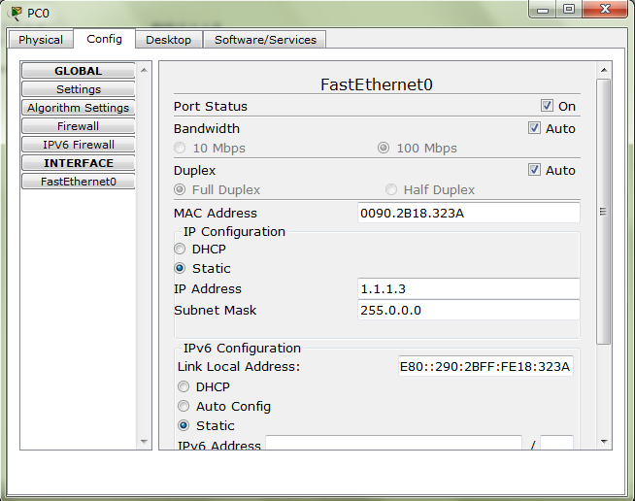
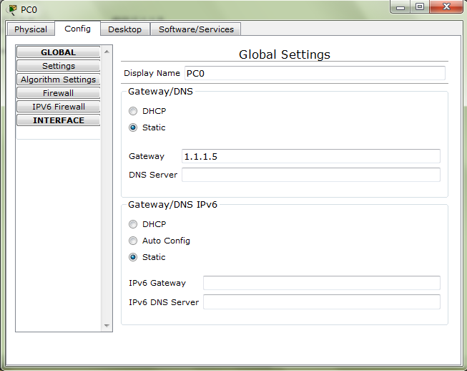
RIP协议路由器配置实例
PC1配置过程：

Slide 11
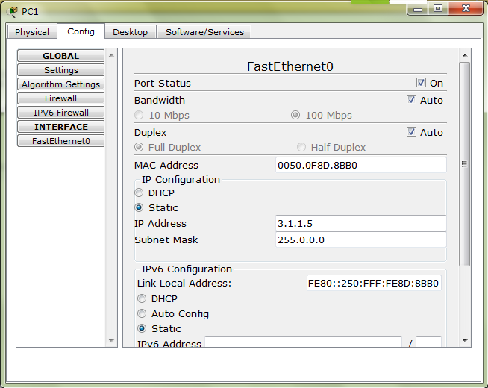
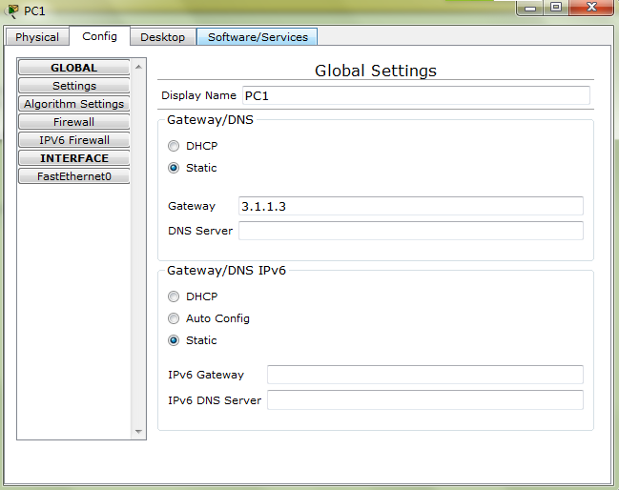
RIP协议路由器配置实例
PC2配置过程：

Slide 12
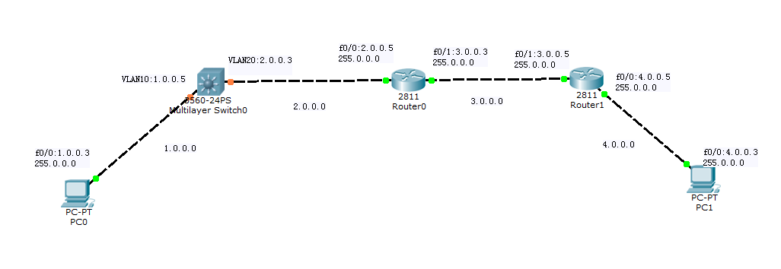
RIP协议路由器配置实例-2

Slide 13
RIP协议路由器配置实例-2
Switch3560的配置
Switch#configure terminal
Switch(config)#interface VLAN 10
Switch(config-if)#ip address 1.0.0.5 255.0.0.0
Switch(config-if)#no shutdown
Switch(config-if)#exit
Switch(config)#interface VLAN 20
Switch(config-if)#
%LINK-5-CHANGED: Interface Vlan20, changed state to up
Switch(config-if)#IP ADDress 2.0.0.3 255.0.0.0
Switch(config-if)#no shutdown
Switch(config-if)#exit
Switch(config)#INterface F0/1

Slide 14
RIP协议路由器配置实例-2
Switch3560的配置
Switch(config-if)#SWitchport ACCEss vlan 10
Switch(config-if)#no shutdown
Switch(config-if)#exit
Switch(config)#interface f0/1
Switch(config-if)#switchport access VLAN 20
Switch(config-if)#
%LINEPROTO-5-UPDOWN: Line protocol on Interface Vlan20, changed state to up
Switch(config-if)#EXIT
Switch(config)#ROUTER RIP
Switch(config-router)#network 1.0.0.0
Switch(config-router)#network 2.0.0.0
Switch(config-router)#version 2
Switch(config-router)#end

Slide 15
RIP协议路由器配置实例-2
Router0的配置
Router#show ip route
Codes: C - connected, S - static, I - IGRP, R - RIP, M - mobile, B - BGP
D - EIGRP, EX - EIGRP external, O - OSPF, IA - OSPF inter area
N1 - OSPF NSSA external type 1, N2 - OSPF NSSA external type 2
E1 - OSPF external type 1, E2 - OSPF external type 2, E - EGP
i - IS-IS, L1 - IS-IS level-1, L2 - IS-IS level-2, ia - IS-IS inter area
* - candidate default, U - per-user static route, o - ODR
P - periodic downloaded static route
Gateway of last resort is not set
R 1.0.0.0/8 [120/1] via 2.0.0.3, 00:00:01, FastEthernet0/0
C 2.0.0.0/8 is directly connected, FastEthernet0/0
C 3.0.0.0/8 is directly connected, FastEthernet0/1
R 4.0.0.0/8 [120/1] via 3.0.0.5, 00:00:06, FastEthernet0/1

Slide 16
RIP协议路由器配置实例-2
Router1的配置
Router#show ip route
Codes: C - connected, S - static, I - IGRP, R - RIP, M - mobile, B - BGP
D - EIGRP, EX - EIGRP external, O - OSPF, IA - OSPF inter area
N1 - OSPF NSSA external type 1, N2 - OSPF NSSA external type 2
E1 - OSPF external type 1, E2 - OSPF external type 2, E - EGP
i - IS-IS, L1 - IS-IS level-1, L2 - IS-IS level-2, ia - IS-IS inter area
* - candidate default, U - per-user static route, o - ODR
P - periodic downloaded static route
Gateway of last resort is not set
R 1.0.0.0/8 [120/2] via 3.0.0.3, 00:00:11, FastEthernet0/1
R 2.0.0.0/8 [120/1] via 3.0.0.3, 00:00:11, FastEthernet0/1
C 3.0.0.0/8 is directly connected, FastEthernet0/1
C 4.0.0.0/8 is directly connected, FastEthernet0/0

Slide 17
动态路由协议——OSPF协议
OSPF协议，即“开放最短路径优先”协议，适用于所有的路由器和三层交换机。
OSPF协议原理：
1）区域内每台路由器根据自身的网络连接情况生成自己的链路状况，并告知主路由器；
2）主路由器将所有路由器的链路状态信息组成链路状态数据库，发布给区域内部各个路由器；
3）每个路由器根据该数据库信息，利用最短路径算法，计算出以自己为根的最短路径，形成路由表。
OSPF协议支持各种规模网络，反应速度快，能够减少网络带宽，减少对其它设备的干扰。

Slide 18
OSPF协议的配置
OSPF协议配置语法：
Router(config)#router ospf process_id
－－－进入OSPF协议配置模式，process_id为ospf进程号
例： Router(config)#router ospf 1
Router(config-router)#network address wildcard area area_id
address wildcard:表示运行OSPF端口所在网段地址及相应的子网掩码反码
例：Router(config-router)#network 1.0.0.0 0.255.255.255 area 0
OSPF协议删除语法
Router(config)# no router ospf process_id

Slide 19
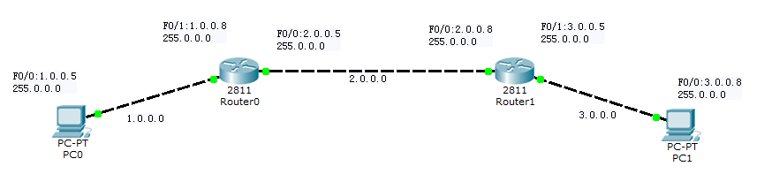
OSPF协议的配置

Slide 20
OSPF协议的配置
Router0配置过程：
Router0(config)#ip routing －－－－启用IP路由协议
Router0(config)#router ospf 1 －－－启用进程处理号为1的OSPF协议
Router0(config-router)#network 1.0.0.0 0.255.255.255 area 0
Router0(config-router)#network 2.0.0.0 0.255.255.255 area 0
－－－在区域0上发布直连网段
Router0(config-router)#end

Slide 21
OSPF协议的配置
Router0#show ip route
Codes: C - connected, S - static, I - IGRP, R - RIP, M - mobile, B - BGP
D - EIGRP, EX - EIGRP external, O - OSPF, IA - OSPF inter area
N1 - OSPF NSSA external type 1, N2 - OSPF NSSA external type 2
E1 - OSPF external type 1, E2 - OSPF external type 2, E - EGP
i - IS-IS, L1 - IS-IS level-1, L2 - IS-IS level-2, ia - IS-IS inter area
* - candidate default, U - per-user static route, o - ODR
P - periodic downloaded static route
Gateway of last resort is not set
C 1.0.0.0/8 is directly connected, FastEthernet0/1
C 2.0.0.0/8 is directly connected, FastEthernet0/0
O 3.0.0.0/8 [110/2] via 2.0.0.8, 00:00:40, FastEthernet0/0

Slide 22
OSPF协议的配置
Router1配置过程：
Router1(config)#ip routing －－－－启用IP路由协议
Router1(config)#router ospf 1 －－－启用进程处理号为1的OSPF协议
Router1(config-router)#network 2.0.0.0 0.255.255.255 area 0
Router1(config-router)#network 3.0.0.0 0.255.255.255 area 0
－－－在区域0上发布直连网段
Router1(config-router)#end

Slide 23
OSPF协议的配置
Router1#show ip route
Codes: C - connected, S - static, I - IGRP, R - RIP, M - mobile, B - BGP
D - EIGRP, EX - EIGRP external, O - OSPF, IA - OSPF inter area
N1 - OSPF NSSA external type 1, N2 - OSPF NSSA external type 2
E1 - OSPF external type 1, E2 - OSPF external type 2, E - EGP
i - IS-IS, L1 - IS-IS level-1, L2 - IS-IS level-2, ia - IS-IS inter area
* - candidate default, U - per-user static route, o - ODR
P - periodic downloaded static route
Gateway of last resort is not set
O 1.0.0.0/8 [110/2] via 2.0.0.5, 00:02:27, FastEthernet0/0
C 2.0.0.0/8 is directly connected, FastEthernet0/0
C 3.0.0.0/8 is directly connected, FastEthernet0/1
注意：OSPF协议必须将网络内各路由器的OSPF都配置完成才可以查看出结果

Slide 24
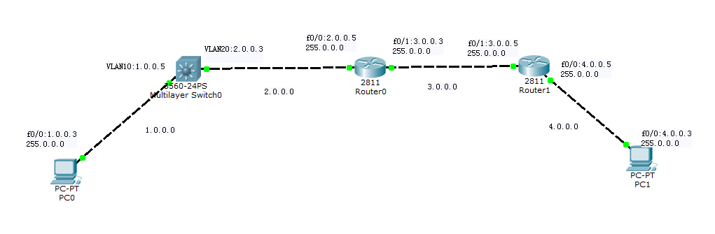
OSPF协议的配置-2

Slide 25
OSPF协议路由器配置实例-2
Switch3560的配置
Switch#configure terminal
Switch(config)#interface VLAN 10
Switch(config-if)#ip address 1.0.0.5 255.0.0.0
Switch(config-if)#no shutdown
Switch(config-if)#exit
Switch(config)#interface VLAN 20
Switch(config-if)#
%LINK-5-CHANGED: Interface Vlan20, changed state to up
Switch(config-if)#ip address 2.0.0.3 255.0.0.0
Switch(config-if)#no shutdown
Switch(config-if)#exit
Switch(config)#interface F0/1

Slide 26
OSPF协议的配置实例-2
Switch3560的配置
Switch(config-if)#swtchport access vlan 10
Switch(config-if)#no shutdown
Switch(config-if)#exit
Switch(config)#interface f0/1
Switch(config-if)#switchport access VLAN 20
Switch(config-if)#
%LINEPROTO-5-UPDOWN: Line protocol on Interface Vlan20, changed state to up
Switch(config-if)#EXIT
Switch(config)#router ospf 1
Switch(config-router)#network 1.0.0.0 0.255.255.255 area 0
Switch(config-router)#network 2.0.0.0 0.255.255.255 area 0
Switch(config-router)#end

Slide 27
OSPF协议的配置实例-2
Switch#show ip route
Codes: C - connected, S - static, I - IGRP, R - RIP, M - mobile, B - BGP
D - EIGRP, EX - EIGRP external, O - OSPF, IA - OSPF inter area
N1 - OSPF NSSA external type 1, N2 - OSPF NSSA external type 2
E1 - OSPF external type 1, E2 - OSPF external type 2, E - EGP
i - IS-IS, L1 - IS-IS level-1, L2 - IS-IS level-2, ia - IS-IS inter area
* - candidate default, U - per-user static route, o - ODR
P - periodic downloaded static route
Gateway of last resort is not set
C 1.0.0.0/8 is directly connected, Vlan10
C 2.0.0.0/8 is directly connected, Vlan20
O 3.0.0.0/8 [110/2] via 2.0.0.5, 00:10:52, Vlan20
O 4.0.0.0/8 [110/3] via 2.0.0.5, 00:10:52, Vlan20

Slide 28
OSPF协议的配置实例-2
Router0配置过程：
Router0(config)#ip routing －－－－启用IP路由协议
Router0(config)#router ospf 1 －－－启用进程处理号为1的OSPF协议
Router0(config-router)#network 1.0.0.0 0.255.255.255 area 0
Router0(config-router)#network 2.0.0.0 0.255.255.255 area 0
－－－在区域0上发布直连网段
Router0(config-router)#end

Slide 29
OSPF协议的配置实例-2
Router0#show ip route
Codes: C - connected, S - static, I - IGRP, R - RIP, M - mobile, B - BGP
D - EIGRP, EX - EIGRP external, O - OSPF, IA - OSPF inter area
N1 - OSPF NSSA external type 1, N2 - OSPF NSSA external type 2
E1 - OSPF external type 1, E2 - OSPF external type 2, E - EGP
i - IS-IS, L1 - IS-IS level-1, L2 - IS-IS level-2, ia - IS-IS inter area
* - candidate default, U - per-user static route, o - ODR
P - periodic downloaded static route
Gateway of last resort is not set
O 1.0.0.0/8 [110/2] via 2.0.0.3, 00:12:34, FastEthernet0/0
C 2.0.0.0/8 is directly connected, FastEthernet0/0
C 3.0.0.0/8 is directly connected, FastEthernet0/1
O 4.0.0.0/8 [110/2] via 3.0.0.5, 00:12:34, FastEthernet0/1

Slide 30
OSPF协议的配置实例-2
Router1配置过程：
Router1(config)#ip routing －－－－启用IP路由协议
Router1(config)#router ospf 1 －－－启用进程处理号为1的OSPF协议
Router1(config-router)#network 3.0.0.0 0.255.255.255 area 0
Router1(config-router)#network 4.0.0.0 0.255.255.255 area 0
－－－在区域0上发布直连网段
Router1(config-router)#end

Slide 31
OSPF协议的配置实例-2
Router1#show ip route
Codes: C - connected, S - static, I - IGRP, R - RIP, M - mobile, B - BGP
D - EIGRP, EX - EIGRP external, O - OSPF, IA - OSPF inter area
N1 - OSPF NSSA external type 1, N2 - OSPF NSSA external type 2
E1 - OSPF external type 1, E2 - OSPF external type 2, E - EGP
i - IS-IS, L1 - IS-IS level-1, L2 - IS-IS level-2, ia - IS-IS inter area
* - candidate default, U - per-user static route, o - ODR
P - periodic downloaded static route
Gateway of last resort is not set
O 1.0.0.0/8 [110/3] via 3.0.0.3, 00:13:30, FastEthernet0/1
O 2.0.0.0/8 [110/2] via 3.0.0.3, 00:13:30, FastEthernet0/1
C 3.0.0.0/8 is directly connected, FastEthernet0/1
C 4.0.0.0/8 is directly connected, FastEthernet0/0

Slide 32
作业内容与要求
1.理解并熟练掌握路由器的IOS操作命令；
2.使用Cisco Paket Tracer平台，自行设计网络拓扑结构图。网络内至少包含两台路由器设备及若干台终端；
3.注明各网段地址和各端口地址；
4.配置各终端的网卡地址和网关，并给出图示；
5.使用RIP/OSPF路由协议配置，使全网互通，并给出主要配置过程；
6.给出全网联通测试图示。

Slide 33
谢谢！

