Slide 1
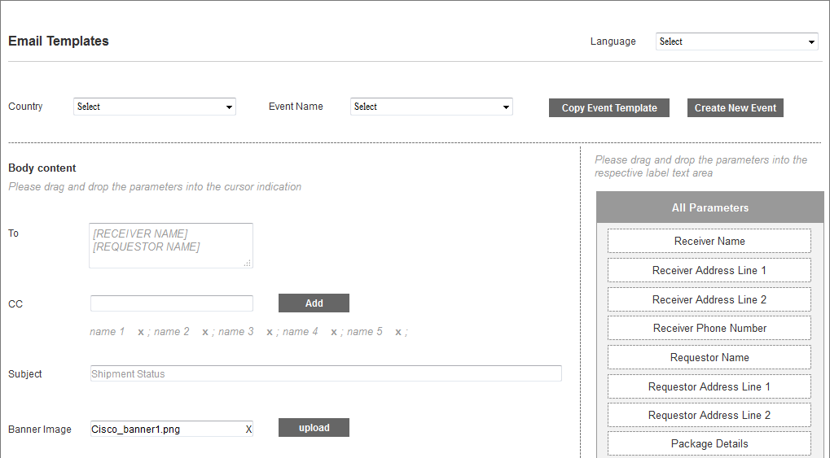
Email Template

Slide 2
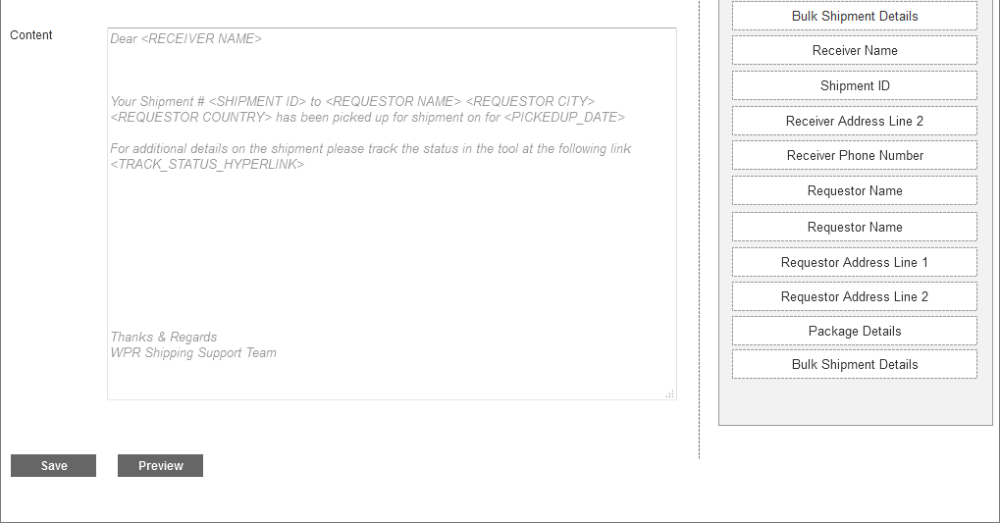
Email Template – Cont 1

Slide 3
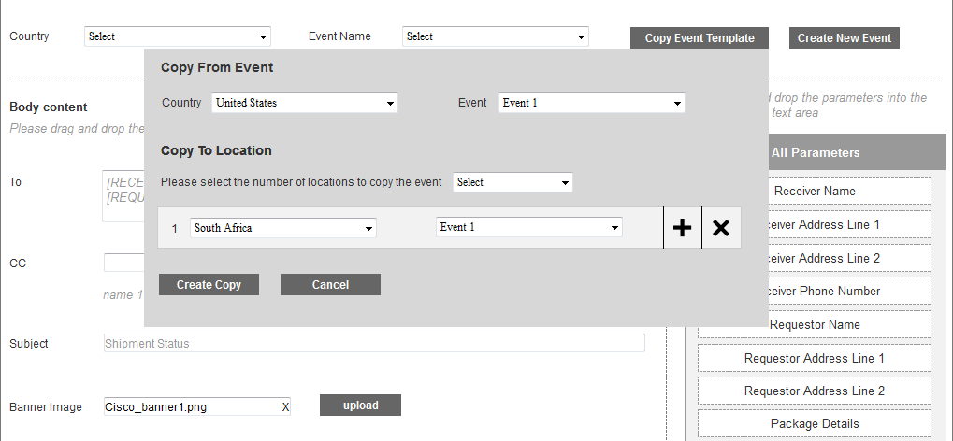
Email Template – Copy Template

Slide 4
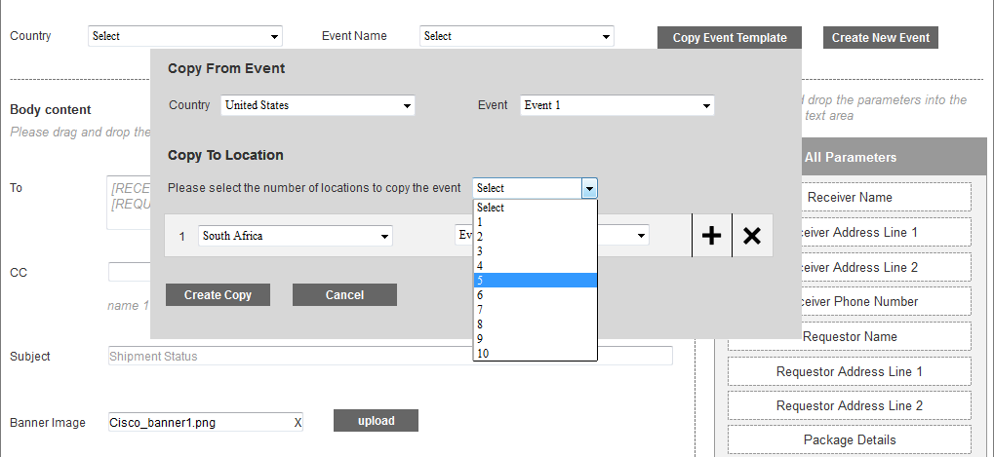
Email Template – Copy Template – Cont 1

Slide 5
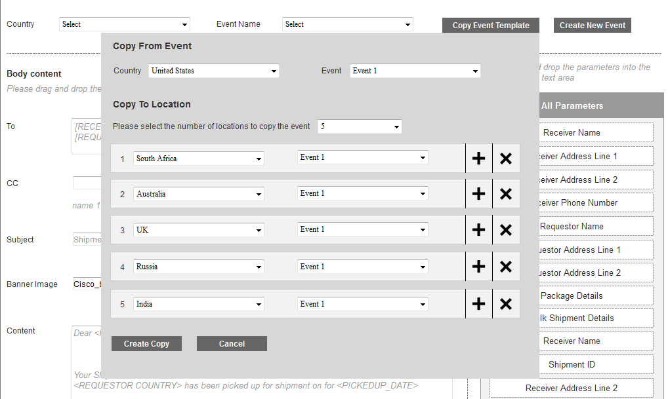
Email Template – Copy Template – Cont 2

