Slide 1
Eye Points

Slide 2
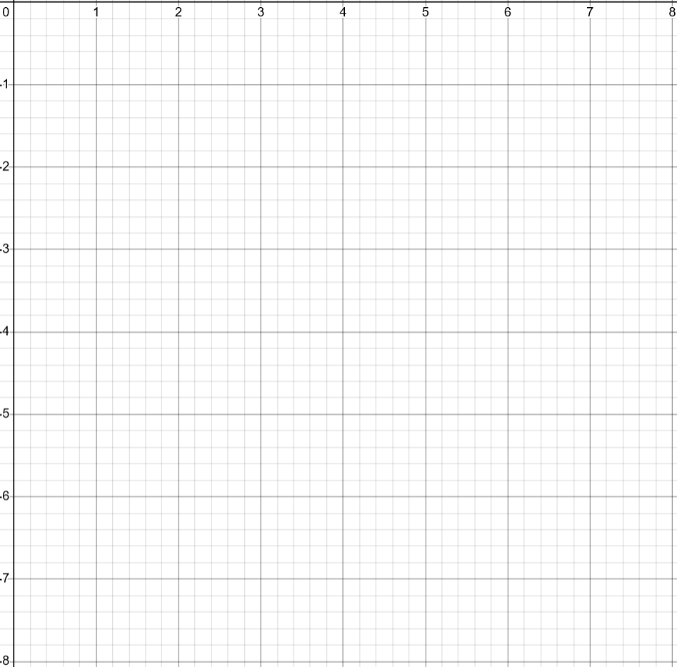
Eye #1

Slide 3
Eye #2

Slide 4
Eye #3

Slide 5
Eye #4

Slide 6
Eye #5

