Slide 1
Emotion Registry
Index | Desc | Eye # | Face #
0 | Happy | 1 | 1
1 | Neutral | 2 | 2
2 | Sad | 3 | 3
3 | Determined | 4 | 1
4 | Mad | 4 | 3
5 | Embarrassed | 5 | 3

Slide 2
Eye Points

Slide 3
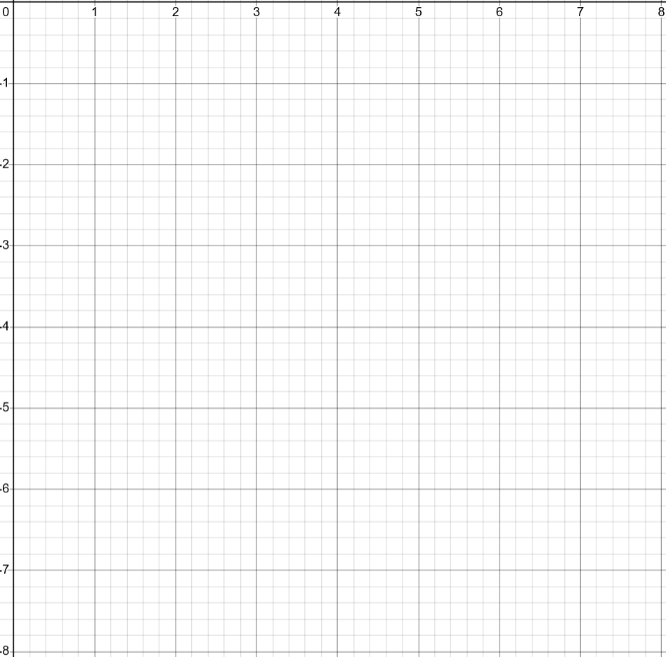
Eye #1

Slide 4
Eye #2

Slide 5
Eye #3

Slide 6
Eye #4

Slide 7
Eye #5

Slide 8
Faces

Slide 9
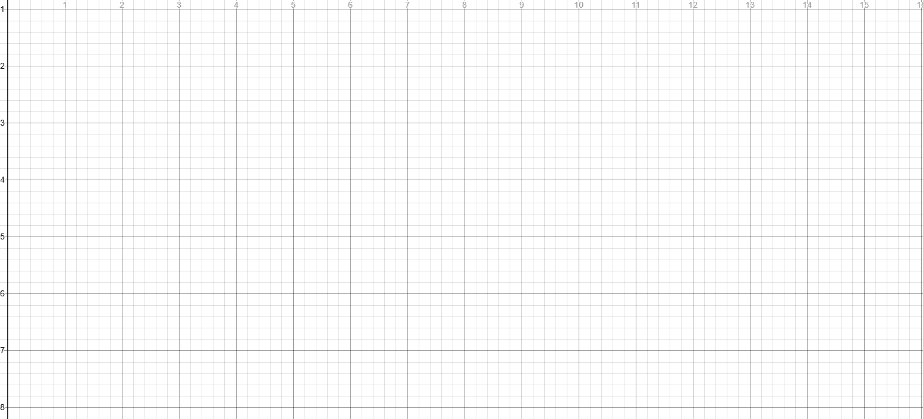
Face #1

Slide 10
Face #2

Slide 11
Face #3

Slide 12
Face #4 (special)

