Slide 1
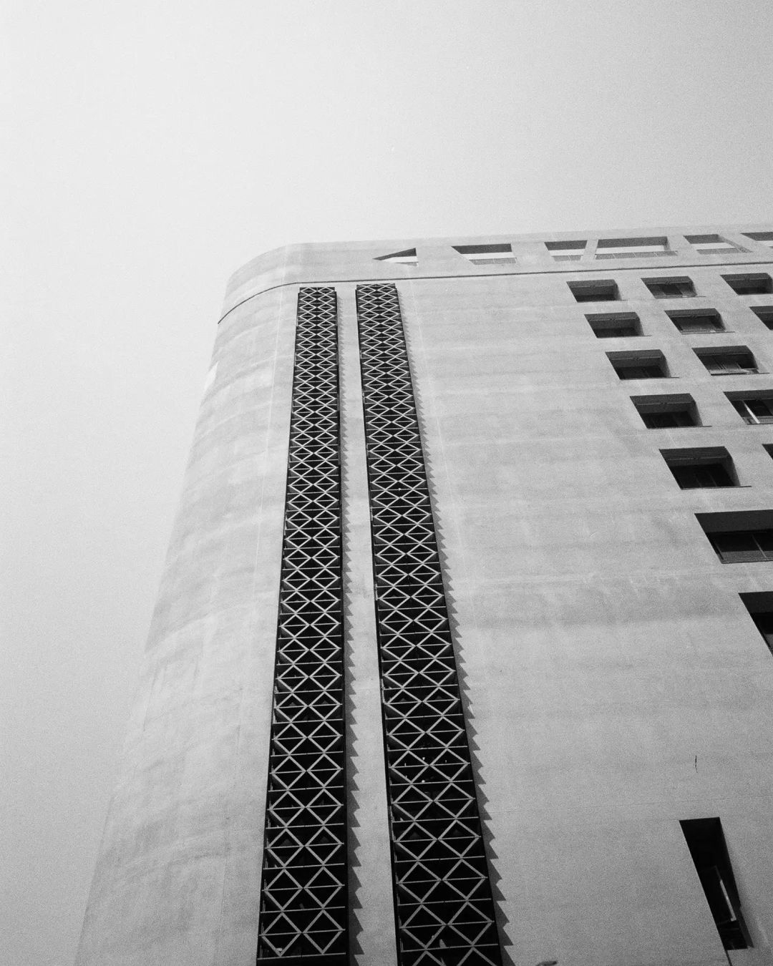
What is Kibo-RPC?
2 0 2 3 S U M M E R
Presented by WhyMyCodeWork?

Slide 2
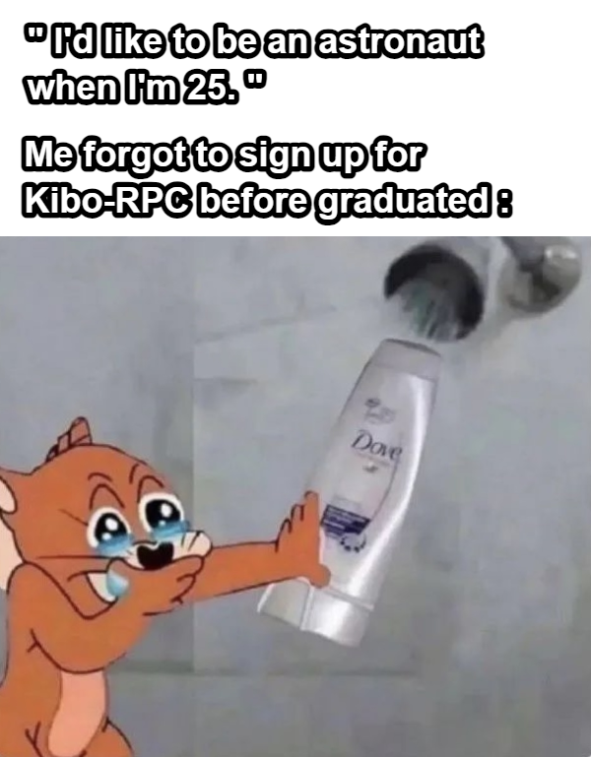

Slide 3
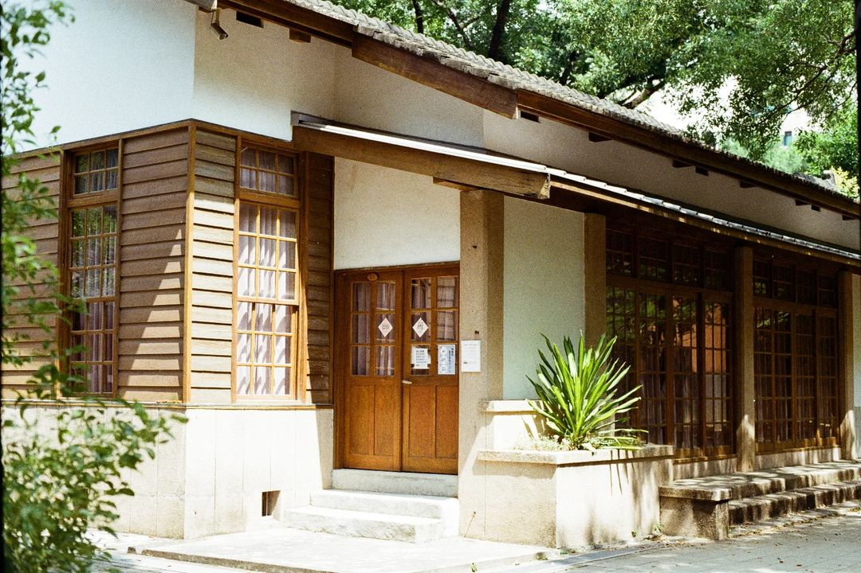
Contest for student
01.
You can build up Ur team with at least 3 students.

Slide 4
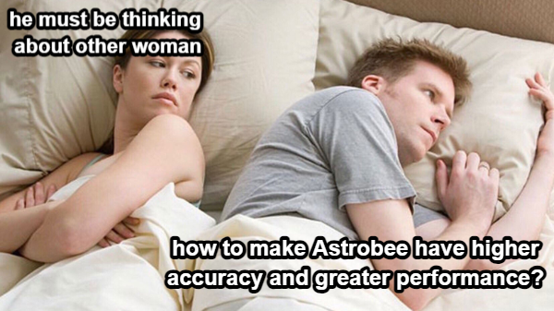

Slide 5
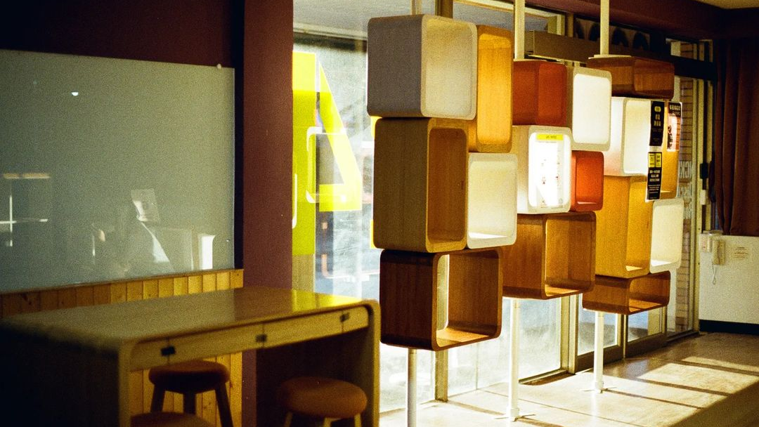
Get higher score !
02.
Ur team can try the best to get higher score as you can due to the submission deadline.

Slide 6
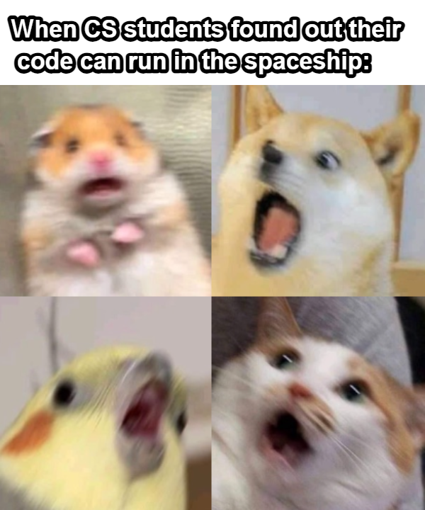

Slide 7

Let’s go to space!
03.
Join the Kibo-RPC contest, U will have the chance to run your code on Robot Astrobee in the ISS!

Slide 8
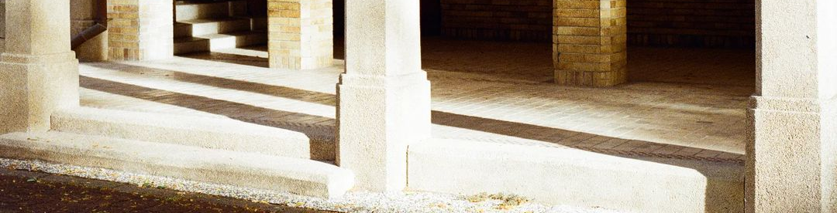
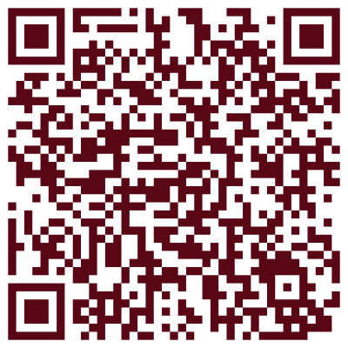
Welcome to sign up for
the Kibo-RPC in 2024!

