Slide 1
課表模板
Emoji
https://emojipedia.org
 | MON | TUE | WES | THU | FRI
08 - 09
09 - 10
10 - 11
11 - 12
LUNCH
01 - 02
02 - 03
03 - 04
04 - 05
05 - 06

Slide 2
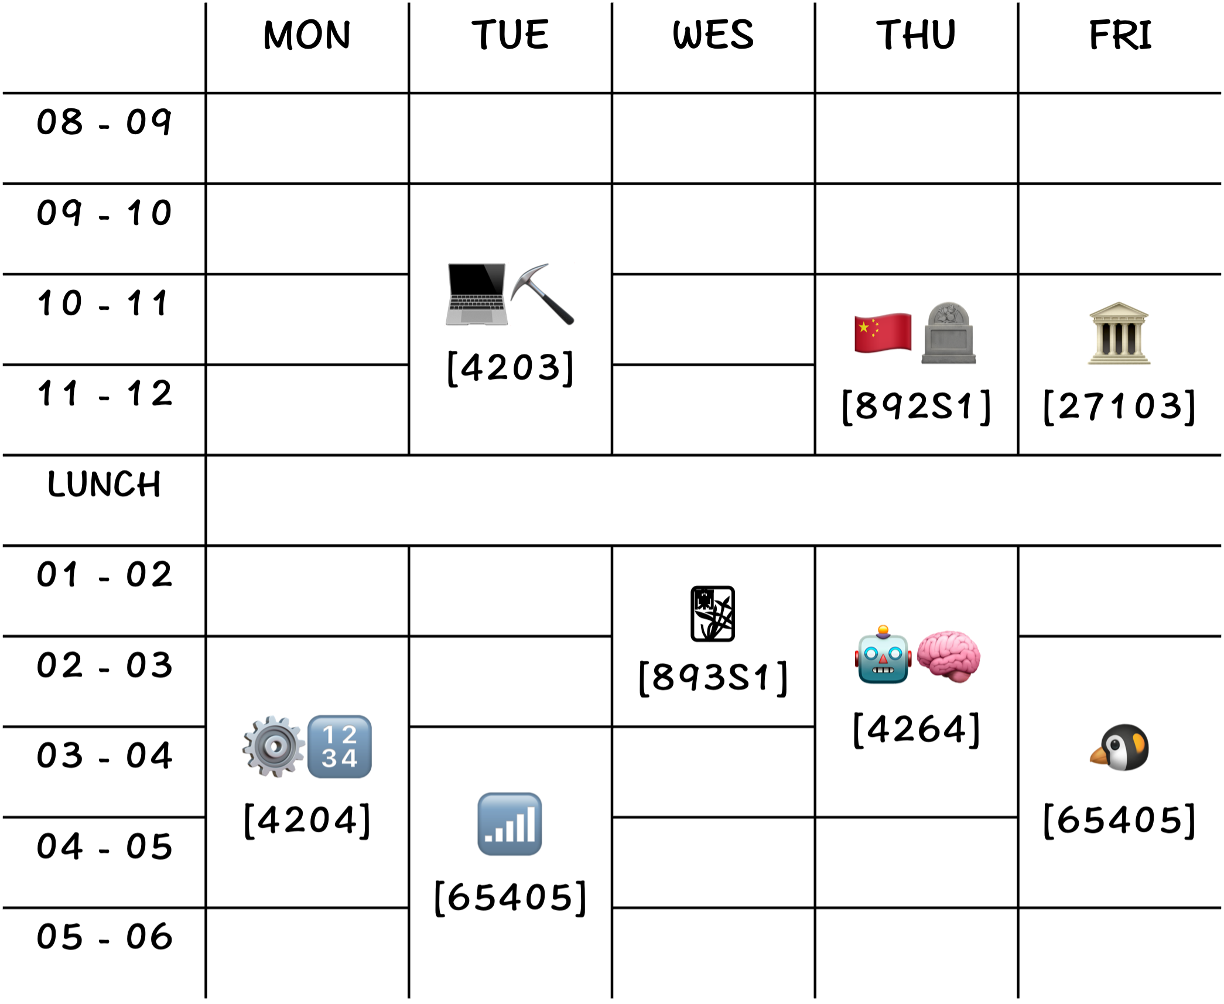
大四上
 | MON | TUE | WES | THU | FRI
08 - 09
09 - 10 |  | 💻⛏️ [4203]
10 - 11 |  |  |  | 🇨🇳🪦 [892S1] | 🏛️ [27103]
11 - 12
LUNCH
01 - 02 |  |  | 🀣 [893S1] | 🤖🧠 [4264]
02 - 03 | ⚙️🔢 [4204] |  |  |  | 🐧 [65405]
03 - 04 |  | 📶 [65405]
04 - 05
05 - 06

Slide 3
大四上
 | MON | TUE | WED | THU | FRI
08 - 09
09 - 10 |  | 💻⛏️ [4203]
10 - 11 |  |  |  | 🇨🇳🪦 [892S1] | 🏛️ [27103]
11 - 12
LUNCH
01 - 02 |  |  | 🀣 [893S1] | 🤖🧠 [4264]
02 - 03 | ⚙️🔢 [4204] |  |  |  | 🐧 [65405]
03 - 04 |  | 📶 [65405]
04 - 05
05 - 06

Slide 4
大四上
 | MON | TUE | WED | THU | FRI
08 - 09
09 - 10 |  | 💻⛏️ [4203]
10 - 11 |  |  |  | 🇨🇳🪦 [892S1] | 🏛️ [27103]
11 - 12
LUNCH
01 - 02 |  |  | 🀣 [893S1] | 🤖🧠 [4264]
02 - 03 | ⚙️🔢 [4204] |  |  |  | 🐧 [65405]
03 - 04 |  | 📶 [65405]
04 - 05
05 - 06

