Slide 1
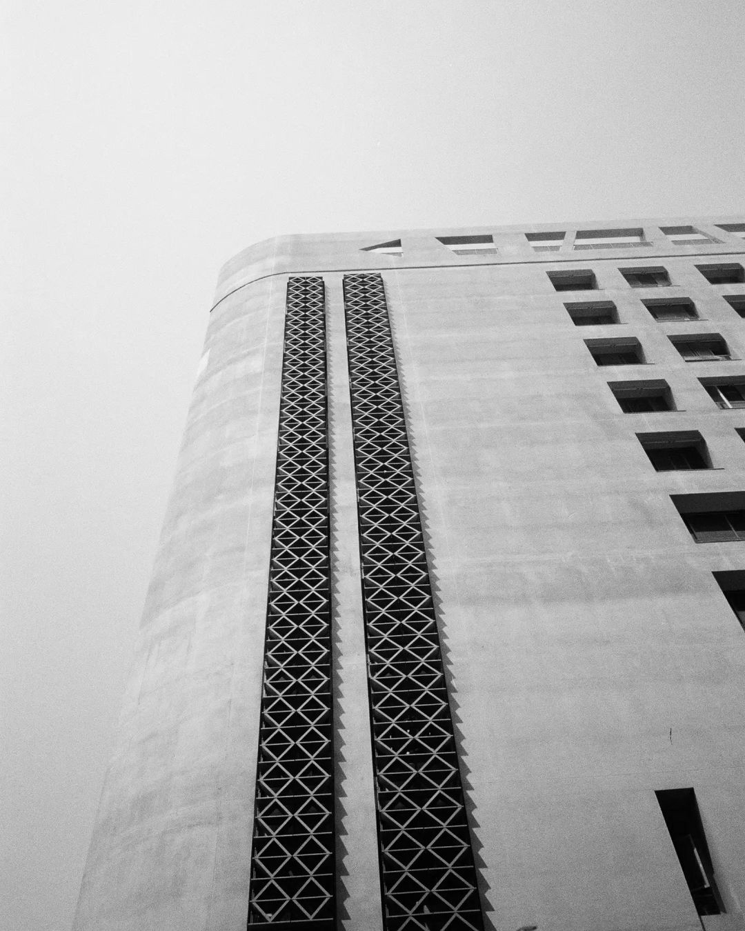
WhyMyCodeWork?
2023(SUMMER) Kibo-RPC
Based in NCKU

Slide 2
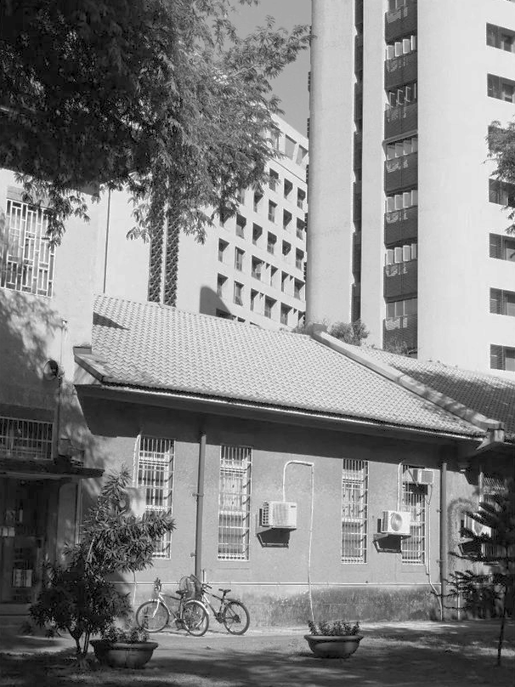
Team Introduction
Code Introduction
Special Acknowledgment
Contents

Slide 3
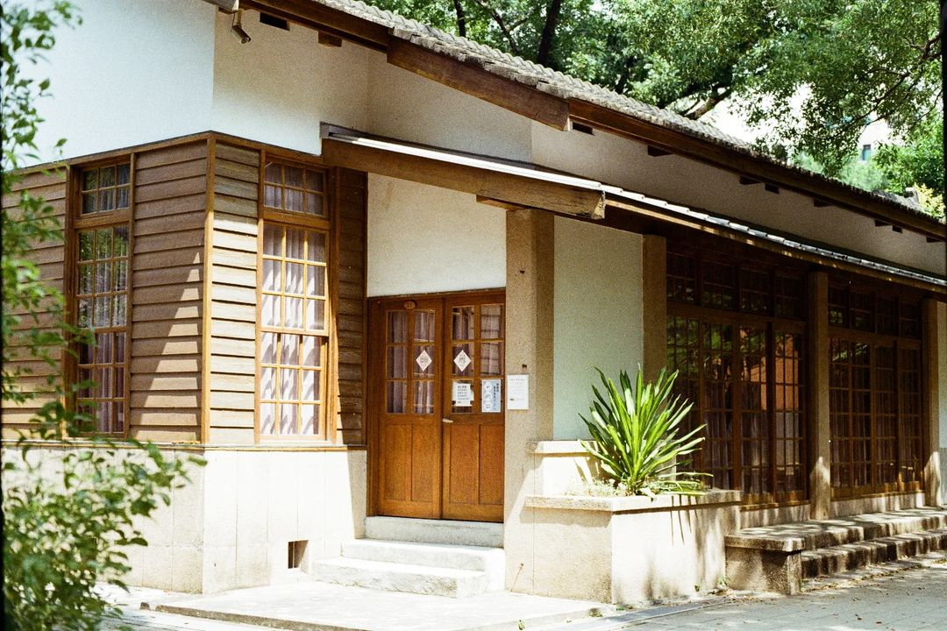
Team Introduction
01.
We are students from NCKU.

Slide 4

Code Introduction
02.
We will quickly introduce the logic of the program.

Slide 5

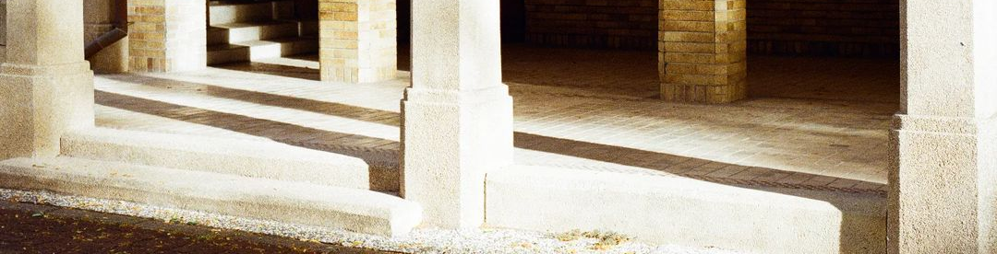




Undock, then go to ”Tunnel”.
Scan QR Code
↓
Get String
↓
Trans.
↓
Go Back to Tunnel
Choose Target Close to Dock.
Choose Target Close to Goal.
Give up.
Go to Goal
↓
Mission Complete
Undock -> “Turnnel”
Mission1 -> Scan QRCode -> Get String -> Trans.-> Go Back to Turnnel
-> Phase1 (Choose Target close to Dock)
-> Phase2 (Choose Target close to Goal)
-> Phase3 (Give up cause choose the worst case in 10 tries)
-> Goal
-> Mission Complete

Slide 6
T h a n k s
2023(SUMMER) Kibo-RPC

