Slide 1
DecentralStream
Streaming using IPFS
https://github.com/1yam/HackatonPoc
Lyam Gomès
Epitech Lyon
Noah Gomès
SupInfo
Antoine Hernu
Université de Lille

Slide 2
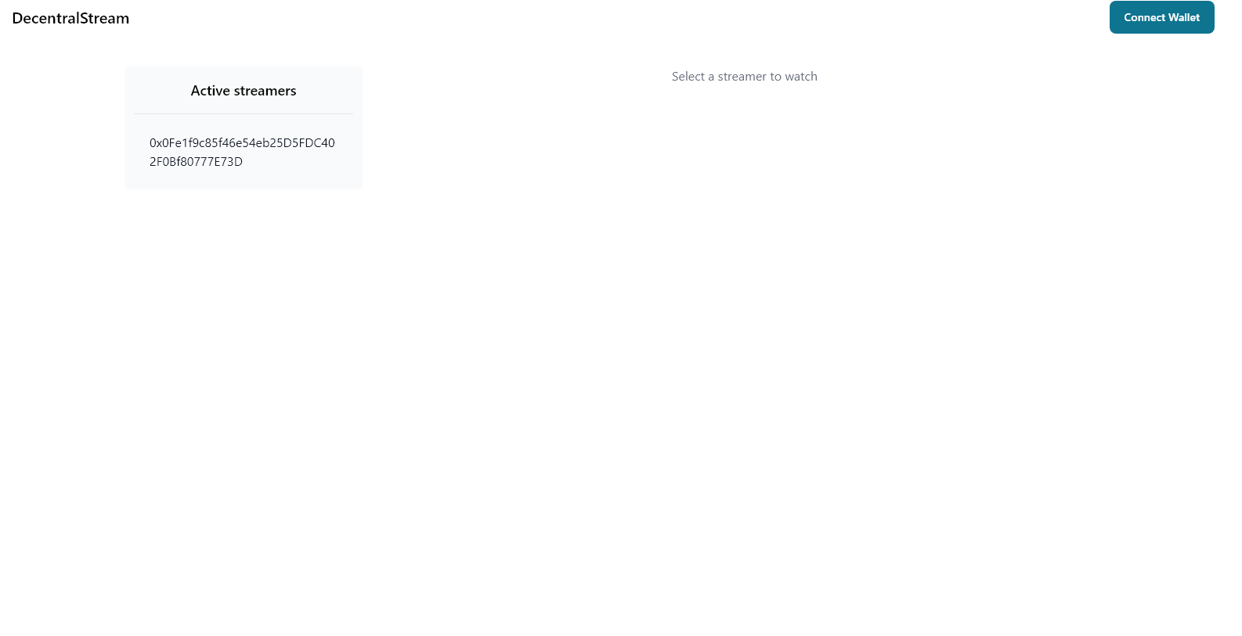
DEMO
http://nohomelab.ddns.net:3000/

Slide 3
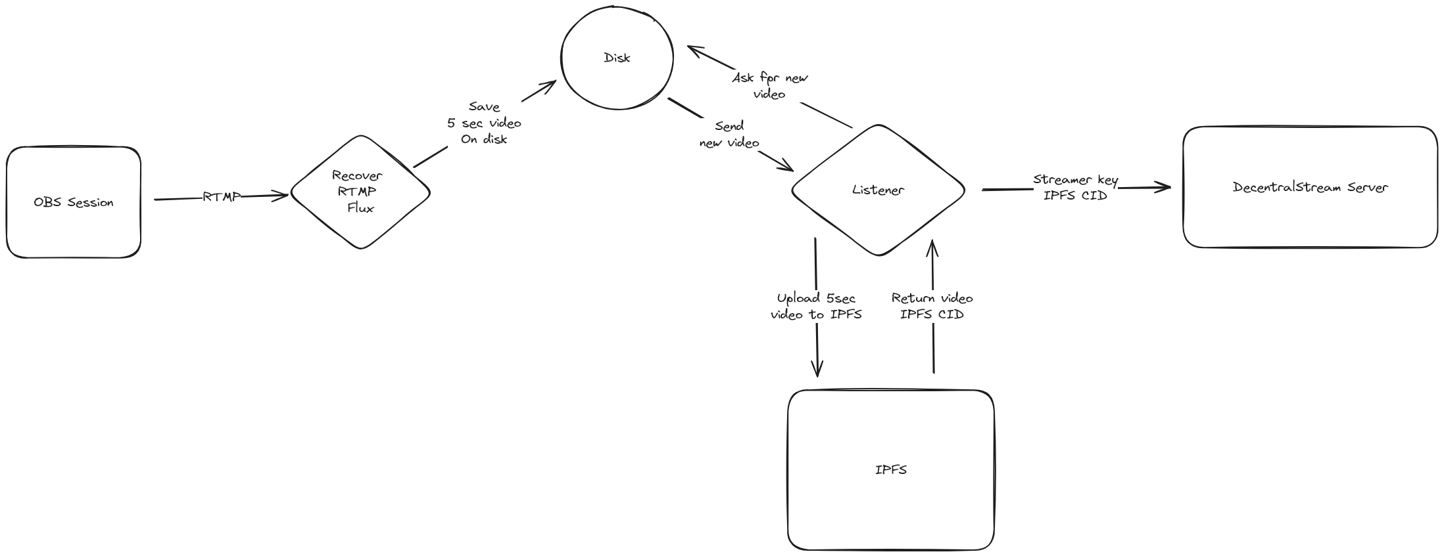
Video Treatment

Slide 4
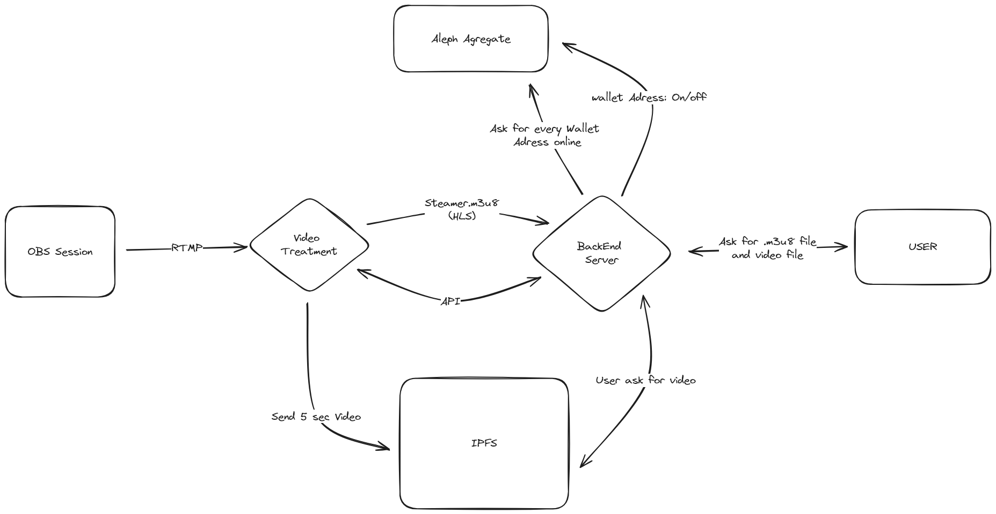
How work DecentralStream

Slide 5
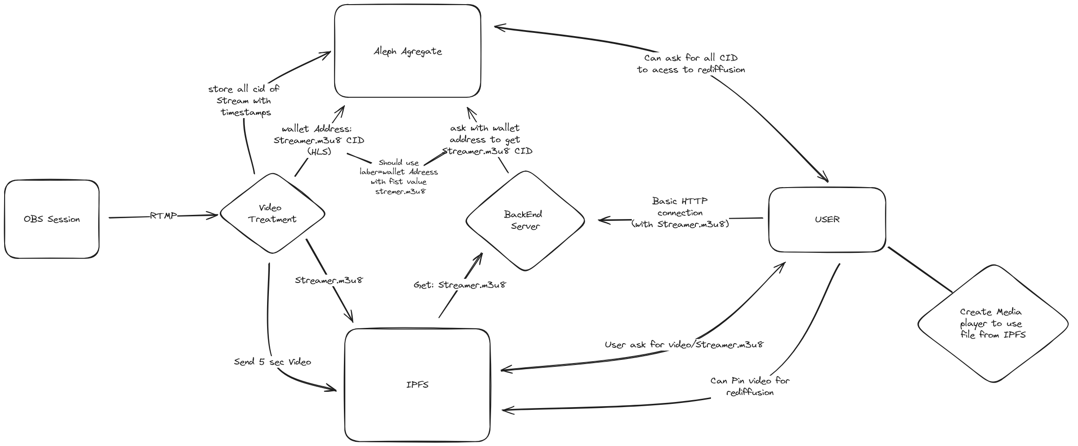
Future Upgrade

Slide 6
Why IPFS/Aleph ?
It solve principal issue of live stream bandwidth usage: User can simply ask themself for moment of live and never ask for video on server
Every moment of the stream is publicly store on IPFS that mean you can't censor anymore
Anyone who want to save extract from live stream can simply pin this moment on IPFS:
Viewer can pay to store rediffusion not necessarily host or streamer
IPFS allow two people to save same moment without creating anycopy of the video (really usefull if lot a people create almost same clips)
Future :
  Use agregate to access the streamer.m3u8 file (don’t need to ask server)
  Use aleph VM To do Video Treatment
  Host DecenralStream server on Aleph

Slide 7
Monetization
Manage Pin with server and do user pay for it and take commission
Commition on donation (smart contract on cross chain)
Make our own treatment video server and add advertisement

