Slide 1
Verification & ABC
2020

Slide 2
Exercise 7 (5ABC)
Write a program to
Read a benchmark circuit
/benchmark/mlex/xxx.blif
Print the information of the nodes that have more than one fanout
Hint: refer to /5ABC/basic

Slide 3
Exercise 8 (5ABC)
Write a parallel (bitwise) random simulator
Read a benchmark circuit
Simulate n words of random patterns
Output the top-5 nodes that have the highest rate of being 1
E.g.: >> ./ace –w 5 xxx.blif
Hint: refer to /1Program2_SAT/1Programming2/6_bitwise

Slide 4
Exercise 9: SAT-based combinational equivalence checker
Implement a SAT-based combinational equivalence checking with the ABC environment
Inputs
Two combinational circuits in the blif format
Output
EQ or
NEQ with an input pattern that can distinguish the two circuits
>>./scec input1.blif input2.blif
Hint: refer to /5ABC/sat

Slide 5
Procedure
Read the two circuits
Construct a miter of the two circuits
Build the CNF formula of the miter with the output O=1
Call the SAT solver
Check the solving result
SAT: NEQ, get the values of the primary inputs
UNSAT: EQ

Slide 6
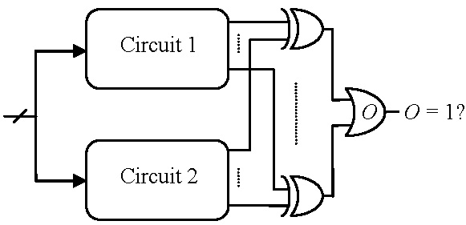
Miter

