Slide 1
ABC

Slide 2
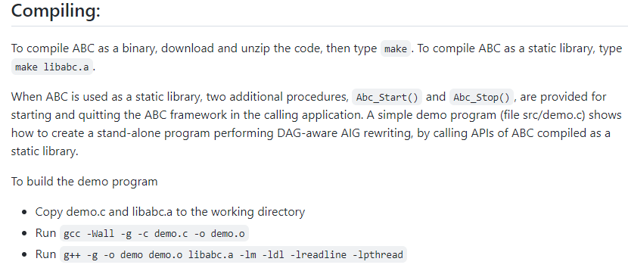
ABC
A very powerful academic tool for logic synthesis and verification
https://people.eecs.berkeley.edu/~alanmi/abc/
How to install ABC
How to use it in the iterative mode and API mode

Slide 3
Getting ABC
https://github.com/berkeley-abc/abc
Run ABC in the iterative mode
See the website
Add –lrt for solving the error of “clock_gettime”
Verification with cec

Slide 4
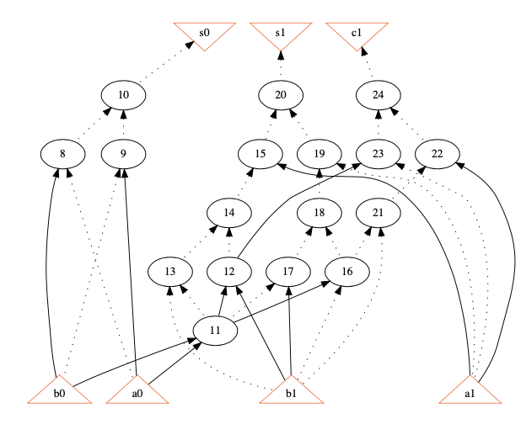
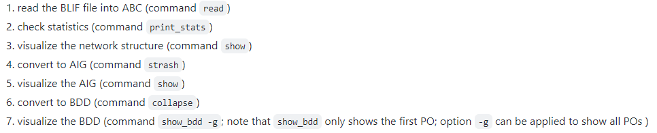
What can abc do?
Read network
Show information of the network
Resynthesis (optimize)
Transform network into various structure
Example of steps using ABC

Slide 5
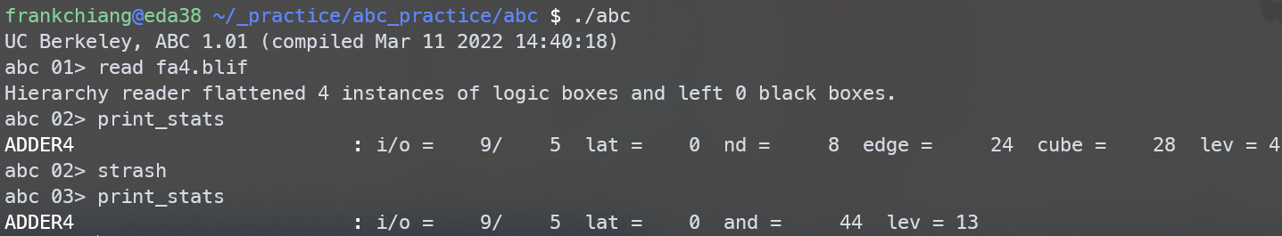
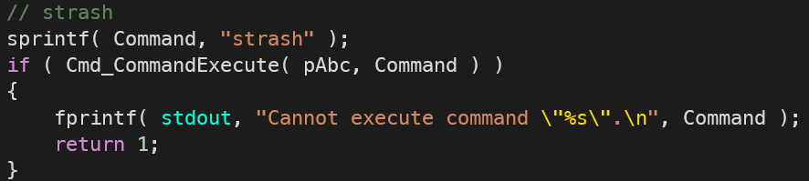
3 Ways for Using ABC
Command mode
In C/C++ (recommand)
Command mode
Function mode

Slide 6
Run ABC in the API mode (c/c++)
Setup your makefile
Library: libabc.a
Include header files
Add Abc_Start() and Abc_Stop() in main.c for the ABC framework

Slide 7
What you can do with ABC
Read netlists in many file formats
Transferred to the And-Inverter Graph (AIG) format
Manipulate the netlists
For each primary inputs
For each primary outputs
For each nodes (gates)
Most functions can be found in src/base/abc/abc.h

Slide 8
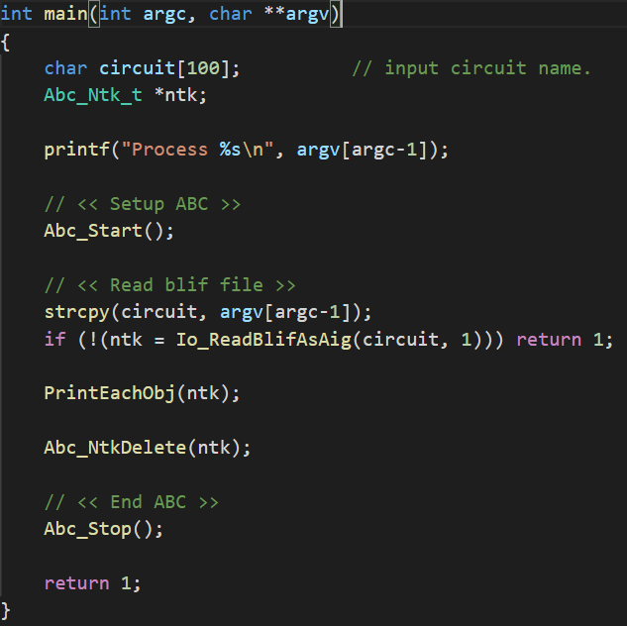
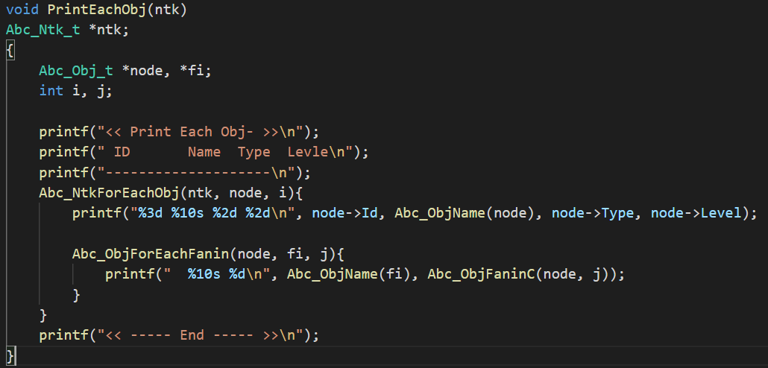
Example
Framework
Ntk traversal

Slide 9
SAT

Slide 10
How to use MiniSAT in ABC
Include the header file
Create a CNF formula
Create clauses
Add literals
(normal) variables and negated variables
Add clauses
Run SAT solver
Show results

Slide 11
Include the header file
#include “sat/bsat/satSolver.h”
…

Slide 12
Create a CNF formula
sat_solver *S; // declaration
S = sat_solver_new(); // create
…
sat_solver_delete(S); // delete

Slide 13
Create clauses
veci lits; // declaration
veci_new(&lits); // create
…
veci_delete(&lits); // delete

Slide 14
Add literals
veci_resize(&lits, 0); // initialize a clause
veci_push(&lits, toLit(varA)); // add a variable varA
veci_push(&lits, toLit(varB)); // add a variable varB
veci_push(&lits, lit_neg(toLit(varC))); // add a negated variable varA
// varA, varB, and varC are positive integers

Slide 15
Add clauses
lit* begin;// declaration
…
begin = veci_begin(&lits);
st = sat_solver_addclause(S, begin, begin+veci_size(&lits)); // return false if S is detected unsatisfiable
// st is a Boolean variable

Slide 16
Example: Add two clauses
…
// add the first clause: varA, varB, varC’
veci_resize(&lits, 0);
veci_push(&lits, toLit(varA));
veci_push(&lits, toLit(varB));
veci_push(&lits, lit_neg(toLit(varC)));
begin = veci_begin(&lits);
st = sat_solver_addclause(S, begin, begin+veci_size(&lits));
// add the second clause; varA’, varC
veci_resize(&lits, 0);
veci_push(&lits, lit_neg(toLit(varA)));
veci_push(&lits, toLit(varC));
begin = veci_begin(&lits);
st = sat_solver_addclause(S, begin, begin+veci_size(&lits));

Slide 17
Run SAT solver
…
st = sat_solver_solve(S, 0, 0, (ABC_INT64_T)0, (ABC_INT64_T)0, (ABC_INT64_T)0, (ABC_INT64_T)0);
// sat_solver_solve(sat_solver* s, lit* begin, lit* end, ABC_INT64_T nConfLimit, ABC_INT64_T nInsLimit, ABC_INT64_T nConfLimitGlobal, ABC_INT64_T nInsLimitGlobal);
// return -1, if UNSAT
// return 1, if SAT
// return 0, if out of conflict limit

Slide 18
Show results
…
printf("%d %d, ", varId, sat_solver_var_value(S, varId));
// show the variable, varId

Slide 19
Incremental SAT solving
Current SAT solving run reuse the learned information of previous SAT solving runs
S1: common_clauses & (A | B)
S2: common_clauses & (B | C)
S3: common_clauses & (A | C’)

Slide 20
Incremental SAT solving
…
// Suppose the common clauses have been added into S
// for clause (A | B)
veci_resize(&lits, 0);
veci_push(&lits, toLit(varA));
veci_push(&lits, toLit(varB));
begin = veci_begin(&lits);
st = sat_solver_solve(S, begin, begin+veci_size(&lits), (ABC_INT64_T)0, (ABC_INT64_T)0, (ABC_INT64_T)0, (ABC_INT64_T)0);
// for clause (B | C)
veci_resize(&lits, 0);
veci_push(&lits, toLit(varB));
veci_push(&lits, toLit(varC));
begin = veci_begin(&lits);
st = sat_solver_solve(S, begin, begin+veci_size(&lits), (ABC_INT64_T)0, (ABC_INT64_T)0, (ABC_INT64_T)0, (ABC_INT64_T)0);
…

Slide 21
More than one different clause?
S1: common_clauses & (A | B) & (B | D)
S2: common_clauses & (B | C) & (C | D)
S3: common_clauses & (A | C’)
S1: common_clauses & (K1 | A | B) & (K1 | B | D) & (K1’)
S2: common_clauses & (K1 | A | B) & (K1 | B | D) & (K1) & (K2 | B | C) & (K2 | C | D) & (K2’)
S3: common_clauses & (K1 | A | B) & (K1 | B | D) & (K1) & (K2 | B | C) & (K2 | C | D) & (K2) & (A | C’)

Slide 22
Combinational Equivalence Checking
Check whether two combinational circuits are functionally equivalent or not?
Simulation
Formal method
SAT-based method

Slide 23
SAT-based CEC
Construct a miter of the two circuits
C1 and C2 are equivalent, if O is never 1
Transform the miter into a CNF formula
Check whether the formula is satisfiable or not with the clause (O)
SAT -> non-equivalent, UNSAT -> equivalent
C1
O
C2

Slide 24






Tseitin Transformation
WIKI: http://en.wikipedia.org/wiki/Tseitin-Transformation

