Slide 1
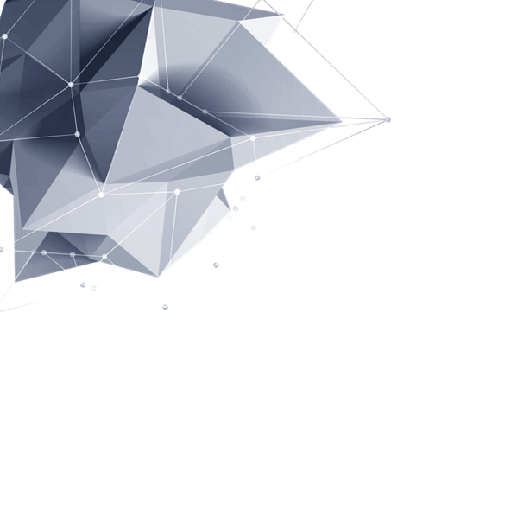
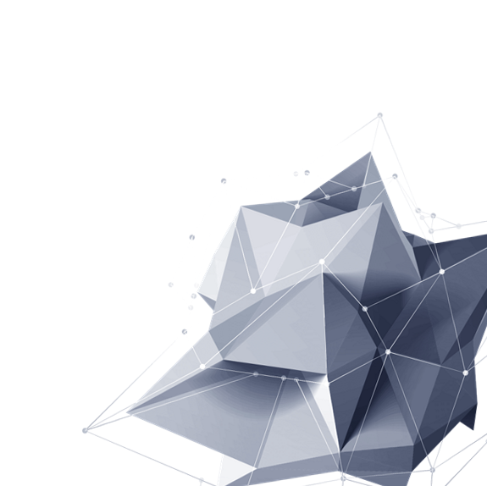
Supermicro-1 HackEDA
陳冠誠 | 王政元 | 許致瑋 | 姜承佑

Slide 2

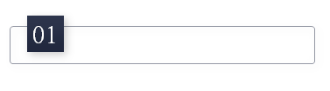



C O N T E N T S
題目介紹 INTRODUCTION
P R E S E N T
題目分析 ANALYSIS
實作過程 PROCESS
成果展現 DEMONSTRATION

Slide 3
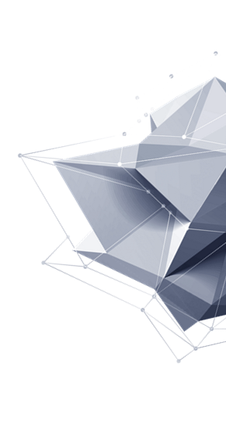
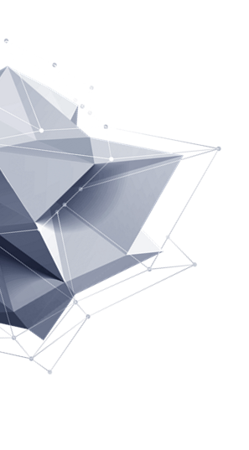

題目介紹
INTRODUCTION

Slide 4
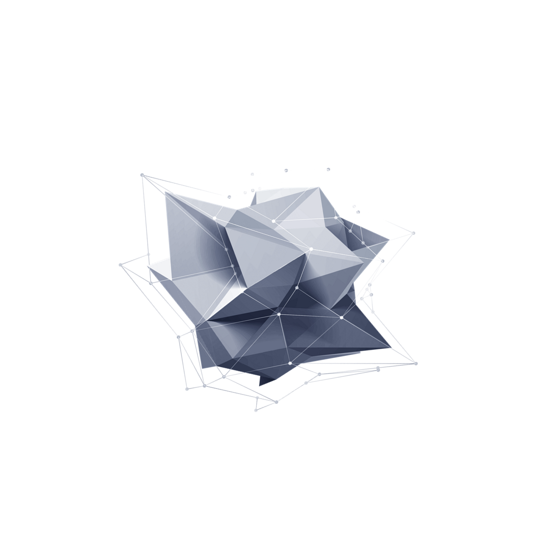
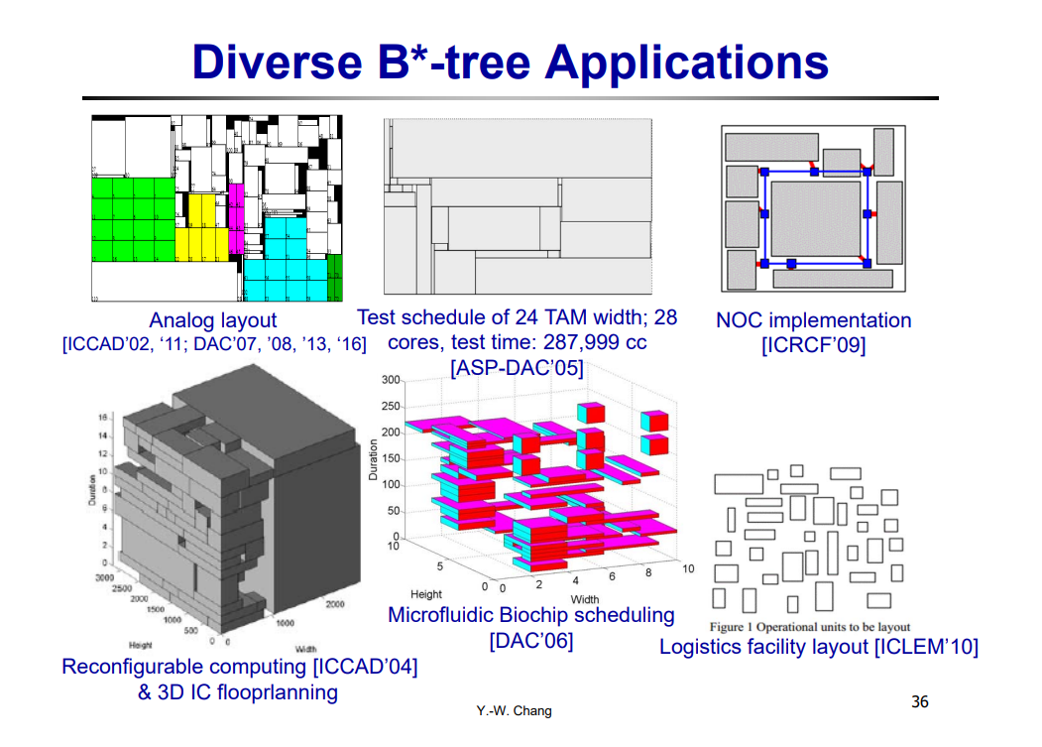
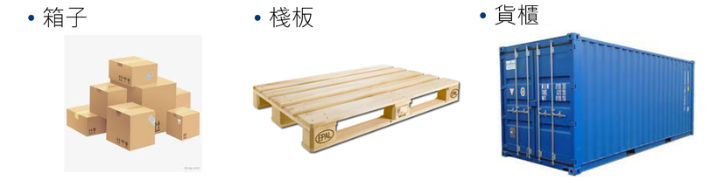
INTRODUCTION
Problem Formulation
Given a set of n_1 containers, n_2 pallets, n_3 boxes, output a packing methodology such that all boxes are in the container.
Notes:
題目會給定數個貨櫃、棧板與箱子，而我們的任務就是將箱子疊好，並最佳化空間使用率。

Slide 5

題目分析
ANALYSIS

Slide 6








ANALYSIS
Complexity Consideration
Method
Decision
01
05
Cases Observation
Execution
Notes:
Complexity Consideration:
Cases Observation：一開始我們先觀察題目，我們會發現 Method Desion:

Slide 7
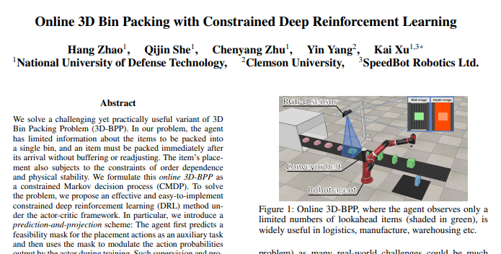
Simulated Annealing
Drawback of previous work
Do not support rectangle pallets
Cannot support large size pallets

Slide 8

實作過程
PROCESS

Slide 9

PROCESS
3D-Bin-Packing with Sequence Triple
Legalization Considering Gravity and Weight-Balance
01
02
03
04
Simulated Annealing
Result Visualization
Notes:
我們的流程主要可以分為4大步驟:
資料結構的建立、模擬退火眼算法、考慮重力與平衡的合法化，與最後的結果視覺化

Slide 10
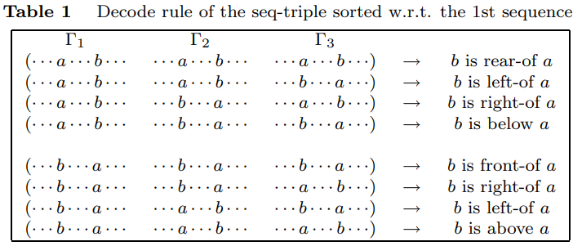
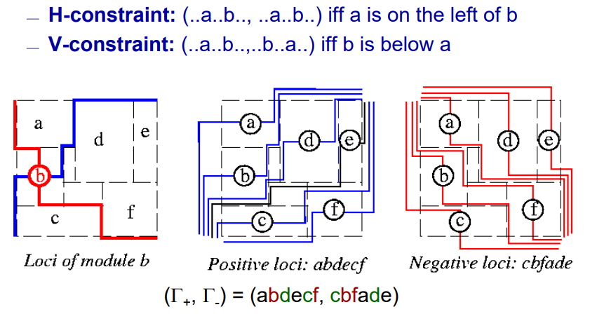
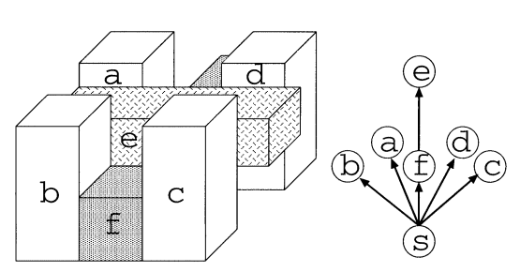
Sequence Triple
Data Structure for 3D Relationship
Notes:
對於2D方塊之間關係，有一種簡單的資料結構 --- SP，他從很早之前就已經被廣泛使用在EDA的Floorplaning最佳化問題中，而我們這次使用他的進化版 --- ST來紀錄3D空間方塊之間的關係。

Slide 11
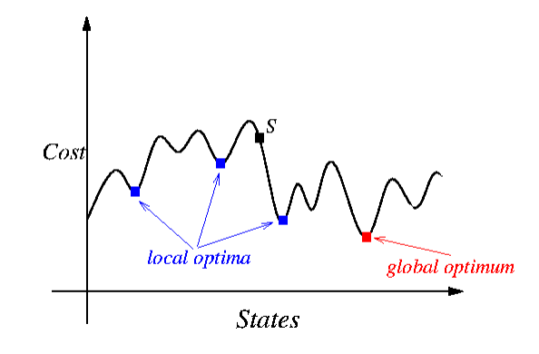
Simulated Annealing
Probabilistic technique
It is a technique to approximate global optimization in a large search space for an optimization problem.
Notes:
由於3D BP這種優化問題有非常大的解空間，要找到全域最佳解是一件非常難的事，而SA是一種概率演算法，它常用來在一定時間內、在一個很大搜尋空間中尋找近似最佳解。
Reference: Wong & Liu, “A new algorithm for floorplan design,” DAC-86. ;
Kirkpatrick, Gelatt, and Vecchi, “Optimization by simulated annealing,” Science, May 1983
Three-Dimensional Container Loading: A Simulated Annealing Approach
The-3D-Packing-by-Meta-Data-Structure-and-Packing-Heuristics

Slide 12
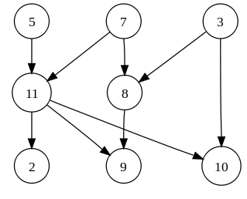
Legalization
Gravity consideration
Create topological order along y-axis. Make sure every boxes have a maximum height of the boxes below it.

Slide 13
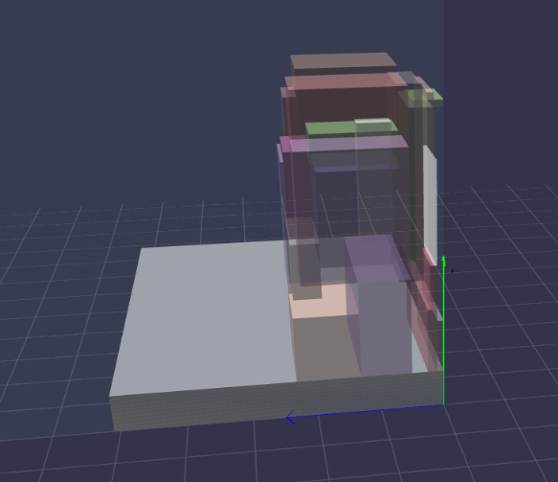
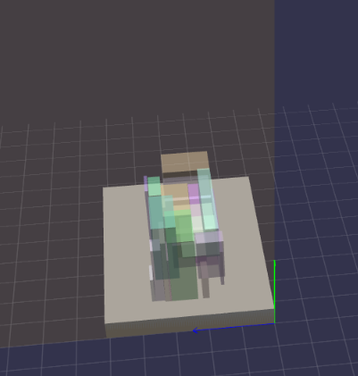
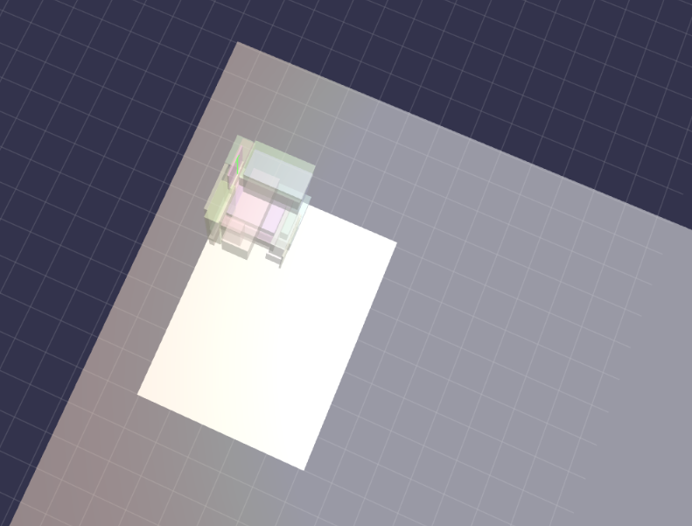
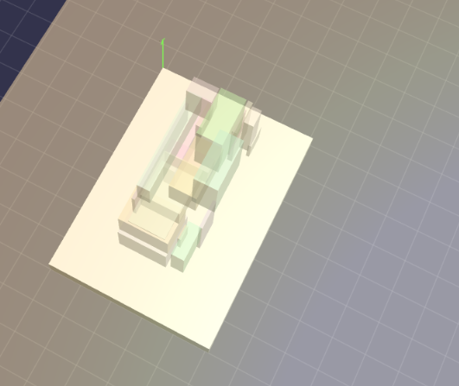
Weight-Balance
Before considering weight-balance
After considering weight-balance

Slide 14

成果展示
DEMONSTRATION

Slide 15
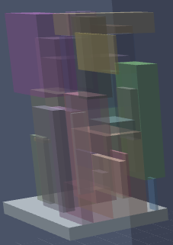
DEMONSTRATION
Graphics
30 boxes in 140*102

Slide 16
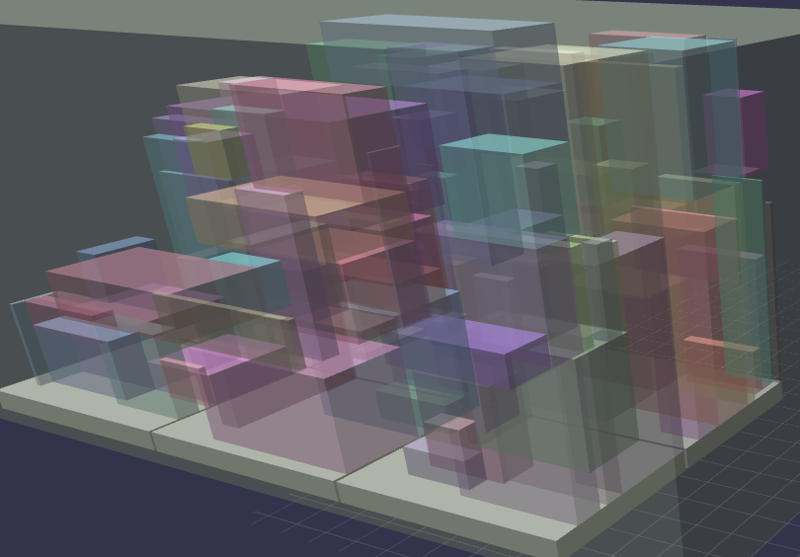
DEMONSTRATION
Graphics
100 boxes in 6 pallets

Slide 17
DEMONSTRATION
Cases | # of Boxes | # of Pallets | Runtime | Boxes Volume | Packing Volume | Packing Rate | Fit Outline | Weight-Balence
1 | 10 | 2 | 18s | 2,284,244 | 2,550,854 | 1.11 | ✔ | ✔
2 | 22 | 1 | 2m39s | 318739 | 411916 | 1.29 | ✔ | ✔
3 | 50 | 6 | 53s | 7697373 | 9945075 | 1.29 | ✔ | ✔
4 | 100 | 6 | 2m51s | 7955562 | 11260308 | 1.42 | ✔ | ✔

Slide 18
Contribution
Our Features
The Whole Flow (testcase → 3dbp → render visualization)
Weight-Balance-Aware 3D packing
Parallel Computing

Slide 19
Thanks for Listening
Q&A

Slide 20
Backup slides

Slide 21
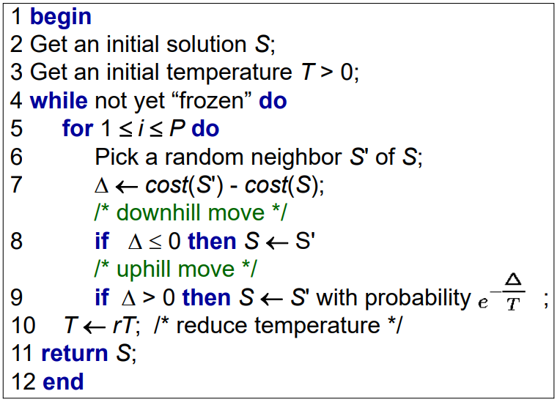
Pseudocode for Simulated Annealing

Slide 22
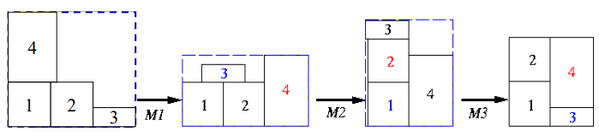
Objective for Simulated Annealing

