Slide 1
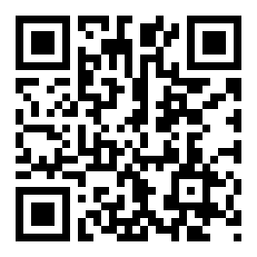
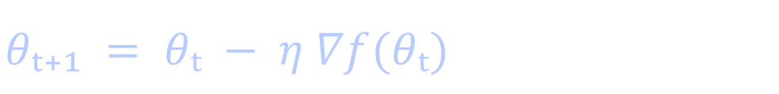
GRADIENT DESCENT
Gradient Descent
and optimizer variants
How local slope becomes a parameter update
$$θₜ₊₁ = θₜ − η ∇f(θₜ)$$
https://1zuki.github.io/gradient-descent/
A visual lecture in local optimization
01 / 29

Slide 2


FOUNDATIONS
A model can be a line
Model:
$$ŷ = wx + b$$
WHY MINIMIZE?
Different values of w and b produce different predictions. The squared error gives us one number to make smaller.
Loss function (MSE)
$$L\left(w,b\right)=\frac{1}{n} \sum_{i=1}^{n}{(wxᵢ + b − yᵢ)²}$$
The loss turns “fit the data” into an optimization problem.
Three observations
$$(x, y) = (1, 2), (2, 3), (3, 5)$$
02 / 29

Slide 3
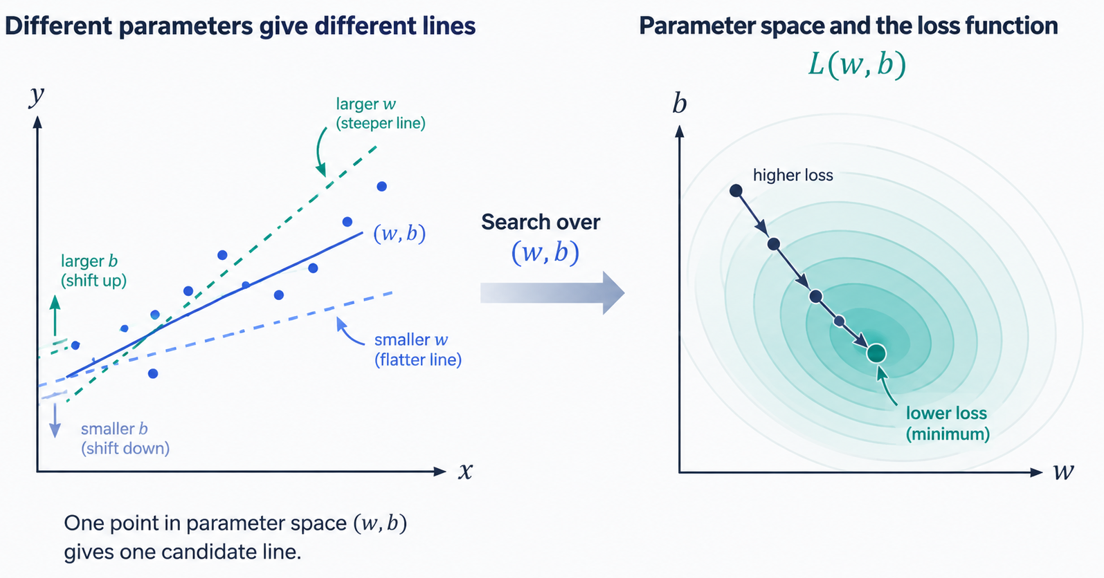


FOUNDATIONS
Two parameters make a two-dimensional search
$$θ = (w, b)$$
$$f(θ) = L(w,b)$$
THE ABSTRACT PICTURE
Training searches through parameter space for a point with a lower loss.
03 / 29

Slide 4
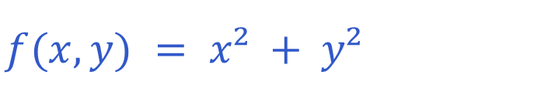
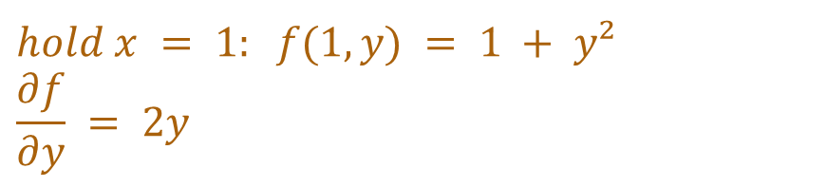
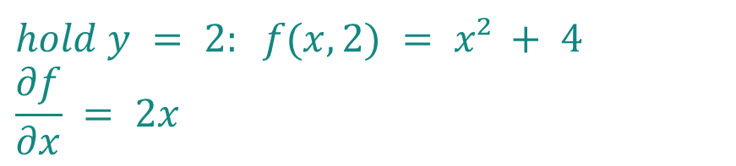
FOUNDATIONS
A partial derivative holds the other coordinate fixed
$$f(x,y) = x² + y²$$
$$hold y = 2: f(x,2) = x² + 4$$
$$\frac{∂f}{∂x} = 2x$$
MEANING
Each partial derivative asks how the loss changes when one parameter moves and the others stay fixed.
$$hold x = 1: f(1,y) = 1 + y²$$
$$\frac{∂f}{∂y} = 2y$$
04 / 29

Slide 5
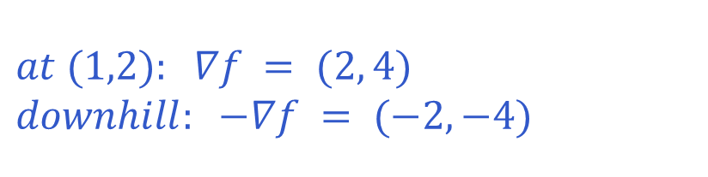
GEOMETRY
The gradient lives in parameter space
$$at (1,2): ∇f = (2, 4)$$
$$downhill: −∇f = (−2,−4)$$
The gradient points toward local increase.
The negative gradient points toward local decrease.
It is perpendicular to the contour through the current point.
05 / 29

Slide 6
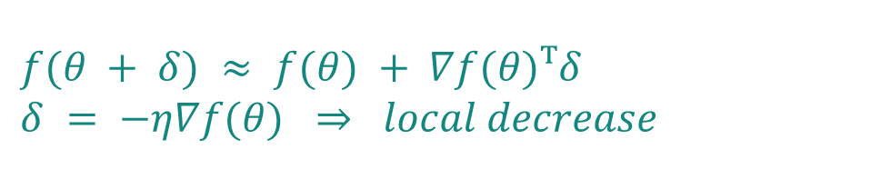
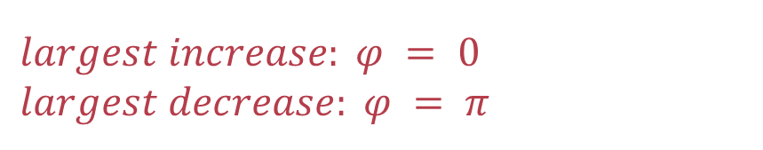
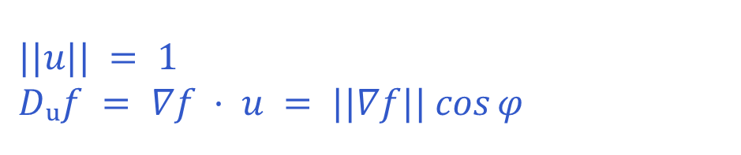
FOUNDATIONS
Why the negative gradient decreases the function
$$||u|| = 1$$
$$Dᵤf = ∇f · u = ||∇f|| cos⁡φ$$
$$largest increase: φ = 0$$
$$largest decrease: φ = π$$
$$f(θ + δ) ≈ f(θ) + ∇f(θ)ᵀδ$$
$$δ = −η∇f(θ) ⇒ local decrease$$
06 / 29

Slide 7
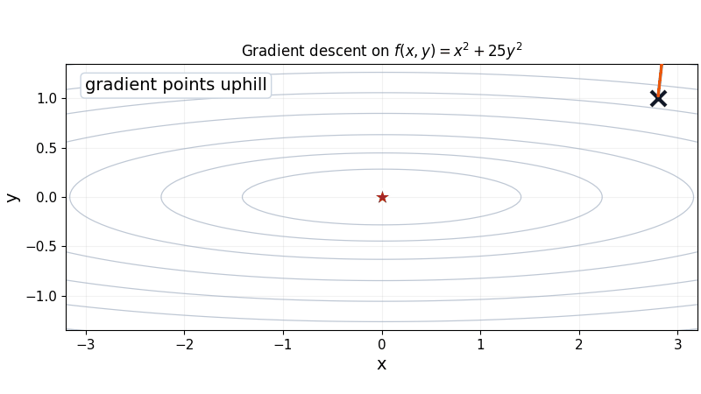
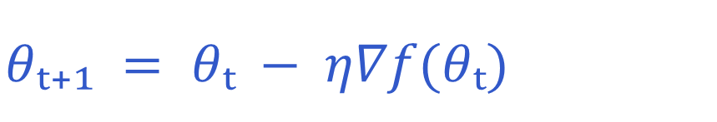

FOUNDATIONS
Gradient descent repeats one update
$$θₜ₊₁ = θₜ − η∇f(θₜ)$$
The gradient supplies a direction. The step length is $η||∇f(θₜ)||.$
ANIMATED TRAJECTORY
The orange arrow points uphill. The blue step follows its negative.
07 / 29

Slide 8
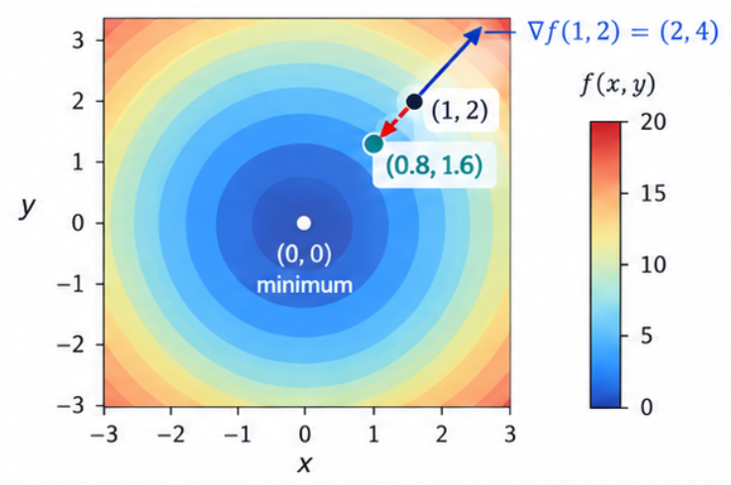
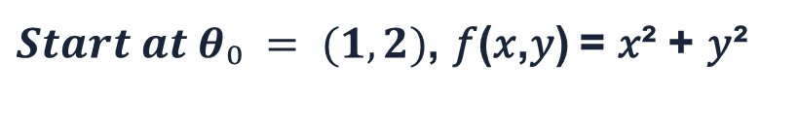
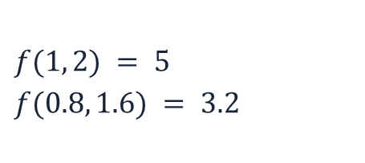
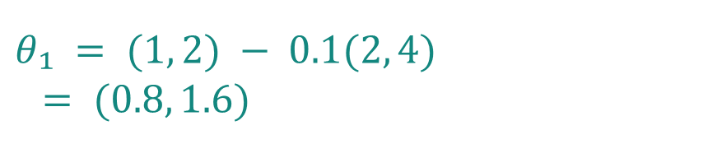
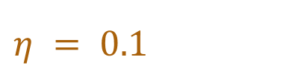
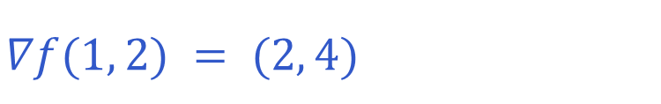
FOUNDATIONS
One numerical step
$Start at θ₀ = (1, 2)$, 𝑓(𝑥,𝑦) = 𝑥² + 𝑦²
Gradient:
$$∇f(1, 2) = (2, 4)$$
Learning rate:
$$η = 0.1$$
$$f(1, 2) = 5$$
$$f(0.8, 1.6) = 3.2$$
Update parameter:
LOSS
$$θ₁ = (1, 2) − 0.1(2, 4)$$
$$= (0.8, 1.6)$$
The update moved downhill.
08 / 29

Slide 9
STABILITY
The learning rate controls stability
Same gradient information. Different step sizes.
Small η: stable but slow.
Moderate η: steady progress.
Large η: overshoot or divergence.
INTERPRETATION
A correct gradient can still produce a bad update when the step is too large.
09 / 29

Slide 10
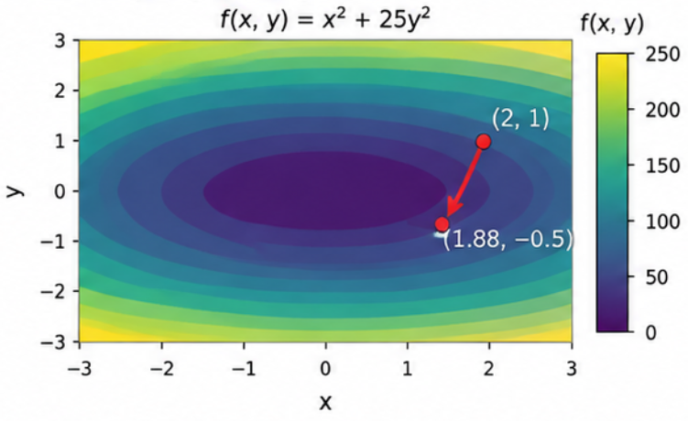
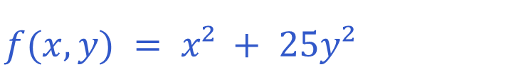
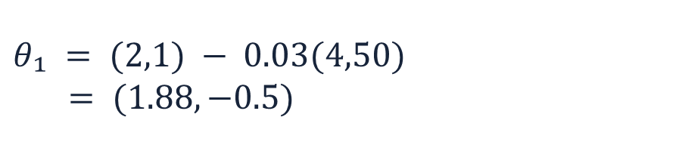
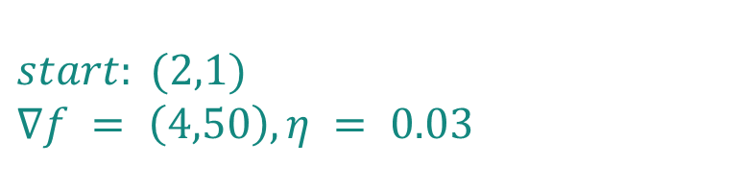
STABILITY
Higher curvature makes gradient descent more sensitive to the learning rate
$$f(x, y) = x² + 25y²$$
$$start: (2,1)$$
$$∇f = \left(4,50\right), η = 0.03$$
STABILITY
$$θ₁ = (2,1) − 0.03(4,50)$$
$$= (1.88, −0.5)$$
|1 − 50η| < 1 ⇒ 0 < η < 0.04
The x-coordinate also imposes |1 − 2η| < 1. The intersection is controlled by the sharper curvature.
ONE MINIMUM
This surface is convex. Zigzags come from unequal curvature, not local-minimum traps.
10 / 29

Slide 11
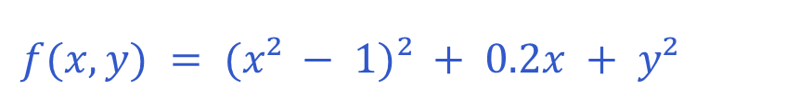
STABILITY
Nonconvex landscapes have multiple basins
$$f(x, y) = (x² − 1)² + 0.2x + y²$$
Different starting points can enter different basins.
A local minimum can have a higher value than another minimum.
The gradient describes local change, not the full global landscape.
11 / 29

Slide 12
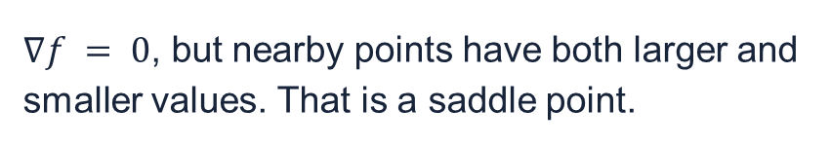
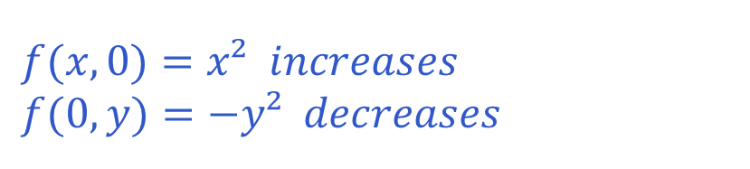
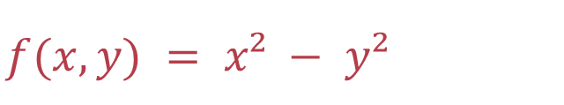
STABILITY
A zero gradient does not guarantee a minimum
$$f(x, y) = x² − y²$$
$$f(x,0)=x² increases$$
$$f(0,y)=−y² decreases$$
AT (0, 0)
$∇f = 0$, but nearby points have both larger and smaller values. That is a saddle point.
12 / 29

Slide 13
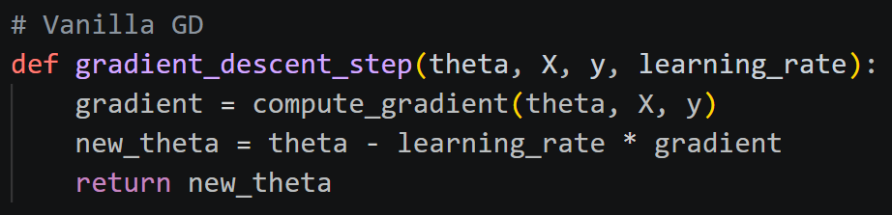
OPTIMIZERS
What an optimizer changes in the update
𝜃ₜ₊₁ = 𝜃ₜ − 𝜂 𝑢ₜ
The optimizer turns a gradient signal into the direction actually applied to the parameters.
MEASURE
REMEMBER
RESCALE
How do we compute the gradient signal gₜ?
Full-batch, stochastic, or mini-batch
Should the update remember previous directions?
Momentum and Nesterov
Should each parameter have its own effective step size? AdaGrad, RMSProp, Adam
Stability still matters: 𝜂 sets the step size. The optimizer determines 𝑢ₜ.
13 / 29

Slide 14
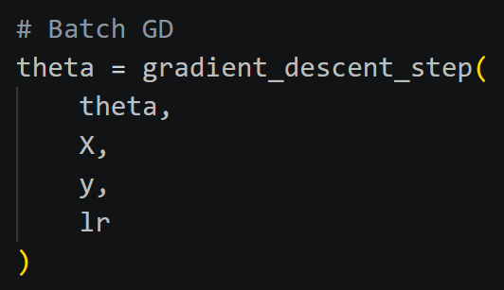
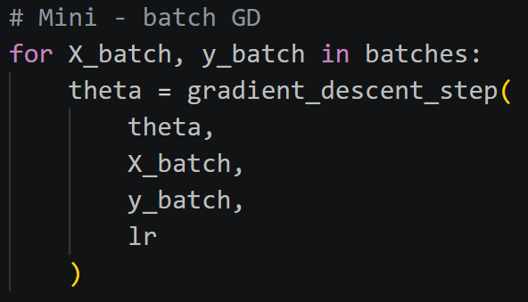
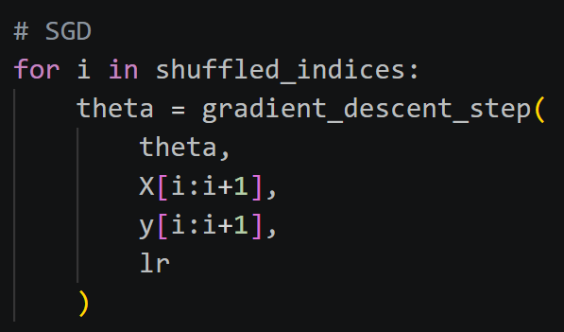
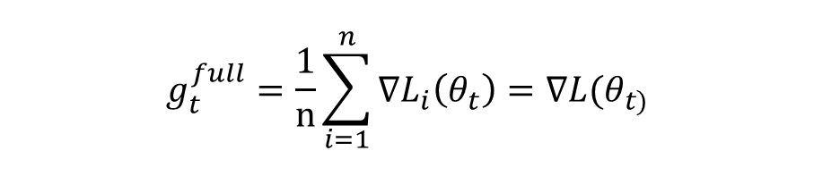
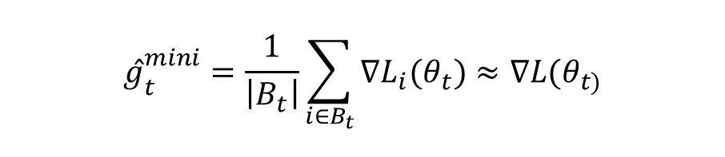


OPTIMIZERS
How much data do we use to compute the gradient?
In a dataset of n samples:
Mini-batch (batch size $B$, e.g. 32 or 64)
Stochastic (SGD) (1 sample per update
Full–batch (all n samples)
$$g_{t}^{full}=\frac{1}{n}\sum_{i=1}^{n}{∇L_{i}\left(θ_{t}\right)=∇L(θ_{t)}}$$
$${ĝ}_{t}^{mini}=\frac{1}{\left|B_{t}\right|}\sum_{i∈B_{t}}{∇L_{i}(θ_{t})≈∇L(θ_{t)}}$$
$${ĝ}_{t}^{SGD}=∇L_{i_{t}}(θ_{t)}$$
Stable, expensive
Moderately noisy, practical compromise
Noisy, cheap
ĝ: estimates of the full-batch gradient
14 / 29
vₜ = state / accumulated direction
, ε = small stabilizer
g², √v, and g/(√v+ε) operate coordinate by coordinate.

Slide 15

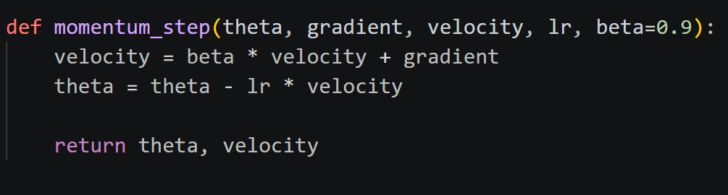
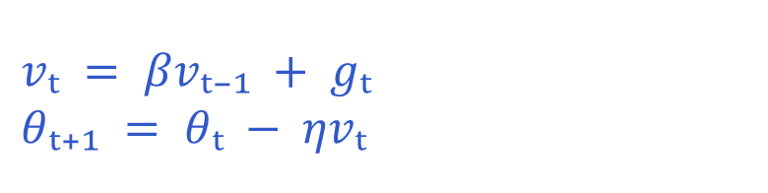
OPTIMIZERS
Momentum accumulates consistent directions
Vanilla GD can struggle with:
Noisy gradients → different mini-batches give slightly different directions.
Narrow valleys → GD oscillates across steep directions and moves slowly along shallow ones.
No memory → every step ignores previous motion.
Momentum adds memory through a velocity term:
$$vₜ = βvₜ₋₁ + gₜ$$
$$θₜ₊₁ = θₜ − ηvₜ$$
vₜ = state / accumulated direction; β = memory coefficient
15 / 29

Slide 16

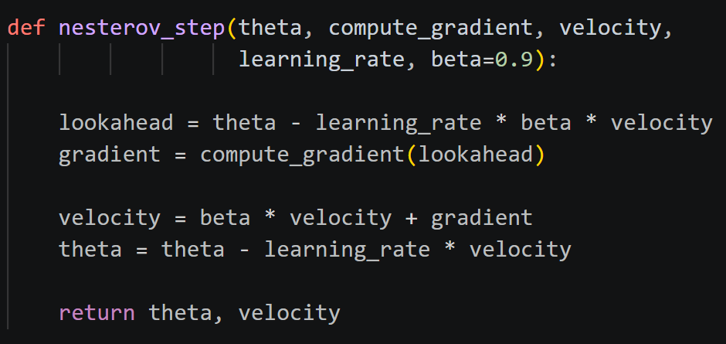
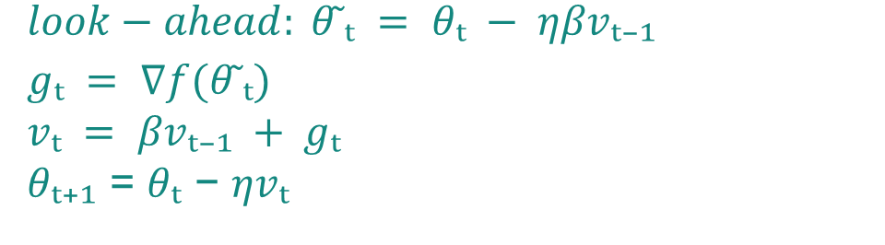
OPTIMIZERS
Nesterov evaluates a look-ahead gradient
Momentum's limitation
Gradient is measured before momentum carries us forward.
Instead of evaluating the gradient where you are, Nesterov evaluates it where momentum is about to take you.
$$look−ahead: θ ̃ₜ = θₜ − ηβvₜ₋₁$$
$$gₜ = ∇f(θ ̃ₜ)$$
$$vₜ = βvₜ₋₁ + gₜ$$
𝜃ₜ₊₁ = 𝜃ₜ − 𝜂𝑣ₜ
LOOK AHEAD
Preview first, measure the slope there, then update the actual parameters.
16 / 29

Slide 17

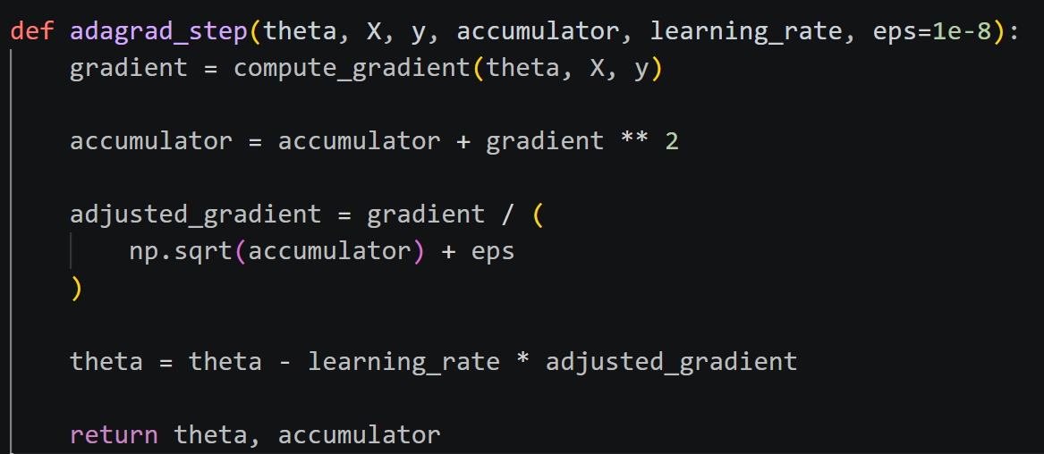
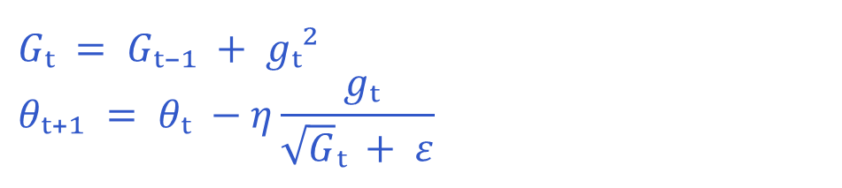
OPTIMIZERS
AdaGrad: different parameters need different step sizes
Vanilla GD uses one learning rate for all features
Rare features learn too slowly, while frequent features oscillate
Coordinates with large accumulated gradients receive smaller effective steps.
$$Gₜ = Gₜ₋₁ + gₜ²$$
$$θₜ₊₁ = θₜ −η\frac{ gₜ}{\sqrt{G}ₜ + ε}$$
The accumulator only grows, so the effective step can shrink indefinitely.
𝐺ₜ: sum of past squared gradients; ε = small stabilizer
17 / 29

Slide 18
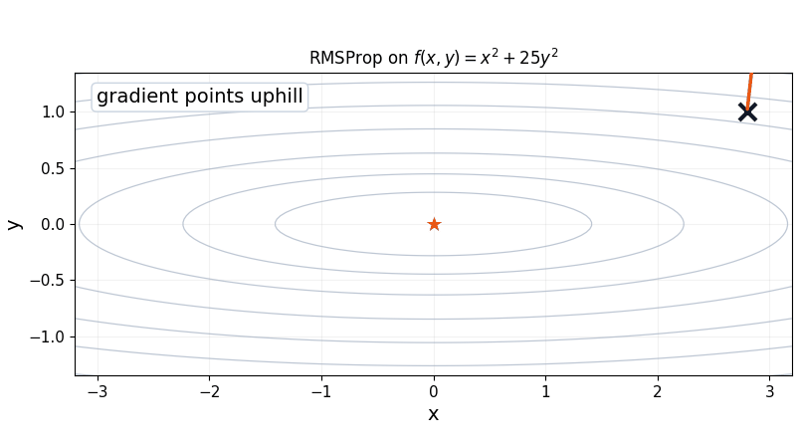
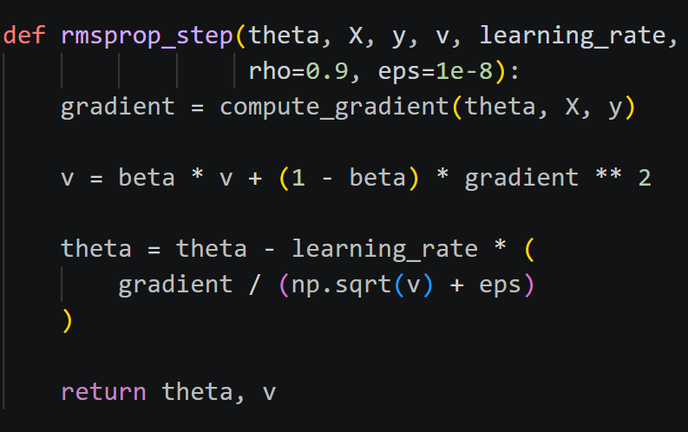
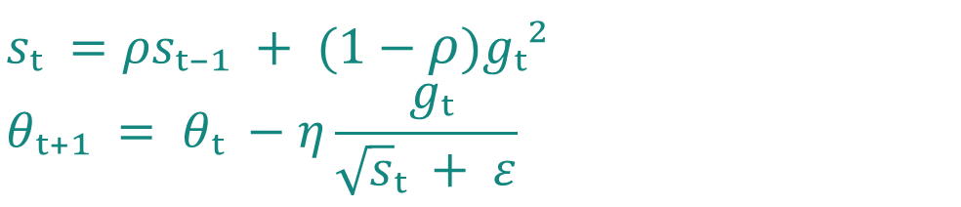
OPTIMIZERS
RMSProp keeps recent gradient history
But AdaGrad's accumulator only grows
The effective learning rate eventually shrinks to near zero and the model stops learning.
RMSProp replaces this with an exponentially decaying average
$$sₜ =ρsₜ₋₁ + (1−ρ)gₜ²$$
$$θₜ₊₁ = θₜ −η\frac{ gₜ}{\sqrt{s}ₜ + ε}$$
An exponential moving average emphasizes recent gradient magnitudes.
𝑠ₜ: weighted average of recent squared gradients
18 / 29

Slide 19
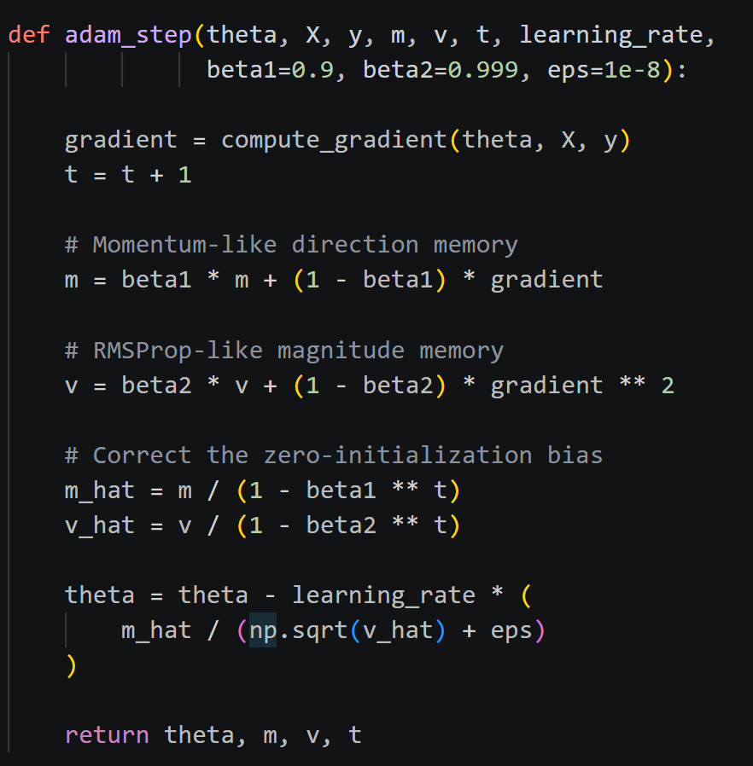
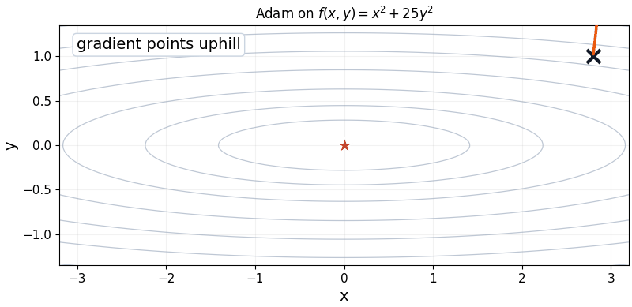
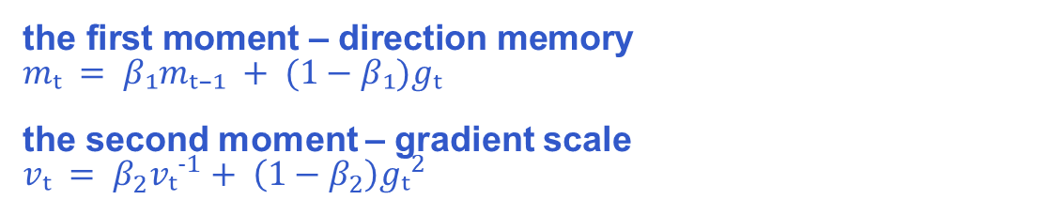
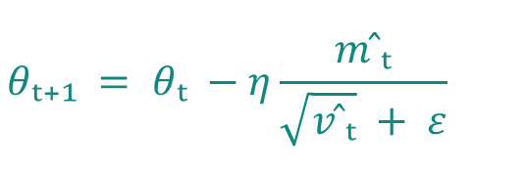
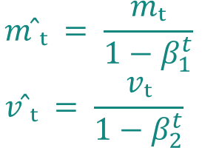
OPTIMIZERS
Adam combines memory with scale
$$\text{the} \text{first} \text{moment} \text{– }\text{direction} \text{memory}$$
$mₜ = β₁mₜ₋₁ + (1−β₁)gₜ$
the second moment – gradient scale
$vₜ = β_{2}vₜ^{-1}+ \left(1−β_{2}\right)gₜ^{2}$
$$m ̂ₜ = \frac{mₜ}{1−β_{1}^{t}}$$
$$v ̂ₜ = \frac{vₜ}{1−β_{2}^{t}}$$
$$θₜ₊₁ = θₜ −η\frac{m ̂ₜ}{\sqrt{v ̂ₜ} + ε}$$
vₜ: second-moment estimate (not velocity); $m ̂ₜ$, 𝑣 ̂ₜ: bias-corrected direction memory, squared-gradient scale
19 / 29

Slide 20
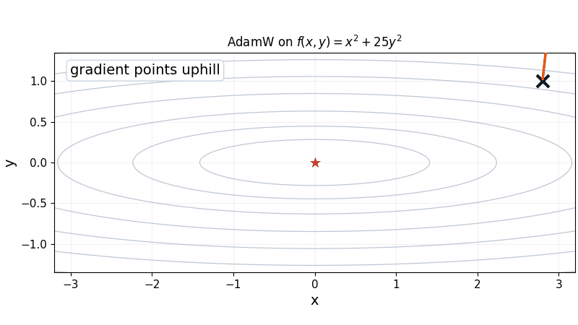
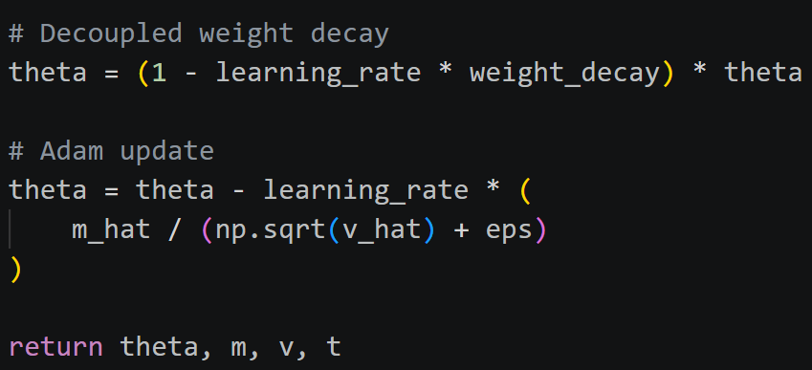
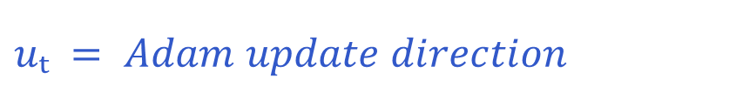
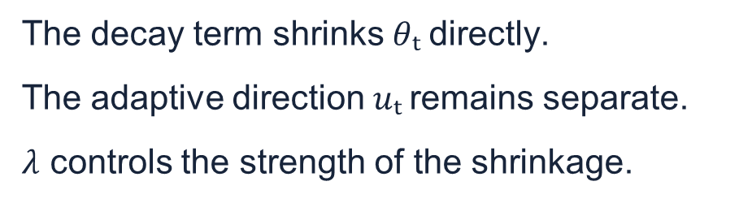

OPTIMIZERS
AdamW decouples weight decay
Adam + L2 regularization
regularization term gets mixed into the gradient and then also gets adaptively rescaled by Adam.
$$uₜ = Adam update direction$$
$$θₜ₊₁ = (1−ηλ)θₜ − ηuₜ$$
The decay term shrinks $θₜ$directly.
The adaptive direction $uₜ$remains separate.
$λ$ controls the strength of the shrinkage.
20 / 29

Slide 21
OPTIMIZERS
Optimizer choices change different parts of the loop
UPDATE RULE
SGD
Momentum
Nesterov
AdaGrad / RMSProp
Adam / AdamW
GRADIENT SOURCE
full batch
mini-batch
REGULARIZATION
weight decay
(dropout is model-side)
ALTERNATIVE METHODS
SAM · L-BFGS · Lion
These choices can be combined, but they answer different questions.
21 / 29

Slide 22
OPTIMIZERS
Compare mechanisms before comparing every optimizer
Same objective and starting point
Method-specific learning rates
Fixed step budget
Mechanism evidence, not a universal ranking
TEACHING SEQUENCE
Show one pair, pause, predict the next step, then reveal the trajectory.
22 / 29

Slide 23

APPLICATION
The same update loop appears in a NumPy CNN
Input → feature learning → classification
23 / 29

Slide 24
APPLICATION
Forward pass, loss, backpropagation, update
Backpropagation computes gradients. The optimizer transforms them into parameter updates.
24 / 29

Slide 25
APPLICATION
A fair comparison needs controlled conditions
Hold the architecture, data split, initialization, batch order, and step budget constant.
Use validation data during development and reserve the test set for final evaluation.
Compare multiple random seeds and report variability with the mean.
Report accuracy, loss, runtime, and the comparison conditions together.
INTERPRETATION
A faster path on one two-dimensional surface is evidence about a mechanism, not a universal performance claim.
25 / 29

Slide 26



APPLICATION
Softmax cross-entropy starts backpropagation
$p_{k}=$ $\frac{e^{z_{k}}}{\sum_{j}{e^{z_{j}}} }$
$$L = −\log{p_{y}}⁡$$
THE CONNECTION
The loss creates a gradient at the logits. Backpropagation carries it into the weights. The optimizer changes those weights.
$$\frac{∂L}{∂z_{k}} = p_{k} − 1\{k=y\}$$
$$\frac{∂L}{∂W} = \frac{∂L}{∂z}hᵀ$$
$$W ← W − η\frac{∂L}{∂W}$$
26 / 29

Slide 27
APPLICATION
Training is a cycle
FORWARD PASS
predictions
from θₜ
LOSS
measure
error
BACKPROPAGATION
compute
∇θL
repeat
UPDATED PARAMETERS
θₜ₊₁
OPTIMIZER
use η and
state
27 / 29

Slide 28

SUMMARY
TL;DR
The loss tells us how wrong the model currently is. Training tries to make that number smaller.
The gradient tells us which way increases the loss the fastest. So we move in the opposite direction.
The learning rate decides how big each step is. The shape of the loss surface determines whether those steps are smooth, zigzag, or diverge.
Different optimizers change how we use the gradient. Momentum remembers previous directions; adaptive methods change the step size for each parameter; Adam does both.
Backpropagation calculates the gradients. The optimizer uses those gradients to update the model's weights.
When comparing optimizers, keep everything else the same. Otherwise we can't tell whether the difference actually came from the optimizer.
CORE UPDATE
$$θₜ₊₁ = θₜ − η∇f(θₜ)$$
28 / 29

Slide 29
SUMMARY
References
Primary methods
Kingma and Ba, “Adam: A Method for Stochastic Optimization” — arXiv:1412.6980
Duchi et al., “Adaptive Subgradient Methods for Online Learning and Stochastic Optimization” — JMLR 2011
Tieleman and Hinton, “RMSProp” — lecture notes, 2012
Loshchilov and Hutter, “Decoupled Weight Decay Regularization” — arXiv:1711.05101
Chen et al., “Symbolic Discovery of Optimization Algorithms” — arXiv:2302.06675
Source code
Visualizations: https://github.com/1zuki/gradient-descent/
Numpy CNN: https://github.com/1zuki/numpy-cnn/
Additional sources
Foret et al., “Sharpness-Aware Minimization” — arXiv:2010.01412
PyTorch optimizer documentation — docs.pytorch.org/docs/stable/optim.html
MNIST archive — storage.googleapis.com/tensorflow/tf-keras-datasets/mnist.npz
29 / 29

