Slide 1

UIT CS115 / MATHEMATICS FOR COMPUTER SCIENCE
Gradient Descent
and Optimizer Variants
A math-first seminar about local information, curvature, and parameter updates
Open the web companion
1zuki.github.io/gradient-descent/
θₜ₊₁ = θₜ − η ∇f(θₜ)
120-minute seminar • main deck
01
Notes:
Opening: Today we are not trying to memorize ten optimizer names. We are trying to understand one idea: if a function tells us which direction goes uphill fastest, can we use that information to go downhill?
Source: PROJECT_PLAN.md, sections 1 and 6.

Slide 2
OPENING
The central question
Given a function, a starting point, and only local information, how can we move toward a lower value reliably?
THE TEACHING STORY
Begin where the whole landscape is visible. Then transfer the same ideas to a neural network with many parameters.
Opening
02
Notes:
Use this slide to establish the problem before introducing vocabulary.
Source: PROJECT_PLAN.md, sections 1 and 6.

Slide 3
OPENING
Why optimization matters
A model turns parameters into a loss value.
KEY DISTINCTION
parameters θ → model → loss f(θ)
Backpropagation computes gradients. The optimizer decides how to use them.
The loss tells us how well the current parameters fit the objective.
The gradient gives local direction information.
The optimizer decides how to turn that information into an update.
Opening
03
Notes:
Frame training as a repeated parameter-search problem.
Do not imply that the loss surface is literally only two-dimensional; the 2D view is a teaching projection.
Source: PROJECT_PLAN.md, sections 1 and 7.

Slide 4
GRADIENT FOUNDATIONS
The derivative as local change
f(x) = x² f′(x) = 2x
BRIDGE TO TWO DIMENSIONS
In several variables, local change needs one partial derivative per coordinate.
At x = 3, the derivative is positive: increasing x locally increases f.
At x = −3, the derivative is negative: increasing x locally decreases f.
Gradient foundations
04
Notes:
Activate prior calculus knowledge with f(x) = x².
Source: PROJECT_PLAN.md, section 7.1.

Slide 5
GRADIENT FOUNDATIONS
Partial derivatives assemble into a gradient
f(x, y) = x² + y²
The gradient is a vector in parameter space. It assigns a direction and magnitude to each point.
∂f/∂x = 2x
∂f/∂y = 2y
∇f(x, y) = (2x, 2y)
NOTATION MATTERS
A gradient is not another scalar derivative. It collects coordinate-wise local changes.
Gradient foundations
05
Notes:
Keep the distinction between a scalar derivative and a vector of partial derivatives explicit.
Source: PROJECT_PLAN.md, sections 7.2 and 11.

Slide 6
GRADIENT FOUNDATIONS
A hand calculation before the picture
Start at θ₀ = (1, 2)
∇f(1, 2) = (2, 4)
LOSS CHECK
f(1, 2) = 5
f(0.8, 1.6) = 3.2
The update moved downhill.
η = 0.1
θ₁ = (1, 2) − 0.1(2, 4) = (0.8, 1.6)
Gradient foundations
06
Notes:
Pause here and ask students to compute the update before revealing the answer.
Source: PROJECT_PLAN.md, section 7.2; docs/QUESTIONS_FOR_CLASS.md.

Slide 7
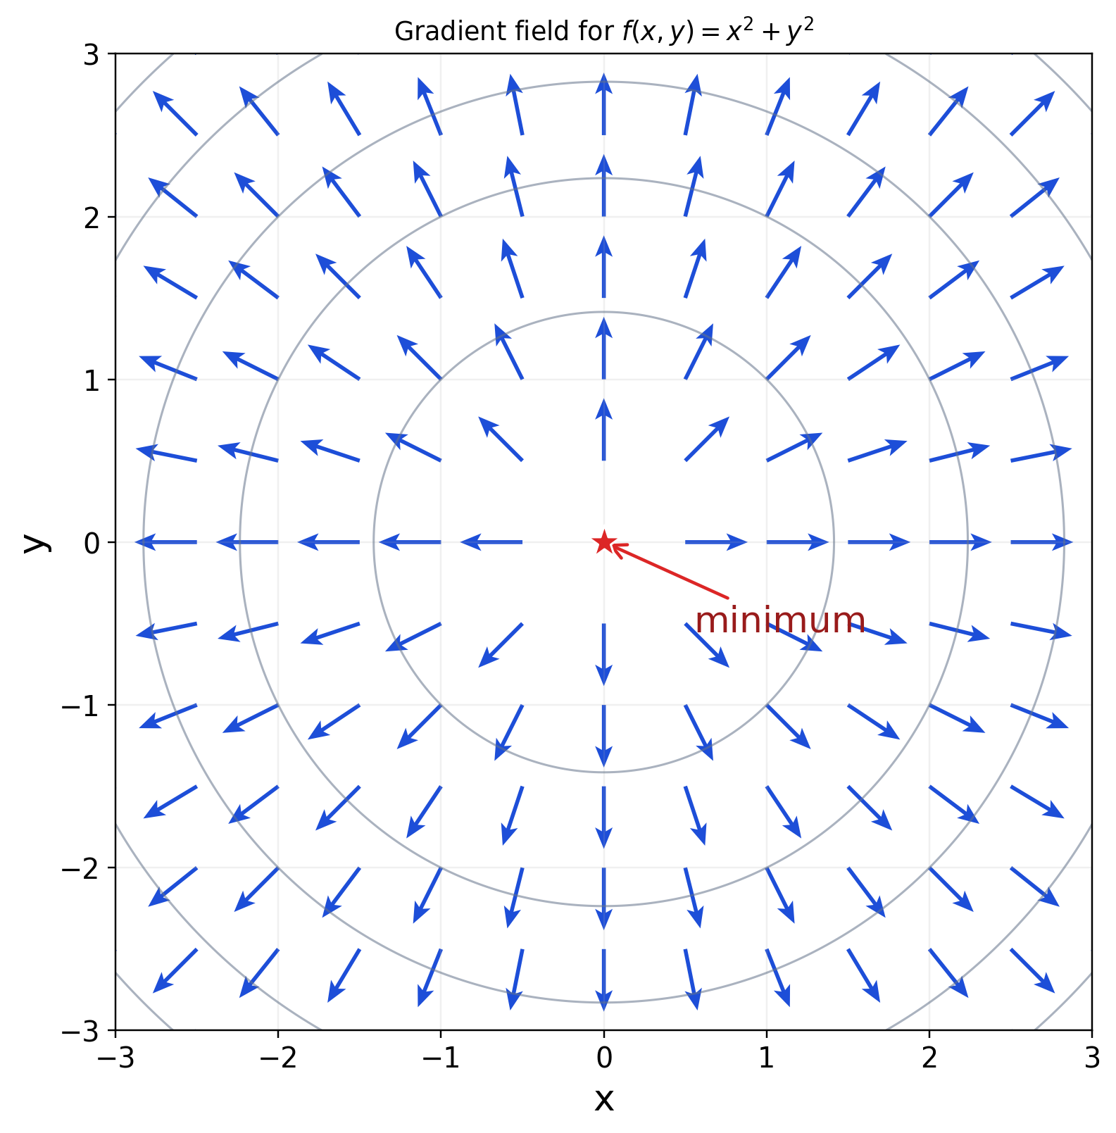
GRADIENT FOUNDATIONS
The gradient as a vector field
Every point has its own gradient vector.
Farther from the minimum, the vector is larger.
Gradient descent uses the opposite direction.
QUESTION FOR THE ROOM
Which direction would decrease the function fastest at the red point?
Gradient foundations
07
Notes:
The arrows show the gradient direction at many points. The gradient points toward increasing f.
Source figure: figures/png/01_gradient_field_sphere.png.

Slide 8
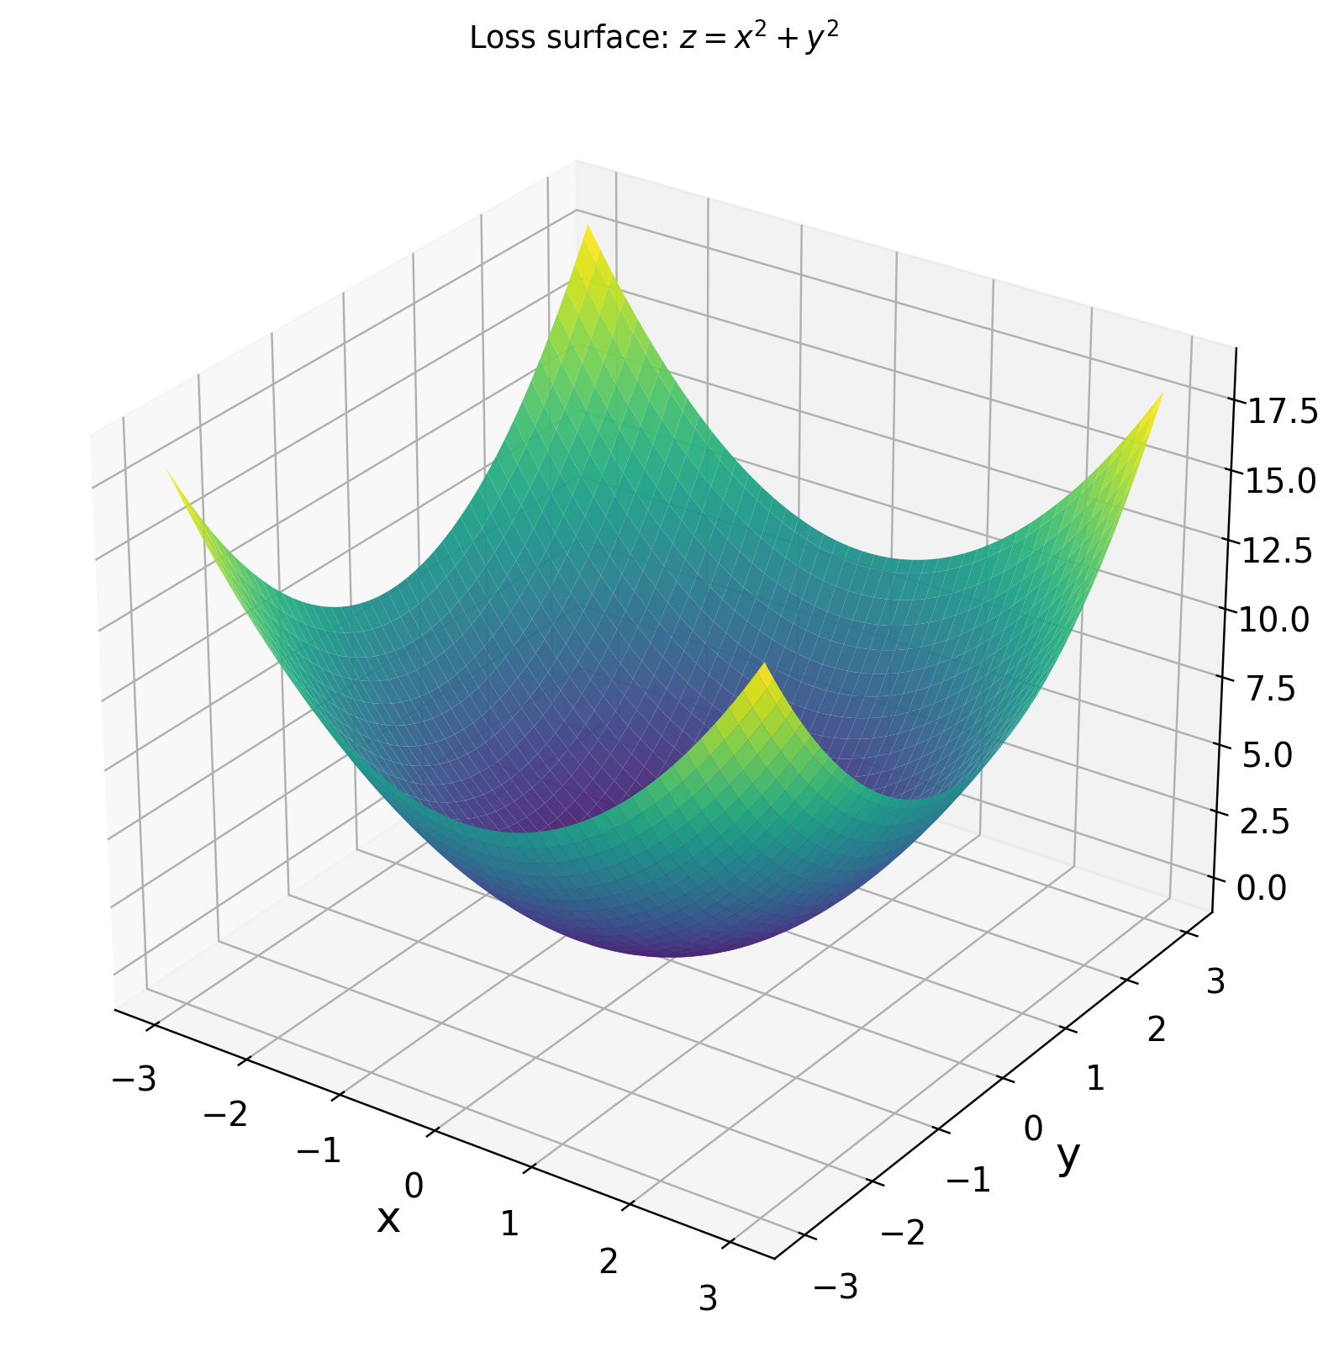
GRADIENT FOUNDATIONS
The same function as a surface
z = f(x, y) = x² + y²
The minimum is at (0, 0).
Contours are level sets: equal loss along each curve.
A trajectory moves through the parameter plane, not along the 3D surface itself.
Gradient foundations
08
Notes:
Use the surface to connect the equation and the geometry.
Source figure: figures/png/02_surface_sphere_3d.png.

Slide 9
GRADIENT FOUNDATIONS
Why the negative gradient is downhill
Dᵤ f = ∇f · u
|∇f · u| ≤ ||∇f|| ||u||
INTERPRETATION
The gradient points toward steepest local increase. Its negative points toward steepest local decrease.
most positive: u ∥ ∇f
most negative: u ∥ −∇f
Gradient foundations
09
Notes:
Derive the direction argument with the directional derivative and Cauchy–Schwarz.
Source: PROJECT_PLAN.md, section 7.3.

Slide 10
GRADIENT FOUNDATIONS
A local decrease from the Taylor approximation
f(θ + δ) ≈ f(θ) + ∇f(θ)ᵀδ
δ = −η∇f(θ)
CAVEAT
The approximation predicts local decrease for a sufficiently small positive η. An arbitrarily large step can overshoot.
f(θ − η∇f(θ)) ≈ f(θ) − η||∇f(θ)||²
Gradient foundations
10
Notes:
This slide gives the local mathematical justification, while keeping the caveat about step size.
Source: PROJECT_PLAN.md, section 7.3.

Slide 11
GRADIENT FOUNDATIONS
Gradient descent is a repeated update
θₜ₊₁ = θₜ − η ∇f(θₜ)
θₜ
η
∇f(θₜ)
current parameters
learning rate
local direction
Gradient foundations
11
Notes:
Make the baseline algorithm explicit before naming variants.
Source: PROJECT_PLAN.md, sections 1 and 7.3.

Slide 12
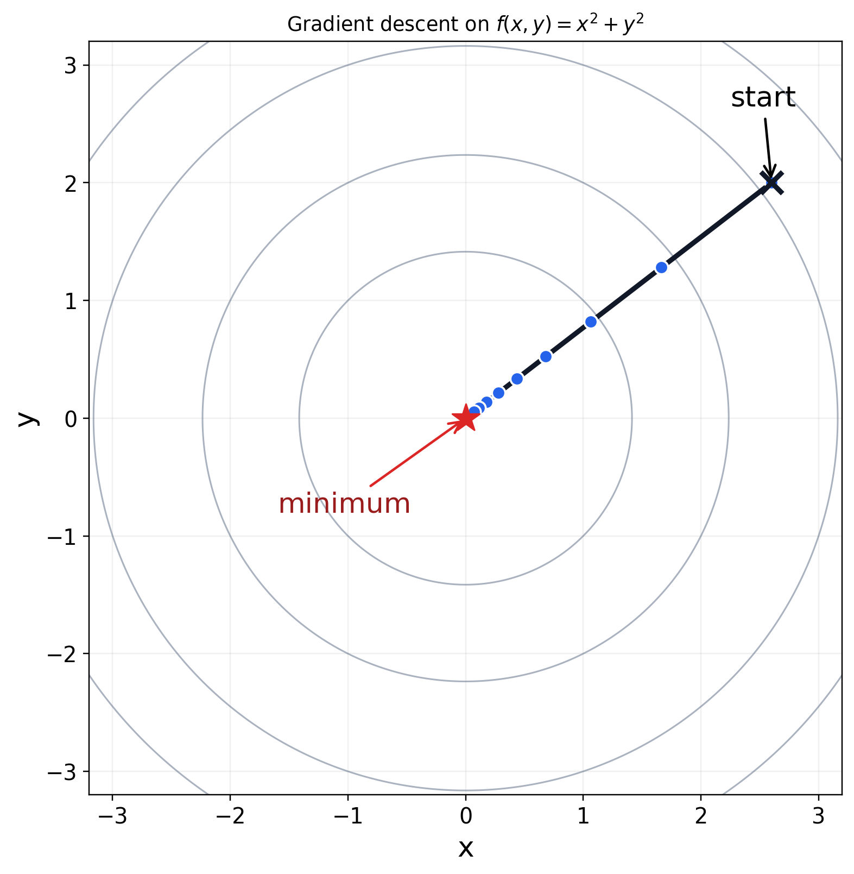
GRADIENT FOUNDATIONS
The first trajectory
One update becomes a path.
The path follows local gradient information.
The step length depends on η and the gradient magnitude.
The same logic scales to many parameters.
Gradient foundations
12
Notes:
The visual should confirm the hand calculation, not replace it.
Source figure: figures/png/03_gd_steps_sphere.png.

Slide 13
CURVATURE AND FAILURE MODES
The learning rate controls stability
η too small
η appropriate
η too large
QUESTION
Why can a larger learning rate make training worse even when the gradient is correct?
stable, but slow
steady progress
overshoot or diverge
many small steps
balanced updates
sign changes grow
Curvature and failure modes
13
Notes:
Use this as a prediction slide: ask what happens when η is too small, appropriate, or too large.
Source: PROJECT_PLAN.md, sections 7.4 and 11.

Slide 14
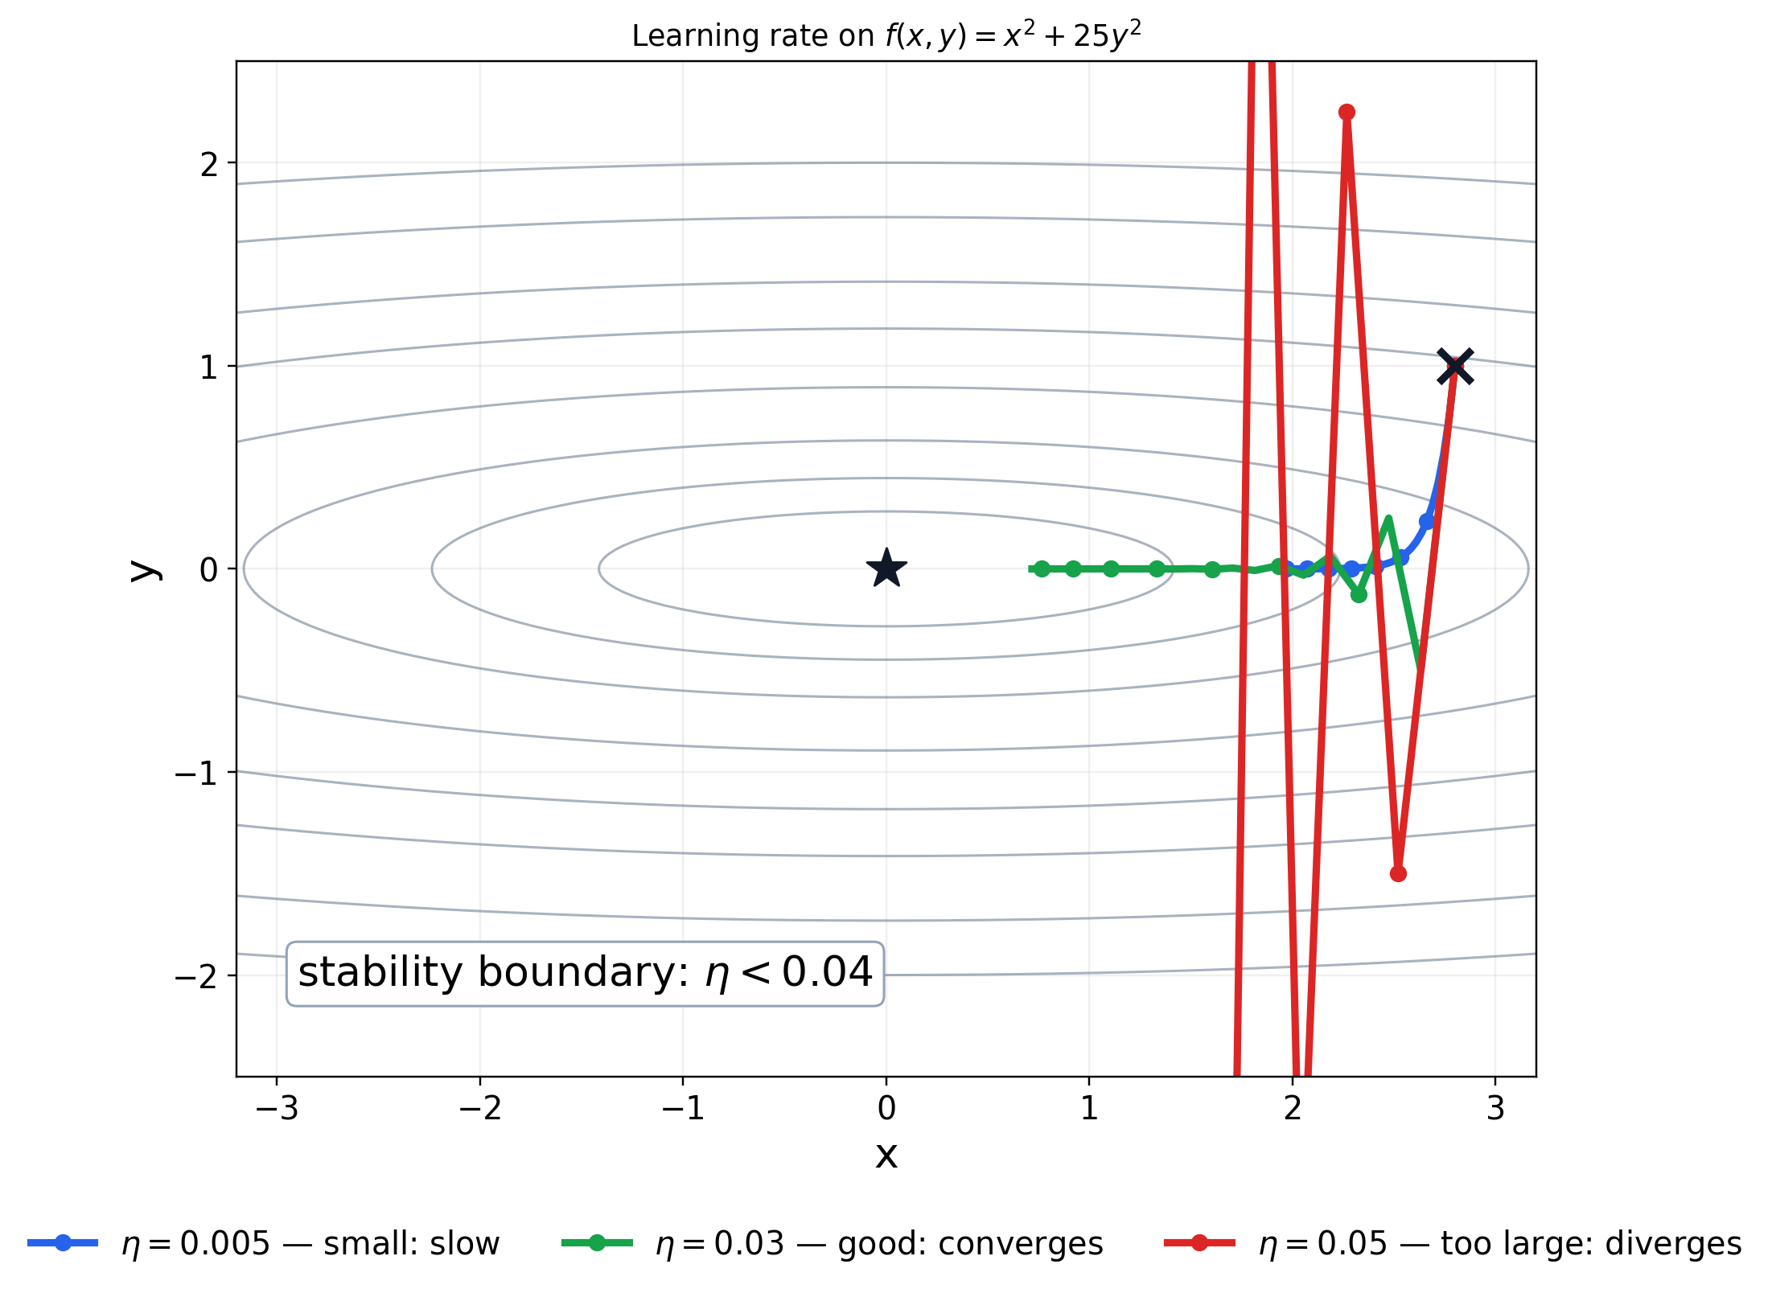
CURVATURE AND FAILURE MODES
Ill-conditioned curvature
f(x, y) = x² + 25y²
Curvature is much stronger in y than in x.
The contours are narrow ellipses.
The steep direction constrains the learning rate.
The shallow direction can still move slowly.
Curvature and failure modes
14
Notes:
State explicitly that x² + 25y² is convex and has one global minimum.
Source: PROJECT_PLAN.md, section 7.4; figure: figures/png/04_learning_rate_ill_conditioned.png.

Slide 15
CURVATURE AND FAILURE MODES
The condition number explains the constraint
∇f(x, y) = (2x, 50y)
xₜ₊₁ = (1 − 2η)xₜ
yₜ₊₁ = (1 − 50η)yₜ
H = [[2, 0], [0, 50]]
κ(H) = 50 / 2 = 25
STABILITY
Both coordinate multipliers must stay inside [−1, 1]. The stricter condition is 0 < η < 0.04.
Curvature and failure modes
15
Notes:
Use the diagonal Hessian to derive the coordinate multipliers.
Source: PROJECT_PLAN.md, section 7.4.

Slide 16
CURVATURE AND FAILURE MODES
Learning-rate behavior on one objective
One surface, four learning-rate regimes
Curvature and failure modes
16
Notes:
Compare regimes on identical axes. This is a mechanism demonstration, not a universal benchmark.
Source figure: figures/png/04_learning_rate_ill_conditioned.png.

Slide 17
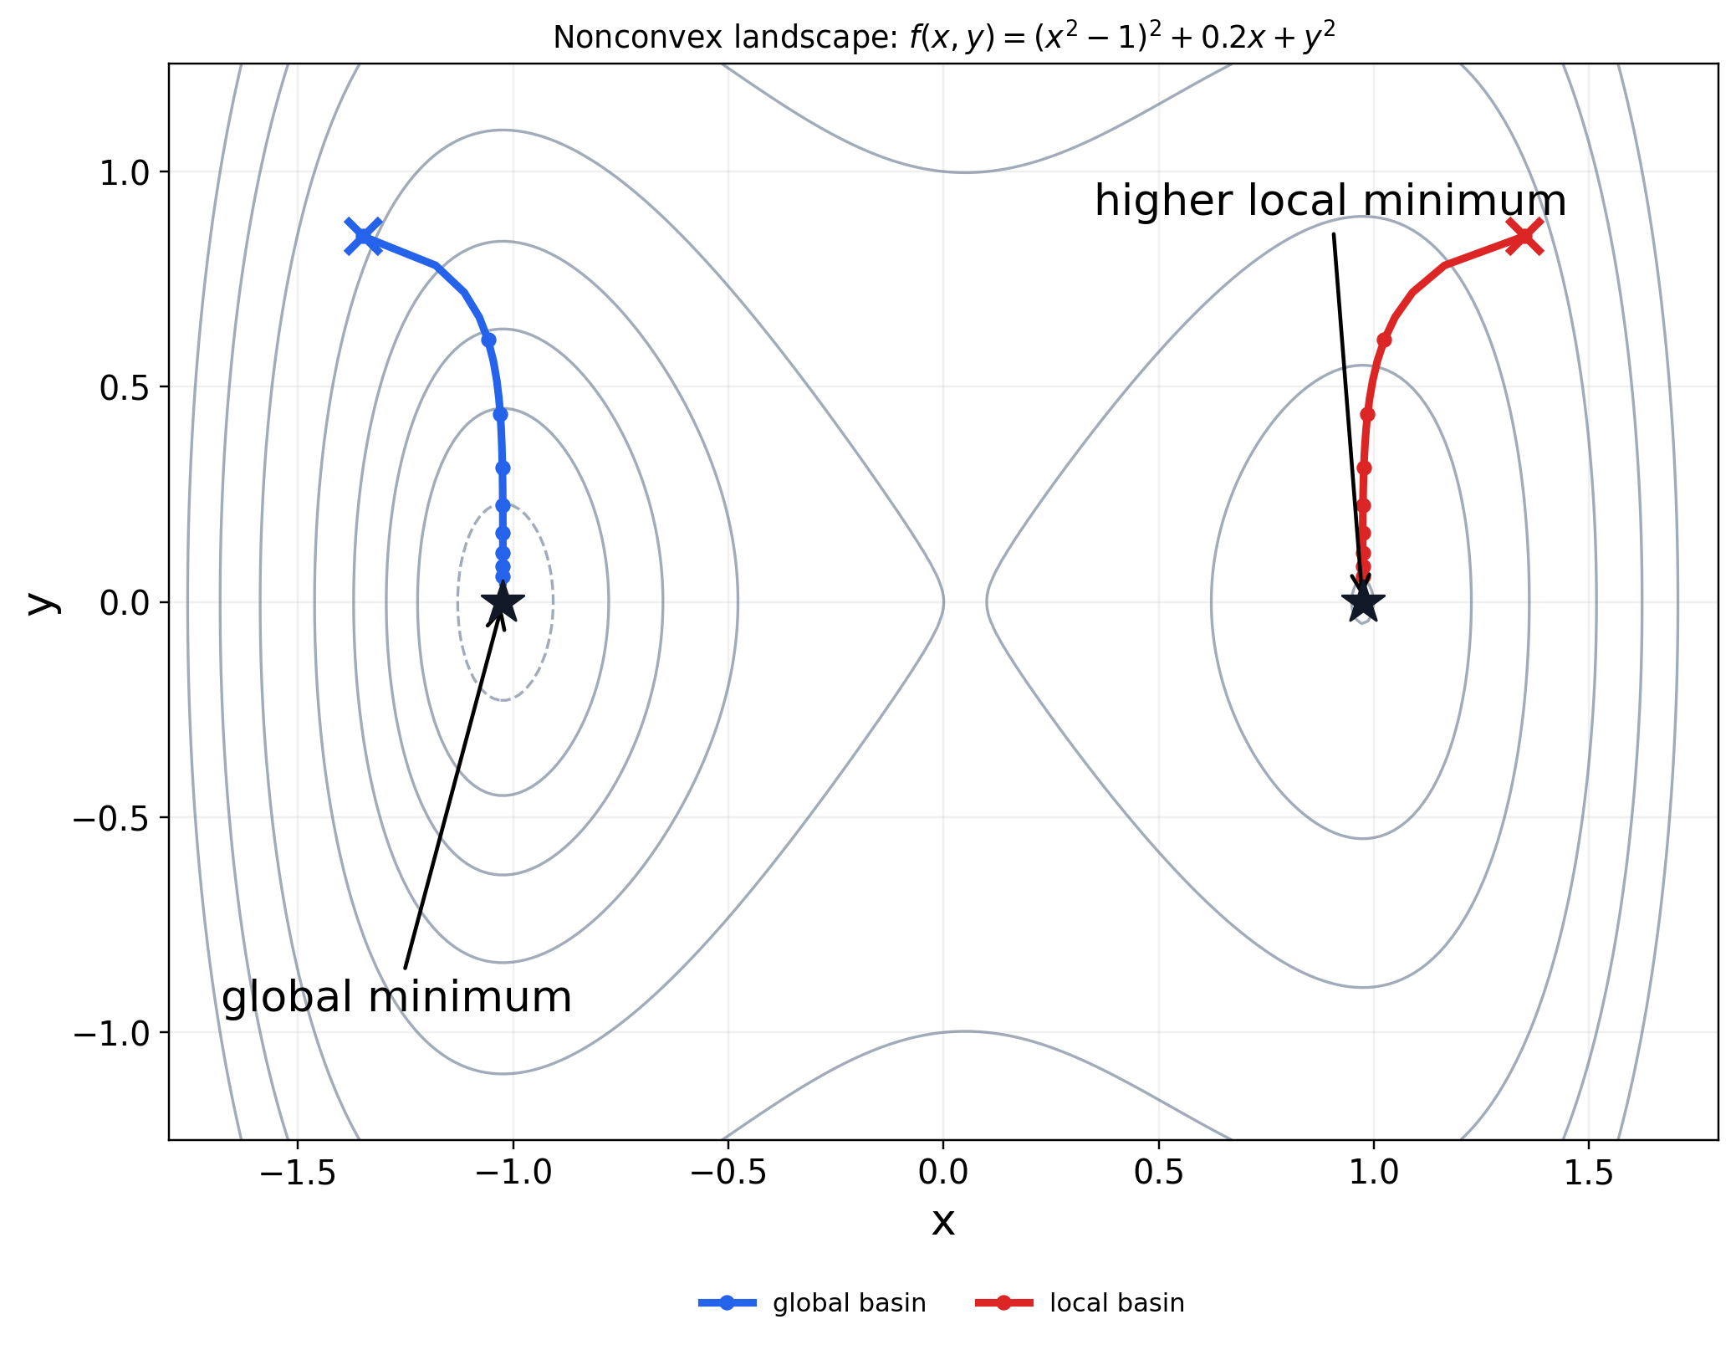
CURVATURE AND FAILURE MODES
Local minima and global minima are different
f(x, y) = (x² − 1)² + 0.2x + y²
Different starts can fall into different basins.
A local minimum can be higher than another minimum.
The gradient alone does not reveal the whole global landscape.
Curvature and failure modes
17
Notes:
Keep this example separate from the ill-conditioned quadratic.
Source: PROJECT_PLAN.md, section 7.5; figure: figures/png/06_nonconvex_local_minima.png.

Slide 18
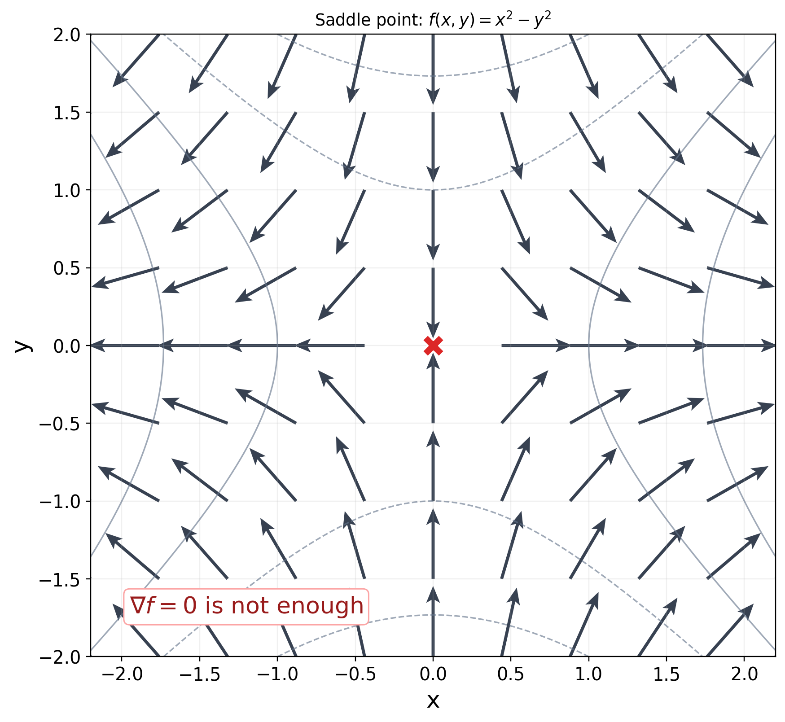
CURVATURE AND FAILURE MODES
A zero gradient does not guarantee a minimum
f(x, y) = x² − y²
∇f(x, y) = (2x, −2y)
AT (0, 0)
∇f = 0, but the point is neither a local minimum nor a local maximum.
Curvature and failure modes
18
Notes:
Use the saddle to break the shortcut: gradient equals zero means stationary, not necessarily minimum.
Source: PROJECT_PLAN.md, section 7.5; figure: figures/png/07_saddle_point.png.

Slide 19
CURVATURE AND FAILURE MODES
Prediction exercise
Compute the next point before the reveal
θ = (1, 2)
∇f = (2, 4)
η = 0.1
REVEAL
θ₁ = ?
θ₁ = (0.8, 1.6)
Curvature and failure modes
19
Notes:
Give students a minute to calculate before showing the answer.
Source: docs/QUESTIONS_FOR_CLASS.md.

Slide 20
OPTIMIZER FAMILY
Gradient estimation and parameter updates are separate
full batch: gₜ = ∇L(θₜ)
KEEP THE CONCEPTS DISTINCT
Batch size affects the estimate. Momentum, adaptive scaling, and weight decay affect the update.
mini-batch: ĝₜ ≈ ∇L(θₜ)
Both estimates feed an update rule.
Optimizer family
20
Notes:
Clarify that batch size describes how the gradient is estimated; optimizer state describes how the estimate is transformed.
Source: PROJECT_PLAN.md, section 8.

Slide 21
OPTIMIZER FAMILY
Momentum remembers a direction
vₜ = βvₜ₋₁ + gₜ
θₜ₊₁ = θₜ − ηvₜ
PROBLEM ADDRESSED
Vanilla gradient descent can oscillate across a narrow ravine while progressing slowly along it.
Accumulates a velocity-like state.
Smooths noisy updates.
Can move faster along consistent directions.
Optimizer family
21
Notes:
Introduce momentum as a response to zigzagging and persistent directions.
Source: PROJECT_PLAN.md, section 8; figure: figures/png/05_optimizer_trajectories_ill_conditioned.png.

Slide 22
OPTIMIZER FAMILY
Nesterov evaluates a look-ahead gradient
look ahead: θₜ − ηβvₜ₋₁
TEACHING POINT
gₜ = ∇f(θₜ − ηβvₜ₋₁)
Optimizer variants differ in what information they remember and where they evaluate the gradient.
The gradient is evaluated where momentum is about to take us.
Optimizer family
22
Notes:
Present Nesterov as a natural extension of momentum, without deriving every implementation variant.
Source: PROJECT_PLAN.md, section 8.

Slide 23
OPTIMIZER FAMILY
AdaGrad scales each coordinate by its history
Gₜ = Gₜ₋₁ + gₜ ⊙ gₜ
PROBLEM ADDRESSED
θₜ₊₁ = θₜ − η gₜ / (√Gₜ + ε)
Different coordinates can have very different gradient scales.
Coordinates with large historical gradients receive smaller effective steps.
The accumulator only grows, so steps can shrink indefinitely.
Optimizer family
23
Notes:
Introduce adaptive methods as a response to coordinate-wise scale differences.
Source: PROJECT_PLAN.md, section 8.

Slide 24
OPTIMIZER FAMILY
RMSProp replaces the infinite accumulator
sₜ = ρsₜ₋₁ + (1 − ρ)gₜ²
CONTRAST
AdaGrad keeps a cumulative sum. RMSProp keeps an exponentially weighted average.
θₜ₊₁ = θₜ − η gₜ / (√sₜ + ε)
Recent gradient magnitudes matter more than the entire history.
Optimizer family
24
Notes:
Explain the moving average as the key conceptual change from AdaGrad.
Source: PROJECT_PLAN.md, section 8.

Slide 25
OPTIMIZER FAMILY
Adam combines a direction estimate with scale
mₜ = β₁mₜ₋₁ + (1 − β₁)gₜ
vₜ = β₂vₜ₋₁ + (1 − β₂)gₜ²
INTUITION
First moment: smoothed direction. Second moment: smoothed scale.
m̂ₜ = mₜ/(1−β₁ᵗ), v̂ₜ = vₜ/(1−β₂ᵗ)
θₜ₊₁ = θₜ − η m̂ₜ/(√v̂ₜ + ε)
Optimizer family
25
Notes:
Give Adam the most detail because it combines the two main ideas in the family.
Source: PROJECT_PLAN.md, section 8.

Slide 26
OPTIMIZER FAMILY
AdamW separates weight decay from the adaptive step
adaptive update: θ ← θ − η · update(g, state)
TEACHING POINT
decay: θ ← (1 − ηλ)θ
The optimizer state and the regularization mechanism have different jobs.
Weight decay acts directly on the parameters instead of being folded into the gradient before adaptive scaling.
Optimizer family
26
Notes:
Explain why AdamW is a meaningful distinction rather than a cosmetic rename.
Source: PROJECT_PLAN.md, section 8.

Slide 27
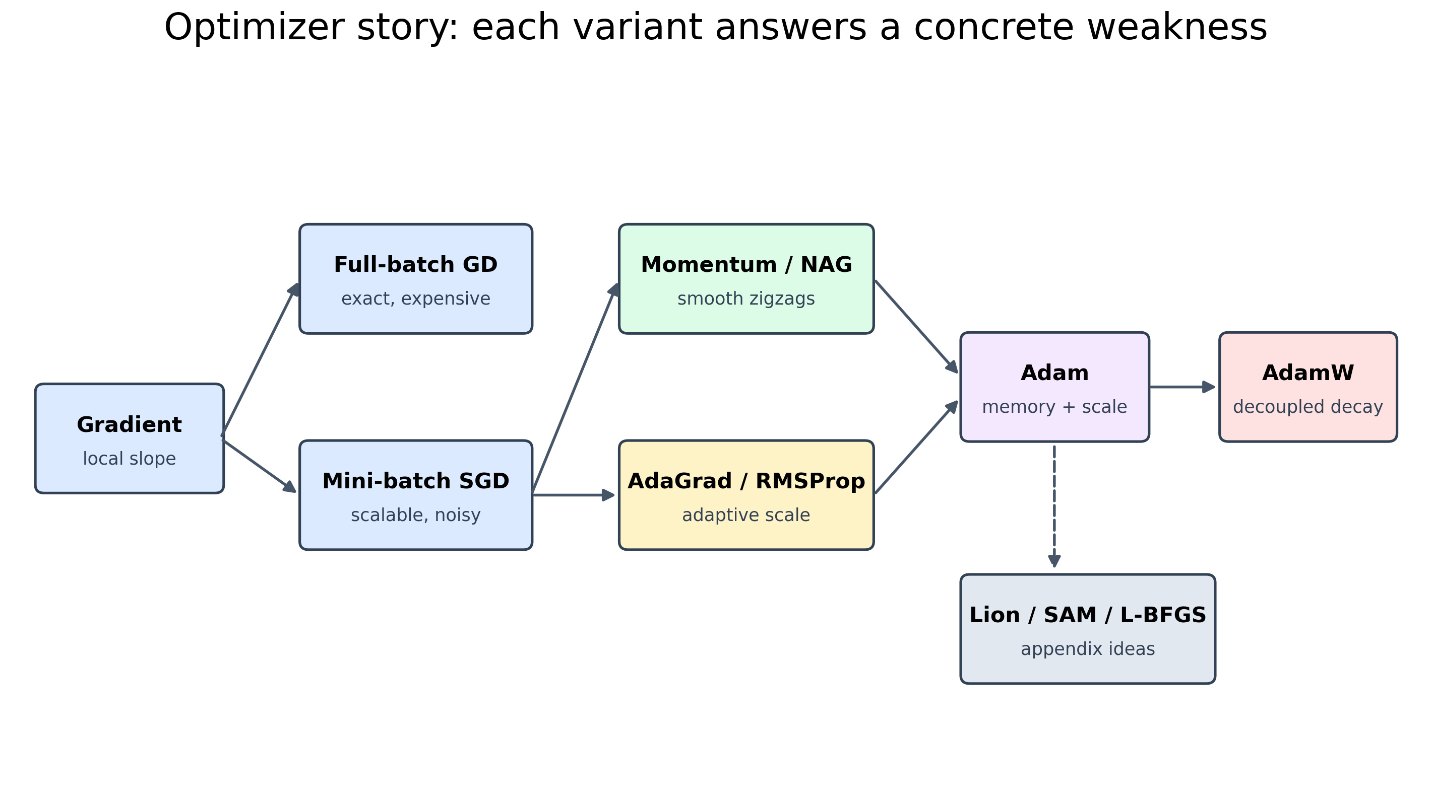
OPTIMIZER FAMILY
Optimizer variants answer different problems
Optimizer family
27
Notes:
Use the family map as the transition from formulas to comparison.
Source figure: figures/png/08_optimizer_family_map.png; scope: PROJECT_PLAN.md, section 8.

Slide 28
OPTIMIZER FAMILY
Advanced views belong in proportion
Lion
SAM
L-BFGS / Muon
sign-based momentum updates
optimizes a neighborhood around the point
appendix-level geometry
SCOPE DECISION
Main story: GD, mini-batch gradients, momentum, Nesterov, AdaGrad, RMSProp, Adam, and AdamW.
Optimizer family
28
Notes:
Keep advanced methods available without letting them displace the gradient-first story.
Source: PROJECT_PLAN.md, sections 2 and 8.

Slide 29
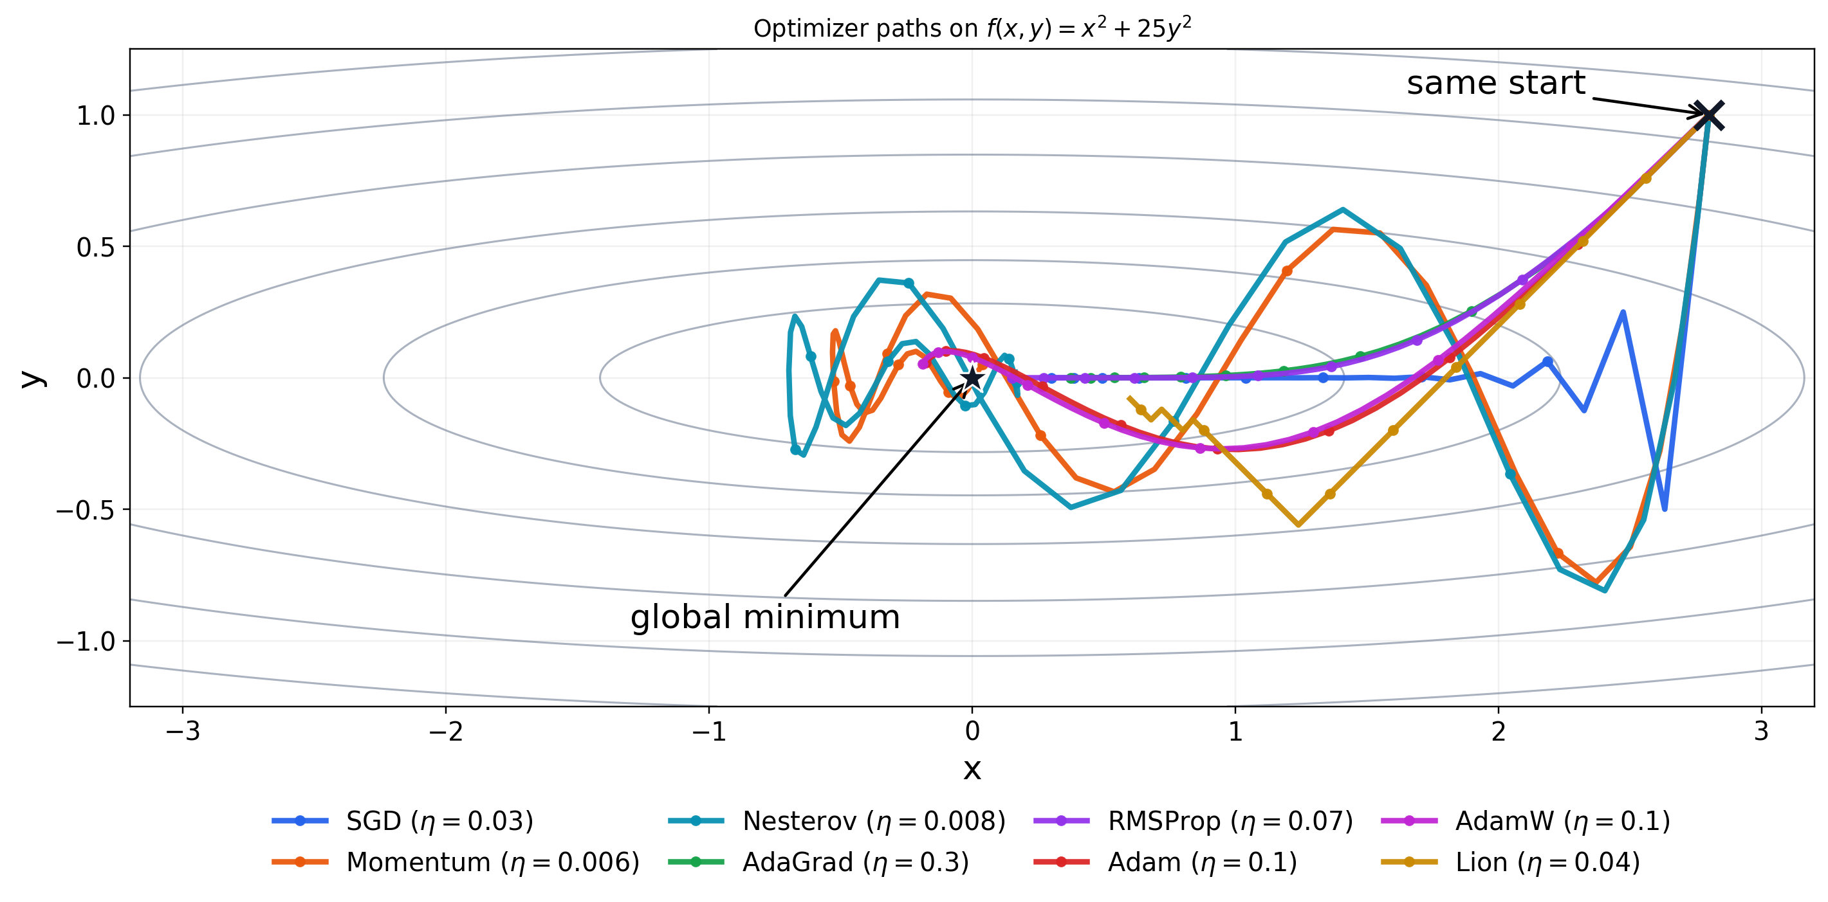
CONTROLLED COMPARISON
Compare trajectories under the same conditions
FAIR VISUAL COMPARISON
Same start point, objective, axes, parameter budget, and stopping rule.
Controlled comparison
29
Notes:
The 2D plots teach mechanisms. They do not prove universal optimizer superiority.
Source figure: figures/png/05_optimizer_trajectories_ill_conditioned.png; PROJECT_PLAN.md, sections 5 and 9.

Slide 30
CONTROLLED COMPARISON
What a defensible CNN comparison requires
Add a validation split before serious comparisons.
Save structured training and validation metrics.
Compare multiple random seeds.
Report accuracy, loss, runtime, and variability together.
Do not call one optimizer universally best.
CURRENT STATUS
The NumPy CNN and optimizer interface are implemented. The final comparison protocol still needs the validation and metrics work described in the plan.
Controlled comparison
30
Notes:
This slide preserves the project plan's uncertainty: the current loop is not yet final evidence.
Source: docs/EXPERIMENT_PLAN.md and PROJECT_PLAN.md, section 10.

Slide 31
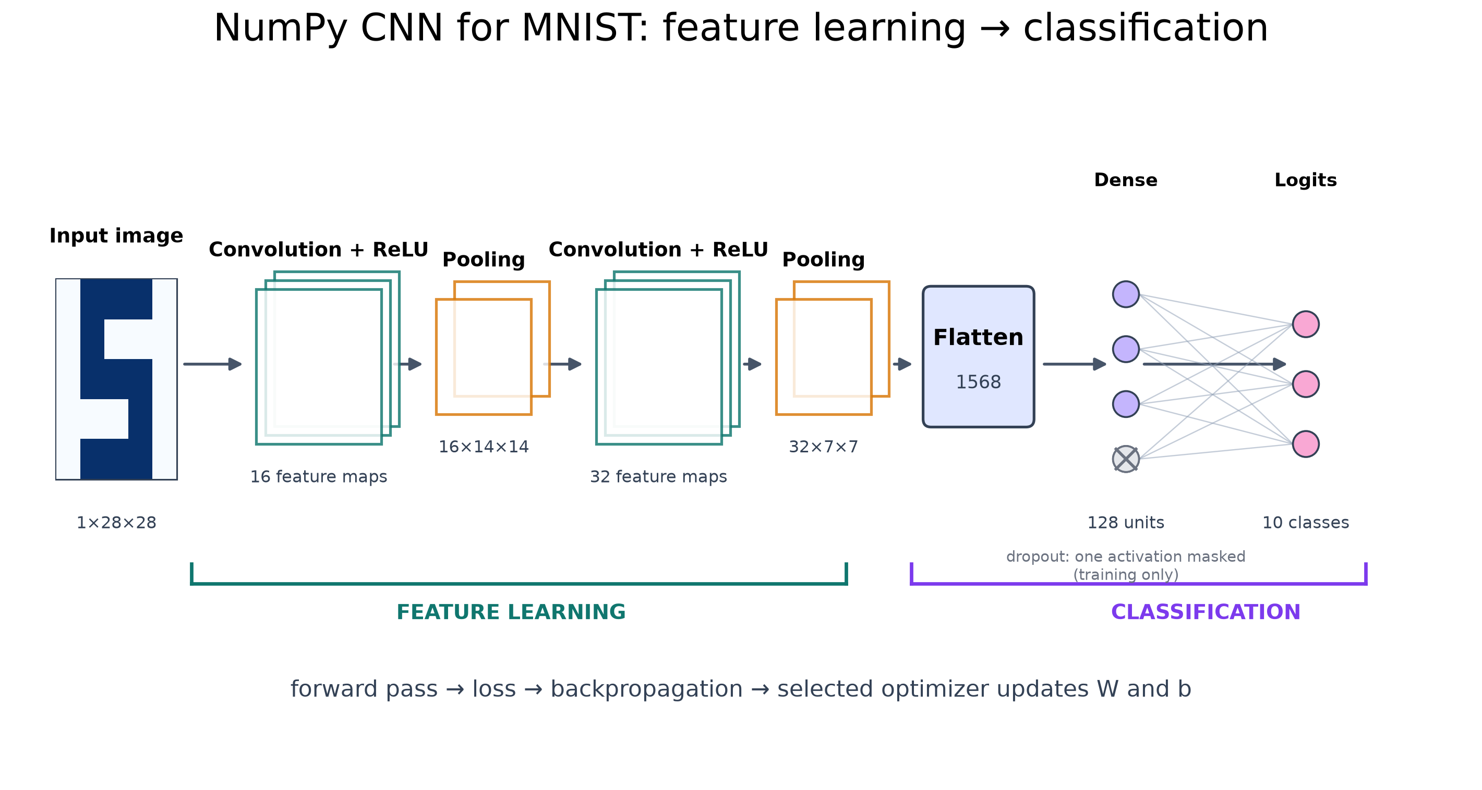
APPLICATION
The NumPy CNN makes the pieces visible
Input → convolution → pooling → dense layers → logits
Application
31
Notes:
This is deliberately a NumPy implementation so forward pass, gradients, and updates remain visible in code.
Source: PROJECT_PLAN.md, section 10; figure: figures/png/09_numpy_cnn_architecture.png.

Slide 32
APPLICATION
Backpropagation computes the gradient; the optimizer uses it
FORWARD + BACKWARD
Compute predictions, loss, and parameter gradients
OPTIMIZER UPDATE
Use gradients, state, learning rate, and regularization
∇θL → update θ
Application
32
Notes:
Do not drown the audience in convolution internals. Show the separation of responsibilities.
Source: docs/TALK_SCRIPT.md and PROJECT_PLAN.md, sections 2 and 10.

Slide 33
CONCLUSION
What every student should remember
The gradient points toward steepest local increase; gradient descent moves against it.
The learning rate controls how far each local decision moves.
Curvature explains slow progress, oscillation, and divergence.
Optimizer variants change how gradients are estimated, remembered, scaled, regularized, or evaluated.
A 2D mechanism demo is not a universal ranking. CNN claims need controlled experiments and multiple seeds.
ONE-SENTENCE THESIS
Gradient descent uses local steepest-ascent information to move downhill; optimizer variants change the update's memory, scale, geometry, or regularization.
Conclusion
33
Notes:
Use this slide to consolidate the story, not to introduce new material.
Source: PROJECT_PLAN.md, sections 1, 3, 8, and 10.

Slide 34
Q&A
Which part of the update rule still feels least intuitive?
Suggested discussion
Why can a larger learning rate make training worse?
What does momentum remember?
Why might a 2D result not transfer directly to a CNN?
34
Notes:
Close by returning to the central question and inviting students to name the role of the gradient, learning rate, and optimizer state.
Source: docs/QUESTIONS_FOR_CLASS.md.

