Slide 1

GRADIENT DESCENT
Gradient Descent
and optimizer variants
How local slope becomes a parameter update
WEB COMPANION
https://1zuki.github.io/gradient-descent/
θₜ₊₁ = θₜ − η ∇f(θₜ)
SOURCE CODE
github.com/1zuki/numpy-cnn
A visual lecture in local optimization
01 / 28
Notes:
Opening prompt: The deck follows one question: how does local slope become a parameter update?
Source: PROJECT_PLAN.md and docs/TALK_SCRIPT.md.

Slide 2
FOUNDATIONS
A model can be a line
ŷ = wx + b
WHY MINIMIZE?
Different values of w and b produce different predictions. The squared error gives us one number to make smaller.
L(w,b) = 1/n Σᵢ (wxᵢ + b − yᵢ)²
Three observations
(x, y) = (1, 2), (2, 3), (3, 5)
The loss turns “fit the data” into an optimization problem.
02 / 28
Notes:
Start with a familiar problem: fit a line to observations before introducing abstract parameters.
Ask: what can change in the line? The slope w and intercept b.
Source: PROJECT_PLAN.md, sections 1 and 7.

Slide 3
FOUNDATIONS
Two parameters make a two-dimensional search
θ = (w, b)
THE ABSTRACT PICTURE
Training searches through parameter space for a point with a lower loss.
f(θ) = L(w,b)
One point in parameter space is one candidate line.
Changing w tilts the line.
Changing b shifts the line vertically.
03 / 28
Notes:
Connect the line-fitting example to the notation used later.
Explain that θ is pronounced “theta” and stores all adjustable parameters.
Source: docs/MATH_NOTES.md and PROJECT_PLAN.md.

Slide 4
FOUNDATIONS
A partial derivative holds the other coordinate fixed
f(x,y) = x² + y²
hold y = 2: f(x,2) = x² + 4
∂f/∂x = 2x
MEANING
Each partial derivative asks how the loss changes when one parameter moves and the others stay fixed.
hold x = 1: f(1,y) = 1 + y²
∂f/∂y = 2y
04 / 28
Notes:
Work through the meaning of holding a coordinate fixed, rather than treating partial derivatives as a notation jump.
Ask students to differentiate x² + 4 with respect to x before revealing 2x.
Source: docs/MATH_NOTES.md.

Slide 5
GEOMETRY
The gradient lives in parameter space
at (1,2): ∇f = (2,4)
downhill: −∇f = (−2,−4)
The gradient points toward local increase.
The negative gradient points toward local decrease.
It is perpendicular to the contour through the current point.
05 / 28
Notes:
Pause at (1,2) and ask for the uphill and downhill directions before showing the values.
Clarify that the arrows are vectors in the x-y parameter plane. They are not physical objects sliding on the 3D surface.
For this quadratic only, the gradient magnitude grows with distance from the minimum.
Source figure: figures/svg/01_gradient_field_sphere.svg.

Slide 6
FOUNDATIONS
Why the negative gradient decreases the function
||u|| = 1
Dᵤf = ∇f · u = ||∇f|| cos φ
largest increase: φ = 0
largest decrease: φ = π
f(θ + δ) ≈ f(θ) + ∇f(θ)ᵀδ
δ = −η∇f(θ) ⇒ local decrease
06 / 28
Notes:
State the missing assumption explicitly: the direction vector has unit length.
Derive the extremum using the dot-product identity and Cauchy–Schwarz.
Qualify the Taylor statement: nonzero gradient, positive and sufficiently small η.
Source: docs/MATH_NOTES.md, directional derivative and Taylor sections.

Slide 7
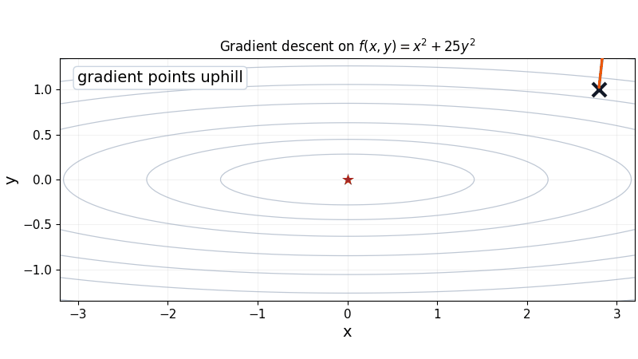
FOUNDATIONS
Gradient descent repeats one update
θₜ₊₁ = θₜ − η∇f(θₜ)
The gradient supplies a direction. The step length is η||∇f(θₜ)||.
ANIMATED TRAJECTORY
The orange arrow points uphill. The blue step follows its negative.
07 / 28
Notes:
Source: PROJECT_PLAN.md, sections 1 and 7.3; animated source: figures/gif/gradient_descent.gif.

Slide 8
FOUNDATIONS
One numerical step
Start at θ₀ = (1, 2)
∇f(1, 2) = (2, 4)
LOSS
f(1, 2) = 5
f(0.8, 1.6) = 3.2
η = 0.1
θ₁ = (1, 2) − 0.1(2, 4)
= (0.8, 1.6)
The update moved downhill.
08 / 28
Notes:
Pause: Before revealing the final line, compute the update from θ₀ = (1, 2), ∇f = (2, 4), and η = 0.1.
Source: docs/MATH_NOTES.md and docs/QUESTIONS_FOR_CLASS.md.

Slide 9
STABILITY
The learning rate controls stability
Same gradient information. Different step sizes.
Small η: stable but slow.
Moderate η: steady progress.
Large η: overshoot or divergence.
INTERPRETATION
A correct gradient can still produce a bad update when the step is too large.
09 / 28
Notes:
Prediction prompt: Which trajectory should be stable, and what changes when η becomes too large?
Source figure: figures/svg/04_learning_rate_ill_conditioned.svg.

Slide 10
STABILITY
Curvature predicts the next step
f(x, y) = x² + 25y²
STABILITY
start: (2,1)
∇f = (4,50), η = 0.03
|1 − 50η| < 1 ⇒ 0 < η < 0.04
The x-coordinate also imposes |1 − 2η| < 1. The intersection is controlled by the sharper curvature.
θ₁ = (2,1) − 0.03(4,50)
= (1.88, −0.5)
ONE MINIMUM
This surface is convex. Zigzags come from unequal curvature, not local-minimum traps.
10 / 28
Notes:
Prediction checkpoint: Ask students to choose the next point before revealing it.
Starting at (2,1) with η = 0.03, ∇f = (4,50), so θ₁ = (1.88,−0.5).
Then derive |1−50η| < 1 and intersect it with the x-coordinate condition.
Source: docs/MATH_NOTES.md, ill-conditioned quadratic section; exercise adapted from the seminar review.

Slide 11
STABILITY
Nonconvex landscapes have multiple basins
f(x, y) = (x² − 1)² + 0.2x + y²
Different starting points can enter different basins.
A local minimum can have a higher value than another minimum.
The gradient describes local change, not the full global landscape.
11 / 28
Notes:
Source figure: figures/svg/06_nonconvex_local_minima.svg; docs/MATH_NOTES.md.

Slide 12
STABILITY
A zero gradient does not guarantee a minimum
f(x, y) = x² − y²
f(x,0)=x² increases
f(0,y)=−y² decreases
AT (0, 0)
∇f = 0, but nearby points have both larger and smaller values. That is a saddle point.
12 / 28
Notes:
Demonstrate the two paths through the origin before naming the point a saddle.
Along y=0, f(x,0)=x² increases away from 0. Along x=0, f(0,y)=−y² decreases away from 0.
Source figure: figures/svg/07_saddle_point.svg; docs/MATH_NOTES.md.

Slide 13
OPTIMIZERS
The gradient can be estimated
gₜ = gradient estimate at step t
ĝₜ ≈ ∇L(θₜ) for a mini-batch
FULL BATCH VS MINI-BATCH
A full batch uses every example. A mini-batch uses an estimate that is cheaper and noisier.
vₜ = state / accumulated direction
β = memory coefficient, ε = small stabilizer
g², √v, and g/(√v+ε) operate coordinate by coordinate.
13 / 28
Notes:
Define every symbol before using it in a new update rule.
Explain that vector squaring and division are element-wise in these formulas.
Source: PROJECT_PLAN.md, section 8; docs/OPTIMIZER_CHEATSHEET.md.

Slide 14

OPTIMIZERS
Momentum accumulates consistent directions
vₜ = βvₜ₋₁ + gₜ
θₜ₊₁ = θₜ − ηvₜ
v₁ = (2,4)
θ₁ = θ₀ − 0.1(2,4)
v₂ = 0.5(2,4) + (2,−4)
= (3,−2)
14 / 28
Notes:
Work the two updates aloud before showing the animation.
Use β=0.5, η=0.1, v₀=(0,0), g₁=(2,4), and g₂=(2,−4). The x-component accumulates while the y-component cancels.
Source: docs/OPTIMIZER_CHEATSHEET.md; animated source: figures/gif/momentum.gif.

Slide 15

OPTIMIZERS
Nesterov evaluates a look-ahead gradient
look-ahead: θ̃ₜ = θₜ − ηβvₜ₋₁
gₜ = ∇f(θ̃ₜ)
vₜ = βvₜ₋₁ + gₜ
θₜ₊₁ = θₜ − ηvₜ
The gradient is evaluated near the position momentum is about to reach.
LOOK AHEAD
Preview first, measure the slope there, then update the actual parameters.
15 / 28
Notes:
Emphasize the state update before interpreting the look-ahead position.
Source: docs/OPTIMIZER_CHEATSHEET.md; animated source: figures/gif/nesterov.gif.

Slide 16

OPTIMIZERS
AdaGrad scales coordinates by their history
Gₜ = Gₜ₋₁ + gₜ²
θₜ₊₁ = θₜ − η gₜ/(√Gₜ + ε)
Coordinates with large accumulated gradients receive smaller effective steps.
TRADEOFF
The accumulator only grows, so the effective step can shrink indefinitely.
16 / 28
Notes:
Source: docs/OPTIMIZER_CHEATSHEET.md; animated source: figures/gif/adagrad.gif.

Slide 17
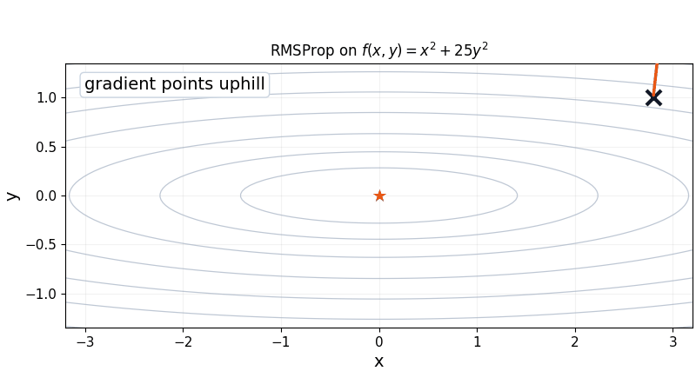
OPTIMIZERS
RMSProp keeps recent gradient history
sₜ = ρsₜ₋₁ + (1−ρ)gₜ²
θₜ₊₁ = θₜ − η gₜ/(√sₜ + ε)
An exponential moving average emphasizes recent gradient magnitudes.
CONTRAST
RMSProp replaces AdaGrad's cumulative sum with a moving average.
17 / 28
Notes:
Source: docs/OPTIMIZER_CHEATSHEET.md; animated source: figures/gif/rmsprop.gif.

Slide 18
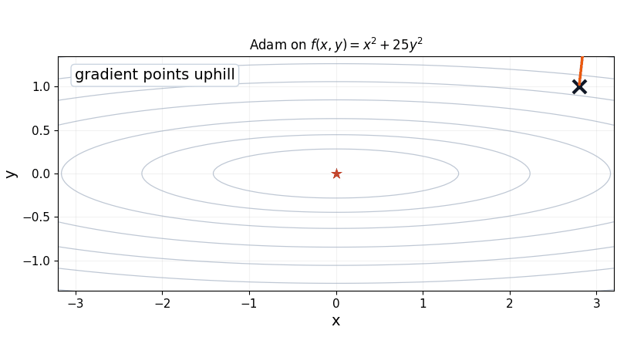
OPTIMIZERS
Adam combines memory with scale
mₜ = β₁mₜ₋₁ + (1−β₁)gₜ
vₜ = β₂vₜ₋₁ + (1−β₂)gₜ²
m̂ₜ = mₜ/(1−β₁ᵗ)
v̂ₜ = vₜ/(1−β₂ᵗ)
at t=1: m₁=(1−β₁)g₁
m̂₁=g₁
18 / 28
Notes:
Connect Adam to the previous slides: m remembers direction, v remembers squared magnitude.
Derive the first-step bias correction: m₁=(1−β₁)g₁, so m̂₁=m₁/(1−β₁)=g₁.
Source: docs/OPTIMIZER_CHEATSHEET.md; Kingma and Ba, arXiv:1412.6980; animated source: figures/gif/adam.gif.

Slide 19
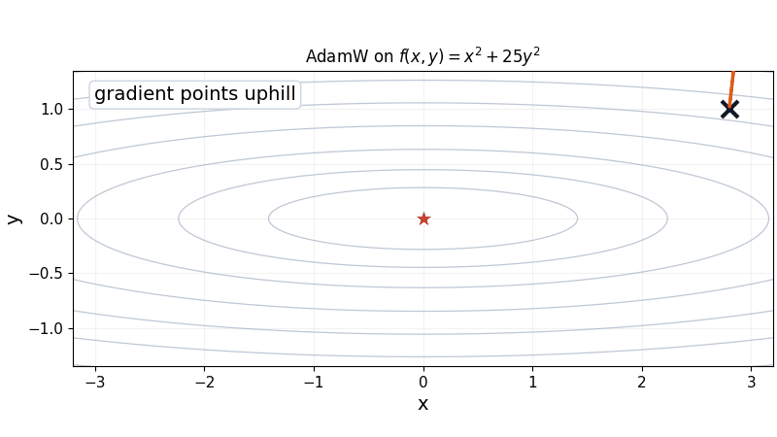
OPTIMIZERS
AdamW decouples weight decay
uₜ = Adam update direction
θₜ₊₁ = (1−ηλ)θₜ − ηuₜ
The decay term shrinks θₜ directly.
The adaptive direction uₜ remains separate.
λ controls the strength of the shrinkage.
19 / 28
Notes:
Emphasize that the decay term acts on the original parameters, not on the already-updated parameters.
Use the combined rule shown on the slide. This is the conventional decoupled form.
Source: docs/OPTIMIZER_CHEATSHEET.md; Loshchilov and Hutter, arXiv:1711.05101; animated source: figures/gif/adamw.gif.

Slide 20
OPTIMIZERS
Optimizer choices change different parts of the loop
STATEFUL UPDATE
SGD
Momentum
Nesterov
AdaGrad / RMSProp
Adam / AdamW
GRADIENT SOURCE
full batch
mini-batch
REGULARIZATION
weight decay
(dropout is model-side)
ALTERNATIVE METHODS
SAM · L-BFGS · Lion
These choices can be combined, but they answer different questions.
20 / 28
Notes:
Do not present this as a single family tree. Separate sampling, stateful update rules, regularization, and alternative methods.
SAM wraps an update with a sharpness-aware perturbation. L-BFGS uses curvature approximations. Lion uses sign-based momentum.
Source: docs/OPTIMIZER_CHEATSHEET.md and docs/SOURCES.md.

Slide 21
OPTIMIZERS
Compare mechanisms before comparing every optimizer
Same objective and starting point
Method-specific learning rates
Fixed step budget
Mechanism evidence, not a universal ranking
TEACHING SEQUENCE
Show one pair, pause, predict the next step, then reveal the trajectory.
21 / 28
Notes:
Use animations in pairs: gradient descent vs momentum, AdaGrad vs RMSProp, then Adam vs AdamW.
Treat the combined plot as a summary, not a ranking. State objective, starting point, steps, learning rates, and decay coefficient.
The deterministic curves are gradient descent unless stochastic gradient noise is explicitly introduced.
Source figure: figures/svg/05_optimizer_trajectories_ill_conditioned.svg; PROJECT_PLAN.md, sections 5 and 9.

Slide 22
APPLICATION
The same update loop appears in a NumPy CNN
Input → feature learning → classification
22 / 28
Notes:
Connect the architecture diagram to the loop: forward pass, loss, backpropagation, and optimizer update.
Source figure: figures/svg/09_numpy_cnn_architecture.svg; docs/CNN_NOTES_FROM_UPLOADED_CODE.md.

Slide 23
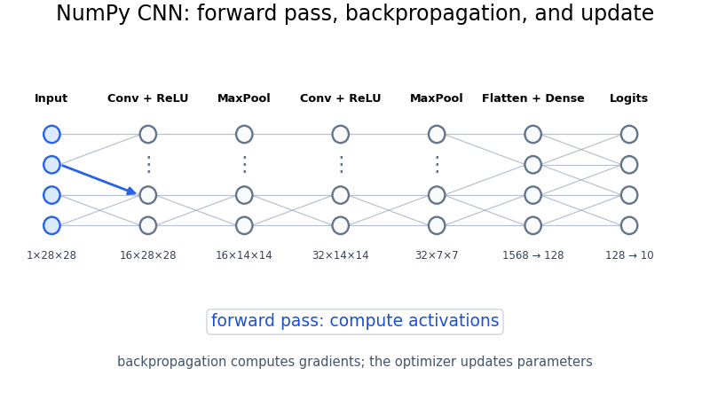
APPLICATION
Forward pass, loss, backpropagation, update
Backpropagation computes gradients. The optimizer transforms them into parameter updates.
23 / 28
Notes:
Point out the boundary between gradient computation and parameter update.
Source: docs/TALK_SCRIPT.md and animated source: figures/gif/cnn_forward_backward.gif.

Slide 24
APPLICATION
A fair comparison needs controlled conditions
Hold the architecture, data split, initialization, batch order, and step budget constant.
Use validation data during development and reserve the test set for final evaluation.
Compare multiple random seeds and report variability with the mean.
Report accuracy, loss, runtime, and the comparison conditions together.
INTERPRETATION
A faster path on one two-dimensional surface is evidence about a mechanism, not a universal performance claim.
24 / 28
Notes:
Comparison prompt: If an optimizer wins on one seed or one learning rate, what evidence is still missing?
Source: docs/EXPERIMENT_PLAN.md and PROJECT_PLAN.md, sections 9 and 10.

Slide 25
APPLICATION
Softmax cross-entropy starts backpropagation
p_k = e^{z_k}/Σⱼe^{zⱼ}
L = −log p_y
THE CONNECTION
The loss creates a gradient at the logits. Backpropagation carries it into the weights. The optimizer changes those weights.
∂L/∂z_k = p_k − 1{k=y}
∂L/∂W = (∂L/∂z)hᵀ
W ← W − η ∂L/∂W
25 / 28
Notes:
Show one concrete derivative connecting the CNN's output to its parameter gradients.
For the true class y, the logit derivative is p_k − 1{k=y}. The final dense layer receives this vector through the chain rule.
This slide explains the mechanism. It does not claim validated MNIST benchmark results.
Source: docs/CNN_NOTES_FROM_UPLOADED_CODE.md and standard softmax cross-entropy derivative.

Slide 26
APPLICATION
Training is a cycle
FORWARD PASS
predictions
from θₜ
LOSS
measure
error
BACKPROPAGATION
compute
∇θL
repeat
UPDATED PARAMETERS
θₜ₊₁
OPTIMIZER
use η and
state
26 / 28
Notes:
Trace the arrows in order and emphasize the return to updated parameters.
The cycle is the central mechanism: compute a loss, differentiate it, update parameters, and repeat.
Source: PROJECT_PLAN.md, sections 2 and 10.

Slide 27
SUMMARY
TL;DR
A loss turns model behavior into a number we can minimize.
The gradient combines coordinate-wise slopes and points toward local increase.
The learning rate and curvature determine whether steps converge, oscillate, or diverge.
Momentum remembers direction. Adaptive methods rescale coordinates. Adam combines both ideas.
Backpropagation computes gradients. The optimizer updates parameters.
A fair CNN comparison needs controlled conditions and validated measurements.
CORE UPDATE
θₜ₊₁ = θₜ − η∇f(θₜ)
27 / 28
Notes:
Closing checkpoint: ask students to explain where the gradient comes from and what the optimizer changes.
Source: PROJECT_PLAN.md, sections 1, 3, 8, and 10; discussion prompts: docs/QUESTIONS_FOR_CLASS.md.

Slide 28
SUMMARY
References
Primary methods
Kingma and Ba, “Adam: A Method for Stochastic Optimization” — arXiv:1412.6980
Duchi et al., “Adaptive Subgradient Methods for Online Learning and Stochastic Optimization” — JMLR 2011
Tieleman and Hinton, “RMSProp” — lecture notes, 2012
Loshchilov and Hutter, “Decoupled Weight Decay Regularization” — arXiv:1711.05101
Chen et al., “Symbolic Discovery of Optimization Algorithms” — arXiv:2302.06675
Additional sources
Foret et al., “Sharpness-Aware Minimization” — arXiv:2010.01412
PyTorch optimizer documentation — docs.pytorch.org/docs/stable/optim.html
MNIST archive — storage.googleapis.com/tensorflow/tf-keras-datasets/mnist.npz
Source code — github.com/1zuki/numpy-cnn
28 / 28
Notes:
These sources support the optimizer terminology, primary methods, and MNIST dataset reference.
Source: docs/SOURCES.md.

