Slide 1
Introduction to NLP with Sentiment Analysis
Isuru Alagiyawanna
Big Data Engineer

Slide 2
Agenda
Introduction to NLP
Classical Machine Learning vs Deep Learning
How do we preprocess & Extract Text Features?
Recurrent Neural Networks & It’s use cases
Sentiment Analysis as an Application
Sentiment Analysis Demo

Slide 3
1. Introduction to NLP
Natural Language Processing (NLP) is a Domain of artificial intelligence that deals with analyzing, understanding and generating the languages that humans use naturally in order to interface with computers in both written and spoken contexts using human languages instead of computer languages

Slide 4
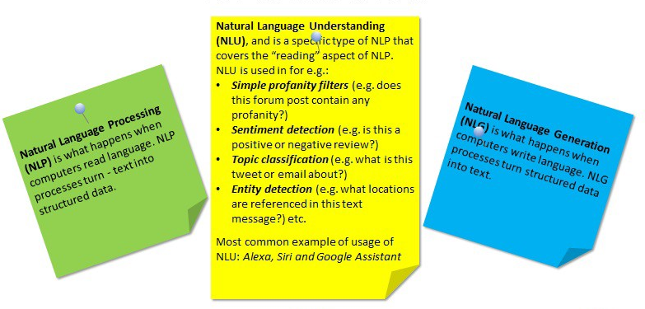
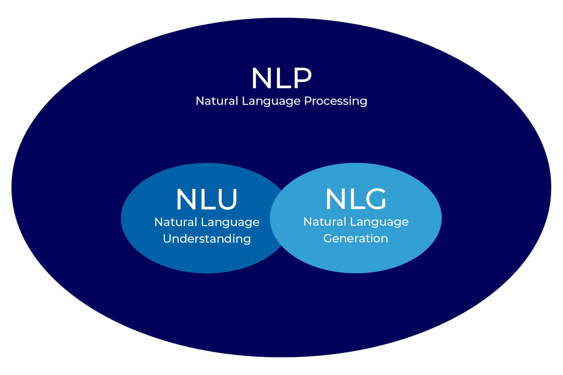
1.1 NLP vs NLU vs NLG
NLP > NLU , NLG

Slide 5
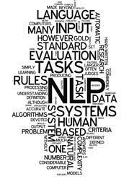
1.2 Applications of NLP
Sentiment Analysis
Neural Machine Translation
POS Tagging / NER
Image Captioning
Web Search Engines
Chatbots / Voice Assistants
Recommendation Systems
Text Summarization
Spam Filters (Ex : Email)

Slide 6
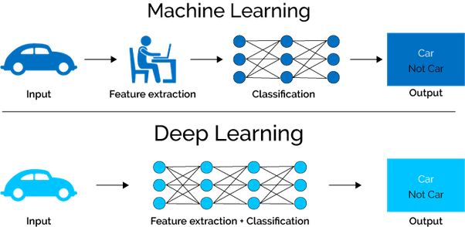
2. Classical Machine Learning vs Deep Learning
Deep Learning | Classical Machine Learning
Superior performance in Complex Tasks | Inability to handle complex tasks
Performance Scales effectively with data | Less Effective / Infeasible for Big data
End-to-End Processing Capabilities (Specially for Unstructured data) | Need Separate Models for Feature Extraction & Classification
Transferable Modeling | Training should be done from the scratch
Need Bigger Dataset | Works better on small data
Computationally Expensive | computationally cheap

Slide 7
3. How do we Preprocess & Extract Text Features?
Text Preprocessing Steps
Feature Extraction Techniques
Tokenization
Lower Casing
Removing Stop Words
Removing Numbers (optional)
Lemmatization
Padding
Bag-of-Words (BoW)
TF-IDF Vectorizer
Word Embedding
- Embedding Layer
- Word2Vec
- GloVe Embedding

Slide 8
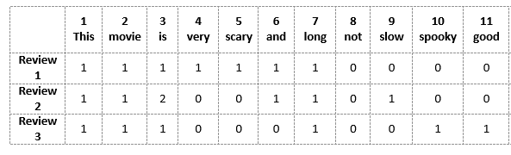

3.1 Bag of Words (BoW)
Movie Reviews (Data Corpus)
Major Drawbacks of BoW
1. Size of the Vector increases with the size of Vocabulary
2. High Sparsity of the Feature Matrix
3. Retaining no information on the grammar of the sentences nor on the
ordering of the words in the text
One problem that encounters in the BoW approach is that it treats every word equally. Using TF-IDF we can overcome this & assign more weight for words with high frequency.

Slide 9
3.2 Word Embedding
Method | Description
Embedding Layer | learned jointly with a neural network model on a specific NLP task, such as Sentiment Analysis or Neural Machine Translation
Word2Vec | 2-layer Unsupervised NN with 2 different learning techniques (CBOW & Continuous Skip-Gram).
GloVe | Unsupervised NN & used combined approach of matrix factorization techniques & context-based learning
Advantages of Word Embedding
1. Capability of Predetermine the Size of Word Vectors.
2. Reduce the Sparsity of the Feature Matrix.
3. Use information like Word Ordering & Frequency when designing.

Slide 10
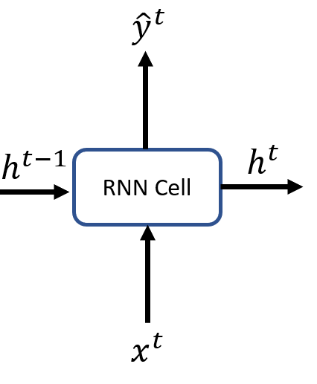
4. Recurrent Neural Networks & It’s use cases
Output Tensor at time, t (Optional)
Hidden State at time, t-1
(Previous State)
Hidden State at time, t
(Current State)
Input Tensor at time, t (Optional)
Basic Structure of RNN cell
Notes:
2 inputs & 2 outputs

Slide 11
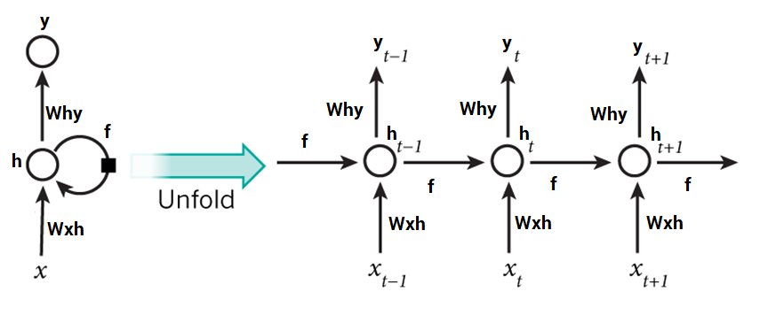
4.1 RNN Explained
Unfold Recurrent Neural Network

Slide 12
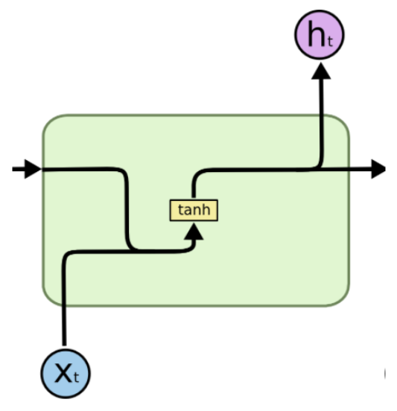
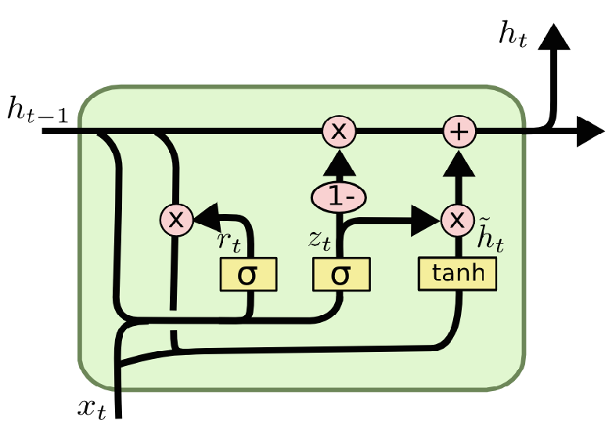
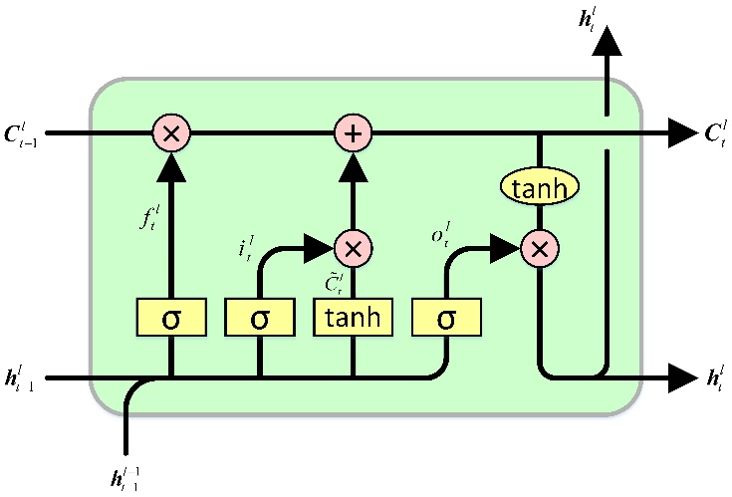
4.2 Types of RNN Architectures based on Operation
Vanilla RNN LSTM GRU

Slide 13
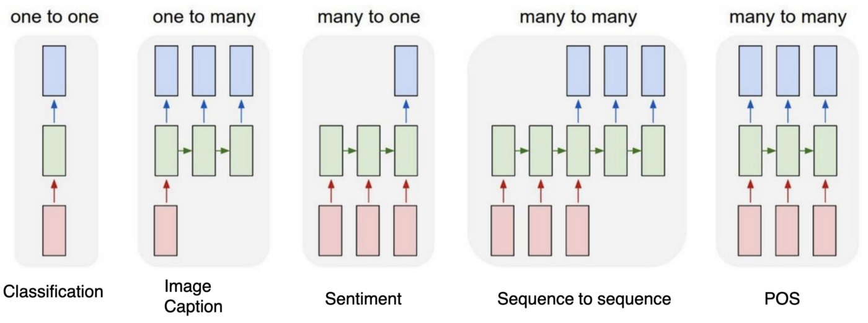
4.3 Types of RNN Architectures based on Relationship

Slide 14
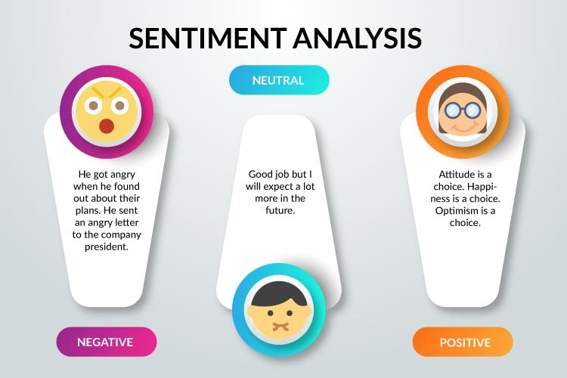

5. Sentiment Analysis as an Application
Overview of Sentiment Analysis Application

Slide 15
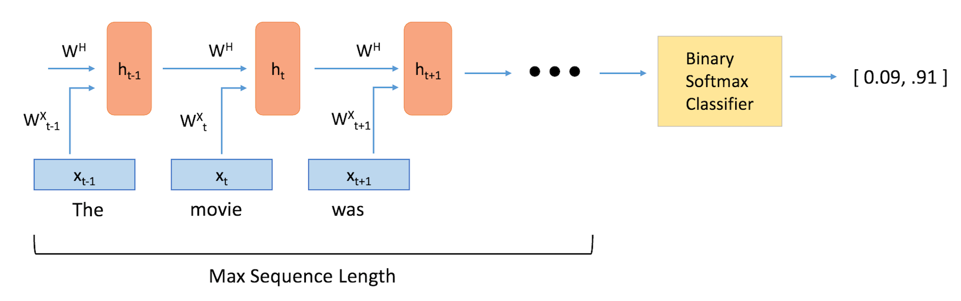
5.1 Model Architecture
Many-to-One Relationship Architecture

Slide 16

6. Sentiment Analysis Demo
You can find the dataset of Women's E-Commerce Clothing Reviews here

Slide 17


