Slide 1


SMART INDIA HACKATHON 2025
Problem Statement ID – SIH25019
Problem Statement Title- Digital Learning
Platform for Rural School Students in Nabha
Theme- Smart Education
PS Category- Software
Team ID-
Team Name - Xenovate

Slide 2
GYAAN GANGA
XENOVATE
SOLUTION
Developing a web-based application for teachers and students to collaborate without high-end networking.
Teachers can share lectures, schedules, and planners.
Runs on simple connectivity for maximum participation.
Includes digital quizzes and games for learning.
Provides administrative control to school authorities and Punjab government.
FACING PROBLEMS
Rural schools in Nabha lack reliable internet and updated infrastructure
Teachers struggle with outdated systems.
Students cannot access modern digital learning.
Parents have no digital visibility into student progress.
Rural education is facing a growing digital divide.

Slide 3
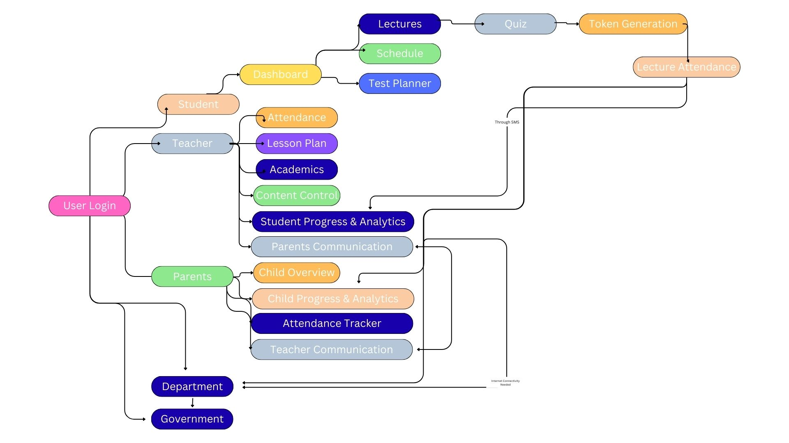






TECHNICAL APPROACH
XENOVATE
Programming Languages
Python / JavaScript
Database
Supabase / MySQL
Frontend
React.js / Tailwind
Backend
FastAPI

Slide 4
FEASIBILITY AND VIABILITY
XENOVATE
ANALYSIS OF FEASIBILITY OF DATA
Technical Feasibility
Market Feasibility
CHALLENGES & RISKS
The required technologies (react.js , MySQL , FastAPI) are readily available and well documented , making development feasible.
Cloud platforms ensure scalability and performance.
There is a growing interest in digital learning , especially in rural sectors.
The solution aligns with the growing trend of digital education and virtual experiences.
Data Handling: Managing and storing large lecture files for daily sharing is a major challenge.
Data Accuracy: Ensuring correct content, reports, and sensitive information reach teachers, parents, and authorities is crucial.
User Adoption: Engaging users on a virtual platform is difficult, especially for non-technical audiences.

Slide 5
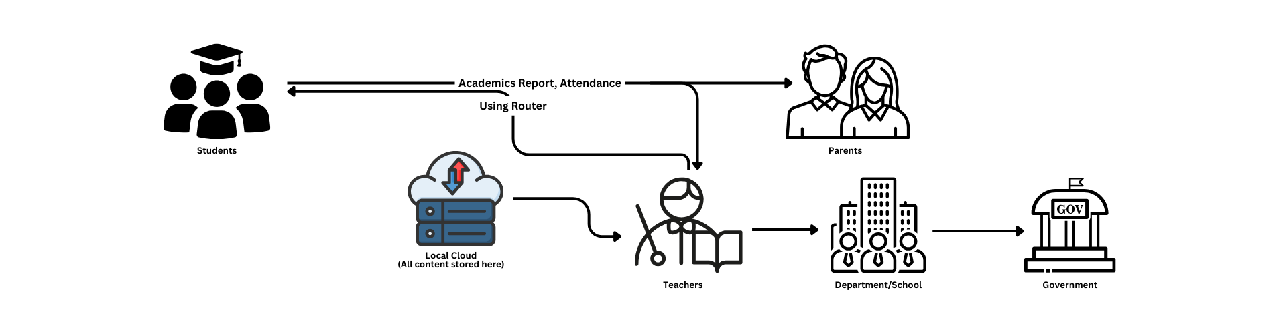
IMPACT AND BENEFITS
XENOVATE
Improved Accessibility – Rural students can access lectures anytime, reducing the digital divide.
Enhanced Engagement – Interactive quizzes and planners make learning enjoyable.
Transparency – Teachers, parents, and authorities receive accurate academic updates.
Skill Development – Students and teachers adapt to digital platforms, building technical confidence.
Technical Feasibility – Use of lightweight frameworks ensures smooth performance on low resources.
Data Handling Insights – Efficient storage strategies help manage large lecture files.
Adoption Strategies – Simple UI/UX encourages non-technical users to participate.
Best Practices – Referenced models from existing e-learning solutions guided design improvements.

Slide 6
RESEARCH AND REFERENCES
XENOVATE
The Nabha Foundation — Education Programs, Nabha (free, equitable, quality education, Navi Disha Schools)
Annual Status of Education Report 2024 — Punjab Rural Data (enrollment, learning levels, school resources)
“ASER 2024: In rural Punjab, only 34% class-III kids can read basic text but arithmetic skills improve significantly” — Indian Express article Nabha Power
CSR: To Promote Inclusive Education, Distribution of School Kits to Rural Students

