Slide 1
KINECT AR
TECHNICAL COMPONENTS - BIS

Slide 2

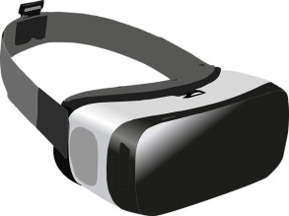


COMPONENTS – REVISITED
SERVER
Unity
SpaceBrew client
Kinect interface
Tracking module
SpaceBrew
CLIENT
Node.js
Unity
SpaceBrew client
(Orientation manager)
Gyroscope
Kinect SDK
DISPLAY
AR/VR
CAMERA
KINECT

Slide 3
SERVER
Requirements:
Hardware:
Kinect v2
Software:
Windows
Unity
Kinect SDK
SpaceBrew
Node.js
Role:
Inputs from Kinect:
RGB image
Depth image
Bodies/skeletons
Process data
Determine heads orientation
Detect “collisions”
Update global game state
Outputs to Client i:
Position of Client i Head
Orientation of Client i Head
Position of Client i Hand(s)
Relevant game data
SERVER
Unity
SpaceBrew client
Kinect interface
Tracking module
SpaceBrew
Can be integrated in
Unity project
Node.js
Kinect SDK
KINECT

Slide 4
CLIENT
Requirements:
Hardware:
(Gyroscope)
=> Optional *
Screen
Camera
=> Display only
Software:
Android
Unity
Role:
Inputs from Server:
Orientation of Head
Position of Head
Position of Hand(s)
Relevant game data
Process data
Update local game state
Update position
Update orientation
=> * Could combine with
gyroscope data
Display world
Outputs to Server:
(nothing)
(Head orientation?)
CLIENT
Unity
SpaceBrew client
(Orientation manager)
For calibration?
Gyroscope
DISPLAY
AR/VR
CAMERA

Slide 5
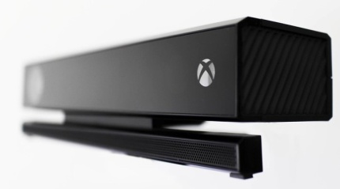
SERVER – KINECT
Position & Orientation:
=> Unity scene must be a close representation of real world
Position:
- Provided body joints positions are relative to centre of Kinect sensor
=> Need to offset the objects:
Use Kinect world centre as centre of the scene
OR
Position objects locally in a container located at Kinect’s position
OR
Add required offsets to each object’s position
Orientation:
- Kinect and Unity scene should have same orientation
=> Same “up” & “right” vectors (not “forward”*)
YAW = 0.0
PITCH = 0.0
=> Make sure the Kinect is not tilted! (REMOVE/ADJUST STAND)
ROLL = 0.0

Slide 6
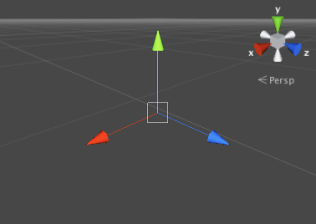
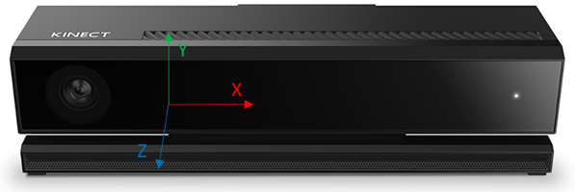
SERVER – KINECT
Position offset:
Kinect position relative to centre of world, to be determined based on scene
Typical initial offset:
- X = 0.0
- Y = (Height from floor)
=> Hardcoded? Provided input? Automatically measured?
- Z* = 3.0 (meters) – (ideal)
=> Determine based on scene.
* – Kinect data is mirrored from real world, Z axis is facing the opposite direction!
=> Z values need to be inverted if mimicking real world

Slide 7
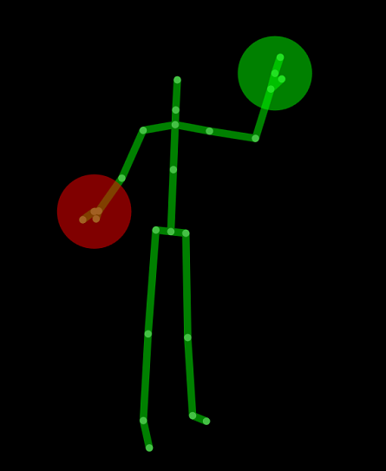
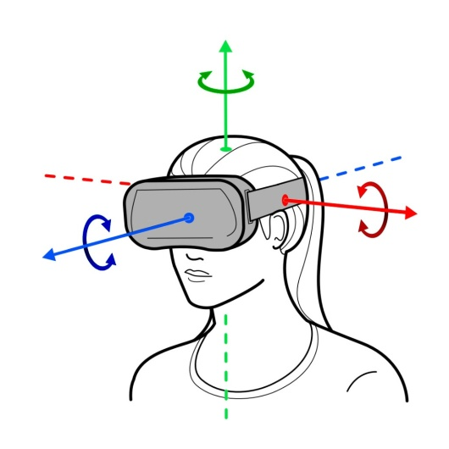
CLIENT – HEAD
Position:
In scene: Provided by server from Kinect skeletal joints (body frames)
In real world: Need to consider offset
=> Screen/VR headset offset in regards to head central position
? => How to determine?
=> Current world position + “offset” correctly oriented
Orientation:
In real world: Provided by gyroscope (Android API)
! - Gyroscope not reliable! (esp YAW)
=> Compute from Kinect RGB images
In scene: Need to be calibrated at initialisation
=> Relative to Kinect orientation
=> Initial scene orientation + current world orientation
1
2

Slide 8
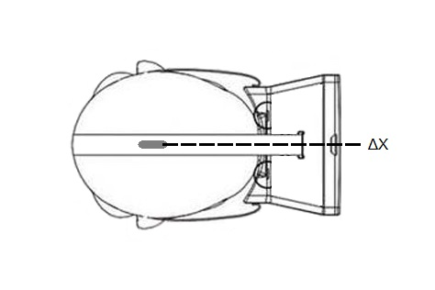
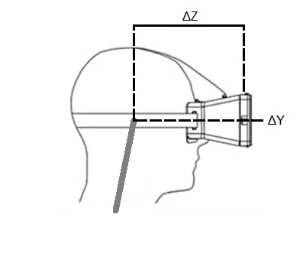
CLIENT – HEAD
1
Position offset:
=> Screen/VR headset offset in regards to head central position
ΔX = 0.0 (unless camera not centered!)
! => To be tested/checked
ΔY should be close to 0.0
! => To be tested/checked
ΔZ to be measured
? => Can have same values for every player? Or based on height?
Kinect head joint
Kinect head joint

Slide 9
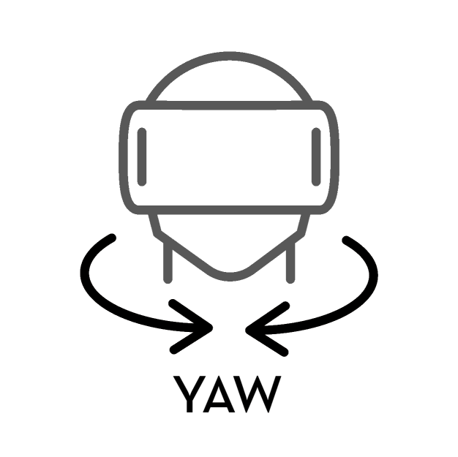
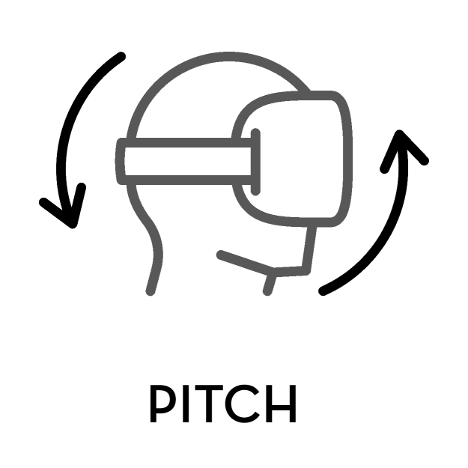
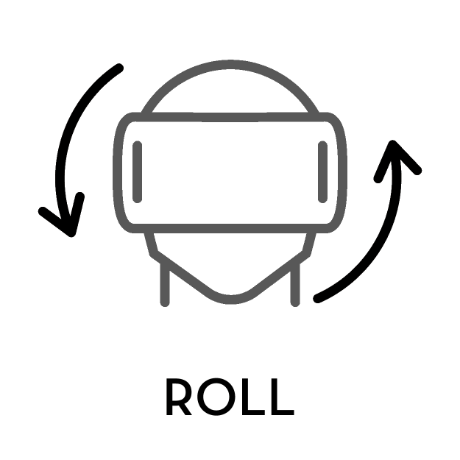
CLIENT – HEAD
2
Orientation determination:
=> Using Kinect RGB video feed to determine head orientation
YAW
PITCH
ROLL
=> PITCH & ROLL can be combined/validated with gyroscope data
! – Kinect must be properly aligned to world!

Slide 10
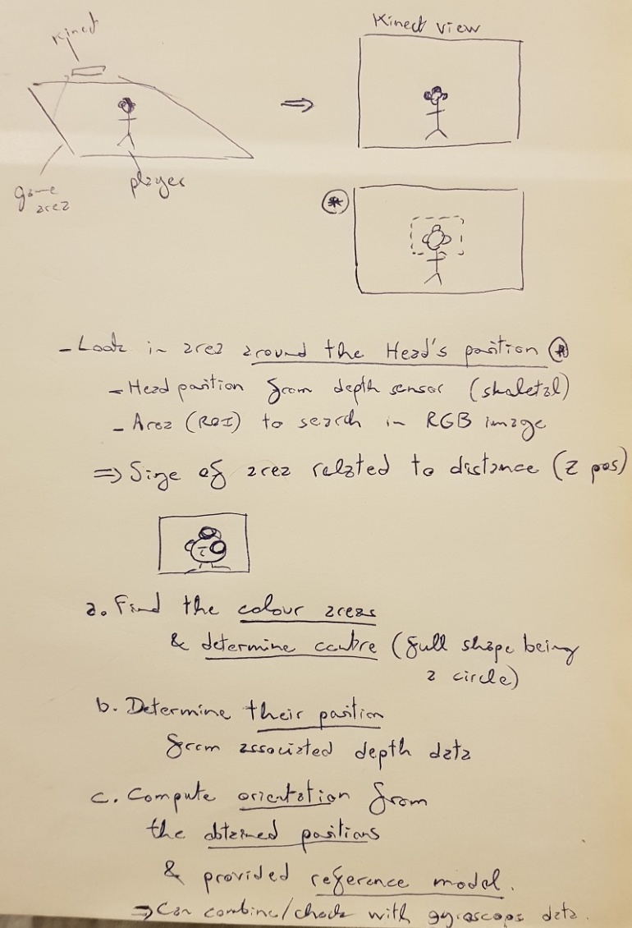
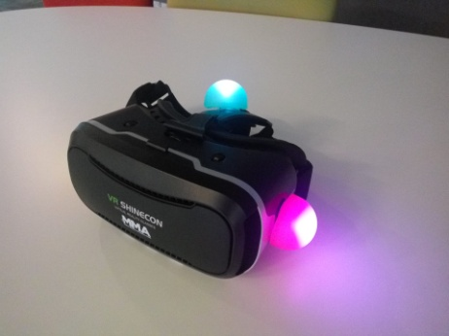
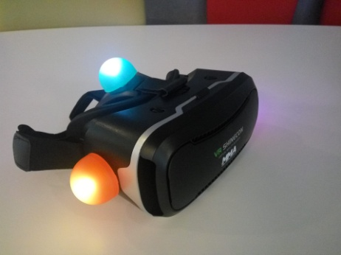
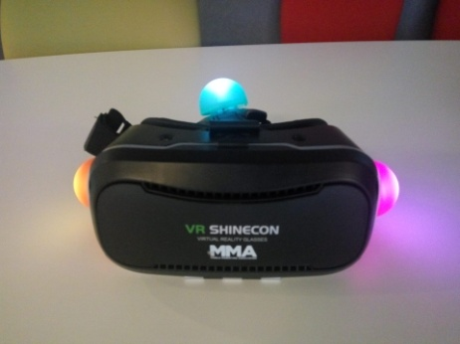
CLIENT – HEAD
!!!! TODO !!!!
Orientation:
=> ... (TODO: explain Kinect image analysis method ...

Slide 11
CLIENT – HEAD
!!!! TODO !!!!
HEAD TRACKING:
- Tracking using the Kinect:
=> Colour tracking in area around the head (area size related to distance from camera)
Process:
1 - Colour Segmentation - Blobs Detection
=> Biggest clusters of specific colours in RGB image.
2 - Positions Determination
=> From values in depth image at corresponding positions.
3 - Pose Estimation
=> Determine transformation from original model to found model.
(Only orientation is required, no position)

Slide 12
CLIENT – HEAD
!!!! TODO !!!!
HEAD TRACKING:
Requirements:
- Hardware:
- Minimum 4 (3?) markers to determine the rotation matrix
- Markers need to be unique and easily trackable
=> Bright/luminescent colours.
- Markers physical layout must be deterministic
=> Combined ears and "mohawk"?
(Could use flashy 80s earpuffs)
- Players need to wear a special headset holding markers
- Players can't get out of Kinect FOV
(shouldn't anyway, as positioning will not work either)
=> If losing tracking, use the device's gyroscope? (How to manage?)

Slide 13
CLIENT – HEAD
!!!! TODO !!!!
HEAD TRACKING:
LOOK AT:
- Software:
!? => LOOK AT:
- AForge.NET (in C#):
http://www.aforgenet.com
https://www.codeproject.com/Questions/738734/blob-detection-in-csharp
http://www.emgu.com/forum/viewtopic.php?t=477
=> Search for:
- OpenCV for Unity
=> Look at links in other PowerPoint (or buy plugin...)
- OpenCV in Unity:
- OpenCV Unity Asset
https://assetstore.unity.com/packages/tools/integration/opencv-for-unity-21088
! - BUT: Not free!
- OpenCV from sources
http://amin-ahmadi.com/2017/05/24/how-to-use-opencv-in-unity-example-project/
https://thomasmountainborn.com/2016/09/11/unity-and-opencv-part-one-install/
Others:
- OpenCV & Unity using sockets:
https://github.com/hasanavi/OpenCV-Unity3D-Object-Tracking
https://www.raywenderlich.com/5475-introduction-to-using-opencv-with-unity
=> Not ideal, as Kinect already integrated in Unity.

Slide 14
CLIENT – HEAD
!!!! TODO !!!!
HEAD TRACKING:
LOOK AT:
- Kinect Colour tracking:
- How to Detect and Track Red, Green and Blue Colored Object in LIVE Video:
https://www.mathworks.com/matlabcentral/fileexchange/40154-how-to-detect-and-track-red-green-and-blue-colored-object-in-live-video
- OpenCV color detection
- Colour tracking in Unity (using OpenCV plugin...)
https://handmap.github.io/opencv-colour-tracking-unity3d/
- Invisibility Cloak using Color Detection and Segmentation with OpenCV:
https://www.learnopencv.com/invisibility-cloak-using-color-detection-and-segmentation-with-opencv/
(Need to subscribe to download the code)
- Blob Detection Using OpenCV (using SimpleBlobDetector):
https://www.learnopencv.com/blob-detection-using-opencv-python-c/
https://docs.opencv.org/3.4.3/d0/d7a/classcv_1_1SimpleBlobDetector.html
- Circular bob detection:
https://riptutorial.com/opencv/example/22518/circular-blob-detection
!- Fast Color Based Object Tracking Using OpenCV and Kinect
https://imufeed.wordpress.com/2013/04/03/fast-color-based-object-tracking-using-opencv-and-kinect/
https://www.youtube.com/watch?v=d_c0Bqqvj6c
- Color Based Object Tracking Using Open Kinect and Processing
http://www.nbertagnolli.com/jekyll/update/2015/10/13/Object_Tracking.html
- object pose estimation
=> Might not need to use specific algorithms: only need to determine orientation from the different points.

Slide 15
CLIENT – HEAD
!!!! TODO !!!!
HEAD TRACKING:
Alternative: WII Remote tracking (1)
- Tracking using Wii Remote
=> LED tracking by IR camera on Wiimote
- Need extra installation for LED lights
- Need more than a sensor bar (viewing angle of Wiimote only around 40°)
=> Use several LEDs beacon covering the whole gaming area (at least front & sides)
=> The simplest solution is to only use Kinect tracking (easier hardware setup and software processing).
But maybe the Wiimote tracking would be more precise (& already gives the transformation).

Slide 16
CLIENT – HEAD
!!!! TODO !!!!
HEAD TRACKING:
Alternative: WII Remote tracking (2)
"The Wii IR camera [...] has an integrated processor which outputs the X and Y positions and size of the 4 brightest IR points that is sees."
- Can get position & orientation with custom 4 LEDs beacon
- 6DOF Positional Tracking with the Wiimote
https://franklinta.com/2014/09/30/6dof-positional-tracking-with-the-wiimote/
- Tracking using Wiimote
https://www.youtube.com/watch?v=KyvIlKSA0BA
- VRHome - Wiimote Virtual Reality Desktop
=> Wiimote tracking with 4 LEDs
https://channel9.msdn.com/coding4fun/articles/Wiimote-Virtual-Reality-Desktop
http://www.vrhome.de/downloads
- Wii Remote Tracking:
From:
http://idav.ucdavis.edu/~okreylos/ResDev/Wiimote/MainPage.html
- Technology:
=> Maths.
http://idav.ucdavis.edu/~okreylos/ResDev/Wiimote/Technology.html
- IR Tracker Beacon:
=> Homemade sensor bar.
http://idav.ucdavis.edu/~okreylos/ResDev/Wiimote/IRBeacon.html
!
OR:
!- Using the sensor bar, can determine the yaw (& combine with the rest!)
BUT: limited to 40°!
=> Use multiple bars...
https://www.dailymotion.com/video/xu7i0f
(look at PDFs)
OR:
- Can also have data from gyroscopes (preferably with Wii Motion Plus addon)
LIBRARIES:
- Unity Wiimote API:
https://github.com/Flafla2/Unity-Wiimote
- Wiimote library:
https://github.com/BrianPeek/WiimoteLib

Slide 17
CLIENT – HANDS
!!!! TODO !!!!
...
Hand tracking
=> Using Kinect body frames
! – Tracking struggle when hands in front of body!
Could hold coloured devices to allow different types of interactions
=> Colour tracking with Kinect RGB image (using OpenCV?)

